Slide 1
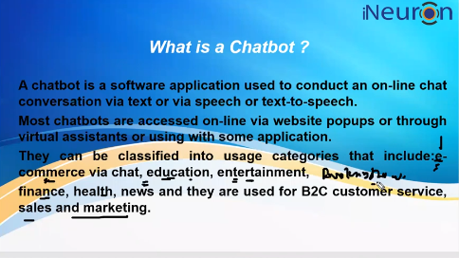

Slide 2
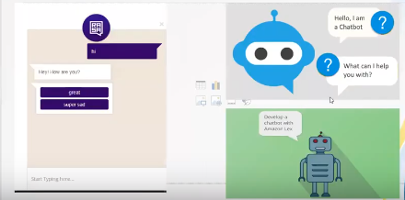

Slide 3
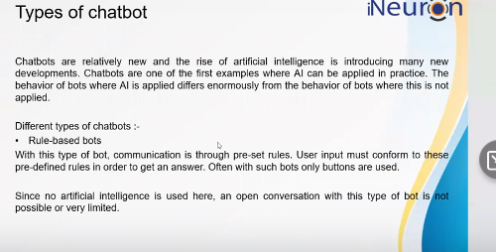
Rule based: If and else kind of chatbot
We can create setup python statement

Slide 4
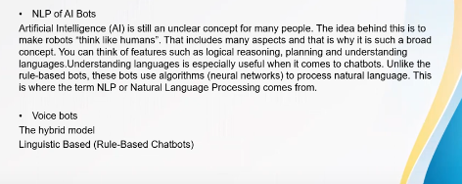
Text classification/summarization
Question and Answer
Text generation & push answer
Ineuron- Chatbot – which type
We will the pass sentence & identify the sentence and Answar- So it’s based on Question and Answer

Slide 5
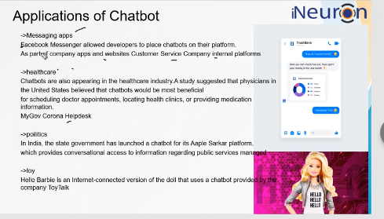

Slide 6
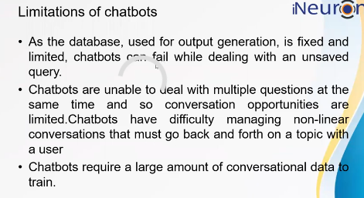
Fail in two ways
1.Data
2.Non linear conversion ( multiple statement can’t handle in parallel)

Slide 7
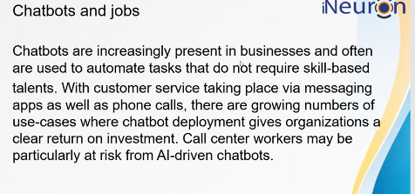
Automate the Skype job –Example. ( Reduce the manpower)

Slide 8
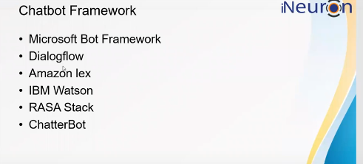
Dialog flow- Give the set of input data given by answer and we will get fixed output.- many organization using simple chatbot.
We can create the NLP based chatbot from scratch also.
Chattebot- python based – install
Microsoft,Amazon,RASA,IBM – Cloud based

Slide 9
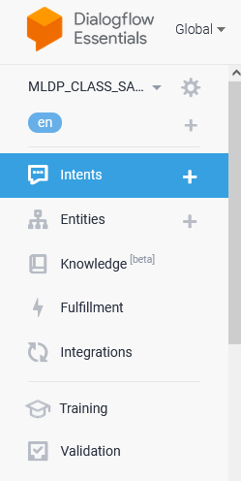
Google dialog flow:
https://dialogflow.cloud.google.com
Two types:
https://cloud.google.com/dialogflow/docs/editions
ES: https://cloud.google.com/dialogflow/es/docs/basics

Slide 10
Integration : we can develop & integrate with various platform.

