Slide 1

Movie Recommendation System Big Data Project
Hybrid Recommendation Engine using PySpark, ALS & LSH
Team - ScaleCraft
BY
NAGARAJA S B
SANUJ KULSHRESTHA
THANGARAJ N
SWAPNA GUNDEBOYINA

Slide 2

Problem Definition
Personalized movie recommendations at scale (25M+ ratings).
Low latency (<3 seconds) and high accuracy (RMSE < 0.85).
Cold-start handling for new users.

Slide 3
Problem Motivation
Recommendations drive 80% of content watched.
Inappropriate Recommendations may lead to new user attrition.
Processing 25M ratings requires distributed computing.
Real-time responses required under 3 seconds.
Can be extended to other recommendation systems (e-commerce, Advertising, Music)

Slide 4
Design Goals
High accuracy.
Scalability.
Low latency inference pipeline.
Cold-start solution for new user recommendations.
Production-ready reusable models.
.

Slide 5
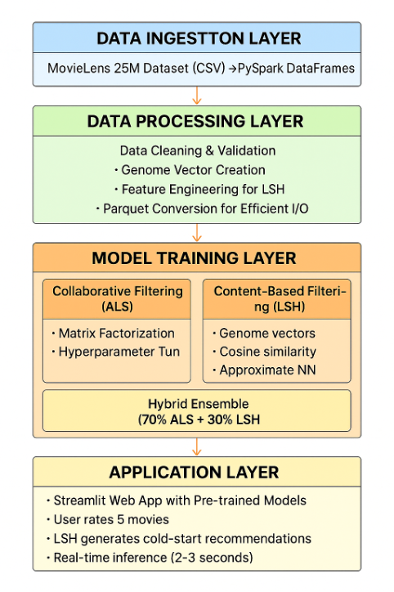
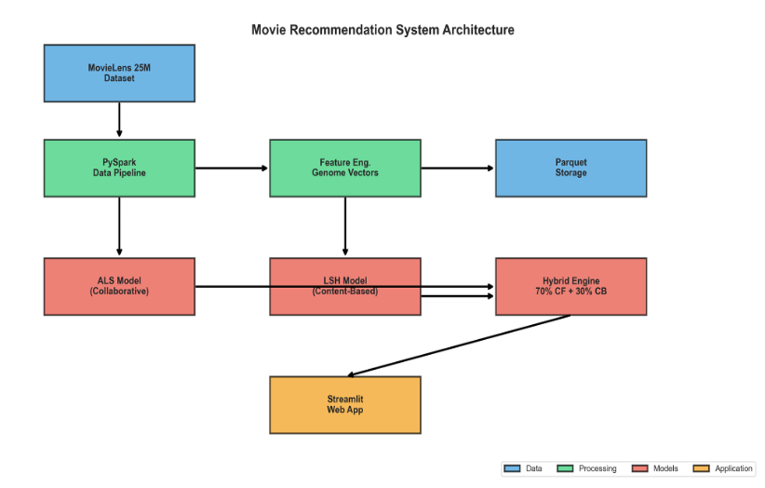
Data Pipeline Architecture

Slide 6
Model - ALS
ALS (Alternating Least Squares)
Matrix factorization: R ≈ U × Vᵀ.
Decomposes user-item rating matrix into two lower-rank matrices:
User factors (162,541 users × rank)
Item factors (62,423 movies × rank)
Learns User Preferences
Discovers hidden patterns
3-fold cross-validation (8 configurations)
Best Parameters: (Rank – 30, Max Iterations – 20, Regularization – 0.1)

Slide 7
Why ALS over other CF Algos ?
Algorithm | Pros | Cons | Our Choice
ALS (Alternative Least Squares) | Handles sparse data Parallelizable Implicit feedback support Proven at scale (Netflix, Spotify) | Cold-start problem | CHOSEN
SVD (Singular Value Decomposition) | Accurate | Not parallelizable Requires dense matrix | ❌
KNN (K Nearest Neighbors) | Simple | O(n²) complexity Doesn't scale | ❌
Neural CF | State-of-art | Requires GPU Complex tuning Overkill for this dataset | ❌

Slide 8
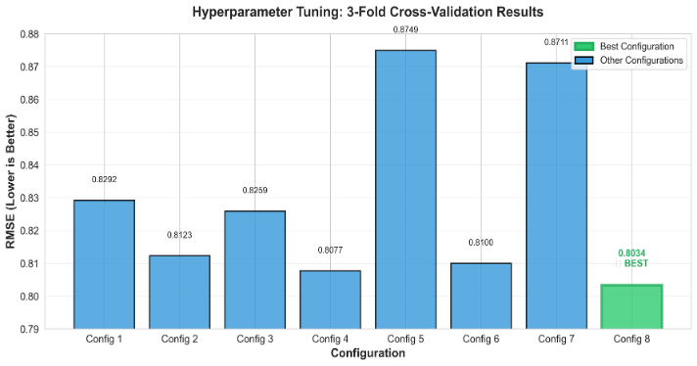
ALS Hyperparameter Tuning
Config | Rank | Max Iter | Reg Param | RMSE
1 | 10 | 10 | 0.01 | 0.8292
2 | 10 | 10 | 0.1 | 0.8123
3 | 10 | 20 | 0.01 | 0.8259
4 | 10 | 20 | 0.1 | 0.8077
5 | 30 | 10 | 0.01 | 0.8749
6 | 30 | 10 | 0.1 | 0.8100
7 | 30 | 20 | 0.01 | 0.8711
8 | 30 | 20 | 0.1 | 0.8034

Slide 9
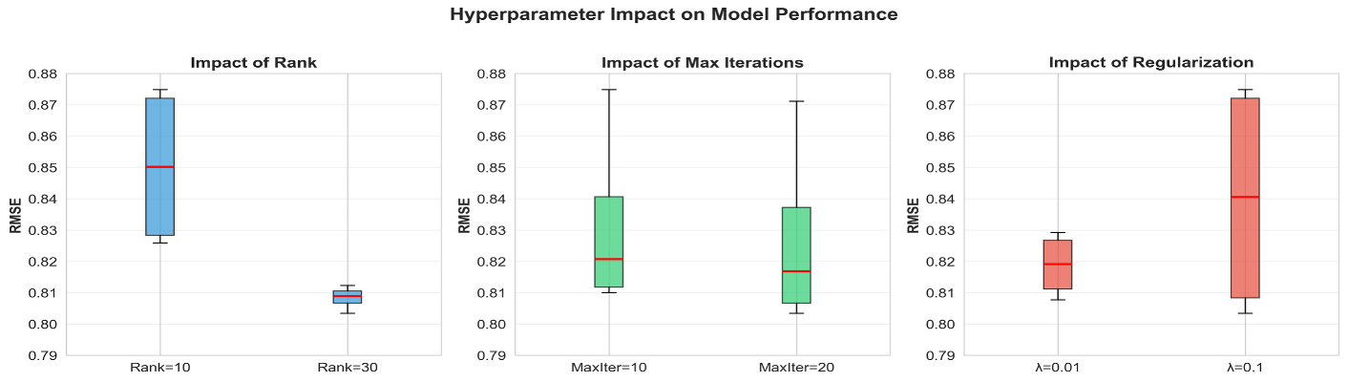
Hyperparameter Impact on Model Performance

Slide 10
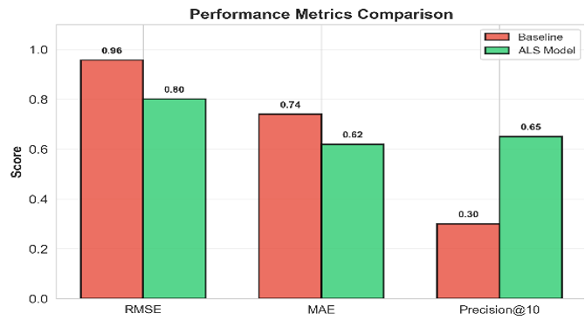
ALS vs Baseline Model
Metric | Baseline | Our Model | Improvement
RMSE | 0.9571 | 0.8011 | 16.30% ↓
MAE | 0.7398 | 0.6195 | 16.27% ↓
Precision@10 | 0.30 | 0.65 | 65% accuracy
Training Time | 0s | ~120-150 min | Acceptable with single machine
Inference Time | <1s | 2-3s | Fast

Slide 11
Model - LSH
LSH (Locality Sensitive Hashing)
Approximate nearest neighbor search algorithm
Maps similar items to same "buckets" using hash functions
Enables fast similarity search in high-dimensional spaces
Random Projections from 1128-d to lower dim space.
No User History Needed.
Used for Cold-Start Problem Handling
Parameters:
Bucket Length: 2
Controls granularity. Balances precision vs recall.
Hash Tables: 3
Each Hash Table uses different random projections.
Dimensions: 1128
1. Random Projection:
- Generate 3 random hyperplanes in 1,128-dim space
- Each hyperplane divides space into 2 regions
2. Hashing:
- For each movie vector, determine which side of hyperplane
- Create binary hash code (e.g., [1, 0, 1])
3. Bucketing:
- Movies with same hash code → same bucket
- Similar movies likely in same bucket
4. Similarity Search:
- Query movie's bucket
- Return nearby movies (approximate neighbors)

Slide 12
Model - Hybrid Recommendation Engine
Approach | Strengths | Weaknesses
Collaborative Filtering (ALS) | Discovers hidden patterns Personalized to user behavior No domain knowledge needed | Cold-start problem Popularity bias Sparsity issues
Content-Based (LSH) | No cold-start Explainable Works for new items | Limited serendipity Over-specialization Requires features
Hybrid (70% CF + 30% Content) hybrid_score = 0.7 × cf_score + 0.3 × content_score | Best of both worlds Handles cold-start Diverse recommendations | More complex

Slide 13
Big Data Platform
Layer | Technology | Purpose
Data Processing | PySpark 4.0.1 | Distributed processing of 25M records
Storage | Parquet | Columnar storage for efficient I/O
ML Framework | PySpark MLlib | ALS, LSH, model persistence
Web Framework | Streamlit 1.50.0 | Interactive UI
Runtime | Java 17 | Required for PySpark 4.x
Language | Python 3.9+ | Core development

Slide 14
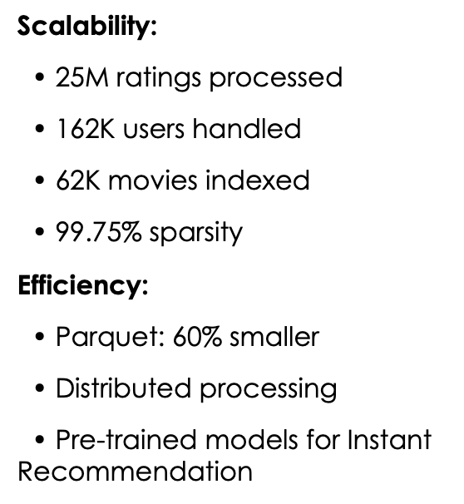
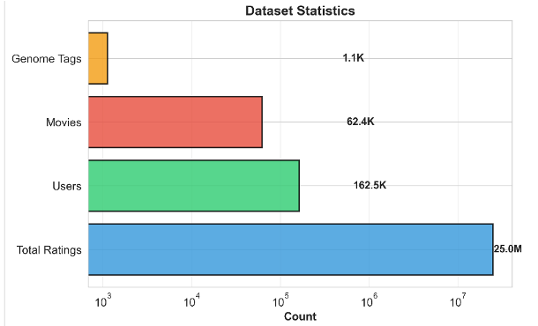
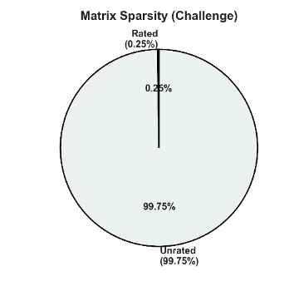
Scalability & Performance Goals

Slide 15
Scalability & Performance Metrics
Processing Performance:
Task | Data Size | Processing Time | Hardware
Data Loading (CSV → PySpark) | 1.1GB | 45 sec | 8GB RAM, 2 cores
Genome Vector Creaton | 15M records | 12 min | Distributed Spark
ALS Training (10 iterations) | 25M ratings | 120-150 min | 8GB RAM, 2 cores
LSH Model Training | 62K items | 3 min | Single node
Parquet Conversion | 1.1GB → 400MB | 8 min | Distributed I/O

Slide 16
Scalability & Performance Metrics
Inference Performance (New Use Recommendation)
Operation | Latency | Method
Load Pre-trained Models | 1.2 sec | Disk → Memory
LSH Cold-Start (5 ratings) | 2.1 sec | Approximate NN
Total Recommendation Time | 2.4 sec | End-to-end

Slide 17
Challenges & Solutions
Cold-Start Problems:
LSH content-Based Filtering
25M Records:
PySpark Distributed Computing
99.75% Sparsity:
ALS + Normalization

Slide 18
Live Demo
► Interactive Streamlit Web Application
► User rates 5 movies (e.g., Inception, Interstellar, Matrix)
► System generates 5 personalized recommendations
► Response time: 2-3 seconds
► Demonstrates cold-start handling with LSH

Slide 19
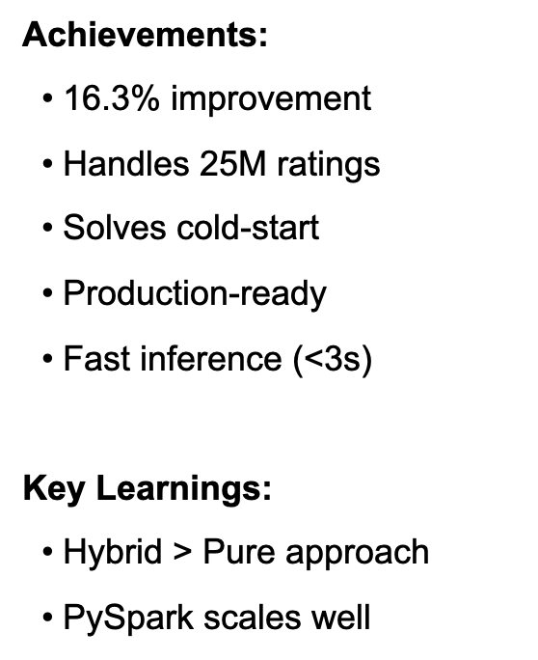
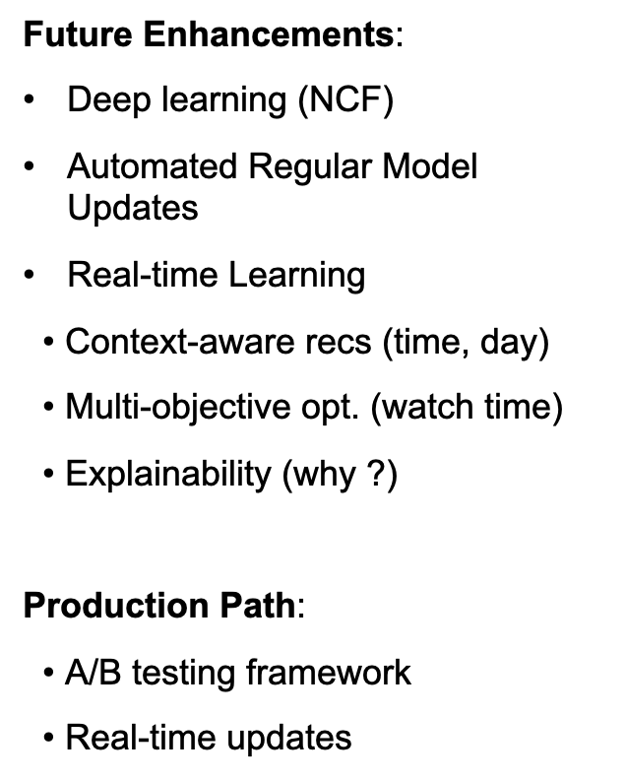
Conclusion & Future Scope

Slide 20
Reference Links
Github Repository: Movie Recommender-By-ScaleCraft
Project Report: ScaleCraft Project Report
ALS: Collaborative Filtering for Implicit Feedback datasets
LSH: Locality Sensitive Hashing Scheme on p-stable distribution
Movie Lens: 25M Movie Ratings Dataset

Slide 21
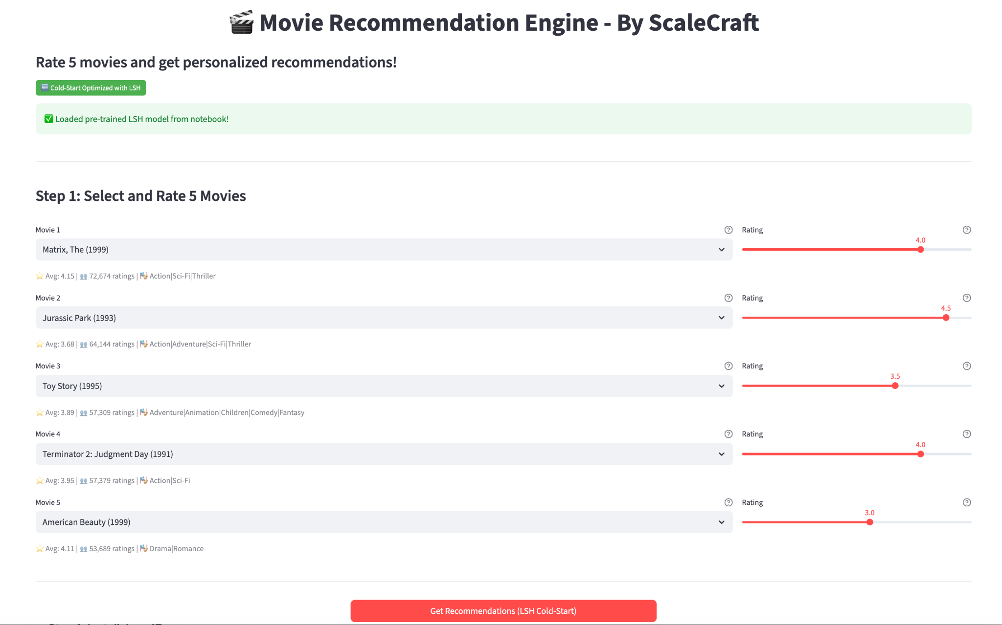
UI App Screenshots

Slide 22
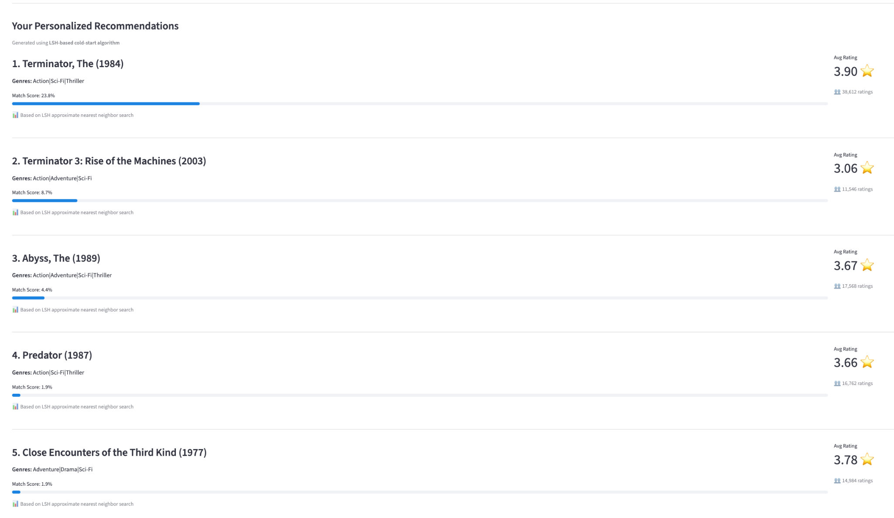
UI App Screenshots

Slide 23
Queries

