Slide 1
Webservice Testing and Performance Testing Using JMeter

Slide 2


Slide 3
Webservice Testing
To ensure the quality of the software product different tests has been performed.
Once such test is Load Testing.
Load Testing is a kind of Performance Testing that helps in determining how the application behaves when multiple users/requests hit the application simultaneously.
From many tools helping us to resolve this, for now we will see how Apache JMeter (JMeter) an Open Source tool helps us to achieve this, what are the pros and cons using this tool.

Slide 4
About JMeter
JMeter is an Open Source testing desktop based application. It is 100% pure Java application used as a performance testing tool for analysing and measuring the performance in variety of graphical reports.
We can perform load testing, stress testing and functional testing for the applications.
If there are any flaws in application such as buffer overflow, memory leaks using this we can easily simulate the situation in our own environment, and avoid the Prod issue surprises.
Using JMeter we can achieve all this easily, with minimum to no knowledge in coding.

Slide 5
Installation
Please follow the below detailed steps on the installation of JMeter on the respective operating system.
Windows & Linux: https://jmeter.apache.org/usermanual/get-started.html
Mac: https://psychowhiz.medium.com/install-jmeter-on-mac-25531bc2b2ad

Slide 6
JMeter Supports
JMeter supports following and more types of the applications that can be tested with the tool.
Websites – HTTPS and HTTP
Web services – REST, SOAP and Graphql
Database servers
FTP servers
LDAP servers
Mail servers – SMTP, POP3, IMAP
TCP Servers

Slide 7
Elements of JMeter
There are different elements in JMeter each performing a task to achieve our goal. Below are few elements which will be important to know perquisites:
Thread Group: Collection of Threads, each thread represents one user accessing the application in the thread. Ideally it simulates one real user making one request to the application server. We can have multiple number of threads configured here.
Samplers: Type of request, such as FTP, HTTP, etc.
Listeners: Shows the results in different formats.
Configuration: Setup defaults and variables for later use by the samplers.
Assertions: Validate response from the server is expected or not.

Slide 8
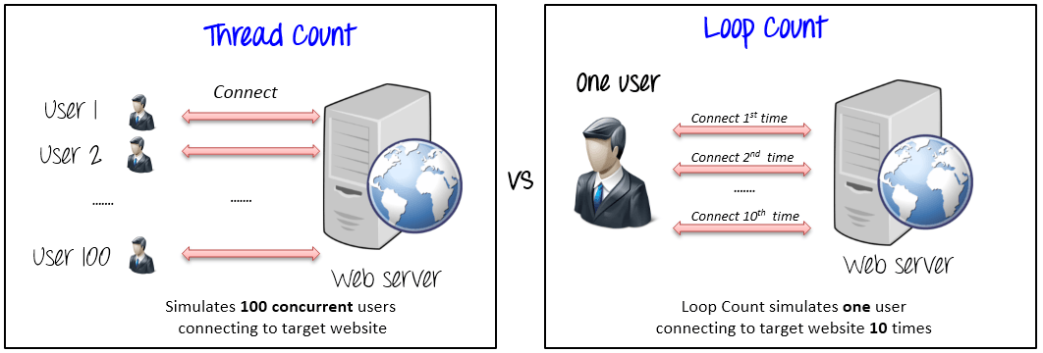
Thread Group

Slide 9
Demo

Slide 10
Pros of Using JMeter
Open Source: JMeter is an open source software, so no licensing costs
Ease to Use: The user can install and use JMeter easily
Platform independent: As JMeter is 100% Java based, so it is platform independent and can run on multiple platforms.
Customisable: Since JMeter is open source, developers can customize its source code as per their specific requirements. Also there is prescript and postscript execution process where we can run customisable code in Java or Jpython.
Data driven testing: The CSV Data Set Config, allows you to read different parameters from text file and convert into parameters which can be used in making dynamic requests.
Record and Playback: JMeter provides record and playback options alone with drag and drop feature which makes it easier and faster to create scripts.
Supports distributed load testing: JMeter supports distributed load testing features in which we can create master-slave setup for carrying out load test on multiple machines. Link is : https://jmeter.apache.org/usermanual/jmeter_distributed_testing_step_by_step.html
Good community support and Documentation: JMeter has many online tutorials(edureka I really like) and helping community support. It also has freely available plugins that helps in different aspects of script creation and analysis.
Reporting: Helps to visualise test results. As see before, test results can be displayed in a different format such as chart, table, tree, log file, html and etc.

Slide 11
Cons of Using JMeter
Passwords are saved as plain text, involves risk when the JMX file is accidentally shared
It supports only Java or Java backed languages for custom coding
Jpython is support though

Slide 12
Similar Tools
LoadView
LoadUI
NeoLoad
WEBLOAD
LoadRunner

Slide 13
Conclusion
One of the most used tool for performance and api testing. Definitely can be used to make sure the web applications are meeting the performance benchmarks.
The feature list of JMeter is exhaustive, this is just a sample of its usage.
The User Manual will have the detailed description of each its features, link is https://jmeter.apache.org/usermanual/index.html

Slide 14
References
https://www.edureka.co/blog/load-testing-using-jmeter/
https://jmeter.apache.org/usermanual/get-started.html
https://www.guru99.com/jmeter-tutorials.html

