Slide 1
Python Logging
Introduction
Logging Module
Configurations
  Basic Configurations
  File Configurations
Logging from Multiple Modules
Logging from Multiple Threads
Context Logging and Filter
Best Practices
Conclusion
References

Slide 2
Introduction
Logging is an important part of software development, which can help endless hours of debugging. If used it right we can use it for different flow analysis, how and what to scale, health checks, issue analysis, performance checks, security scan, audit and so on.
Calling log calls from the program, indicates certain events has occurred during the timestamp, from where, may be IP address and other additional information. Event will hold the descriptive message, eg: dynamic or static values, importance of message (debug, info, warn, error).
Python provides a logging system as a part of its standard library, so you can quickly add logging to your application.

Slide 3
Logging Module
The logging module readily available, adding logs to your module is as easy as below.
Code:
import logging
logging.debug('This is a debug message')
logging.info('This is an info message')
logging.warning('This is a warning message')
logging.error('This is an error message')
logging.critical('This is a critical message')
Output:
WARNING:root:This is a warning message
ERROR:root:This is an error message
CRITICAL:root:This is a critical message

Slide 4
Logging Levels
DEBUG
Detailed messages, usually for diagnosing problems
INFO
Confirmation or Facts of working as expected
WARNING
Alarming for future breaks, but until now the application is working
ERROR
Due to serious problem in the function
CRITICAL
Due to serious problem, the program failed to continue to execute

Slide 5
Logging Configuration
Parameter and Description
level
Root logger will be set to the specified severity level
filename
Name of the file logs should be stored
filemode
Mode in which the log file should be opened, default is “a” append mode
format
Pattern the log message to be written
datefmt
Format in which date should be written

Slide 6
Basic Configuration
Code:
import logging
logging.basicConfig(level=logging.DEBUG, filename='/project/log/app.log', filemode='w', format='%(asctime)s - %(message)s', datefmt='%d-%b-%y %H:%M:%S')
logging.debug('This is a debug message')
logging.info('This is an info message')
logging.warning('This is a warning message')
logging.error('This is an error message')
logging.critical('This is a critical message')
Output: (from app.log)
27-Nov-21 07:28:09 - This is a debug message
27-Nov-21 07:28:09 - This is an info message
27-Nov-21 07:28:09 - This is a warning message
27-Nov-21 07:28:09 - This is an error message
27-Nov-21 07:28:09 - This is a critical message

Slide 7
File Configuration
Logging Flow
File Config Example
Dict Config Example
Multiple Handlers Example

Slide 8
Logging Flow
So far, we have seen the default logger named root, which is used by the logging module whenever its functions are called directly like this: logging.debug(). But we can or should define your own logger.
The logging module, follows the modular approach and has split the functionalities in below components:
Logger: This is exposed to application code to directly use. Logging is performed by calling methods on instances of the Logger class.
logger = logging.getLogger(__name__)
LogRecord: Loggers automatically create LogRecord objects that have all the information related to the event being logged, like the name of the logger, the function, the line number, the message, and more.
Filter: Provide a finer grained facility for determining which log records to output. Later we will see an example using Filters
Handler: Sends the LogRecords (created by loggers) to the appropriate destination. For example it could be file, stdout, http, etc.
Formatter: Specify the format of LogRecord, by mentioning in the list attributes needs to be logged to be written in the final output.

Slide 9
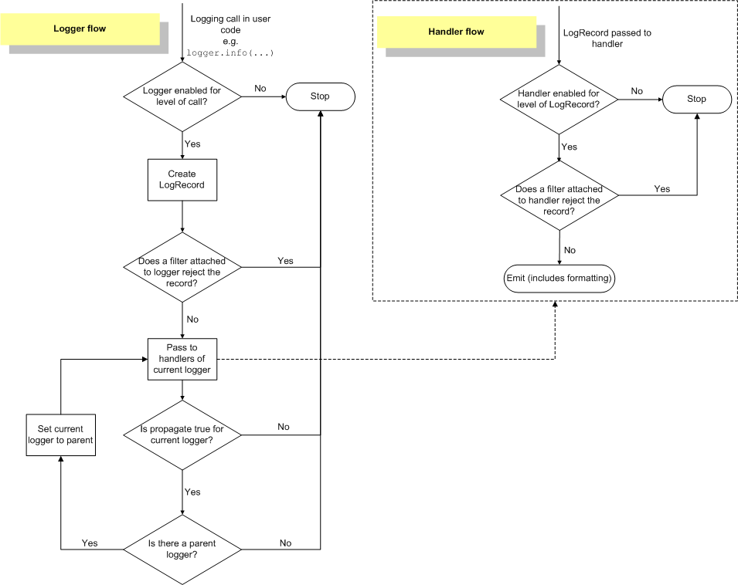

Slide 10
File Configuration Example Demo

Slide 11
Dict Configuration Example Demo

Slide 12
Multiple Handler Configuration Example Demo

Slide 13
No Configuration
When no configuration is provided, the events are output using a handler of last resport, which is stored in logging.lastResort.
This acts as StreamHandler, which writes the messages to sys.stderr.
Default handler's level is set to WARNING
The behaviour of the logging package in these circumstances is dependent on the Python version. We are seeing here for python 3.2 and above.
Recommend to not to change the default behaviour rather use own Logger.

Slide 14
Logging From Multiple Modules
Calling multiple times same getLogger(“NAME”) will return a reference to the same object.
Can be used across modules to get the same object but it requires to be same Python interpreter process.
Also the application code can define and configure a parent logger in one module and create (but not configure) a child logger in a separate module, and all logger calls to the child will pass up to the parent.
The parent and child mapping is done by the name of the logger, please find the example below in the getLogger method
  parent: getLogger('test_app')
  child: getLogger('test_app.sub_app') # here all the configuration is inherited from the parent

Slide 15
Logging From Multiple Threads
Logging from multiple threads is as simple as normal process
To differentiate the logs generated from each thread, threadName can be used
Below example shows the logging from the main thread and another one more thread

Slide 16
Context Logging
LoggerAdapter
  Sometimes you want logging output to contain contextual information in addition to the parameters passed to the logging call.
  For example, in a networked application, it may be desirable to log client-specific information in the log (e.g. remote client’s username, or IP address).
  An easy way in which you can pass contextual information to be output along with logging event information is to use the LoggerAdapter class.

Slide 17
Filter Logging
Filter
  Filter can be used for both at the logger level or by handler level.
  Such as they can stop certain information to be passed to be logger
  Also inject additional information into the LogRecord which will be logged
  In our below example, we are using filter to allow only certain levels to be logged. Though the log level is set to DEBUG, we are only allowing INFO and ERROR to be logged.

Slide 18
Logging Best Practices
Create loggers using getlogger function
Using appropriate log levels in different regions
Create module level loggers
Use rotating file handler
Include timestamp in logs, preferred to use standard format exists, and it’s called ISO-8601.
Eg:
import logging
logging.basicConfig(format='%(asctime)s %(message)s')
logging.info('Example of logging with ISO-8601 timestamp')
Avoid opening same log file multiple times
Do not pass logger as parameter in class or methods

Slide 19
Conclusion
As seen the logging module is very flexible, customisable and ease to use. There are much more features such as,
context based logging
customisable log records
logging to multiple destination and servers
multiple processes logging to same file log
speaking logging messages
And many more, readymade code is available in the python cookbook URL: https://docs.python.org/3/howto/logging-cookbook.html.
It would be great to start using if you haven’t been using logging in your applications. You will see the difference and increase the code quality by adding this. Happy Logging!

Slide 20
References
https://realpython.com/python-logging/
https://docs.python.org/3/howto/logging.html
https://docs.python.org/3/howto/logging-cookbook.html

