Slide 1

DIGITAL DYNAMIC SIGNBOARD AND TRAFFIC CONTROL SYSTEM
Presented by:
V.SUBASH VARUN 95072114100
B.SUJESH 95072114104
V.SUYAMBU LINGAM 95072114108
M.THANGA VEL 95072114112

Slide 2
Scope of the project
The scope of the project entails developing a Digital Dynamic Signboard and Traffic Control System to enhance urban transportation.
The primary goals include dynamically adjusting speed limits and traffic signals based on vehicle density and weather conditions to improve road safety, optimize traffic flow, and reduce environmental impact.

Slide 3
Abstract:
This study presents a solution to enhance urban traffic management through the implementation of a Digital Dynamic Signboard and Traffic Control System. Integrating real-time weather data and strategically positioned sensors, the system dynamically adjusts speed limits and optimizes traffic signals based on vehicular density and weather conditions. This comprehensive approach aims to bolster safety, alleviate congestion, and mitigate environmental impact. Leveraging real-time data and advanced technology, the proposed solution offers a multifaceted strategy to enhance traffic management efficiency in urban environments.

Slide 4
Literature Survey :
Title: Message Display on Dynamic Message Signs.
Dynamic Message Signs (DMS) are crucial for guiding drivers and managing traffic. Wang et al. (2006) looked into how adding graphics to DMS can make messages clearer and easier to understand.
Wang, J.-H., Collyer, C., E, & Hesar, S., G. (2006). Employing Graphics to Aid
The "Traffic Yaham" youtube video explains how digital LED displays work for managing traffic. These displays are clear and can change messages based on traffic. They help drivers understand and stay safe on the road, making traffic flow better.
https://youtu.be/BBqGcOg3Lss?si=AFnTUGPSeZOGlGgH
traffic yaham/youtube

Slide 5
Existing system:
The current way we manage traffic involves using things like road signs, traffic lights, cameras, and control centers. These help keep traffic moving and monitor what's happening on the roads.
we also rely on traffic management centers to oversee and coordinate activities like adjusting signal timings

Slide 6
Problem identification:
The issue we're facing is that our current traffic management systems don't always provide enough up-to-date information. This lack of real-time data means drivers might not know about accidents or hazards ahead, which can lead to accidents or delays.

Slide 7
Proposed system:
The proposed system, named the Digital Dynamic Signboard and Traffic Control, utilizes the sensors and real-time weather data to autonomously adjust speed limits and traffic signals. This initiative aims to enhance road safety, alleviate congestion, and minimize environmental impact.

Slide 8
Explanation
This project employs an Arduino board, sensors, and a display screen to manage traffic conditions efficiently. The code continuously monitors vehicle presence with an infrared sensor, incrementing a count for each passing vehicle. It resets the count to 1 after reaching 60 to prevent overflow. Utilizing a for loop, it dynamically adjusts the speed limit based on vehicle count: below 30 vehicles, the limit is set to 70 km/h, while between 30 and 60, it's reduced to 50 km/h, aiming for safety and efficiency. Moreover, the system checks for rain using a rain sensor; if detected, it lowers the displayed speed limit to 50 km/h to account for wet road conditions.

Slide 9
Components:
Arduino uno
Ir sensor
Rain drop sensor
I2c lcd display
Battery

Slide 10
Block diagram:
RAIN
SENSOR
DC POWER SUPPLY
CONTROLLR
DISPLAY
IR
SENSOR

Slide 11
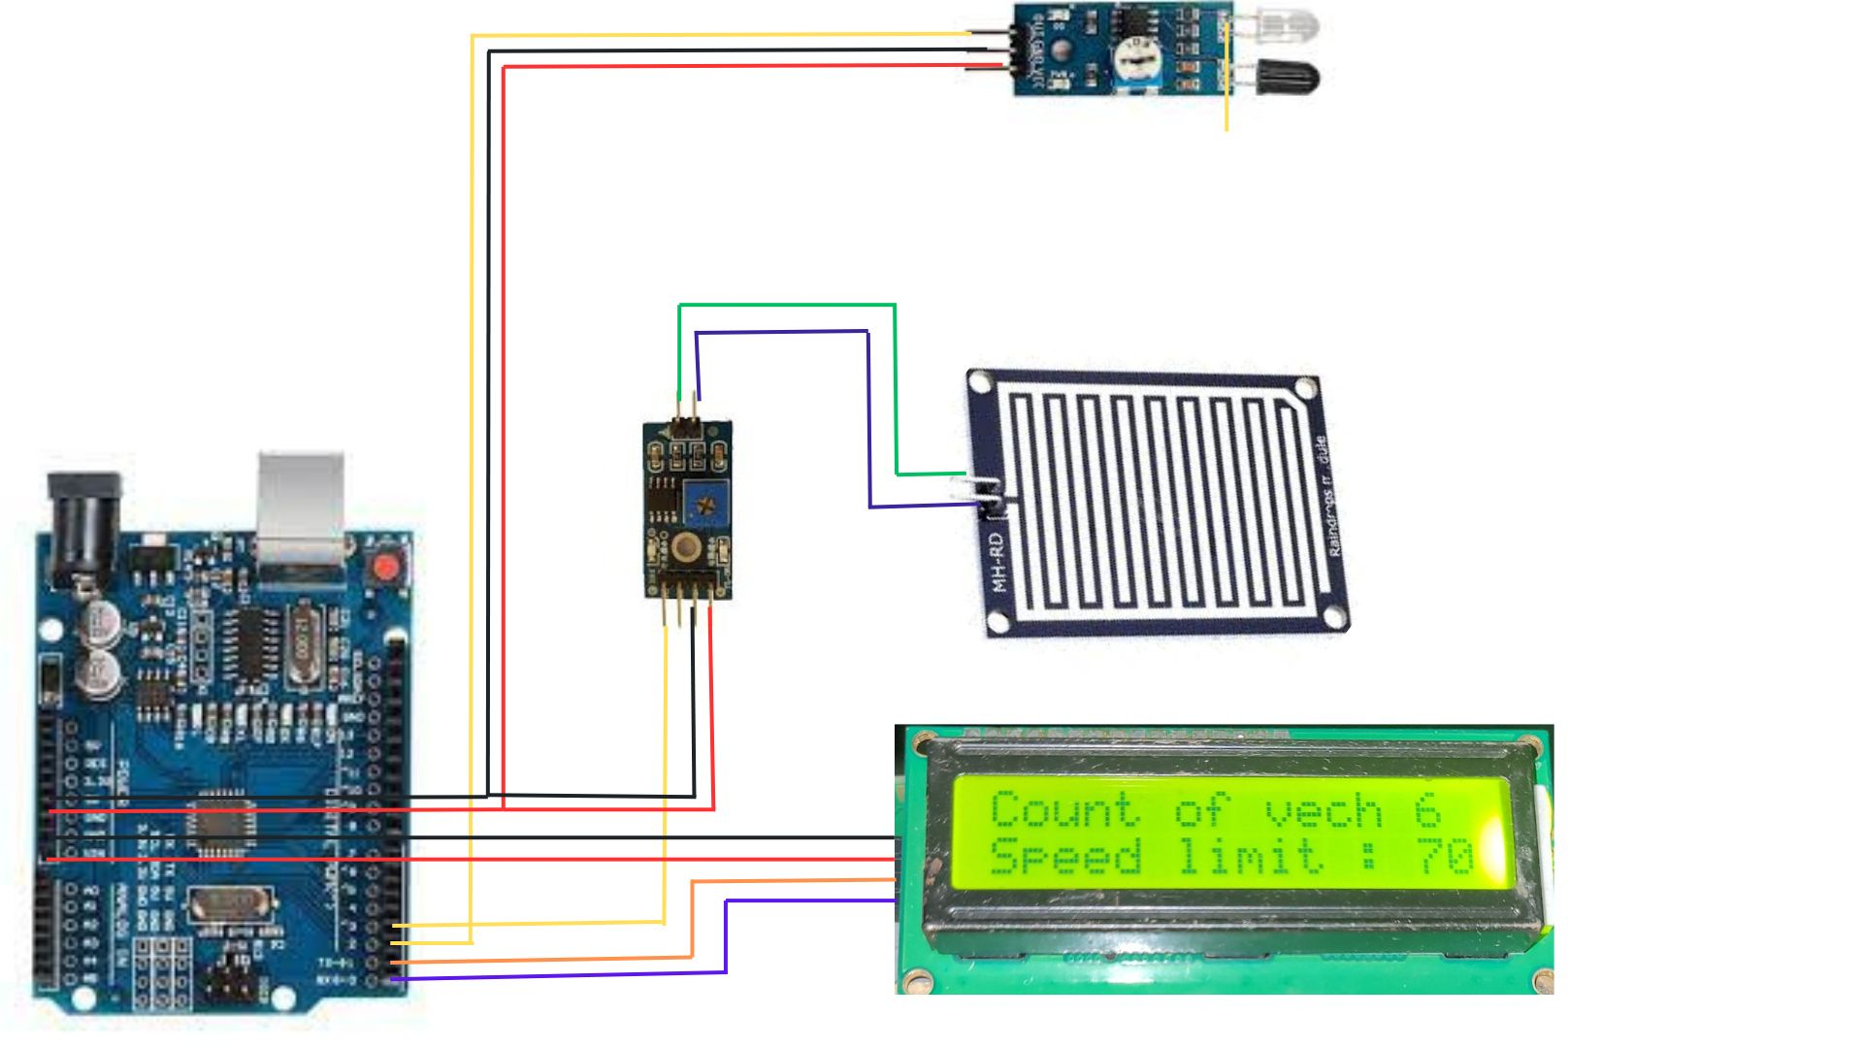
Circuit diagram:

Slide 12
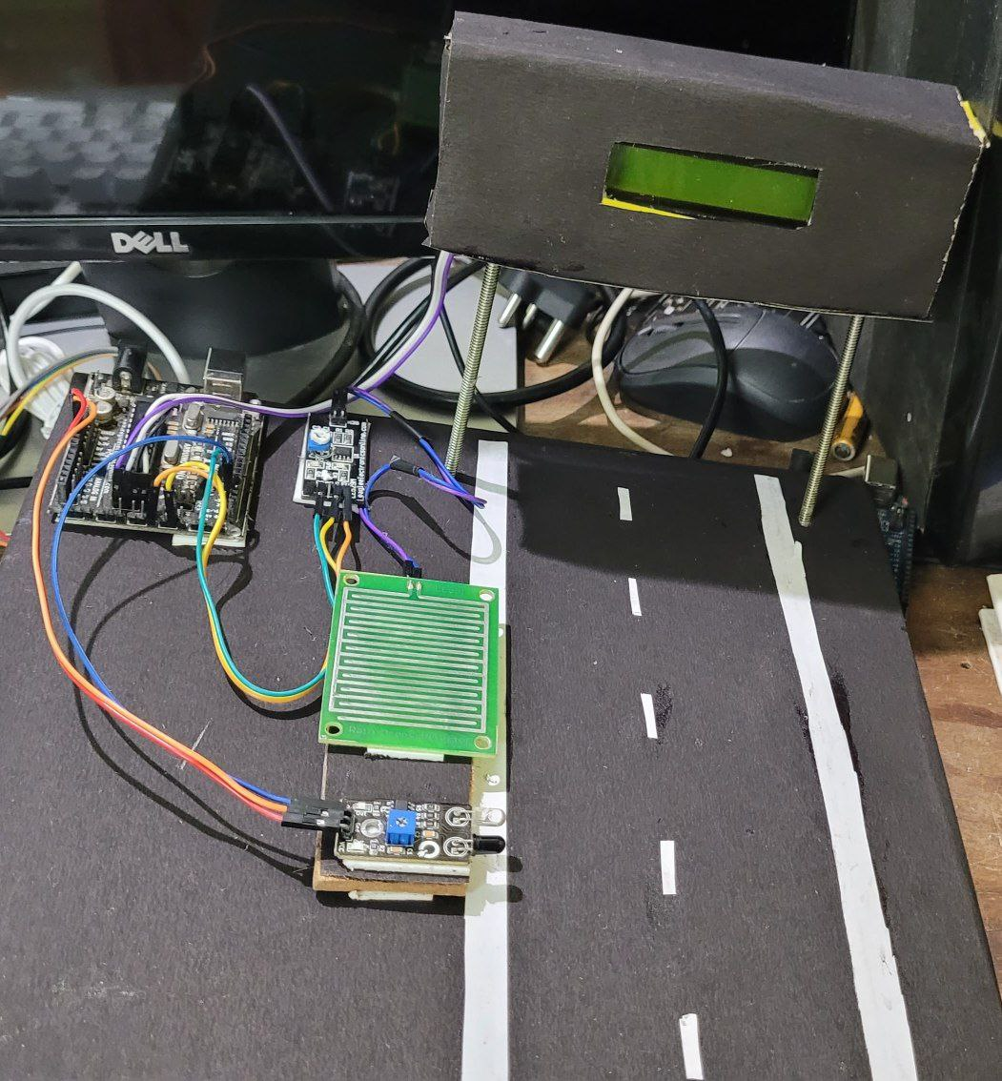
Thank You...

