Slide 1
SDSoC
Tool
FPGA PL
データの変換
xfOpenCV lib
DPU
・Xilinx IP ?
・User IP ?
AXI interconnect
AXI interconnect
FPGA PS
点群(point cloud) data
Depth data
TOF
Web
IR data
DNNDK
Flask Server
(Python)
DNNDK Tool

Slide 2
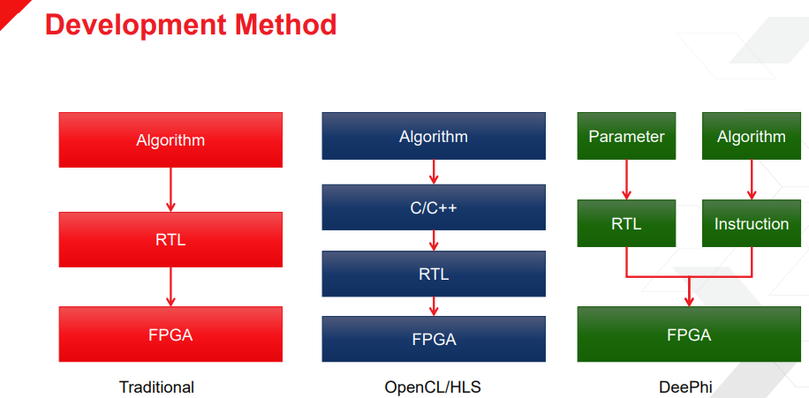
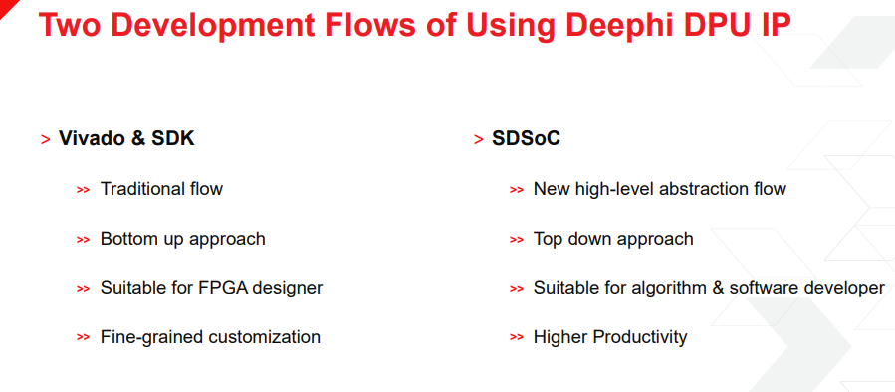

Slide 3
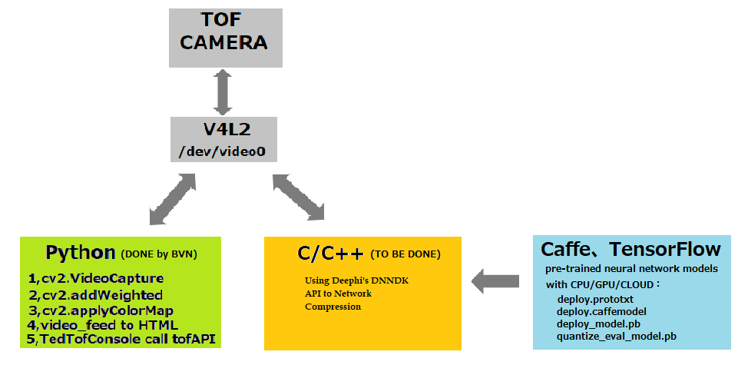
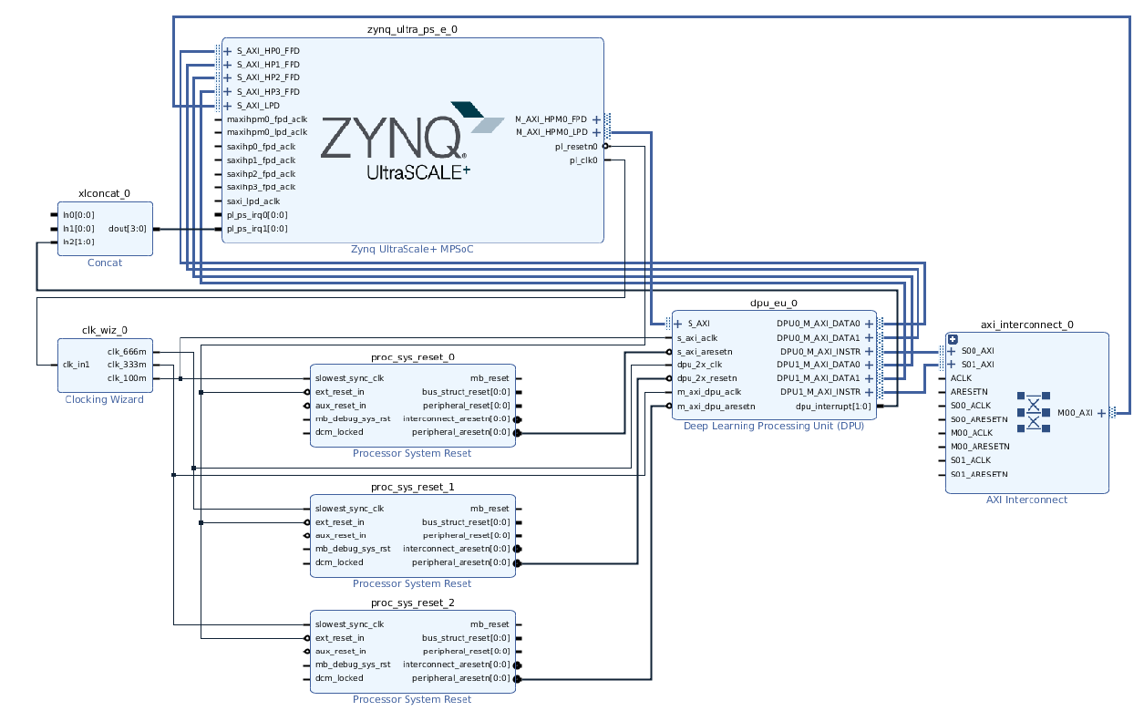
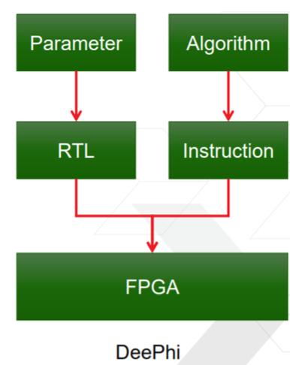
The DNNDK need to be installed in your Host that have ubuntu1804
The DNNDK need to be installed in our ultra96 demoboard
You can read 「UG1327」to get more information

Slide 4
ユーザー回路
DPU
ユーザー回路
Tool(SDSoC)でソースコードを回路に変換
・そのままで変換できる？
・ソースコードを書き直し、変換する？
SDSoC

Slide 5
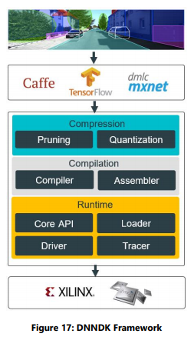
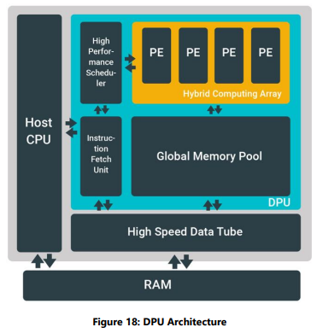
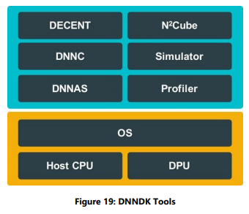

Slide 6
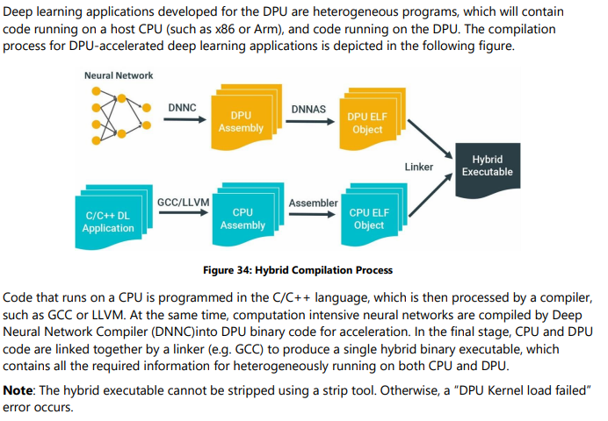
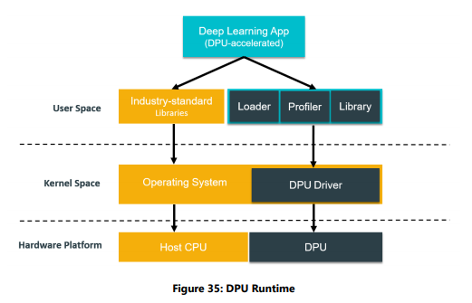

Slide 7
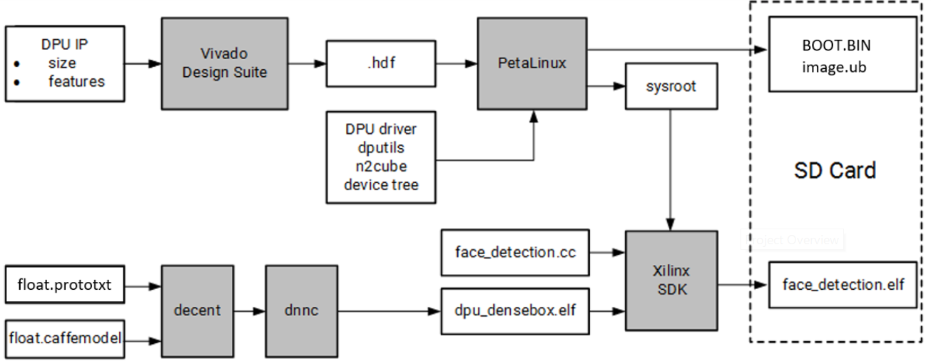
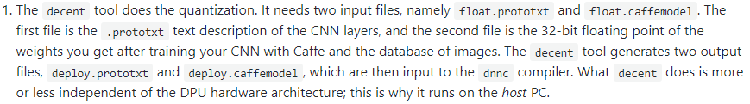
Host PC

Slide 8
SDSoC
Tool
FPGA PL
Get Image Frame
AXI interconnect
xfOpenCV lib
AXI interconnect
FPGA PS
Depth data
TOF
Monitor
IR data
MiniDisplay
interface

Slide 9
Voucherライセンス取得&
SDSoCインストール
Ultra96用Platform作成
xfOpenCV lib調査
ToF frame get program
並行で資料作成

Slide 10
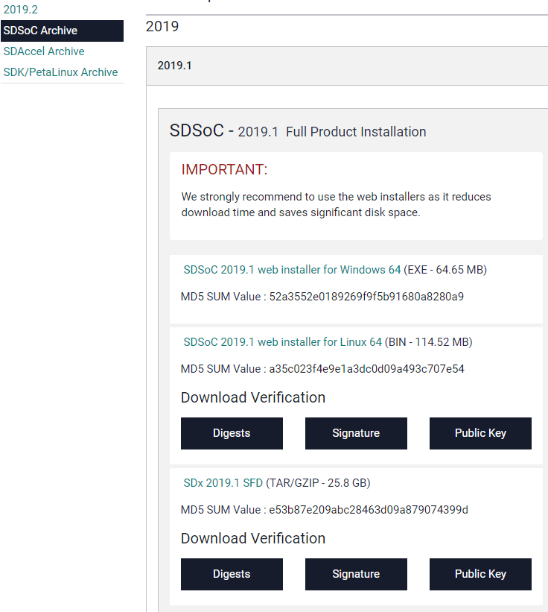
Download SDSoC URL link:
https://www.xilinx.com/support/download/index.html/content/xilinx/en/downloadNav/vitis/archive-sdsoc.html
Run the file after you downloaded it.
Note: download and install take 5 hour and make PC so slow, you should do this at night.

Slide 11
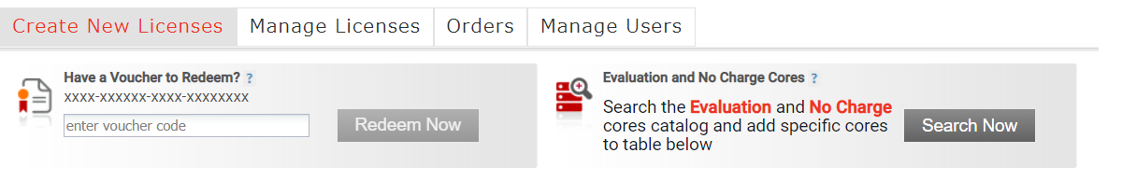
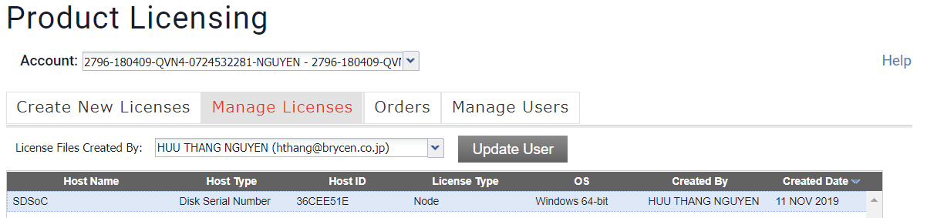
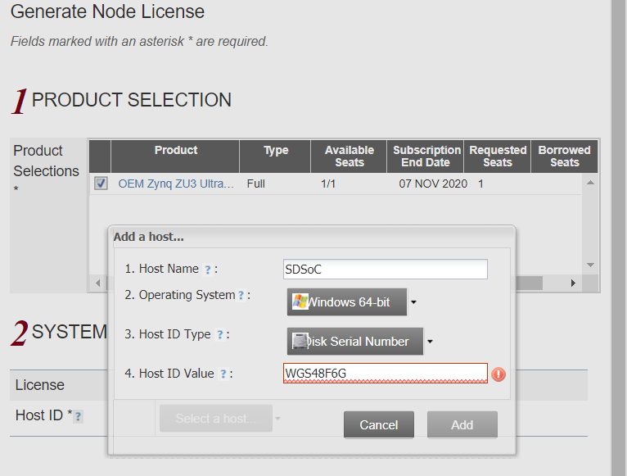
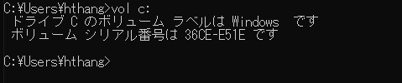
Host name: SDSoC
Operating System: Windows 64-bit
Host ID Type: Disk Serial Number
Host ID Value: 36CE-E51E

Slide 12
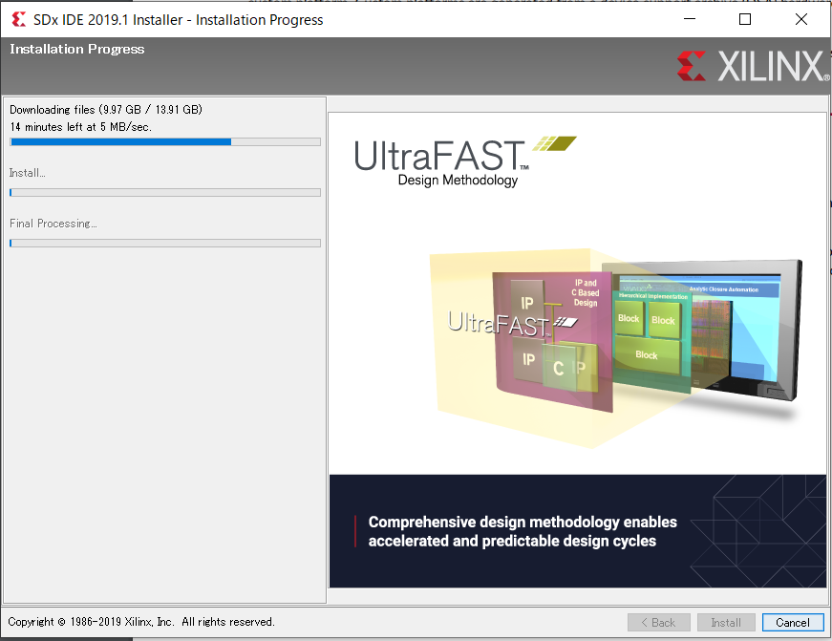
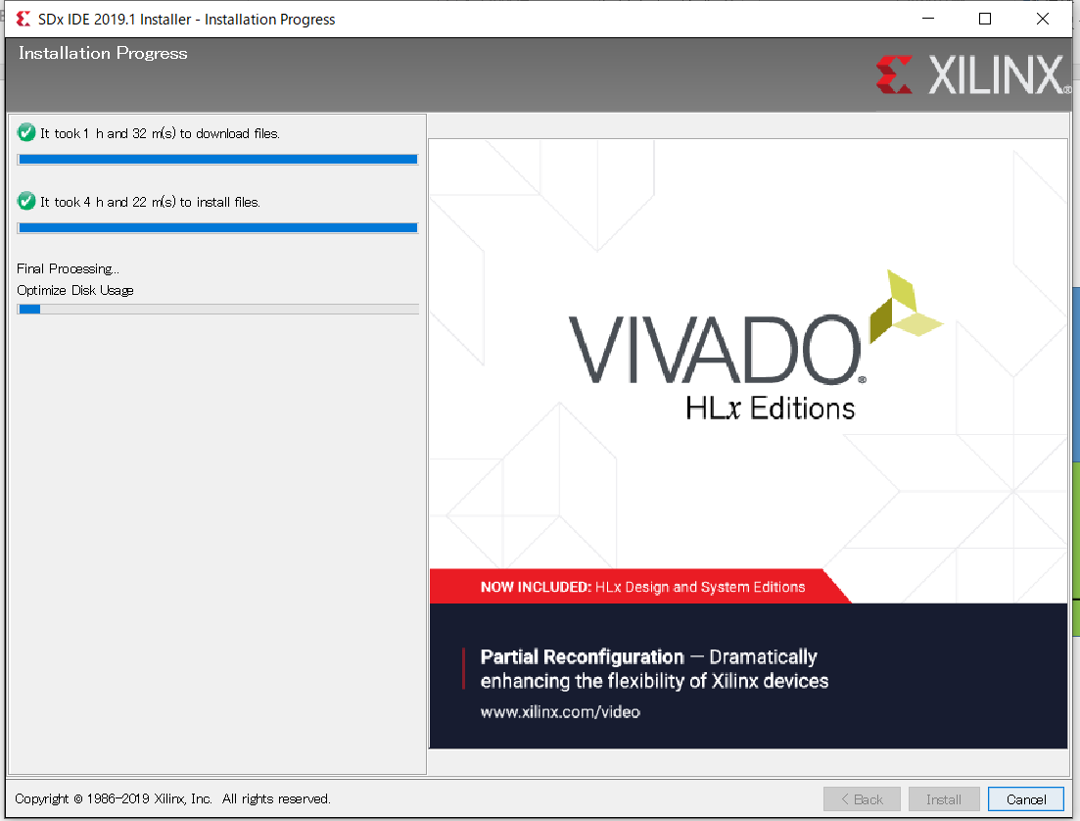
Before install SDSoC you should stop antivirut software

Slide 13
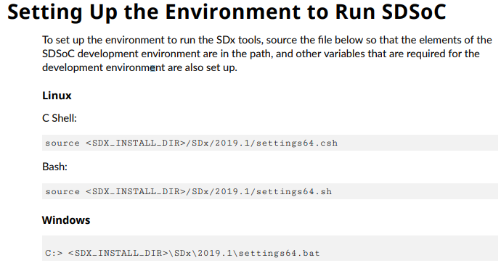

Slide 14

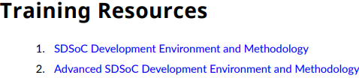
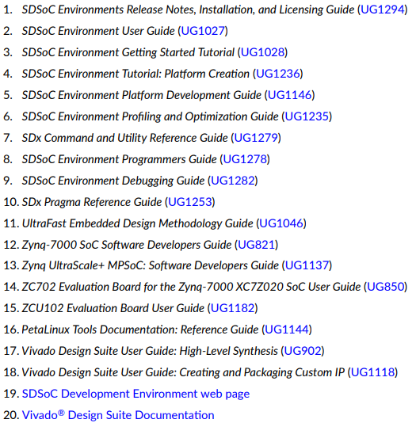

Slide 15
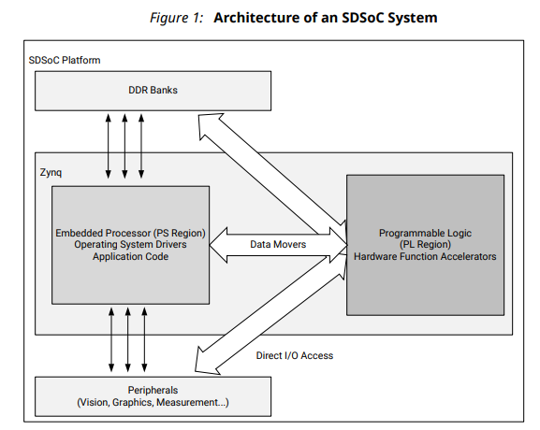
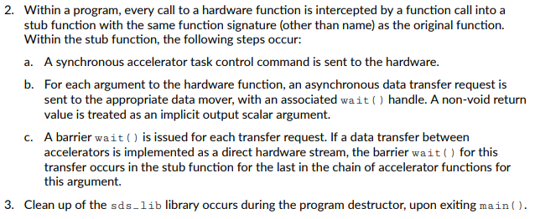

Slide 16
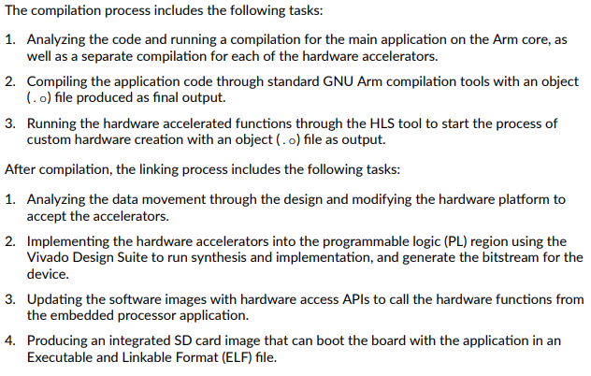
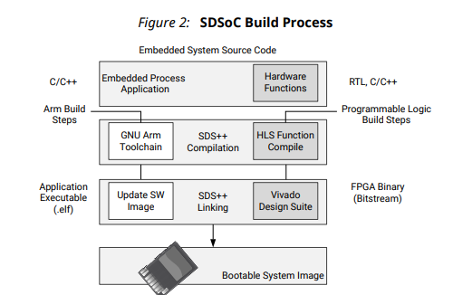

Slide 17
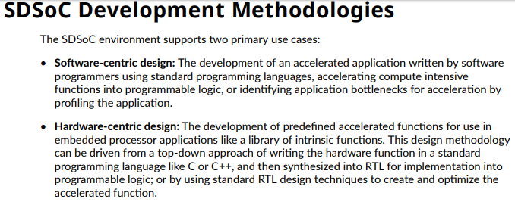

Slide 18

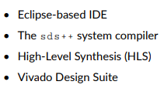
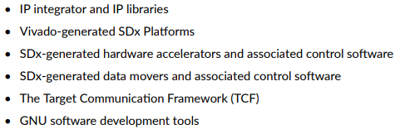

Slide 19
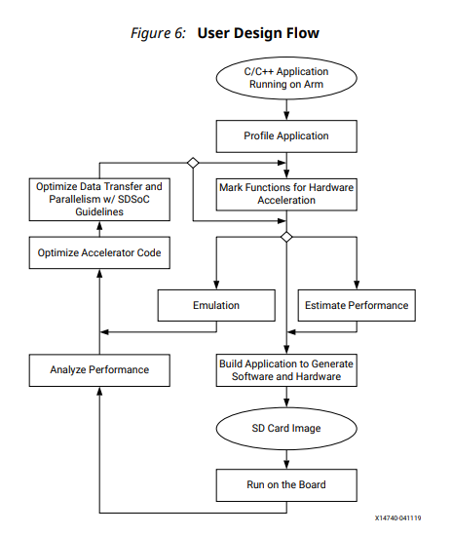
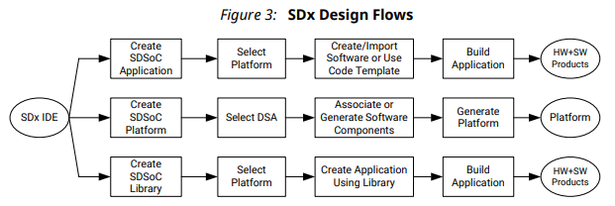
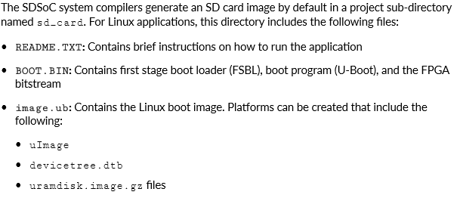

Slide 20
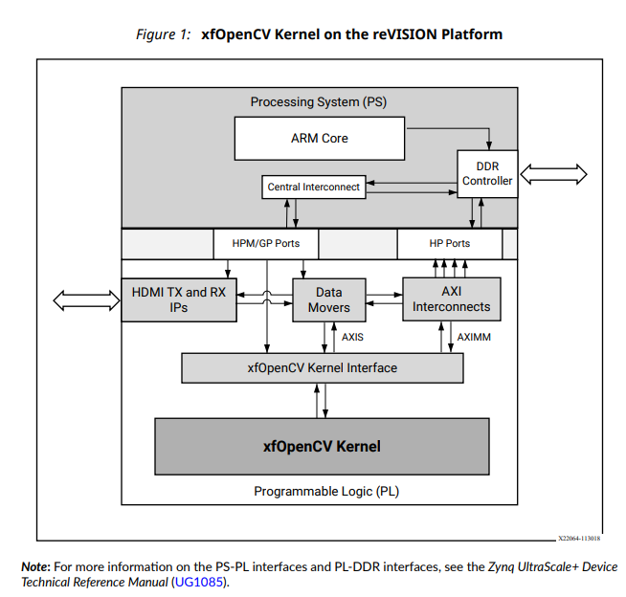
https://www.xilinx.com/support/documentation/sw_manuals/xilinx2019_1/ug1233-xilinx-opencv-user-guide.pdf

