Slide 1
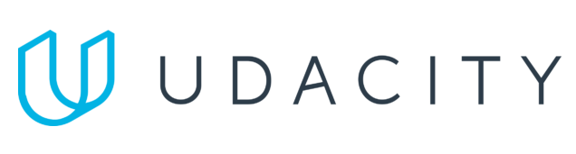
Data Lake Value Proposition
Medical Data Processing Company
Name XXXX
Udacity IPS Version 1.0
Notes:
Hi, I am XXXX, today I will present the value proposition of a Data Lake platform for the Medical Data Processing Company.

Slide 2
Agenda
What is a Data Lake
Components of a Data Lake
Data Lake vs Data Warehouse
Business Value of Data Lake Solution
Proposed Data Lake Architecture for Medical Data Processing system
Udacity IPS Ver. 1 2/2020
Notes:
The agenda is as follows.
Firstly, I will talk about definition of Data Lake.
Then I will show some componentes and benefits of a Data Lake.
I will also talk about the diferences between data lake and data warehouse, along with the business value of it
and at the end I will show the architecture of the new system

Slide 3
What is a Data Lake
Executive summary
Data lake is a large-scale storage system that holds a significant amount of raw data.
Data lake can store enormous volumes of data which provides scalability as per your needs
This data can be structured, semi-structured, or unstructured.
Notes:
A data lake is a centralized repository designed to store, process, and secure large amounts of structured, semistructured, and unstructured data. It can store data in its native format and process any variety of it, ignoring size limits.

Slide 4
Components of Data Lake
Raw Data Layer
Standardized Data Layer
Cleansed Data Layer
Application Data Layer
Sandbox Data Layer
Notes:
Raw Data Layer : The raw data layer, or as it is often referred to as the ingestion layer, is the first checkpoint where data enters the data lake. This layer ingests raw data from various external sources such as IoT devices, data streaming devices, social media platforms, wearable devices, and many more.
Standardized Data Layer : This layer acts as an intermediary between the raw and curated data layers and improves the performance of data transfer between the two. Here, the raw data from the ingestion layer undergoes a format transformation, converting it into a standardized form best suited for further processing and cleansing. This transformation includes changing the data structure, encoding, and file formats to enhance the efficiency of subsequent layers.
Cleansed Data Layer : This is where the data is transformed into consumable datasets, ready for analysis and insights generation. The layer executes data processing tasks that include data cleansing, denormalization, and consolidation of different objects.
Application Data Layer : The application data layer, also known as the trusted layer, adds a tier of business logic to the cleansed and curated data. It ensures that the data aligns perfectly with business requirements and is ready for deployment in various applications.
Sandbox Data Layer : the sandbox data layer, an optional but highly valuable layer, serves as an experimental playground for data scientists and analysts. This layer provides a controlled environment for advanced analysts to explore the data, identify patterns, test hypotheses, and derive insights.

Slide 5
Data Lake vs Data Warehouse

Slide 6
Data Warehouse
Data Lake
Structured data
schema-on-write or schema-on-read
Highly curated data
ELT
All types of data
schema-on-read
Any data
ETL
Udacity IPS Ver. 1 2/2020
Notes:
Data:
DW: Contains structured data that has been cleaned and processed
DL: All data, including structured, semi-structured, and unstructured. In Medical Data Processing Company, we can store files from FTP Server, CDC Data from Database, API Call Data from API Gateway.
Schema:
DW: Often designed prior to the data warehouse implementation but also can be written at the time of analysis (schema-on-write or schema-on-read)
DL: Written at the time of analysis (schema-on-read)
Data quality:
DW: Highly curated data that serves as the central version of the truth
DL: Any data that may or may not be curated (i.e. raw data)
Processing:
DW: ELT (Extract, Load, Transform). In this process, the data is extracted from its source for storage in the data lake, and structured only when needed
DL: ETL (Extract, Transform, Load). In this process, data is extracted from its source(s), scrubbed, then structured so it's ready for business-end analysis....

Slide 7
Business Value of Data Lake
Cheap Scalability
Ensure data availability at all times
Handling data at speed
Unlock historical data
Notes:
Cheap Scalability: One of the biggest benefits of a Data Lake to the enterprise is the ability to keep a large amount of data for a considerable price, which is less than a managed data enterprise warehouse.
Ensure data availability at all times: A Data Lake ensures that all employees no matter their designation have access to data. It can be considered as single source of truth, eliminate the issue of data inconsistency in Data silos.
Handling data at speed: Data Lake also handles data at high speed. It makes use of reliable tools like Spark Streaming, Storm, Flick, Kafka, which are built for scalability and speed to handle data and produce a fast result.
Unlock historical data : By using Apache Hudi, this open table format unlocks the ability to write time travel queries, which means you can query the previous state of the data. This is particularly useful for a few use cases: Rollbacks, Debugging, Audit History

Slide 8
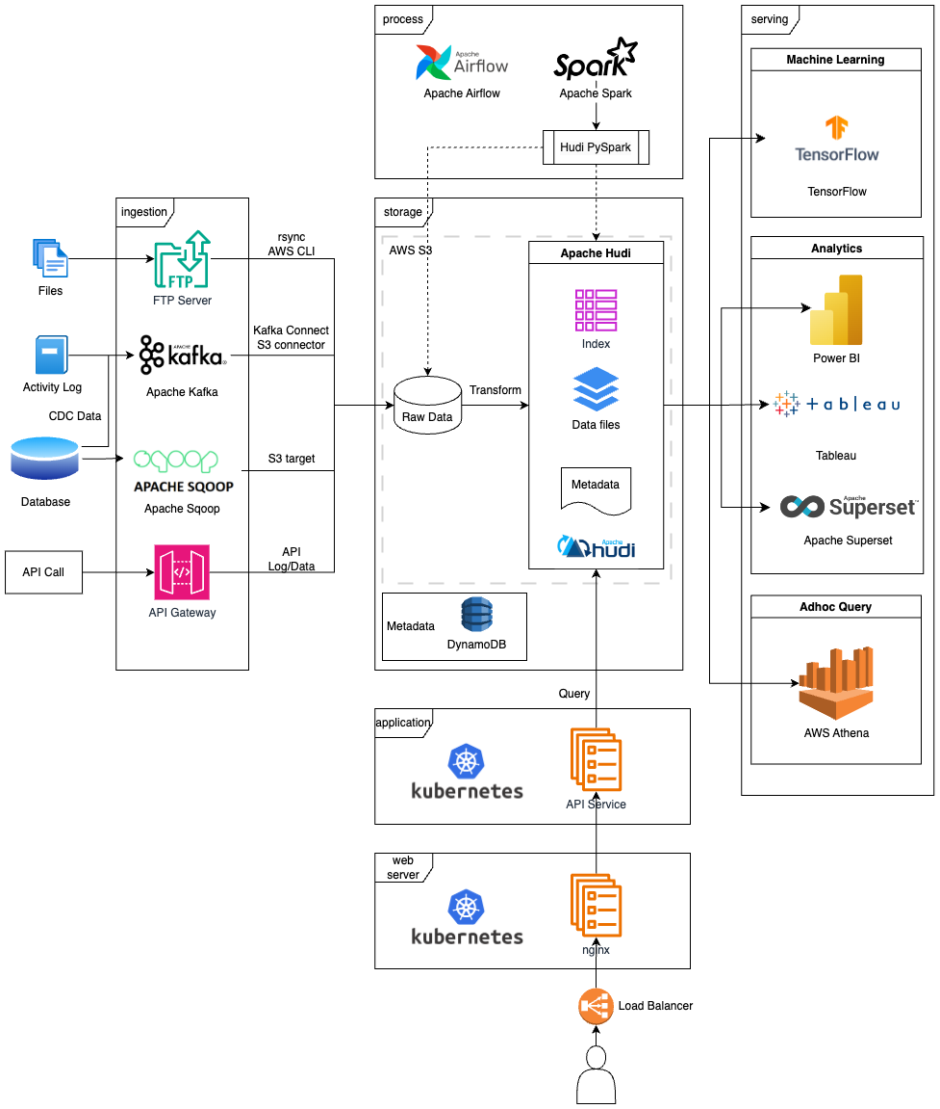
Data Lake Architecture
Notes:
In this slide, I show my propose Data architect to solve current problems/issues of Medical Data Processing Company.

Slide 9
THANK YOU
Udacity IPS Version 1.0

