Slide 1


Data Governance @ SneakerPark
Prepared by:
Submitted on:

Slide 2
Background
SneakerPark is an online shoe reseller that allows people to buy and sell used and new shoes. Buyers can bid for shoes or buy them outright, and sellers can set a price or sell to the highest bidder.
Each buyer and seller must have an active account in order to sell, bid, or purchase sneakers using SneakerPark’s website.
SneakerPark authenticates the shoes before shipping them to the buyer, so before listing an item, the seller must ship it to SneakerPark’s warehouse. Upon receipt, SneakerPark assigns an item number to each pair of sneakers and notifies the seller that they are now free to list their item. If the item is not listed within 45 days, SneakerPark returns it to the seller and sends an invoice to the seller for the shipping cost.
If the item is found to be inauthentic or in an unacceptable condition, it is also returned back to the seller in a similar fashion.
When the item sells, the buyer’s account is credited with the purchase price minus the SneakerPark service fee and shipping fees to deliver the item to the buyer.
Currently, SneakerPark only supports sales within the United States.

Slide 3
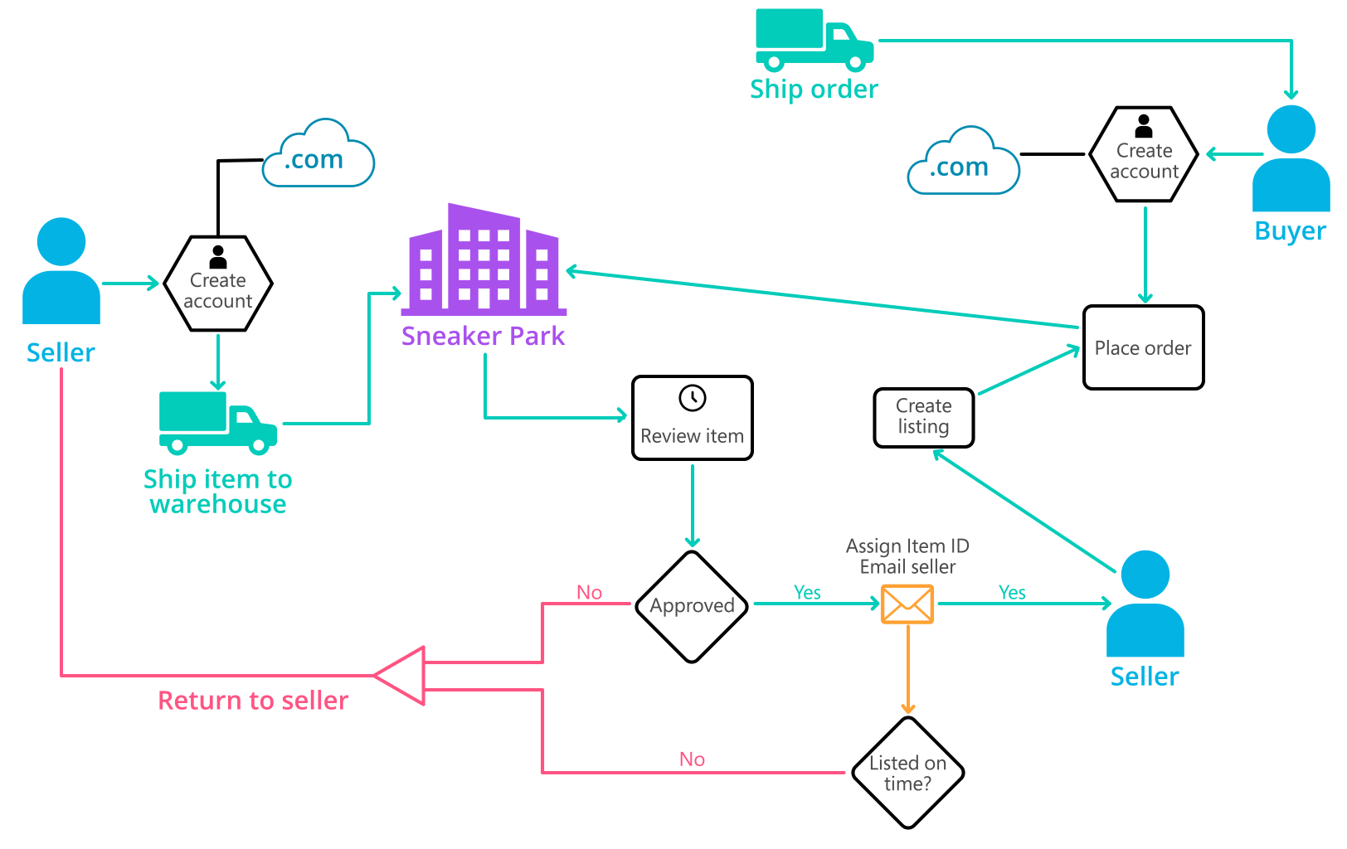
Background (cont’d)
Below you can see a diagram that will hopefully help you visualize some of SneakerPark's business processes. Keep in mind that it does not capture ALL processes and every nuance, but simply serves as another artifact to use in your project.

Slide 4
Step 1
Enterprise Data Catalog Part 1: Enterprise Data Model

Slide 5
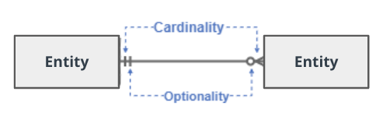
Create a conceptual data model that will provide SneakerPark with a holistic view of its data systems and help you grasp the organization's important entities and relationships, which will be instrumental as you move further in the project. You can use Lucidchart or any other diagramming tool of your choice, but please use the Crow’s Foot/IE Notation and please be sure to indicate both cardinality (the type of a relationship such as 1:N or N:N) and optionality (whether the relationship is optional or mandatory).

Slide 6
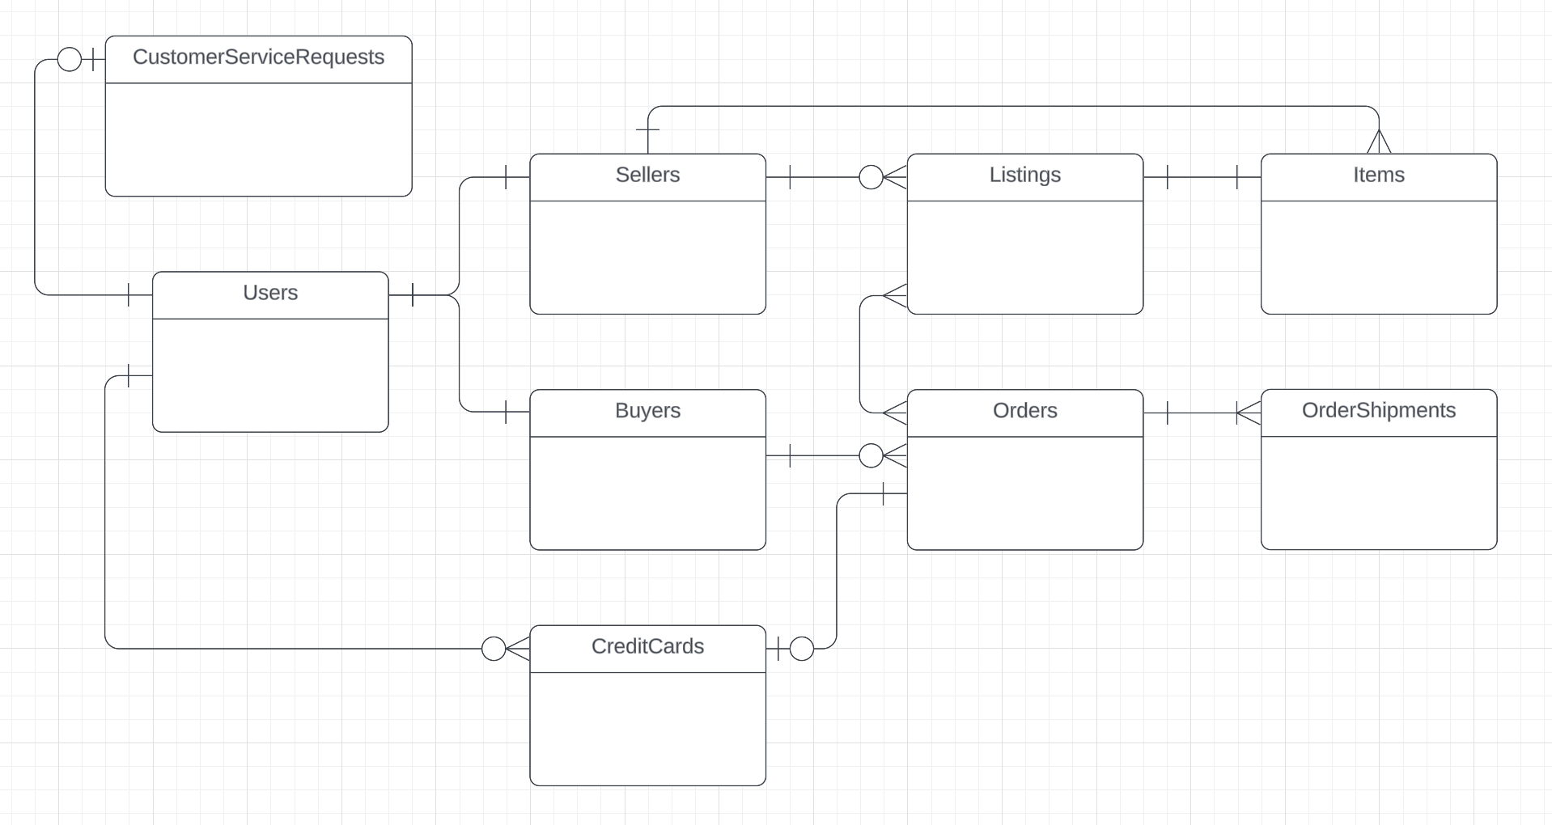
Replace the example below with your own solutions (obviously feel free to take more space):

Slide 7
Step 2
Enterprise Data Catalog Part 2: Metadata

Slide 8
Create the first version of the Metadata Catalog by documenting the metadata from all systems in the "Data Dictionary" and the “Enterprise Data Catalog” tabs of the provided Sheets template.
Please note that you are required to fill out all fields in both tabs.

Slide 9
Step 3
Data Quality
Part 1: Profiling and Cleansing

Slide 10
Profile the data to identify at least 3 data quality issues you see in the data. Also provide at least 1 data quality issue that you haven’t yet seen in the data, but can foresee occurring in the future. Based on the issues you’ve identified, come up with the data quality rule for each data quality issue, including for the one that you foresee.
Make sure you fill out all columns in the "Data Quality Issues" tab with your answers in the provided Sheets template.

Slide 11
Step 4
Data Quality
Part 2: Monitoring

Slide 12
Using the metrics you've created in the last step, please create a mock-up of a data quality monitoring dashboard that will be used to monitor the data to ensure compliance with your data quality rules.
Please make sure to label your metrics clearly on your mock-up.
Replace the example dashboard below with your own. (obviously feel free to take more space).

Slide 13
Step 5
Master Data Management
Part 1: MDM Architecture

Slide 14
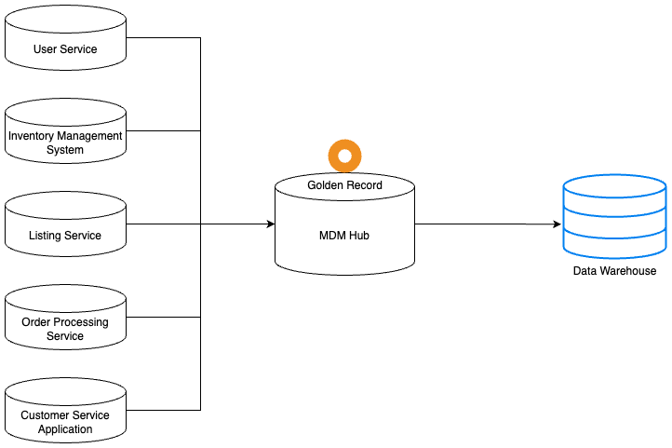
Based on what you’ve read about SneakerPark’s systems and business model, sketch out a proposed MDM implementation architecture, and write a detailed explanation of why you chose this specific approach.
Tip: Think about how your plan and its implementation might affect existing systems.
Replace example screenshot below with your own solutions (obviously feel free to take more space).
Next, please write at least a paragraph explaining your choice.

Slide 15
Explanation:
I've chosen to go with the Consolidated style of architecture.
SneakerPark has many duplicate data of users, user data are stored in both users table and customerservicerequests table, this maybe cause inconsistency in data. For example: first name, last name, email
About items, we can also see duplication of items attribute data in both listings table and items table. For example: brand name, color, size
We need to verify customers & items gold records from current SneakerPark system, and centralize this data into MDM Hub.
The master data can then be ingested into an Enterprise Data Warehouse and used by downstream systems and users for analytics and reporting.
With consolidated architecture, the implementation is not complex, so we can change system architecture fast without disruption.

Slide 16
Step 6
Master Data Management
Part 2: Master Record

Slide 17
In this step, you will define a set of matching rules that will be used by the SneakerPark's MDM Hub to match item and customer entities between the company's different systems.
Items:
Brand name: Matching itemid of items table with productid of listings table. Because brandname in items table is required, we take brand name from items table.
Color: Matching itemid of items table with productid of listings table. Because Color in items table is required, we take color value from items table.
Customers:
First name: Matching userID of users tables with userid of customerservicerequests table. We will take the value if it is the same across 2 table. If not, validation is needed.
Last name: Matching userID of users tables with userid of customerservicerequests table. We will take the value if it is the same across 2 table. If not, validation is needed.

Slide 18
Step 7
Data Governance:
Roles and Responsibilities

Slide 19
Write 1-2 paragraphs discussing what data governance roles and responsibilities will be necessary to oversee this new Data Management initiative. Please be sure to discuss the responsibilities in the context of at least 3 different aspects of Data Governance (such as Data Quality Management, Metadata Management, MDM, etc). Based on what you know, do SneakerPark's current employees have the necessary skills for these roles or should the company make new hires?
Data steward : In SneakerPark, Jessica can take this role. She can review data flow, create rules for data creation. She ensure that data is properly classified, documented, and protected according to the defined policies and standards.
Data Administrator : In SneakerPark, Jake can take this role, with his background in IT. He can support company in Infrastructure Management, Data Transformation, and support customer if any issues occur.
Executive Sponsor : high-level executives like the CxO of SneakerPark can take this role. They can act as the driving force behind data governance initiatives within the organization. Their leadership is essential to secure the program's success.

Slide 20
Standout Suggestions

Slide 21
Create a Business Glossary for SneakerPark and define common terms such as Item, Buyer, etc. Think and discuss how SneakerPark can improve on the consistency of the terms that its systems currently use. (You can use the “Business Glossary” tab of the same Sheets template you’ve been using for the other parts of this project to get you started.)
Document SneakerPark’s current naming conventions. Can you think of any improvements? (You can use the “Standard Naming Conventions” tab of the same Sheets template you’ve been using for the other parts of this project to get you started.) Some examples of Naming Conventions include;
Do not use spaces or special characters.
Use only LOWERCASE.
All identifier fields should end in “_id”.
Avoid acronyms and abbreviations.
Write SQL scripts for the matching rules that you’ve created in Step 6.

