Slide 1

Improving Vietnamese Accent Recognition via ASR Transfer Learning
Bao Thang Ta, Tung Lam Nguyen, Dinh Son Dang, Nhat Minh Le, Van Hai Do
Viettel Cyberspace Center, Viettel Group, Vietnam

Slide 2
‹#›
Contents
Introduction
Related Work
Proposed Model
Experimental results
Conclusion

Slide 3
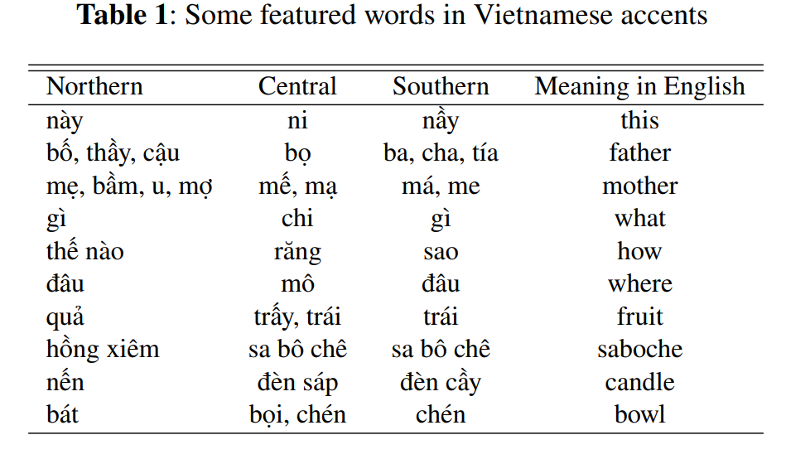
‹#›
Vietnamese Accent Recognition (AR)
Accent refers to a variety of pronouncing behaviors of speakers
Vietnamese accents are divided into three categories: Northern, Central, and Southern
Southern and Central have many local region words

Slide 4
‹#›
Motivation: Why do study Vietnamese AR
Discover difference between accents
To improve Vietnamese Automatic Speech Recognition (ASR)
Model adaptation: Pronunciation, Acoustic, …
To Infer speaker’s regional origin:
Adapt Text-to-Speech system
Speech to speech translation
Call center - crucial in emergency situations

Slide 5
‹#›
Related Works
Almost AR works for English language
[3,4,5] applied SV model for AR tasks
[8,9,10] solves AR task by multitask learning with ASR tasks
Vietnamese accent studies still only limited to feature selections and basic signal processing approaches:
Hung [11] proposed a GMM models using MFCC
[1] proposed a combination between MFCC and F0 as input
Tien [12] applied CNN and Resnet50
[1] Pham Ngoc Hung et al., “Vietnamese dialect identification on embedded system”, UTEHY Journal of Science and Technology, 2018
[10] Gao at al., ““An end-to-end speech accent recognition method based on hybrid ctc/attention transformer asr”, ICASSP, 2021
[11] Pham Ngoc Hung et al. “Automatic identification of vietnamese dialects,” Journal of Computer Science and Cybernetics, 2016
[12] Duong Quang Tien et al., “Development of accent recognition systems for vietnamese speech”, O-COCOSDA, 2021

Slide 6
‹#›
Related Works
All existing methods:
- only trained AR task from scratch although public Vietnamese AR datasets are very modest
- did not pay attention to linguistic information
Our works showed that it can achieve SOTA (62%) results for Vietnamese AR by only using LSTM model on transcripts learned from ASR
Linguistic information is very important for Vietnamese AR

Slide 7
‹#›
Proposed Model
Mi về khi mô rứa?
(When did you go home?)
Northern / Central/ Southern
FCs
RNN-T decoder
Statistical Pooling
Conformer blocks
linguistic information
Conformer blocks
Convolution Subsampling
Transfer learning
Convolution Subsampling
log Mel-spectrogram
ASR model
log Mel-spectrogram
b) AR model
(*) Gulati. et. al (Google Inc), Conformer: Convolution-augmented Transformer for Speech Recognition, Proc. Interspeech 2020
Notes:
‹#›

Slide 8
‹#›
Experimental setup
Dataset: Vietnamese telephone call dataset: 26 hours
Model Configuration
Accent | Northern | Central | Southern | Total
#speakers | 1929 | 1540 | 1540 | 5009
For both ASR and AR encoders: Small Conformer [22]
For the decoder: 3 fully-connected layers
[22] Gulati. et. al (Google Inc), Conformer: Convolution-augmented Transformer for Speech Recognition, Proc. Interspeech 2020

Slide 9
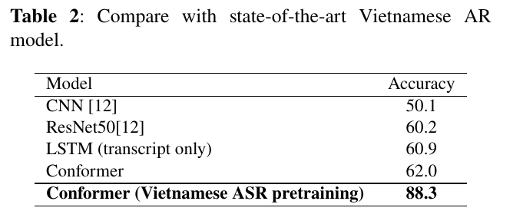
‹#›
Compare with SoTA Vietnamese AR models
The proposed model is compared with:
- Two most recent Vietnamese AR works
- A model only using transcripts from ASR tasks
Our model outperformed all compared models with a significant improvement

Slide 10
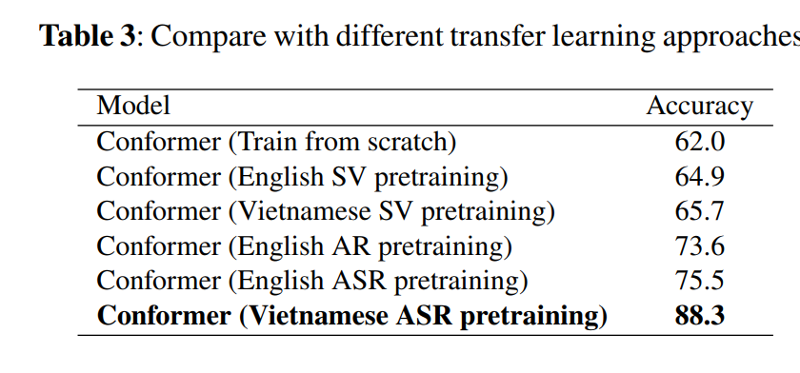
‹#›
Compare with several transfer learning methods
Notes:
Trained-from-scratch model: there is significant overlap among all accents
SV pretraining: Central, Northern, and Southern accents are classified with clearer clusters
English AR pretraining: distinctions across accent classes are more evident.
ASR pretraining: accent embeddings are much better grouped
Vietnamese pretrained models makes accent embeddings more discriminative compared to English pretrained models

Slide 11
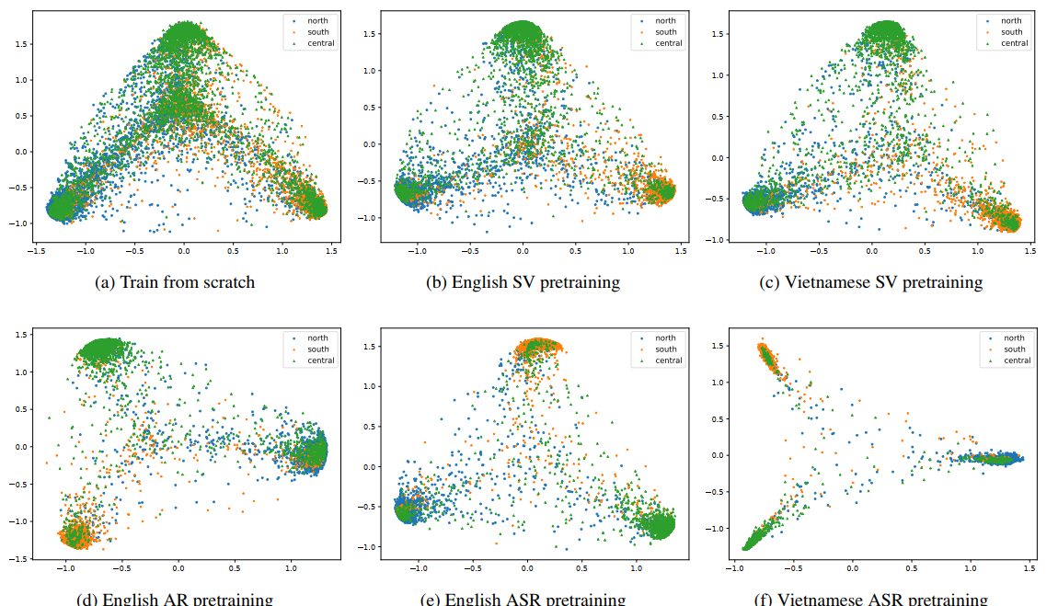
‹#›
Compare with several transfer learning methods
Northern
Central
Southern
Notes:
Trained-from-scratch model: there is significant overlap among all accents
SV pretraining: Central, Northern, and Southern accents are classified with clearer clusters
English AR pretraining: distinctions across accent classes are more evident.
ASR pretraining: accent embeddings are much better grouped
Vietnamese pretrained models makes accent embeddings more discriminative compared to English pretrained models

Slide 12
‹#›
Conclusion
This paper proposed a transfer learning method that finetunes the pretrained ASR encoder for Vietnamese accent recognition
Several transfer learning from different pretrained speech models also are analyzed
Experiments on a Vietnamese telephone dataset proved the superior performance of our method over existing methods.
In the future, we will examine the effectiveness of pretrained self-supervised models in Vietnamese accent recognition

Slide 13
‹#›
Acknowledgement

Slide 14
‹#›
Thank you for listening!

