Slide 1

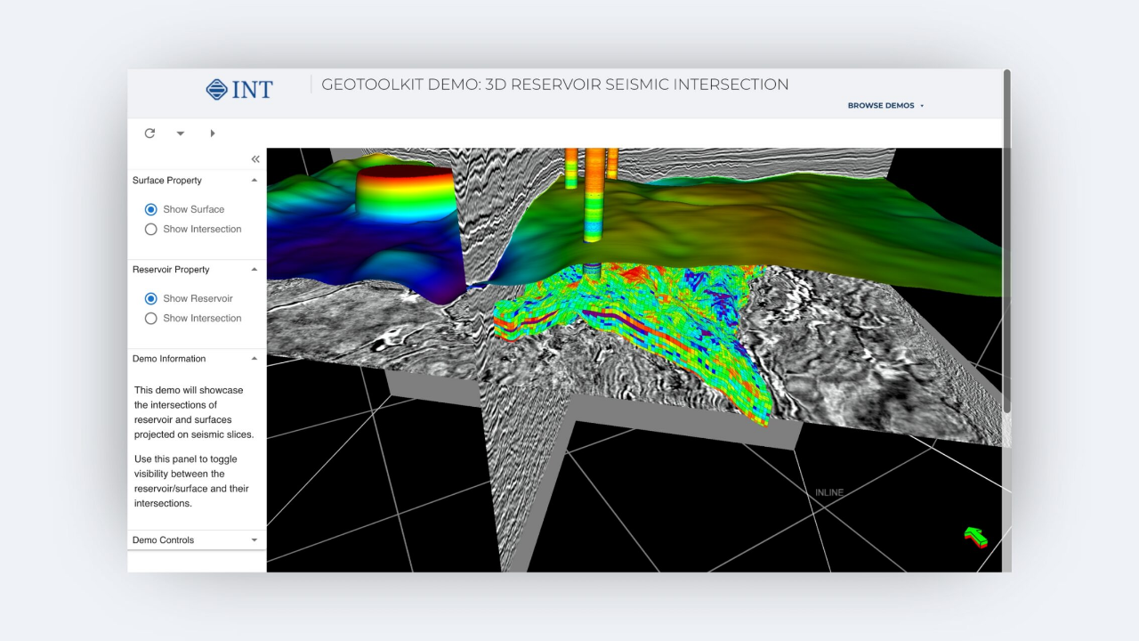








FEATURED PROJECT
Conrad Mako Gas Field
Model Update 2023
PORTFOLIO
Reservoir Geologist
& Static Modeler
Conrad Mako Gas Field ·Petrel ·3D Seismic ·AI Inversion
116 km² 3D Seismic
GIIP +6%
6-Well Dataset
NEW DATA INTEGRATED
SIGNIFICANT GIIP UPLIFT
MAKO FIELD FOUNDATION

Slide 2








CONRAD MAKO GAS FIELD · PETREL
Core Competencies
3D Seismic Interpretation
Petrel Static Modeling
Facies & Property Modeling
Interpreted reservoir tops and bases in Two-Way Time (TWT), then applied depth conversion across 116 km² of new 3D seismic data.
Executed full reservoir model update in Petrel following the Three60 standard workflow, integrating new structural and property data.
Applied AI-guided Sequential Indicator Simulation (SIS) to model facies distribution and populate reservoir property grids.
SEISMIC · TWT · DEPTH CONV.
PETREL · THREE60 · STRUCTURAL
SIS · AI-GUIDED · FACIES
Seismic AI Integration
GIIP Volumetric Estimation
Merged 3D Acoustic Impedance (AI) with legacy 2D Pseudo AI after rebalancing, ensuring seamless data continuity across the full field extent.
Ran best-estimate volumetric workflow delivering a measurable uplift in gas-in-place, reflecting improved structural mapping and AI-guided facies quality.
AI INVERSION · 2D/3D MERGE
GIIP · VOLUMETRICS · +6% UPLIFT

Slide 3
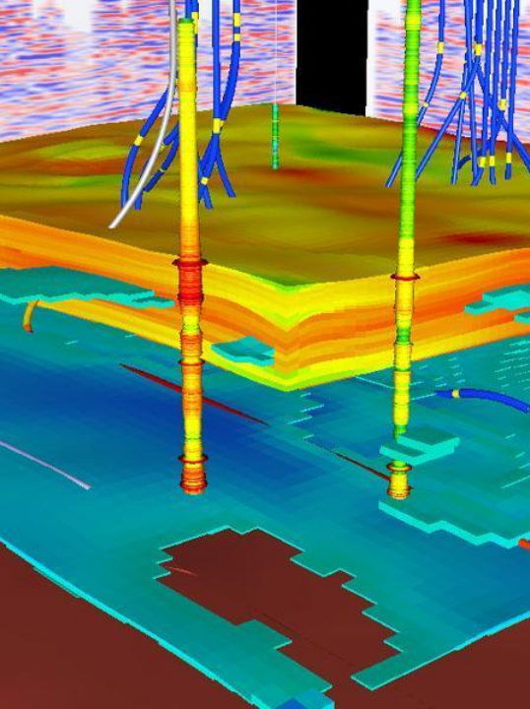













FEATURED PROJECT
Conrad Mako
Gas Field
Model Update 2023 — SW Area 3D Seismic Integration
3D SEISMIC COVERAGE
116 km² of new 3D seismic data integrated into the SW area with full inversion analysis
STRUCTURE UPDATE
Reservoir found up to 12m shallower than legacy 2D mapping— significant structural revision
2D / 3D DATA MERGE
3D AI merged with 2D Pseudo AI after rebalancing — seamless integration in Petrel reference project
WELL DATASET FOUNDATION
6-well dataset underpins the static model — all wells originally drilled on 2D seismic interpretation
KEY OUTCOME — GIIP UPLIFT
Gas Initially In Place recorded a +6% uplift following the updated structural model, confirming improved resource estimation across all reservoir zones
PETREL STATIC MODEL

Slide 4

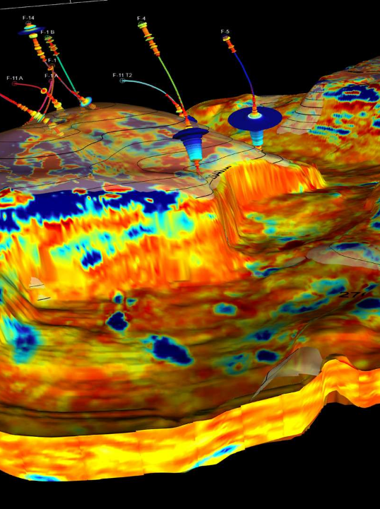










SUBSURFACE MODELING
Seismic Interpretation
& AI Integration
TWT Interpretation → Depth Conversion → Legacy 2D Merge
Reservoir tops and bases interpreted in 3D TWT domain, depth-converted, then merged with existing 2D legacy interpretations for full-field coverage.
AI Crossplot & Histogram QC
3D Acoustic Impedance rigorously compared with 2D AI using crossplots and
histograms.
Area A: No rebalancing
Area B: Rebalanced
Rebalancing 3D AI to 2D AI Overlap
3D Pseudo AI (derived from 2D) merged with 3D AI after rebalancing. Moving average method applied for 2D AI population across the field.
Anomaly Detection & Removal
DYG-13 Excluded
DYG-13 identified as anomalous line and removed from the AI point set to ensure data consistency and prevent bias in facies population.
TECHNICAL PARAMETERS
3D Seismic Area: 115.405 km² (Area A) | Method: Moving average for 2D AI population | Output: Merged 3D + Pseudo AI dataset for facies guidance
3D SEISMIC VOLUME — AREA A (115.4 KM²)

Slide 5
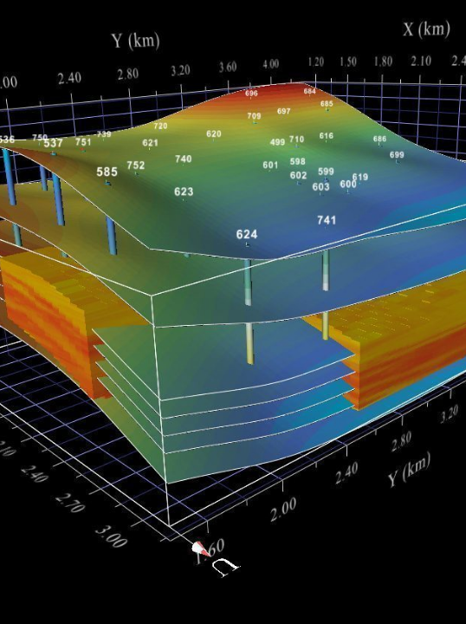









STATIC MODEL UPDATE
Facies & Property Modeling
Three60 Standard Workflow · AI-Guided Simulation · Petrel Integration
AI-Guided SIS Simulation
Three60 workflow driven by seismic Acoustic Impedance — lower AI values in 3D area increased proportion of good-quality reservoir facies ; 2D area proportions remained stable.
Active Gas Zone Cells +4%
Updated model: 303,863 active gas cells vs. legacy 291,739 — a 4% volumetric increase reflecting improved facies quality and structural update.
Porosity, Permeability & Sw Updated
Full property model suite (Porosity, Permeability, Water Saturation) rebuilt using standard workflow and integrated into the Petrel reference project.
Water-to-Gas AI Substitution
AI substitution applied in paleo-gas and water leg zones to correctly represent historical gas presence and improve property population accuracy.
Model Scale: Updated grid — 610,634 total cells vs. 585,501 legacy | +4.3% cell count driven by refined structural interpretation and AI-guided facies expansion.
3D FACIES MODEL — MAKO FIELD

Slide 6






Volumetric Model Update
Static Model Update · Mako Field
Legacy Baseline (100%)
Updated Model
GAS VOLUME CHANGE BY ZONE (INDEXED TO LEGACY = 100%)
Key Findings
Y-axis shows relative change vs. legacy model baseline
+6% Total Field — Field-wide gas volume increased across all zones, confirming the updated model delivers a stronger resource estimate than the legacy model.
+8% Primary Reservoir Zone — The main producing zone (Muda Sand1) recorded the largest absolute uplift, driven by the shallower updated structure.
+49% Upside Outside Boundary — The area outside the contract boundary showed the highest relative gain — nearly doubling the legacy estimate in that zone.
Uplift driven by
shallower structure (+12 m GRV)
and improved
reservoir quality from AI-guided facies modeling.
KEY TAKEAWAY
The integrated 3D seismic and AI-guided modeling workflow delivered a measurable uplift across all reservoir zones — demonstrating the value of data- driven static model updates.

Slide 7







PORTFOLIO · SUBSURFACE SPECIALIST
Let's Work
Together
Specialist in Static Reservoir Modeling & Seismic Interpretation
Available for consulting, contract, or full-time roles.
Open to consulting & contract roles — flexible engagement across oil & gas projects worldwide.
Expertise in Petrel & subsurface modeling — 3D seismic interpretation, facies & property modeling, GIIP volumetrics.
Proven track record: 6% GIIP uplift delivered — measurable gas-in- place increase confirmed across a 116 km² 3D seismic, 6-well field model.
GET IN TOUCH
Seismic AI Integration · Petrel Static Modeling
Subsurface Characterization · GIIP Volumetrics
SUBSURFACE PORTFOLIO · 2024

