Slide 1
ISC2017
20th Information Security Conference
22-24th November, 2017
Ho Chi Minh, Viet Nam
Improving Gait Cryptosystem Security Using Gray Code Quantization and Linear Discriminant Analysis
Lam Tran^{1,3}, Thang Hoang², Thuc Nguyen³, Deokjai Choi¹
¹ ECE, Chonnam National University, Gwangju, South Korea dchoi@jnu.ac.kr ² EECS, Oregon State University, Corvallis, Oregon, USA hoangmin@oregonstate.edu ³ FIT, Ho Chi Minh University Of Science, Ho Chi Minh, Vietnam {thlam,ndthuc}@fit.hcmus.edu.vn
Notes:
Hello everyone. Thank you for having me. It is an honor to be here with you today. My name is Lam Tran.
Today, I’d like to present you about “Improving Gait Cryptosystem Security Using Gray Code Quantization and Linear Discriminant Analysis”

Slide 2
Outline
Introduction
Contributions
Proposed Methods
Solution for the Less Discriminability of Gait Data
Method to Handle the High Variation of Gait Data
Experiments
Conclusion
Notes:
First I’d like to give an introduction to my work
Then, I summarize our contribution in this paper
Next, I present the proposed methods
After this, I present the experiments and results
Finally, I’d like to give a conclusion and future works

Slide 3
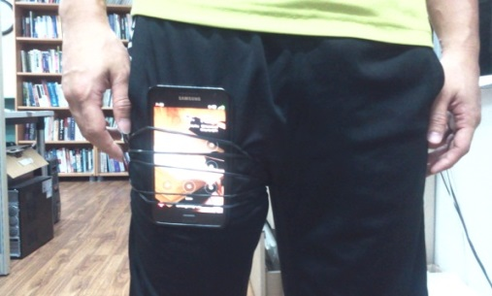
Introduction
Gait has been considered as an efficient modality for recognizing individual via human motion.
Inertial sensors based gait authentication:
Uses inertial sensors to collect gait data.
Allows authenticating user implicitly.
Significant schemes have been proposed in literature [2]:
Patten recognitions, machine learning
Potential risk:
The extracted gait templates/models are stored insecurely (i.e., in mobile phone)
→ Security and user privacy problems.
Inertial sensors based
gait authentication
Notes:
Beside some well-known modality as iris or face, gait has been, in which the characteristics of human motion are used to reconigized individual.
There are various approaches to use gait for authentication/recognition. And inertial sensors based is the newest one which uses inertial sensors to collect gait data.
The noticeable advantage of this approach is it allows authenticating user implicitly.
However, there is a potential risk in the state of the art researches
If these data is obtained by the attacker

Slide 4
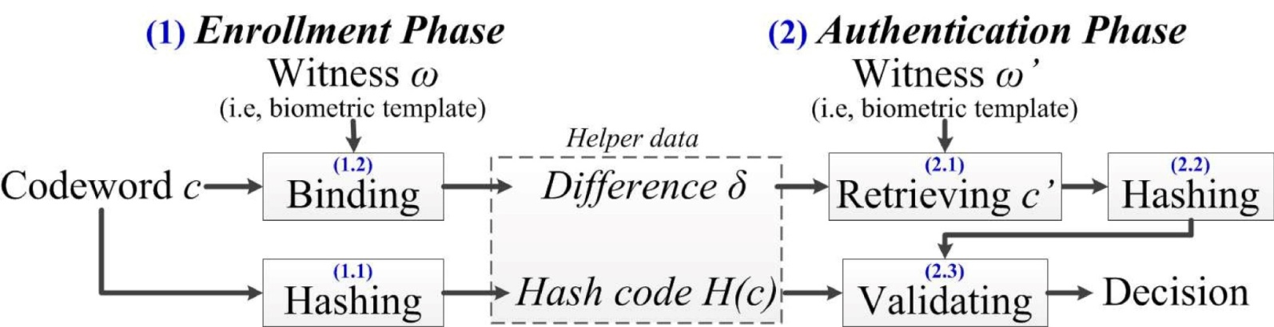
Introduction
Fuzzy Commitment Scheme (FCS):
Biometric cryptosystem framework to secure biometric templates by binding it with a secret key before storing.
Several studies applied FCS to the inertial-sensor based gait authentication [1].
Provide elegant strategy to protect the stored gait templates.
Drawbacks:
No attention to the low discriminability and high variation of gait data.
→ Decrease the system performance (e.g., FAR, FRR) and security (e.g., key length).

Slide 5
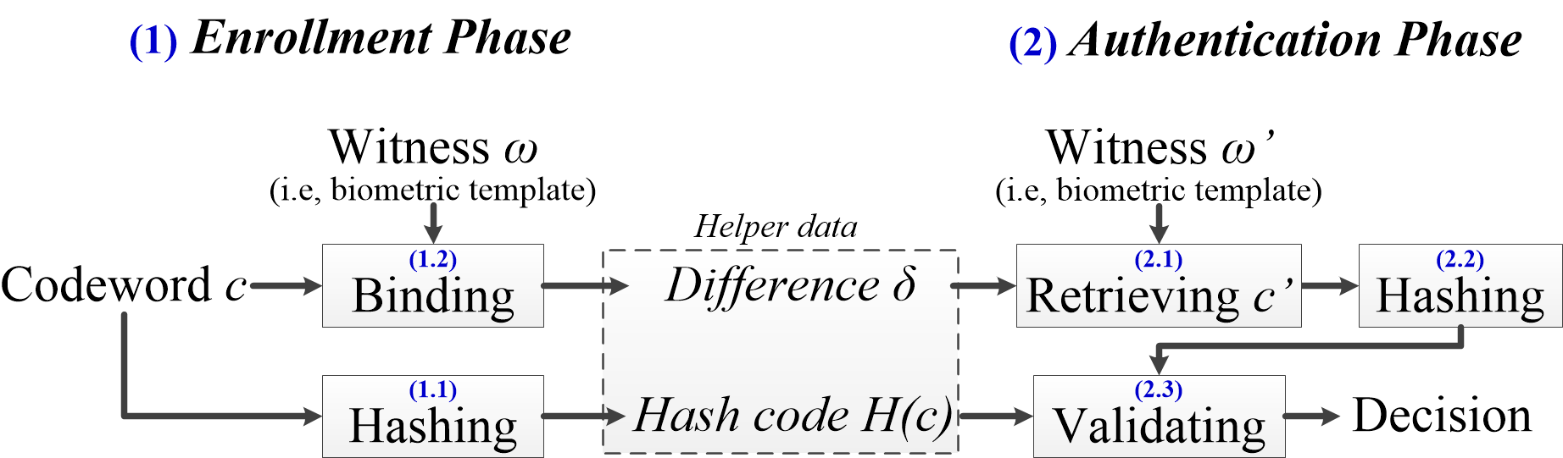

Introduction
Main task: how to extract witness $ω$ (usually is a binary string) from biometric data:
Length: directly affects the security strength (key length)
Discriminability and stability: affects the performance
Low discriminability → high FAR.
Low stability → high FRR.

Slide 6

Contributions
Gait signals
Preprocessing & Features extraction [3]
LDA
Binarization
Quantization
Reliable bits extraction
Binary string $ω$
FCS
1. Use Linear Discriminant Analysis to solve the low discriminability of gait data.
→ Reduce FAR.
2. Apply Graycode quantization to reduce the variation of gait data.
→ Increase the key length and reduce FRR.
Notes:
Main challenge when applying FCS
How to extract a discriminative and stable template from biometric.
Low discriminative → high FAR
Low stability → high FRR, short key length.

Slide 7
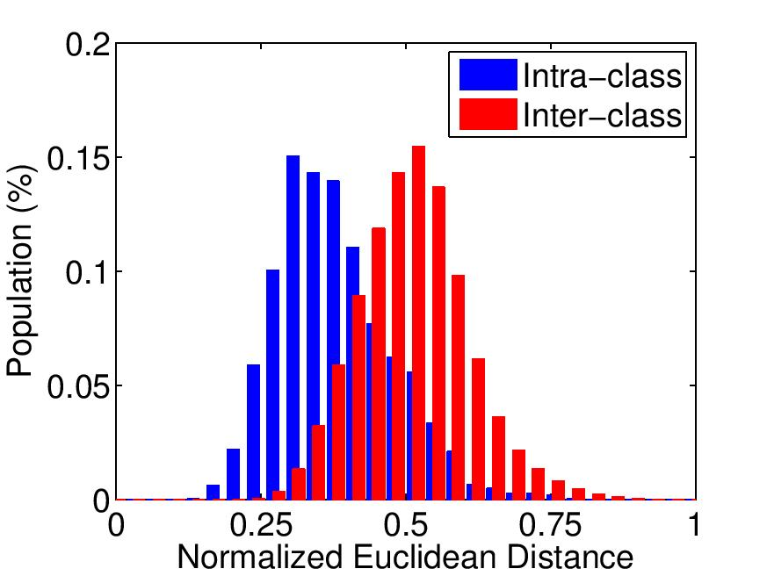
The low discriminability
Gait templates extracted from inertial-sensors based gait signals:
The resulted gait templates are low discriminability (the overlapping area between inter and intra class is large).
→ Ideas: Apply LDA to enhance the discriminability.
Noise filtering
Disorientation elimination
Time & domain features extraction
Gait signals
Preprocessing & Features extraction [3]

Slide 8
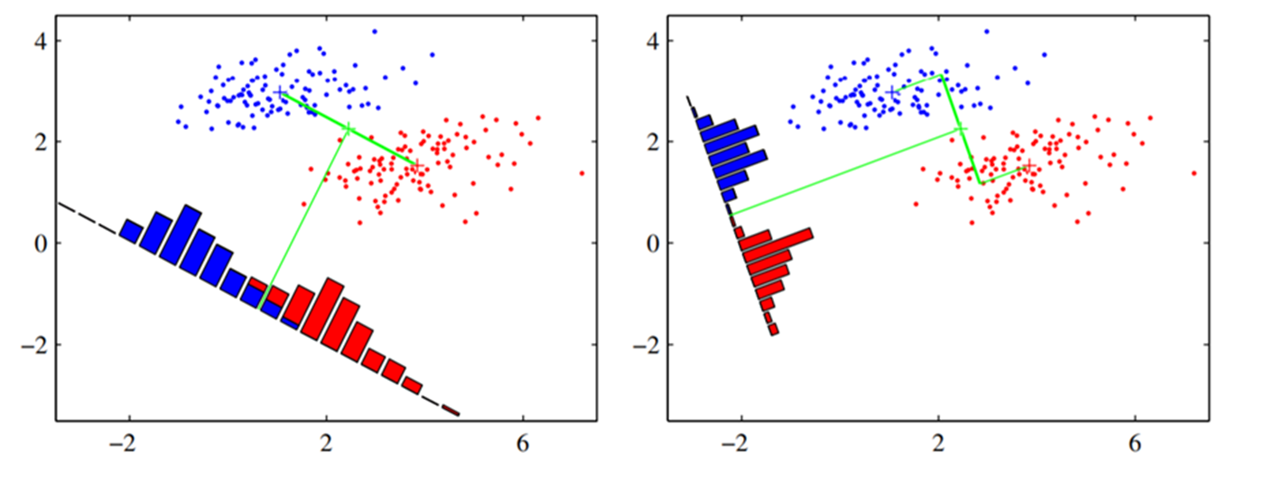
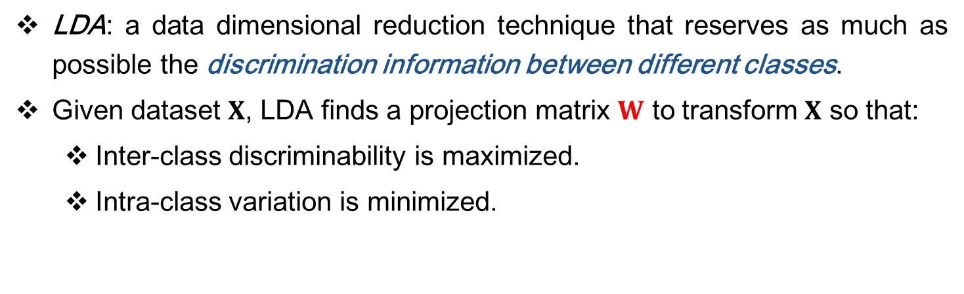
Fisher’s Linear Discriminant Analysis (LDA)
LDA: a data dimensional reduction technique that reserves as much as possible the discrimination information between different classes.
Given dataset $X$, LDA finds a projection matrix $W$ to transform $X$ so that:
Inter-class discriminability is maximized.
Intra-class variation is minimized.
Notes:
Pattern Recognition and Machine Learning, p. 188

Slide 9
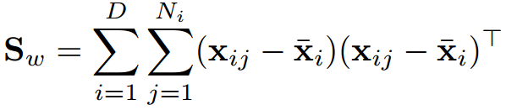
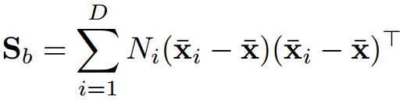


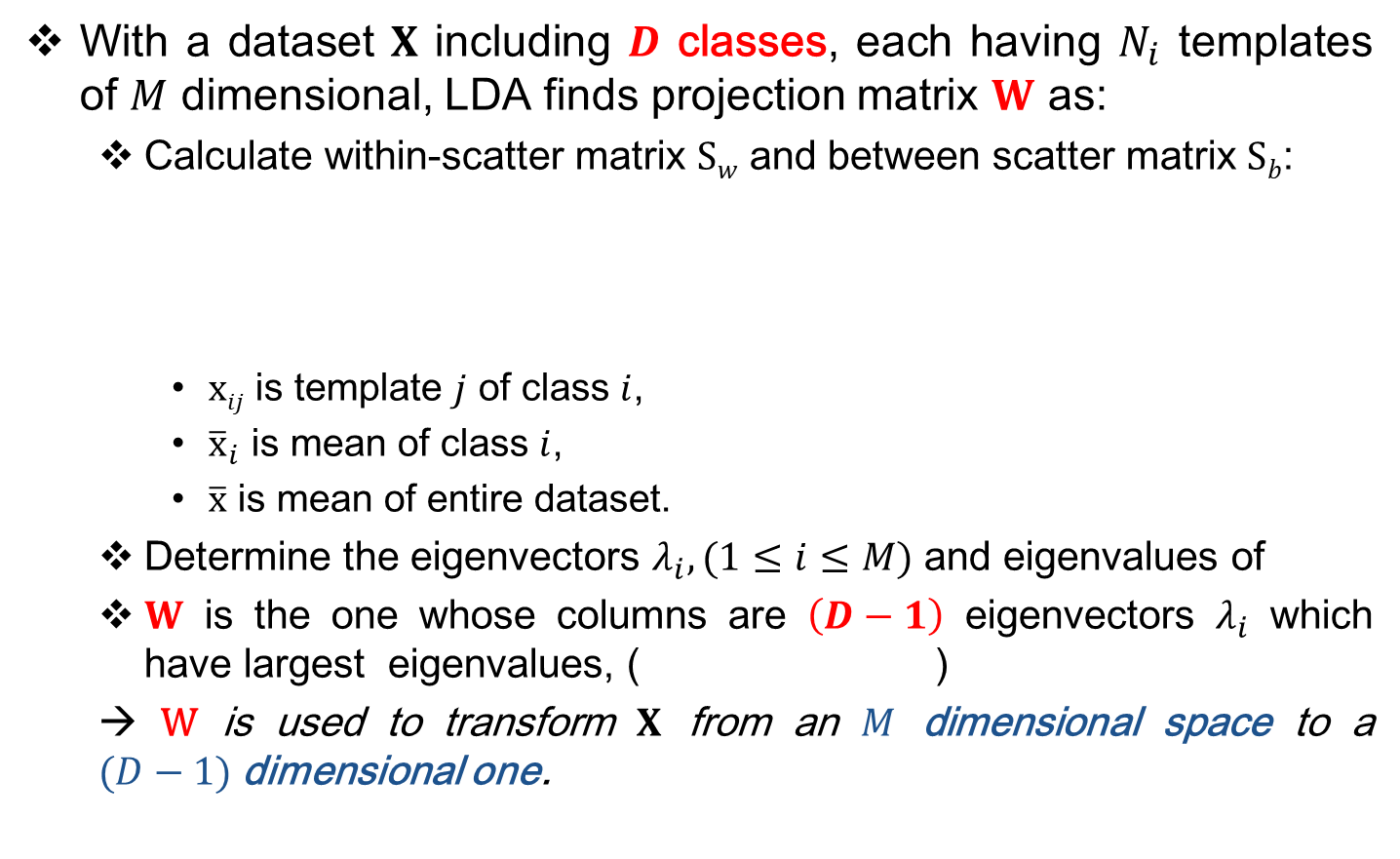
Fisher’s Linear Discriminant Analysis (LDA)
With a dataset $X$ including $D$ classes, each having $N_{i}$ templates of $M$ dimensional, LDA finds projection matrix $W$ as:
Calculate within-scatter matrix $Sw$ and between scatter matrix $Sb$:
$xij$ is template $j$ of class $i$,
${\overline{x}}_{i}$ is mean of class $i$,
$\overline{x}$ is mean of entire dataset.
Determine the eigenvectors $λ_{i},(1≤i≤M)$ and eigenvalues of
$W$ is the one whose columns are $\left(D−1\right)$ eigenvectors $λ_{i}$ which have largest eigenvalues, ( )
→ W is used to transform $X$ from an $M$ dimensional space to a $(D−1)$dimensional one.
Notes:
Pattern Recognition and Machine Learning, p. 188

Slide 10

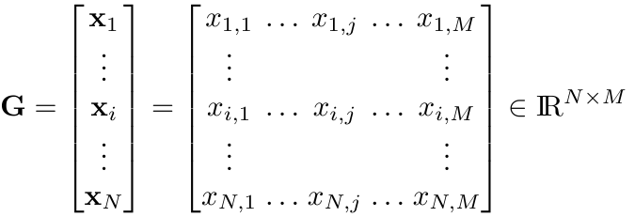
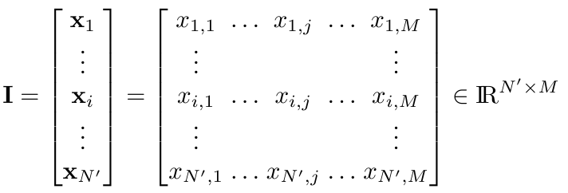


Training data set forming
Denote the $i$^{th} extracted gait template as:
Form the training dataset:
Genuine user:
Other users:
Gait signals
Preprocessing & Features extraction
LDA
Quantization
Reliable bits extraction
Binary string $ω$
FCS
Notes:
Number of groups $k$ when adopting LDA:
- $k$ increases: number of meaning features increases, however, the lost of correlations between extracted features are increased (which reduces the performances).
- $k$ decreases: number of meaning features decrease (to 2), the correlations are reserved.

Slide 11


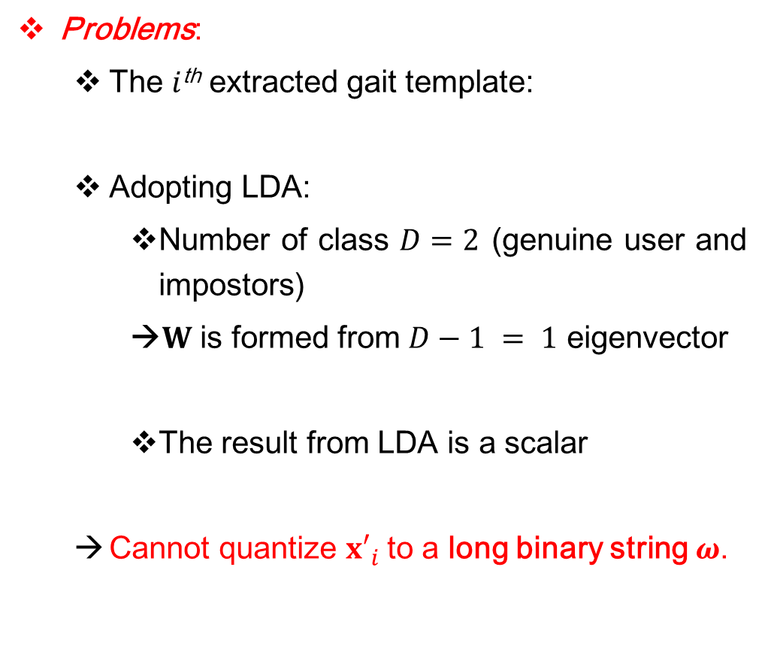

Problem in adopting LDA
Problems:
The $i$^{th} extracted gait template:
Adopting LDA:
Number of class $D=2$ (genuine user and impostors)
→$W$ is formed from $D−1 = 1$ eigenvector
The result from LDA is a scalar
Cannot quantize ${x′}_{i}$to a long binary string $ω$.
Gait signals
Preprocessing & Features extraction
LDA
Quantization
Reliable bits extraction
Binary string $ω$
FCS
Notes:
Number of groups $k$ when adopting LDA:
- $k$ increases: number of meaning features increases, however, the lost of correlations between extracted features are increased (which reduces the performances).
- $k$ decreases: number of meaning features decrease (to 2), the correlations are reserved.

Slide 12
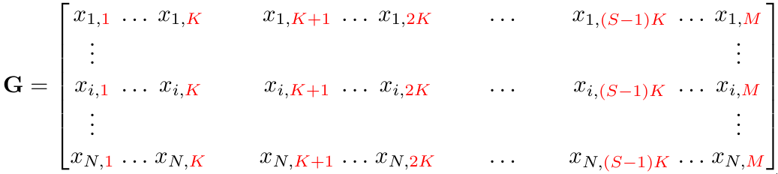
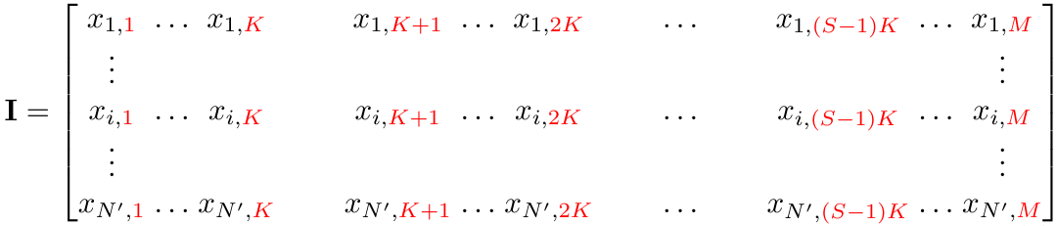


LDA Training
Divide the original dimensional space of gait data to $S$ sub-spaces, then apply LDA to each one.
sub-space 0
sub-space 1
…
sub-space $(S−1)$
LDA
LDA
LDA
Notes:
Number of groups $k$ when adopting LDA:
- $k$ increases: number of meaning features increases, however, the lost of correlations between extracted features are increased (which reduces the performances).
- $k$ decreases: number of meaning features decrease (to 2), the correlations are reserved.

Slide 13
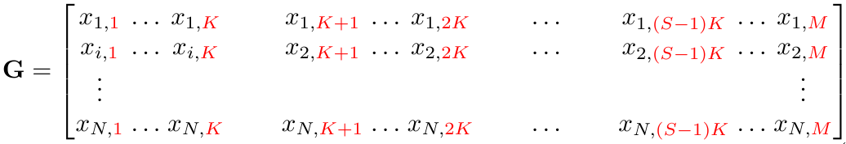
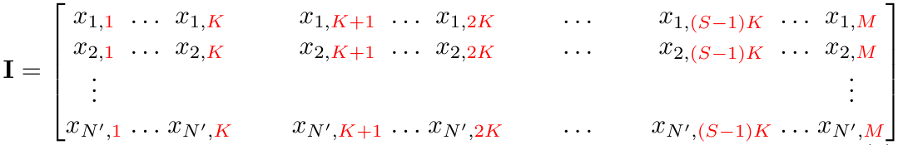
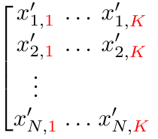
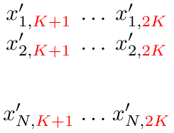
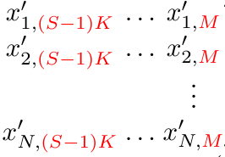


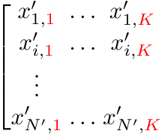
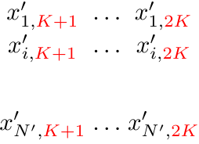
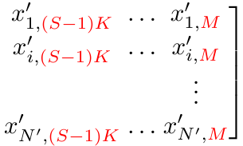


LDA Training and Projecting
Use all $λ_{i}$ to form projection matrix $W$
LDA
…
LDA
LDA
Notes:
Number of groups $k$ when adopting LDA:
- $k$ increases: number of meaning features increases, however, the lost of correlations between extracted features are increased (which reduces the performances).
- $k$ decreases: number of meaning features decrease (to 2), the correlations are reserved.

Slide 14
Graycode Quantizatiton
The gait templates are in real-valued representation. The inputs for FCS are binary strings.
Use quantization
Provide error toleration.
Graycode: technique for designing binary numeral systems in which two successive strings differ in only one bit.
→ minimize errors occurred in the quantization step

Slide 15



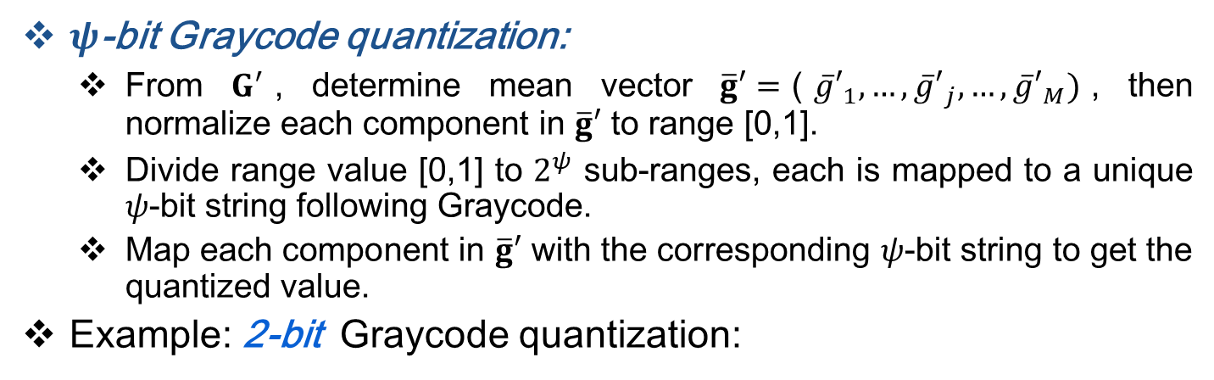














Graycode Quantizatiton
$ψ$-bit Graycode quantization:
From $G^{′}$, determine mean vector $\overline{g}′=$(${\overline{g}′}_{1},…,{\overline{g}′}_{j},…,{\overline{g}′}_{M})$, then normalize each component in $\overline{g}′$ to range [0,1].
Divide range value [0,1] to $2^{ψ}$ sub-ranges, each is mapped to a unique $ψ$-bit string following Graycode.
Map each component in $\overline{g}′$ with the corresponding $ψ$-bit string to get the quantized value.
Example: 2-bit Graycode quantization:
$${\overline{g}′}_{1}$$
$${\overline{g}′}_{2}$$
$${\overline{g}′}_{3}$$
$${\overline{g}′}_{4}$$
$$…$$
$${\overline{g}′}_{M}$$
$$1$$
00
$$0.75$$
00
$$0.5$$
01
$$0.25$$
11
$$0$$
10
Graycode
00
00
11
01
….
11
$$ω_{1}$$
$$ω_{2}$$
$$ω_{3}$$
$$ω_{4}$$
$$…$$
$$ω_{M}$$
Notes:
$ψ$: psi

Slide 16
















Reliable string extraction
From the quantized string $ω_{j}$, select $R$ reliable ones to form the reliable string $ω$.
$R=\left\lceil \frac{n}{ψ}\right\rceil$, ($n$ is codeword size of ECC).
Statistical approach to calculate the reliability $φ_{j}$ of $ω_{j}$:
Genuine user’s samples
$${\overline{g}′}_{2}$$
$${\overline{g}′}_{3}$$
Impostors’ samples
$$1$$
Intra-class variation of ${x′}_{2}$ is smaller than ${x′}_{3}$.
Inter-class difference of ${x′}_{2}$ is larger than ${x′}_{3}$.
→ $φ_{2} > φ_{3}$
00
$$0.75$$
01
$$0.5$$
11
$$0.25$$
10
$$0$$
00
00
11
01
….
11
⇨$ω=ω_{2}+ω_{4}+…+ω_{M}$
$$ω_{1}$$
$$ω_{2}$$
$$ω_{3}$$
$$ω_{4}$$
$$…$$
$$ω_{M}$$

Slide 17
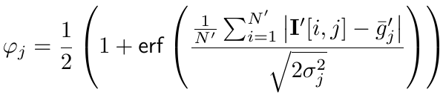
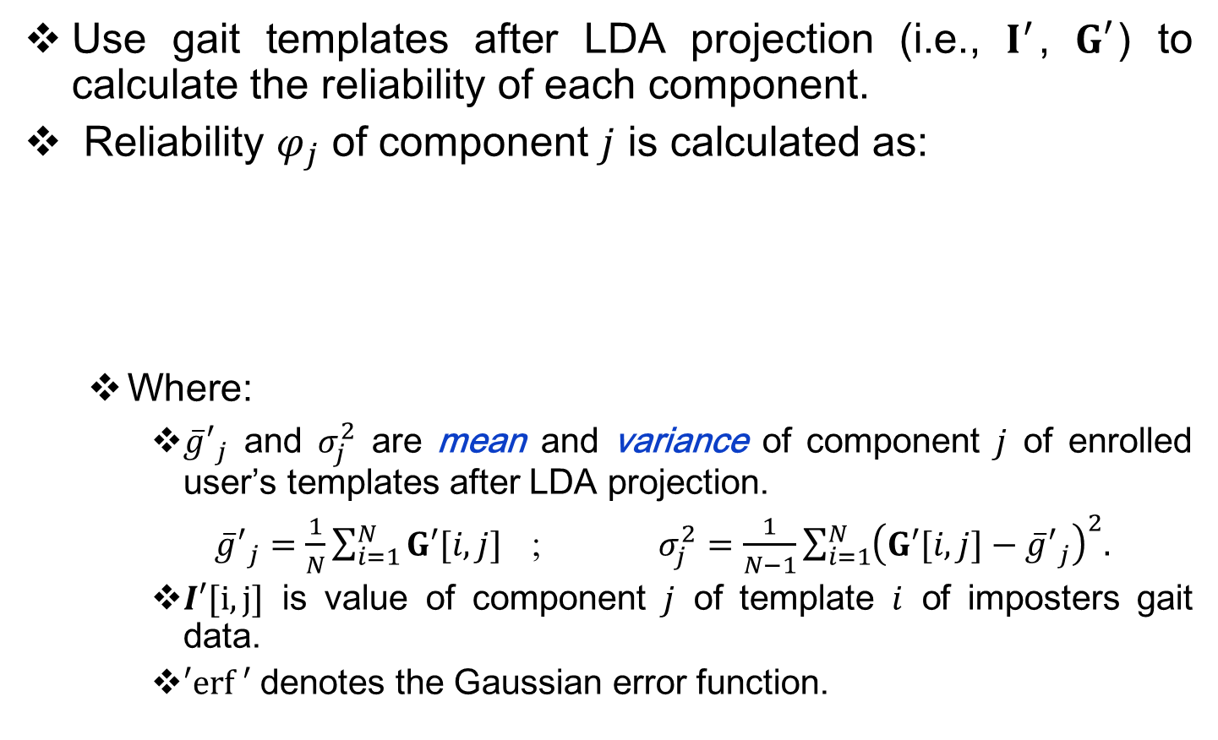
Reliable string extraction
Use gait templates after LDA projection (i.e., $I^{′}$, $G′$) to calculate the reliability of each component.
Reliability $φ_{j}$ of component $j$ is calculated as:
Where:
${\overline{g}′}_{j}$ and $σ_{j}^{2}$ are mean and variance of component $j$ of enrolled user’s templates after LDA projection.
${\overline{g}′}_{j}=\frac{1}{N}\sum_{i=1}^{N}{G′[i,j] }$ ; $σ_{j}^{2}=\frac{1}{N−1}\sum_{i=1}^{N}{{\left(G′[i,j]−{\overline{g}′}_{j}\right)}^{2}.}$
$I′[i,j]$ is value of component $j$ of template $i$ of imposters gait data.
$′erf ′$ denotes the Gaussian error function.
Inter-class difference
Intra-class variance
Notes:
sigma

Slide 18
Experiment and results
Experiment
Dataset: 38 subjects [3].
Build 38 authentication models for 38 users.
LDA:
Enrollment: 100 gait templates/user.
Authenticating: 12 templates/trial.
Graycode quantization: different values of 𝜓.
FCS:
BCH code with the length of 255 and 511 bits.
Different values of key length.
Notes:
Pattern Recognition and Machine Learning, p. 188

Slide 19
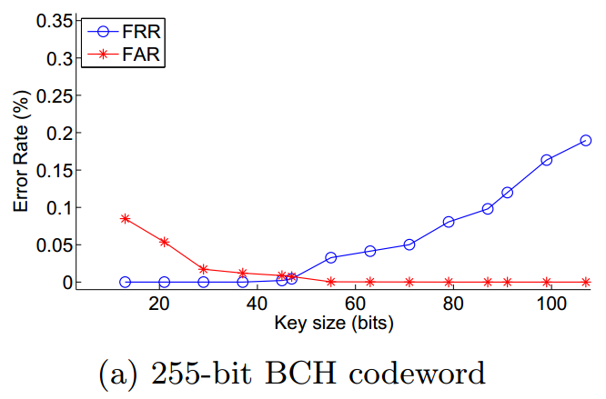
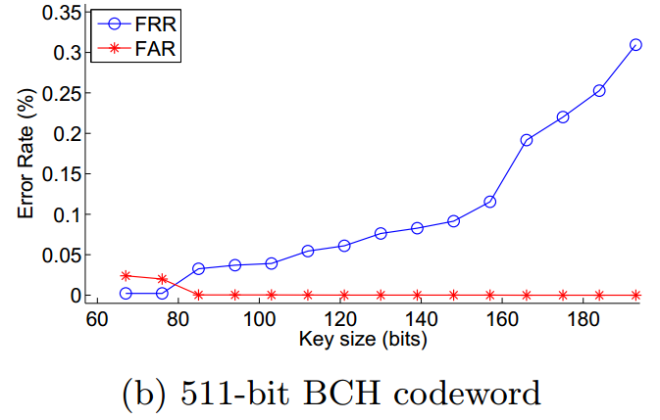
Experiment and results
Authentication results
Quantization bit number: 𝜓 = 4

Slide 20
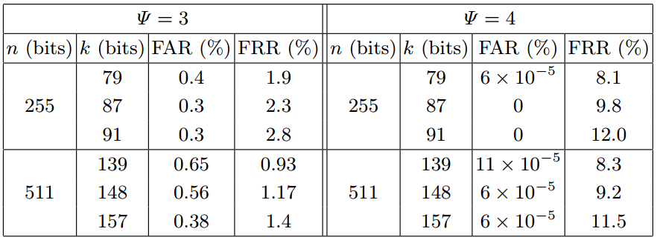
Experiment and results
Authentication results

Slide 21
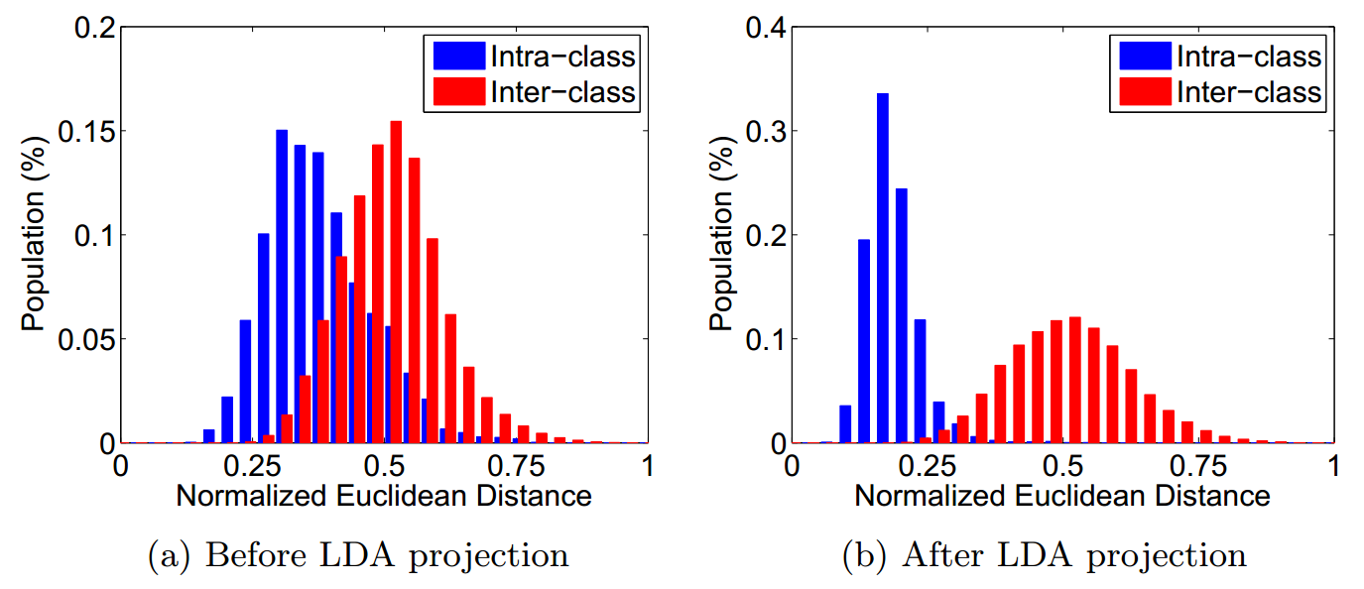
Experiment and results
The impact of LDA projection

Slide 22
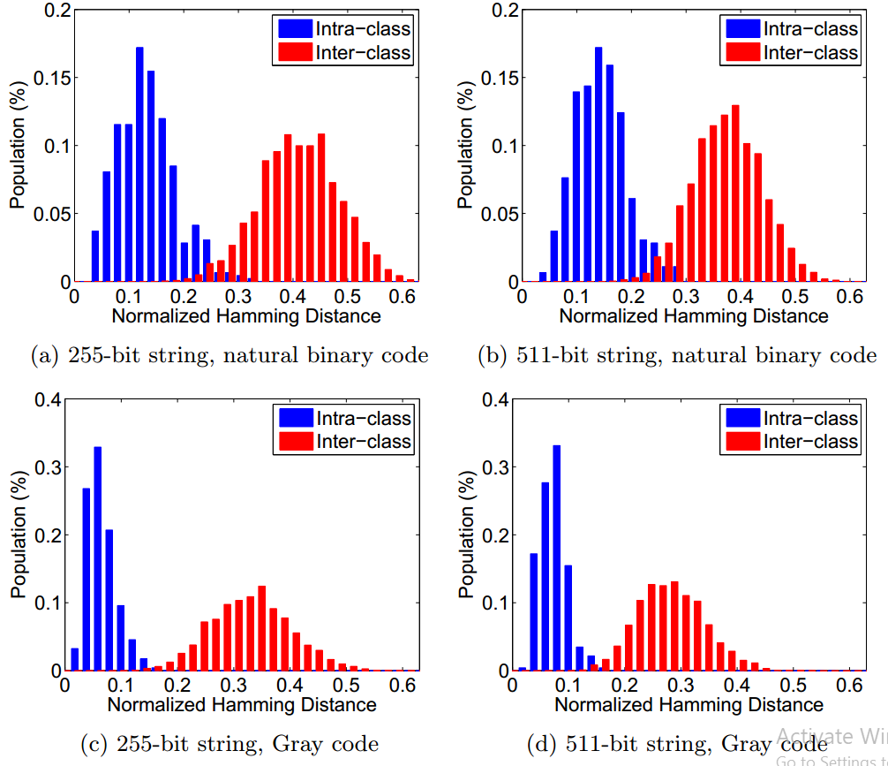
Experiment and results
The impact of Graycode in quantization

Slide 23
Conclusions
Addressed the low discriminability and high variation of gait data to improve both the performance and security of gait cryptosystem.
Drawback:
Analyzed in laboratory.
FRR is high.
Future works:
Experiment in real condition.
Overhead time.
Power consuming.

Slide 24
References
T. Hoang, D. Choi, and T. Nguyen. Gait authentication on mobile phone using biometric cryptosystem and fuzzy commitment scheme. International Journal of Information Security, 14(6):549–560, 2015.
S. Sprager and M. B. Juric. Inertial sensor-based gait recognition: A review. Sensors, 15(9):22089–22127, 2015.
T. Hoang, D. Choi, and T. Nguyen. On the instability of sensor orientation in gait verification on mobile phone. In 12th International Conference on Security and Cryptography (SECRYPT), volume 4, pages 148–159. IEEE, 2015.

Slide 25
Thank you
for your attention!

