Slide 1


ezDPS: An Efficient and Zero-Knowledge Machine Learning Inference Pipeline
Privacy-Enhancing Technologies Symposium (PETS) 2023
Haodi Wang†, ‡, Thang Hoang‡
†Beijing Normal University, Beijing, CN
‡ Virginia Tech, Virginia, USA

Slide 2


Introduction
Machine Learning as a Service (MLaaS)
Computation integrity problem
Models are hard to train!
Data
Correct results?
Zero-Knowledge Proof
Client
Server
ML results
ML parameters

Slide 3
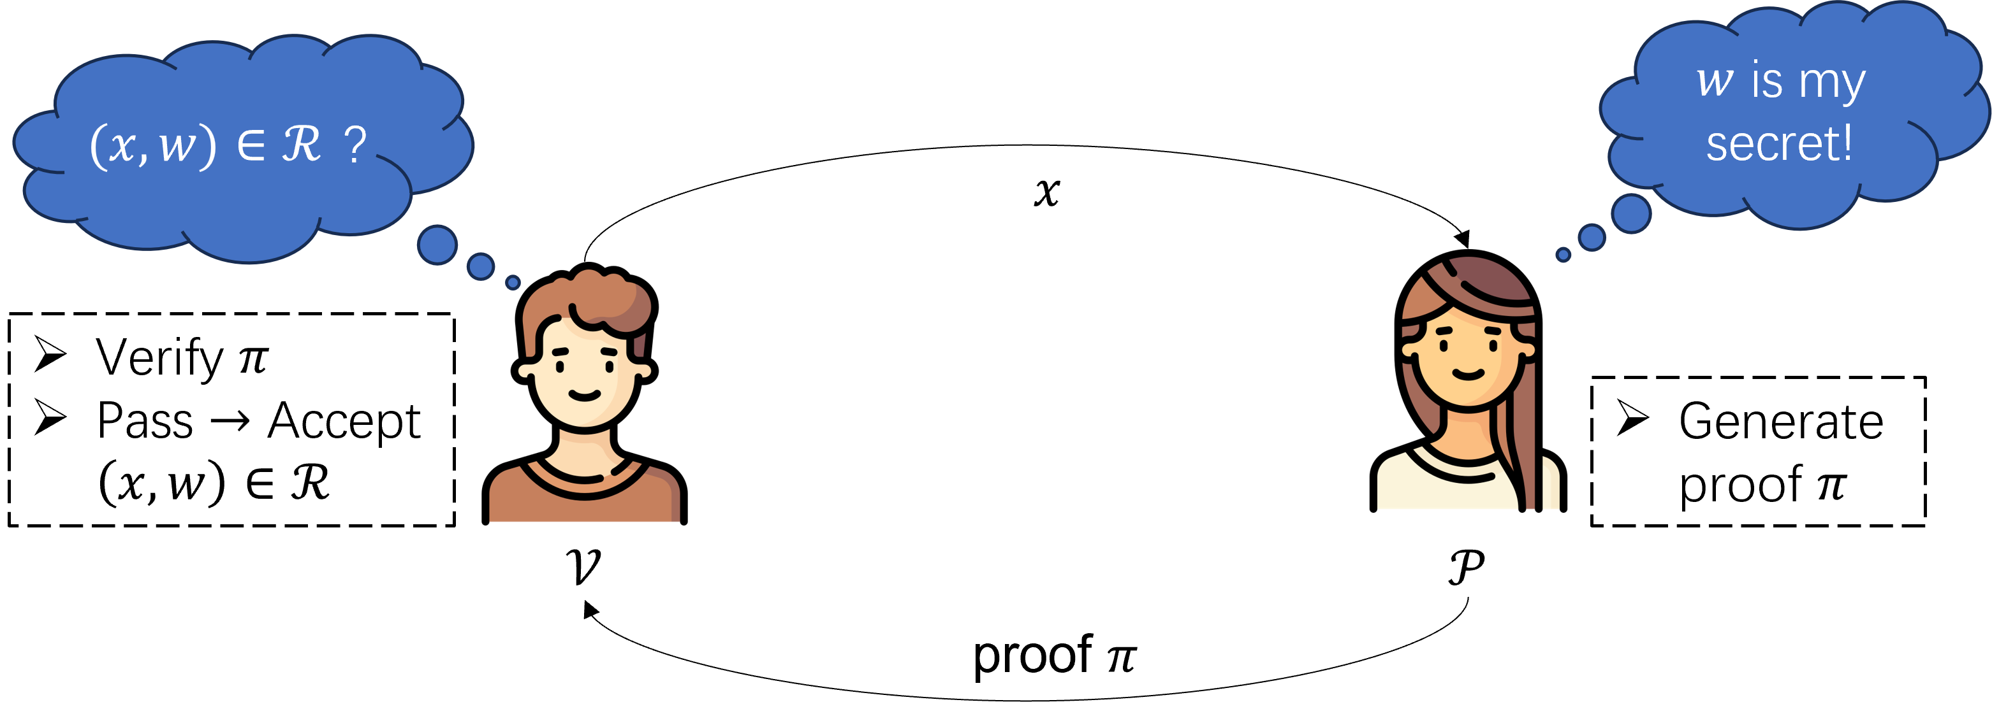










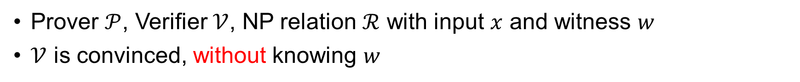

Zero Knowledge Proof
Prover $𝒫$, Verifier $𝒱$, NP relation $ℛ$ with input $x$ and witness $w$
$𝒱$ is convinced, without knowing $w$
$w$ is my secret!
$(x,w)∈ℛ$ ?
Completeness: Pr[$π$ is correct & Verification pass] = 1
Soundness:Pr[$π$ is incorrect & Verification fail] $≤ε$
Zero-knowledge: the client gets nothing about $w$.
$$x$$
Verify $π$
Pass $→$ Accept $\left(x,w\right)∈ℛ$
Generate proof $π$
$$𝒱$$
$$𝒫$$
proof $π$
Commit and Prove (CP) paradigm: prove on committed $w$

Slide 4



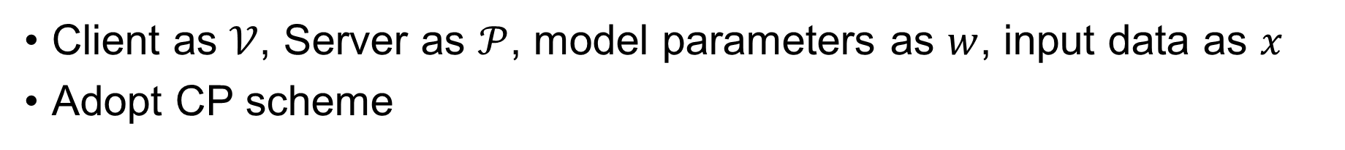


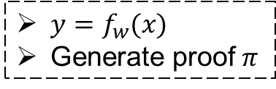
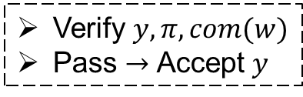


MLaaS with ZKP
Client as $𝒱$, Server as $𝒫$, model parameters as $w$, input data as $x$
Adopt CP scheme
$(x,w)∈ℛ$ ?
$w$ is my secret!
Is $y$ the correct result?
$$x$$
Verify $y, π,com(w)$
Pass $→$ Accept $y$
$y=f_{w}(x)$
Generate proof $π$
Client
Server
$$𝒱$$
$$𝒫$$
commit
$$y, π,com(w)$$
$$com(w)$$

Slide 5
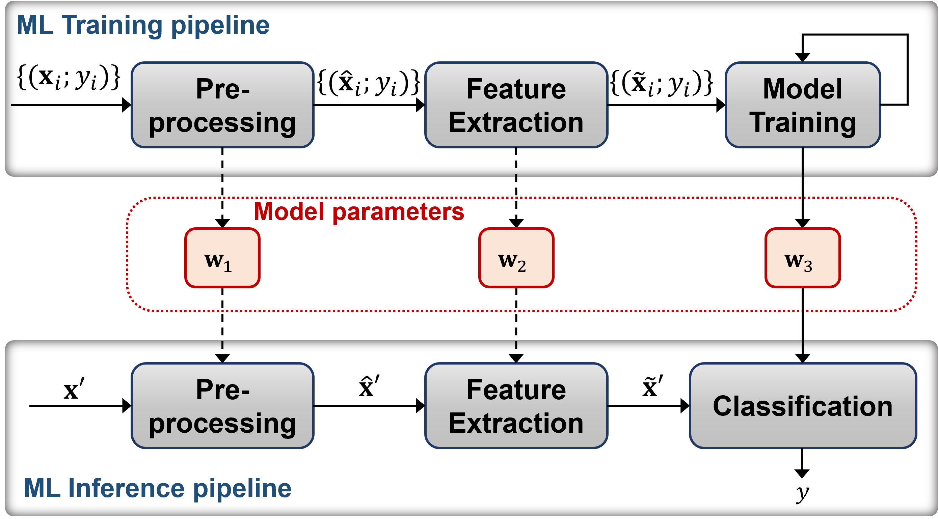
Prior ZK ML/DL
Focus solely on single stage & simple models [1-4]
ZK for decision tree / ZK for CNN
In fact, ML involves multiple stages
Classical ML algorithms

Slide 6
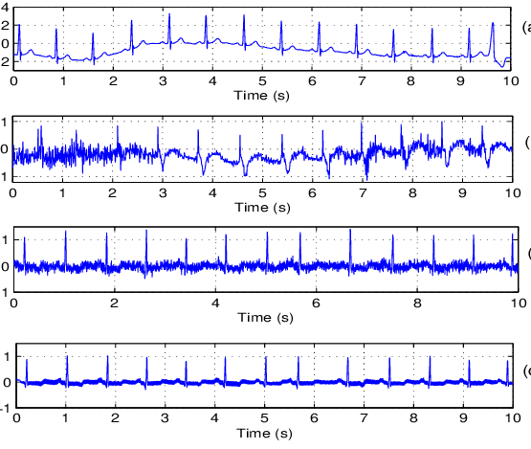
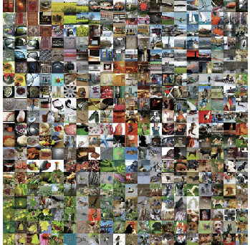

ezDPS
New gadgets for classical ML operations.
Building blocks in proving concrete ML algorithms
Can be used to prove diverse ML even DL methods
New zero-knowledge ML inference pipeline scheme.
Design methods to prove:
Discrete Wavelet Transformation (DWT) [5] – based preprocessing
Principal Components Analysis (PCA) [6] – based feature extraction
Support Vector Machine (SVM) [7] – based classification
Compatible with any zkp backend
Signal Processing
Classification
Regression

Slide 7
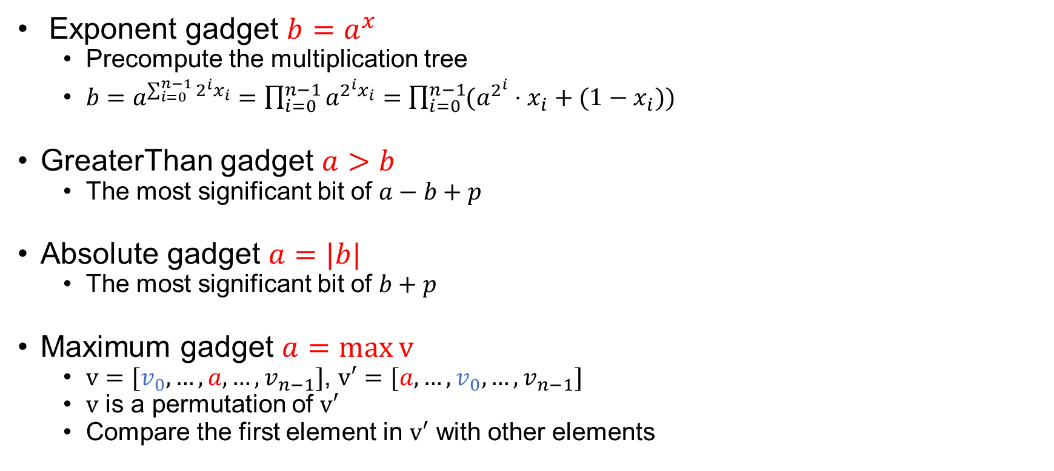
Gadgets for zkMLIP
Exponent gadget $b=a^{x}$
Precompute the multiplication tree
$b=a^{\sum_{i=0}^{n−1}{2^{i}x_{i}}}=\prod_{i=0}^{n−1}{a^{2^{i}x_{i}}}=\prod_{i=0}^{n−1}{(a^{2^{i}}⋅x_{i}+(1−x_{i}))}$
GreaterThan gadget $a>b$
The most significant bit of $a−b+p$
Absolute gadget $a=|b|$
The most significant bit of $b+p$
Maximum gadget $a=\max{v}$
$v=[v_{0},…,a,…,v_{n−1}]$, $v′=[a,…,v_{0},…,v_{n−1}]$
$v$ is a permutation of $v′$
Compare the first element in $v′$ with other elements
Different in dealing with the most significant bit
More gadgets:
Permutation gadget
Binarization gadget
…

Slide 8
















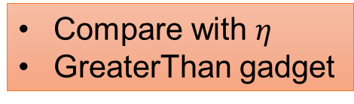






















ezDPS – Proving DWT
low-pass part
$$z_{1}$$
$$z_{2}$$
$$z_{3}$$
$${z′}_{4}$$
$${z′}_{5}$$
$${z′}_{6}$$
$$z_{1}$$
$$z_{2}$$
$$z_{3}$$
STEP 1
DWT – Decomposition
STEP 2
DWT – Thresholding
STEP 3
DWT – Reconstruction
$$z_{4}$$
$$z_{5}$$
$$z_{6}$$
$${z′}_{4}$$
$${z′}_{5}$$
$${z′}_{6}$$
high-pass part
Inverse low-pass filter
low-pass filter
$$h_{1}$$
$$h_{2}$$
$$h_{3}$$
$$h_{4}$$
$${\overline{h}}_{1}$$
$${\overline{h}}_{2}$$
$${\overline{h}}_{3}$$
$${\overline{h}}_{4}$$
input data
$$x_{1}$$
$$x_{2}$$
$$x_{3}$$
$$x_{4}$$
$$x_{5}$$
$$x_{6}$$
Convolution-like operation
Compare with $η$
GreaterThan gadget
Convolution-like operation
$$g_{1}$$
$$g_{2}$$
$$g_{3}$$
$$g_{4}$$
Inverse high-pass filter
high-pass filter
$${\overline{g}}_{1}$$
$${\overline{g}}_{2}$$
$${\overline{g}}_{3}$$
$${\overline{g}}_{4}$$
Directly compute: $O(m)$
Split Technique

Slide 9






















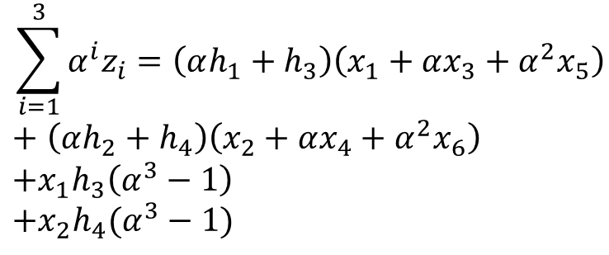

















Split technique
Split the input and the filters into the odd part and the even part before applying the random linear combination
input data
$$x_{1}$$
$$x_{2}$$
$$x_{3}$$
$$x_{4}$$
$$x_{5}$$
$$x_{6}$$
$$z_{1}=x_{1}h_{1}+x_{2}h_{2}+x_{3}h_{3}+x_{4}h_{4}$$
$$z_{1}$$
$$z_{2}$$
$$z_{3}$$
$$z_{2}=x_{3}h_{1}+x_{4}h_{2}+x_{5}h_{3}+x_{6}h_{4}$$
12 muls
$$h_{1}$$
$$h_{3}$$
$$h_{2}$$
$$h_{4}$$
$$h_{3}$$
$$h_{1}$$
$$h_{4}$$
$$h_{2}$$
$$h_{1}$$
$$h_{3}$$
$$h_{2}$$
low-pass filter
$$h_{4}$$
$$z_{3}=x_{5}h_{1}+x_{6}h_{2}+x_{1}h_{3}+x_{2}h_{4}$$
$$α$$
$$\left( \right)α$$
$$α^{2}$$
$$\left( \right)α^{2}$$
$$x_{1}$$
$$x_{1}$$
$$x_{2}$$
$$x_{3}$$
$$x_{4}$$
$$x_{5}$$
$$x_{6}$$
$$α^{3}$$
$$\left( \right)α^{3}$$
$$\sum_{i=1}^{3}{α^{i}z_{i}}=\left(αh_{1}+h_{3}\right)\left(x_{1}+αx_{3}+α^{2}x_{5}\right)$$
$+$ $\left(αh_{2}+h_{4}\right)\left(x_{2}+αx_{4}+α^{2}x_{6}\right)$
$$+x_{1}h_{3}\left(α^{3}−1\right)$$
$$+x_{2}h_{4}(α^{3}−1)$$
$$z_{11}$$
$$z_{21}$$
$$z_{31}$$
extra
16 muls
$$\sum{α^{2+i}}z_{i}=\left(α^{3}h_{1}+α^{2}h_{2}+αh_{3}+h_{4}\right)\left(x_{1}+αx_{2}+α^{2}x_{3}+…+α^{5}x_{6}\right)−$$
$$h_{3}$$
$$h_{1}$$
$$h_{1}$$
$$h_{3}$$
$$D$$
$$z_{1}$$
$$z_{2}$$
$$z_{3}$$
4 muls
$$z_{12}$$
$$z_{22}$$
$$z_{32}$$
$$h_{1}$$
$$h_{4}$$
$$h_{2}$$
$$h_{2}$$
$$h_{3}$$
$$h_{2}$$
$$h_{4}$$
$$h_{4}$$

Slide 10

























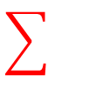

























ezDPS – Proving PCA
Adopt the random linear combination
Eigenvectors
$$v_{11}$$
$$v_{12}$$
$$v_{13}$$
$$v_{14}$$
input data
$$v_{21}$$
$$v_{22}$$
$$v_{23}$$
$$v_{24}$$
output
$$x_{1}$$
$$x_{2}$$
$$x_{3}$$
$$x_{4}$$
$$x_{5}$$
$$x_{6}$$
$$v_{31}$$
$$v_{32}$$
$$v_{33}$$
$$v_{34}$$
$$α$$
$$y_{1}$$
$$y_{2}$$
$$y_{3}$$
$$y_{4}$$
$$×$$
$$α$$
$$+α^{2}$$
$$+α^{3}$$
$$+α^{4}$$
$$=$$
$$+α^{2}$$
$$($$
$$)$$
$$+α^{3}$$
$$+α^{4}$$
$$v_{41}$$
$$v_{42}$$
$$v_{43}$$
$$v_{44}$$
$$m$$
$$k$$
$$v_{51}$$
$$v_{52}$$
$$v_{53}$$
$$v_{54}$$
$$v_{61}$$
$$v_{62}$$
$$v_{63}$$
$$v_{64}$$
$$m×k$$
$$O(mk)$$
$$O(k)$$

Slide 11
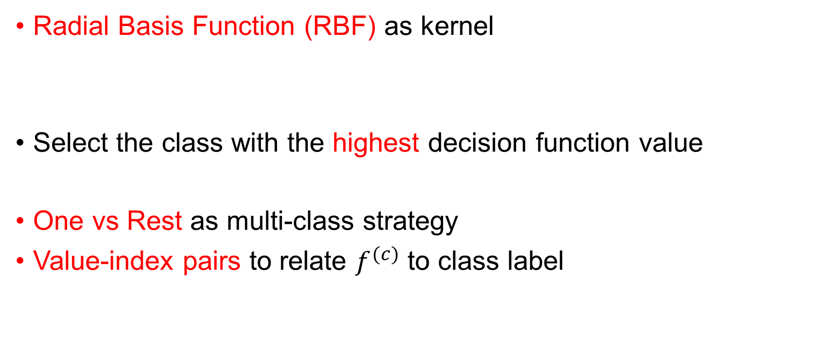

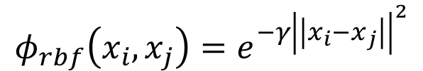

ezDPS – Proving SVM
Radial Basis Function (RBF) as kernel
Select the class with the highest decision function value
One vs Rest as multi-class strategy
Value-index pairs to relate $f^{(c)}$ to class label
$$φ_{rbf}\left(x_{i}, x_{j}\right)=e^{−γ{\left|\left|x_{i}−x_{j}\right|\right|}^{2}}$$
exponent gadget
$$y=\max_{\hat{c}}{f^{(c)}}$$
maximum gadget
$$\{\left(f^{\left(1\right)}, 1\right),\left(f^{\left(2\right)}, 2\right),…,\left(f^{\left(s\right)}, s\right)\}$$
$$\{\left(f^{\left(max\right)}, σ(1)\right),\left({f′}^{\left(2\right)}, σ(2)\right),…,\left(f^{′\left(s\right)}, σ(s)\right)\}$$
permutation gadget

Slide 12
More Functionalities
Gadgets and techniques can be adapted to other regions
zkPOA: effectiveness of a committed model
Prove the accuracy of a whole dataset
Prove other SVM kernels
Laplace kernel / Sigmoid kernel / Polynomial kernel
Prove deep learning techniques
Covolutional layers / Activation layers / Pooling layers
Prove zero-knowledge CNN method
Adopt the split technique recursively

Slide 13
Experiments
Configurations
Hardware: 4-Core Intel Core i5 CPU, 16 GB DDR4 RAM, no thread-level parallization.
Dataset:
UCR-ECG: 42 classes, 1800 records of ECG signals
Labeled Faces in the Wilds (LFW): 5749 human faces
Cifar-100: 100 classes, image dataset
Parameters:
Standard parameters as suggested in Spartan [8]
Grid search in SVM
Libraries:
Spartan [8] ZKP backend
Hyrax polynomial commitment scheme
sklearn library

Slide 14
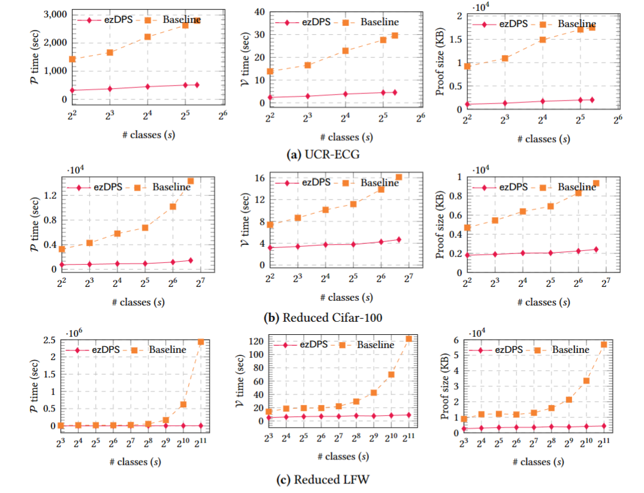
Experiments
1-3 orders of magnitudes more efficient than the generic circuits
ezDPS takes seconds to verify and the proof size is less than 5 MB

Slide 15
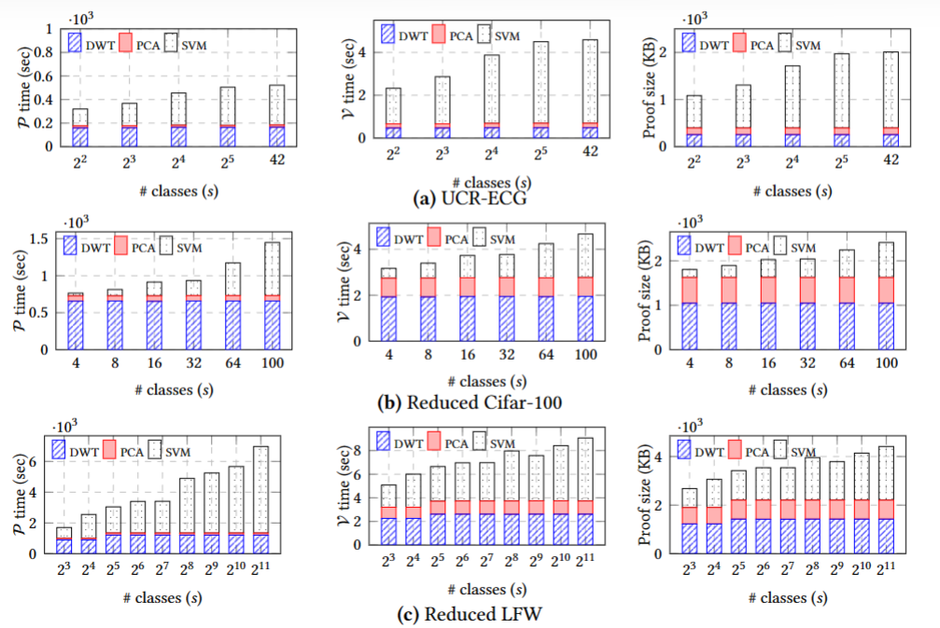
Experiments
Cost of DWT: stable when varying #classes
Cost of PCA: stable and contributes the least portion
Cost of SVM: most dominant factor

Slide 16
Discussions
Proving time is relatively high
The size of the arithmetic circuit can be further reduced
ezDPS incurs certain accuracy loss (1%-2%)
Privacy of the client’s data cannot be protected

Slide 17
Conclusions
New gadgets for multiple ML/DL operations
Optimizations for three concrete classical ML algorithms
An efficient and zero-knowledge ML inference pipeline
Fully implemented ezDPS and provide open-sourced codes https://github.com/vt-asaplab/ezDPS

Slide 18


ezDPS: An Efficient and Zero-Knowledge Machine Learning Inference Pipeline
Q & A
open-source code link

Slide 19
References
[1] Tianyi Liu, Xiang Xie, and Yupeng Zhang. 2021. ZkCNN: Zero Knowledge Proofs for Convolutional Neural Network Predictions and Accuracy. In Proceedings of the 2021 ACM SIGSAC Conference on Computer and Communications Security (CCS '21). Association for Computing Machinery, New York, NY, USA, 2968–2985. https://doi.org/10.1145/3460120.3485379
[2] J. Zhang, Z. Fang, Y. Zhang, and D. Song. Zero knowledge proofs for decision tree predictions and accuracy. In Proceedings of the 2020 ACM SIGSAC Conference on Computer and Communications Security, pages 2039–2053, 2020
[3] S. Lee, H. Ko, J. Kim, and H. Oh. vcnn: Veriable convolutional neural network based on zk-snarks. Technical report, Cryptology ePrint Archive, Report 2020/584. https://eprint. iacr. org/2020/584, 2020
[4] B. Feng, L. Qin, Z. Zhang, Y. Ding, and S. Chu. Zen: An optimizing compiler for veriable, zero-knowledge neural network inferences. Cryptology ePrint Archive, 2021
[5] C. Vonesch, T. Blu, and M. Unser. Generalized daubechies wavelet families. IEEE Transactions on
Signal Processing, 55(9):4415–4429, 2007.
[6] S. Wold, K. Esbensen, and P. Geladi. Principal component analysis. Chemometrics and intelligent
laboratory systems, 2(1-3):37–52, 1987.
[7] K. M. Chung, W. C. Kao, C. L. Sun, L. L. Wang, and C. J. Lin. Radius margin bounds for support
vector machines with the rbf kernel. Neural Computation, 15(11), 2003.
[8] S. Setty. Spartan: Ecient and general-purpose zksnarks without trusted setup. In Annual Inter-
national Cryptology Conference, pages 704–737. Springer, 2020.

