Slide 1
Efficient Privacy-Preserving Machine Learning with Lightweight Trusted Hardware
15th Jul 2024
Pengzhi Huang, Thang Hoang, Yueying Li, Elaine Shi, G.Edward Suh
Notes:
Hello everyone welcome to my A exam today. Thank you for coming. The talk I’m going to present today is the efficient secure computation for private machine learning. Before we started i'd like to thank my committee members for attending, prof Noah Stephens-Davidowitz, prof zhiru zhang, and my advisor Prof Edward Suh.

Slide 2
Secure Computing Techniques
Crypto Based Techniques
Secure Multiparty Computation (MPC)
Secret Sharing
Garbled Circuit
Hybrid method (e.g., ABY3 Protocol)
Homomorphic Encryption
…
Hardware Based Techniques
Intel Software Guard Extensions (SGX)
AMD Secure Encrypted Virtualization (SEV)
Trusted Platform Module, Google Titan, Apple T1
Post Evaluation Protection
Differential Privacy
Notes:
Trusted Execution Environment
Secure Enclave

Slide 3
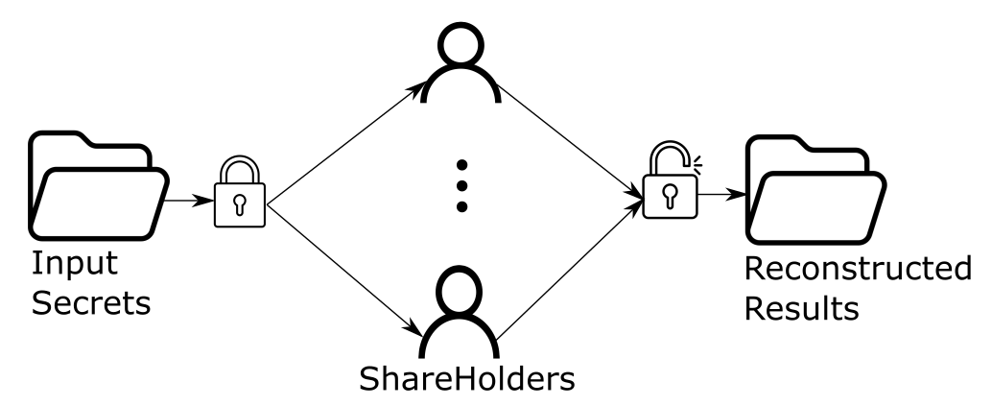
Background: Secure Multiparty Computation
Joint evaluation of a certain function
Multiple parties involved in the computation
Centralized federated learning
Secure outsourcing
Multiparty Computation
Parties want to keep their secrets secure (input data,
model…).
Two Fashions: Secret Sharing and Garbled Circuit
Notes:
Secure Multiparty Computation (MPC) refers to a protocol that allows multiple participants
to jointly evaluate a particular problem while keeping their inputs from being revealed to
each other.
This can be done easily if we have a trusted server
Two method: a central server, but with encrypted evaluation
Or collaborate together…

Slide 4
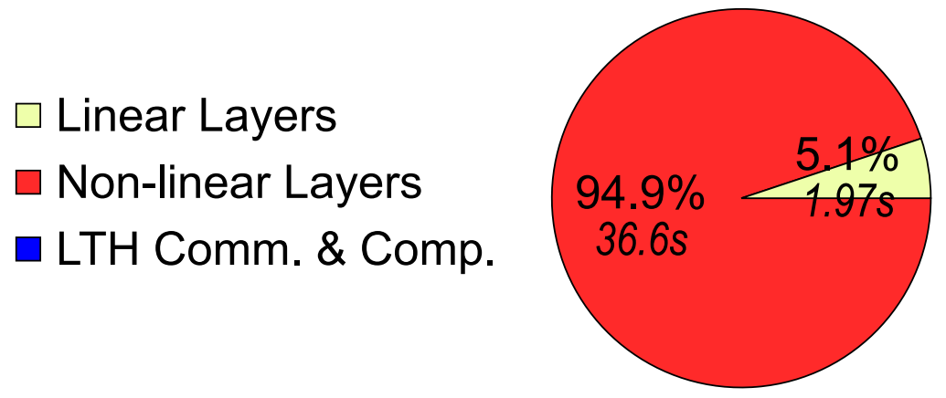

Background: Secret Sharing-based MPC
Linear operations
Cheap in communication
Additions can be done locally.
Multiplications between secrets can be done with one round communication.
Non-linear Functions
Expensive in communication
Commonly used in ML: MaxPool, ReLU, Softmax, BatchNorm…
They all need multiple rounds of communication and TONS of data to be transmitted.
Notes:
E.g., state of the art protocol (Falcon, PoPETs’21) do inference of VGG16 on 128 batch CIFAR10 (see-far) data will need around than 2GB data to be transmitted in about than 400 rounds of communication. About 95% of the total execution time are related to non-linear operations.
Linear operations still dominate the computation overhead as in plaintext, due to the cubic complexity growth of matrix multiplication.

Slide 5
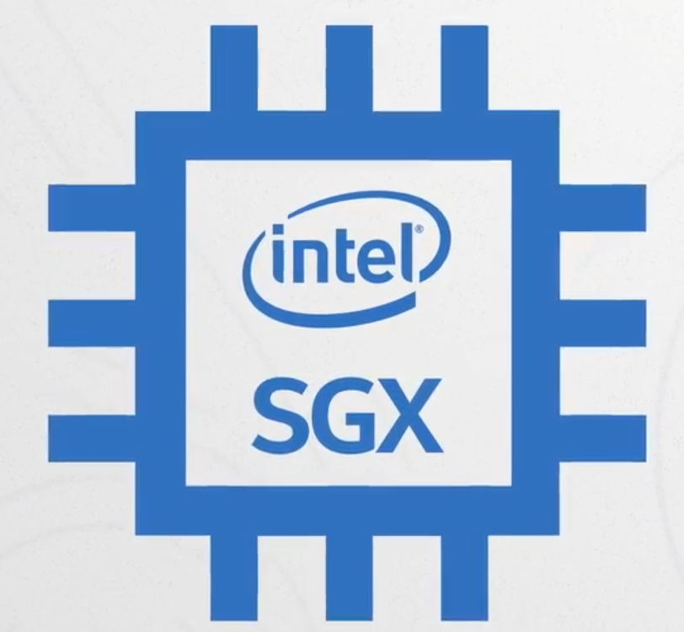
Background: Trusted Execution Environment (TEE)
Hardware Protection
TEE Provides strong protection for confidentiality and integrity even from low-level software and physical tampering
Intel SGX, AMD SEV, ARM TrustZone, RISC-V KeyStone
Enable remote users to authenticate both hardware and software
Remote attestation
Protect program state from untrusted software and physical tampering
Memory isolation and protection
https://www.intel.com/content/www/us/en/developer/tools/software-guard-extensions/overview.html
GuardNN: secure accelerator architecture for privacy-preserving deep learning
Notes:
TEE guarantees code and data loaded inside to be protected with respect to confidentiality and integrity. Unauthorized entities cannot alter the data inside or change how the code operates. This is usually done by hardware-based memory encryption that isolates specific application code and data in memory
Out-of-order execution, speculation → Transient execution attacks (Meltdown, Spectre)
Shared HW resources → Timing side-channel attacks
No protection against memory address side channels → data-oblivious code

Slide 6
Background: Trusted Execution Environment (TEE)
Hardware Protection
TEE Provides strong protection for confidentiality and integrity even from low-level software and physical tampering
Intel SGX, AMD SEV, ARM TrustZone, RISC-V KeyStone
Enable remote users to authenticate both hardware and software
Remote attestation
Protect program state from untrusted software and physical tampering
Memory isolation and protection
Limitations
Security vulnerabilities due to complexity
Transient execution attacks, Timing side-channel attacks…
Deployment cost
https://www.intel.com/content/www/us/en/developer/tools/software-guard-extensions/overview.html
GuardNN: secure accelerator architecture for privacy-preserving deep learning
Notes:
TEE guarantees code and data loaded inside to be protected with respect to confidentiality and integrity. Unauthorized entities cannot alter the data inside or change how the code operates. This is usually done by hardware-based memory encryption that isolates specific application code and data in memory
Out-of-order execution, speculation → Transient execution attacks (Meltdown, Spectre)
Shared HW resources → Timing side-channel attacks
No protection against memory address side channels → data-oblivious code
TEEs require hardware changes that are expensive and time-consuming to deploy.

Slide 7
Combining MPC and TEE
What if we…
Utilize TEE to help the computationally light part of MPC
Make it small and simple to shrink the Trusted Computing Base (TCB) and the cost
STAMP: Efficient Privacy-Preserving Machine Learning with Lightweight Trusted Hardware
 | Advantage | Disadvantage
TEE | Confidentiality and Integrity | Vulnerable if too complicated
MPC | Small overhead in linear operations | Large communication overhead due to non-linear operations

Slide 8
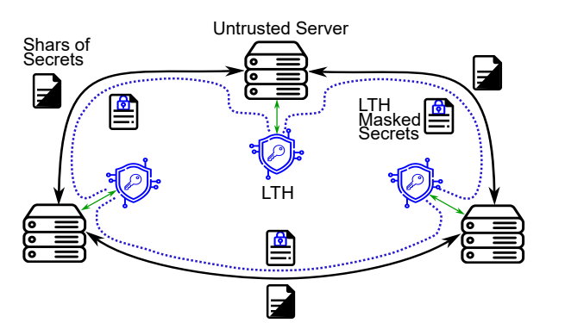
STAMP
Protocols
Initializations
Remote attestation to validate the identity
A key exchange protocol among the LTEE
Linear Operations
Mostly done in MPC fashion
With optimization
Non-linear Operations
Mostly can be offloaded and done in plaintext
SoftMax (or exponent) is computationally heavy and require special protocol
Notes:
They are done in a classical way and they are not the main contribution of this work

Slide 9
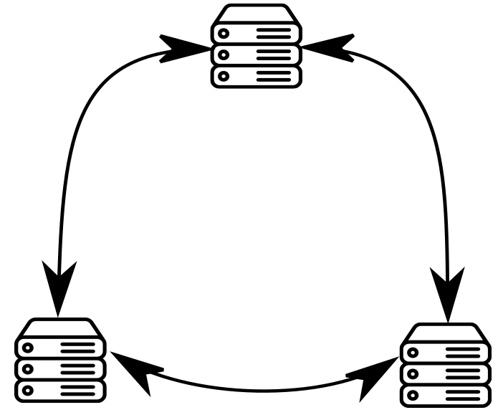
STAMP: Small Tee Assisted MPC

Slide 10
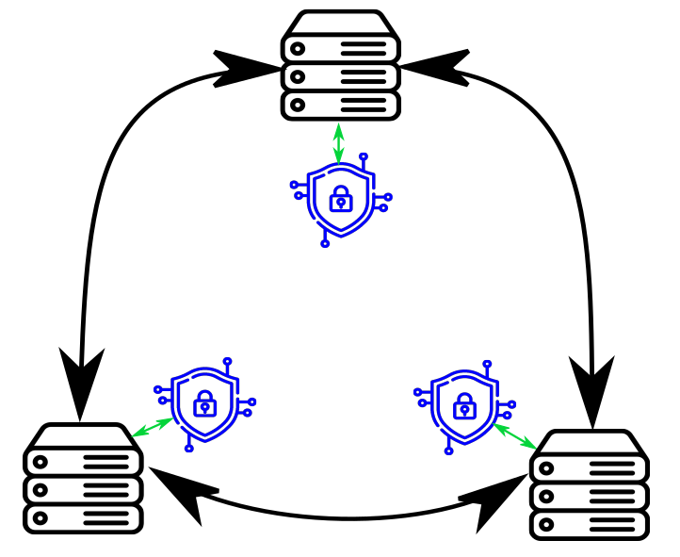
STAMP: Small Tee Assisted MPC
Notes:
Each party is equipped with LTEE

Slide 11
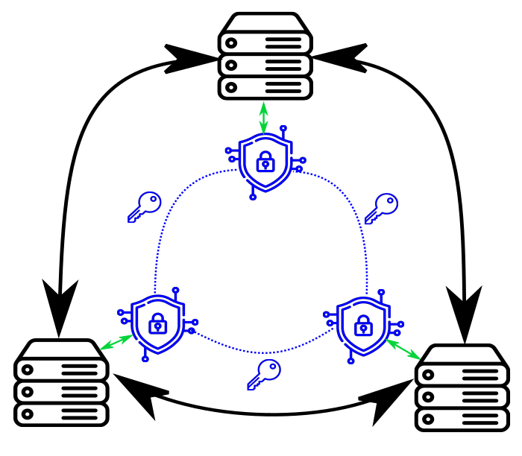
STAMP: Small Tee Assisted MPC
Notes:
LTEE has not direct connection among them, Those parties cannot obtain the keys

Slide 12
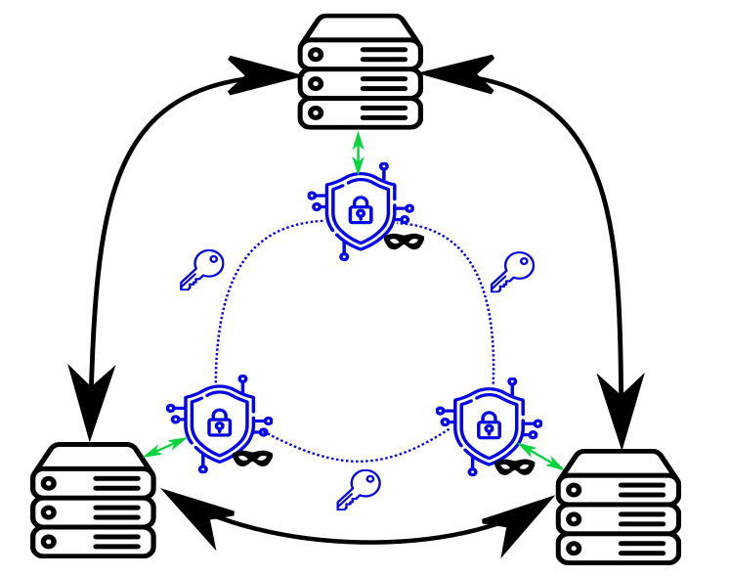
STAMP: Small Tee Assisted MPC

Slide 13
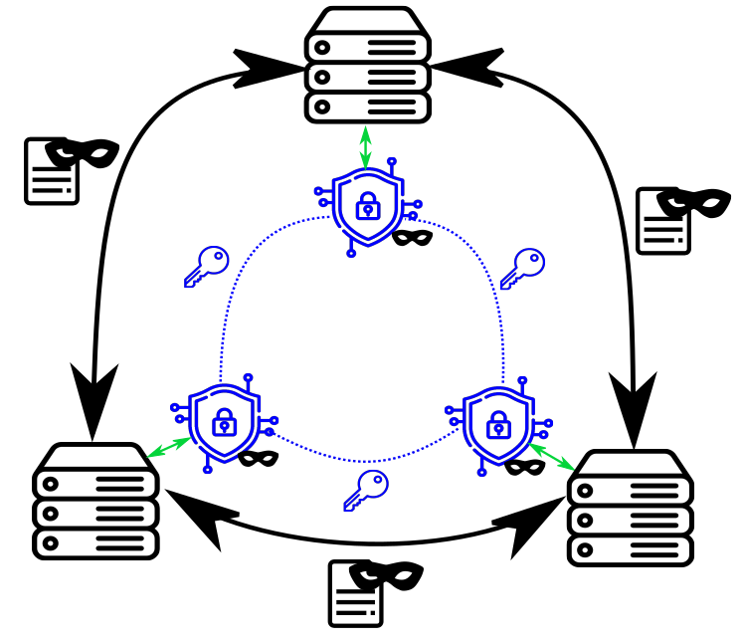
STAMP: Small Tee Assisted MPC
Notes:
Send masdk

Slide 14
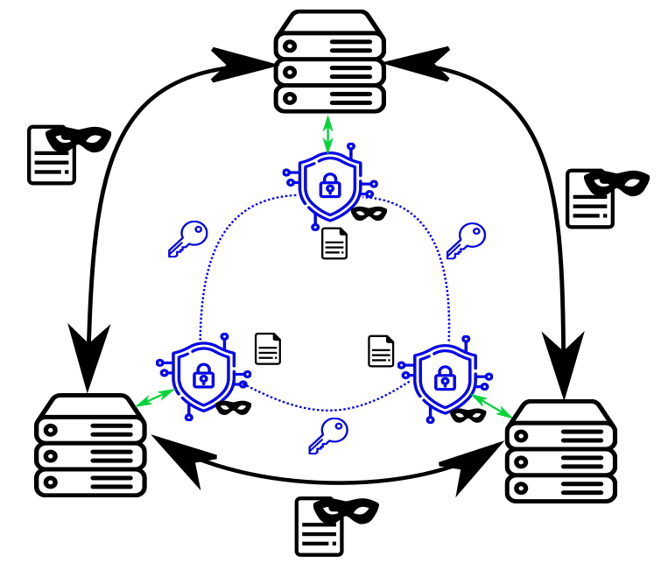
STAMP: Small Tee Assisted MPC
Notes:
Recover the plaintext data inside of it
Compute easily
Return the value masked again to the untrusted parties

Slide 15
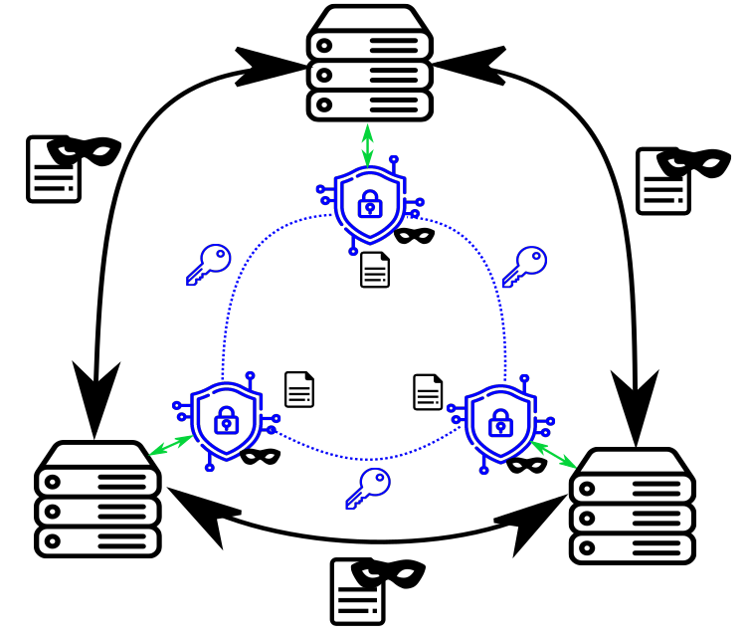
STAMP: Small Tee Assisted MPC
Overview
A 3-party MPC setting with honest majority assumption
An untrusted powerful machine (GPU/CPU)
A trusted Lightweight TEE (LTEE) with limited capability, like the widely distributed TPM
Fixed point representation
Correlated randomness built by shared keys in LTEEs
Untrusted machines cannot obtain the keys
“Offloading” the non-linear operations to the LTEE
Masking by the keys which can only be decrypted in the LTEEs
Linear operations are still done on powerful untrusted machines

Slide 16

STAMP
Initializations
Chain of Trust
Notes:
Now let’s see the initialization protocol
Although widely used and often believed to
In computer science, a one-way function is a function that is easy to compute on every input, but hard to invert given the image of a random input.

Slide 17
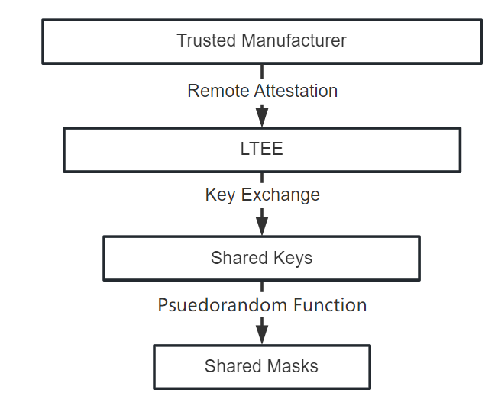
STAMP
Initializations
Chain of Trust
Three Assumptions:
Manufacturer Assumption: Trusted, Hardware cannot be broken physically
Key exchange protocol assumption: Cannot be broken by a polynomial time algorithm
Pseudorandom Function (PRF) assumption: Assume its existence
Notes:
Now let’s see the initialization protocol
Although widely used and often believed to
In computer science, a one-way function is a function that is easy to compute on every input, but hard to invert given the image of a random input.

Slide 18
STAMP
Initializations
Chain of Trust
Three Assumptions:
Manufacturer Assumption: Trusted, Hardware cannot be broken physically
Key exchange protocol assumption: Cannot be broken by a polynomial time algorithm
Pseudorandom Function (PRF) assumption: Assume its existence
Notes:
Diffie–Hellman assumption

Slide 19
STAMP
Initializations
Chain of Trust
Three Assumptions:
Manufacturer Assumption: Trusted, Hardware cannot be broken physically
Key exchange protocol assumption: Cannot be broken by a polynomial time algorithm
Pseudorandom Function (PRF) assumption: Assume to be cryptographically secure (or it exists)
Notes:
Masks should seem to be random and you should not find some pattern in them.
Although widely used and often believed to
In computer science, a one-way function is a function that is easy to compute on every input, but hard to invert given the image of a random input.
Generally we always assume it’s true and it’s widely used.

Slide 20
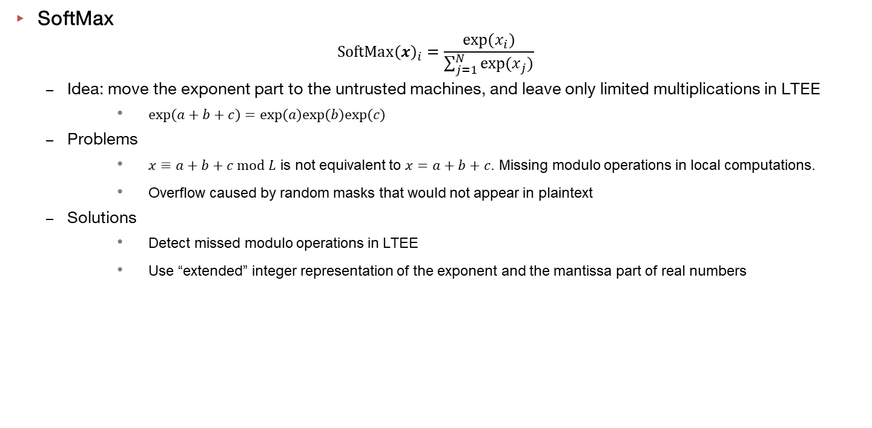
STAMP
SoftMax
$$SoftMax{\left(x\right)}_{i}=\frac{{exp⁡(x}_{i})}{\sum_{j=1}^{N}{{exp⁡(x}_{j})}}$$
Idea: move the exponent part to the untrusted machines, and leave only limited multiplications in LTEE
$exp(a+b+c)=exp(a)exp(b)exp(c)$
Problems
$x≡a+b+c mod L$ is not equivalent to $x=a+b+c$. Missing modulo operations in local computations.
Overflow caused by random masks that would not appear in plaintext
Solutions
Detect missed modulo operations in LTEE
Use “extended” integer representation of the exponent and the mantissa part of real numbers
Notes:
Fractional part
The standard?

Slide 21
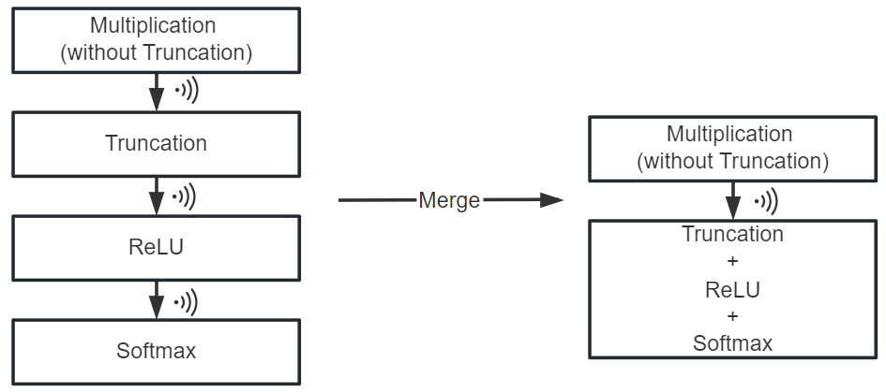

STAMP
Other Optimizations
Merging end-of-multiplication operations with following non-linear operations
Truncation (recover the precision) is required after multiplications between fixed-point representation to keep the precision consistency
E.g., $1.1×2.0=2.2$, $11×20=220$, $×10→×100$
Multiple non-linear operations can be done in one round to save communication

Slide 22
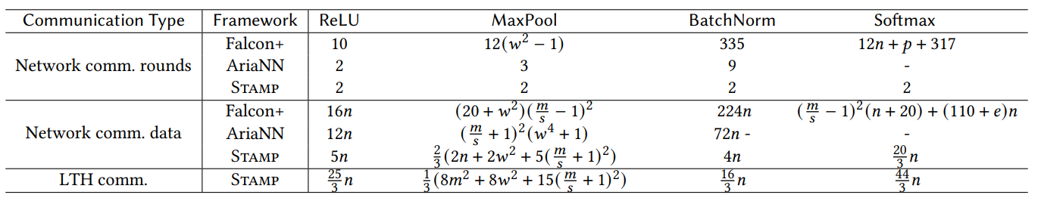
STAMP
Theoretical analysis of communication overhead

Slide 23
STAMP
Malicious security
Supported by replicative operations and reconstruction of masked values
~2X overhead compared to Semi-honest setting
Implementation
Support GPU
Support both Semi-honest and Malicious inference
Support various models including VGG16, ResNet18, Vanilla Transformers
Experiment
Compared with two state-of-the-art frameworks
Done under WAN/LAN networks setting and GPU/CPU equipped cloud machines, plus LTEE prototype
Breakdown on overhead on linear/non-linear layers, Computation/Communication/LTEE.

Slide 24
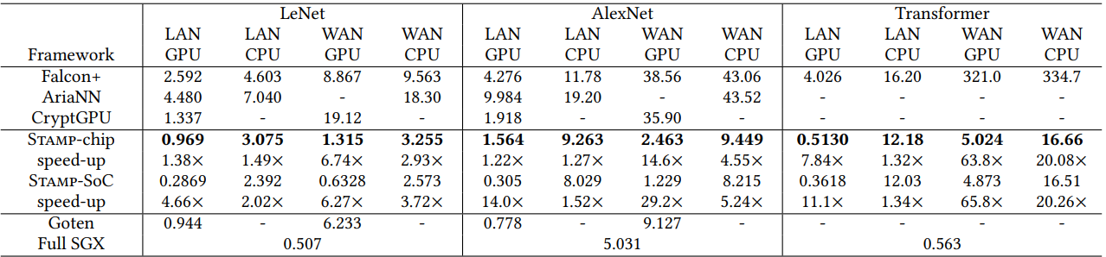
Results
Speedup Comparing with State-of-the-Art Frameworks

Slide 25
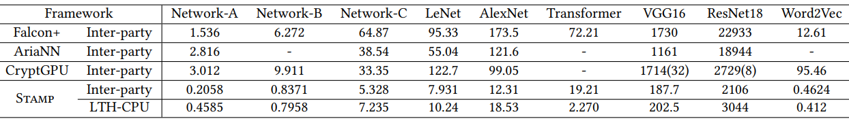
Breakdown of Overhead
Communication

Slide 26
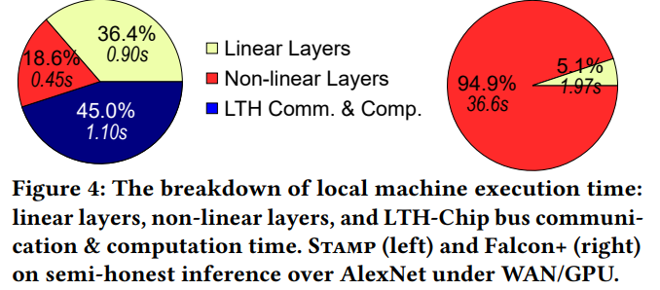

Breakdown of Overhead: Back to Our Intuition
Linear and non-linear operation overhead

Slide 27
Thank You!
Questions?

