Slide 1


Breaking Privacy in Model-Heterogeneous Federated Learning
Atharva Haldankar, Arman Riasi, Hoang-Dung Nguyen, Tran Phuong, Thang Hoang
RAID 2024
Padua, Italy

Slide 2
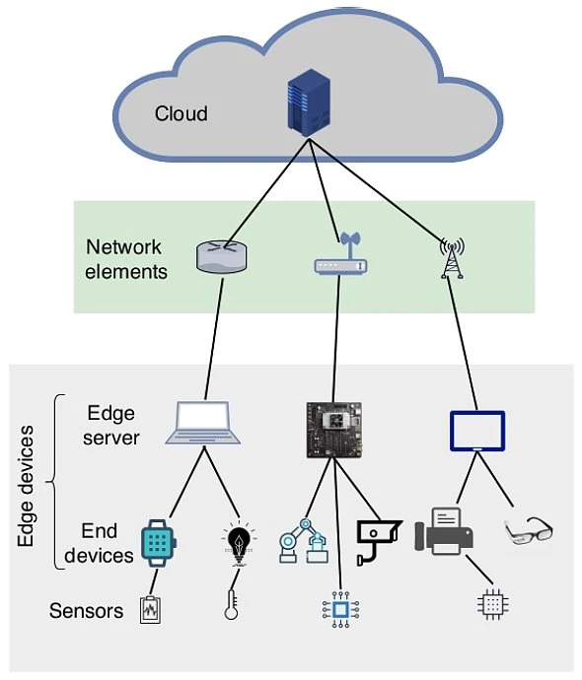
Introduction
Edge devices gather a large amount of data
Conducive to ML
Traditional distributed ML:
Devices upload raw data to server
Privacy concerns (HIPAA, GDPR)
Federated Learning (FL) introduced
Model updates sent instead of raw data
https://viso.ai/wp-content/uploads/2021/04/general-overview-of-the-edge-computing-architecture.jpg
Notes:
Intro:
1. Edge devices, like phones, smart watches, and various other IoT devices generate a large amount of data.
Already, there are billions of IoT devices, and the number of these devices is only expected to increase in the future.
The data collected by these devices is very conducive to ML tasks. With traditional distributed machine learning, …
In the near future, billions of IoT devices will collect data for individuals, corporations, and governments, and this data is very conducive to training ML models.
2. This high volume of data is suitable for ML applications
However, due to the sensitive nature of the data collected by IoT devices, there are privacy concerns at play.
–Probably don’t need. –
For example, these models could be used in healthcare, to better monitor and treat patients, or help government officials with critical transportation and public safety issues.

Slide 3
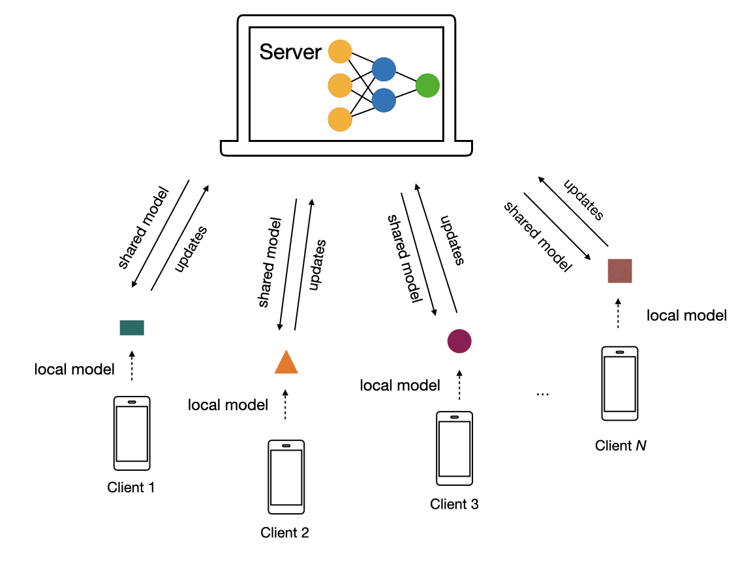
Introduction
Federated Learning (FL):
Decentralized approach to traditional ML
Organized into rounds
For each round:
Server distributes global model
Clients perform local updates
Clients send updates to server
Server aggregates client updates
Data never leaves client devices

Slide 4
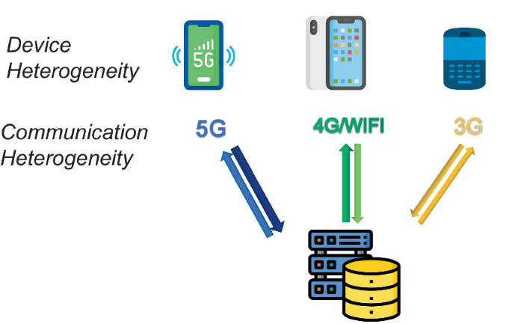
Challenges in FL
Device Heterogeneity
Clients may have vastly different
Compute Resources
Memory Availability
Network Connectivity
Upholding Client Privacy
With individual gradients, server can conduct:
Inference Attacks (Property, Membership, etc.)
Data Reconstruction Attacks
Notes:
Mention Secure aggregation → enhances privacy

Slide 5
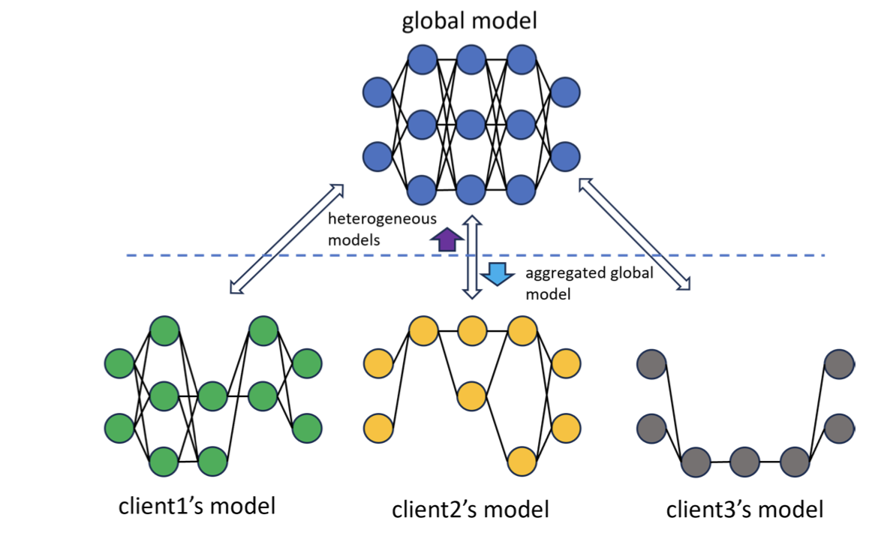
Model-Heterogeneous FL
Partial Training (PT): Client model architecture ⇒ subset of global model
Static: Same nodes updated across rounds
Dynamic: Submodels may change across rounds
Overall: Privacy implications of PT schemes not rigorously investigated
Is the server able to break privacy of model updates for one or more clients?
Notes:
Image Source: https://arxiv.org/pdf/2312.12091

Slide 6
Our Contributions
Convergence Rate Attack:
Targets Static PT schemes (HeteroFL [ICLR’21], FjORD [NeurIPS’21], etc.)
Exploits pattern of submodel distribution and computational heterogeneity
Rolling Model Attack:
Targets dynamic PT schemes (FedRolex [NeurIPS’22], Helios [DAC’21], etc.)
Exploits the submodel selection mechanism

Slide 7
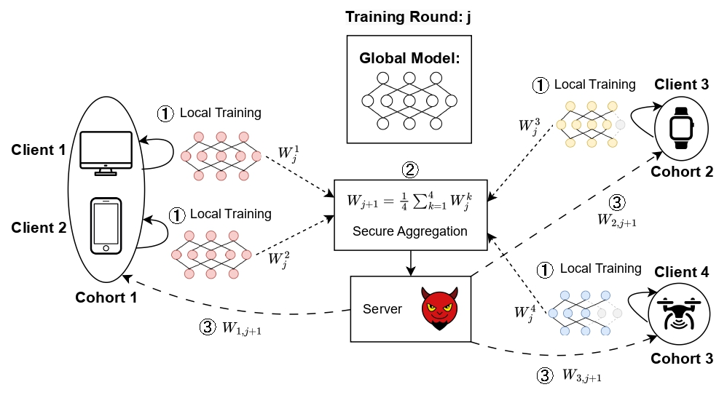
System and Threat Model

Slide 8
Convergence Rate Attack

Slide 9
High Level
Server chooses a target cohort, p.
Server waits for all cohorts i ≤ p to converge.
Server issues malicious model parameters to cohort p.
Server extracts the gradient update from cohort p.

Slide 10
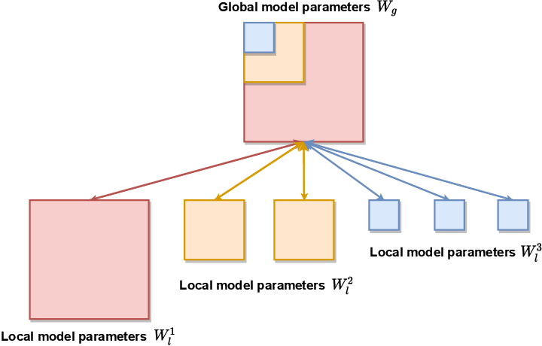
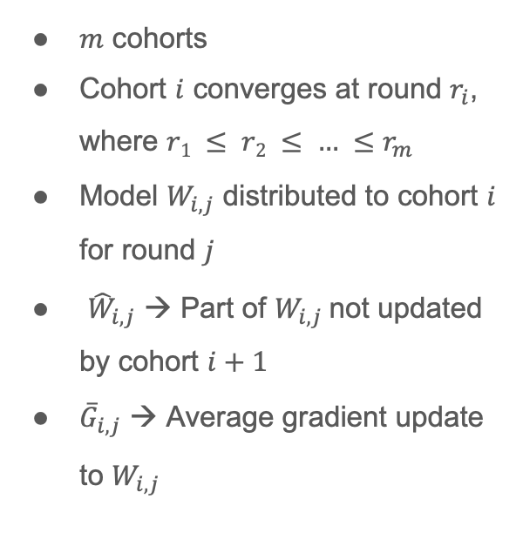
Details
$m$ cohorts
Cohort $i$ converges at round $r_{i}$, where $r1 ≤ r2 ≤ … ≤r_{m}$
Model $W_{i,j}$ distributed to cohort $i$ for round $j$
${\hat{W}}_{i,j}$ → Part of $W_{i,j}$not updated by cohort $i+1$
${\overline{G}}_{i,j}$ → Average gradient update to $W_{i,j}$
Notes:
Here, explain how the server can obtain the aggregate gradient update for the target cohort.
First, explain notation. Then, explain the which cohorts update which model parameters.
W hat i, j: Explain.

Slide 11
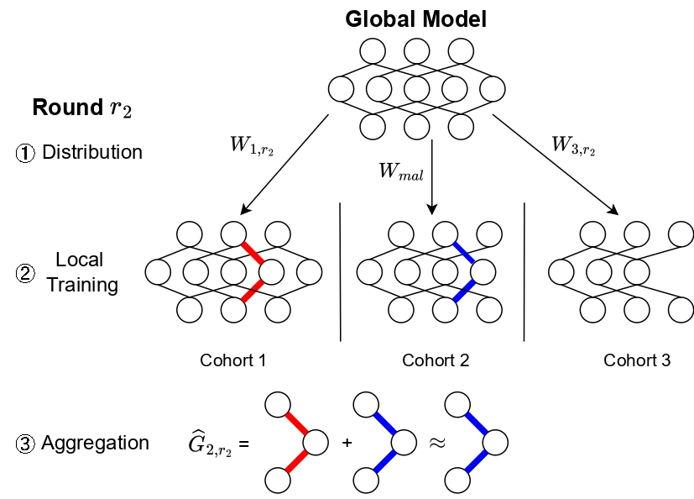
Example

Slide 12
Rolling Model Attack

Slide 13
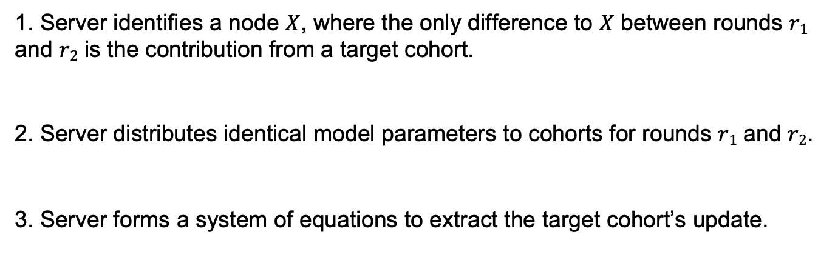
High Level
Server identifies a node $X$, where the only difference to $X$ between rounds $r1$ and $r2$ is the contribution from a target cohort.
Server distributes identical model parameters to cohorts for rounds $r1$ and $r2$.
Server forms a system of equations to extract the target cohort’s update.

Slide 14
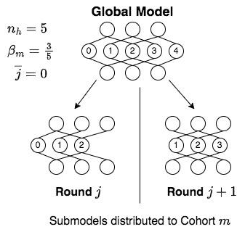
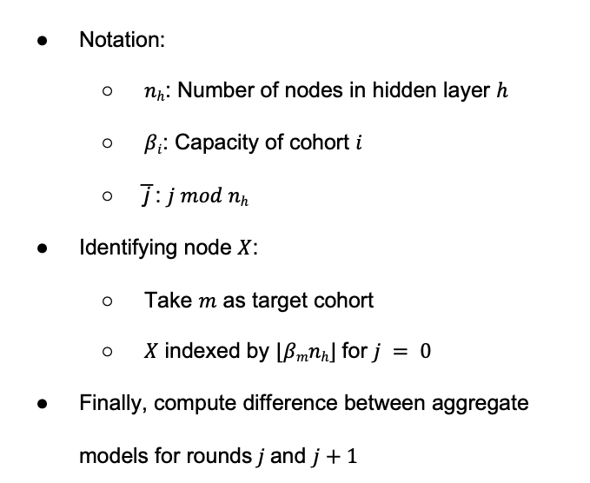
Details
Notation:
$nh$: Number of nodes in hidden layer $h$
$βi$: Capacity of cohort $i$
̅j : $j mod nh$
Identifying node $X$:
Take $m$ as target cohort
$X$ indexed by $⌊βmnh⌋$for $j = 0$
Finally, compute difference between aggregate models for rounds$j$and $j+1$
Notes:
First, here’s some notation…
Put all notation in math mode.

Slide 15
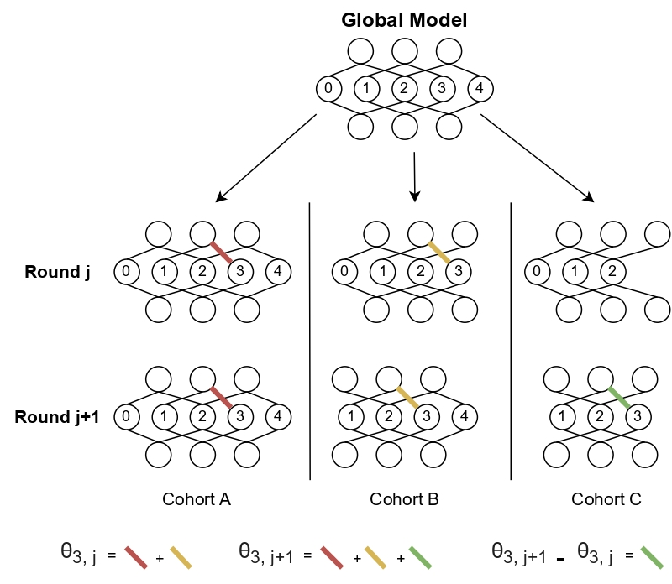
Rolling Model Attack: Example

Slide 16

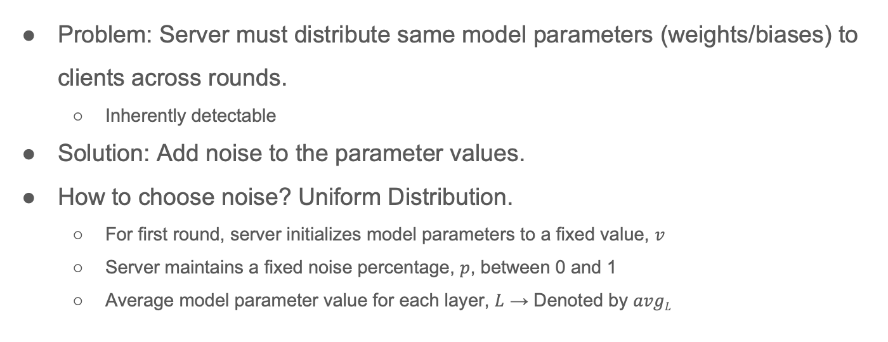
Noisy Initialization
Problem: Server must distribute same model parameters (weights/biases) to clients across rounds.
Inherently detectable
Solution: Add noise to the parameter values.
How to choose noise? Uniform Distribution.
For first round, server initializes model parameters to a fixed value, $v$
Server maintains a fixed noise percentage, $p$, between 0 and 1
Average model parameter value for each layer, $L$ → Denoted by $avgL$
Notes:
Then the distributed model parameter values for the subsequent round will be determined by the following equation.

Slide 17
Evaluation

Slide 18
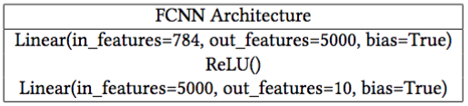
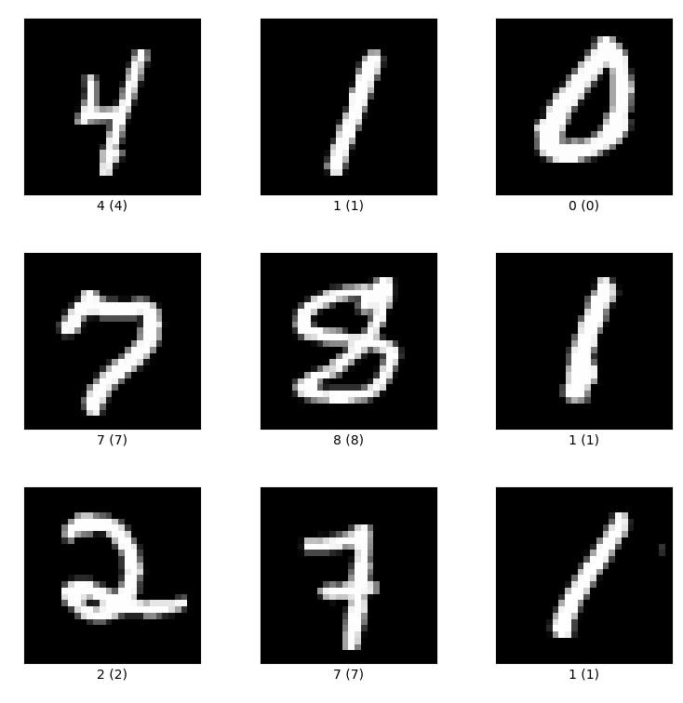
Experimental Setup
3 cohorts → A, B, C
A: Issued full model
B: Hidden layers scaled down by ½
C: Hidden layers scaled down by ¼
Convergence Rate Attack:
5 active users: 1, 1, and 3 in cohorts A, B, and C
Targeted user in cohort B
10 rounds, Non-IID setting
Rolling Model Attack:
3 active users: 1 each in cohorts A, B, and C
Targeted user in cohort C
2 rounds, IID setting
Notes:
TODO: Mention datasets and model architecture.
Say experimental results were similar for MNIST and CIFAR, so we will focus on MNIST results.
OR add MNIST + CIFAR graphs.

Slide 19
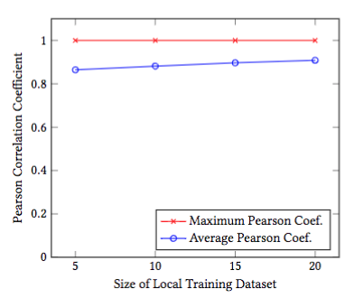
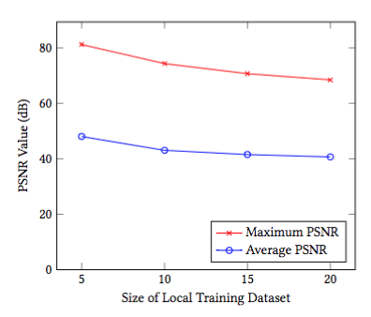
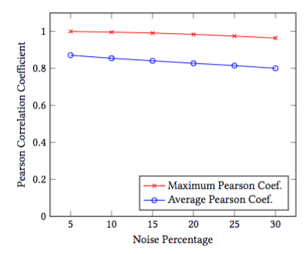
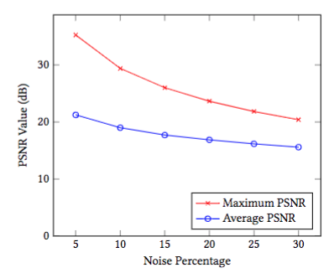
Rolling Model Attack
No Noise Addition: Pearson Coefficient (left) and PSNR value (right)
Noisy Initialization: Pearson Coefficient (left) and PSNR value (right)

Slide 20
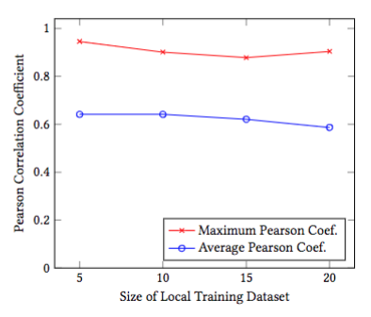
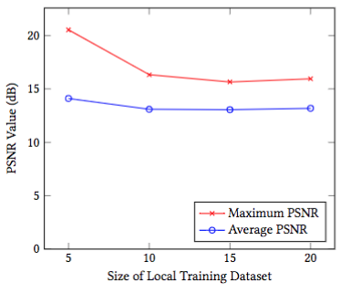
Convergence Rate Attack

Slide 21
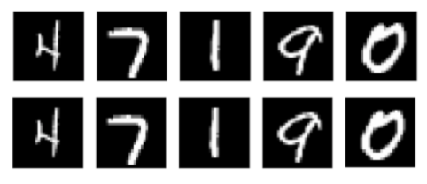
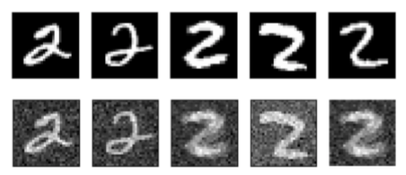
Original Images and Reconstructions
Rolling Model Attack
Convergence Rate Attack
Original images (top row) and their respective reconstructions (bottom row)

Slide 22
Conclusion
Privacy leakage with model-heterogeneous FL schemes, even when secure aggregation is in place
Demonstrated two novel attacks that recover sensitive data from clients
Addition of noise does not guarantee privacy
Potential countermeasures:
Differential Privacy, Blockchain-based FL protocols, Specialized Hardware (TEEs)
Notes:
Mention: No silver bullet countermeasure.
DP: Trade-off between privacy and global model utility.
Blockchain-based FL protocols/Specialized Hardware: May incur high computational and storage overheads, making these solutions infeasible in practice.

Slide 23
Thank You!

