Slide 1





--- PIREX ---
CLIENT EFFICIENT ONLINE OFFLINE PRIVATE INFORMATION RETRIEVAL
HOANG-DUNG NGUYEN JORGE GUAJARDO THANG HOANG
Virginia Tech Robert Bosch Virginia Tech

Slide 2


Risks When Retrieving From Public Database
Health Database:
- Drug Events
- Drug Labels
- Clinical Trials
Media Database:
- Music Tracks
- Video Preference

Slide 3


Risks When Querying Public Database
Health Condition
Health Database:
- Drug Events
- Drug Labels
- Clinical Trials
Personal Interest
Media Database:
- Music Tracks
- Video Preference

Slide 4
Private Information Retrieval – PIR
Health Condition
Health Database:
- Drug Events
- Drug Labels
- Clinical Trials
PIR
Personal Interest
Media Database:
- Music Tracks
- Video Preference
PIR

Slide 5

Private Information Retrieval – PIR
Health Database:
- Drug Events
- Drug Labels
- Clinical Trials
PIR
Media Database:
- Music Tracks
- Video Preference
PIR

Slide 6



PIR – Many Promising Applications ...
Private DNS Lookup
Private Search Engine
Private Media Streaming

Slide 7
PIR – Many Promising Applications ... But Not Yet Practical Enough
Private DNS Lookup
Private Search Engine
Private Media Streaming
 | Server Computation | Response Bandwidth
Traditional PIR
Preprocessing PIR
For example: To retrieve a 16KB entry from a public database of 2³² entries
- Traditional PIR needs to process 70TB
- Preprocessing PIR needs to download 525MB

Slide 8
Introducing PIREX
server computation
Efficient
response bandwidth
55ms to retrive 4KB entry under large-scale database and real-world network setting
Practical
For client with constrainted resource (low bandwidth or memory)
Ideal

Slide 9



Our Starting Point: A Client Preprocessing Model
Left
Right
Preprocessing Phase:
Client requests a random hint component H₀ from the Left server
H₀

Slide 10
Our Starting Point: A Client Preprocessing Model
Left
Right
Preprocessing Phase:
Client requests a random hint component H₀ from the Left server
H₀
Left
Right
For each Online Phase:
Client uses the preprocessed hint to perform any queries (with Right server) in sublinear time
Client refresh the hint (with Left server) in sublinear time to ensure independency between queries
Refresh 1
Query 1
H₀
Refresh 2
Query 2
H₁

Slide 11
How Preprocessing Works ?
F₁ | F₂ | F₃ | F₄ | F₅ | F₆ | F₇ | F₈ | F₉ | F₁₀ | F₁₁ | F₁₂ | F₁₃ | F₁₄ | F₁₅ | F₁₆
Database DB = F₁ ... F₁₆
Left
Right
Preprocessing Phase:
Client requests a random hint component H₀ from the Left server
H₀

Slide 12
How Preprocessing Works ?
F₁ | F₂ | F₃ | F₄ | F₅ | F₆ | F₇ | F₈ | F₉ | F₁₀ | F₁₁ | F₁₂ | F₁₃ | F₁₄ | F₁₅ | F₁₆
Database DB = F₁ ... F₁₆
Left
Right
Preprocessing Phase:
Client requests a random hint component H₀ from the Left server
H₀
F₄ ⨁ F₅ ⨁ F₁₀ ⨁ F₁₆ = P₁
F₃ ⨁ F₇ ⨁ F₁₁ ⨁ F₁₅ = P₂
F₃ ⨁ F₈ ⨁ F₁₂ ⨁ F₁₄ = P₃
F₂ ⨁ F₆ ⨁ F₁₁ ⨁ F₁₃ = P₄
...

Slide 13
How Preprocessing Works ?
F₁ | F₂ | F₃ | F₄ | F₅ | F₆ | F₇ | F₈ | F₉ | F₁₀ | F₁₁ | F₁₂ | F₁₃ | F₁₄ | F₁₅ | F₁₆
Database DB = F₁ ... F₁₆
Left
Right
Preprocessing Phase:
Client requests a random hint component H₀ from the Left server
H₀
F₄ ⨁ F₅ ⨁ F₁₀ ⨁ F₁₆ = P₁
F₃ ⨁ F₇ ⨁ F₁₁ ⨁ F₁₅ = P₂
F₃ ⨁ F₈ ⨁ F₁₂ ⨁ F₁₄ = P₃
F₂ ⨁ F₆ ⨁ F₁₁ ⨁ F₁₃ = P₄
...
For each equation:
- LHS is denoted by a random seed
- RHS is a single XOR sum
Total storage cost:

Slide 14
How Online Query Works ?
F₁ | F₂ | F₃ | F₄ | F₅ | F₆ | F₇ | F₈ | F₉ | F₁₀ | F₁₁ | F₁₂ | F₁₃ | F₁₄ | F₁₅ | F₁₆
F₄ ⨁ F₅ ⨁ F₁₀ ⨁ F₁₆ = P₁
F₃ ⨁ F₇ ⨁ F₁₁ ⨁ F₁₅ = P₂
F₃ ⨁ F₈ ⨁ F₁₂ ⨁ F₁₄ = P₃
F₂ ⨁ F₆ ⨁ F₁₁ ⨁ F₁₃ = P₄
...
Database DB = F₁ ... F₁₆
Hint H₀
Use Equation: F₄ ⨁ F₅ ⨁ F₁₀ ⨁ F₁₆ = P₁
Need Equation: F₄ ⨁ F₅ ⨁ F₁₀ ⨁ F₁₆ = P'
Left
Right
server workload
? F₅
Query 1

Slide 15
How Online Query Works ?
F₁ | F₂ | F₃ | F₄ | F₅ | F₆ | F₇ | F₈ | F₉ | F₁₀ | F₁₁ | F₁₂ | F₁₃ | F₁₄ | F₁₅ | F₁₆
F₄ ⨁ F₅ ⨁ F₁₀ ⨁ F₁₆ = P₁
F₃ ⨁ F₇ ⨁ F₁₁ ⨁ F₁₅ = P₂
F₃ ⨁ F₈ ⨁ F₁₂ ⨁ F₁₄ = P₃
F₂ ⨁ F₆ ⨁ F₁₁ ⨁ F₁₃ = P₄
...
Database DB = F₁ ... F₁₆
Hint H₀
Use Equation: F₄ ⨁ F₅ ⨁ F₁₀ ⨁ F₁₆ = P₁
Need Equation: F₄ ⨁ F₅ ⨁ F₁₀ ⨁ F₁₆ = P'
Left
Right
server workload
Query 1
Asking Right to compute this is the same as revealing: - I am not interest in [ F₄ F₁₀ F₁₆ ] - I am only interest in [ F₅ F₆ F₇ F₈ ]

Slide 16
How Online Query Works ?
F₁ | F₂ | F₃ | F₄ | F₅ | F₆ | F₇ | F₈ | F₉ | F₁₀ | F₁₁ | F₁₂ | F₁₃ | F₁₄ | F₁₅ | F₁₆
F₄ ⨁ F₅ ⨁ F₁₀ ⨁ F₁₆ = P₁
F₃ ⨁ F₇ ⨁ F₁₁ ⨁ F₁₅ = P₂
F₃ ⨁ F₈ ⨁ F₁₂ ⨁ F₁₄ = P₃
F₂ ⨁ F₆ ⨁ F₁₁ ⨁ F₁₃ = P₄
...
Database DB = F₁ ... F₁₆
Hint H₀
Use Equation: F₄ ⨁ F₅ ⨁ F₁₀ ⨁ F₁₆ = P₁
Need Equation: F₄ ⨁ F₅ ⨁ F₁₀ ⨁ F₁₆ = P'
Left
Right
server workload
Query 1
Asking Right to compute this is the same as revealing: - I am not interest in [ F₄ F₁₀ F₁₆ ] - I am only interest in [ F₅ F₆ F₇ F₈ ]
Randomly puncture [ F₄ F₅ F₁₀ F₁₆ ] which may not correctly remove F₅ => Run multiple protocol for negligible probability of failure
Prior Solution
Send [ F₄ F₁₀ F₁₆ ] as offsets. Server guesses the puncture position => response bandwidth for equation guesses

Slide 17
Our Protocol - PIREX
F₁ | F₂ | F₃ | F₄ | F₅ | F₆ | F₇ | F₈ | F₉ | F₁₀ | F₁₁ | F₁₂ | F₁₃ | F₁₄ | F₁₅ | F₁₆
F₄ ⨁ F₅ ⨁ F₁₀ ⨁ F₁₆ = P₁
F₃ ⨁ F₇ ⨁ F₁₁ ⨁ F₁₅ = P₂
F₃ ⨁ F₈ ⨁ F₁₂ ⨁ F₁₄ = P₃
F₂ ⨁ F₆ ⨁ F₁₁ ⨁ F₁₃ = P₄
...
Database DB = F₁ ... F₁₆
Hint H₀
Use Equation: F₄ ⨁ F₅ ⨁ F₁₀ ⨁ F₁₆ = P₁
Use Modified: F₄ ⨁ F₇ ⨁ F₁₀ ⨁ F₁₆ = P'
Left
Right
[ F₄ F₇ F₁₀ F₁₆ ]
(modified)

Slide 18
Our Protocol - PIREX
F₁ | F₂ | F₃ | F₄ | F₅ | F₆ | F₇ | F₈ | F₉ | F₁₀ | F₁₁ | F₁₂ | F₁₃ | F₁₄ | F₁₅ | F₁₆
F₄ ⨁ F₅ ⨁ F₁₀ ⨁ F₁₆ = P₁
F₃ ⨁ F₇ ⨁ F₁₁ ⨁ F₁₅ = P₂
F₃ ⨁ F₈ ⨁ F₁₂ ⨁ F₁₄ = P₃
F₂ ⨁ F₆ ⨁ F₁₁ ⨁ F₁₃ = P₄
...
Database DB = F₁ ... F₁₆
Hint H₀
Use Equation: F₄ ⨁ F₅ ⨁ F₁₀ ⨁ F₁₆ = P₁
Use Modified: F₄ ⨁ F₇ ⨁ F₁₀ ⨁ F₁₆ = P'
Use Required: F₄ ⨁ F₇ ⨁ F₁₀ ⨁ F₁₆ = P'
Left
Right
[ F₄ F₇ F₁₀ F₁₆ ]
(modified)

Slide 19
Our Protocol - PIREX
F₁ | F₂ | F₃ | F₄ | F₅ | F₆ | F₇ | F₈ | F₉ | F₁₀ | F₁₁ | F₁₂ | F₁₃ | F₁₄ | F₁₅ | F₁₆
F₄ ⨁ F₅ ⨁ F₁₀ ⨁ F₁₆ = P₁
F₃ ⨁ F₇ ⨁ F₁₁ ⨁ F₁₅ = P₂
F₃ ⨁ F₈ ⨁ F₁₂ ⨁ F₁₄ = P₃
F₂ ⨁ F₆ ⨁ F₁₁ ⨁ F₁₃ = P₄
...
Database DB = F₁ ... F₁₆
Hint H₀
Use Equation: F₄ ⨁ F₅ ⨁ F₁₀ ⨁ F₁₆ = P₁
Use Modified: F₄ ⨁ F₇ ⨁ F₁₀ ⨁ F₁₆ = P'
Use Required: F₄ ⨁ F₇ ⨁ F₁₀ ⨁ F₁₆ = P'
Left
Right
We can craft two additional patching queries to instantly and privately retrieve F₇
[ F₄ F₇ F₁₀ F₁₆ ]
(modified)
1. Define a random logical database
2. Generate two random subsets of identifiers such that their symmetric difference is F₇
F₃ | F₇ | F₉ | F₁₄
[ F₃ F₁₄ ]
[ F₃ F₇ F₁₄ ]

Slide 20
Our Protocol - PIREX
F₁ | F₂ | F₃ | F₄ | F₅ | F₆ | F₇ | F₈ | F₉ | F₁₀ | F₁₁ | F₁₂ | F₁₃ | F₁₄ | F₁₅ | F₁₆
F₄ ⨁ F₅ ⨁ F₁₀ ⨁ F₁₆ = P₁
F₃ ⨁ F₇ ⨁ F₁₁ ⨁ F₁₅ = P₂
F₃ ⨁ F₈ ⨁ F₁₂ ⨁ F₁₄ = P₃
F₂ ⨁ F₆ ⨁ F₁₁ ⨁ F₁₃ = P₄
...
Database DB = F₁ ... F₁₆
Hint H₀
Use Equation: F₄ ⨁ F₅ ⨁ F₁₀ ⨁ F₁₆ = P₁
Use Modified: F₄ ⨁ F₇ ⨁ F₁₀ ⨁ F₁₆ = P'
Use Required: F₄ ⨁ F₇ ⨁ F₁₀ ⨁ F₁₆ = P'
Left
Right
We can craft two additional patching queries to instantly and privately retrieve F₇
[ F₄ F₇ F₁₀ F₁₆ ]
(modified)
1. Define a random logical database
2. Generate two random subsets of identifiers such that their symmetric difference is F₇
[ F₃ F₇ F₁₄ ]
(patching)
[ F₃ F₁₄ ]
(patching)
F₃ | F₇ | F₉ | F₁₄
[ F₃ F₁₄ ]
[ F₃ F₇ F₁₄ ]

Slide 21
Our Protocol - PIREX
F₁ | F₂ | F₃ | F₄ | F₅ | F₆ | F₇ | F₈ | F₉ | F₁₀ | F₁₁ | F₁₂ | F₁₃ | F₁₄ | F₁₅ | F₁₆
F₄ ⨁ F₅ ⨁ F₁₀ ⨁ F₁₆ = P₁
F₃ ⨁ F₇ ⨁ F₁₁ ⨁ F₁₅ = P₂
F₃ ⨁ F₈ ⨁ F₁₂ ⨁ F₁₄ = P₃
F₂ ⨁ F₆ ⨁ F₁₁ ⨁ F₁₃ = P₄
...
Database DB = F₁ ... F₁₆
Hint H₀
Use Equation: F₄ ⨁ F₅ ⨁ F₁₀ ⨁ F₁₆ = P₁
Use Modified: F₄ ⨁ F₇ ⨁ F₁₀ ⨁ F₁₆ = P'
Use Required: F₄ ⨁ F₇ ⨁ F₁₀ ⨁ F₁₆ = P'
Left
Right
We can craft two additional patching queries to instantly and privately retrieve F₇
[ F₁ F₆ F₁₂ F₁₃ ]
(random)
[ F₄ F₇ F₁₀ F₁₆ ]
(modified)
[ F₃ F₇ F₁₄ ]
(patching)
[ F₃ F₁₄ ]
(patching)

Slide 22
Our Protocol - PIREX
F₁ | F₂ | F₃ | F₄ | F₅ | F₆ | F₇ | F₈ | F₉ | F₁₀ | F₁₁ | F₁₂ | F₁₃ | F₁₄ | F₁₅ | F₁₆
F₄ ⨁ F₅ ⨁ F₁₀ ⨁ F₁₆ = P₁
F₃ ⨁ F₇ ⨁ F₁₁ ⨁ F₁₅ = P₂
F₃ ⨁ F₈ ⨁ F₁₂ ⨁ F₁₄ = P₃
F₂ ⨁ F₆ ⨁ F₁₁ ⨁ F₁₃ = P₄
...
Database DB = F₁ ... F₁₆
Hint H₀
Use Equation: F₄ ⨁ F₅ ⨁ F₁₀ ⨁ F₁₆ = P₁
Use Modified: F₄ ⨁ F₇ ⨁ F₁₀ ⨁ F₁₆ = P'
Use Required: F₄ ⨁ F₇ ⨁ F₁₀ ⨁ F₁₆ = T₀ ⨁ T₁
Left
Right
Using the above three equations We can locally recover F₅
F₁ ⨁ F₆ ⨁ F₁₂ ⨁ F₁₃ = R
(random)
F₄ ⨁ F₇ ⨁ F₁₀ ⨁ F₁₆ = P'
(modified)
F₃ ⨁ F₇ ⨁ F₁₄ = T₀
(patching)
F₃ ⨁ F₁₄ = T₁
(patching)

Slide 23
PIREX – Hint Refreshment
F₁ | F₂ | F₃ | F₄ | F₅ | F₆ | F₇ | F₈ | F₉ | F₁₀ | F₁₁ | F₁₂ | F₁₃ | F₁₄ | F₁₅ | F₁₆
F₄ ⨁ F₅ ⨁ F₁₀ ⨁ F₁₆ = P₁
F₃ ⨁ F₇ ⨁ F₁₁ ⨁ F₁₅ = P₂
F₃ ⨁ F₈ ⨁ F₁₂ ⨁ F₁₄ = P₃
F₂ ⨁ F₆ ⨁ F₁₁ ⨁ F₁₃ = P₄
...
Database DB = F₁ ... F₁₆
Hint H₀
Use Equation: F₄ ⨁ F₅ ⨁ F₁₀ ⨁ F₁₆ = P₁
Use Modified: F₄ ⨁ F₇ ⨁ F₁₀ ⨁ F₁₆ = P'
Use Required: F₄ ⨁ F₇ ⨁ F₁₀ ⨁ F₁₆ = T₀ ⨁ T₁
Left
Right
We recovered F₅ and obtained a random F₇
F₁ ⨁ F₆ ⨁ F₁₂ ⨁ F₁₃ = R
(random)

Slide 24
PIREX – Hint Refreshment
F₁ | F₂ | F₃ | F₄ | F₅ | F₆ | F₇ | F₈ | F₉ | F₁₀ | F₁₁ | F₁₂ | F₁₃ | F₁₄ | F₁₅ | F₁₆
Database DB = F₁ ... F₁₆
Left
Right
We recovered F₅ and obtained a random F₇
F₁ ⨁ F₆ ⨁ F₁₂ ⨁ F₁₃ = R
(random)
F₁ ⨁ F₆ ⨁ F₁₂ ⨁ F₁₃ = R
F₃ ⨁ F₇ ⨁ F₁₁ ⨁ F₁₅ = P₂
F₃ ⨁ F₈ ⨁ F₁₂ ⨁ F₁₄ = P₃
F₂ ⨁ F₆ ⨁ F₁₁ ⨁ F₁₃ = P₄
...
F₄ ⨁ F₅ ⨁ F₁₀ ⨁ F₁₆ = P₁
F₃ ⨁ F₇ ⨁ F₁₁ ⨁ F₁₅ = P₂
F₃ ⨁ F₈ ⨁ F₁₂ ⨁ F₁₄ = P₃
F₂ ⨁ F₆ ⨁ F₁₁ ⨁ F₁₃ = P₄
...
Use the random equation to replace the consumed one
Hint H₀

Slide 25
PIREX – Hint Refreshment
F₁ | F₂ | F₃ | F₄ | F₅ | F₆ | F₇ | F₈ | F₉ | F₁₀ | F₁₁ | F₁₂ | F₁₃ | F₁₄ | F₁₅ | F₁₆
Database DB = F₁ ... F₁₆
Left
Right
We recovered F₅ and obtained a random F₇
F₁ ⨁ F₆ ⨁ F₁₂ ⨁ F₁₃ = R
(random)
F₁ ⨁ F₆ ⨁ F₁₂ ⨁ F₁₃ = R
F₃ ⨁ F₇ ⨁ F₁₁ ⨁ F₁₅ = P₂
F₃ ⨁ F₈ ⨁ F₁₂ ⨁ F₁₄ = P₃
F₂ ⨁ F₆ ⨁ F₁₁ ⨁ F₁₃ = P₄
...
F₁ ⨁ F₆ ⨁ F₁₂ ⨁ F₁₃ = R
F₃ ⨁ F₅ ⨁ F₁₁ ⨁ F₁₅ = P₂
F₃ ⨁ F₈ ⨁ F₁₂ ⨁ F₁₄ = P₃
F₂ ⨁ F₆ ⨁ F₁₁ ⨁ F₁₃ = P₄
...
F₄ ⨁ F₅ ⨁ F₁₀ ⨁ F₁₆ = P₁
F₃ ⨁ F₇ ⨁ F₁₁ ⨁ F₁₅ = P₂
F₃ ⨁ F₈ ⨁ F₁₂ ⨁ F₁₄ = P₃
F₂ ⨁ F₆ ⨁ F₁₁ ⨁ F₁₃ = P₄
...
Hint H₁
(secure for next query)
Use the random equation to replace the consumed one
Preserve the hint distribution by adjusting an equation to cover F₅
Hint H₀

Slide 26
PIREX – Support Remote Hint Storage (For Limited-Memmory Client)
F₄ ⨁ F₅ ⨁ F₁₀ ⨁ F₁₆ = P₁
F₃ ⨁ F₇ ⨁ F₁₁ ⨁ F₁₅ = P₂
F₃ ⨁ F₈ ⨁ F₁₂ ⨁ F₁₄ = P₃
F₂ ⨁ F₆ ⨁ F₁₁ ⨁ F₁₃ = P₄
...
For each equation:
- LHS is denoted by a random seed
- RHS is an XOR sum (costly!)
Hint H₀
Left
Right

Slide 27

PIREX – Support Remote Hint Storage (For Limited-Memmory Client)
F₄ ⨁ F₅ ⨁ F₁₀ ⨁ F₁₆ = P₁
F₃ ⨁ F₇ ⨁ F₁₁ ⨁ F₁₅ = P₂
F₃ ⨁ F₈ ⨁ F₁₂ ⨁ F₁₄ = P₃
F₂ ⨁ F₆ ⨁ F₁₁ ⨁ F₁₃ = P₄
...
For each equation:
- LHS is denoted by a random seed
- RHS is an XOR sum (costly!)
Hint H₀
Left
Right
P₁
P₂
P₃
P₄
...
P₁
P₂
P₃
P₄
...
Instead of storing the hint locally, offload an encrypted replica of the hint to both servers

Slide 28
PIREX – Support Remote Hint Storage (For Limited-Memmory Client)
F₄ ⨁ F₅ ⨁ F₁₀ ⨁ F₁₆ = P₁
F₃ ⨁ F₇ ⨁ F₁₁ ⨁ F₁₅ = P₂
F₃ ⨁ F₈ ⨁ F₁₂ ⨁ F₁₄ = P₃
F₂ ⨁ F₆ ⨁ F₁₁ ⨁ F₁₃ = P₄
...
For each equation:
- LHS is denoted by a random seed
- RHS is an XOR sum (costly!)
Hint H₀
Left
Right
To retrieve a hint, use two-server XOR-PIR: Server Computation:
Response Bandwidth:
P₁
P₂
P₃
P₄
...
P₁
P₂
P₃
P₄
...
Instead of storing the hint locally, offload an encrypted replica of the hint to both servers
To write (refresh) a hint, use Write-ORAM: Server Computation:
Response Bandwidth:
For more details, see PIREX+ in our paper!

Slide 29

Implmentation & Experimental Setup
Artifact Reproduced
Counterpart Comparison:
Two-Server:
CK20 [EuroCrypt' 20]
TreePIR [Crypto' 23]
Single-Server:
Piano [S&P' 24]
Piano Ext [ePrint' 24]
Environment Settings:
Database Size: 1GB → 1TB
Block Size: 4KB, 64KB, 256KB
# Entries: 2¹² → 2²⁸
Client-Server Network:
Bandwidth: 40Mbps
Round-trip: 11ms
https://github.com/vt-asaplab/pirex

Slide 30
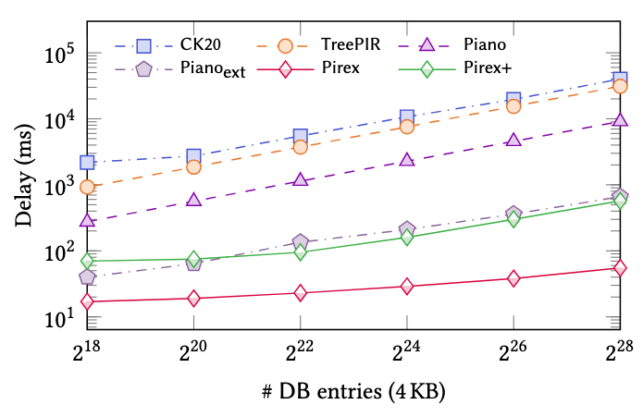
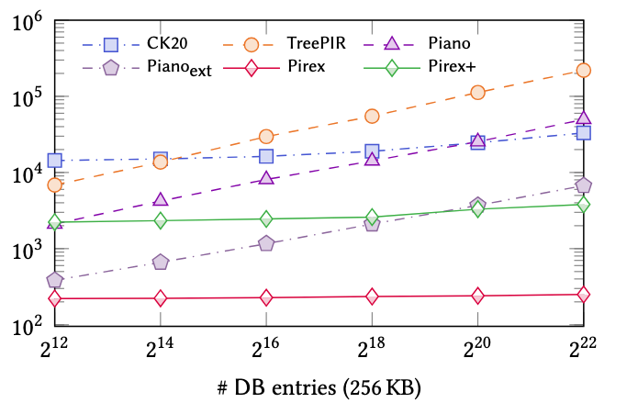
Experimental Comparison
For 1TB database:
- Pirex takes 55ms to retrieve a 4KB entry
- 165✕ faster than Piano
- 565✕ faster than TreePIR
- 728✕ faster than CK20
Two order of magnitude faster
For 1TB database:
- Pirex takes 260ms to retrieve a 256KB entry
- 191✕ faster than Piano
- 845✕ faster than TreePIR
- 127✕ faster than CK20

Slide 31
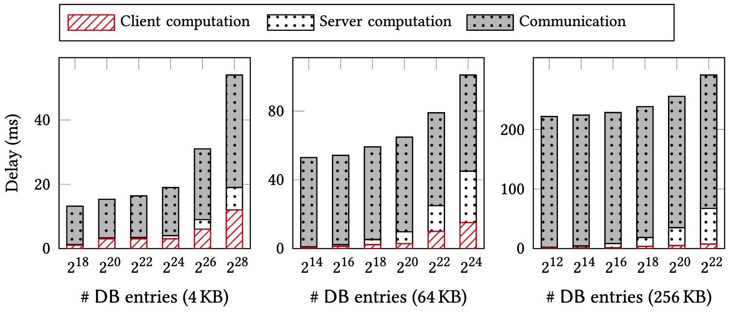
Experimental Breakdown
Client Computation: 20% Server Computation: 20%
Communication: 60%
Communication bandwidth is the dominating factor while it already achieves constant !!!

Slide 32

Thank You For Your Listening !
nhd@vt.edu

