Slide 1
The DSDM Atern approach

Slide 2
What is DSDM? (1)
A generic framework for RAD development
Methodology has evolved as the result of efforts by the Dynamic Systems Development Consortium (DSDM)
Formed in January 1994 by over 300 organisations such as Barclays, Norwich Union and Logica.
Their brief to encourage the take up of RAD development techniques in a structured & systematic way.

Slide 3
What is DSDM? (2)
There have been a number of versions since the early days.
Until recently, DSDM version 4.2 was the definitive version
It is still being used in many environments
The new version (2 years+)
DSDM Atern

Slide 4
The DSDM approach to RAD (1)
Provides a framework for Rapid Development within a controlled project environment.
It does not tie the development to particular tools and techniques
e.g. may use data modelling, object modelling to achieve the design - DSDM is not concerned with this.

Slide 5
The DSDM approach to RAD (2)
Users must be an integral part of the development process.
The DSDM approach aims to address the needs of all parties concerned with the development:
Developers
Users
Project managers
QA Personnel

Slide 6
The DSDM approach to RAD (3)
The original DSDM method was based on
13 principles. From version 2 onward this was refined to 9.
DSDM ATERN has now refined these principles to 8.
We will be looking at these in detail

Slide 7
The DSDM approach to RAD (4)
Things to note about the DSDM approach
It has been developed by RAD practitioners
It has been tested out on real, live projects
Short life cycle has meant that feedback and shaping of the different versions has been undertaken dynamically.

Slide 8
DSDM Atern
DSDM Atern is the latest version of the method
You may have seen version 4.2
The underlying rationale is the same – it has just been refined
You have access to the online DSDM resource as the CMS School is a DSDM consortium member.
Acknowledgements to DSDM Atern
© Copyright DSDM Consortium 2008. All rights reserved

Slide 9
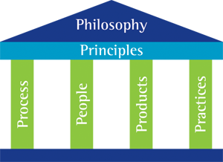
The DSDM Atern philosophy (1)

Slide 10
The DSDM Atern philosophy (2)
Any project must be aligned to clearly defined strategic goals and focus upon early delivery of real benefits to the business.
The Atern framework contains a set of 8 working principles
They are supported by four key areas:
Process, People, Products, Practices
Looks familiar?

Slide 11
A familiar view?
Rapid Application Development
Tools People Management Methodology

Slide 12
The Atern principles
The concept of a ‘principle’ is unique to DSDM
The principles direct the team in the attitude they must take and the mindset they must adopt in order to deliver consistently.
The idea is that if you don’t follow all the principles then the success of the project will be compromised.

Slide 13
Principle 1:
Focus on the business need
What is the business case?
What is the business goal?
We need to deliver what the business needs when it needs it – that’s our overriding goal.

Slide 14
Principle 2:
Deliver on time
Delivering products on time is quite often the single most important success factor for a project.
To ensure that a product is delivered on time, an Atern team will:
Use the timebox approach
Focus on business priorities
Always hit deadlines

Slide 15
Principle 3:
Collaborate
Team working is eveything!
Teams that work in a spirit of active cooperation and commitment will always outperform groups of individuals working only in loose association.
To meet this principle an Atern team must;
Involve the right stakeholders at the right time
Empower the team members
Actively involve the business reps (users)

Slide 16
Principle 4:
Never compromise quality
The level of quality should be agreed at the start.
All work should meet that quality standard
Remember ‘fit for purpose’
To fulfil this principle Atern teams must:
Set level of quality at beginning
Design, document, test appropriately
Constantly review product development
Test continuously (remember prototyping)

Slide 17
Principle 5:
Build incrementally from firm foundations
Incremental delivery benefits business greatly
First, though, the team must understand the scope of the business solution and the proposed solution, but not in such detail that the project becomes paralysed (define the high level requirements)

Slide 18
Principle 6:
Develop iteratively
Only way to converge on an accurate business solution is to refine by backtracking (iterative approach)
It is very rare that anything is built perfectly first time
Projects operate within a changing world.

Slide 19
Principle 7:
Communicate continuously and clearly
Poor communication is often cited as the biggest cause of project failure.
Atern teams will:
Run daily stand-up sessions
Use facilitated workshops
Use rich communication techniques such as modelling and prototyping
Keep documentation lean and timely
Encourage informal, face-to-face communication

Slide 20
Principle 8:
Demonstrate control
The project must be controlled at all times
Iterative, incremental approach using prototyping requires close monitoring to ensure success
To maintain confidence control must be demonstrated at all times:
Plans and progress visible to all
Measure progress through focus on delivery of products rather than completed activities (product-based approach rather than activity-based approach)
Manage proactively
Evaluate project viablity based on business objectives

Slide 21
What next?
We have looked at the Atern Philosophy
We have looked at the Atern Principles
We now need to look at the:
Process (with defined Products)
People
Practices

Slide 22
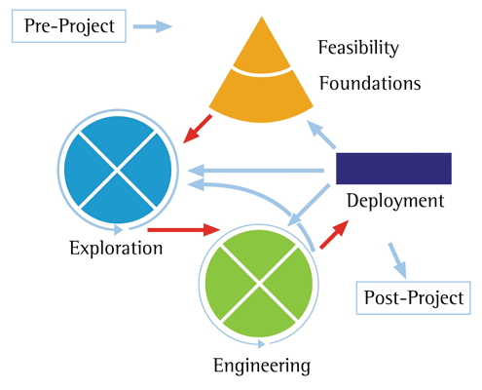
The process with defined products (The DSDM Atern life cycle)

Slide 23
More on these next week…..

