Slide 1
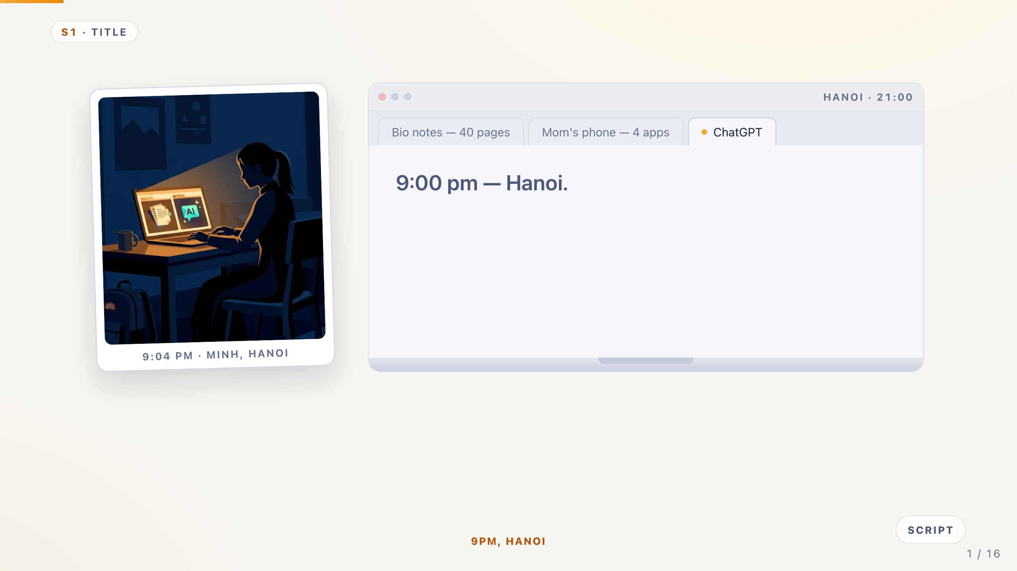
Notes:
S1 · TITLE — Cold open — 9pm at Minh's table
Speaker: DN · 0:35
Cue: Let the lines type. Speak slowly — you are the user, that is your advantage.
It is 9pm in Hanoi. Minh has a science test tomorrow — forty pages of notes.
In the next tab, ChatGPT will do all of it for him. At the table, Mom is quizzing him — with four apps that do not help.
Minh is not lazy. Minh is us. Mom is doing her best.
These tools are teaching him to stop thinking. We built the fix for both of them.
Tip: Backup direct open: "The best students in Vietnam are most at risk. We are 13 and 14, and we built the fix."

Slide 2
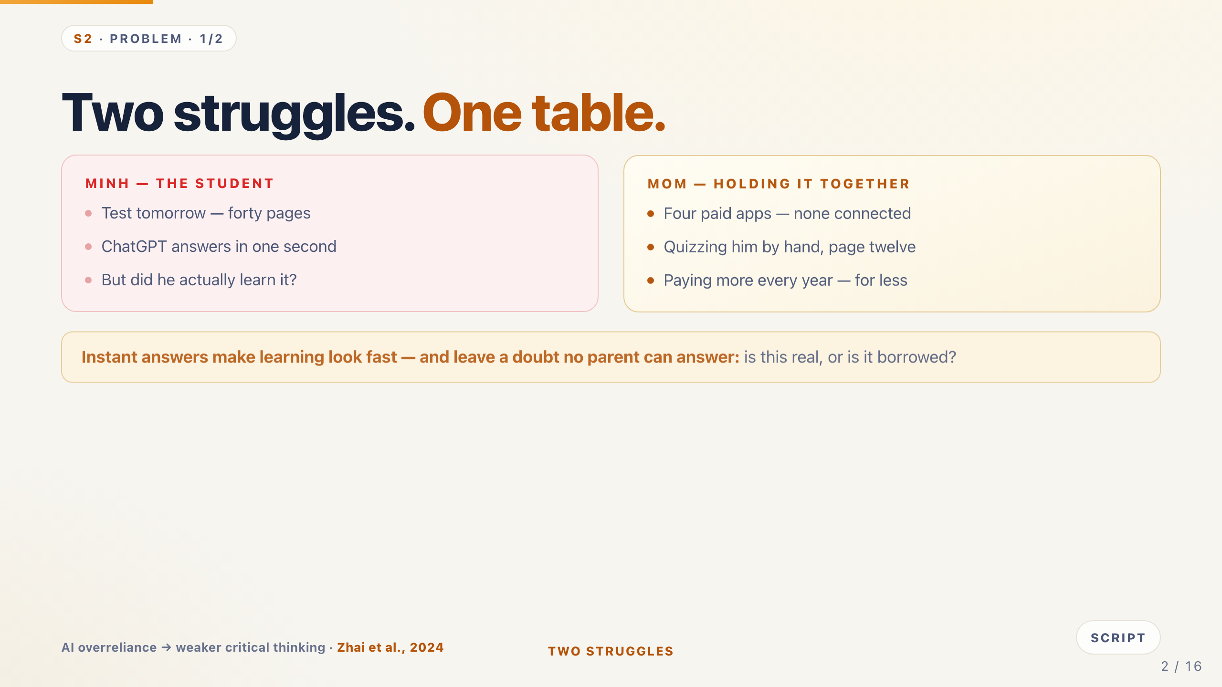
Notes:
S2 · PROBLEM 1/2 — Two struggles at one table.
Speaker: DN · 0:45
Cue: Left card is the kid. Right card is Mom. Land the doubt line at the bottom.
Look at one dinner table. Two struggles.
Left: Minh. Test tomorrow — and ChatGPT answers in one second. But did he learn anything? Nobody knows. That doubt is the problem.
Right: Mom. Four paid apps, none connected. She still quizzes him by hand — paying more every year for less.
Instant answers look fast — but they leave a doubt no parent can answer: is this real, or borrowed?
Tip: Research chip: Zhai et al., 2024 — AI overreliance weakens critical thinking.

Slide 3
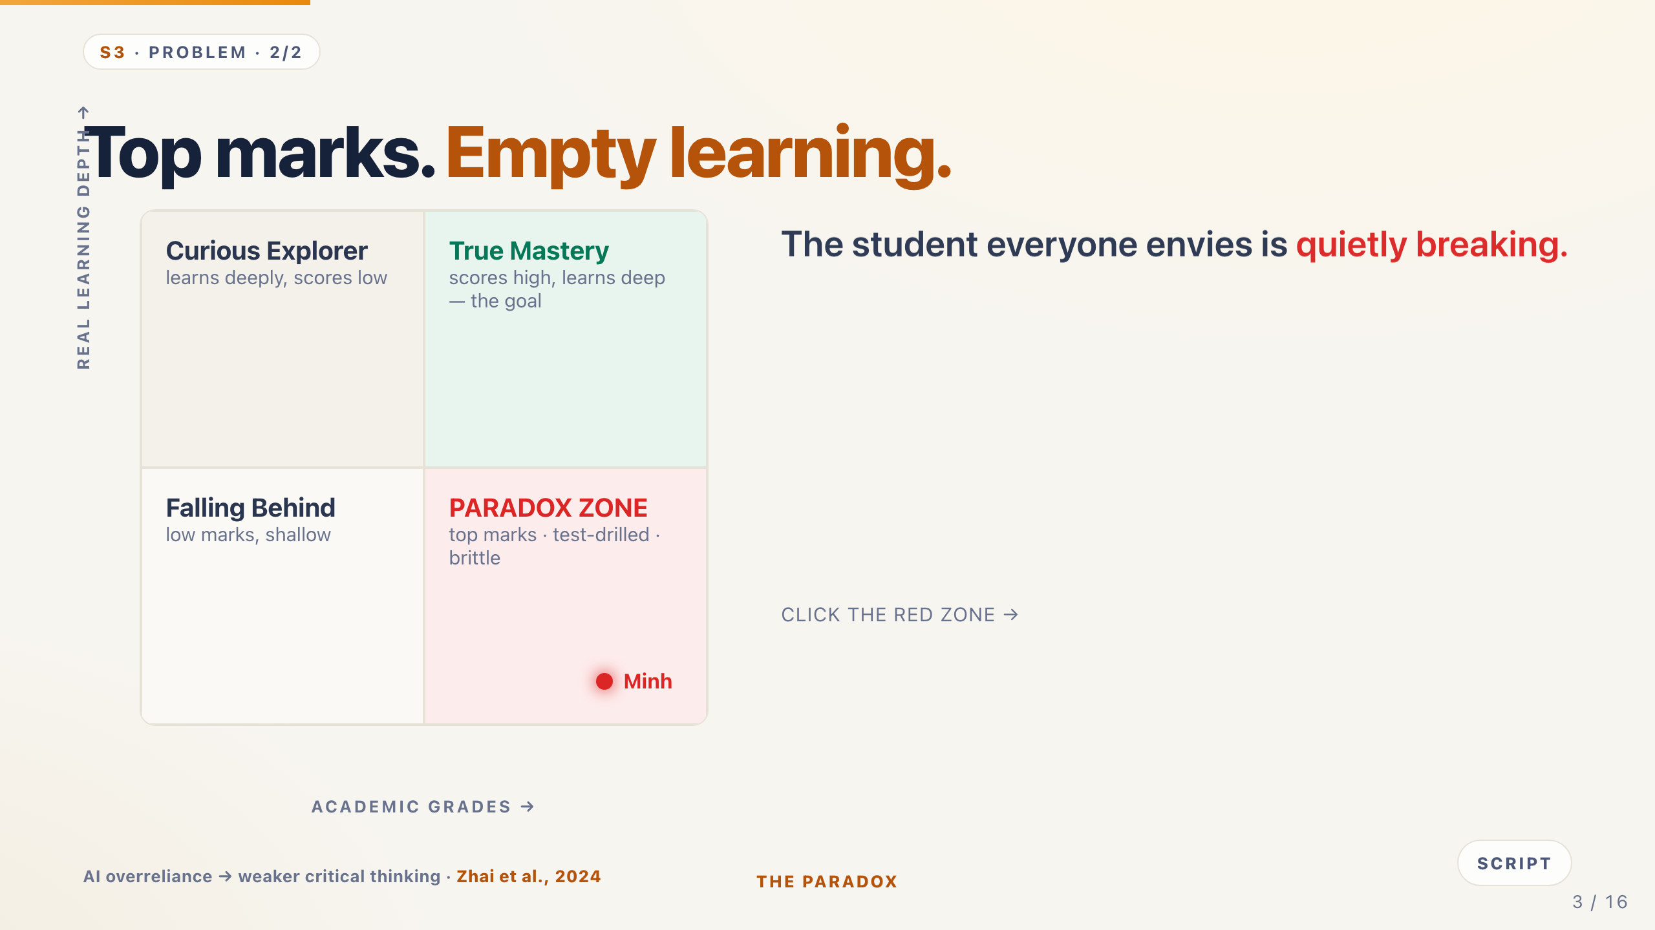
Notes:
S3 · PROBLEM 2/2 — Top marks. Empty learning.
Speaker: DN · 0:50
Cue: Walk the 2×2, land on the Paradox Zone, click it to reveal the three costs.
Here is the strange part. On paper, Minh is a top student.
Grades go right, real learning goes up. Bottom right: the Paradox Zone — top marks, drilled, brittle. That is where Minh lives. [click]
Three invisible costs: burnout nobody sees, practice that breaks when the problem changes, and AI-dependence.
Kids do not need more content. They need to want it — and know how to chase it.
Tip: This is the SE Asian paradox: high marks, thin understanding, highest tutoring spend in the region.

Slide 4
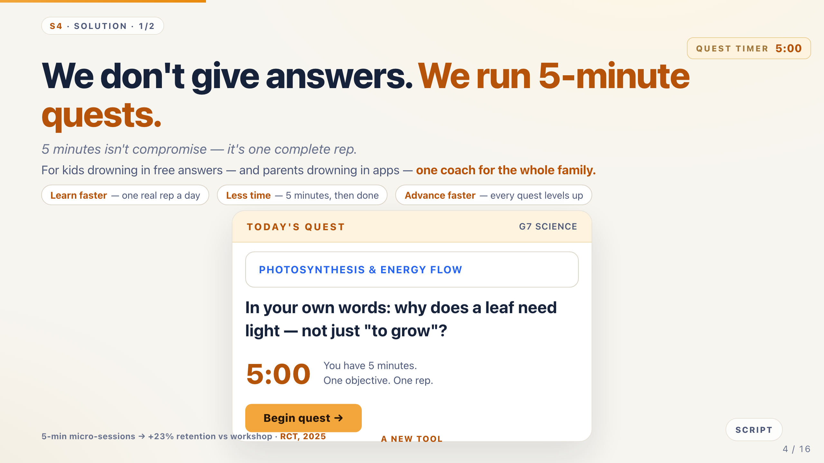
Notes:
S4 · SOLUTION 1/2 — We don't give answers. We run 5-minute quests.
Speaker: GM · 0:50
Cue: The countdown starts now and keeps running through the next slides — point at it.
So the real question is not how to give better answers. It is how to protect the question.
Our answer: we do not give answers. We run five-minute quests.
One quest. One goal. Five minutes. Not a compromise — one complete rep.
Three promises to a parent: learn faster, one real rep a day. Less time, five minutes then done. Move ahead faster, every quest levels up.
Tip: Rule of three: predict · struggle · prove.

Slide 5
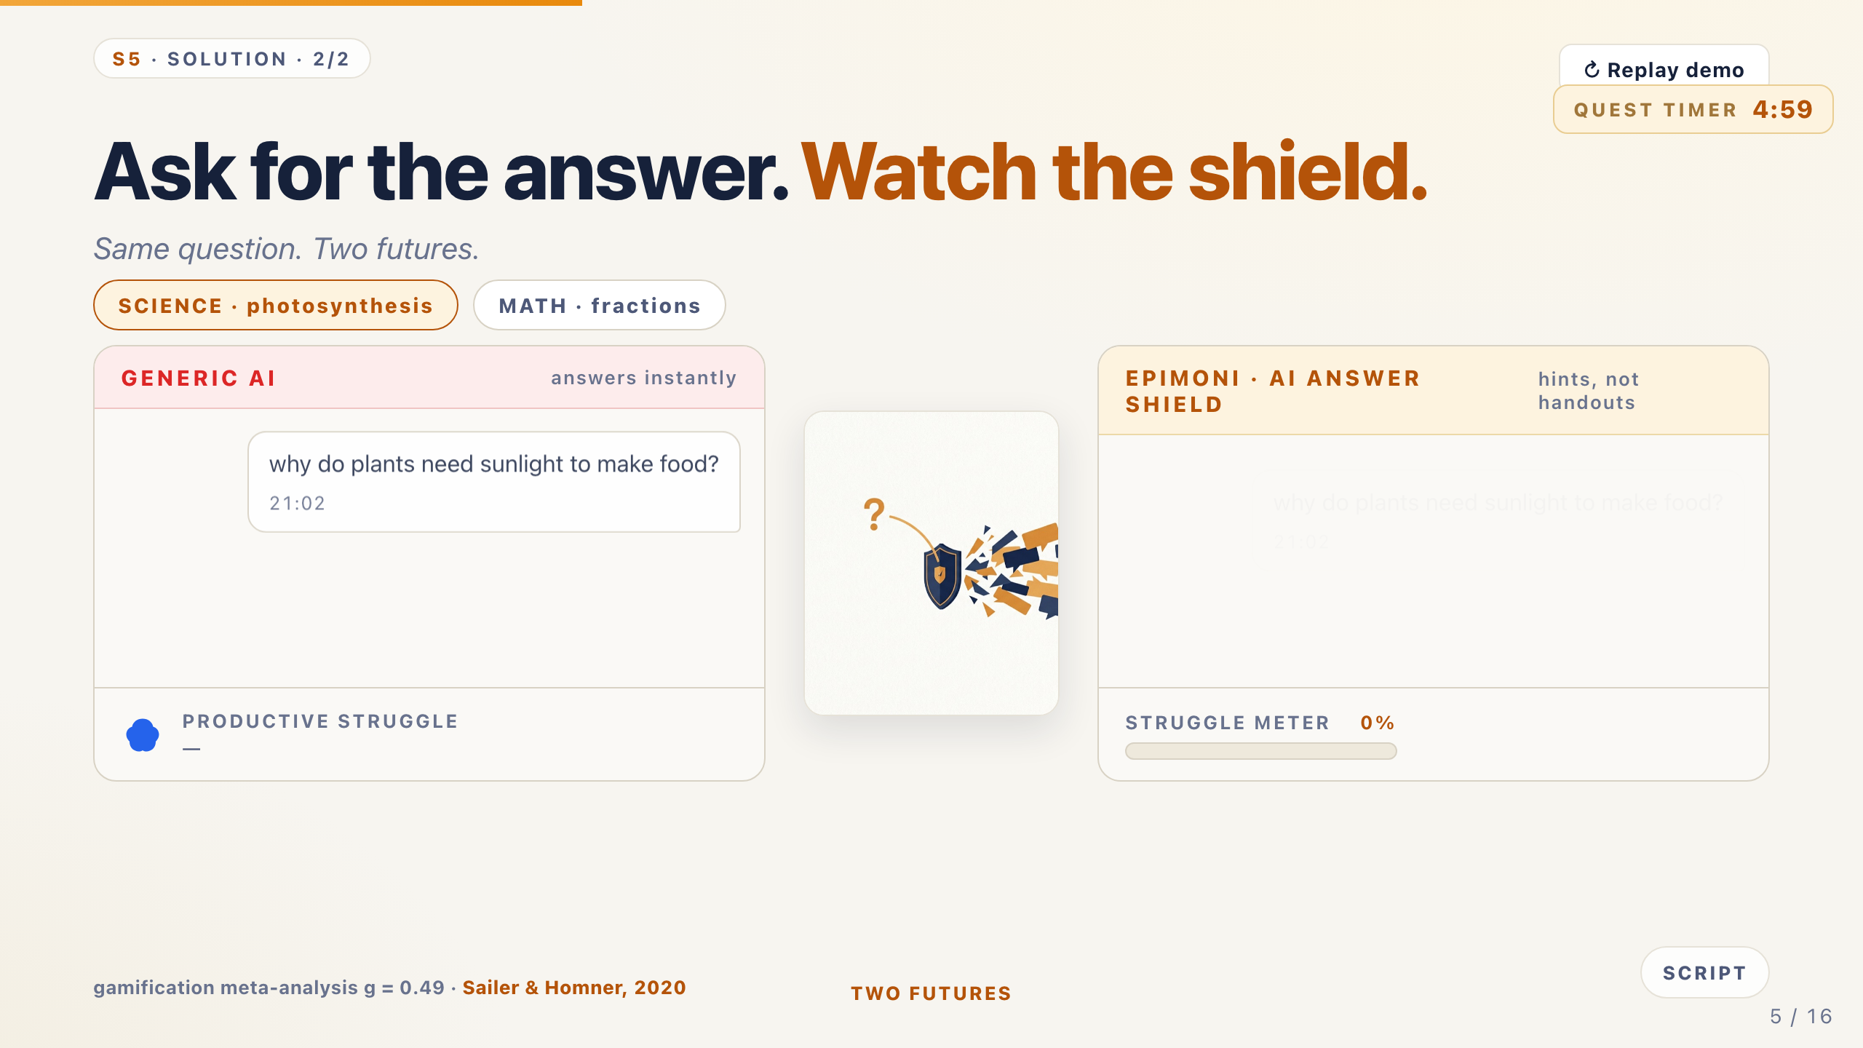
Notes:
S5 · SOLUTION 2/2 — Ask for the answer. Watch the shield.
Speaker: GM · 1:35
Cue: Same question, two windows. Let the chat play. MATH tab top-left if a judge asks about other subjects.
Do not take my word for it. Same question. Two futures.
Left: generic AI — full answer in under a second. Struggle skipped. Learning unverified.
Right: Epimoni. He begs for the answer. The Shield gives a hint, then a guiding question — never the answer.
He tries again and gets it himself. The reward is for the struggle, not the click.
Below: rep, XP, character, gear, tomorrow's quest — his level is his learning.
Tip: Longest slide. Math tab: student guesses 2/5 — the shield catches the wrong idea, not just the wrong answer.

Slide 6
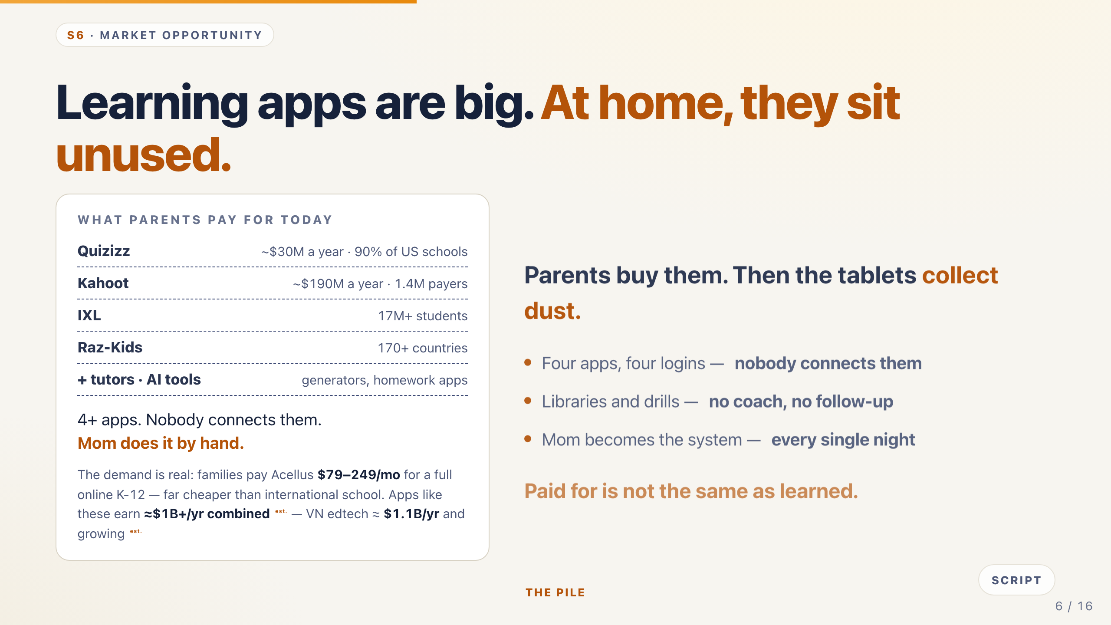
Notes:
S6 · MARKET OPPORTUNITY — Learning apps are big. At home, they sit unused.
Speaker: TC · 0:45
Cue: Every number is an estimate — say so. The point is paid for ≠ learned.
Now the market. Learning apps are big business. Quizizz earns about thirty million dollars a year. Kahoot, about a hundred ninety million. IXL has seventeen million students.
Together with tutors and AI tools — more than a billion dollars a year.
But at home, the tablets collect dust. Four apps, four logins, nobody connecting them. Mom becomes the system, every night.
Paid for is not the same as learned.
Tip: Scores Market Opportunity. If asked for sources: company reports and public user counts, labeled est.

Slide 7
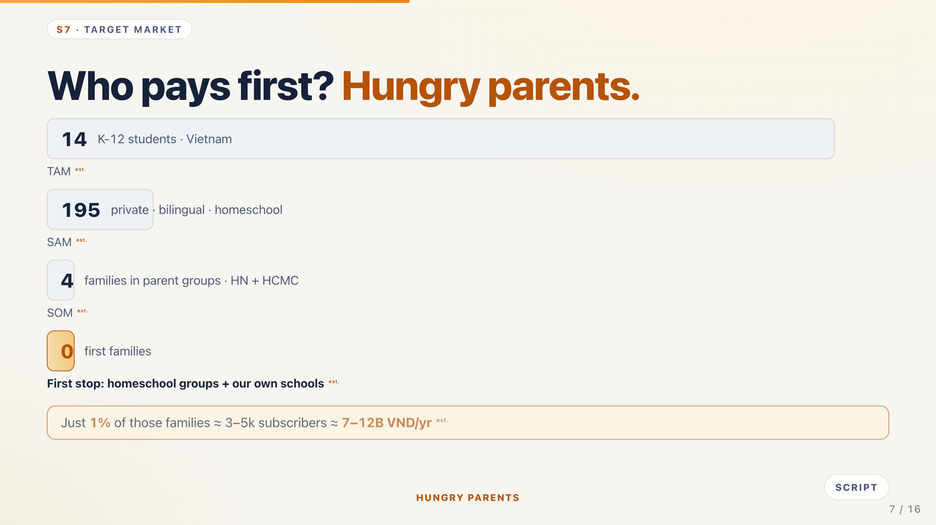
Notes:
S7 · TARGET MARKET — Who pays first.
Speaker: TC · 0:50
Cue: Walk the funnel top to bottom. Numbers labeled est.
So who pays first? Hungry parents.
[walk funnel] Sixteen million K-12 students. Private, bilingual, homeschool — three to five hundred thousand. Parent groups — twenty to fifty thousand. First stop: one to two hundred families.
If one in a hundred joins: three to five thousand subscribers, seven to twelve billion dong a year. Estimated.
Vietnamese families already spend a fifth of their income on education — the highest in the region.
Tip: TAM/SAM/SOM: say the plain words first — everyone, our kind of families, families we can actually reach.

Slide 8
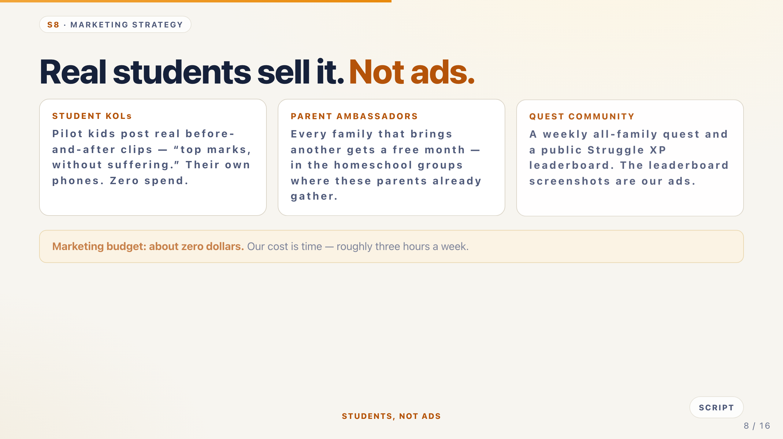
Notes:
S8 · MARKETING STRATEGY — Real students sell it. Not ads.
Speaker: TC · 0:50
Cue: Three channels, zero ad spend. This is a scored section — say the budget line clearly.
How do we reach them without ads? Students.
One: our pilot kids are the influencers — real before-and-after clips, top marks without suffering. Not actors.
Two: parent ambassadors. Bring another family, get a free month — inside the homeschool groups where parents already talk.
Three: a weekly community quest and a public leaderboard. The screenshots are our marketing.
Marketing budget: about zero dollars. Our cost is time — three hours a week.
Tip: Judges like this: real users as KOLs beats paid ads for trust in this segment.

Slide 9
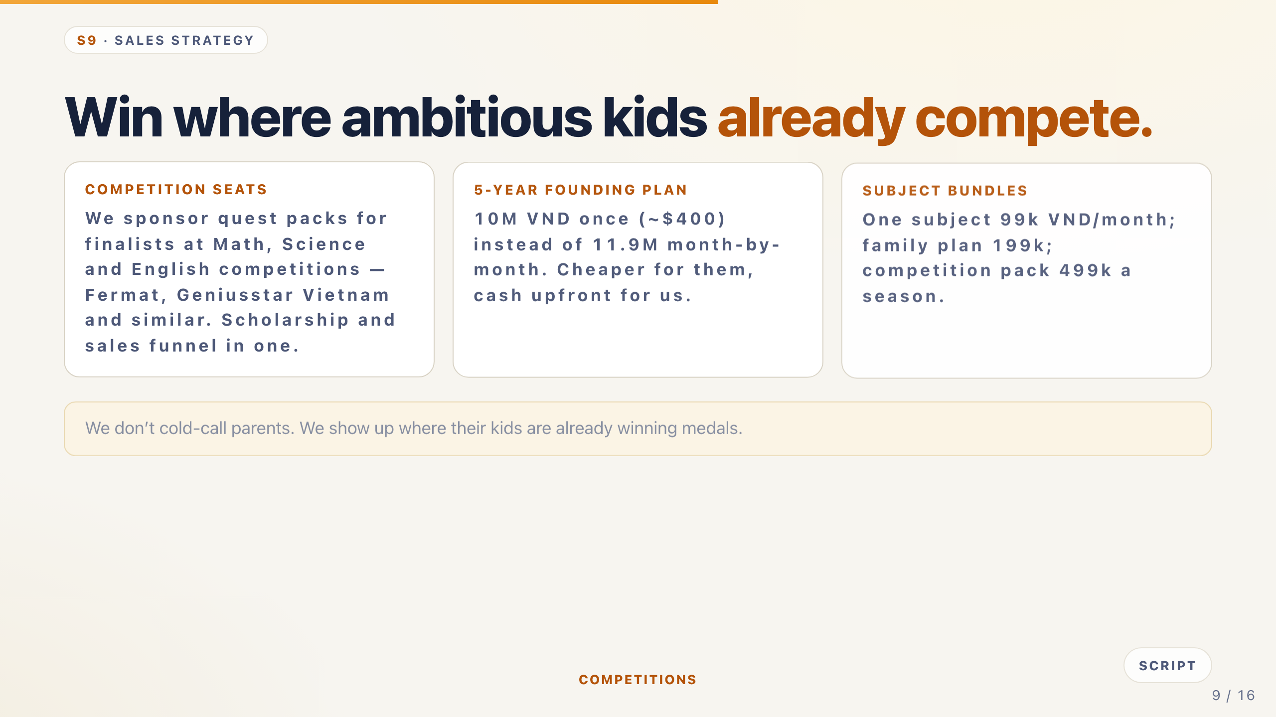
Notes:
S9 · SALES STRATEGY — Win where ambitious kids already compete.
Speaker: LH · 0:55
Cue: Three motions: competition seats, 5-year plan, bundles. Deliver the pricing clearly.
We sell where ambitious kids already are: competitions.
We sponsor quest packs for finalists at Math, Science and English competitions — Fermat, Geniusstar Vietnam and similar. A scholarship and a sales funnel in one.
Then the five-year founding plan: ten million dong once — about four hundred dollars — instead of paying month by month.
Bundles: one subject ninety-nine thousand a month; family plan a hundred ninety-nine.
Tip: If asked about Fermat/Geniusstar: we sponsor seats with them, we do not run the competitions.

Slide 10
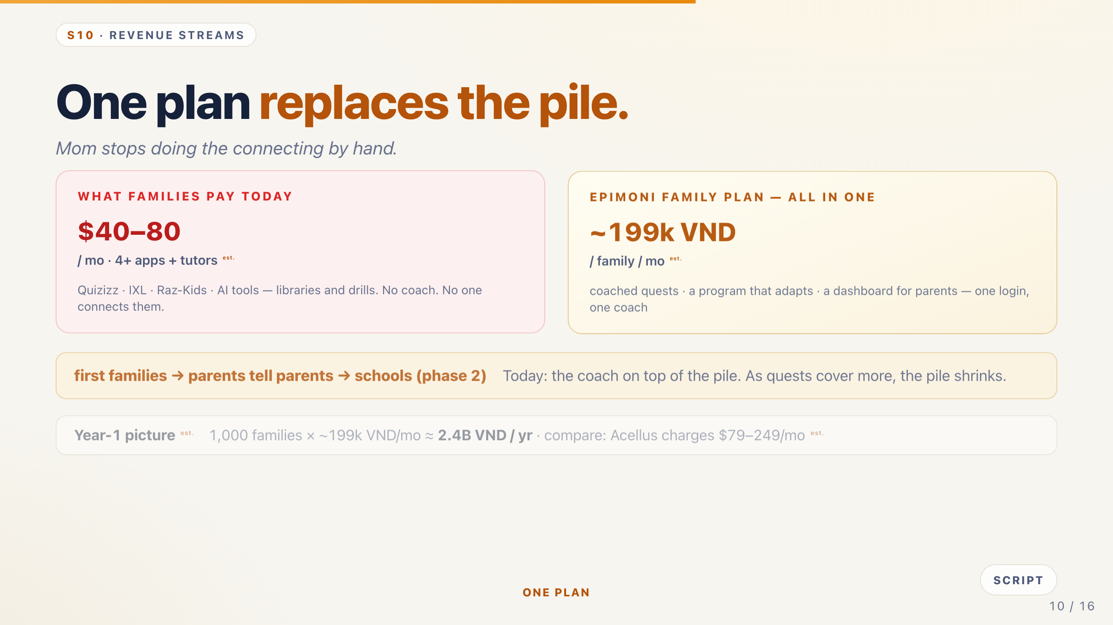
Notes:
S10 · REVENUE STREAMS — One plan replaces the pile.
Speaker: LH · 0:50
Cue: Deliver the stack math cold — this is a scored section.
Today a family pays forty to eighty dollars a month across four or more apps — and Mom connects it by hand.
Epimoni is one family plan: about a hundred ninety-nine thousand VND a month. Every subject, every kid, one login.
One quest costs us a few cents of AI. That is why the price works.
Year one: a thousand families is about two point four billion dong. Estimated.
Tip: Expect "replace IXL? you are four students" — we connect the pile instead of out-writing it.

Slide 11
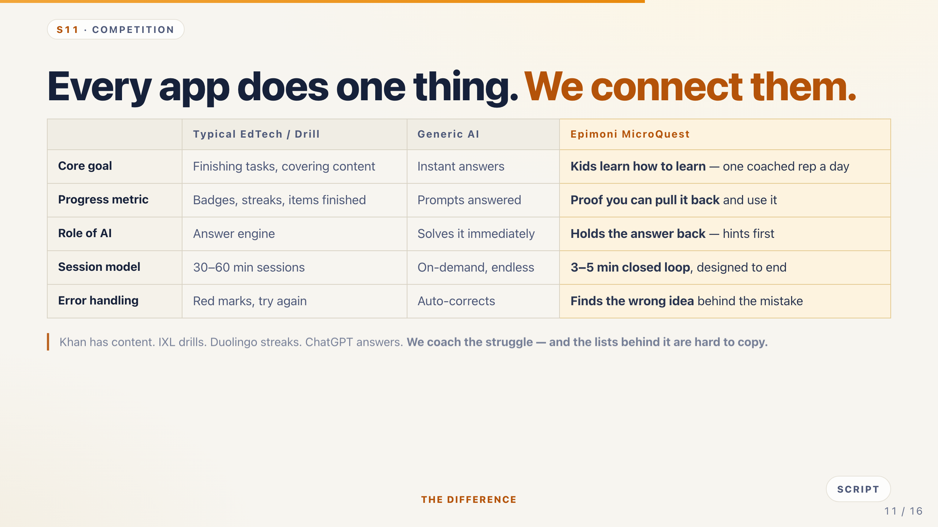
Notes:
S11 · COMPETITION — We connect the pile — we do not out-content it.
Speaker: GM · 0:45
Cue: Read the table down the rows. The last row is the honest one — say it with confidence.
Khan has the lessons — we coach the struggle through them. IXL drills what you know — we fix why you are stuck. Duolingo rewards showing up — we reward thinking hard. ChatGPT hands over the answer — we hand the next hint.
And if a big company copies the code? The hard part is not code — it is our teacher-checked lists of wrong ideas, and our pilot proof.
Tip: Scores Competition. Keep the table short — one line per rival.

Slide 12
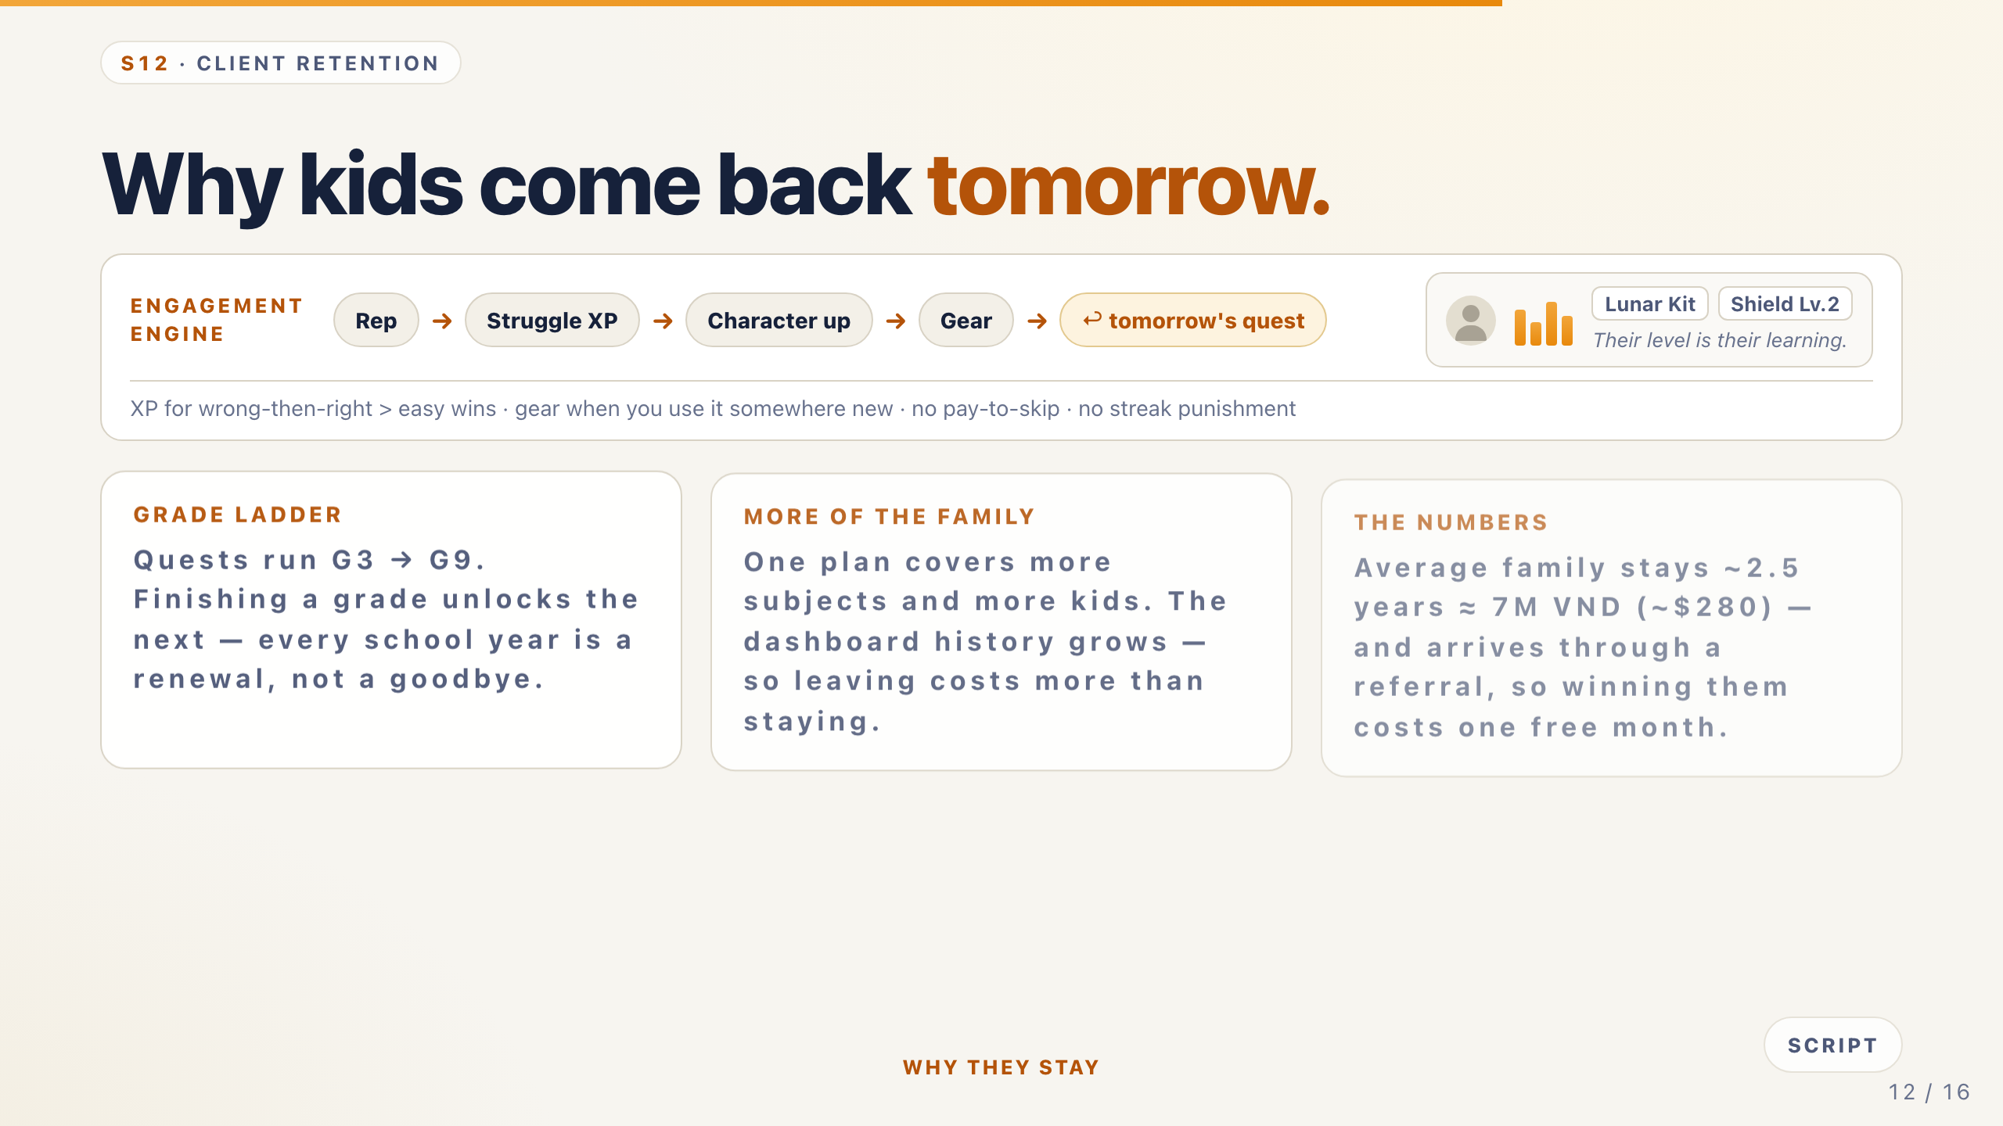
Notes:
S12 · CLIENT RETENTION — Why kids come back tomorrow.
Speaker: GM · 0:45
Cue: Left: the come-back loop. Right: the three retention facts. This is a scored section.
The loop: one rep, Struggle XP, character, gear — and tomorrow's quest. No pay-to-skip, no streak punishment. Kids come back because it ends.
Quests run Grade 3 to Grade 9 — finishing a grade unlocks the next. Every school year is a renewal, not a goodbye.
One plan covers more subjects and more kids. The average family stays two and a half years — seven million dong — and arrives through a referral.
Tip: If asked about churn: the dashboard history and siblings raise the cost of leaving.

Slide 13
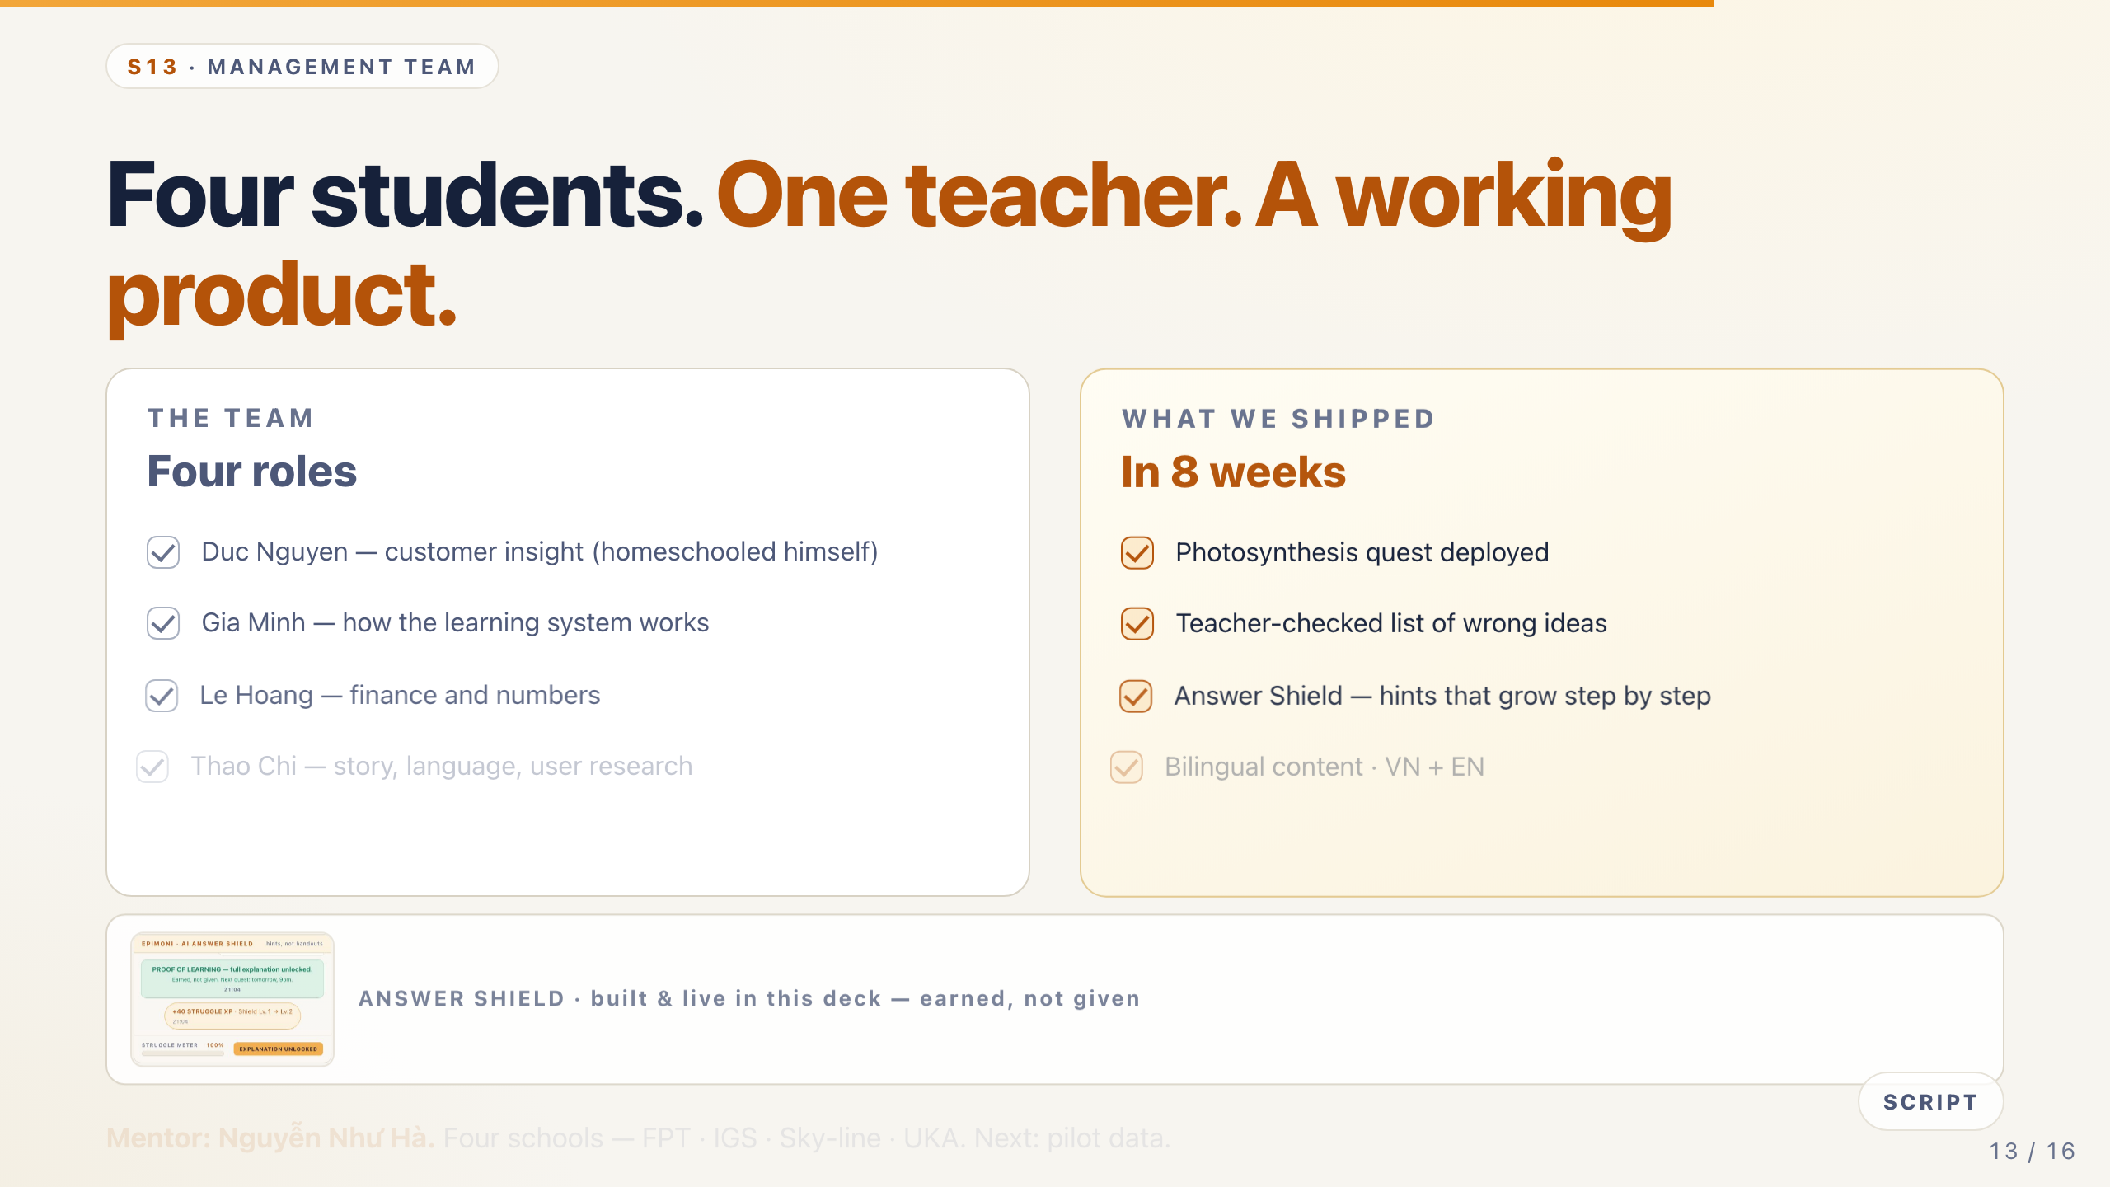
Notes:
S13 · MANAGEMENT TEAM — Four students. One teacher. A working product.
Speaker: ALL · 0:40
Cue: Four names, four roles, one mentor — then point at the real screenshot.
Who are we? Four students, four schools, one teacher.
Duc Nguyen — customer insight; he is homeschooled himself. Gia Minh — how the learning system works. Le Hoang — finance. Thao Chi — story and user research.
Mentor: Nguyễn Như Hà. In eight weeks we shipped a live quest, teacher-checked wrong-idea lists, the Answer Shield, and a pilot plan.
Round one was a design. Round two is a product.
Tip: Scores Team. Say the mentor name clearly — credibility for a student team.

Slide 14
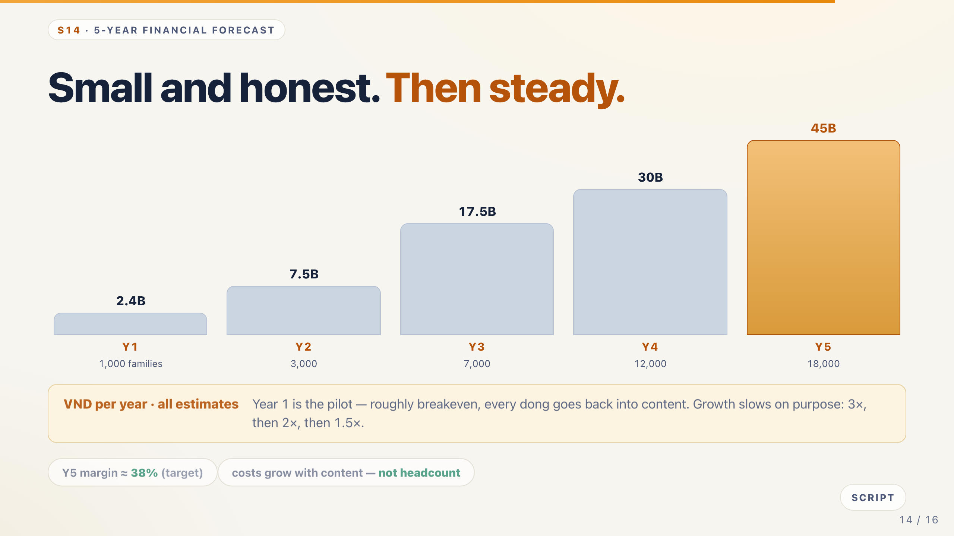
Notes:
S14 · 5-YEAR FORECAST — Small and honest. Then steady.
Speaker: LH · 0:50
Cue: Walk the bars left to right. Say "estimates" out loud.
Our five-year forecast is small and honest.
Year one is the pilot: one thousand families, about two point four billion dong — roughly breakeven, because every dong goes back into content.
Then three thousand families, seven thousand, twelve thousand, eighteen thousand — about forty-five billion dong by year five. Growth slows on purpose; we are four students.
Costs grow with content, not headcount.
Tip: All figures estimates. If challenged: pilot data this term will replace these assumptions.

Slide 15
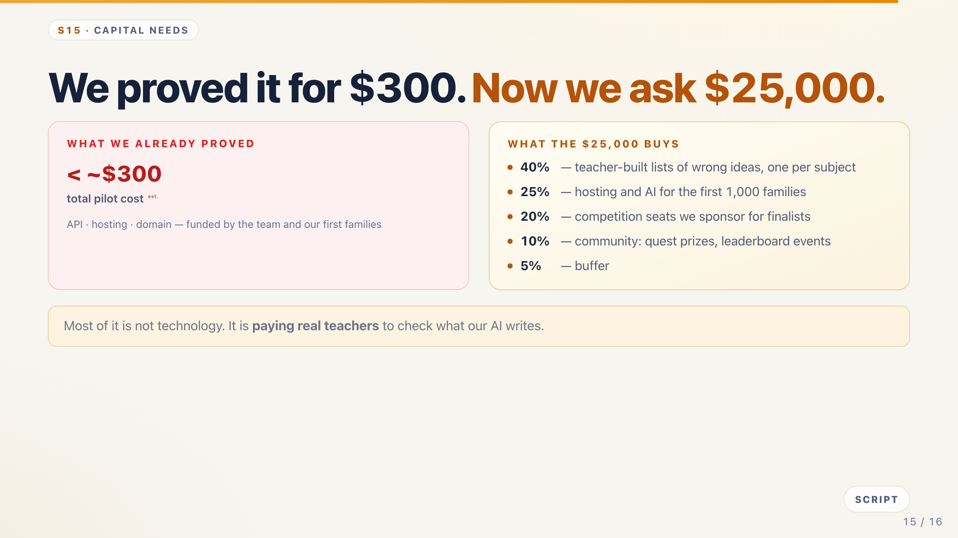
Notes:
S15 · CAPITAL NEEDS — We proved it for $300. Now we ask $25,000.
Speaker: LH · 0:45
Cue: Left: what we proved. Right: the ask and the split. Most of it is not tech — land that.
Our whole pilot cost under three hundred dollars — this deck is the proof.
We are asking for twenty-five thousand dollars — twelve to eighteen months of runway.
Forty percent pays teachers to build the wrong-idea lists. Twenty-five percent covers hosting and AI. Twenty percent sponsors competition seats. Ten percent builds the community. Five percent is buffer.
Most of it is not technology — it is paying teachers to check what our AI writes.
Tip: Scores Capital Needs. If asked "why so little": we are four students with zero salaries.

Slide 16
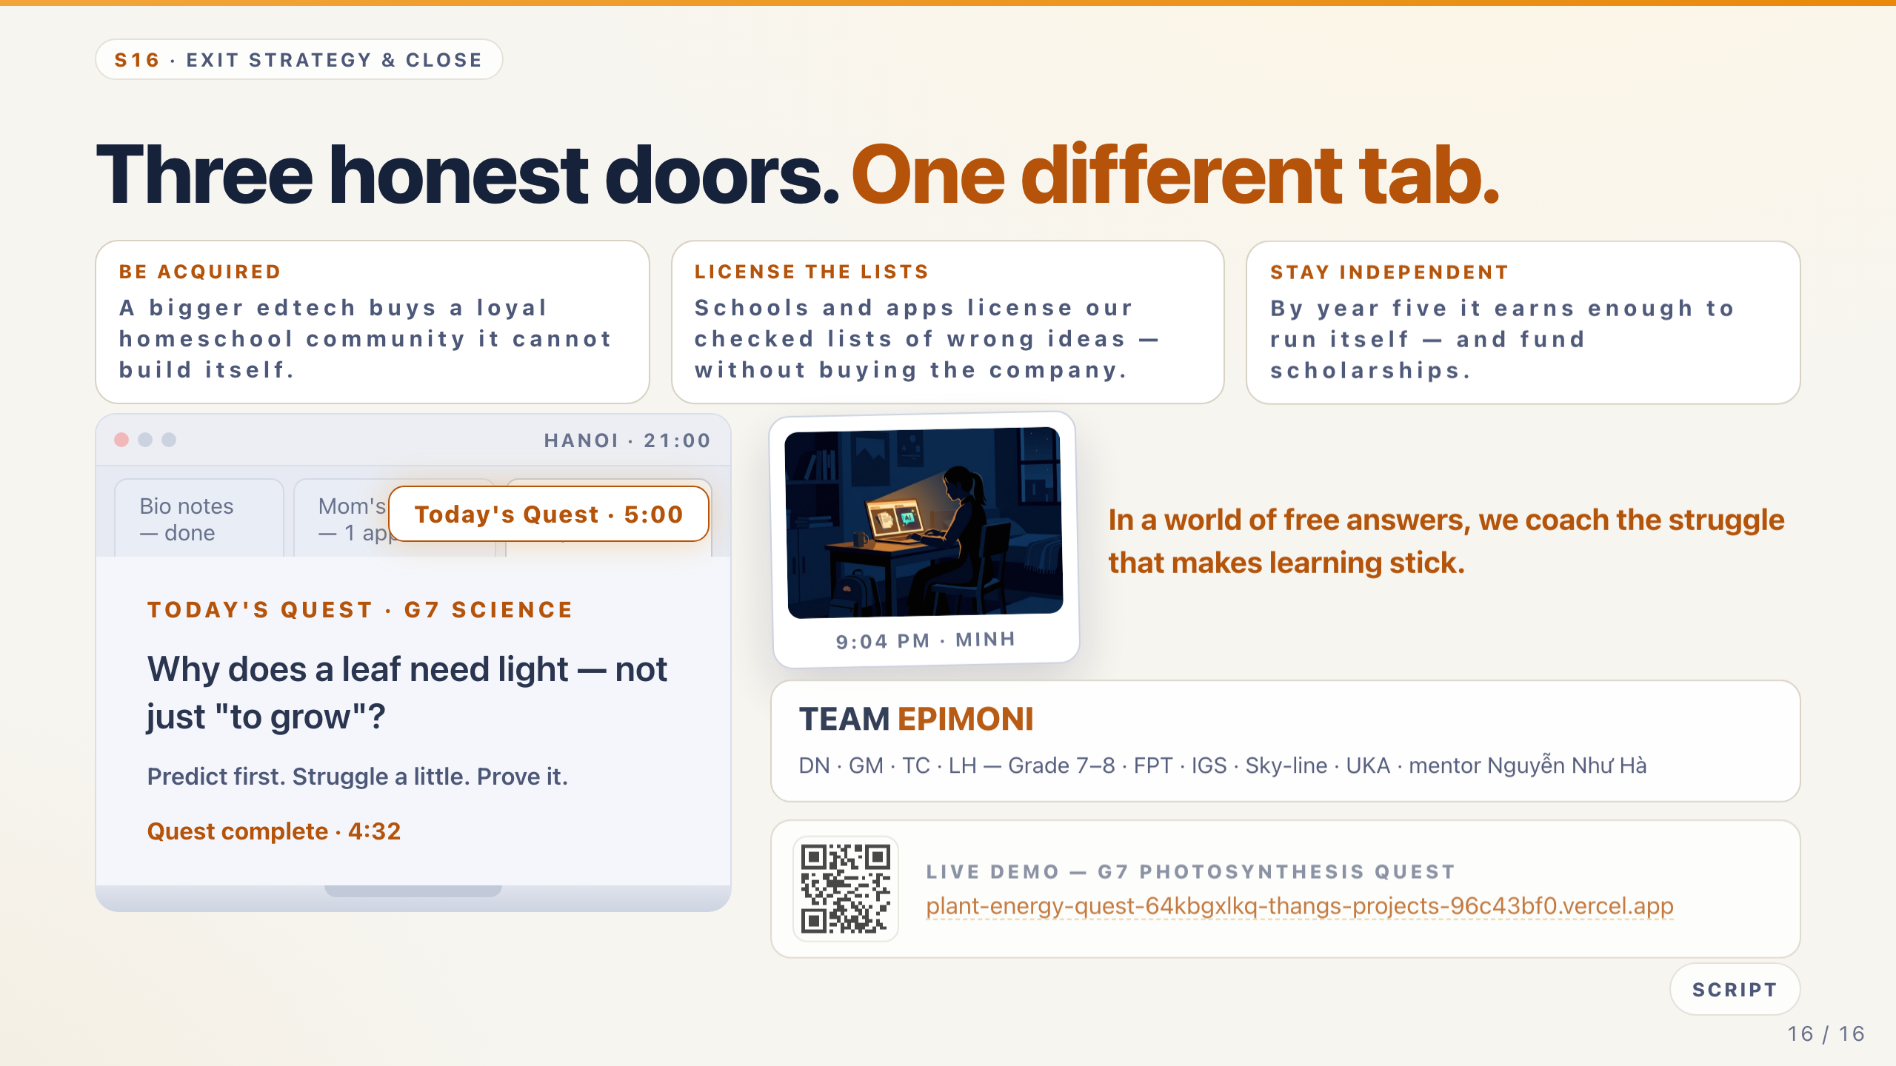
Notes:
S16 · EXIT & CLOSE — Three honest doors — and one different tab.
Speaker: DN · 0:40
Cue: Three doors, then the callback — hold the callback no matter the clock.
We are not promising a unicorn. Three honest doors.
A bigger edtech could buy our community. Schools could license our wrong-idea lists. Or we keep it — by year five it runs itself.
Remember Minh? Tonight he opens a different tab — one that hands him a quest, not answers. And Mom keeps one app, not four.
In a world of free answers, we coach the struggle that makes learning stick. Thank you — questions welcome.
Tip: Designated compress slide if the clock runs long — keep the callback and the spine line.

