Slide 1

Pi Gate
Pied Piper Program
7th March 2018
DucThang, Nguyen
@thangndu

Slide 2
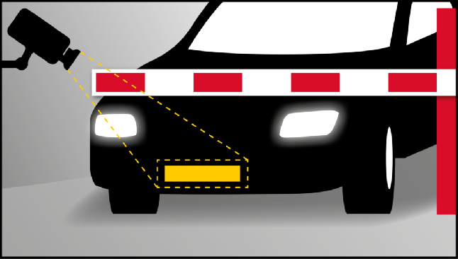
Pi Gate System
Automated Gate System (Pi Gate)
Automatic detect plate number
Automatic display plate number
Automatic/manual gate control
Automatic alarm system (Light and Sound)
Access gate system dashboard anywhere
Github repository
https://github.com/thangndu/pigate
Notes:
Mention the Digital and IT Transformation: Modernize, AUTOMATE, Transform

Slide 3
Bill of Materials
ITEM | QUANTITY
Raspberry PI 3 Model B | 1
Raspberry PI Camera V2 | 1
Distance Sensor | 1
Step Motor (Micro Servo SG90) | 1
LCD 1602 + I2C Interface Module | 1
Speaker | 1
LED Module | 1
Buzzer Module | 1
Button Module | 1
Notes:
Mention the Digital and IT Transformation: Modernize, AUTOMATE, Transform

Slide 4
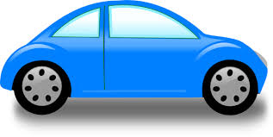
System Architecture
AWS Lambda
AWS Polly
AWS S3
AWS Rekognition
Location
API
Bootstrap
(Raspberry Pi)
Speaker
(Audio streaming)
Distance Sensor
(Car detection)
Camera
(Plate capture)
(Laptop)
(PWS)
Boto3
(Plate recognition)
Flask
(Gate dashboard)
LED and Buzzer
(Alarm)
LCD
(Display)
MQTT Broker
Redis
Button
(Person control)
Step Motor
(Gate controller)
Notes:
Mention the Digital and IT Transformation: Modernize, AUTOMATE, Transform

Slide 5
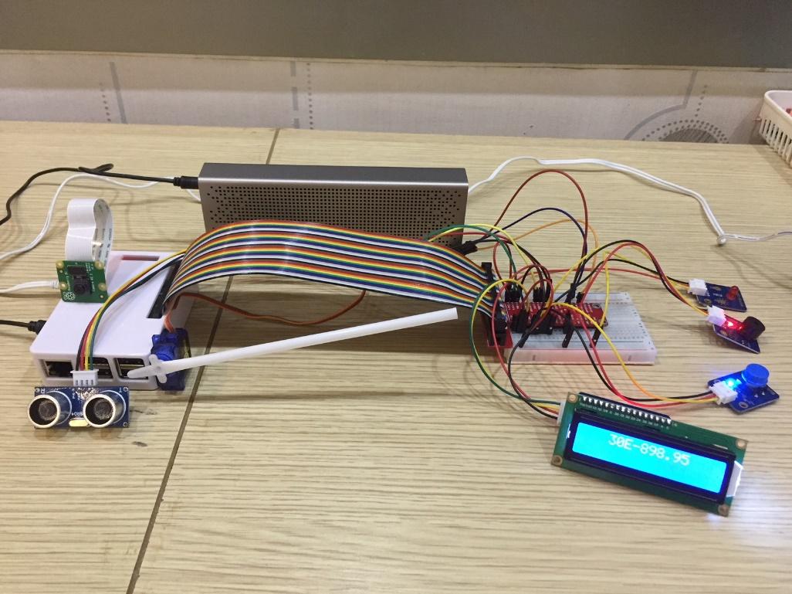
Pi Gate
Speaker
Led & Buzzer
Camera
Button
Gate
Distance
Sensor
Display

Slide 6
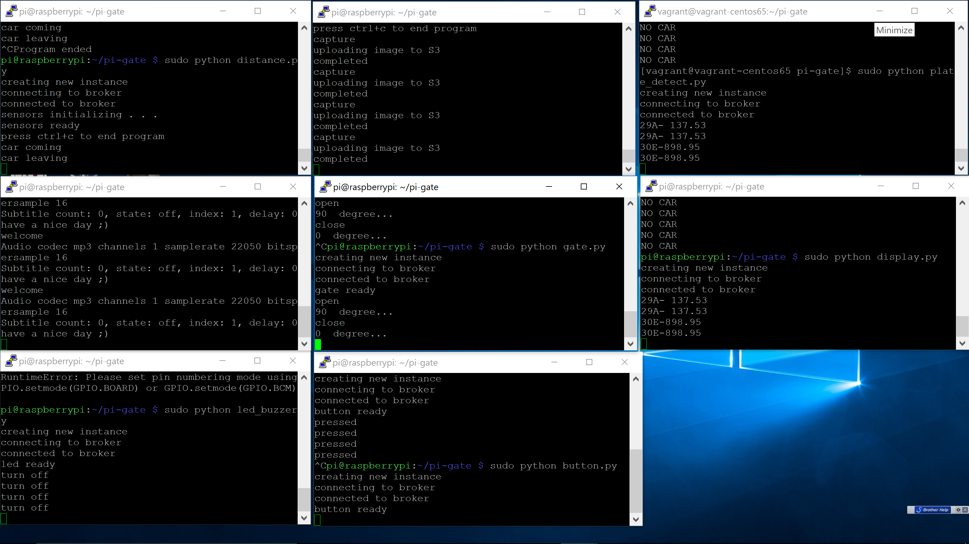
Command Center
Capture
plate number
Detect
plate number
Detect car
Display
plate number
Speaker
Gate
Led & Buzzer
Button
Notes:
Mention the Digital and IT Transformation: Modernize, AUTOMATE, Transform

Slide 7
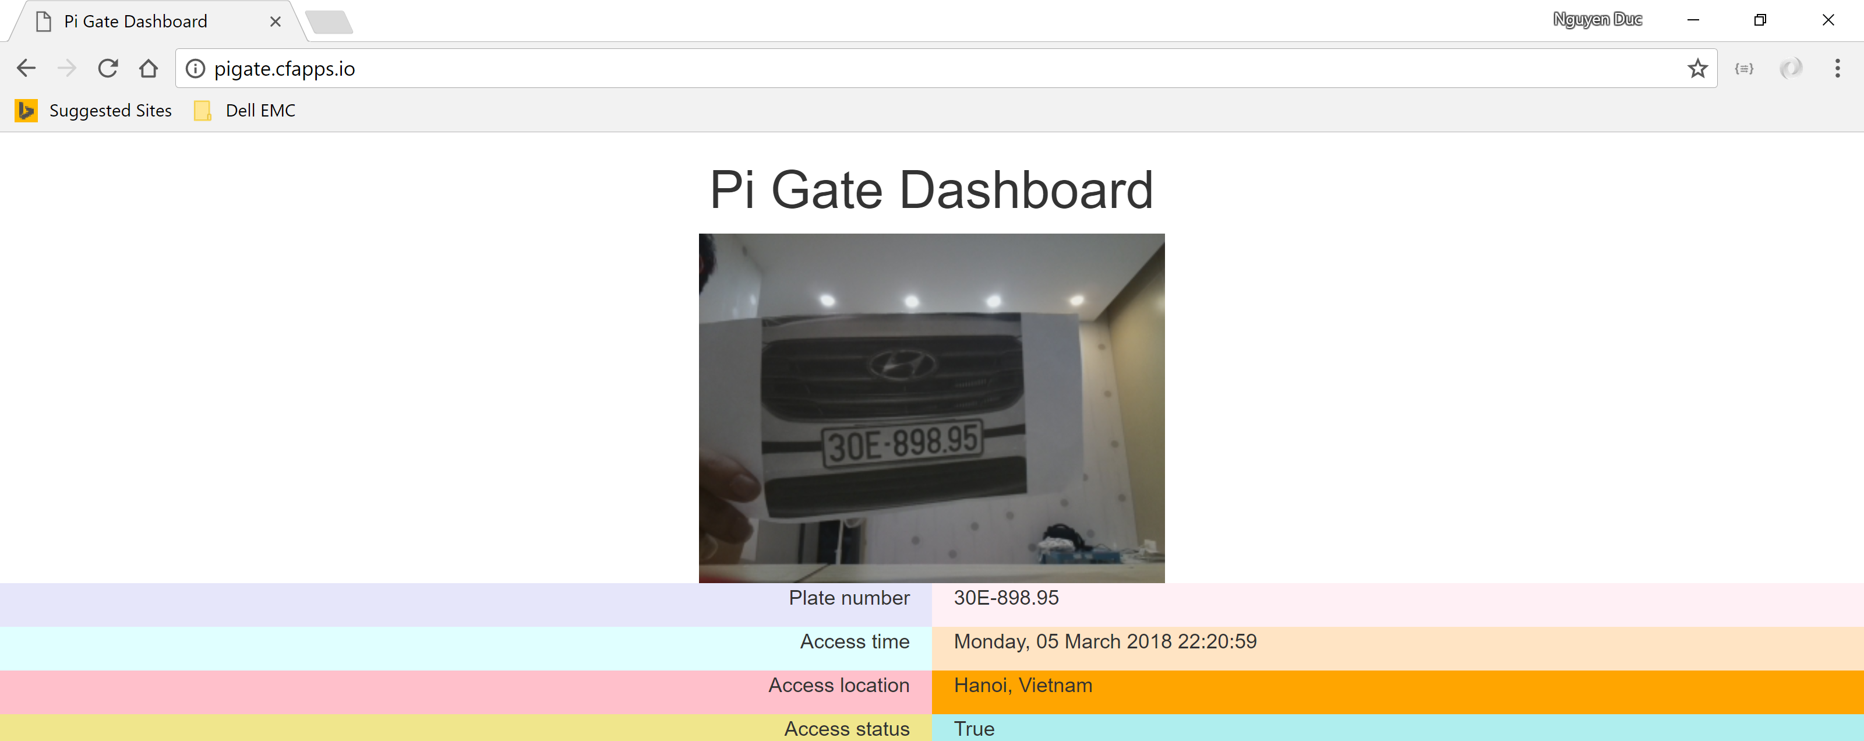
Dashboard (piper.cfapps.io)

Slide 8
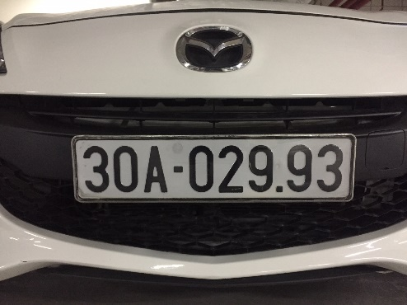
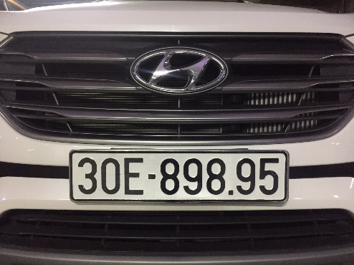
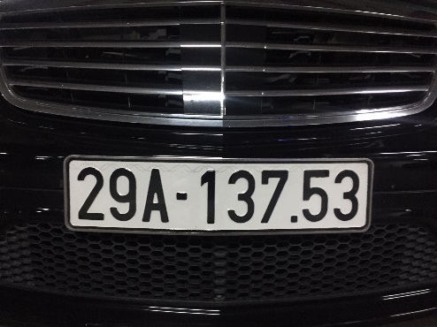
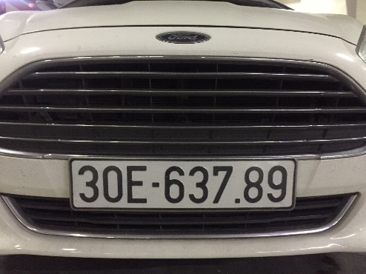
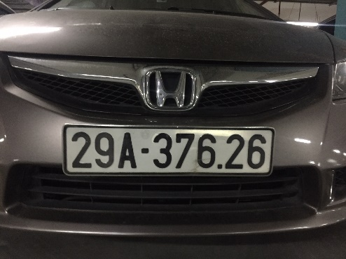
Demo
Registered
plate number
Un-registered
plate number
Notes:
Mention the Digital and IT Transformation: Modernize, AUTOMATE, Transform

