Slide 1

Data Storage, Indexing Structures for Files
Chapter 6

Slide 2

Overview of Database Design Process
Miniworld
REQUIREMENTS - COLLECTION & ANALYSIS
Functional requirements
Data requirements
FUNCTIONAL ANALYSIS
CONCEPTUAL DESIGN
DBMS–independent
High-level transaction specification
Conceptual schema
LOGICAL DESIGN
(DATA MODEL MAPPING)
APPLICATION PROGRAM DESIGN
Database schema
DBMS–specific
PHYSICAL DESIGN
TRANSACTION IMPLEMENTATION
Internal schema
Application program
Application Design
Database Design

Slide 3
Contents
1 | Data Storage
1.1 | Disk Storage Devices
1.2 | Files of Records
1.3 | Operations on Files
1.4 | Unordered Files & Ordered Files & Hashed Files
1.5 | RAID Technology and Storage Area Networks
2 | Indexing Structures for Files
2.1 | Types of Single-level Ordered Indexes
2.2 | Multilevel Indexes
2.3 | Dynamic Multilevel Indexes Using B-Trees and B+-Trees

Slide 4
Contents
1 | Data Storage
1.1 | Disk Storage Devices
1.2 | Files of Records
1.3 | Operations on Files
1.4 | Unordered Files & Ordered Files & Hashed Files
1.5 | RAID Technology and Storage Area Networks
2 | Indexing Structures for Files
2.1 | Types of Single-level Ordered Indexes
2.2 | Multilevel Indexes
2.3 | Dynamic Multilevel Indexes Using B-Trees and B+-Trees

Slide 5
Disk Storage Devices
Preferred secondary storage device for high storage capacity and low cost.
Data stored as magnetized areas on magnetic disk surfaces.
A disk pack contains several magnetic disks connected to a rotating spindle.
Disks are divided into concentric circular tracks on each disk surface .
  Track capacities vary typically from 4 to 50 Kbytes.

Slide 6
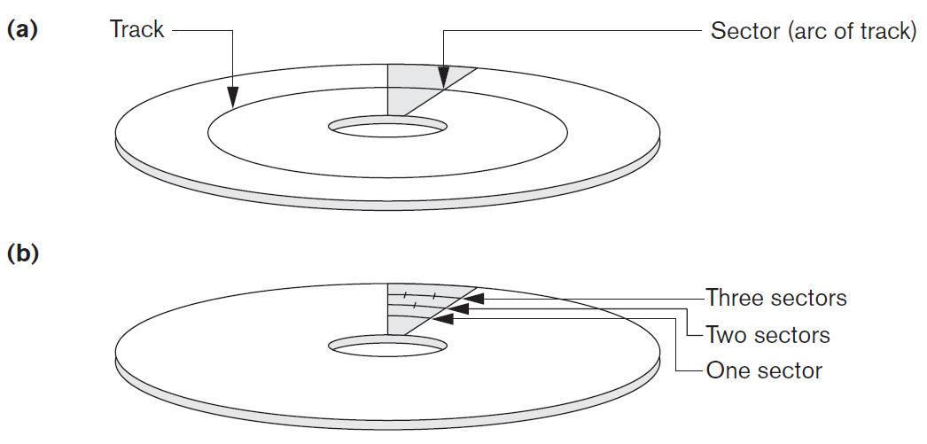
Disk Storage Devices (cont.)

Slide 7
Disk Storage Devices (cont.)
Track
Sector
Spindle

Slide 8
Disk Storage Devices (cont.)
A track is divided into smaller blocks or sectors.
  because a track usually contains a large amount of information .
A track is divided into blocks.
  The block size B is fixed for each system.
    Typical block sizes range from B=512 bytes to B=4096 bytes.
  Whole blocks are transferred between disk and main memory for processing.

Slide 9
Disk Storage Devices (cont.)
A read-write head moves to the track that contains the block to be transferred.
  Disk rotation moves the block under the read-write head for reading or writing.
A physical disk block (hardware) address consists of:
  a cylinder number (imaginary collection of tracks of same radius from all recorded surfaces)
  the track number or surface number (within the cylinder)
  and block number (within track).
Reading or writing a disk block is time consuming because of the seek time s and rotational delay (latency) rd.
Double buffering can be used to speed up the transfer of contiguous disk blocks.

Slide 10
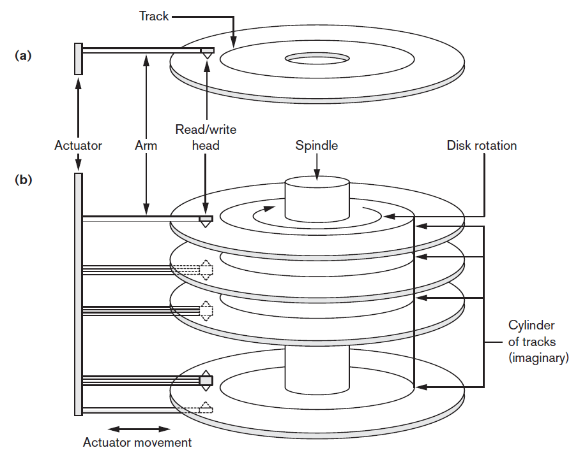
Disk storage devices (cont.)

Slide 11
Contents
1 | Data Storage
1.1 | Disk Storage Devices
1.2 | Files of Records
1.3 | Operations on Files
1.4 | Unordered Files & Ordered Files & Hashed Files
1.5 | RAID Technology and Storage Area Networks
2 | Indexing Structures for Files
2.1 | Types of Single-level Ordered Indexes
2.2 | Multilevel Indexes
2.3 | Dynamic Multilevel Indexes Using B-Trees and B+-Trees

Slide 12
Records
Fixed and variable length records.
Records contain fields which have values of a particular type.
  E.g., amount, date, time, age.
Fields themselves may be fixed length or variable length.
Variable length fields can be mixed into one record:
  Separator characters or length fields are needed so that the record can be “parsed”.

Slide 13
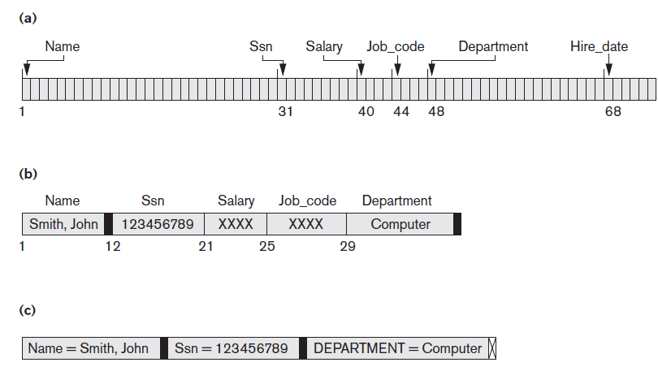
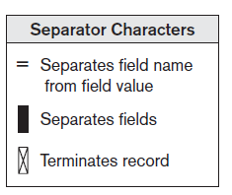
Records (cont.)
A fixed-length record with 6 fields and size of 71 bytes.
A record with 2 variable-length fields and 3 fixed-length fields.
A variable-field record with 3 types of separator characters.

Slide 14
Blocking
Blocking: refers to storing a number of records in one block on the disk.
Blocking factor (bfr): refers to the number of records per block.
There may be empty space in a block if an integral number of records do not fit in one block.
Spanned Records: refer to records that exceed the size of one or more blocks and hence span a number of blocks.

Slide 15
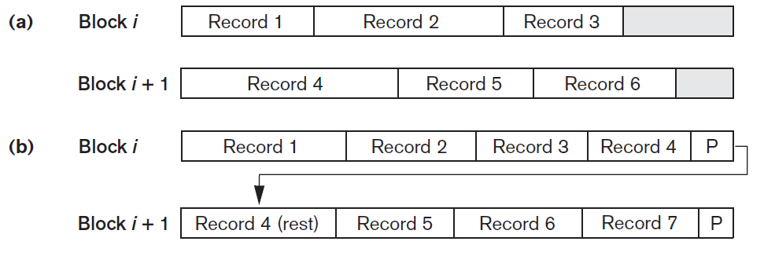
Blocking (cont.)
Unspanned records
Spanned records

Slide 16
Files of Records
A file is a sequence of records, where each record is a collection of data values (or data items).
A file descriptor (or file header) includes information that describes the file, such as the field names and their data types, and the addresses of the file blocks on disk.
Records are stored on disk blocks.
The blocking factor bfr for a file is the (average) number of file records stored in a disk block.
A file can have fixed-length records or variable-length records.

Slide 17
Files of Records (cont.)
File records can be unspanned or spanned:
  Unspanned: no record can span two blocks
  Spanned: a record can be stored in more than one block
The physical disk blocks that are allocated to hold the records of a file can be contiguous, linked, or indexed.
In a file of fixed-length records, all records have the same format. Usually, unspanned blocking is used with such files.
Files of variable-length records require additional information to be stored in each record, such as separator characters and field types.
  Usually spanned blocking is used with such files.

Slide 18
Contents
1 | Data Storage
1.1 | Disk Storage Devices
1.2 | Files of Records
1.3 | Operations on Files
1.4 | Unordered Files & Ordered Files & Hashed Files
1.5 | RAID Technology and Storage Area Networks
2 | Indexing Structures for Files
2.1 | Types of Single-level Ordered Indexes
2.2 | Multilevel Indexes
2.3 | Dynamic Multilevel Indexes Using B-Trees and B+-Trees

Slide 19
Operation on Files
OPEN: Reads the file for access, and associates a pointer that will refer to a current file record at each point in time.
FIND: Searches for the first file record that satisfies a certain condition, and makes it the current file record.
FINDNEXT: Searches for the next file record (from the current record) that satisfies a certain condition, and makes it the current file record.
READ: Reads the current file record into a program variable.
INSERT: Inserts a new record into the file, and makes it the current file record.

Slide 20
Operation on Files (cont.)
DELETE: Removes the current file record from the file, usually by marking the record to indicate that it is no longer valid.
MODIFY: Changes the values of some fields of the current file record.
CLOSE: Terminates access to the file.
REORGANIZE: Reorganizes the file records. For example, the records marked deleted are physically removed from the file or a new organization of the file records is created.
READ_ORDERED: Read the file blocks in order of a specific field of the file.

Slide 21
Contents
1 | Data Storage
1.1 | Disk Storage Devices
1.2 | Files of Records
1.3 | Operations on Files
1.4 | Unordered Files & Ordered Files & Hashed Files
1.5 | RAID Technology and Storage Area Networks
2 | Indexing Structures for Files
2.1 | Types of Single-level Ordered Indexes
2.2 | Multilevel Indexes
2.3 | Dynamic Multilevel Indexes Using B-Trees and B+-Trees

Slide 22
Unordered Files
Also called a heap or a pile file.
New records are inserted at the end of the file.
A linear search through the file records is necessary to search for a record.
  This requires reading and searching half the file blocks on the average, and is hence quite expensive.
Record insertion is quite efficient.
Reading the records in order of a particular field requires sorting the file records.

Slide 23
Ordered Files
Also called a sequential file.
File records are kept sorted by the values of an ordering field.
Insertion is expensive: records must be inserted in the correct order.
  It is common to keep a separate unordered overflow (or transaction) file for new records to improve insertion efficiency; this is periodically merged with the main ordered file.
A binary search can be used to search for a record on its ordering field value.
  This requires reading and searching log₂ of the file blocks on the average, an improvement over linear search.
Reading the records in order of the ordering field is quite efficient.

Slide 24
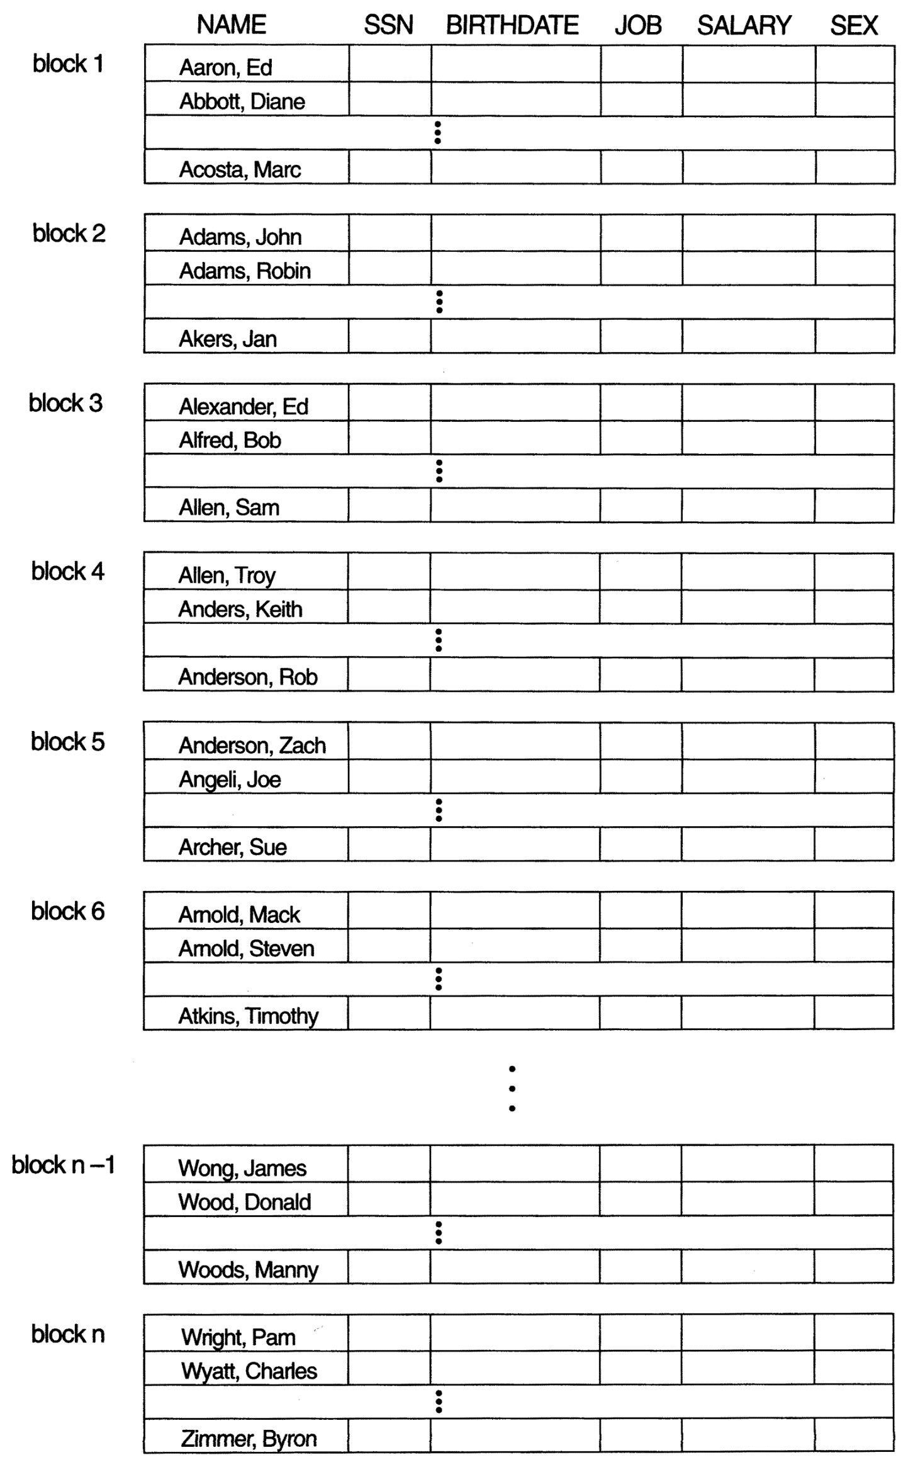
Ordered Files (cont.)

Slide 25
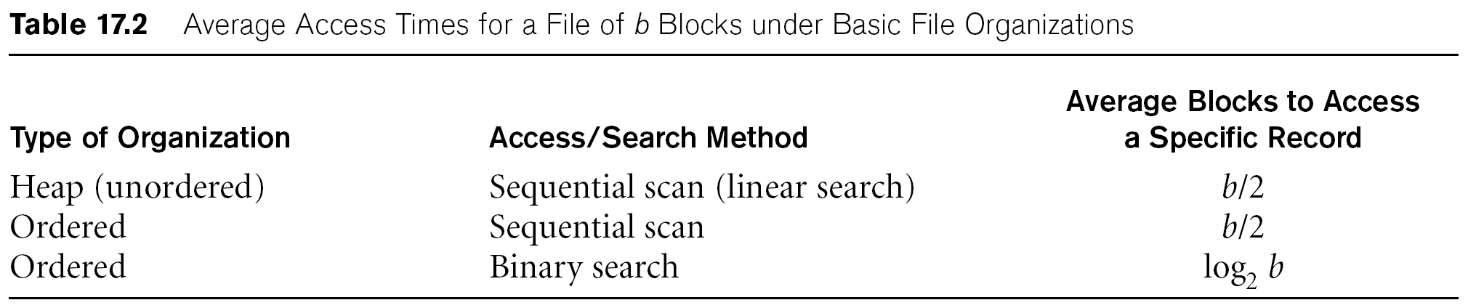
Average Access Times
The following table shows the average access time to access a specific record for a given type of file:

Slide 26
Hashed Files
Hashing for disk files is called External Hashing.
The file blocks are divided into M equal-sized buckets, numbered bucket₀, bucket₁, ..., bucket_{M-1}.
  Typically, a bucket corresponds to one (or a fixed number of) disk block.
One of the file fields is designated to be the hash key of the file.
The record with hash key value K is stored in bucket i, where i=h(K), and h is the hashing function.
Search is very efficient on the hash key.
Collisions occur when a new record hashes to a bucket that is already full.
  An overflow file is kept for storing such records.
  Overflow records that hash to each bucket can be linked together

Slide 27
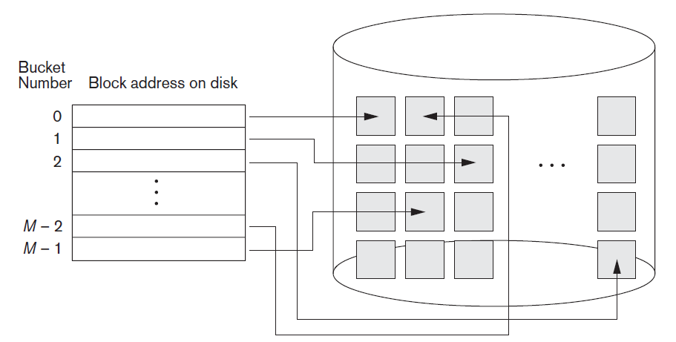
Hashed Files (cont.)

Slide 28
Hashed Files (cont.)
There are numerous methods for collision resolution, including the following:
  Open addressing: Proceeding from the occupied position specified by the hash address, the program checks the subsequent positions in order until an unused (empty) position is found.
  h(K) = K mod 7
  Insert 8
  Insert 15
  Insert 13
0 | 1 | 2 | 3 | 4 | 5 | 6
 | 1 |  | 3 | 11 |  | 6
 | 1 | 8 | 3 | 11 |  | 6
 | 1 | 8 | 3 | 11 | 15 | 6
13 | 1 | 8 | 3 | 11 | 15 | 6

Slide 29
Hashed Files (cont.)
There are numerous methods for collision resolution, including the following:
  Chaining:
    Various overflow locations are kept: extending the array with a number of overflow positions.
    A pointer field is added to each record location.
    A collision is resolved by placing the new record in an unused overflow location and setting the pointer of the occupied hash address location to the address of that overflow location.
  Multiple hashing:
    The program applies a second hash function if the first results in a collision.
    If another collision results, the program uses open addressing or applies a third hash function and then uses open addressing if necessary.

Slide 30
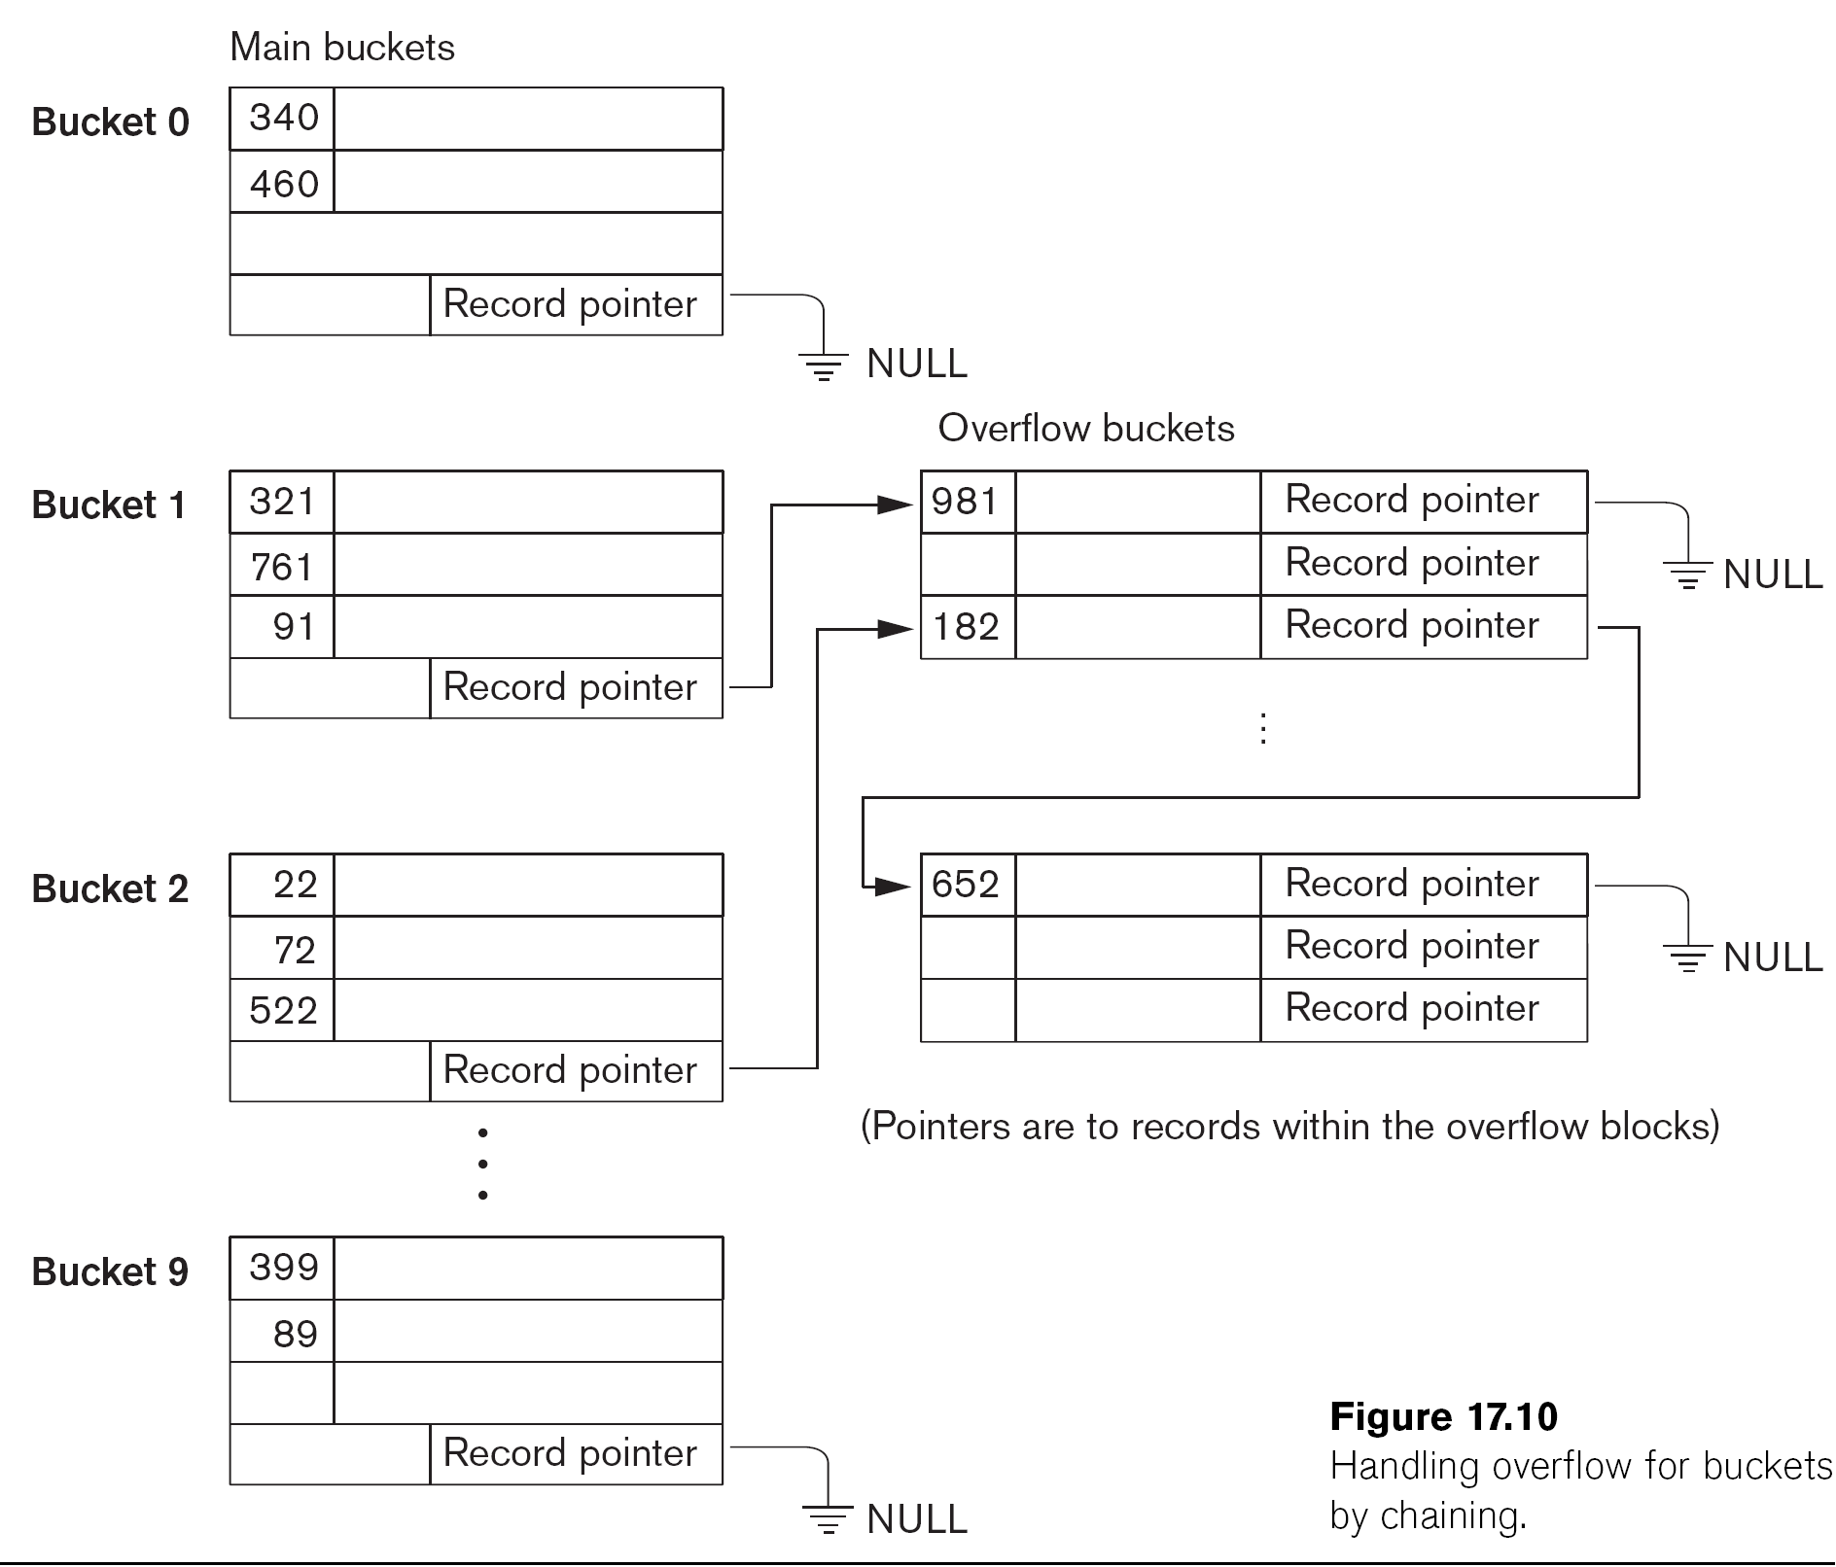
Hashed Files (cont.) - Overflow handling

Slide 31
Contents
1 | Data Storage
1.1 | Disk Storage Devices
1.2 | Files of Records
1.3 | Operations on Files
1.4 | Unordered Files & Ordered Files & Hashed Files
1.5 | RAID Technology and Storage Area Networks
2 | Indexing Structures for Files
2.1 | Types of Single-level Ordered Indexes
2.2 | Multilevel Indexes
2.3 | Dynamic Multilevel Indexes Using B-Trees and B+-Trees

Slide 32
Parallelizing Disk Access using RAID
Technology
Secondary storage technology must take steps to keep up in performance and reliability with processor technology.
A major advance in secondary storage technology is represented by the development of RAID, which originally stood for Redundant Arrays of Inexpensive Disks.
The main goal of RAID is to even out the widely different rates of performance improvement of disks against those in memory and microprocessors.

Slide 33
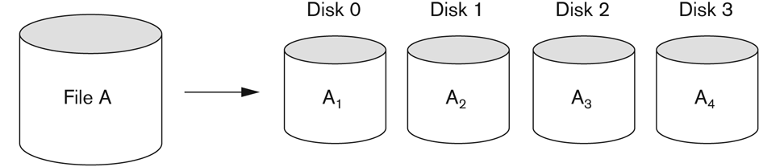
RAID Technology (cont.)
A natural solution is a large array of small independent disks acting as a single higher-performance logical disk.
A concept called data striping is used, which utilizes parallelism to improve disk performance.
Data striping distributes data transparently over multiple disks to make them appear as a single large, fast disk.

Slide 34
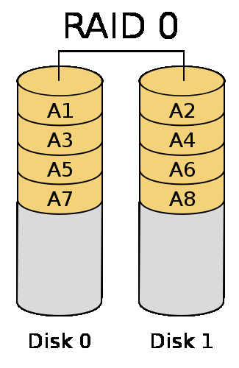
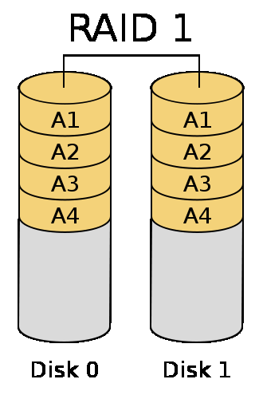
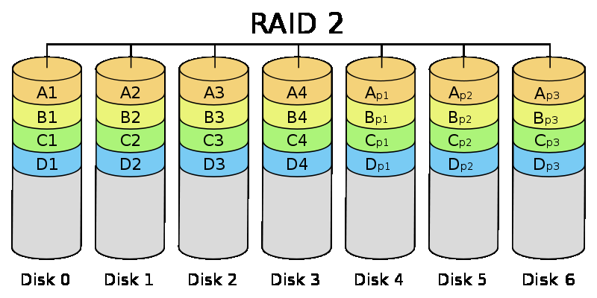
RAID Technology (cont.)
Different raid organizations were defined based on different combinations of the two factors of granularity of data interleaving (striping) and pattern used to compute redundant information.
  Raid level 0 has no redundant data and hence has the best write performance.
  Raid level 1 uses mirrored disks.
  Raid level 2 uses memory-style redundancy by using Hamming codes, which contain parity bits for distinct overlapping subsets of components. Level 2 includes both error detection and correction.

Slide 35
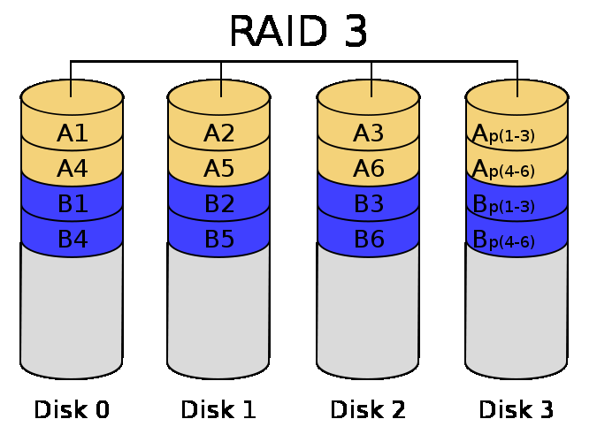
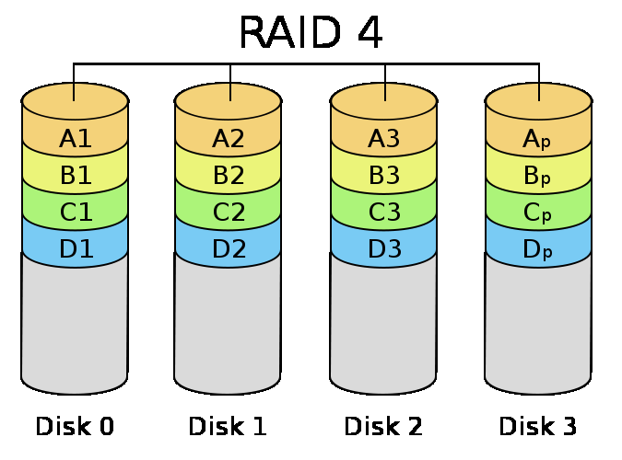

RAID Technology (cont.)
  Raid level 3 uses a single parity disk relying on the disk controller to figure out which disk has failed.
  Raid levels 4 and 5 use block-level data striping, with level 5 distributing data and parity information across all disks.

Slide 36
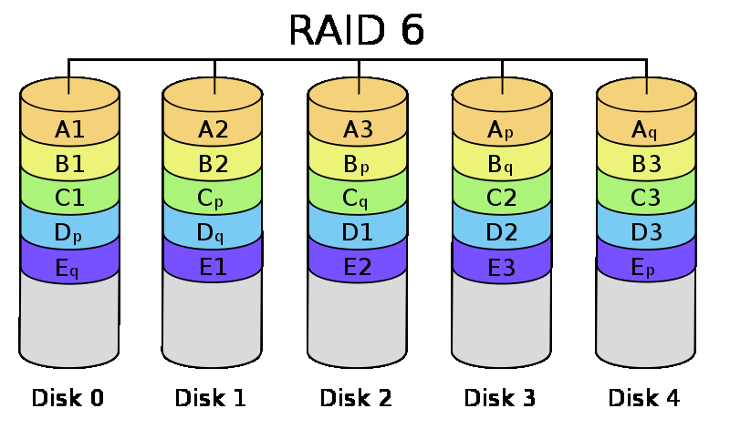
RAID Technology (cont.)
  Raid level 6 applies the so-called P + Q redundancy scheme using Reed-Soloman codes to protect against up to two disk failures by using just two redundant disks.

Slide 37
Use of RAID Technology (cont.)
Different raid organizations are being used under different situations:
  Raid level 1 (mirrored disks)is the easiest for rebuild of a disk from other disks
    It is used for critical applications like logs.
  Raid level 2 uses memory-style redundancy by using Hamming codes, which contain parity bits for distinct overlapping subsets of components. Level 2 includes both error detection and correction.
  Raid level 3 ( single parity disks relying on the disk controller to figure out which disk has failed) and level 5 (block-level data striping) are preferred for large volume storage, with level 3 giving higher transfer rates.
  Most popular uses of the RAID technology currently are: Level 0 (with striping), Level 1 (with mirroring) and Level 5 with an extra drive for parity.
  Design decisions for RAID include – level of RAID, number of disks, choice of parity schemes, and grouping of disks for block-level striping.

Slide 38
Storage Area Networks
The demand for higher storage has risen considerably in recent times.
Organizations have a need to move from a static fixed data center oriented operation to a more flexible and dynamic infrastructure for information processing.
Thus they are moving to a concept of Storage Area Networks (SANs).
  In a SAN, online storage peripherals are configured as nodes on a high-speed network and can be attached and detached from servers in a very flexible manner.
This allows storage systems to be placed at longer distances from the servers and provide different performance and connectivity options.

Slide 39
Storage Area Networks (cont.)
Advantages of SANs are:
  Flexible many-to-many connectivity among servers and storage devices using fiber channel hubs and switches.
  Up to 10km separation between a server and a storage system using appropriate fiber optic cables.
  Better isolation capabilities allowing nondisruptive addition of new peripherals and servers.
SANs face the problem of combining storage options from multiple vendors and dealing with evolving standards of storage management software and hardware.

Slide 40
Contents
1 | Data Storage
1.1 | Disk Storage Devices
1.2 | Files of Records
1.3 | Operations on Files
1.4 | Unordered Files & Ordered Files & Hashed Files
1.5 | RAID Technology and Storage Area Networks
2 | Indexing Structures for Files
2.1 | Types of Single-level Ordered Indexes
2.2 | Multilevel Indexes
2.3 | Dynamic Multilevel Indexes Using B-Trees and B+-Trees

Slide 41
Indexes as Access Paths
A single-level index is an auxiliary file that makes it more efficient to search for a record in the data file.
The index is usually specified on one field of the file (although it could be specified on several fields)
One form of an index is a file of entries <field value, pointer to record>, which is ordered by field value
The index is called an access path on the field.

Slide 42
Indexes as Access Paths (cont.)
The index file usually occupies considerably less disk blocks than the data file because its entries are much smaller.
A binary search on the index yields a pointer to the file record.
Indexes can also be characterized as dense or sparse:
  A dense index has an index entry for every search key value (and hence every record) in the data file.
  A sparse (or nondense) index, on the other hand, has index entries for only some of the search values

Slide 43
Contents
1 | Data Storage
1.1 | Disk Storage Devices
1.2 | Files of Records
1.3 | Operations on Files
1.4 | Unordered Files & Ordered Files & Hashed Files
1.5 | RAID Technology and Storage Area Networks
2 | Indexing Structures for Files
2.1 | Types of Single-level Ordered Indexes
2.2 | Multilevel Indexes
2.3 | Dynamic Multilevel Indexes Using B-Trees and B+-Trees

Slide 44
Types of Single-level Ordered Indexes
Primary Indexes
Clustering Indexes
Secondary Indexes

Slide 45
Primary Index
Defined on an ordered data file.
  The data file is ordered on a key field.
One index entry for each block in the data file
  First record in the block, which is called the block anchor
A similar scheme can use the last record in a block.

Slide 46
Primary key field
ID | Name | DoB | Salary | Sex
1
2
3
4
6
7
8
9
10
12
13
15
Index file
(<K(i), P(i)> entries)
Primary key value | Block pointer
1
4
8
12

Slide 47
Primary Index
Number of index entries?
  Number of blocks in data file.
Dense or Nondense?
  Nondense
Search/ Insert/ Update/ Delete?

Slide 48
Example
Given the following data file: EMPLOYEE(NAME, SSN, ADDRESS, JOB, SAL, ... )
Suppose that:
record size R = 150 bytes (fixed-length)
block size B = 512 bytes
Number of records r = 30.000 records
SSN Field size V_{SSN} = 9 bytes,
record pointer size P_{R} = 7 bytes
block pointer size P_{B} = 6 bytes
Unspanned record
Then, we get:
blocking factor: bfr = ⎣B/R⎦ = ⎣512/150⎦ = 3 records/block
number of blocks needed for the file: b = ⎡r/bfr⎤= ⎡30.000/3 ⎤ = 10.000 blocks

Slide 49
Example
For a primary index on the ordering key field SSN : (using block pointer)
index entry size: R_{i} =(V_{SSN}+ P_{B})=(9+6)=15 bytes
index blocking factor bfr_{i} = ⎣B/R_{I}⎦ = ⎣512/15⎦ = 34 entries/block
number of blocks for index file: b_{i}= ⎡r/bfr_{i}⎤= (10000/34)= 295 blocks
binary search to retrieve a record in index file needs: ⎡log₂b_{i} ⎤ = ⎡log₂295 ⎤ = 9 block accesses
To search for a record using the index, we need one additional block access to the data file for a total of 9 + 1 = 10 block accesses
This is compared to an average linear search cost of:
(b/2)= 10000/2 = 5000 block accesses
If the file records are ordered, the binary search cost would be:
⎡ log₂b ⎤ = ⎡ log₂10000 ⎤ = 14 block accesses

Slide 50
Clustering Index
Defined on an ordered data file.
  The data file is ordered on a non-key field.
One index entry each distinct value of the field.
  The index entry points to the first data block that contains records with that field value

Slide 51
Clustering field
Dept_No | Name | DoB | Salary | Sex
1
1
2
2
2
2
2
3
3
4
4
5
Index file
(<K(i), P(i)> entries)
Clustering field value | Block pointer
1
2
3
4
5

Slide 52
Clustering Index
Number of index entries?
  Number of distinct indexing field values in data file.
Dense or Nondense?
  Nondense
Search/ Insert/ Update/ Delete?
At most one primary index or one clustering index but not both.

Slide 53
Secondary index
A secondary index provides a secondary means of accessing a file.
  The data file is unordered on indexing field.
Indexing field:
  secondary key (unique value)
  nonkey (duplicate values)
The index is an ordered file with two fields.
  The first field: indexing field.
  The second field: block pointer or record pointer.
There can be many secondary indexes for the same file.

Slide 54
Index file
(<K(i), P(i)> entries)
Secondary key field
Index field value | Block pointer
3
4
5
6
8
9
11
13
15
18
21
23
 | 5
 | 13
 | 8
 | 6
 | 15
 | 3
 | 9
 | 21
 | 11
 | 4
 | 23
 | 18
…
Secondary index on key field

Slide 55
Secondary index on key field
Number of index entries?
  Number of record in data file
Dense or Nondense?
  Dense
Search/ Insert/ Update/ Delete?

Slide 56
Secondary index on non-key field
Discussion: Structure of Secondary index on non-key field?
Option 1: include duplicate index entries with the same K(i) value - one for each record.
Option 2: keep a list of pointers <P(i, 1), ..., P(i, k)> in the index entry for K(i).
Option 3:
  more commonly used.
  one entry for each distinct index field value + an extra level of indirection to handle the multiple pointers.

Slide 57
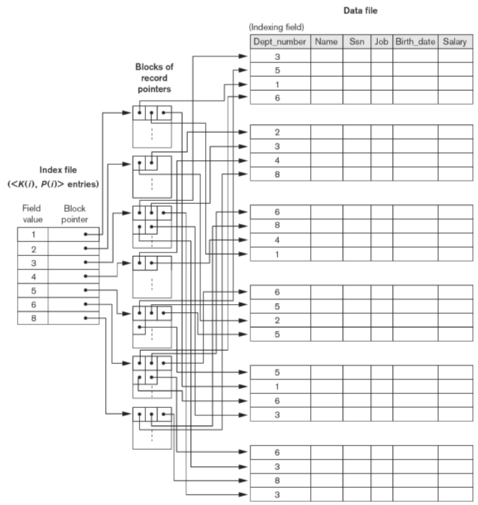
Secondary Index on non-key field:
option 3

Slide 58
Secondary index on nonkey field
Number of index entries?
  Number of records in data file
  Number of distinct index field values
Dense or Nondense?
  Dense/ nondense
Search/ Insert/ Update/ Delete?

Slide 59
Example
Given the following data file: EMPLOYEE(NAME, SSN, ADDRESS, JOB, SAL, ... )
Suppose that:
record size R = 150 bytes (fixed-length)
block size B = 512 bytes
Number of records r = 30.000 records
SSN Field size V_{SSN} = 9 bytes,
record pointer size P_{R} = 7 bytes
block pointer size P_{B} = 6 bytes
Unspanned record
Then, we get:
blocking factor: bfr = ⎣B/R⎦ = ⎣512/150⎦ = 3 records/block
number of blocks needed for the file: b = ⎡r/bfr⎤= ⎡30.000/3 ⎤ = 10.000 blocks

Slide 60
Example
For a secondary index on the SSN field (unordered)
index entry size: R_{i} = (V_{SSN}+ P_{R})=(9+7)=16 bytes
index blocking factor bfr_{i} = ⎣B/R_{I}⎦ = ⎣512/16⎦ = 32 entries/block
number of blocks for index file: b_{i} = ⎡r/bfr_{i}⎤= (30000/32)= 938 blocks
binary search to retrieve a record in index file needs: ⎡log₂b_{i} ⎤ = ⎡log₂938 ⎤ = 10 block accesses
To search for a record using the index, we need one additional block access to the data file for a total of 10 + 1 = 11 block accesses
This is compared to an average linear search cost of:
(b/2)= 10000/2 = 5000 block accesses

Slide 61
Summary of Single-level indexes
Ordered file on indexing field?
  Primary index
  Clustering index
Indexing field is Key?
  Primary index
  Secondary index
Indexing field is not Key?
  Clustering index
  Secondary index

Slide 62
Summary of Single-level indexes
Dense index?
  Secondary index
Nondense index?
  Primary index
  Clustering index
  Secondary index

Slide 63
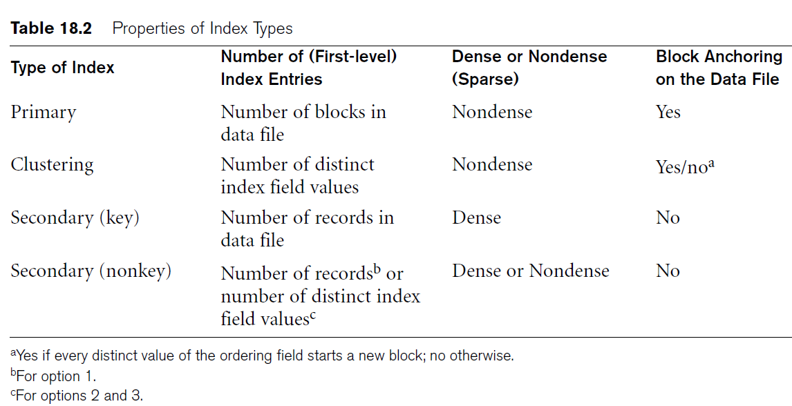
Summary of Single-level indexes

Slide 64
Contents
1 | Data Storage
1.1 | Disk Storage Devices
1.2 | Files of Records
1.3 | Operations on Files
1.4 | Unordered Files & Ordered Files & Hashed Files
1.5 | RAID Technology and Storage Area Networks
2 | Indexing Structures for Files
2.1 | Types of Single-level Ordered Indexes
2.2 | Multilevel Indexes
2.3 | Dynamic Multilevel Indexes Using B-Trees and B+-Trees

Slide 65
Multi-Level Indexes
Because a single-level index is an ordered file, we can create a primary index to the index itself.
  The original index file is called the first-level index and the index to the index is called the second-level index.
We can repeat the process, creating a third, fourth, ..., top level until all entries of the top level fit in one disk block.
A multi-level index can be created for any type of first-level index (primary, secondary, clustering) as long as the first-level index consists of more than one disk block.

Slide 66
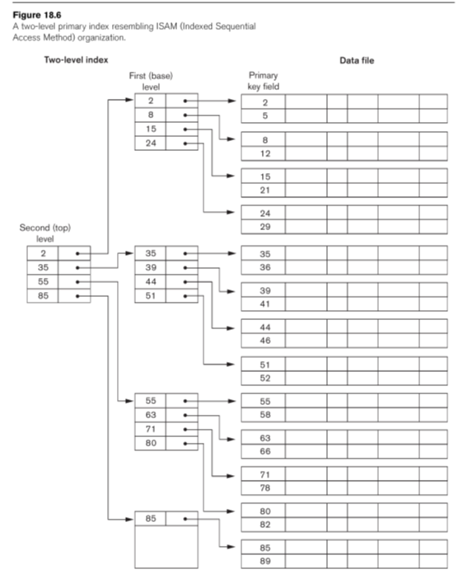
A two-level primary index resembling
ISAM (Indexed
Sequential Access
Method) organization.

Slide 67
Multi-Level Indexes
Such a multi-level index is a form of search tree.
However, insertion and deletion of new index entries is a severe problem because every level of the index is an ordered file.

Slide 68
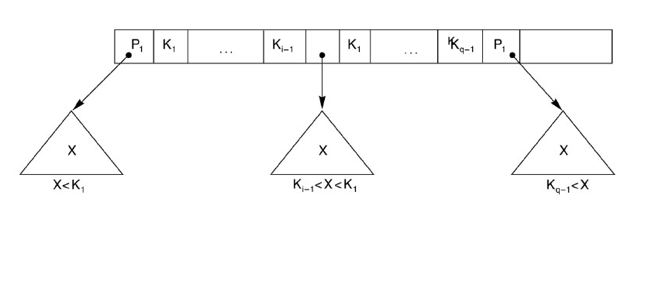
A Node in a Search Tree with Pointers to Subtrees below It

Slide 69
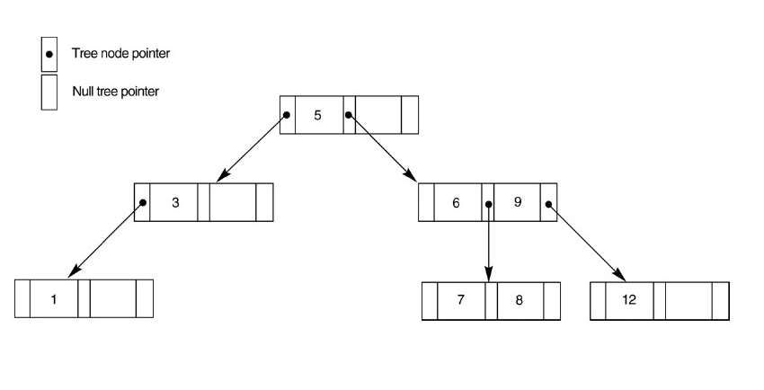
A search tree of order p = 3

Slide 70
Contents
1 | Data Storage
1.1 | Disk Storage Devices
1.2 | Files of Records
1.3 | Operations on Files
1.4 | Unordered Files & Ordered Files & Hashed Files
1.5 | RAID Technology and Storage Area Networks
2 | Indexing Structures for Files
2.1 | Types of Single-level Ordered Indexes
2.2 | Multilevel Indexes
2.3 | Dynamic Multilevel Indexes Using B-Trees and B+-Trees

Slide 71
Dynamic Multilevel Indexes Using B-Trees and B+-Trees
Most multi-level indexes use B-tree or B+-tree data structures because of the insertion and deletion problem.
  This leaves space in each tree node (disk block) to allow for new index entries
These data structures are variations of search trees that allow efficient insertion and deletion of new search values.
In B-Tree and B+-Tree data structures, each node corresponds to a disk block.
Each node is kept between half-full and completely full.

Slide 72
Dynamic Multilevel Indexes Using B-Trees and B+-Trees (cont.)
An insertion into a node that is not full is quite efficient.
  If a node is full, the insertion causes a split into two nodes.
Splitting may propagate to other tree levels.
A deletion is quite efficient if a node does not become less than half full.
If a deletion causes a node to become less than half full, it must be merged with neighboring nodes.

Slide 73
Difference between B-tree and B+-tree
In a B-Tree, pointers to data records exist at all levels of the tree.
In a B⁺-Tree, all pointers to data records exist at the leaf-level nodes.
A B⁺-Tree can have less levels (or higher capacity of search values) than the corresponding B-tree.

Slide 74
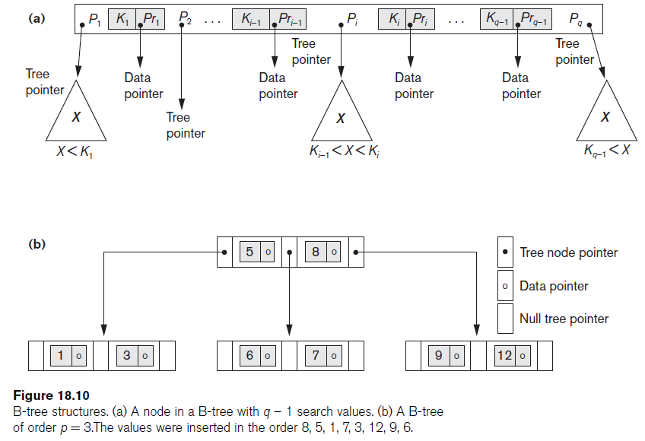
B-tree Structures

Slide 75
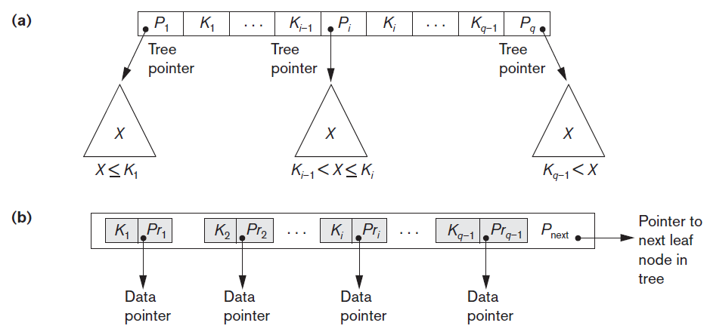

The Nodes of a B⁺-Tree

Slide 76
Contents
1 | Data Storage
1.1 | Disk Storage Devices
1.2 | Files of Records
1.3 | Operations on Files
1.4 | Unordered Files & Ordered Files & Hashed Files
1.5 | RAID Technology and Storage Area Networks
2 | Indexing Structures for Files
2.1 | Types of Single-level Ordered Indexes
2.2 | Multilevel Indexes
2.3 | Dynamic Multilevel Indexes Using B-Trees and B+-Trees

Slide 77



