Slide 1

Functional Dependencies & Normalization for Relational DBs
Chapter 5

Slide 2
Contents
1 | Introduction
2 | Functional dependencies
3 | Normalization

Slide 3
Contents
1 | Introduction
2 | Functional dependencies
3 | Normalization

Slide 4

Overview of Database Design Process
Miniworld
REQUIREMENTS - COLLECTION & ANALYSIS
Functional requirements
Data requirements
FUNCTIONAL ANALYSIS
CONCEPTUAL DESIGN
DBMS–independent
High-level transaction specification
Conceptual schema
LOGICAL DESIGN
(DATA MODEL MAPPING)
APPLICATION PROGRAM DESIGN
Database schema
DBMS–specific
PHYSICAL DESIGN
TRANSACTION IMPLEMENTATION
Internal schema
Application program
Application Design
Database Design

Slide 5
Two Approaches to Database Design
Bottom-Up Design (Design by Synthesis):
  Starts from individual attributes and their binary relationships.
  Builds relation schemas from the ground up.
  Limitations:
    Difficult to gather all necessary attribute relationships in practice.
    Rarely used in real-world systems due to complexity and inefficiency.

Slide 6
Two Approaches to Database Design
Top-Down Design (Design by Analysis):
  Begins with natural groupings of attributes (e.g., invoices, forms, reports).
  These groups are analyzed and decomposed into smaller, refined relations.
  Advantages:
    Aligns with real-world scenarios.
    More intuitive and easier to implement.

Slide 7
Introduction
Each relation schema consists of a number of attributes and the relational database schema consists of a number of relation schemas
Attributes are grouped to form a relation schema
Need some formal measure of why one grouping of attributes into a relation schema may be better than another

Slide 8
Introduction
“Goodness” measures:
  Making sure that the semantics of the attributes is clear in the schema
  Redundant information in tuples and Update anomalies (modification, deletion, insertion)
  Reducing the NULL values in tuples
  Disallowing the possibility of generating spurious tuples

Slide 9
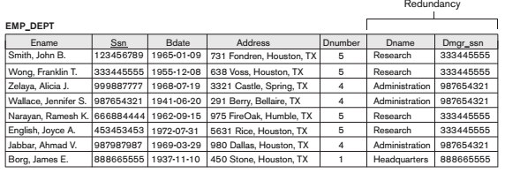
Introduction
Redundant information in tuples: the attribute values pertaining to a particular department (DNUMBER, DNAME, DMGRSSN) are repeated for every employee who works for that department.

Slide 10
Introduction
Update anomalies: modification, deletion, insertion
  Modification
    As the manager of a dept. changes we have to update many values according to employees working for that dept.
    Easy to make the DB inconsistent

Slide 11
Introduction
Deletion: if Borg James E. leaves, we delete his tuple and lose the existing of dept. 1, the name of dept. 1, and who is the manager of dept. 1

Slide 12
Introduction
Insertion:
  How can we create a department before any employees are assigned to it ?

Slide 13
Introduction
Reducing the NULL values in tuples
  Employees not assigned to any dept.: waste the storage space
  Other difficulties: aggregation operations (e.g., COUNT, SUM) and joins

Slide 14
Introduction
Disallowing the possibility of generating spurious tuples
EMP_PROJ (SSN, PNumber, Hours, EName, PName, PLocation)
EMP_LOCS (EName, PLocation)
EMP_PROJ1 (SSN, PNumber, Hours, PName, PLocation)
Generation of invalid and spurious data during JOINS: PLocation is the attribute that relates EMP_LOCS and EMP_PROJ1, and PLocation is neither a primary key nor a foreign key in either EMP_LOCS or EMP_PROJ1

Slide 15
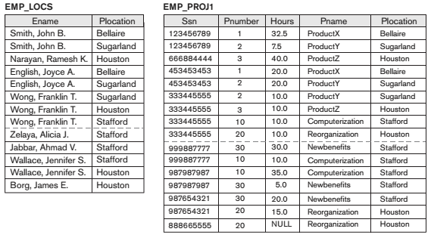
Introduction
Disallowing the possibility of generating spurious tuples

Slide 16
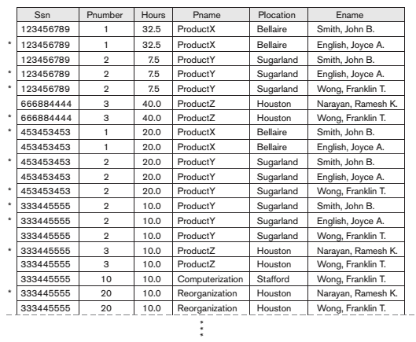
Introduction
Disallowing the possibility of generating spurious tuples

Slide 17
Introduction
“Goodness” measures:
  Redundant information in tuples
  Update anomalies: modification, deletion, insertion
  Reducing the NULL values in tuples
  Disallowing the possibility of generating spurious tuples
☞ Normalization

Slide 18
Contents
1 | Introduction
2 | Functional dependencies
3 | Normalization

Slide 19
Functional Dependencies (FDs)
Definition of FDs
Direct, indirect, partial dependencies
Inference Rules for FDs
Equivalence of Sets of FDs
Minimal Sets of FDs

Slide 20
Functional Dependencies (FDs)
Functional dependencies (FDs) are used to specify formal measures of the "goodness" of relational designs
FDs and keys are used to define normal forms for relations
FDs are constraints that are derived from the meaning and interrelationships of the data attributes
A set of attributes X functionally determines a set of attributes Y if the value of X determines a unique value for Y
X → Y

Slide 21
Functional Dependencies (FDs)
X → Y holds if whenever two tuples have the same value for X, they must have the same value for Y
For any two tuples t₁ and t₂ in any relation instance r(R): If t₁[X]=t₂[X], then t₁[Y]=t₂[Y]
X → Y in R specifies a constraint on all relation instances r(R)
If K is a key of R, K functionally determines all attributes in R (since we never have two distinct tuples with t₁[K]=t₂[K])
Examples:
  social security number determines employee name:
  SSN → EName
  project number determines project name and location:
  PNumber → {PName, PLocation}

Slide 22
Functional Dependencies (FDs)
Definition of FDs
Direct, indirect, partial dependencies
Inference Rules for FDs
Equivalence of Sets of FDs
Minimal Sets of FDs

Slide 23
Functional Dependencies (FDs)
Direct and fully dependency : All attributes in a R must be fully functionally dependent on the primary key (or the PK is a determinant of all attributes in R)
SSN → {Name, BDate, Address, DNO}
EMPLOYEE
SSN | Name | BDate | Address | DNO

Slide 24
Functional Dependencies (FDs)
Indirect dependency : Value of an attribute is not determined directly by the primary key
DNO → DName
SSN → Dname is a transitive dependency through DNO
EMP_DEPT
SSN | Name | BDate | Address | DNO | DName

Slide 25
Functional Dependencies (FDs)
Partial dependency
  Composite determinant - more than one value is required to determine the value of another attribute, the combination of values is called a composite determinant
  {SSN, PNumber} in EMP_PROJ: {SSN, PNumber} → Hours
  Partial dependency - if the value of an attribute does not depend on an entire composite determinant, but only part of it, the relationship is known as the partial dependency
  SSN → EName , Pnumber → {PName, PLocation}
EMP_PROJ
SSN | PNumber | Hours | EName | PName | PLocation

Slide 26
Functional Dependencies (FDs)
Definition of FD
Direct, indirect, partial dependencies
Inference Rules for FDs
Equivalence of Sets of FDs
Minimal Sets of FDs

Slide 27
Functional Dependencies (FDs)
Given a set of FDs F, we can infer additional FDs that hold whenever the FDs in F hold
Armstrong's inference rules:
  IR1. (Reflexive) If Y ⊆ X, then X → Y
  IR2. (Augmentation) If X → Y, then XZ → YZ
  (Notation: XZ stands for X ⋃ Z)
  IR3. (Transitive) If X → Y and Y → Z, then X → Z

Slide 28
Functional Dependencies (FDs)
Some additional inference rules that are useful:
  Decomposition: If X → YZ, then X → Y and X → Z
  Union: If X → Y and X → Z, then X → YZ
  Psuedotransitivity: If X → Y and WY → Z, then WX → Z
The last three inference rules, as well as any other inference rules, can be deduced from IR1, IR2, and IR3 (completeness property)
Armstrong's inference rules:
  IR1. (Reflexive) If Y ⊆ X, then X → Y
  IR2. (Augmentation) If X → Y, then XZ → YZ
  (Notation: XZ stands for X ⋃ Z)
  IR3. (Transitive) If X → Y and Y → Z, then X → Z

Slide 29
Functional Dependencies (FDs)
Closure of a set F of FDs is the set F⁺ of all FDs that can be inferred from F
Closure of a set of attributes X with respect to F is the set X⁺ of all attributes that are functionally determined by X
X⁺ can be calculated by repeatedly applying IR1, IR2, IR3 using the FDs in F

Slide 30
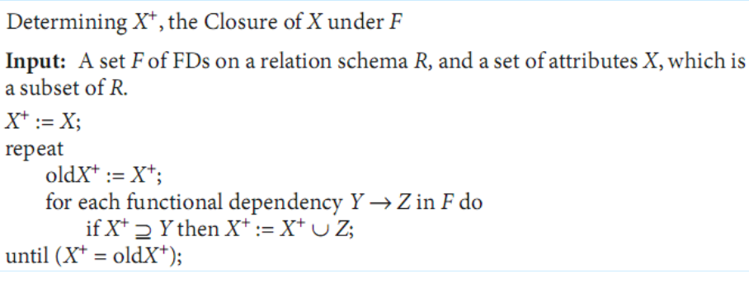

Slide 31
Functional Dependencies (FDs)
Definition of FD
Direct, indirect, partial dependencies
Inference Rules for FDs
Equivalence of Sets of FDs
Minimal Sets of FDs

Slide 32
Functional Dependencies (FDs)
Two sets of FDs F and G are equivalent if F⁺ = G⁺
Definition:
  F covers G if G⁺ ⊆ F⁺
  F and G are equivalent if F covers G and G covers F
There is an algorithm for checking equivalence of sets of FDs

Slide 33
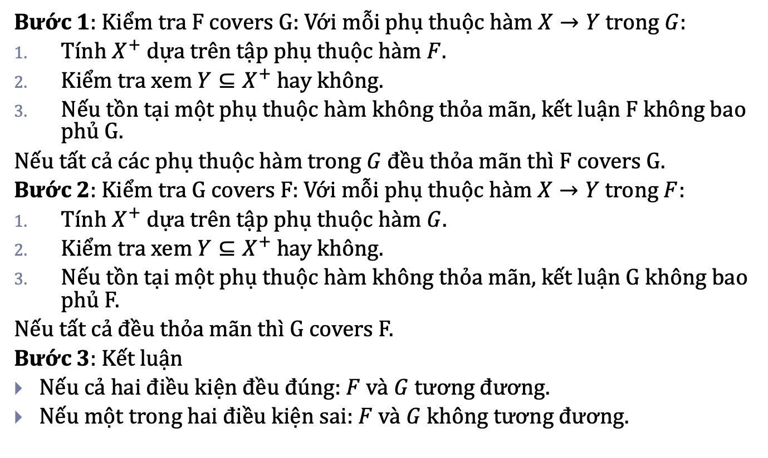
Functional Dependencies (FDs)
Bước 1: Kiểm tra F covers G: Với mỗi phụ thuộc hàm $X→Y$ trong $G$:
Tính $X^{+}$ dựa trên tập phụ thuộc hàm $F$.
Kiểm tra xem $Y⊆X^{+}$ hay không.
Nếu tồn tại một phụ thuộc hàm không thỏa mãn, kết luận F không bao phủ G.
Nếu tất cả các phụ thuộc hàm trong $G$ đều thỏa mãn thì F covers G.
Bước 2: Kiểm tra G covers F: Với mỗi phụ thuộc hàm $X→Y$ trong $F$:
Tính $X^{+}$ dựa trên tập phụ thuộc hàm $G$.
Kiểm tra xem $Y⊆X^{+}$ hay không.
Nếu tồn tại một phụ thuộc hàm không thỏa mãn, kết luận G không bao phủ F.
Nếu tất cả đều thỏa mãn thì G covers F.
Bước 3: Kết luận
Nếu cả hai điều kiện đều đúng: $F$ và $G$ tương đương.
Nếu một trong hai điều kiện sai: $F$ và $G$ không tương đương.

Slide 34
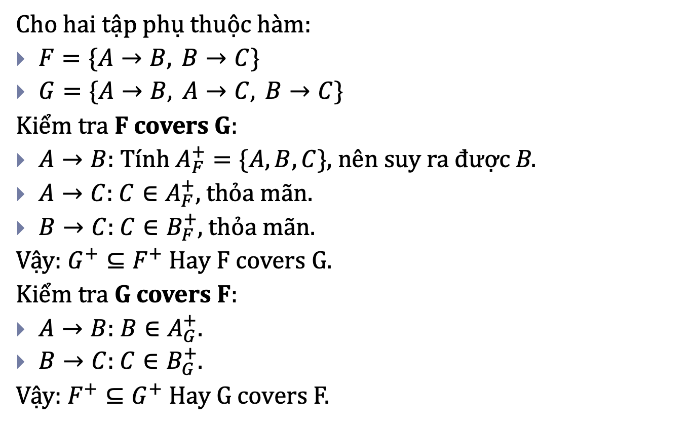
Functional Dependencies (FDs)
Cho hai tập phụ thuộc hàm:
Kiểm tra F covers G:
$A→B$: Tính $A_{F}^{+}=\{A,B,C\}$, nên suy ra được B.
$A→C$: $C∈A_{F}^{+}$, thỏa mãn.
$B→C$: $C∈B_{F}^{+}$, thỏa mãn.
Vậy: $G^{+}⊆F^{+}$ Hay F covers G.
Kiểm tra G covers F:
$A→B$: $B∈A_{G}^{+}$.
$B→C$: $C∈B_{G}^{+}$.
Vậy: $F^{+}⊆G^{+}$ Hay G covers F.

Slide 35
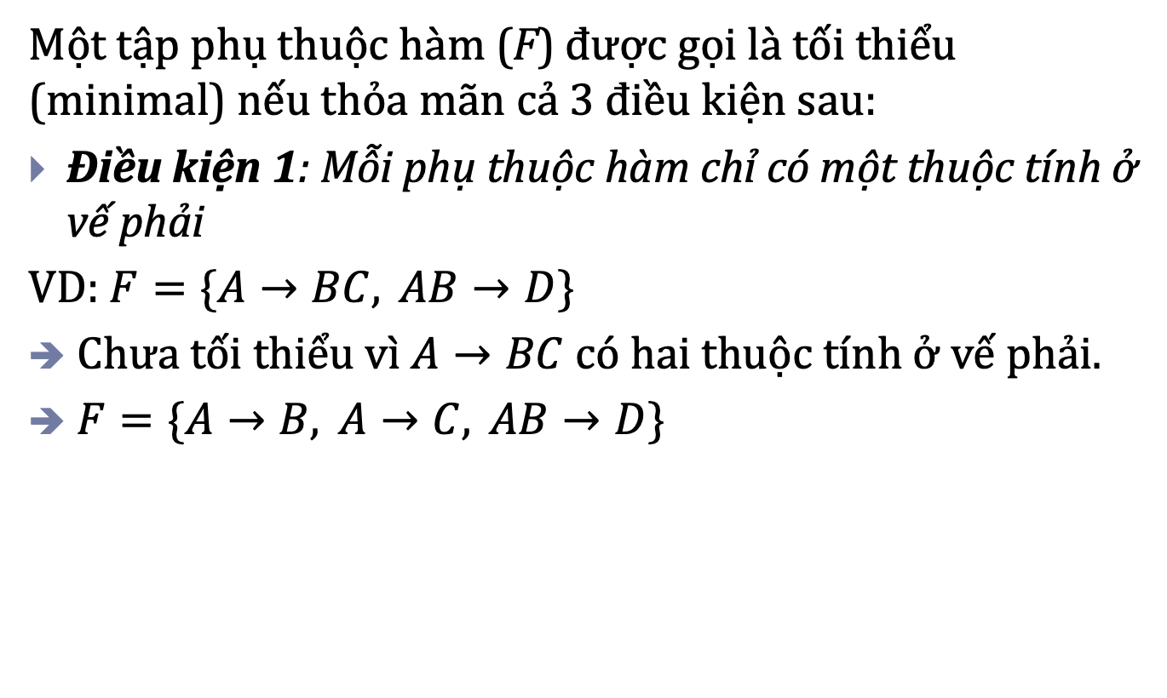
Functional Dependencies (FDs)
Một tập phụ thuộc hàm (F) được gọi là tối thiểu (minimal) nếu thỏa mãn cả 3 điều kiện sau:
Điều kiện 1: Mỗi phụ thuộc hàm chỉ có một thuộc tính ở vế phải
VD: $F=\{A→BC, AB→D\}$
Chưa tối thiểu vì $A→BC$có hai thuộc tính ở vế phải.
$F=\{A→B, A→C, AB→D\}$

Slide 36
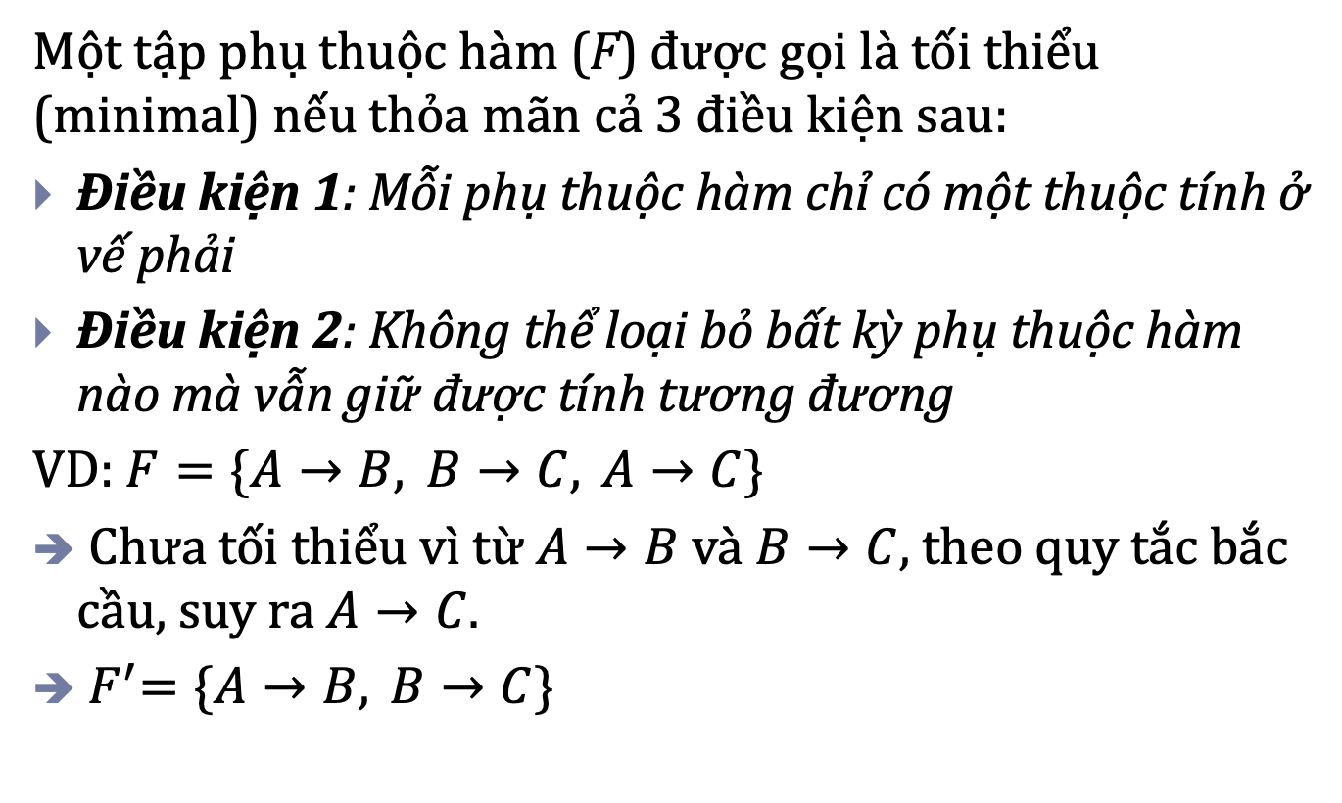
Functional Dependencies (FDs)
Một tập phụ thuộc hàm (F) được gọi là tối thiểu (minimal) nếu thỏa mãn cả 3 điều kiện sau:
Điều kiện 1: Mỗi phụ thuộc hàm chỉ có một thuộc tính ở vế phải
Điều kiện 2: Không thể loại bỏ bất kỳ phụ thuộc hàm nào mà vẫn giữ được tính tương đương
VD: $F=\{A→B, B→C, A→C\}$
Chưa tối thiểu vì từ $A→B$ và $B→C$, theo quy tắc bắc cầu, suy ra $A→C$.
${ F}^{′}=\{A→B, B→C\}$

Slide 37
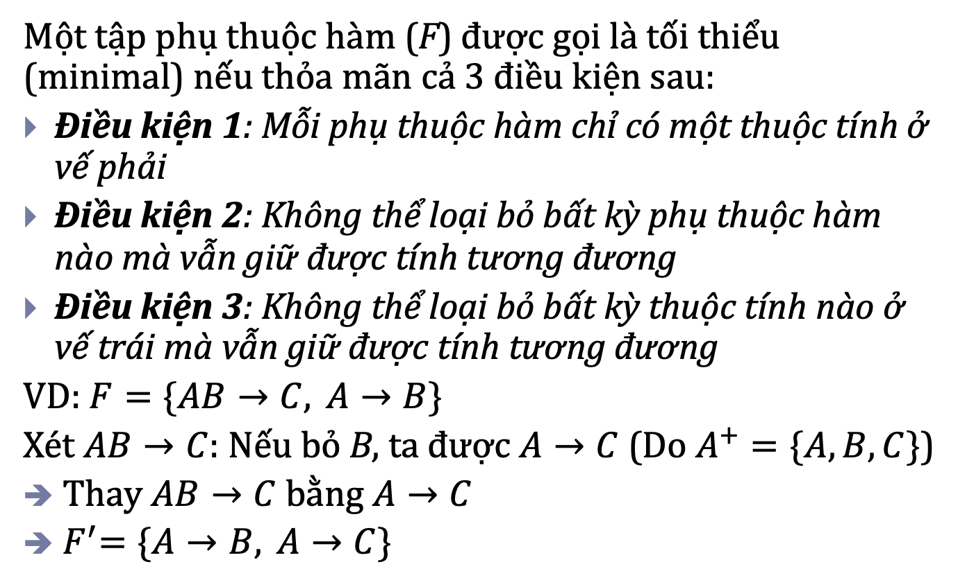
Functional Dependencies (FDs)
Một tập phụ thuộc hàm (F) được gọi là tối thiểu (minimal) nếu thỏa mãn cả 3 điều kiện sau:
Điều kiện 1: Mỗi phụ thuộc hàm chỉ có một thuộc tính ở vế phải
Điều kiện 2: Không thể loại bỏ bất kỳ phụ thuộc hàm nào mà vẫn giữ được tính tương đương
Điều kiện 3: Không thể loại bỏ bất kỳ thuộc tính nào ở vế trái mà vẫn giữ được tính tương đương
VD: $F=\{AB→C, A→B\}$
Xét $AB→C$: Nếu bỏ B, ta được $A→C$ (Do $A^{+}=\{A,B,C\}$)
Thay $AB→C$ bằng $A→C$
${ F}^{′}=\{A→B, A→C\}$

Slide 38
Functional Dependencies (FDs)
Every set of FDs has an equivalent minimal set
There can be several equivalent minimal sets
There is no simple algorithm for computing a minimal set of FDs that is equivalent to a set F of FDs
To synthesize a set of relations, we assume that we start with a set of dependencies that is a minimal set

Slide 39
Contents
1 | Introduction
2 | Functional dependencies
3 | Normalization

Slide 40
Normalization
Normalization: The process of decomposing unsatisfactory "bad" relations by breaking up their attributes into smaller relations
Normal form: Using keys and FDs of a relation to certify whether a relation schema is in a particular normal form
Normalization is carried out in practice so that the resulting designs are of high quality and meet the desirable properties
The database designers need not normalize to the highest possible normal form (3NF, BCNF or 4NF)

Slide 41
Normalization
Two new concepts:
  A Prime attribute must be a member of some candidate key
  A Nonprime attribute is not a prime attribute: it is not a member of any candidate key

Slide 42
Introduction
There are two important properties of decompositions:
  non-additive or losslessness of the corresponding join
  preservation of the functional dependencies
Note that property (1) is extremely important and cannot be sacrificed. Property (2) is less stringent and may be sacrificed

Slide 43
Normalization
1NF and dependency problems
2NF – solves partial dependency
3NF – solves indirect dependency
BCNF – well-normalized relations

Slide 44
Normalization
First normal form (1NF): there is only one value at the intersection of each row and column of a relation - no set valued attributes in 1NF
→ Disallows composite attributes, multivalued attributes, and nested relations
To be part of the formal definition of a relation in the basic (flat) relational model

Slide 45
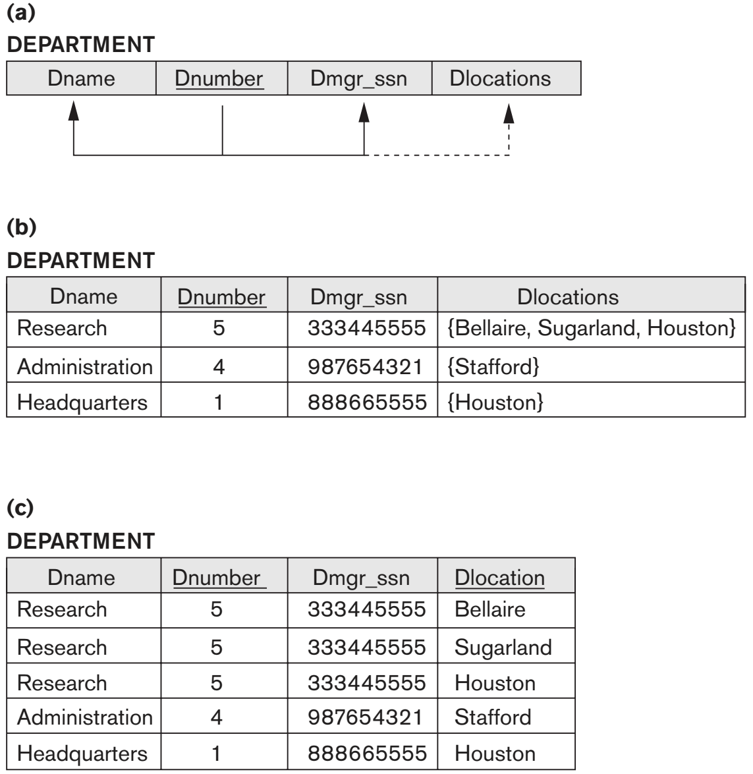
1NF

Slide 46
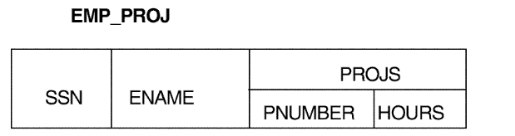
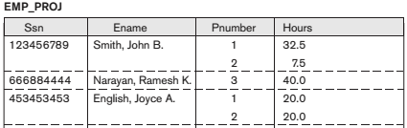
1NF

Slide 47
1NF
It is becoming common in today’s databases to incorporate images, documents, video clips, audio clips, and so on. When these are stored in a relation, the entire object or file is treated as an atomic value, which is stored as a BLOB (binary large object) or CLOB (character large object) data type using SQL.
For practical purposes, the object is treated as an atomic, single-valued attribute and hence it maintains the 1NF status of the relation.

Slide 48
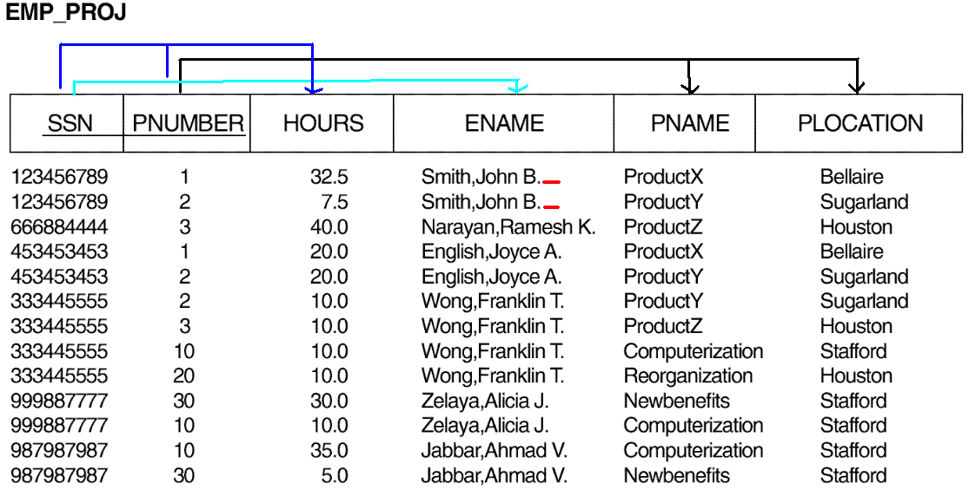
1NF

Slide 49
Normalization
1NF and dependency problems
2NF – solves partial dependency
3NF – solves indirect dependency
BCNF – well-normalized relations

Slide 50
Normalization
A relation schema R is in 2NF if every nonprime attribute A in R is fully functionally dependent on the primary key of R.
2NF solves partial dependency problem in 1NF
Method:
  Decompose and set up a new relation for each partial key with its dependent attribute(s).
  Make sure to keep a relation with the original primary key and any attributes that are fully functionally dependent on it.

Slide 51
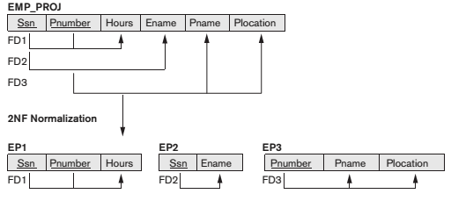
2NF

Slide 52

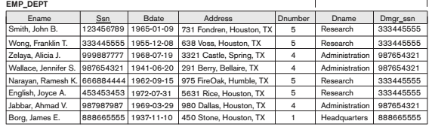
2NF
Problem with 2NF

Slide 53
Normalization
1NF and dependency problems
2NF – solves partial dependency
3NF – solves indirect dependency
BCNF – well-normalized relations

Slide 54
Normalization
A relation schema R is in third normal form (3NF) if it is in 2NF and no non-prime attribute A in R is transitively dependent on the primary key
NOTE:
In X → Y and Y → Z, with X as the primary key, we consider this a problem only if Y is not a candidate key. When Y is a candidate key, there is no problem with the transitive dependency .
E.g., Consider EMP (SSN, Emp#, Salary ).
Here, SSN → Emp# →Salary and Emp# is a candidate key

Slide 55
Normalization
3NF solves indirect (transitive) dependencies problem in 1NF and 2NF
Method: identify all transitive dependencies and each transitive dependency will form a new relation, with non-prime attributes participating in the transitive dependency and the attribute which determines others as the attributes for the new relation

Slide 56
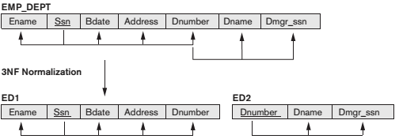
3NF

Slide 57
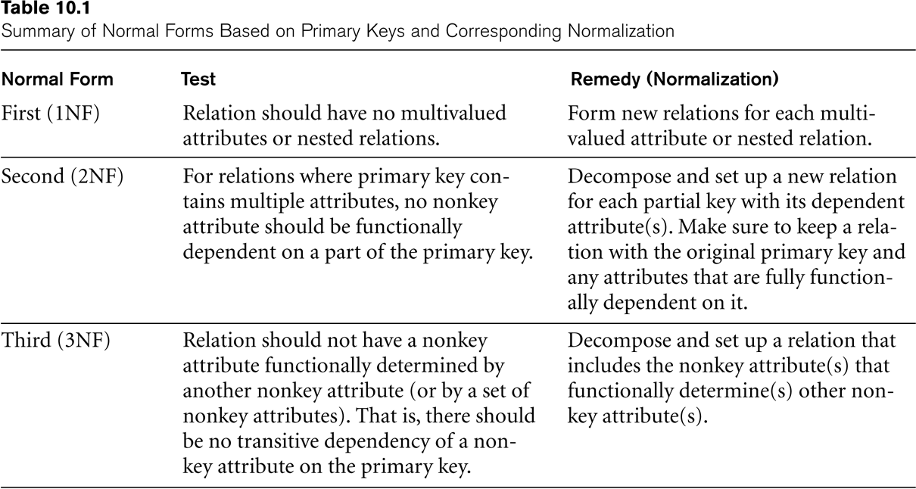
SUMMARY OF NORMAL FORMS based on Primary Keys

Slide 58
General Normal Form Definitions
A relation schema R is in second normal form (2NF) if every nonprime attribute A in R is not partially dependent on any key of R.
A relation schema R is in third normal form (3NF) if whenever a FD X -> A holds in R, then either:
(a) X is a superkey of R, or
(b) A is a prime attribute of R

Slide 59
Normalization
1NF and dependency problems
2NF – solves partial dependency
3NF – solves indirect dependency
BCNF – well-normalized relations

Slide 60
Normalization
A relation schema R is in Boyce-Codd Normal Form (BCNF) if whenever an FD X → A holds in R, then X is a superkey of R
VIETSUB: Mọi determinant (vế trái của một functional dependency không tầm thường) đều phải là superkey.

Slide 61
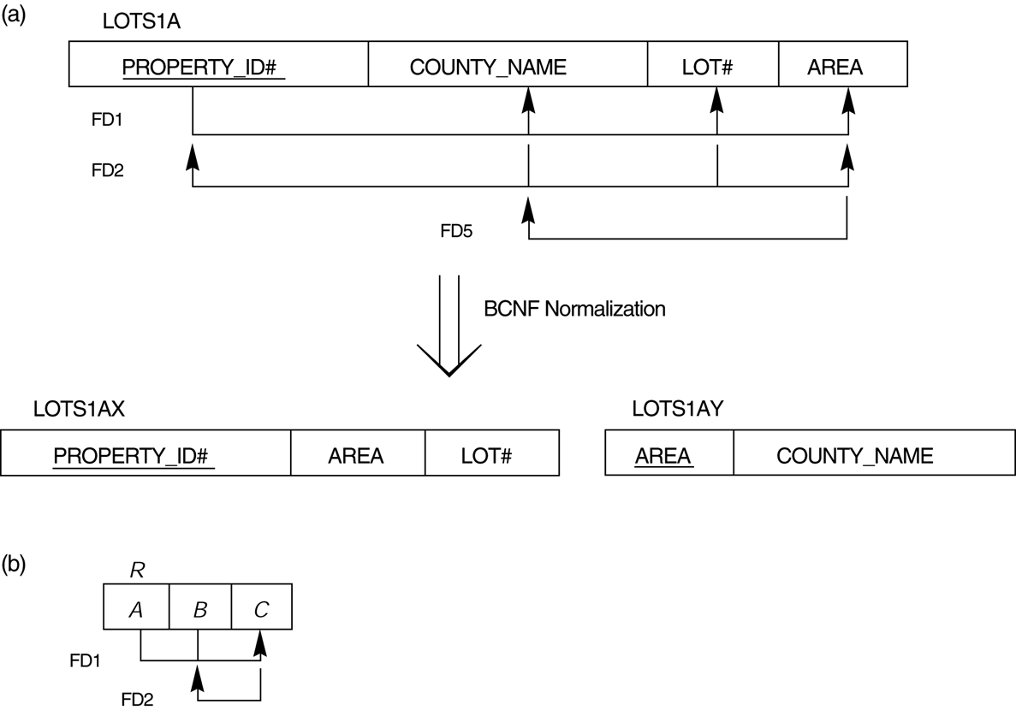
BCNF
Boyce-Codd normal form. (a) BCNF normalization of LOTS1A with the functional dependency FD2 being lost in the decomposition. (b) A schematic relation with FDs; it is in 3NF, but not in BCNF.

Slide 62


BCNF
TEACH (Student, Course, Instructor)

Slide 63

BCNF
Three possible pairs
All three decompositions lose the functional dependency FD1. The desirable decomposition of those just shown is 3 because it will not generate spurious tuples after a join

Slide 64
Nonadditive Join Decomposition into BCNF Schemas
Algorithm. Relational Decomposition into BCNF with Nonadditive Join Property
Input: A universal relation R and a set of functional dependencies F on the attributes of R.
1. Set D := {R} ;
2. While there is a relation schema Q in D that is not in BCNF do
{
  choose a relation schema Q in D that is not in BCNF;
  find a functional dependency X→Y in Q that violates BCNF;
  replace Q in D by two relation schemas (Q – Y) and (X ∪ Y);
} ;

Slide 65
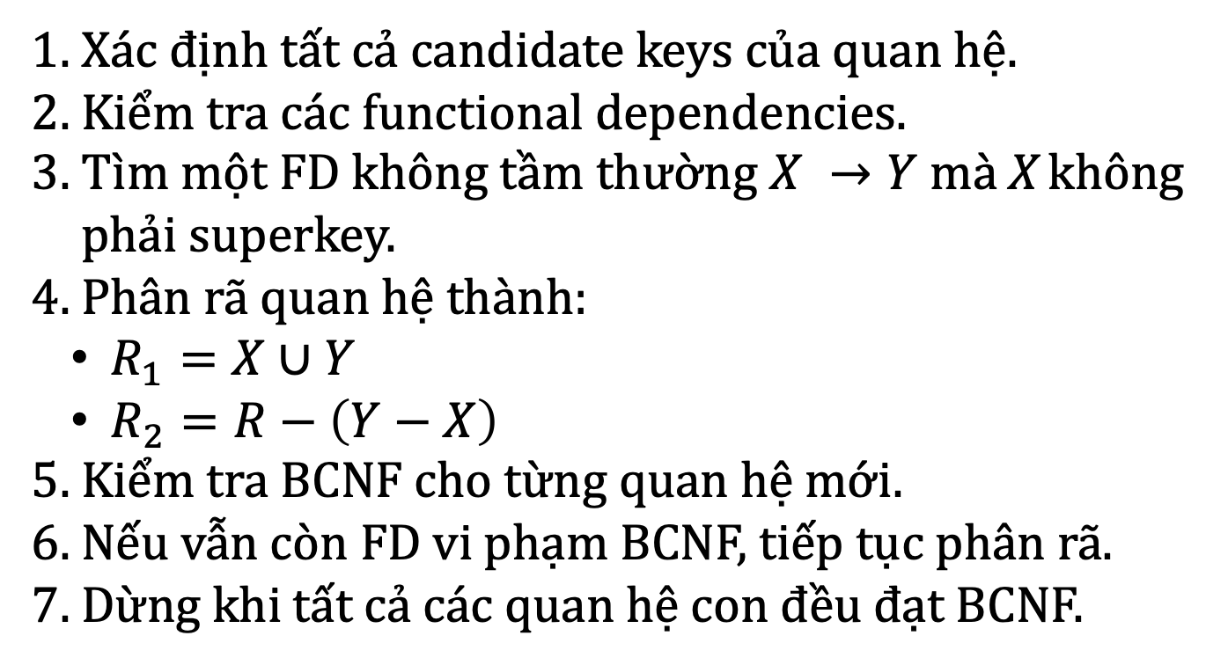
BCNF
Xác định tất cả candidate keys của quan hệ.
Kiểm tra các functional dependencies.
Tìm một FD không tầm thường $X →Y$ mà X không phải superkey.
Phân rã quan hệ thành:
  $R_{1}=X∪Y$
  $R_{2}=R−\left(Y−X\right)$
Kiểm tra BCNF cho từng quan hệ mới.
Nếu vẫn còn FD vi phạm BCNF, tiếp tục phân rã.
Dừng khi tất cả các quan hệ con đều đạt BCNF.

Slide 66
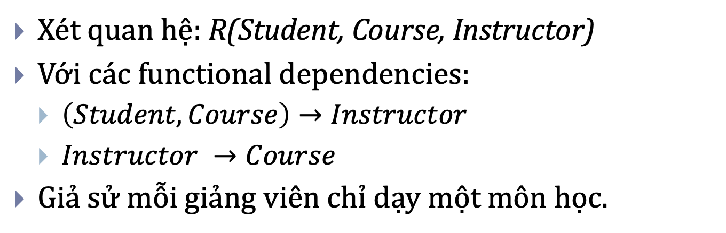
BCNF
Xét quan hệ: R(Student, Course, Instructor)
Với các functional dependencies:
  $\left(Student,Course\right)→Instructor$
  $Instructor →Course$
Giả sử mỗi giảng viên chỉ dạy một môn học.

Slide 67
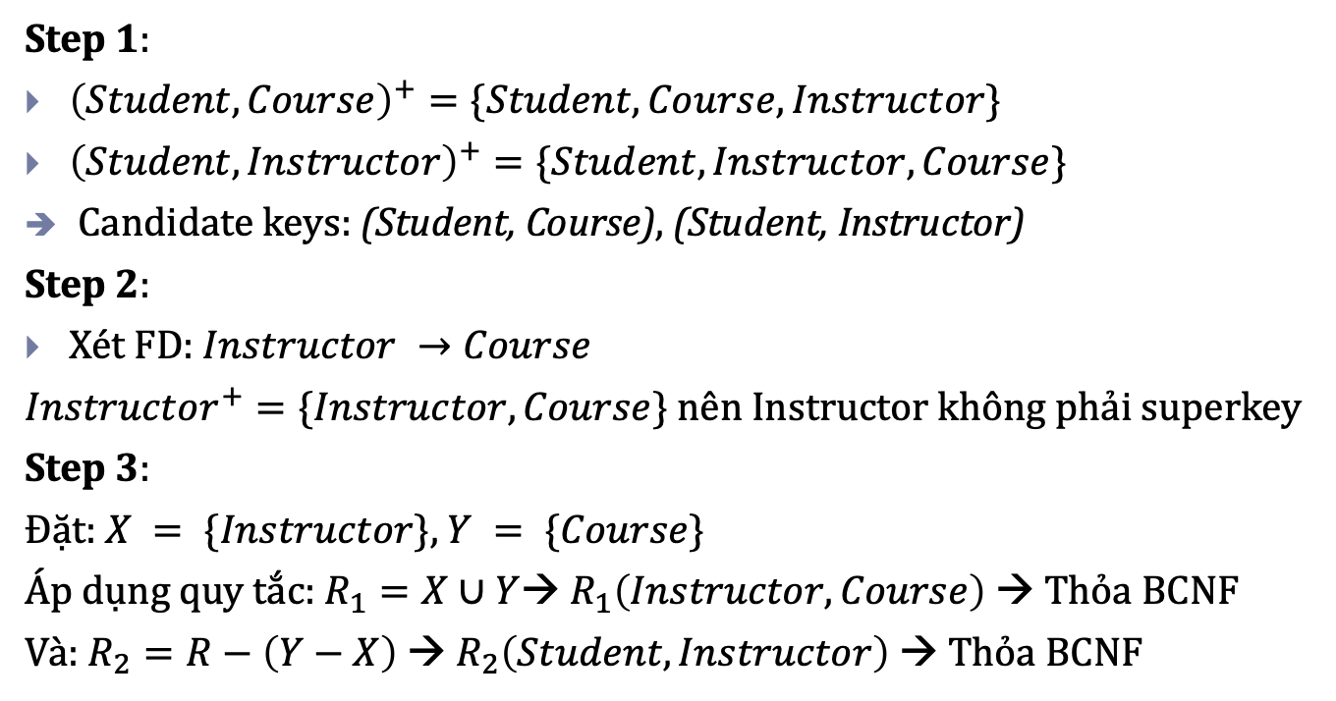
BCNF
Step 1:
${\left(Student,Course\right)}^{+}=\{Student,Course,Instructor\}$
${\left(Student,Instructor\right)}^{+}=\{Student,Instructor,Course\}$
Candidate keys: (Student, Course), (Student, Instructor)
Step 2:
Xét FD:$Instructor →Course$
$Instructor^{+}=\{Instructor,Course\}$ nên Instructor không phải superkey
Step 3:
Đặt: $X = \{Instructor\}$, $Y = \{Course\}$
Áp dụng quy tắc: $R_{1}=X∪Y$→ $R_{1}\left(Instructor,Course\right)$ → Thỏa BCNF
Và: $R_{2}=R−\left(Y−X\right)$ → $R_{2}\left(Student,Instructor\right)$ → Thỏa BCNF

Slide 68
Contents
1 | Introduction
2 | Functional dependencies
3 | Normalization

Slide 69



Slide 70
Key finding algorithms
Extended part

Slide 71
Key and super key
Superkey of R: A set of attributes SK of R such that no two tuples in any valid relation instance r(R) will have the same value for SK. That is, for any distinct tuples t1 and t2 in r(R), t1[SK] ≠ t2[SK]
Key of R: A "minimal" superkey; that is, a superkey K such that removal of any attribute from K results in a set of attributes that is not a superkey
If K is a key of R, then K functionally determines all attributes in R

Slide 72
Key-finding algorithm (1)
By Elmasri and Navathe
Input: A relation R and a set of functional dependencies F on the attributes of R.
Output: a key K of R
Set K to contain all attributes in R
For each attribute A in K {
compute (K – A)⁺ with respect to F;
if (K – A)⁺ contains all attributes in R, then
set K := K – {A}
};

Slide 73
Key-finding algorithm (1)
By Elmasri and Navathe
In algorithm (1), we start by setting K to all the attributes of R; we then remove one attribute at a time and check whether the remaining attributes still form a superkey.
The algorithm (1) determines only one key out of the possible candidate keys for R; the key returned depends on the order in which attributes are removed from R in step 2.

Slide 74
Key-finding algorithm (2)
By Hossein Saiedian & Thomas Spencer
Input: A relation R and a set of functional dependencies F on the attributes of R.
Output: all candidate keys of R
Let:
U contains all attributes of R
U_{l} contains attributes of R that occur only on the left-hand side of FDs in F
  U_{l} also includes attributes of R that do not occur in any FDs.
U_{r} contains attributes of R that occur only on the right-hand side of FDs in F
U_{b} contains attributes of R that occur on both sides of FDs in F
Note:
U_{l} ∩ U_{r} = ф, U_{l} ∩ U_{b} = ф and U_{r} ∩ U_{b} = ф
U_{l} ∪ U_{r} ∪ U_{b} = U
For every attribute A ∈ U, if A ∈ U_{l}, then A must be part of every candidate key of R.
For every attribute A ∈ U, if A ∈ U_{r}, then A will not be part of any candidate key of R.

Slide 75
Key-finding algorithm (2)
By Hossein Saiedian & Thomas Spencer
Input: A relation R and a set of functional dependencies F on the attributes of R.
Output: all candidate keys of R
Determine U_{l}, U_{r} and U_{b}
If U_{l}⁺ = U under F, then U_{l} forms the only key of R and the algorithm stops here.
Else: move to step 3 // U_{l}⁺ ≠ U under F
Consider every subsets U_{bi} of U_{b}: U_{bi} ⊂ U_{b}
For each U_{bi}, if (U_{l} ∪ U_{bi})⁺ = U under F, then K_{i} = (U_{l} ∪ U_{bi}) is a candidate key of R ^{(*)}
^{(*)} If K_{i} = (U_{l} ∪ U_{bi}) is a candidate key of R, then we need not to check U_{bj} ⊂ U_{b} where U_{bi} ⊂ U_{bj}

Slide 76
Key-finding algorithm (2)
By Hossein Saiedian & Thomas Spencer
A simple categorization of attributes into the sets U_{l}, U_{r} and U_{b} allows to distinguish between those attributes that will participate in the candidate keys of a relational database schema and those that do not.
The algorithm (2) finds all candidate keys.

