Slide 1

CASE STUDY
Portfolio Website

Slide 2
Target
Help my friends and clients understand my personal tendency
Share and update information.
A place to archive all my personal projects

Slide 3
1_Information architecture
Homepage
Blog
Profile
Playground
Gallery
Lifestyle
Information
App
Photo
Design
Contact
Video
Fashion
Download Reusme
Project

Slide 4
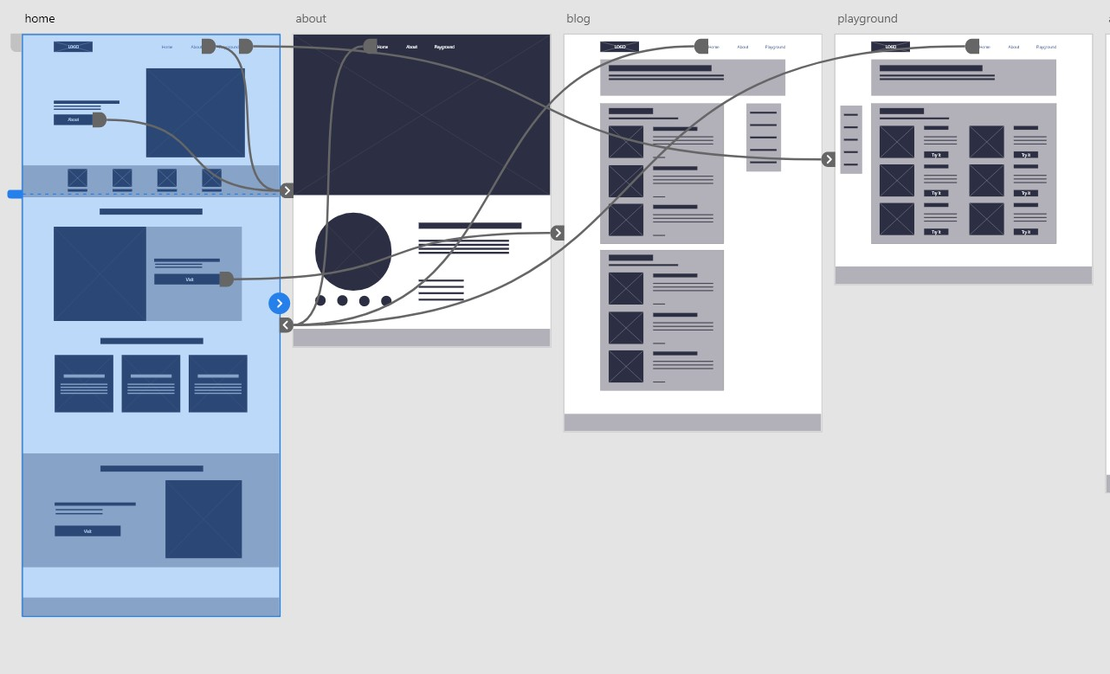
1_Wireframes & Low-fidelity prototypes

Slide 5
DEMO
thangnh0511.github.io/thangg

