Slide 1
Undirected graphs
anhtt-fit@mail.hut.edu.vn

Slide 2
Undirected graphs
A graph G=(V, E) where V is a set of vertices connected pairwise by edges E.
Why study graph algorithms?
  Interesting and broadly useful abstraction.
  Challenging branch of computer science and discrete math.
  Hundreds of graph algorithms known.
  Thousands of practical applications.
    Communication, circuits, transportation, scheduling, software systems, internet, games, social network, neural networks, …

Slide 3
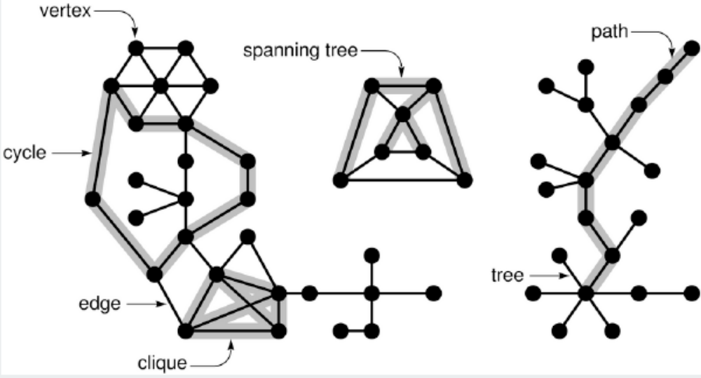
Graph terminology

Slide 4
Some graph-processing problems
Path: Is there a path between s to t?
Shortest path: What is the shortest path between s and t?
Cycle: Is there a cycle in the graph?
Euler tour: Is there a cycle that uses each edge exactly once?
Hamilton tour: Is there a cycle that uses each vertex exactly once?
Connectivity: Is there a way to connect all of the vertices?
MST: What is the best way to connect all of the vertices?
Biconnectivity: Is there a vertex whose removal disconnects the graph?

Slide 5
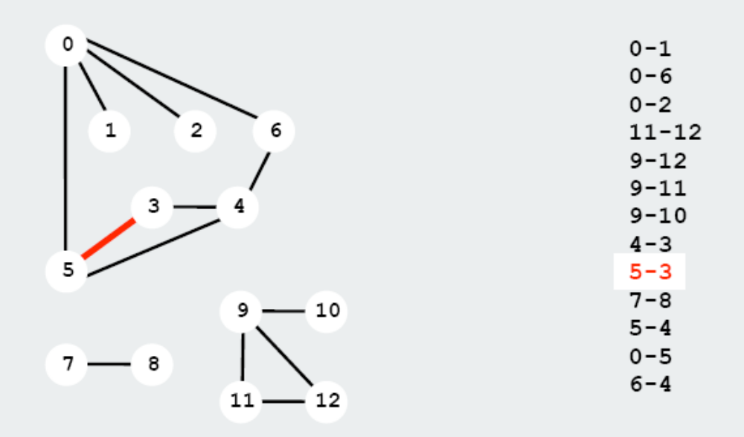
Graph representation (1)
Maintain a list of the edges
Not suitable for searching

Slide 6
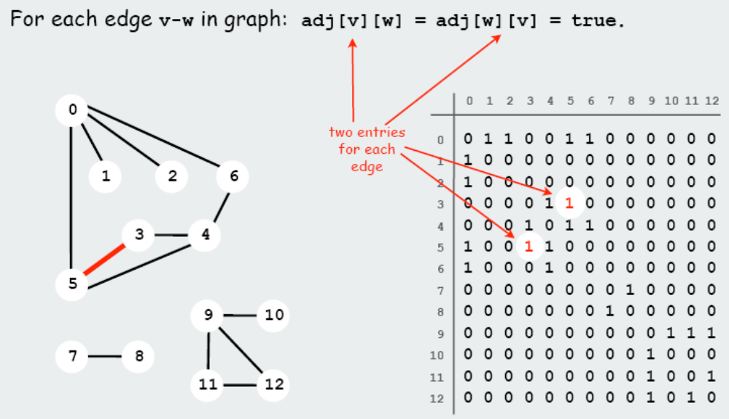
Graph representation (2)
Maintain an adjacency matrix.
Suitable for random accesses to the edges

Slide 7
A graph data structure
Use a dynamic array to represent a graph as the following
  typedef struct {
  int * matrix;
  int sizemax;
  } Graph;
Define the following API
  Graph createGraph(int sizemax);
  void addEdge(Graph graph, int v1, int v2);
  int adjacent(Graph graph, int v1, int v2);
  int getAdjacentVertices(Graph graph, int vertex, int* output); // return the number of adjacent vertices.
  void dropGraph(Graph graph);

Slide 8
How to use the API?
int i, n, output[100];
Graph g = createGraph(100);
addEdge(g, 0, 1);
addEdge(g, 0, 2);
addEdge(g, 1, 2);
addEdge(g, 1, 3);
n = getAdjacentVertices (g, 1, output);
if (n==0) printf("No adjacent vertices of node 1\n");
else {
printf("Adjacent vertices of node 1:");
for (i=0; i<n; i++) printf("%5d", output[i]);
}

Slide 9
Quiz 1
Write the implementation for the API defined in the previous slide
Use the example to test your API

Slide 10
Solution
graph_matrix.c

Slide 11
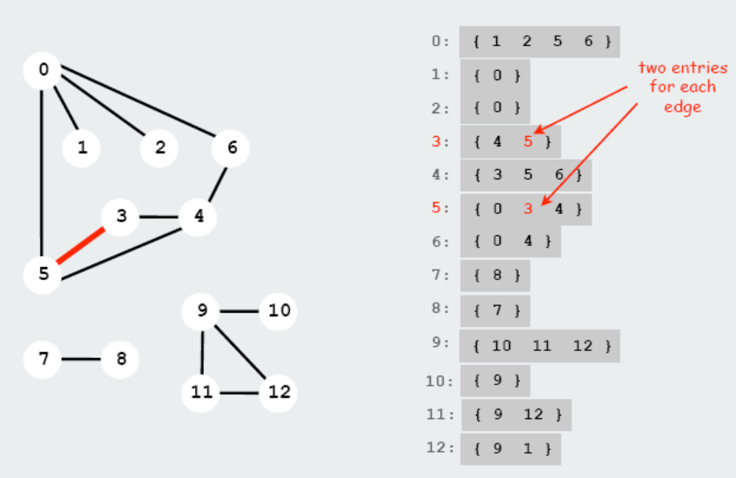
Graph representation (3)
Maintain an adjacency list.

Slide 12
Comparison
Adjacency List is usually preferred, because it provides a compact way to represent sparse graphs – those for which |E| is much less than |V|²
Adjacency Matrix may be preferred when the graph is dense, or when we need to be able to tell quickly if their is an edge connecting two given vertices

Slide 13
Implementation
The red black tree can be used to store such a graph where each node in the tree is a vertex and its value is a list of adjacent vertices.
Such a list of adjacent vertices can be stored in a red black tree as well.

Slide 14
Quiz 2
Rewrite the API defined for graphs using the libfdr library as the following
  #include "jrb.h"
  typedef JRB Graph;
  Graph createGraph();
  void addEdge(Graph graph, int v1, int v2);
  int adjacent(Graph graph, int v1, int v2);
  int getAdjacentVertices (Graph graph, int v, int* output);
  void dropGraph(Graph graph);

Slide 15
Instructions (1)
To create a graph
  Simply call make_jrb()
To add a new edge (v1, v2) to graph g
  tree = make_jrb();
  jrb_insert_int(g, v1, new_jval_v(tree));
  jrb_insert_int(tree, v2, new_jval_i(1));
If the node v1 is already allocated in the graph
  node = jrb_find_int(g, v1);
  tree = (JRB) jval_v(node->val);
  jrb_insert_int(tree, v2, new_jval_i(1));

Slide 16
Instructions (2)
To get adjacent vertices of v in graph g
  node = jrb_find_int(g, v);
  tree = (JRB) jval_v(node->val);
  total = 0;
  jrb_traverse(node, tree)
  output[total++] = jval_i(node->key);
To delete/free a graph
  jrb_traverse(node, graph)
  jrb_free_tree( jval_v(node->val) );

Slide 17
Solution
graph_jrb.c

Slide 18
Homework
In order to describe the metro lines of a city, we can store the data in a file as the following.
  [STATIONS]
  S1=Name of station 1
  S2=Name of station 2
  …
  [LINES]
  M1=S1 S2 S4 S3 S7
  M2=S3 S5 S6 S8 S9
  …
Make a program to read such a file and establish the network of metro stations in the memory using the defined API.
Write a function to find all the stations adjacent to a station given by its name.

