Slide 1
Object Oriented Programming Visualization of operations on tree data structures Professor: PhD Nguyen Thi Thu Trang Teaching Assistance: Nguyen Minh Chau
Group 2: Ngo Quang Huy - 20184272
Nguyen Viet Thang – 20184306
Nguyen Duc Dat - 2018421

Slide 2
Member & Assignment
Ngo Quang Huy – 20184272
Use JavaFX to design GUI, record video demo.
Nguyen Viet Thang – 20184306
Write source code for tree, balanced tree, balanced binary tree, make the slide.
Nguyen Duc Dat – 20184241
Work with binary tree, make usecase diagram and class diagram, report.

Slide 3
Problem statement
Design a program using JavaFX to display and explain some basic operations of four types of tree: generic tree, binary tree, balanced tree, balanced binary tree

Slide 4
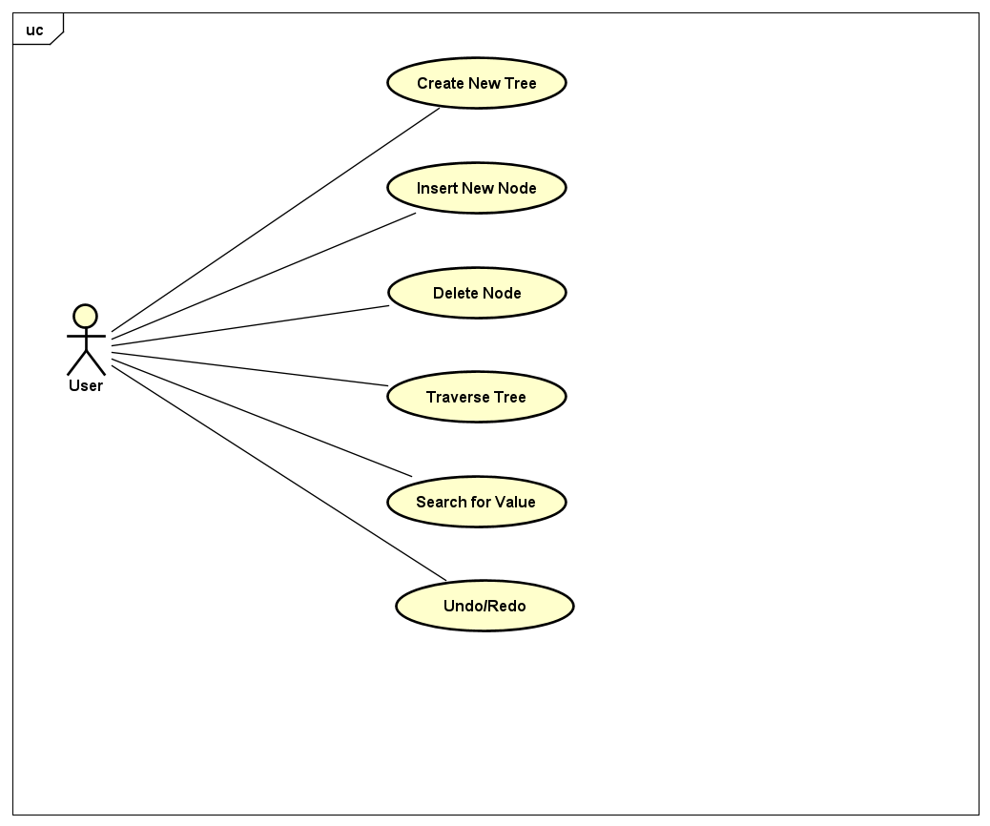
1. Usecase diagram

Slide 5
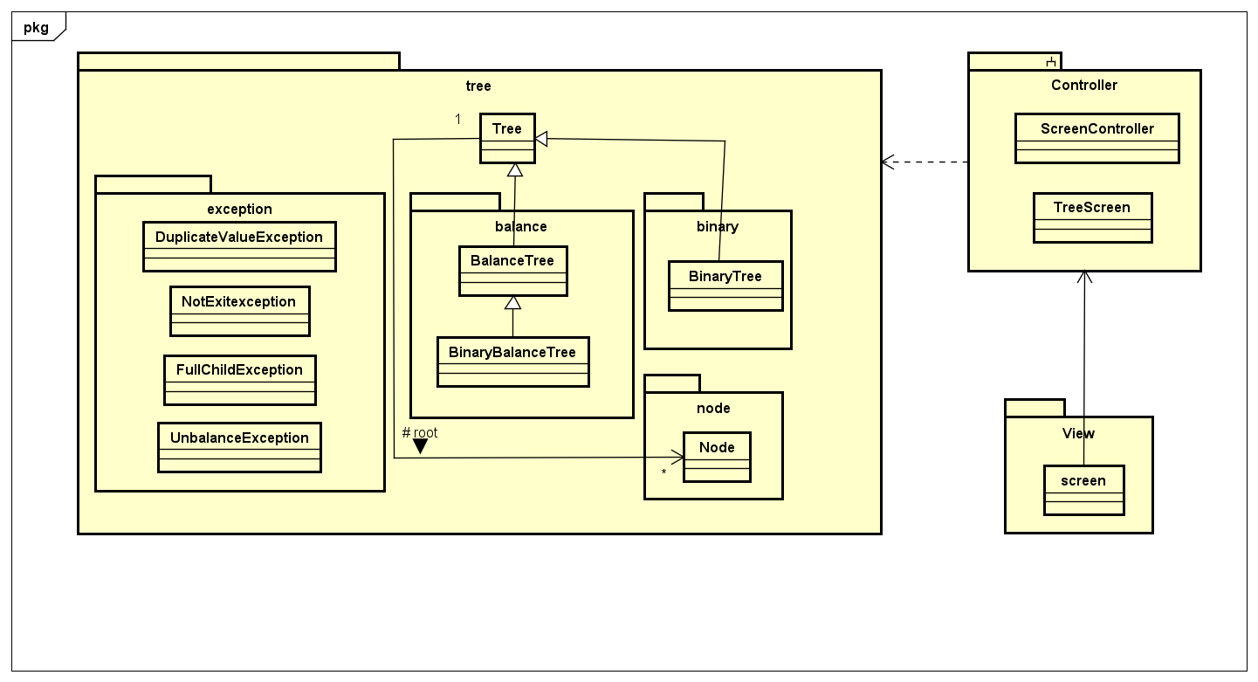
General class diagram

Slide 6
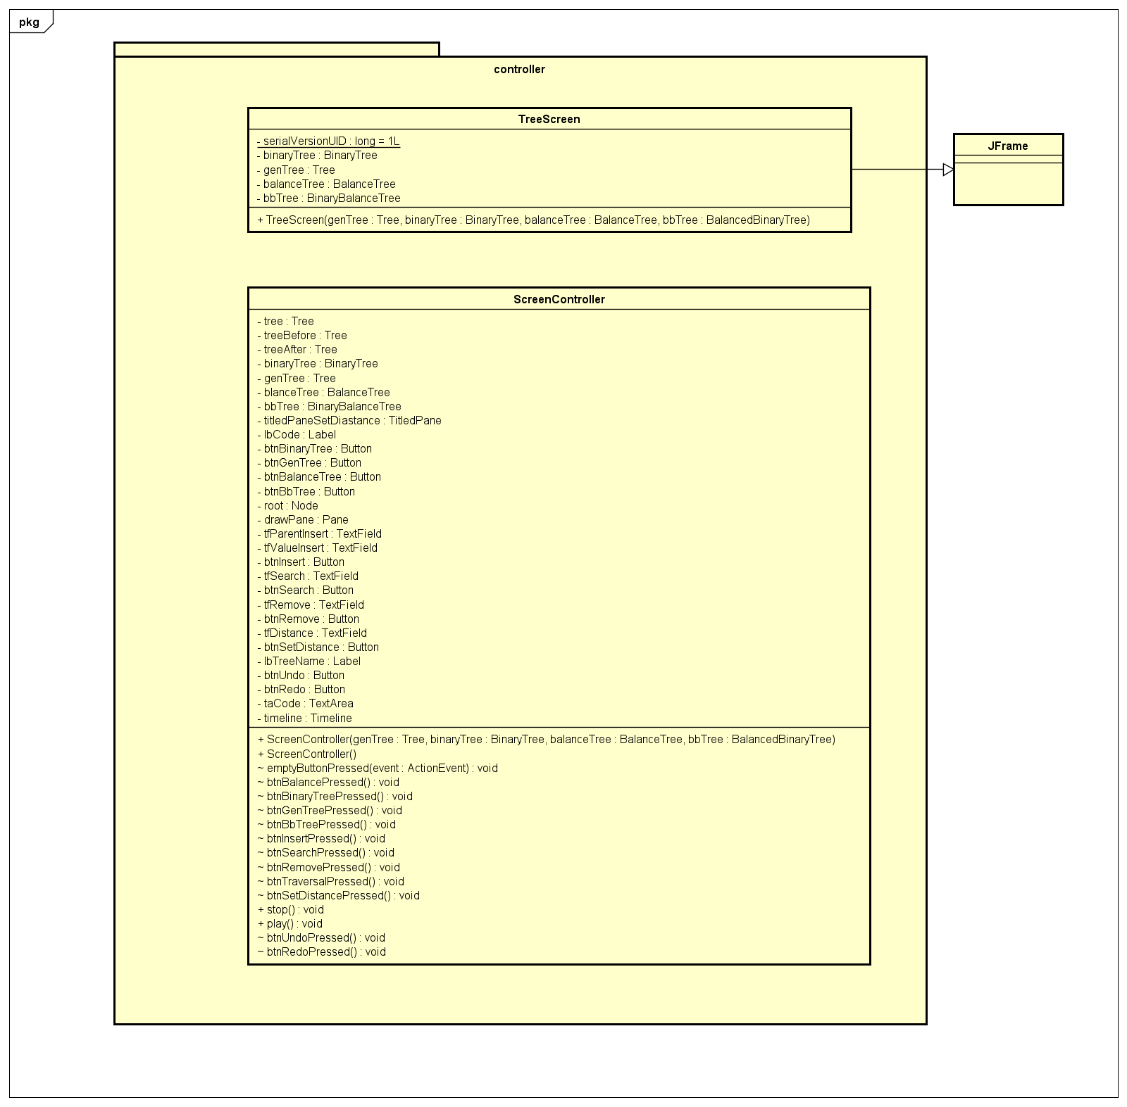
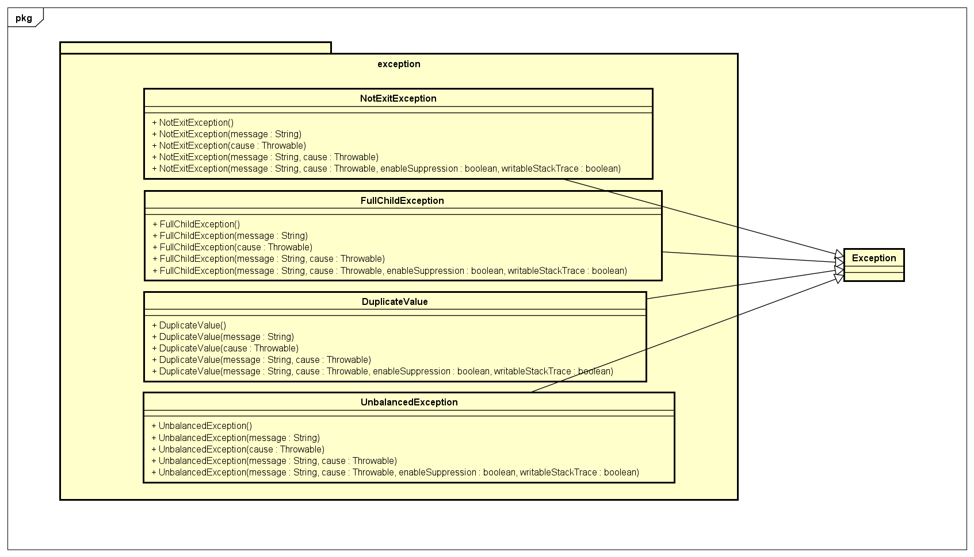
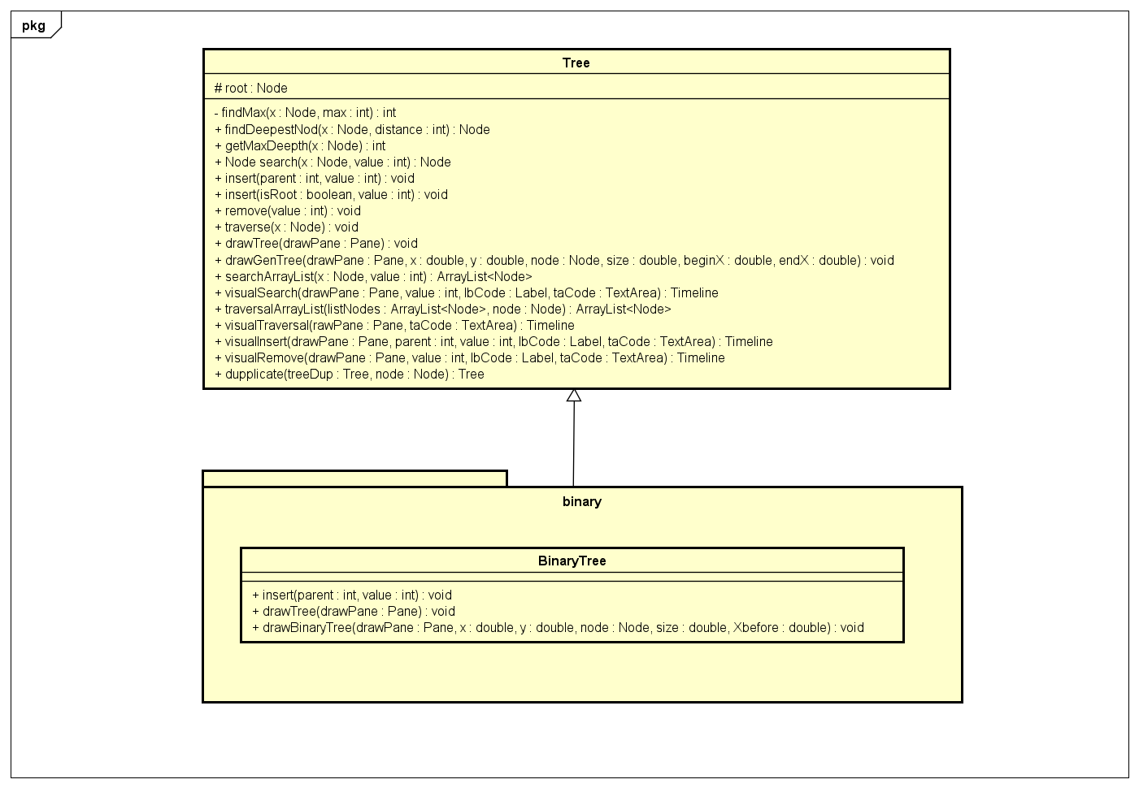
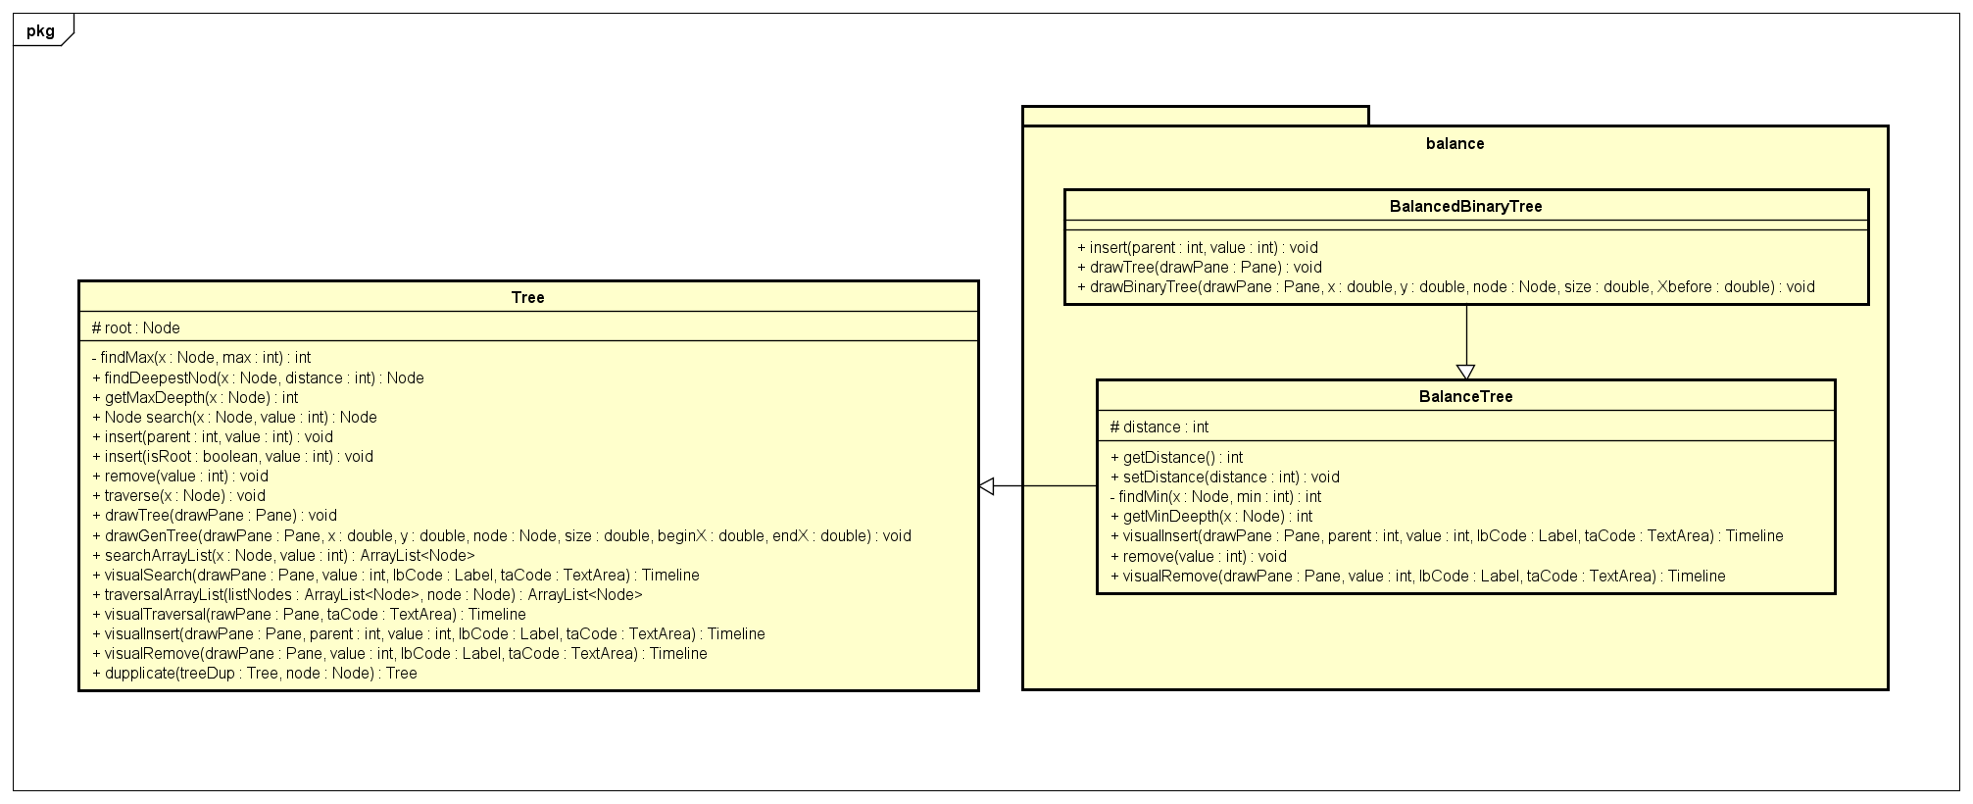
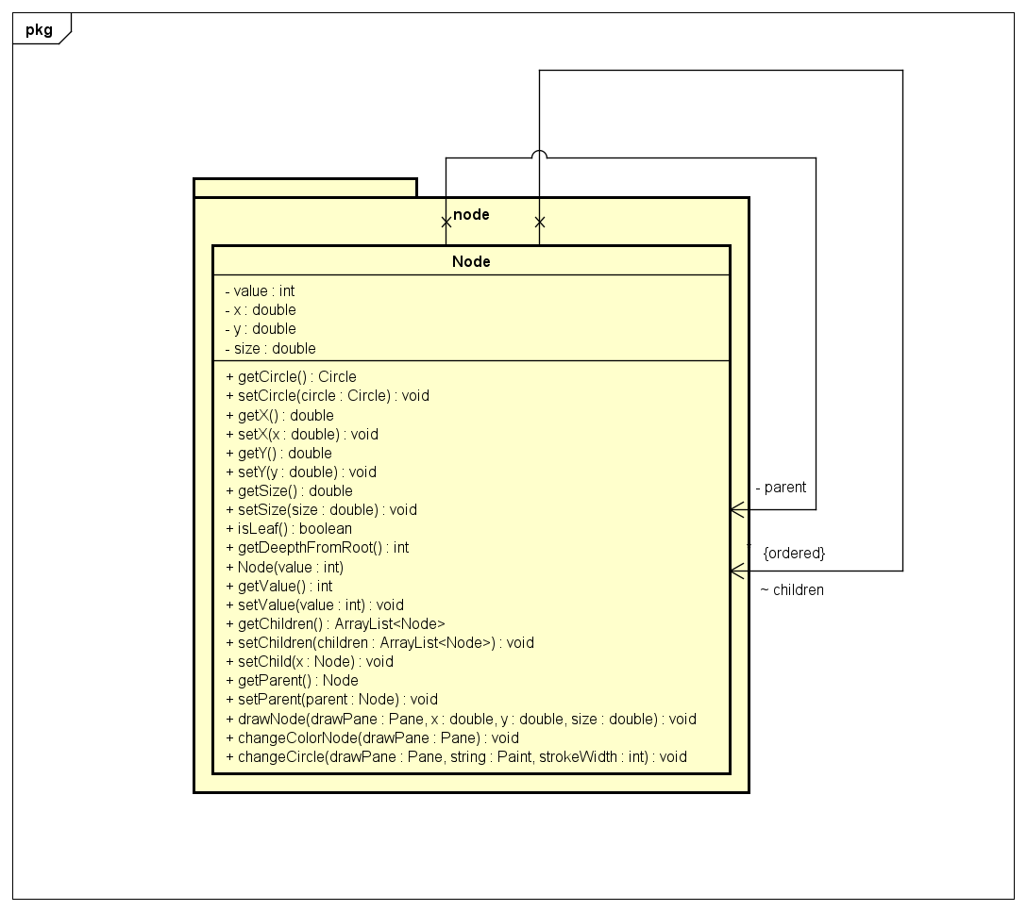
Class diagrams for packages

Slide 7
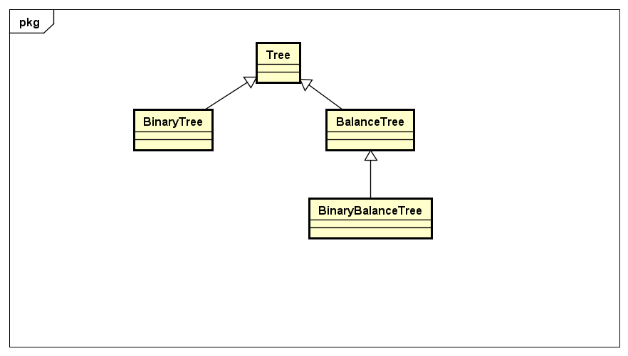
Explanation of OOP technique
1.Association:
In Tree class, we instantiate a Node Object. Because tree and node can exist independently of each other, so the relationship between them is association
2.Inheritance:
3.Polymorphism:

Slide 8
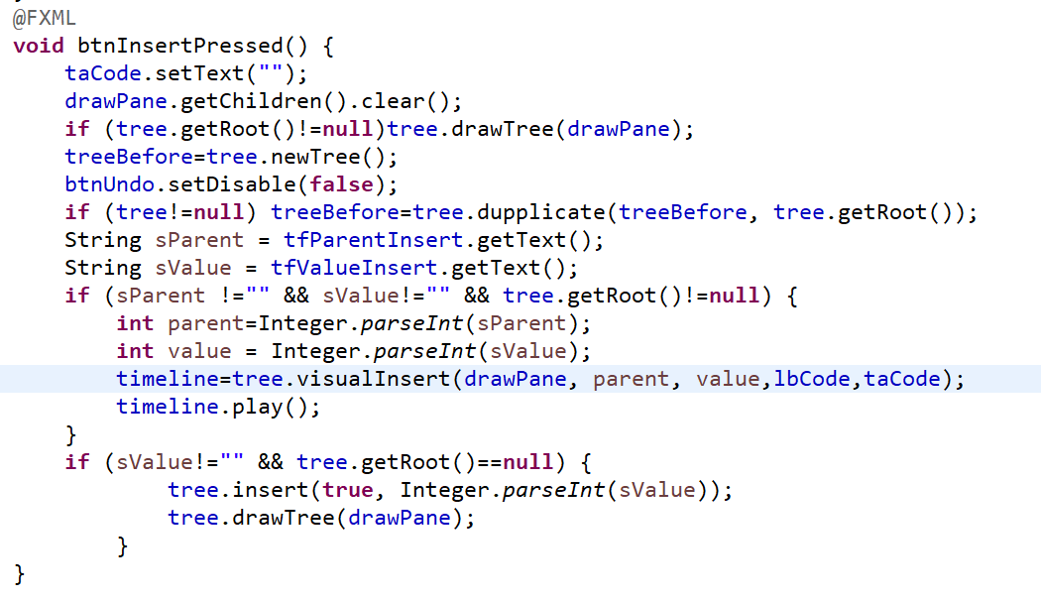
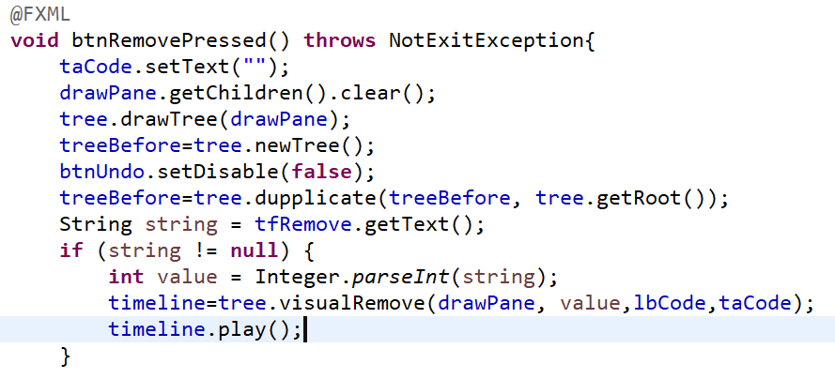
Polymorphism

Slide 9
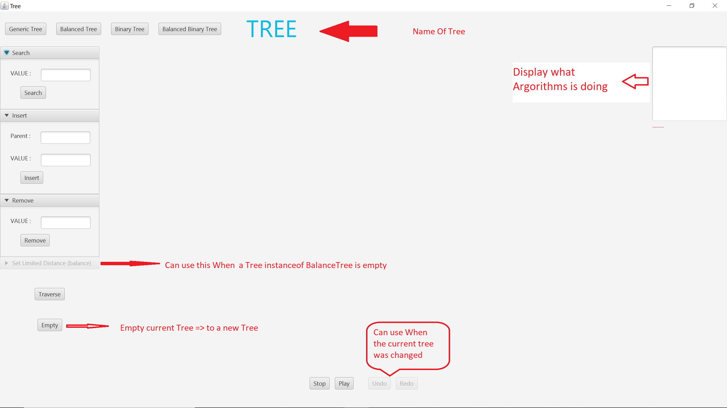
Demo Video
https://drive.google.com/drive/folders/1_5xj4V_bhx-r02q17pp0CIFHsMv1_Xxb?usp=sharing

Slide 10
Thank you for listening

