Slide 1
Object Oriented Programming Visualization of operations on tree data structures Professor: PhD Nguyen Thi Thu Trang Teaching Assistance: Nguyen Minh Chau
Group 2: Ngo Quang Huy - 20184272
Nguyen Viet Thang – 20184306
Nguyen Duc Dat - 2018421

Slide 2
Member & Assignment
Ngo Quang Huy – 20184272
Use JavaFX to design GUI for the project.
Nguyen Viet Thang – 20184306
Work with balance tree, support Huy to make GUI.
Nguyen Duc Dat – 20184241
Work with binary tree, make usecase diagram and class diagram.

Slide 3
Problem statement
Design a program using JavaFX to display and explain some basic operations four types of tree: generic tree, binary tree, balanced tree, balanced binary tree

Slide 4
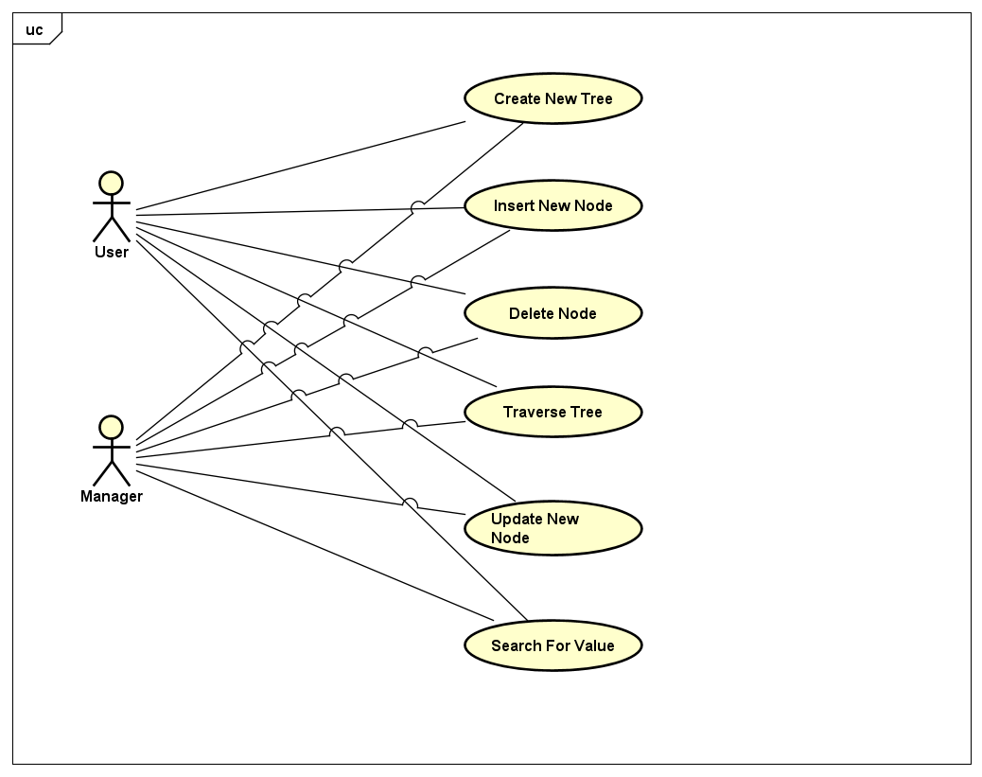
1. Usecase diagram

Slide 5
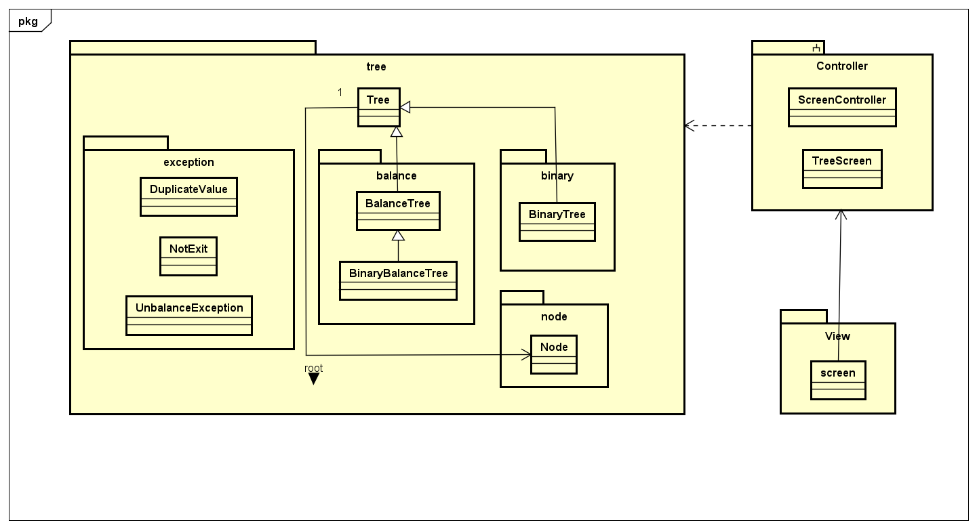
General class diagram

Slide 6
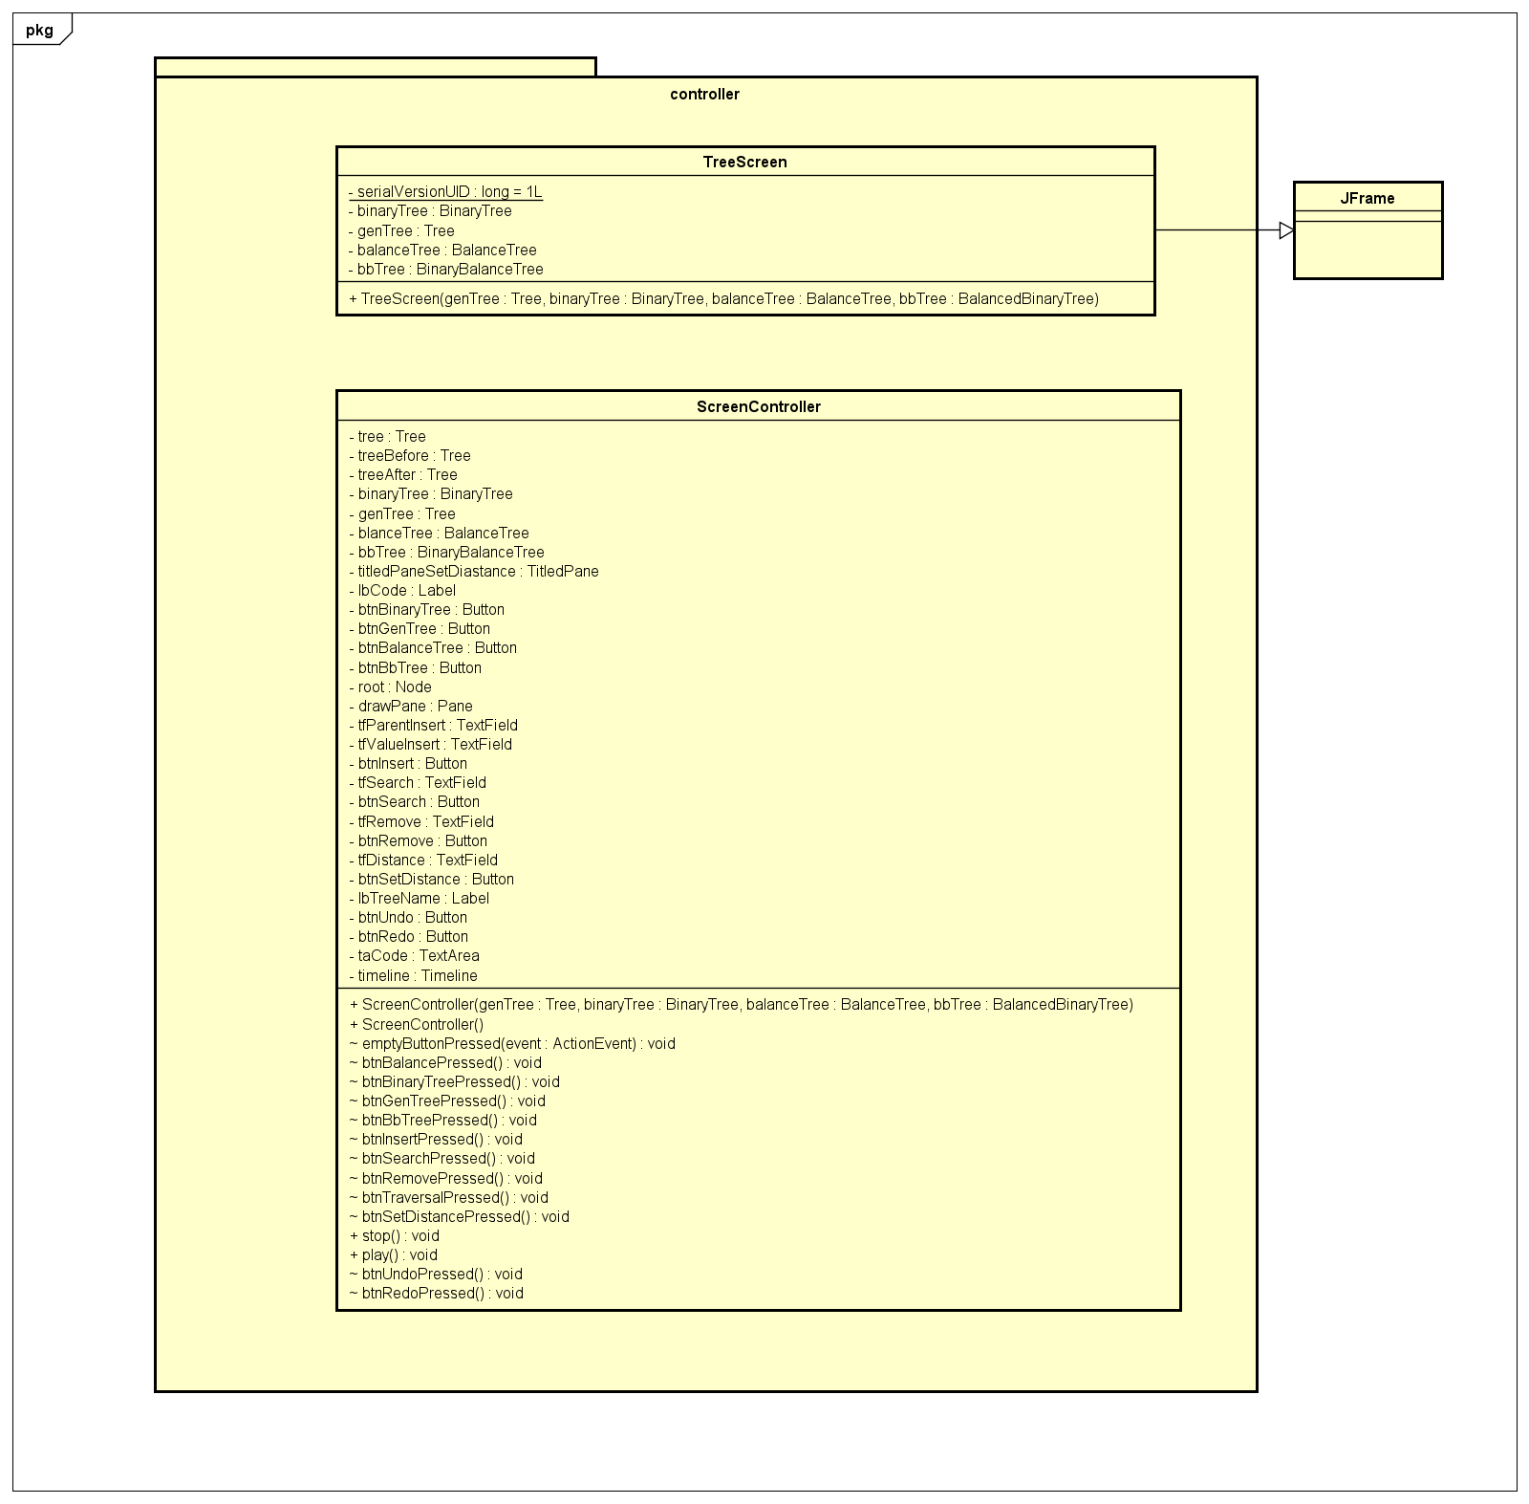
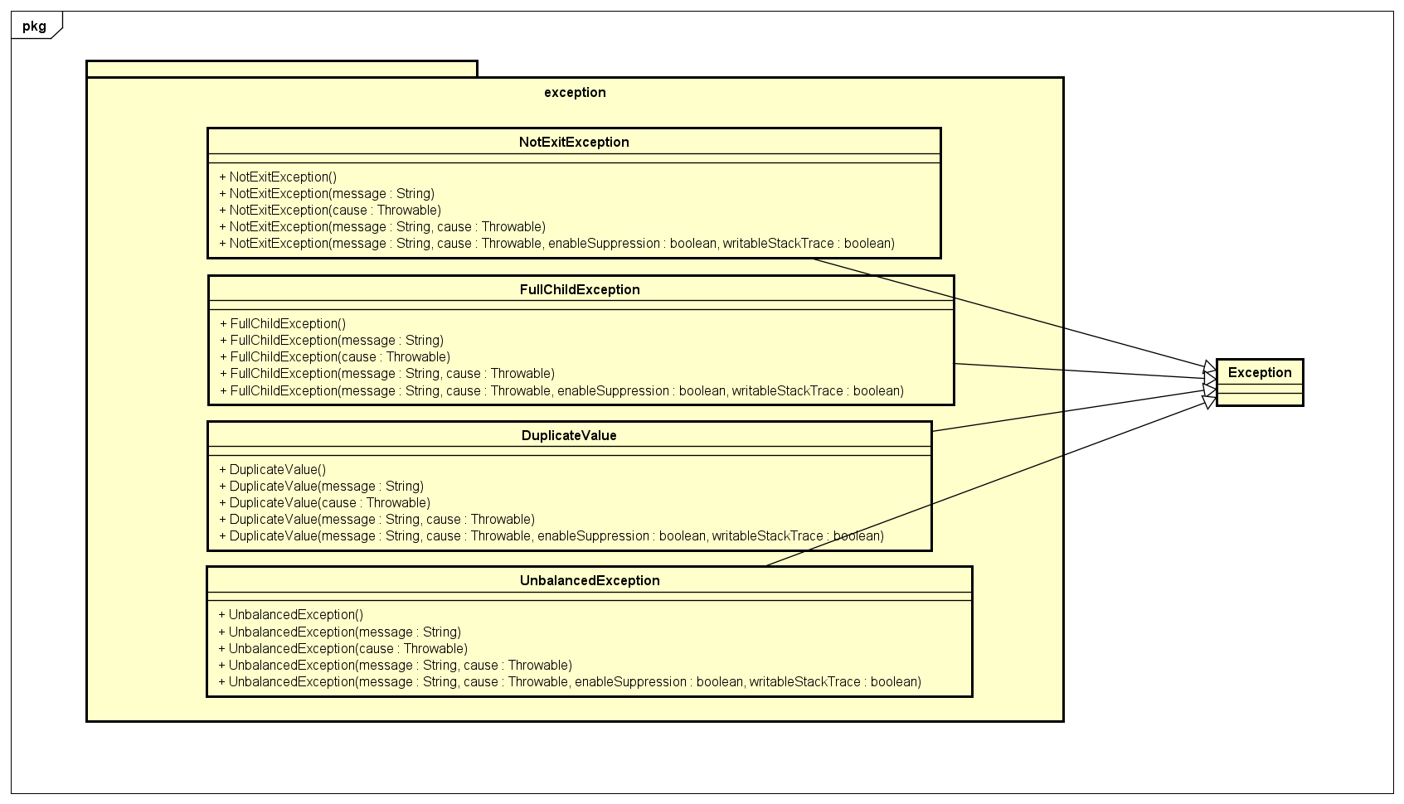
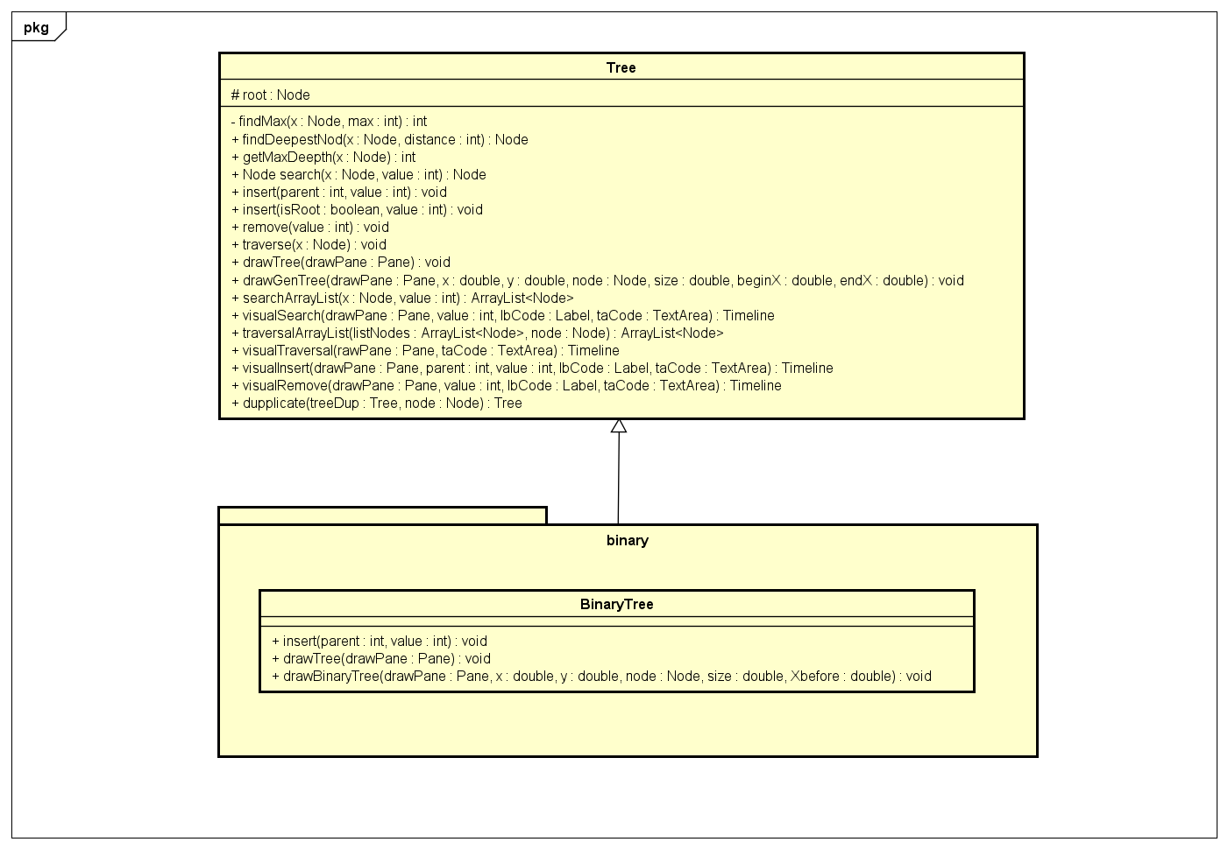
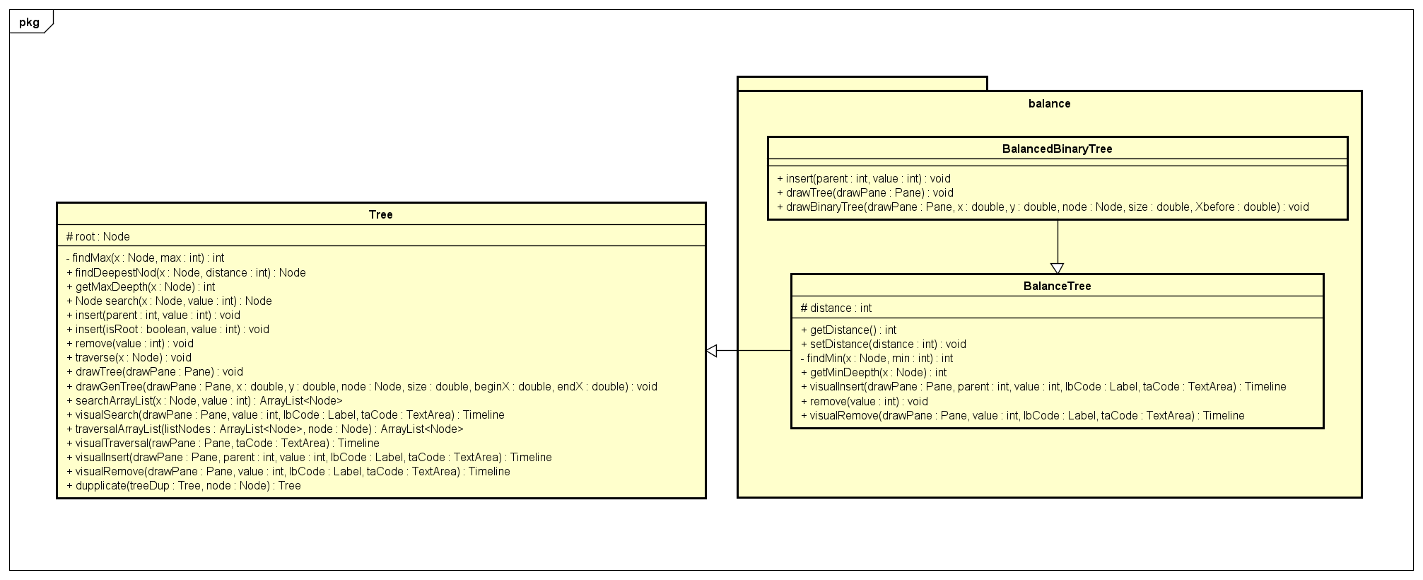
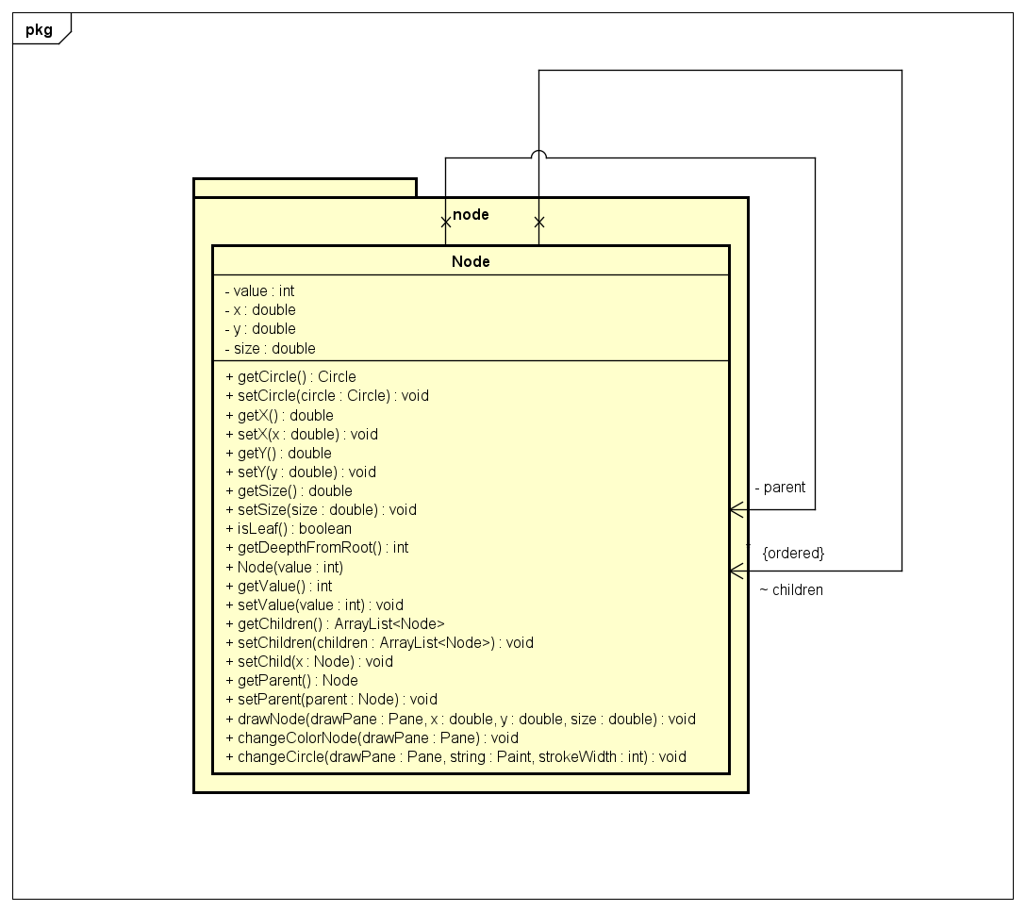
Class diagrams for packages

Slide 7
Explanation of OOP technique
1. Inheritance
Balanced Tree and Binary Tree extend from tree because they share the same attributes(root) and methods(search, traverse,..) with Tree
Balanced Binary Tree extend from Balanced Tree because it share the same attribute(distance) and methods(remove, getMinDeepth, …)
DuplicateValueException, FullChildException, NotExitException, Unbalanced Exception inherit from Exception
2 Polimorphism
Although Binary Tree and Balanced Tree share same methods and attribute, but insertion and deletion of them is different so in each class, we need to override this 2 method
3 Association/Aggregation/Composition
In Tree class, we instantiate a Node Object. Because tree and node can exist independently of each other, so the relationship between them is association

Slide 8
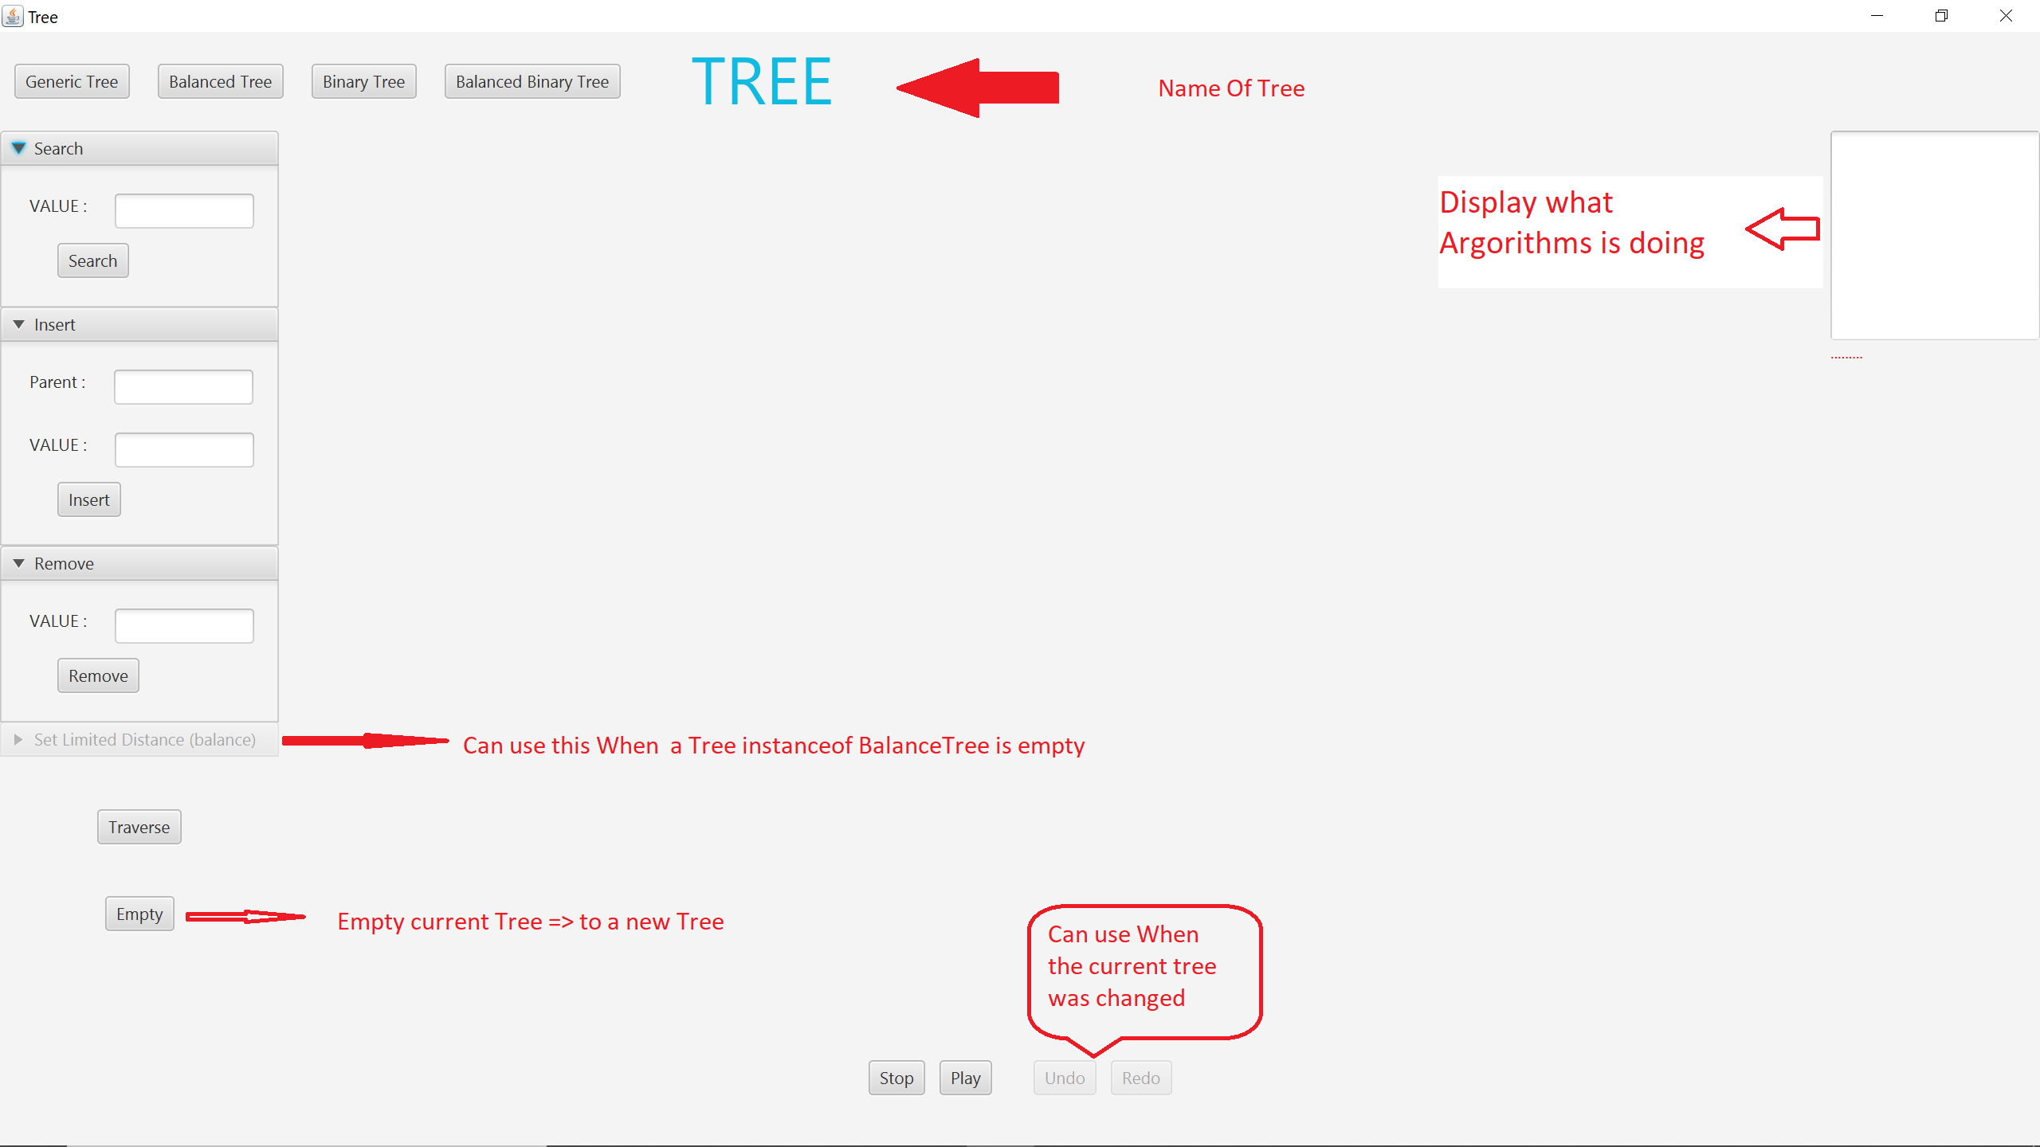
Demo Video
Video Demo :https://drive.google.com/drive/folders/1ZYCJLoF8S-e-QdfZzAFRlLUJq77OCPzz?fbclid=IwAR1bvs-fbeuu8_ndcNHGPrWoZdrvIWeK4TKD2uNKk3VMbjxflv2aLb3_dHs

Slide 9
Thank you for listening

