Slide 1


ASSIGNMENT 01
DS04/ Group04
June 3 2024

Slide 2




Members
Tran Xuan Bao Viet
-QE180024-
Nguyen Thanh Tin
-QE180020-
Nguyen Tan Thang
-QE180019-

Slide 3

1
Problem Statement
2
Assign Task
CONTENT
3
Data Understanding
4
Clean Data
5
Solving Problems
© Copyright FPT Software – Level of Confidentiality
© Copyright FPT Software – Level of Confidentiality

Slide 4
1. Problem Stament
_ Data:
Chicago Public Schools (2011-2012) Link
Chicago Socioeconomic Indicators (2008-2012) Link
Chicago Crime Data (2001-present) Link
© Copyright FPT Software – Level of Confidentiality

Slide 5
1. Problem Stament
_ Requirements:
Problem 1: Find the total number of crimes recorded in the CRIME table.
Problem 2: List community areas with per capita income less than 11000.
Problem 3: List all case numbers for crimes involving minors?
Problem 4: List all kidnapping crimes involving a child?(children are not considered minors for the purposes of crime analysis)
Problem 5: What kind of crimes were recorded at schools?
Problem 6: List the average safety score for all types of schools.

Slide 6
1. Problem Stament
Problem 7: List 5 community areas with highest % of households below poverty line.
Problem 8: Which community area(number) is most crime prone?
Problem 9: Use a sub-query to find the name of the community area with highest hardship index.
Problem 10: Use a sub-query to determine the Community Area Name with most number of crimes?

Slide 7
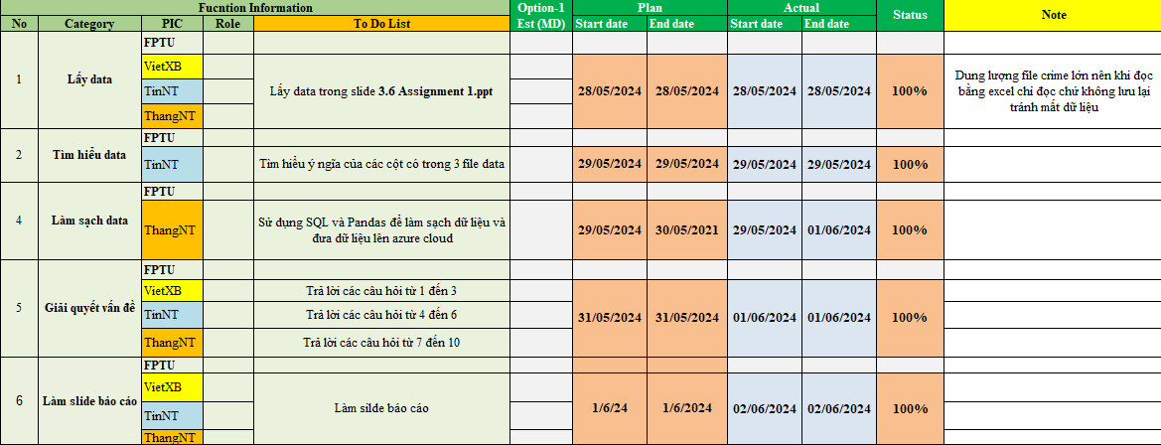
2. Assgin Task

Slide 8
3. Data Understanding
_ Chicago Public School:
Basic information about school: School_ID, NAME_OF_SCHOOL, Elementary_Middle_or_High School, Street_Address, City, State, Zip_Code, Phone_Number, Link, ...
Academic Performent: Pk-2 Literacy %, Pk-2 Math %, Gr3-5 Grade Level Math %, Gr3-5 Grade Level Read %, Gr3-5 Keep Pace Read %, Gr3-5 Keep Pace Math %, Gr6-8 Grade Level Math %, Gr6-8 Grade Level Read %, ...
Survey Result: Safty Score, Safty Icon, Leaders Score, Leaders Icon, Teacher Score, Teacher Icon, ...

Slide 9
3. Data Understanding
_ Chicago Socioeconomic Indicators:
Community Area Number - Community Area Number.
COMMUNITY AREA NAME - Community Area Name.
PERCENT OF HOUSING CROWDED - Percentage of housing units with more than one person per room.
PERCENT HOUSEHOLDS BELOW POVERTY - Percentage of households living below the federal poverty level.
PERCENT AGED 16+ UNEMPLOYED - Percentage of people aged 16 and over who are unemployed.

Slide 10
3. Data Understanding
PERCENT AGED 25+ WITHOUT HIGH SCHOOL DIPLOMA - Percentage of people aged 25 and over without a high school diploma.
PERCENT AGED UNDER 18 OR OVER 64 - Percentage of the population under 18 or over 64 years old (i.e., dependents).
PER CAPITA INCOME - Per capita income of the community area, estimated as the total aggregate income of the area divided by the total population.
HARDSHIP INDEX - A combined score of six selected socioeconomic indicators (see dataset description).

Slide 11
3. Data Understanding
_ Chicago Crimes:
Basic information: ID, Case Number, IUCR, Primary Type, Description, Arrest, Domestic, FBI Code.
Time: Date, Year, Updated On.
Location: Block, Location Description, Beat, District, Ward, Community Area, X Coordinate, Y Coordinate, Latitude, Longitude, Location.

Slide 12



4. Clean Data
4.1 Step by Step
Clean data in Azure
Clean data by pandas
small
big
Chicago Public Schools
Chicago Socioeconomic
Chicago Crimes

Slide 13
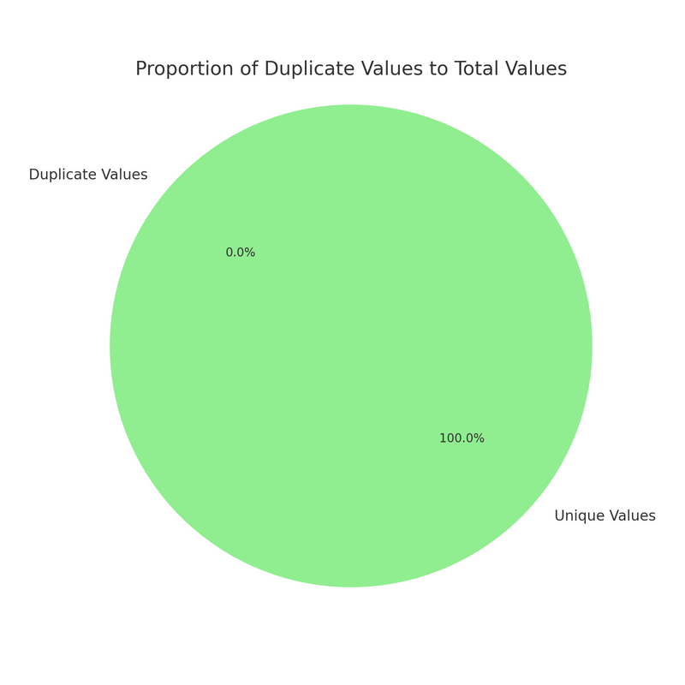
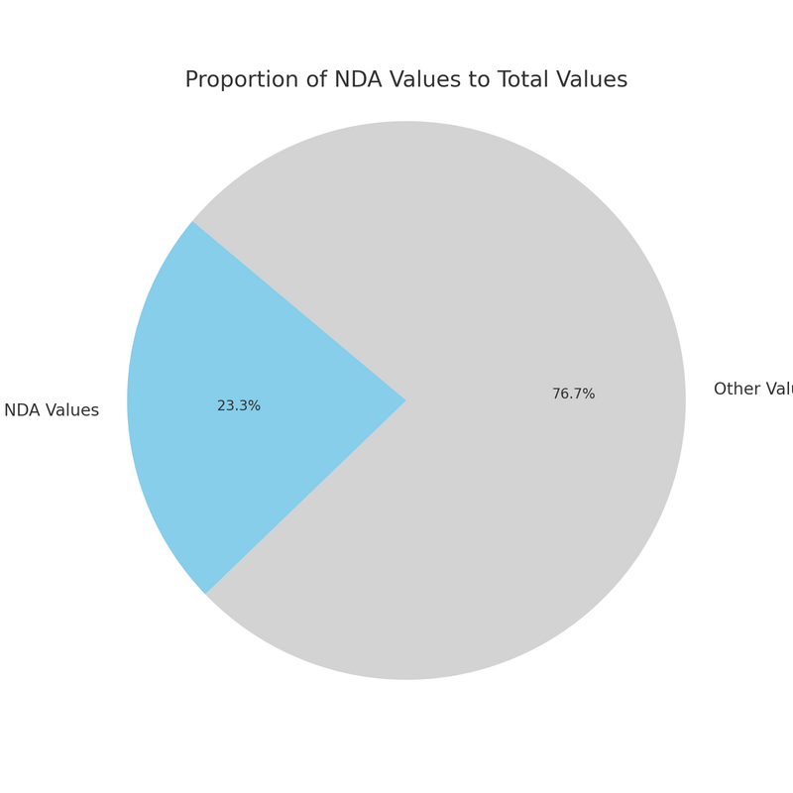
4. Clean Data
4.2 Data Cleaning
_ Chicago Public Schools:
The number of 'NDA' values in the dataset is 10,296 out of 44,148 .
Change all that to ‘NULL” values for consistency.
There are no duplicate value.

Slide 14
4. Prepare Data and Clean Data
4.2 Data Cleaning
_ Chicago Public Schools:
tblChicagoPublicSchools
tblAcademic_Performence
tblChicagoPublicSchools
tblContact_Address
tblCommunity
tblSurvey_Result

Slide 15
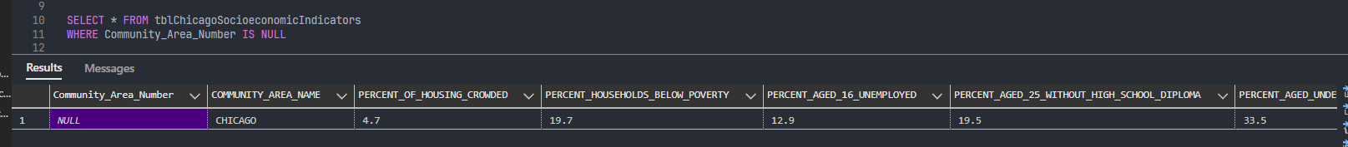
4. Clean Data
4.2 Data Cleaning
_ Chicago Socioeconomic:
Remove the null values of Community_Area_Number.

Slide 16
4. Clean Data
4.2 Data Cleaning
_ Chicago Crime:
Because the file is too large so we must handle it by pandas first.
Split data into 4 .csv file, clean them by remove NaN and duplicated value.
tblChicagoCrime ('ID', 'IUCR', 'Case Number',
'FBI Code', 'Arrest', 'Domestic', 'Date', 'Updated On')
tblIUCR ('IUCR', 'Primary Type', 'Description')
tblChicagoCrime
tblCrimeAddress ('ID','Block','Location Description','Beat','District','Ward','Community Area')
tblCrimeGeometry ('ID','X Coordinate',
'Y Coordinate','Latitude','Longitude')

Slide 17
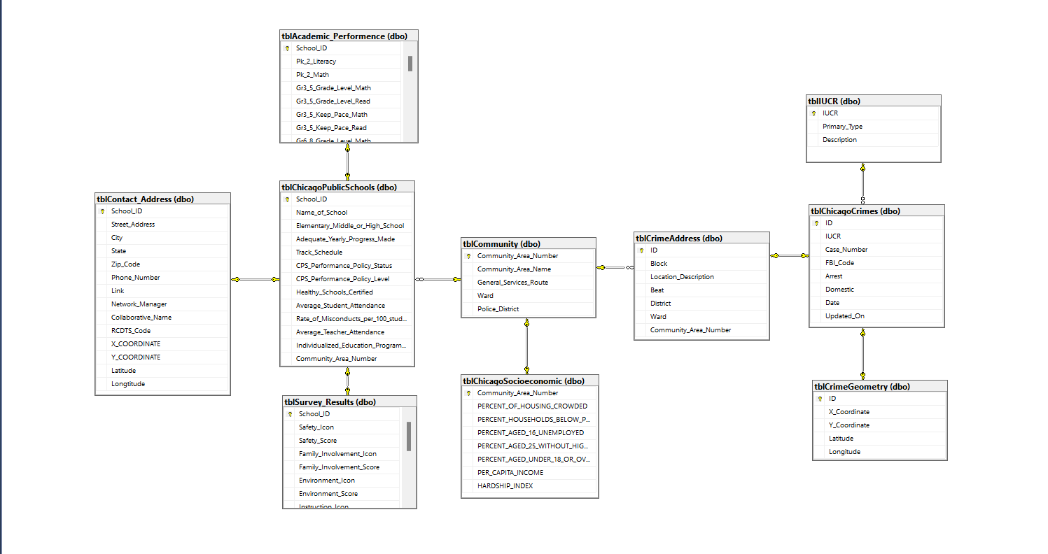
4. Clean Data
4.2 Data Cleaning
_ Database Diagram:

Slide 18
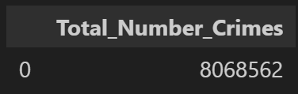
5. Solving Problem
_ Problem 1: Find the total number of crimes recorded in the CRIME table.

Slide 19
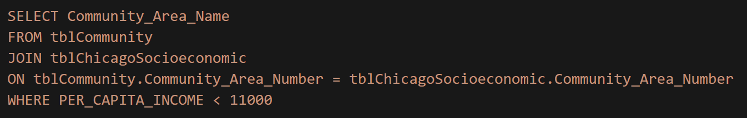
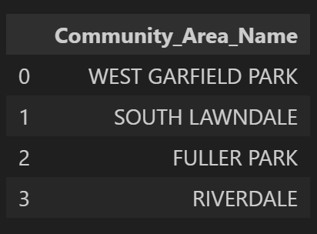
5. Solving Problem
_ Problem 2: List community areas with per capita income less than 11000.

Slide 20
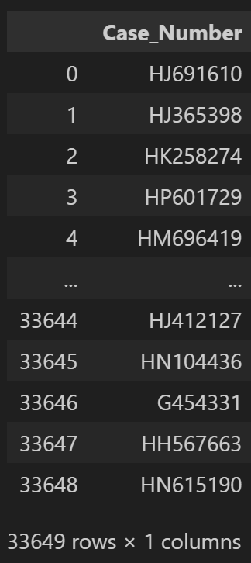
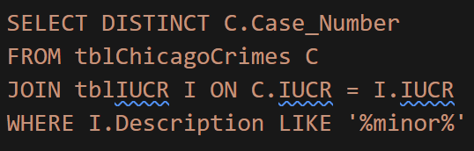
5. Solving Problem
_ Problem 3
List all case numbers for crimes involving minors.

Slide 21
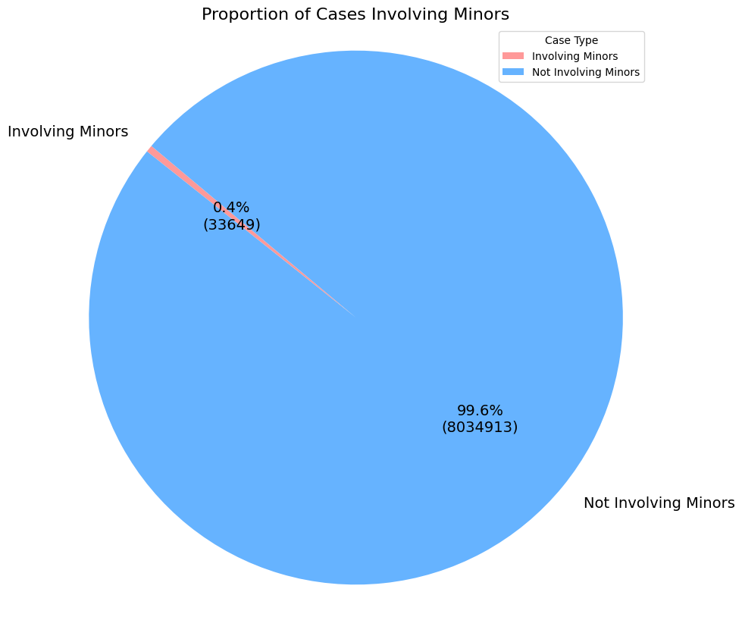
5. Solving Problem
_ Problem 3: List all case numbers for crimes involving minors.

Slide 22
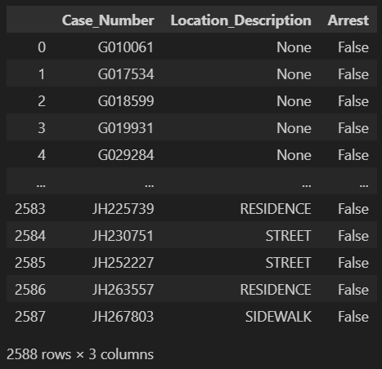
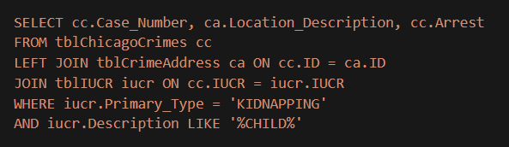

5. Solving Problem
_ Problem 4: List all kidnapping crimes involving a child? (children are not considered minors for the purposes of crime analysis)
A total of 2588 cases were recorded.

Slide 23
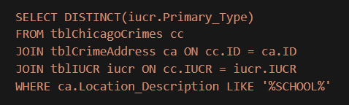
5. Solving Problem
_ Problem 5: What kind of crime were recorded at schools?

Slide 24
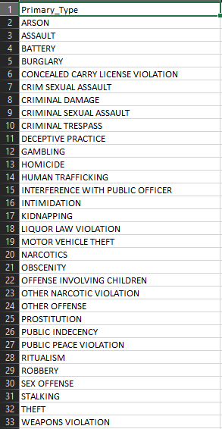
5. Solving Problem
_ Problem 5: What kind of crime were recorded at schools?
A total of 32 different types of crimes are recorded
Battery is the highest: 24.48%

Slide 25
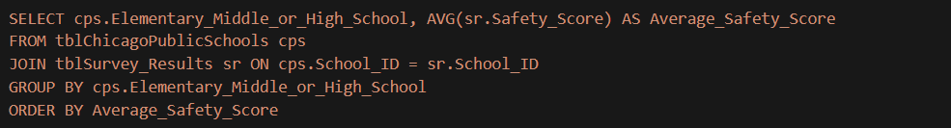
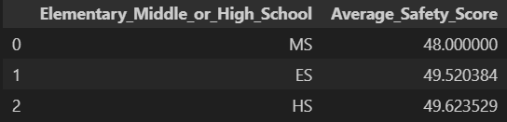
5. Solving Problem
_ Problem 6: List the average safety score for all types of schools.

Slide 26

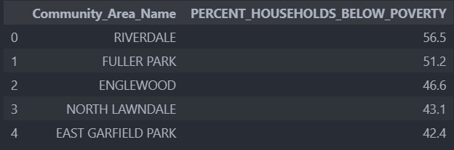
5. Solving Problem
_ Problem 7: List 5 community areas with highest % of households below poverty line.

Slide 27
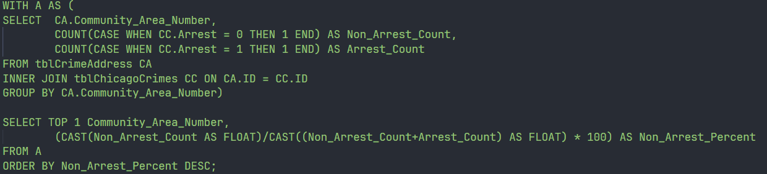

5. Solving Problem
_ Problem 8: Which community area(number) is most crime prone?

Slide 28
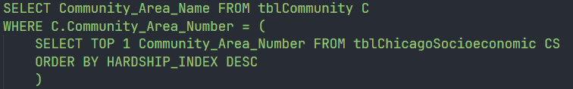

5. Solving Problem
_ Problem 9: Use a sub-query to find the name of the community area with highest hardship index.

Slide 29
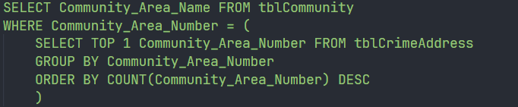

5. Solving Problem
_ Problem 10: Use a sub-query to determine the Community Area Name with most number of crimes?

Slide 30

THANKS FOR WATCHING

