Slide 1


FINAL PROJECT
USED CAR PRICE PREDICTION
Nguyen Tan Thang - QE180019
July 29 2024

Slide 2


1
Introduction
2
Data Exploring
CONTENT
3
Modeling
4
Deployment
5
Future Development
© Copyright FPT Software – Level of Confidentiality
© Copyright FPT Software – Level of Confidentiality

Slide 3

1. Introduction
Predicting used car prices is a common problem in the field of machine learning and data analysis. The goal of this project is to build a model that can predict the price of a used car based on its attributes, such as the year of manufacture, brand, model, mileage, etc from given data.
© Copyright FPT Software – Level of Confidentiality

Slide 4
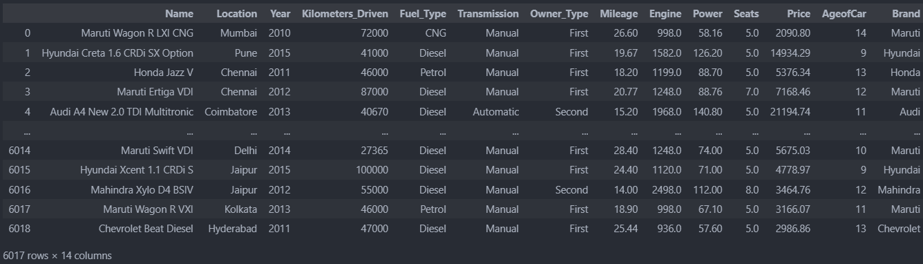
2. Data Exploring
2.1. Dataset Overview
Dataset have 6017 rows vs 14 columns.

Slide 5
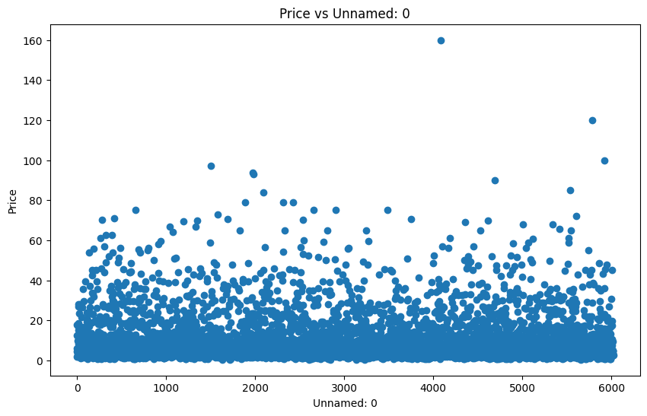
2. Data Exploring
2.1. Cleaning Data
Handling [Unnamed: 0] column.
There is no relationship between Unnamed: 0 vs Price and it look like index column so I will drop it

Slide 6
2. Data Exploring
2.1. Cleaning Data
Checking the unit of the mileage
There are 2 unique unit in mileage are: km/kg and kmpl.
When the Fuel_Type is CNG or LPG then the unit of the Mileage is km/kg and other Fuel_Type is meansured in kmpl.
Since those units are in km for both of them no need of conversion.
Remove unit of Mileage.
Replace 0.0 values with NaN.

Slide 7
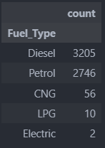
2. Data Exploring
2.1. Cleaning Data
Checking Fuel_Type
There are 5 unique values in Fuel_Type are Diesel, Petrol, CNG, LPG, Electric.
Electric have only 2 values, too small to make a prediction so drop it.

Slide 8
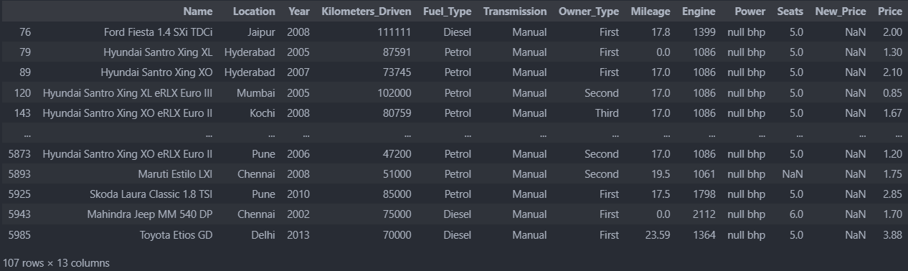
2. Data Exploring
2.1. Cleaning Data
Checking Engine and Power
The unit of Engine is CC and the unit of Power is bhp.
Remove bhp and replace null with NaN.

Slide 9
2. Data Exploring
2.1. Cleaning Data
Checking Tranmission, Owner_Type, Seats
Types of Tranmission: Manual and Automatic.
Types of Owner_Type: First, Second, Third, Fourth & Above.
Types of Seats: 0, 5, 6, 7, 8, 9, 10. There is one car with 0 seat, replace seat of that car with NaN value.

Slide 10
2. Data Exploring
2.1. Cleaning Data
Checking New_Price
There are 5194 null values in New_Price, this take 86.3% of all data. Drop New_Price column.
Checking Price
1 Lakh = 100000 Rupee (India money) and 1 USD = 83.7 Rupee.
Convert all price from Lakh to USD.

Slide 11
2. Data Exploring
2.1. Cleaning Data
Checking Year
Create Age of Car column = current year(2024) - year.
Checking Name
Create Brand of Car colum which is the first word of Name.
There are 30 brands from train data.
Drop Name column.

Slide 12
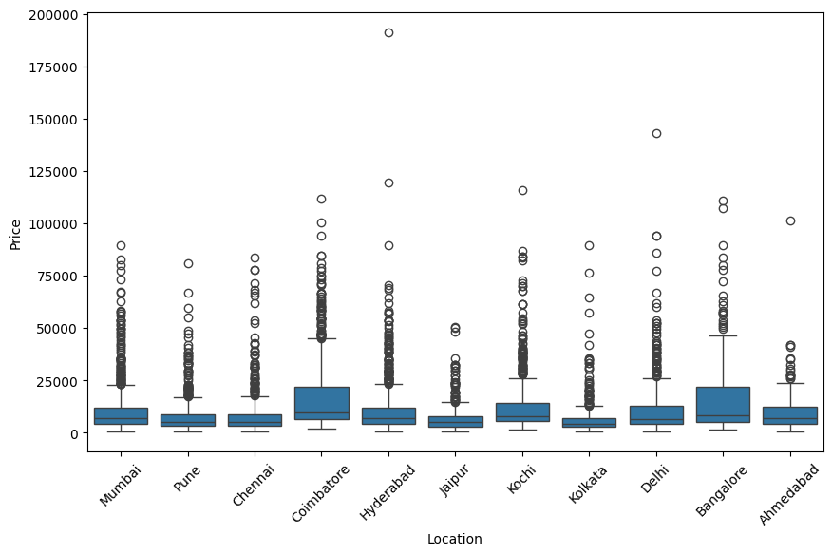
2. Data Exploring
2.1. Cleaning Data
Checking Location
Location does not have much influence on car price so drop it.

Slide 13
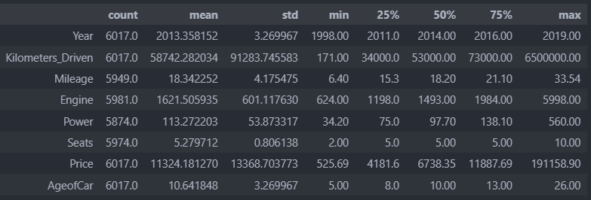
2. Data Exploring
2.1. Exploratory Data Analysis
Data describle

Slide 14
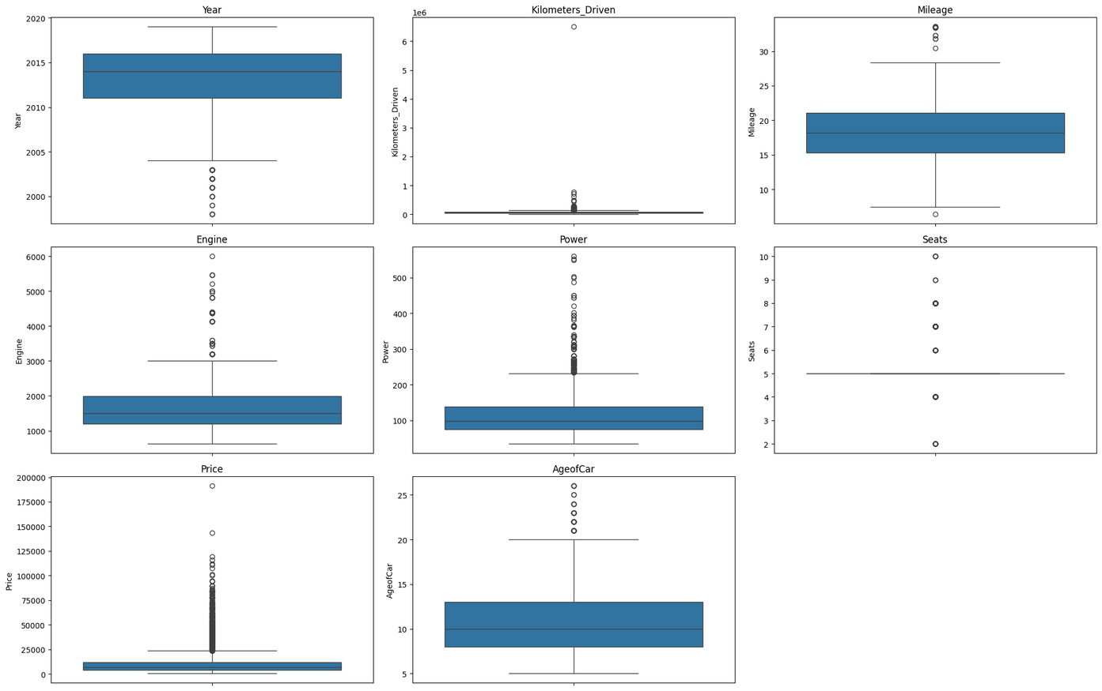
2. Data Exploring
2.1. Exploratory Data Analysis
Box plot of numerical columns

Slide 15
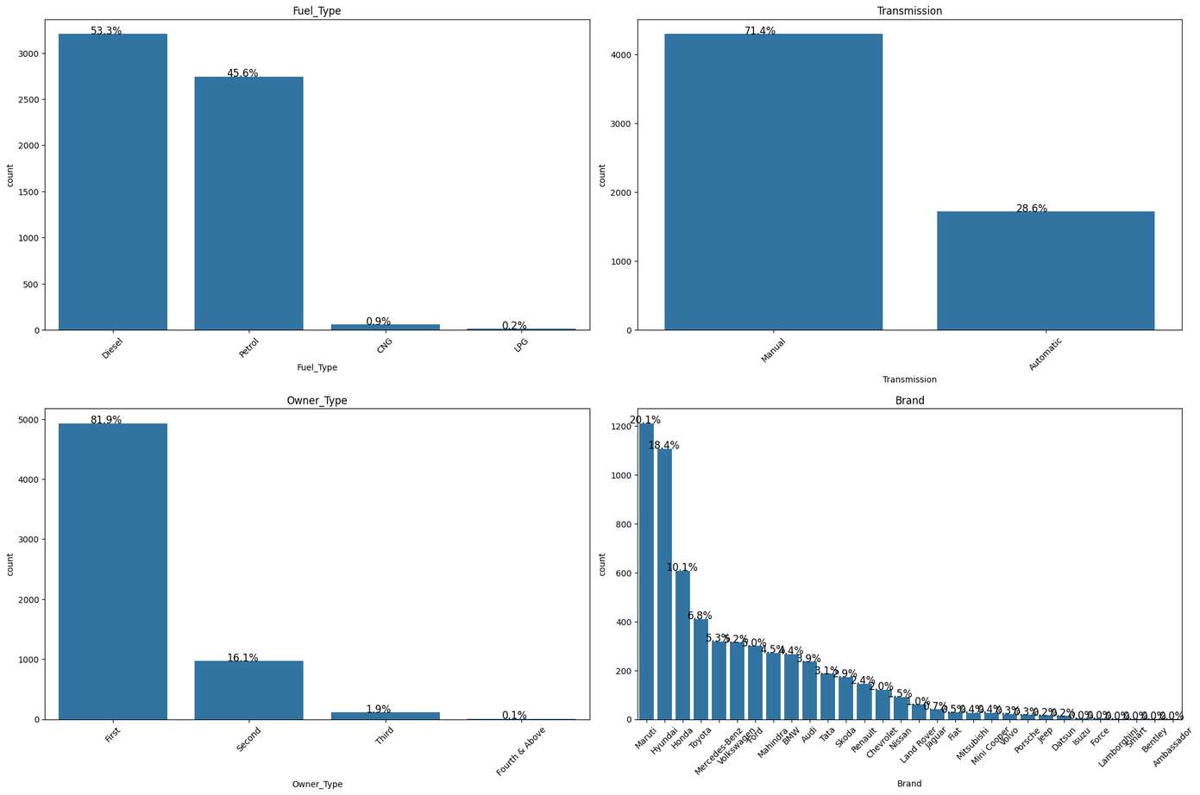
2. Data Exploring
2.1. Exploratory Data Analysis
Distribution of categories columns

Slide 16
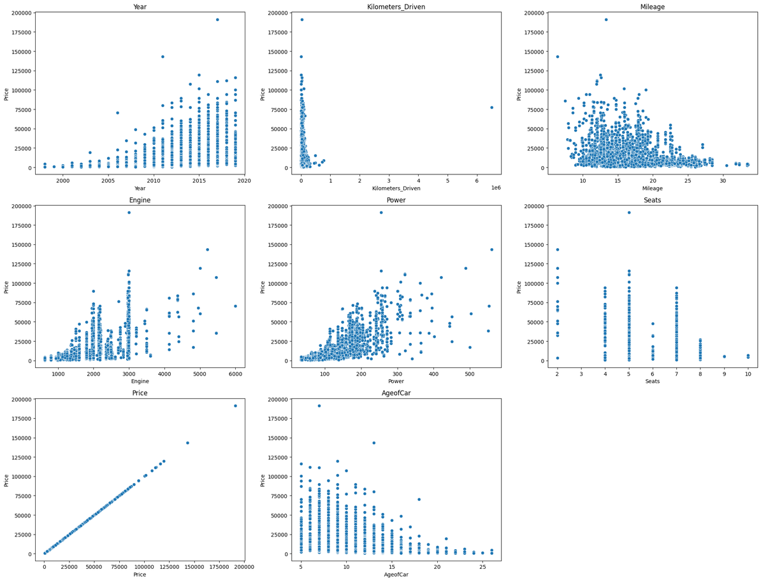
2. Data Exploring
2.2. Exploratory Data Analysis
Correlation beetween feature and price

Slide 17
2. Data Exploring
2.2. Exploratory Data Analysis
Observations
71.4% cars available for sell have manual Transmission.
81.9% cars are First owned cars.
38.5% of car available for sale are from Maruti & Hyundai brands.
53.2% of car being sold/avialable for purchase have fuel type as Diesel.
Most of the cars are 5 seats.
Car being sold/available for purchase are in 5 - 26 years old
Power and Engine have high effect into price
Kilometers_Driven have extreme outliers.

Slide 18
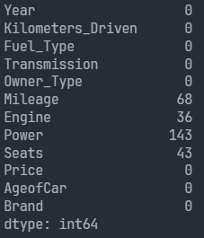
2. Data Exploring
2.3. Handling missing values and outliers
Fill all null values with mean of that column. The seat column is rounded.
Sum of null values

Slide 19
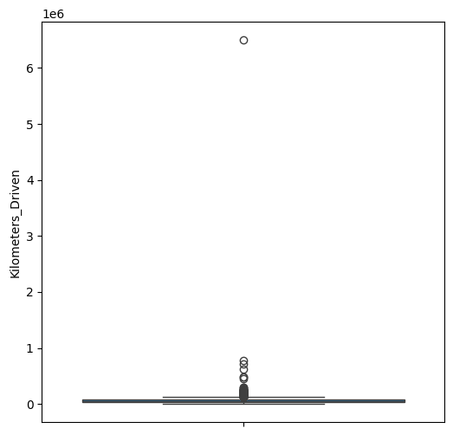
2. Data Exploring
2.3. Handling missing values and outliers
The extreme outlier is a car with kilometers driven is 6500000 (km). Drop it.
Save the cleaned data in sqlite database.

Slide 20
3. Modeling
3.1. Encode
Encode Object Data (Fuel_Type, Tranmission, Owner_Type, Seats, Brand) with OrdinalEncoder in Python.
Save the encoder of the train data in pickle file

Slide 21
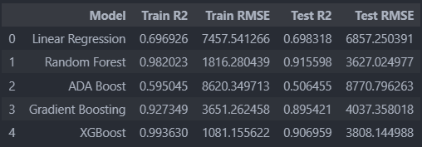
3. Modeling
3.2. Building Model
Spilliting train data to 80% train and 20% test.
Building model with 5 models: LinearRegression, RandomForest, ADA Boost, Gradient Boost, XGBoost.
Evaluating model:

Slide 22
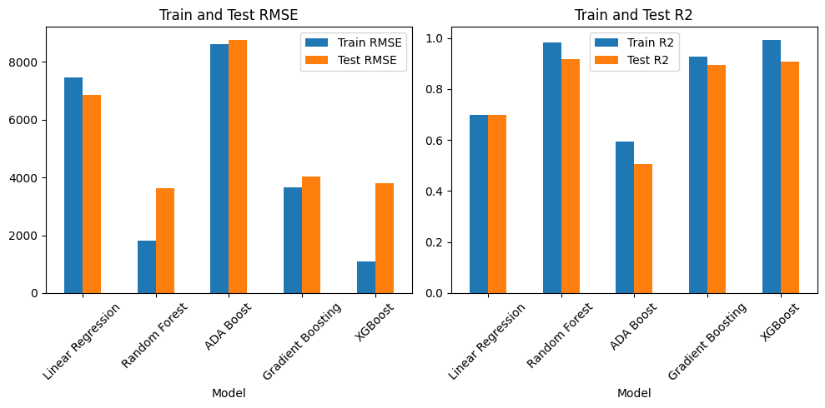
3. Modeling
3.2. Building Model

Slide 23
3. Modeling
3.2. Building Model
Random Forest and XGBoost models have the highest R² scores and the lowest RMSE scores.
However, on the test data, the Random Forest model performs better, so we choose the Random Forest model.
Train model with all of the train data with Random Forest model and GridSearchCV to find the best parameters for the model.
R² score after using GridSeachCV is 0.87.
Save model in pickle file
Predict price for test data and save it to .csv.

Slide 24
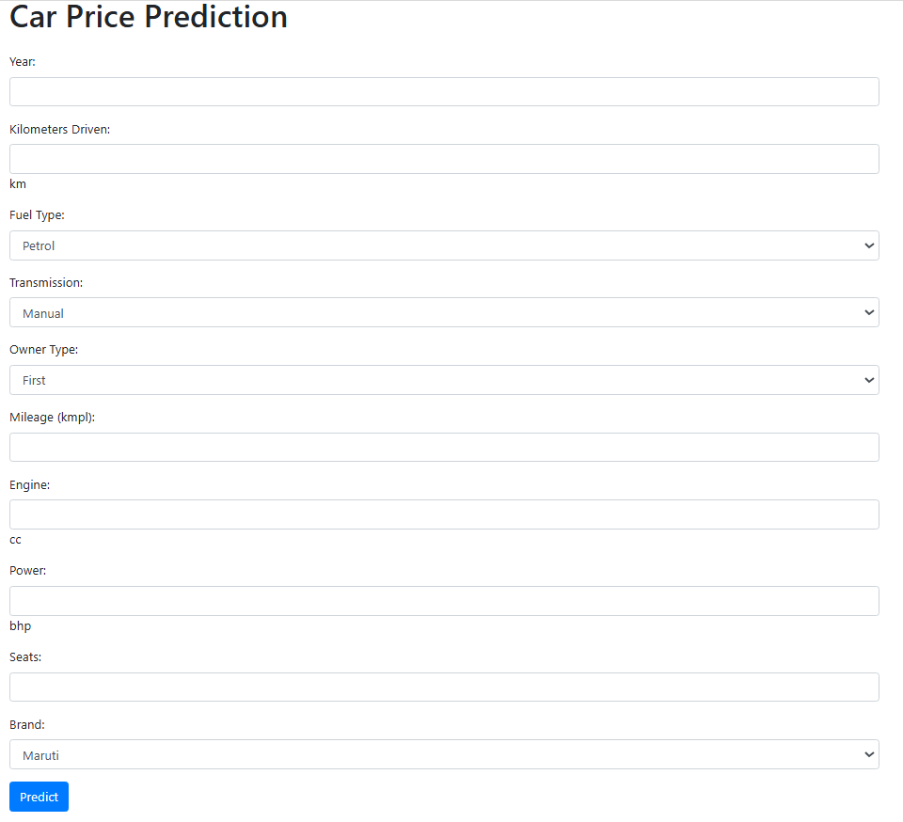
3. Deployment
Using Flask and html to create a webapp.

Slide 25
4. Future Development
Save user input records.
Check the model's overfitting status.
Check the model's overfitting status.

Slide 26

THANKS FOR WATCHING

