Slide 1
Introduction about Theory of Computation

Slide 2
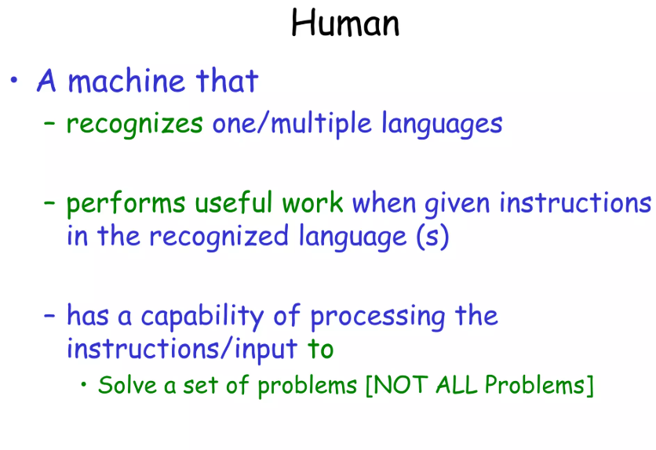

Slide 3
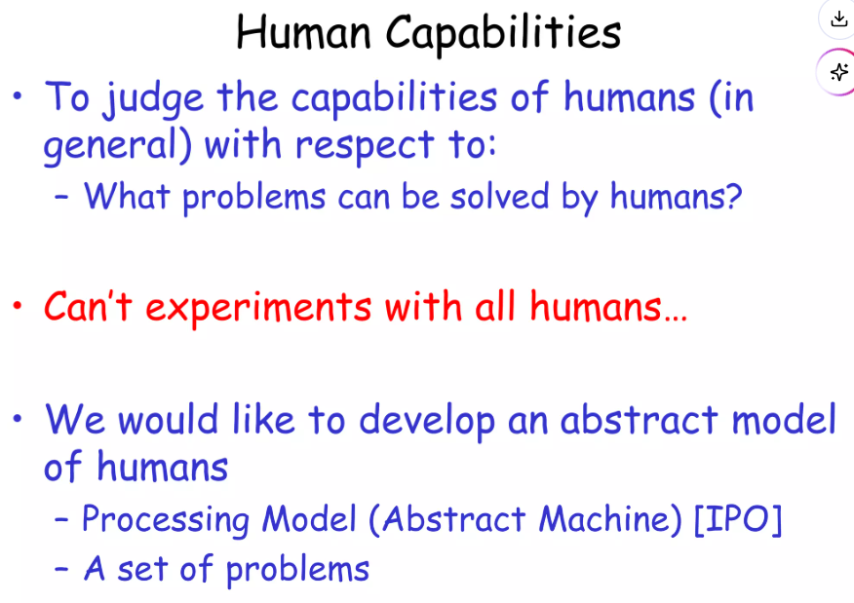

Slide 4
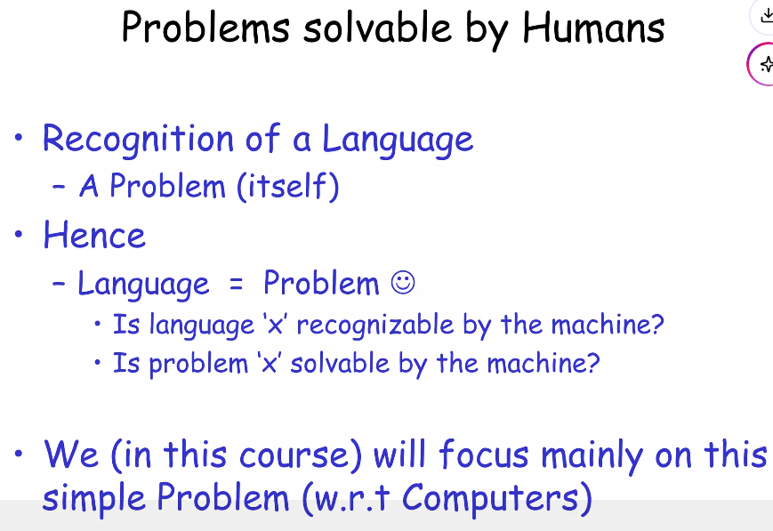

Slide 5
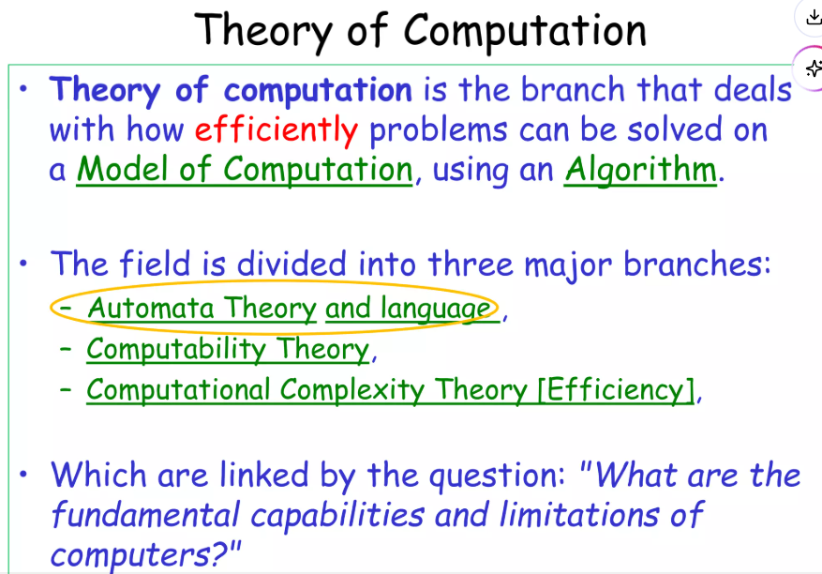

Slide 6
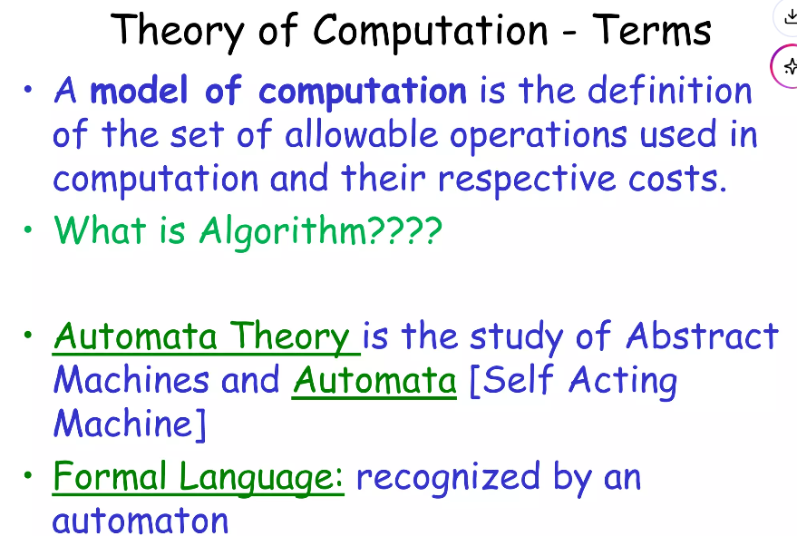

Slide 7
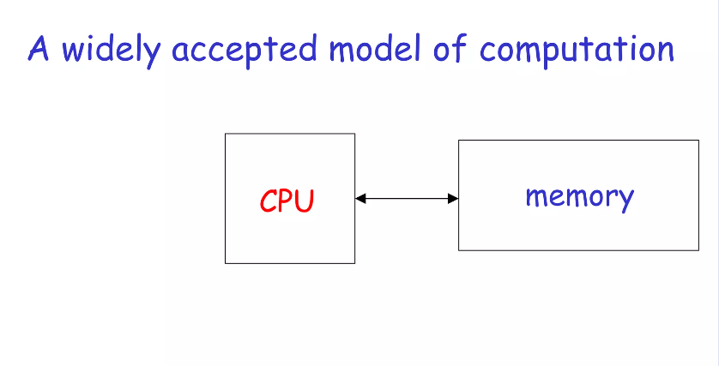

Slide 8
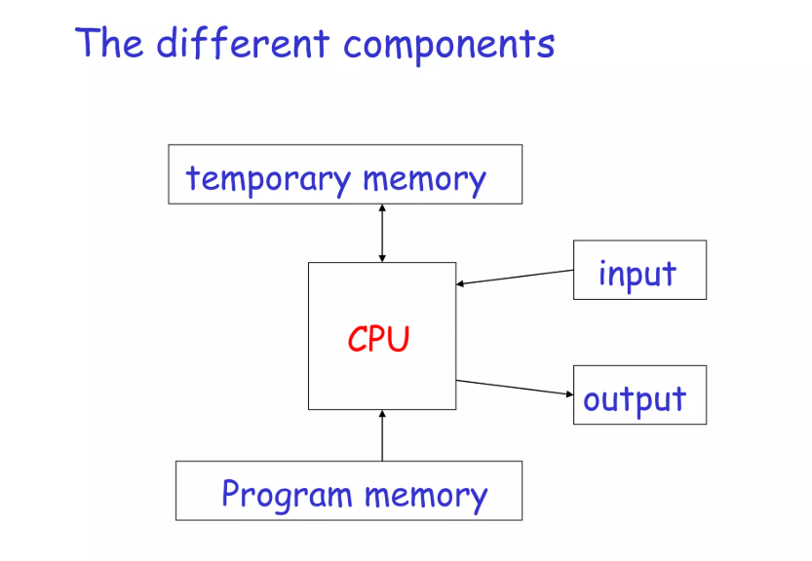

Slide 9
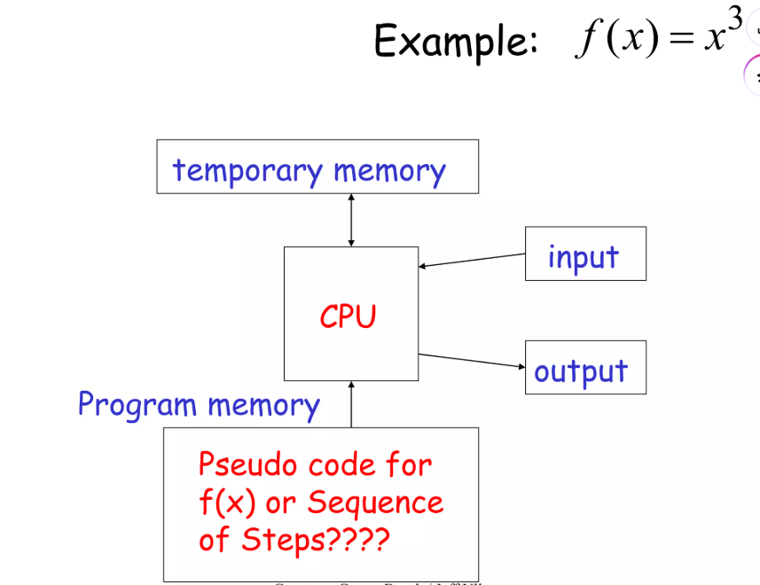

Slide 10
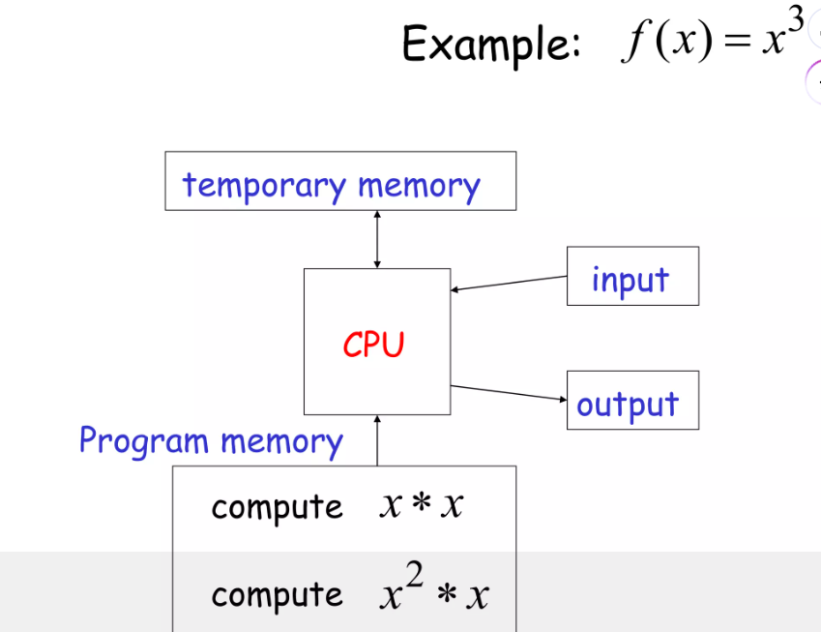

Slide 11
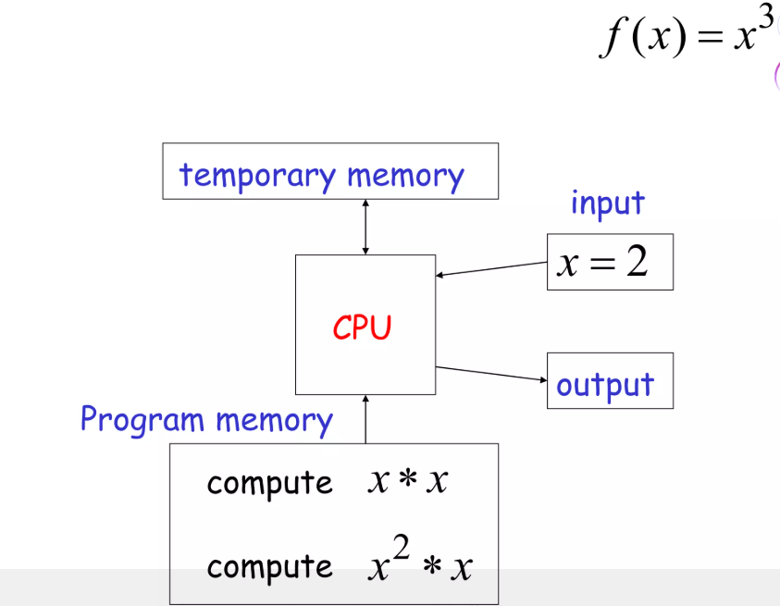

Slide 12
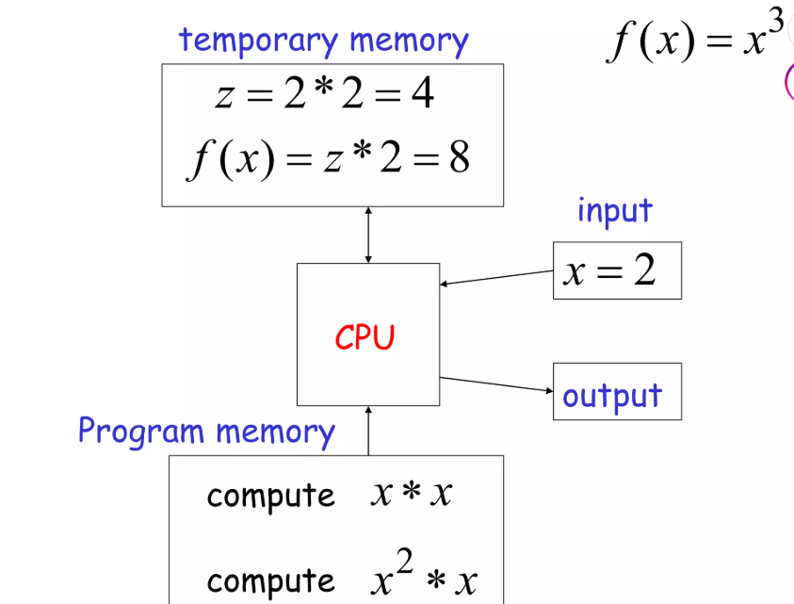

Slide 13
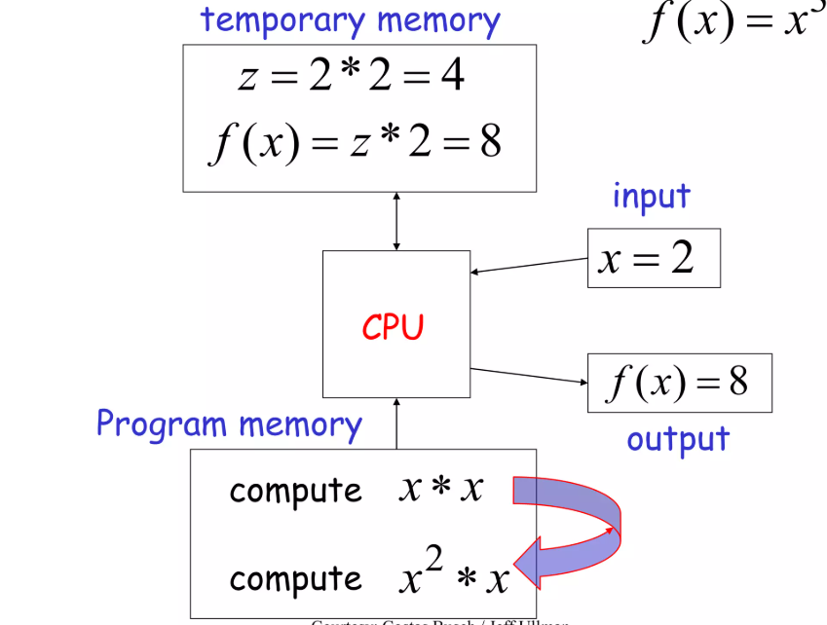

Slide 14
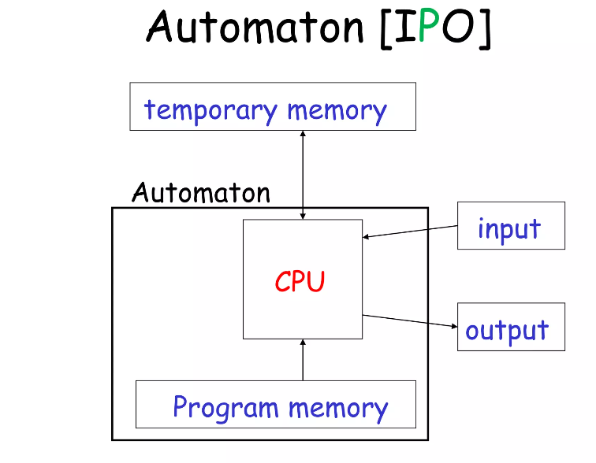

Slide 15
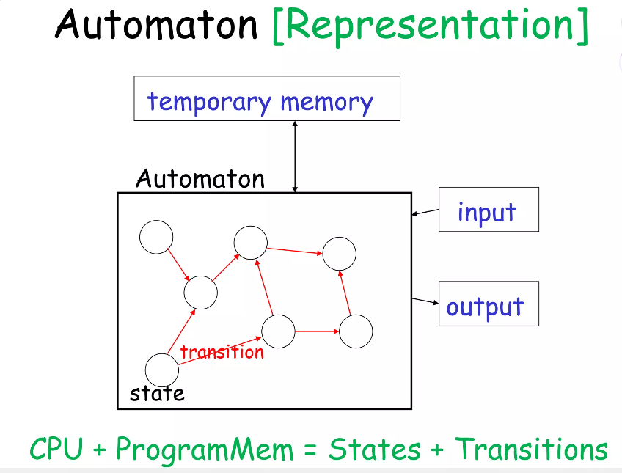

Slide 16
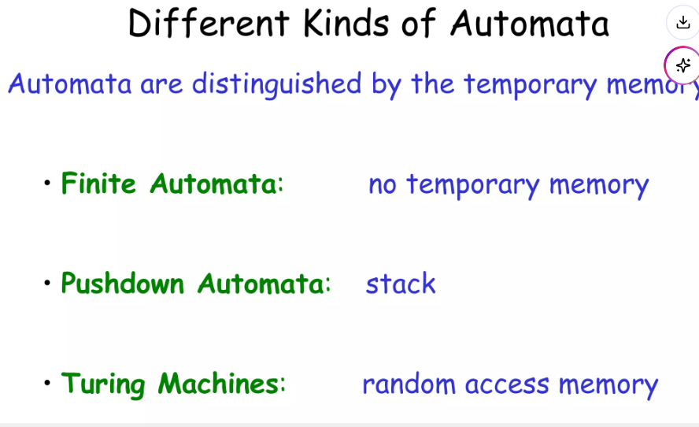

Slide 17
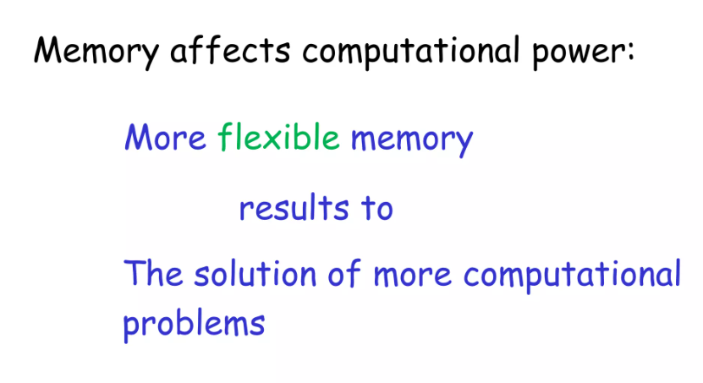

Slide 18
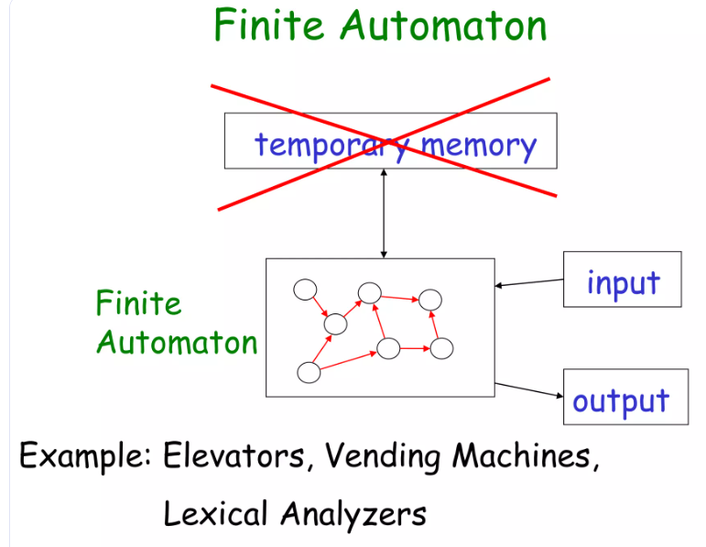

Slide 19
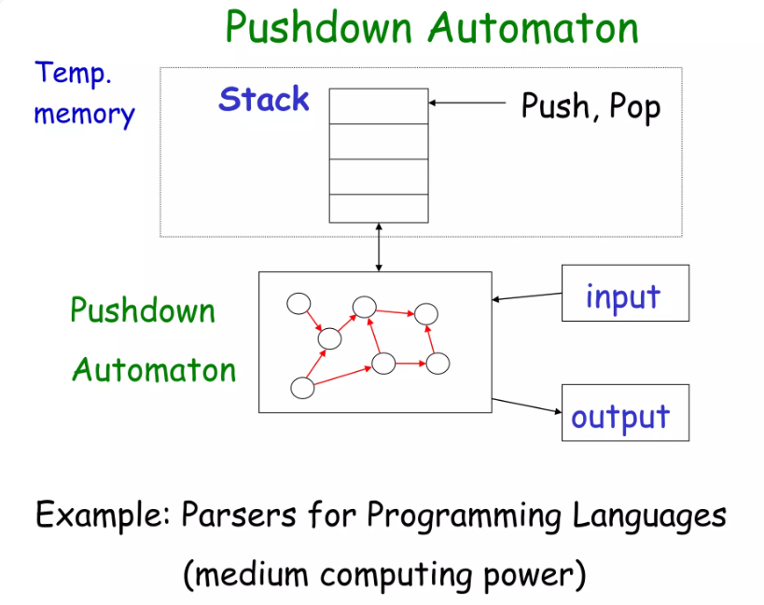

Slide 20
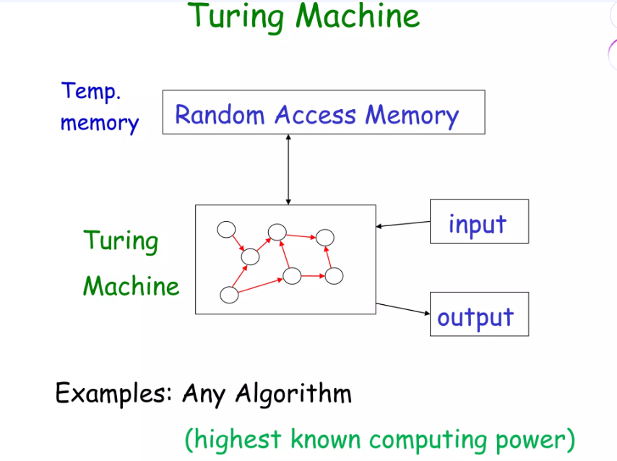

Slide 21
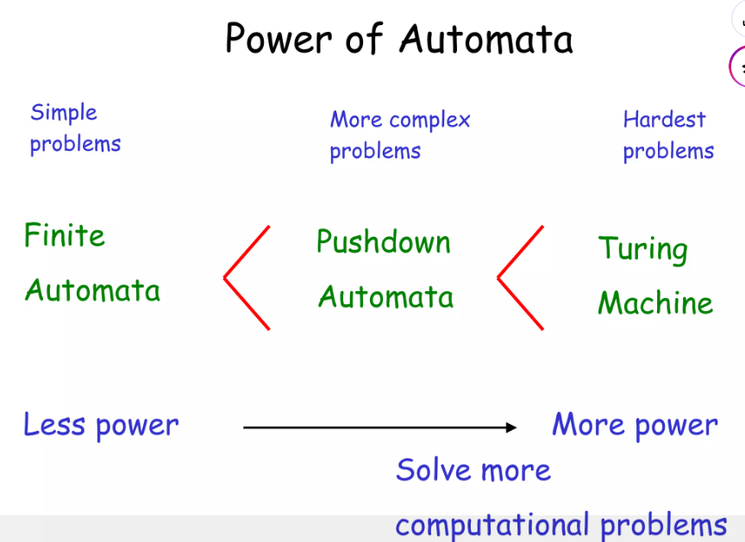

Slide 23
UNIT I - AUTOMATA AND REGULAR EXPRESSIONS
1. formal proof
2.Deterministic Finite Automata (DFA) - MINIMIZED D
3.Non-deterministic Finite Automata (NFA) - convert NFA TO DFA
4. NFA WITH EPCILON TO with out epcilon

Slide 24
UNIT II - REGULAR EXPRESSIONS AND LANGUAGES
1.Regular Expressions
2. Properties of Regular Languages
3. Pumping Lemma
4. Closure properties of regular languages.

Slide 25
UNIT III - CONTEXT FREE GRAMMAR AND PUSH DOWN AUTOMATA
1. Context-Free Grammars and Languages
2. Ambiguity in grammars
3. Push Down Automata
4. Equivalence of PDA's and CFG's
5. Deterministic Pushdown Automata

Slide 26
UNIT IV - NORMAL FORMS AND TURING MACHINES
1. Chomsky Normal Form (CNF
2. Greibach Normal Form (GNF)
3. Turing Machine

Slide 27
UNIT V - UNDECIDABILITY
1. A Language that is Not Recursively Enumerable
2. Post's Correspondence Problem (PCP)
3. Recursive and recursively enumerable languages
4. NP completeness Problem

