Slide 1

Circuit Breaker Pattern
Thang Vỹ Nam - ZaloPay

Slide 2
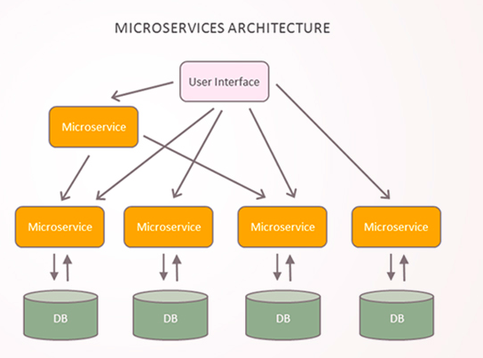
Actual Situation
Microservice architecture
Inter process communication
Services collaborate when handling requests

Slide 3

Drawback
One service synchronously invokes another there is always the possibility that the other service is unavailable or is exhibiting such high latency
Resources such as threads might be consumed in the caller while waiting for the other service to respond
Lead to resource exhaustion, which would make the calling service unable to handle other request

Slide 4
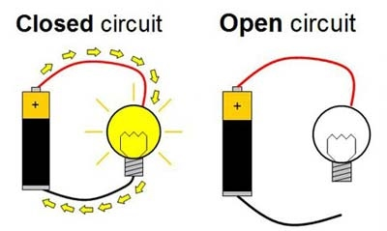
Circuit Breaker Pattern
Circuit Breaker (CB) is a design pattern used in modern software
Used to wrap dangerous operations in a component
Tripping of a circuit happens automatically in case of failure
Facilitates self-healing applications, as in case of open circuit application decides :
To use another similar service or
To stop using the service till a timeout occurs

Slide 5
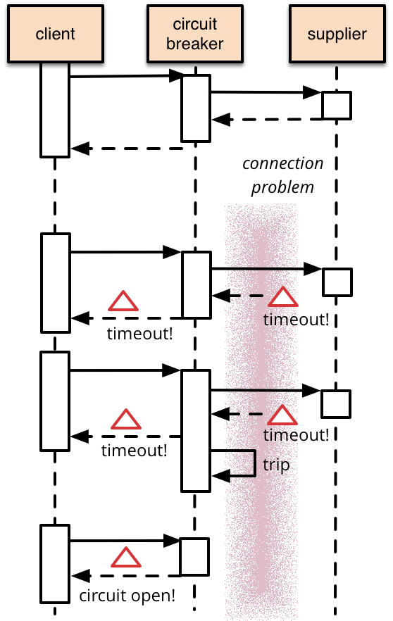
Circuit Breaker Pattern
Wrap function call in CP object, which monitors for failures
Failures reach threshold ===> CB trips
All further calls to CB return with error without calling supplier

Slide 6
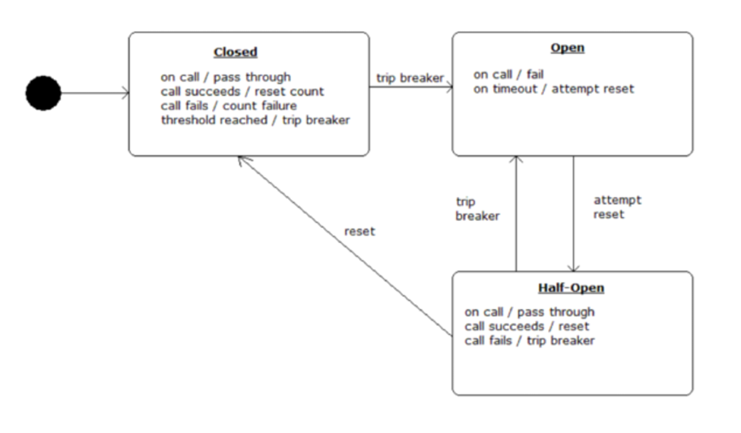
Circuit Breaker Pattern

Slide 7


Slide 8
Netflix Hystrix
Operate, Record and Expose
Protects application against adverse integrations
Exposes and showcase current circuit statuses and statistics through a dashboard
Prevents your application from cascading failures, build more resilience
Open source available at Github

Slide 9
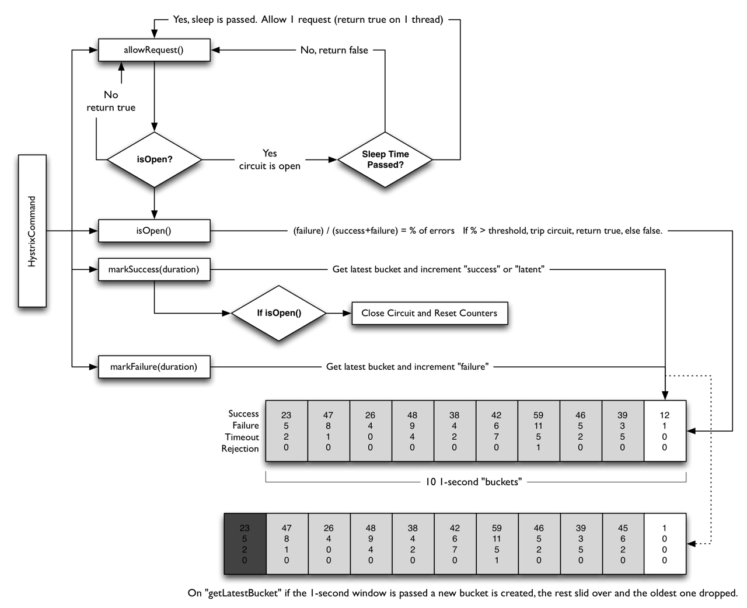
Circuit Breaker
HystrixCommand interacts with HystrixCircuitBreaker
Then its flow of logic and decision-making , include how the counters behave in the circuit breaker

Slide 10
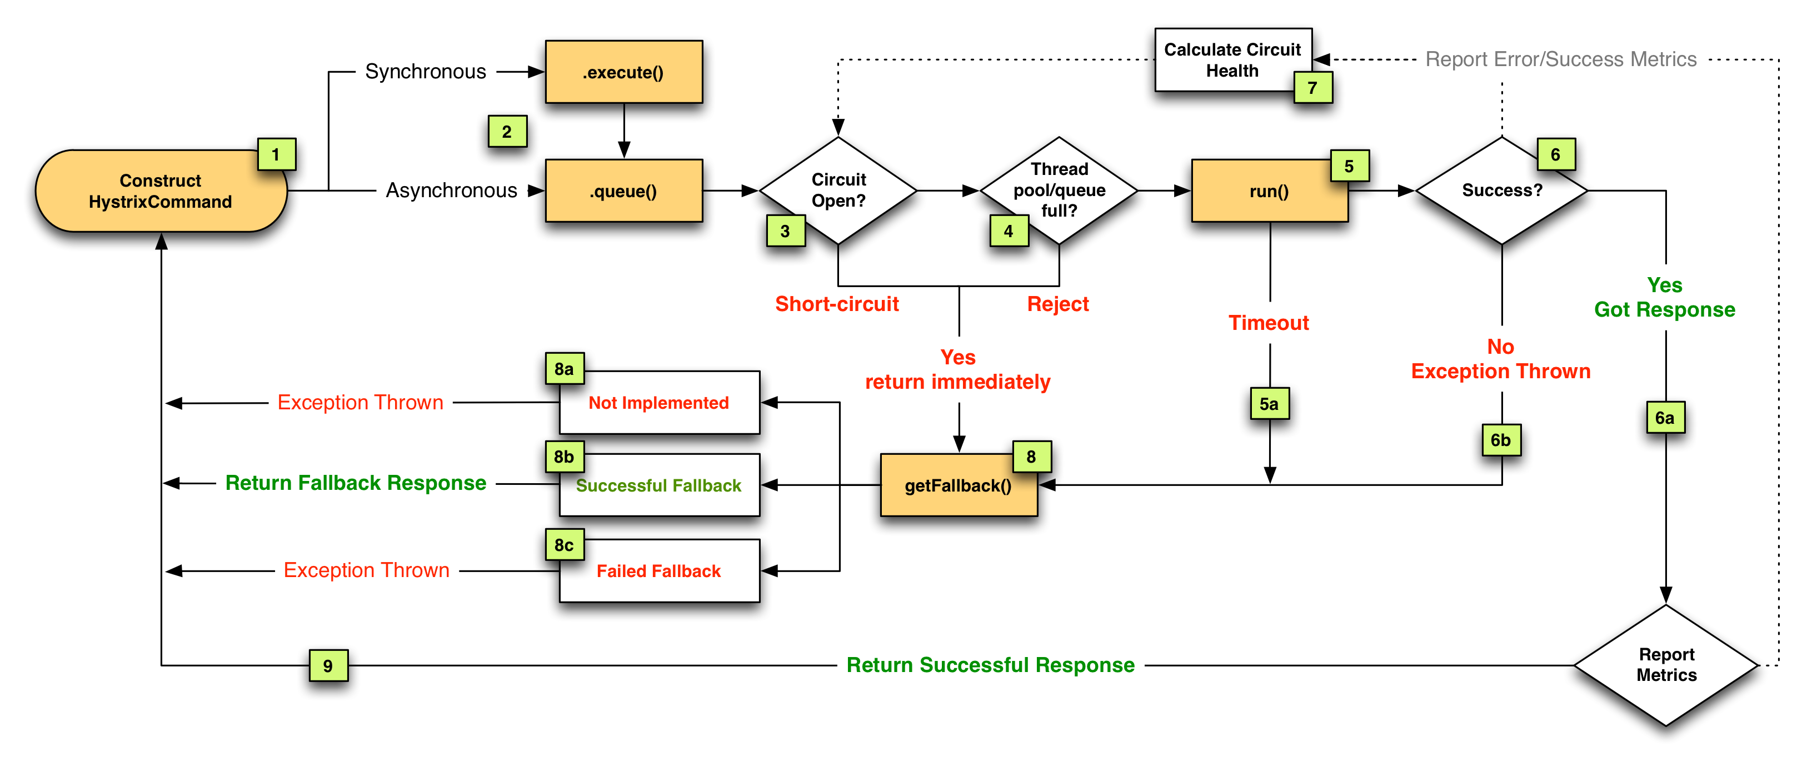
Flow Chart

Slide 11
Sequence Diagram
https://design.codelytics.io/hystrix/how-it-works

Slide 12
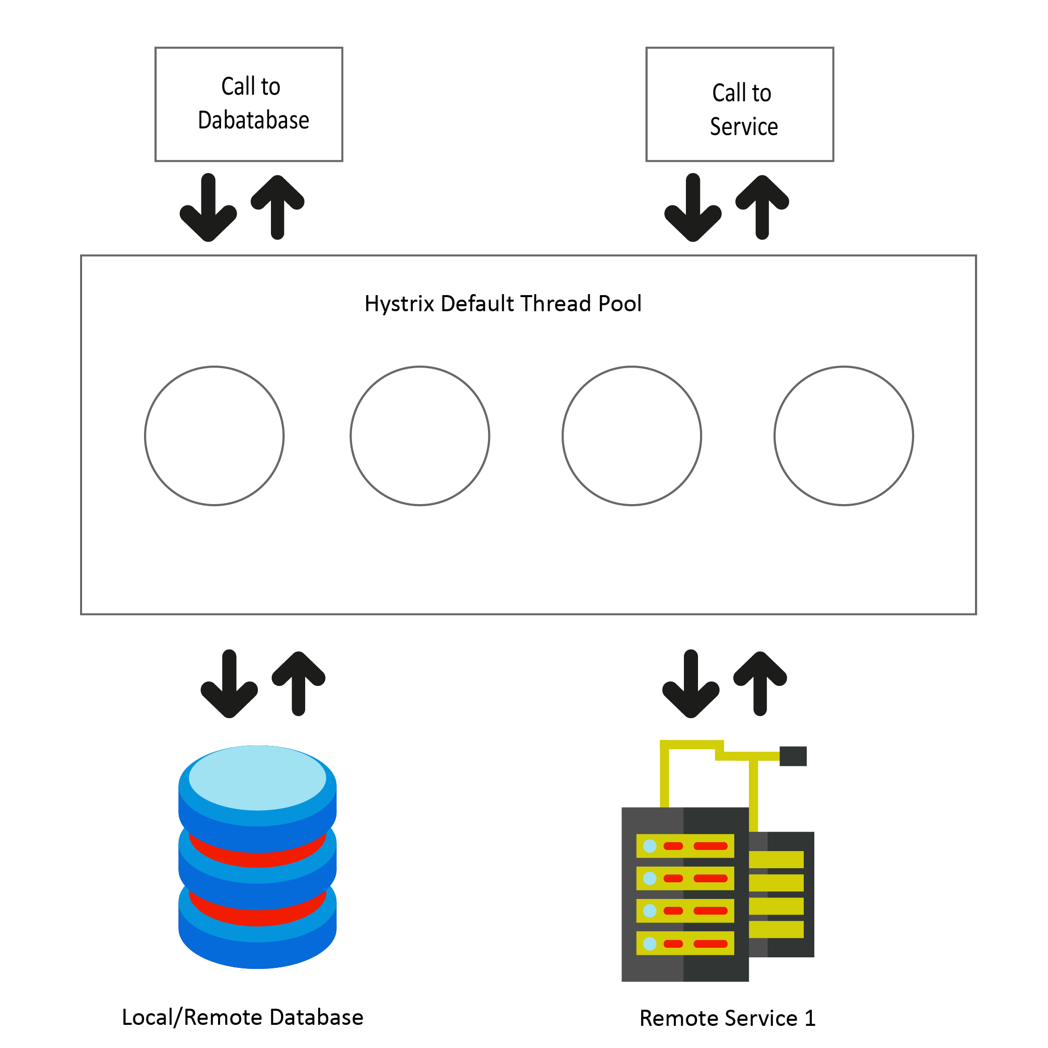
Problem ?
What would happen if the client is a heavy application with a high volume of Hystrix wrapped calls, which can be calls to a remote database or a service?

Slide 13
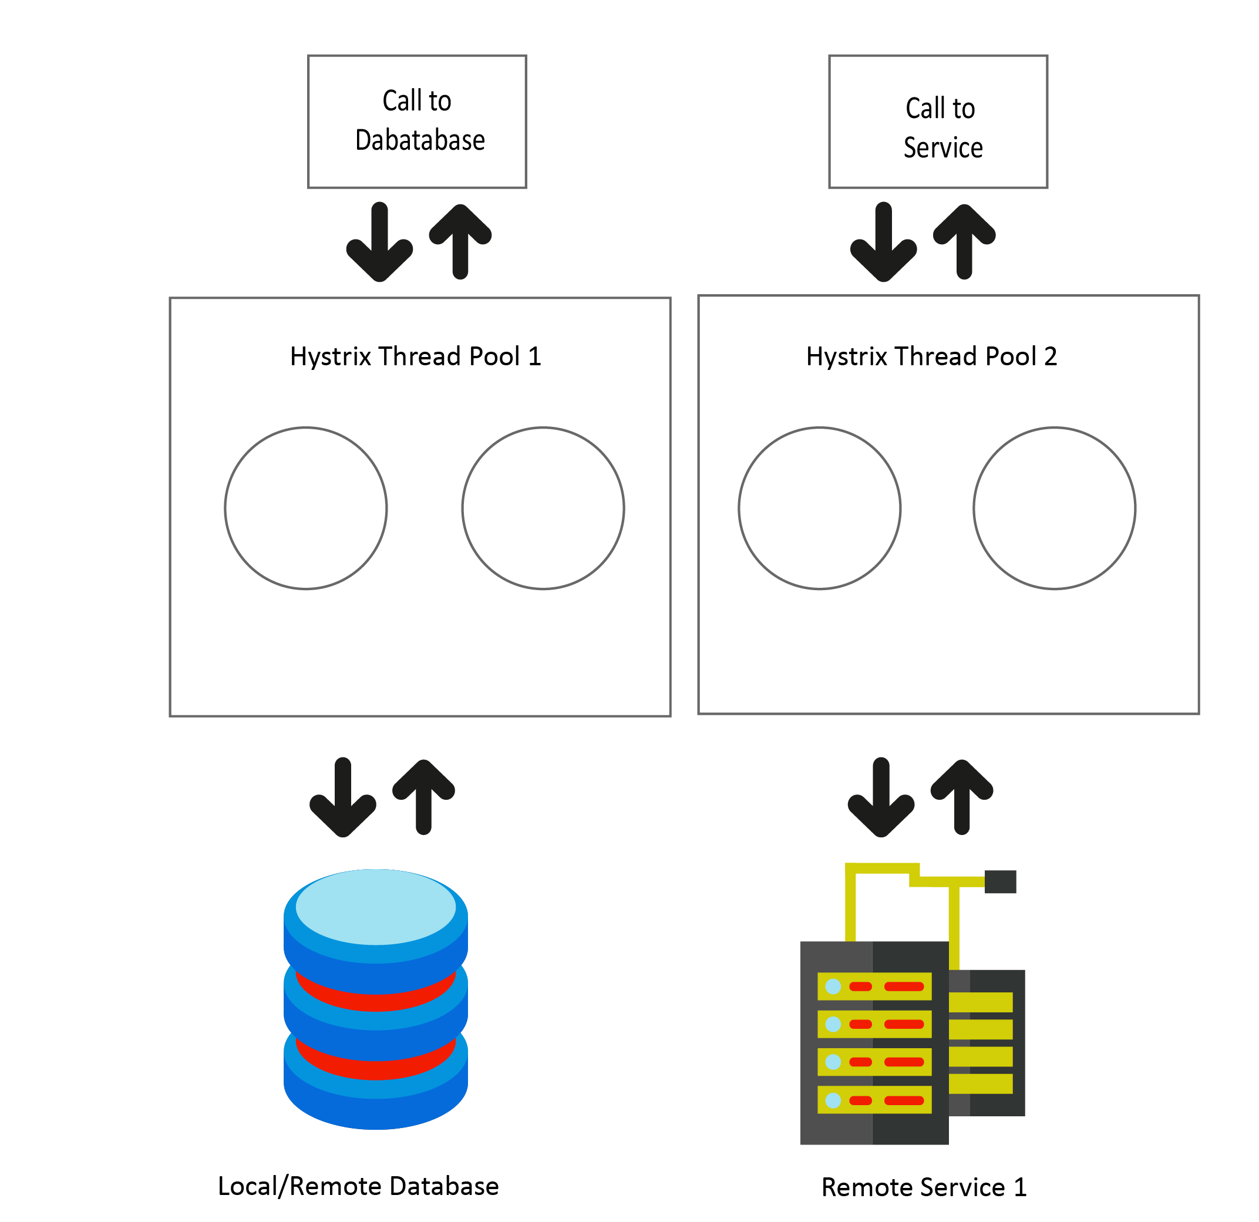
Problem ?
Provides the means to implement the bulkhead pattern
Create separate thread pools for “every” remote resource call

Slide 14
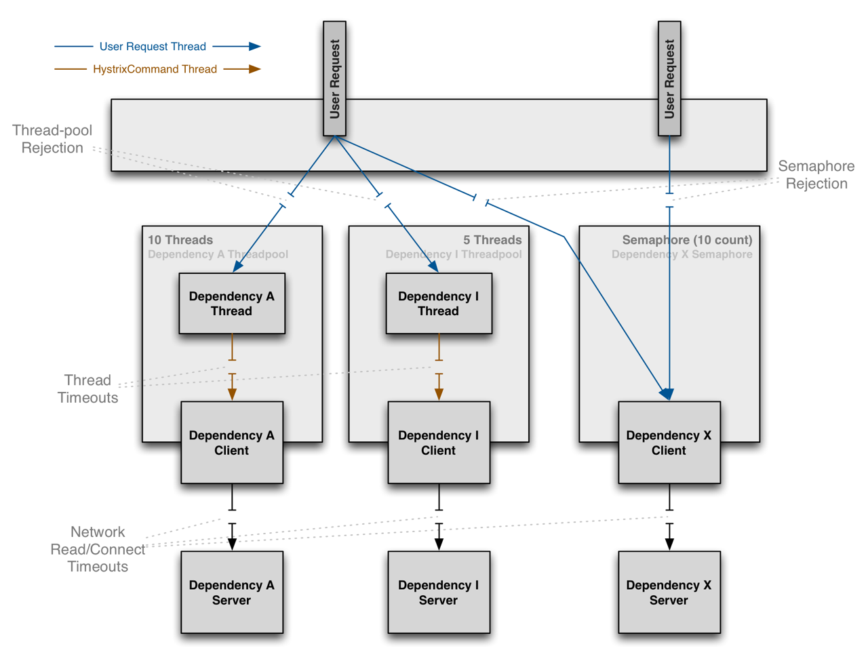
Thread Pools & Semaphores ​
THREAD — it executes on a separate thread and concurrent requests are limited by the number of threads in the thread-pool
SEMAPHORE — it executes on the calling thread and concurrent requests are limited by the semaphore count

Slide 15
Stratergy Hystrix
Thread Pools
Separate threads
Expensive because of Computation overhead
Semaphores
Use semaphore to limit number of concurrent calls
The command will be executed within the thread of the caller

Slide 16
Benefits of Thread Pools
Protect application
Detect timeout and respond to thread interrupts
Isolate a separate thread
Oppose to a long recovery when Tomcat server container is overwhelmed

Slide 17
Configuration
execution.isolation.strategy
execution.isolation.thread.timeoutInMilliseconds
execution.timeout.enabled
circuitBreaker.enabled
circuitBreaker.requestVolumeThreshold
circuitBreaker.sleepWindowInMilliseconds
circuitBreaker.errorThresholdPercentage
circuitBreaker.forceOpen / forceClosed
metrics.rollingStats.timeInMilliseconds
coreSize / maximumSize

Slide 18
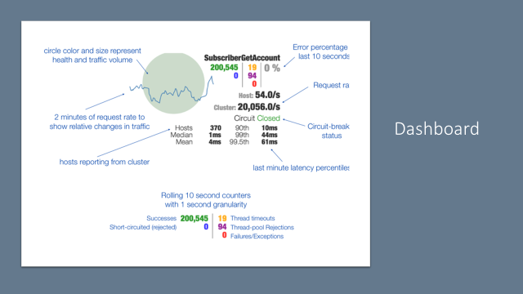

Slide 19
DEMO

