Slide 1
BI10 ROUND 01 · GROUP YAPPERS
ITB Consumer Wellbeing
& Segmentation
Overspending, not low income, drives financial stress — and help can be timed to reach it
999
10,992
1.85M
2025
customers
customer-months
transactions
full year
September 2026
Notes:
A wellbeing study, not credit scoring. In one line: people slide into stress because they overspend on wants, usually in specific months, so ITB can offer help at the right time and never touch anyone's credit.

Slide 2
EXECUTIVE SUMMARY
Overspending drives stress — and it is timed, reachable and fixable
T1
71.6% vs 40.5%
Stress flips the budget to wants
Discretionary share in stressed vs healthy months; purchases ≥ 10M VND are 4% of stressed transactions but 54% of the value.
T2
52%
Stress is episodic and concentrated
Spend-to-income (r −0.90) drives health. Nobody is stressed all year, yet 87% dip below 60; 43 active customers hold 52% of stress months.
T3
91
Engagement is saturated
91% of customers are High / Very high; the entire low tail is 91 customers seen on only 1–2 days. Breadth and regular use drive engagement.
T4
4
Four stable segments, 100% covered
Healthy 351 · Stretched 302 · High-Activity 258 · Occasional 88; stable across seeds (ARI 0.99). December cuts health ~13 pts in every segment.
T5
−28–32%
Six opt-in tools, one rule
Budgeting → November reminders → evening alerts lead. A 10% spend trim could cut stress months 28–32%. FHS never touches credit.
2
Notes:
One row per task: signal, driver, engagement, segments, plan. The 82% (T2) is the variance explained by spend-to-income and utilization; the 28–32% is a what-if tested with holdouts (slide 21).

Slide 3
CONTENTS
What this deck covers
01
02
Introduction & data quality
Task 1 — Exploratory data analysis
slide 4
slides 5–8
03
04
Task 2 — Financial health
Task 3 — Customer engagement
slides 9–12
slides 13–15
05
06
Task 4 — Customer segmentation
Task 5 — Recommendations & impact
slides 16–18
slides 19–22
3
Notes:
Four required sections: Executive Summary (2), Contents (3), Introduction (4), Task results (5–21). Each task follows the brief's question order.

Slide 4
INTRODUCTION
A wellbeing lens on 999 customers — built on clean, reconciled data
ITB wants to understand customers' financial wellbeing, spending and channel engagement — not to score credit risk.
We compare ratios and shares, never absolute VND: synthetic income, credit and balances are inflated.
Stress is measured per customer-month (it comes and goes); segments per customer (yearly profile).
Process: data checks → EDA → health → engagement → segmentation → recommendations.
Data-quality checks (both files)
✓
0 missing cells, 0 duplicate IDs, 0 negative amounts
✓
All timestamps in 2025; 1 name per customer and merchant
✓
Transactions reconcile 100% to monthly spend (10,992 months)
✓
7 minors kept; 5 over-limit months kept as real behaviour
!
908 customers have 12 months; 91 appear on only 1–2 days
Ethical rule financial_health_score is a wellbeing indicator — never used to approve or deny credit, cut a limit, raise a rate or block an account.
!
Two source years folded onto 2025 (case §12) → ratios are the signal
Source: consumer_financial_health_engagement_2025 (10,992 consumer-months, 999 customers); consumer_transactions_2025 (1,852,394 transactions). Charts: notebooks/full_pipeline.ipynb.
4
Notes:
Two rules govern the deck: ratios over magnitudes, wellbeing over credit. The data is clean; the caveats are the synthetic ones the case documents, plus 91 customers seen only once, which we flag wherever they touch a number. 693 merchants, 34 provinces.

Slide 5
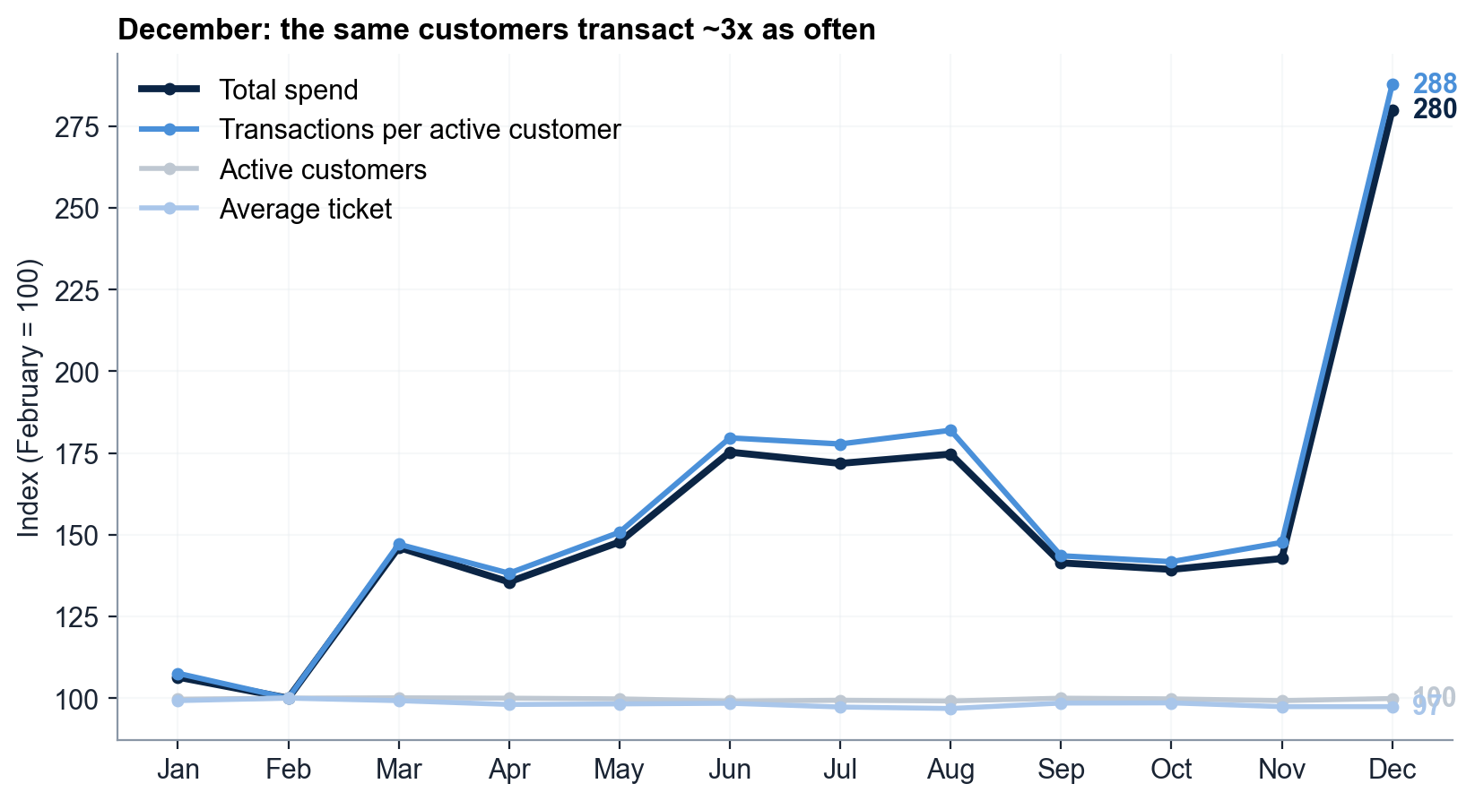
TASK 1 · EDA · Q1
December is 15% of annual spend — driven by more trips, not bigger baskets
2.9×
transactions per customer, December vs February
Dec 488B VND = 15.04% of the year vs Feb 174B = 5.37% (2.8×)
Transactions +187%, average ticket −2.6%; active customers flat (919 → 918)
December is also the weakest-health month (FHS 54.2) → plan support before it
Source: consumer_transactions_2025 (1,852,394 transactions). Charts: notebooks/full_pipeline.ipynb.
5
Notes:
Peak = December 488.0B VND (15.04% of 3.24T), trough = February 174.4B (5.37%); gap +313.7B (+9.7pp). All 14 categories grow +181% to +193% in transactions. Case §12: two source years folded onto 2025 inflate absolute VND, so the share and the 2.8× ratio are the reliable signal.

Slide 6
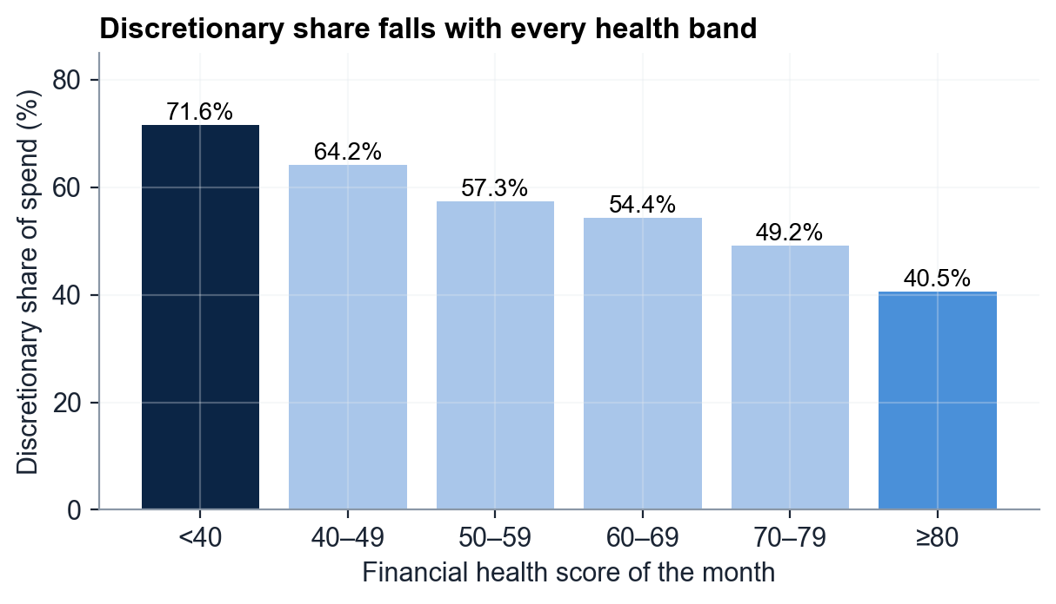
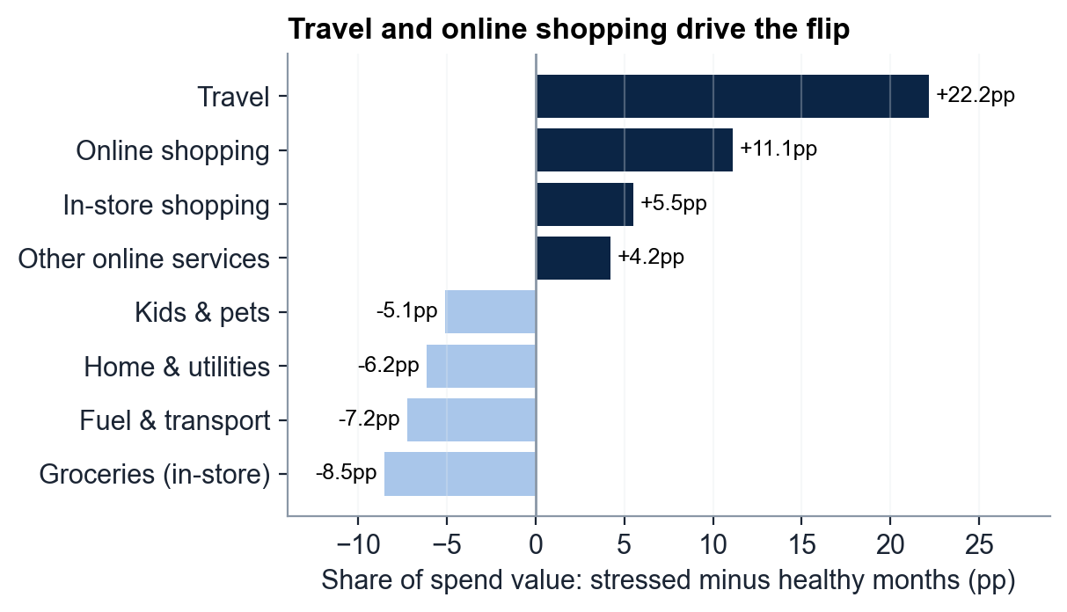
TASK 1 · EDA · Q2
Under stress the budget flips: 71.6% discretionary vs 40.5% when healthy
71.6%
discretionary share in stressed months (FHS < 40) vs 40.5% in healthy months (FHS ≥ 80)
54%
of stressed-month value comes from purchases ≥ 10M VND — only 4.3% of transactions
+22pp
travel's share gain; the mix stays inverted even without travel (37% vs 60% essential)
Source: consumer_financial_health_engagement_2025 (10,992 consumer-months, 999 customers); category shift: transactions joined to consumer-months. Charts: notebooks/full_pipeline.ipynb.
6
Notes:
95 stressed months (70 customers): 28.4% essential / 71.6% discretionary; 475 healthy months (303 customers): 59.5% / 40.5%. The share falls steadily across every band, so it is not a cutoff artefact (FHS<35 vs ≥85: 73.5% vs 30.2%). Essentials are ~47% of transactions in both groups: the flip is in value (discretionary ticket 3.9M vs 1.1M VND). Implication: pre-purchase visibility, never credit restriction.

Slide 7
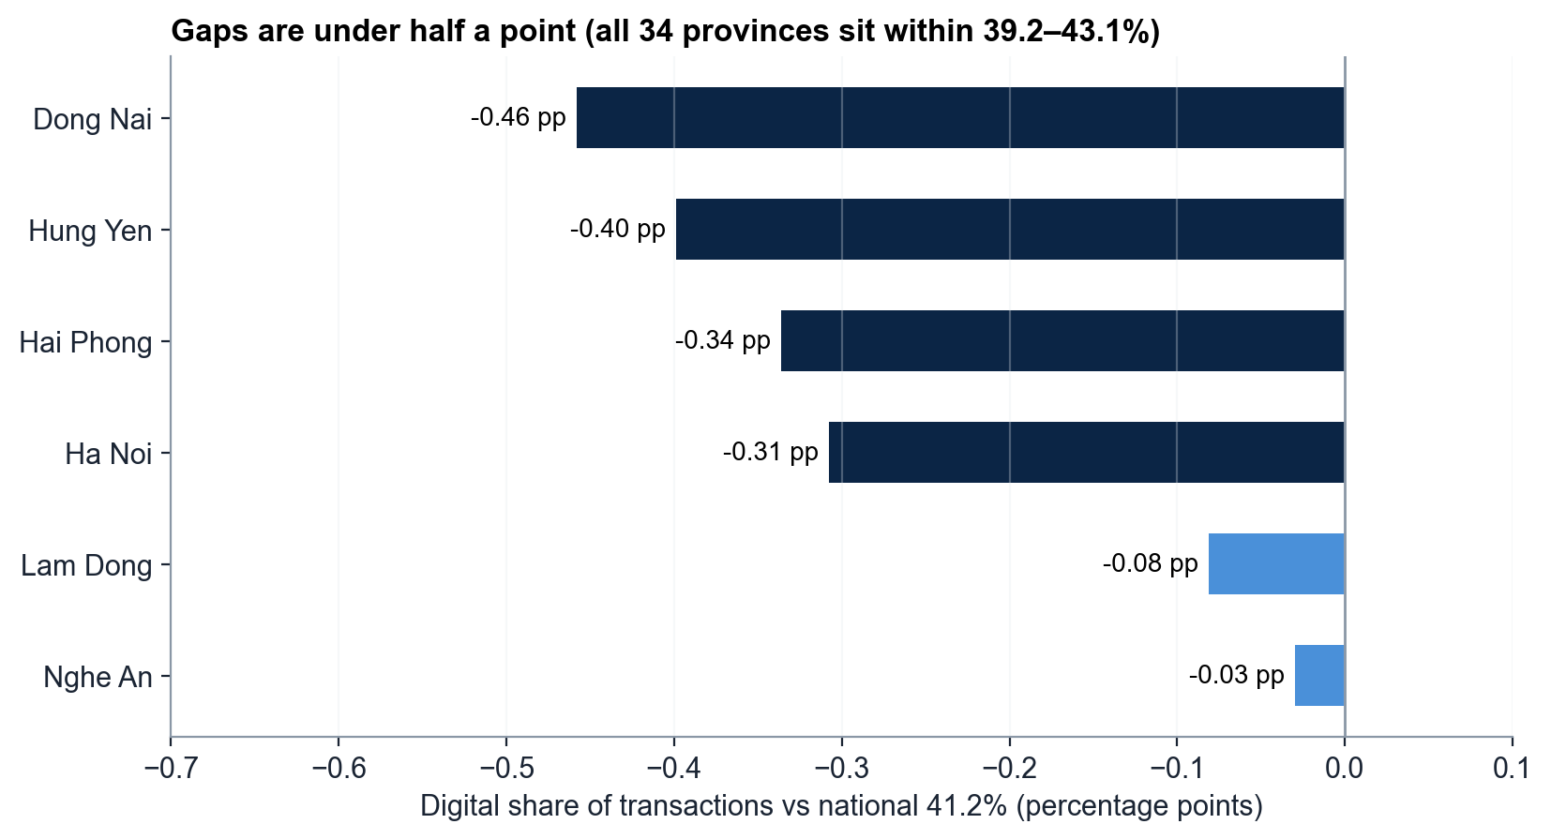
TASK 1 · EDA · Q3
High-spend provinces trail the national digital share by at most 0.46pp
≤ 0.46pp
largest digital gap among high-spend provinces
6 provinces qualify: Ha Noi, Dong Nai, Lam Dong, Hung Yen, Hai Phong, Nghe An
POS 58.9–59.3% vs 58.8% nationally; QR at par; small gaps in e-commerce and app
Customers differ 8.6pp within provinces vs 3.9pp across all 34 → target the customer, not the region
Source: consumer_transactions_2025 (1,852,394 transactions). Charts: notebooks/full_pipeline.ipynb.
7
Notes:
Qualifying = spend above the provincial median (> 82.7B VND) and digital (non-POS) share below the national 41.2%. Only 3 of 6 gaps are significant (p < 0.05). HCMC leads spend (13.6%) at 41.3% digital; range Cao Bang 43.1% to Quang Ngai 39.2%.

Slide 8
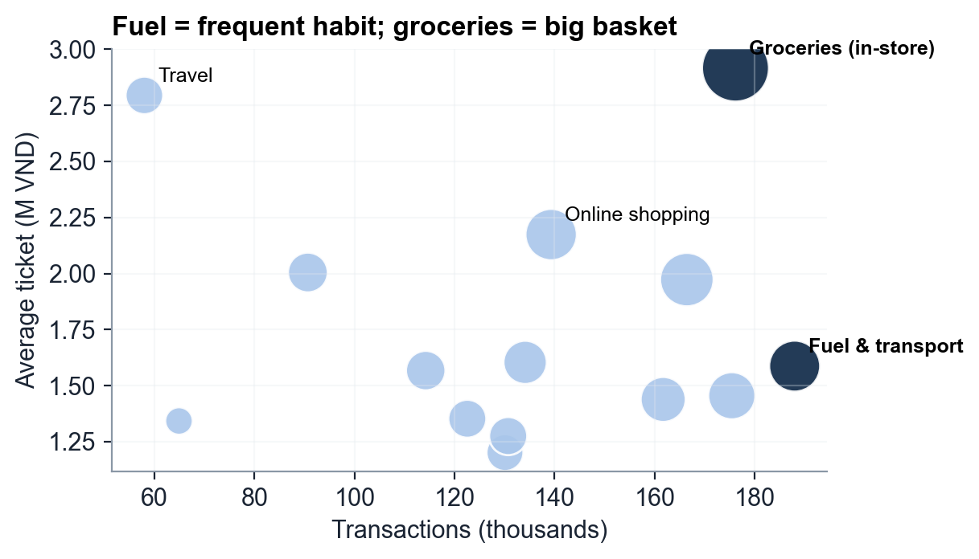
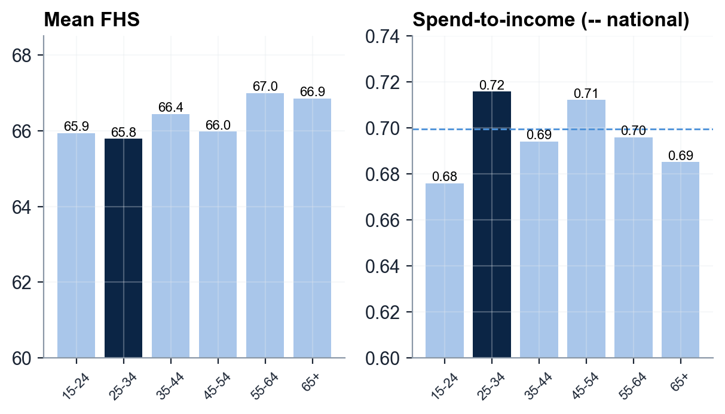
TASK 1 · EDA · Q4 & Q5
Fuel is the everyday habit, groceries the biggest basket; age barely moves health
188,029
Fuel & transport transactions — top by count, 1.59M VND ticket, 17 buys per buyer-month
2.92M
VND ticket for in-store groceries — top by spend (513.8B), 1.8× the fuel ticket
65.8
lowest FHS: 25–34, still active (178.7 txns/month) with the highest spend-to-income 0.716
Source: consumer_transactions_2025 (1,852,394 transactions); cohorts: consumer_financial_health_engagement_2025 (10,992 consumer-months, 999 customers). Charts: notebooks/full_pipeline.ipynb.
8
Notes:
Q4: fuel is a frequent top-up (96.8% of customers buy it), groceries a stock-up basket (99.3%). Q5: 25–34 is the only cohort above national spend-to-income (0.716 vs 0.700) and below the national essential ratio (0.468 vs 0.481) — overspending on wants. But the spread is 1.2 points, 95% CIs overlap and ANOVA p = 0.13: age is a weak lever.

Slide 9
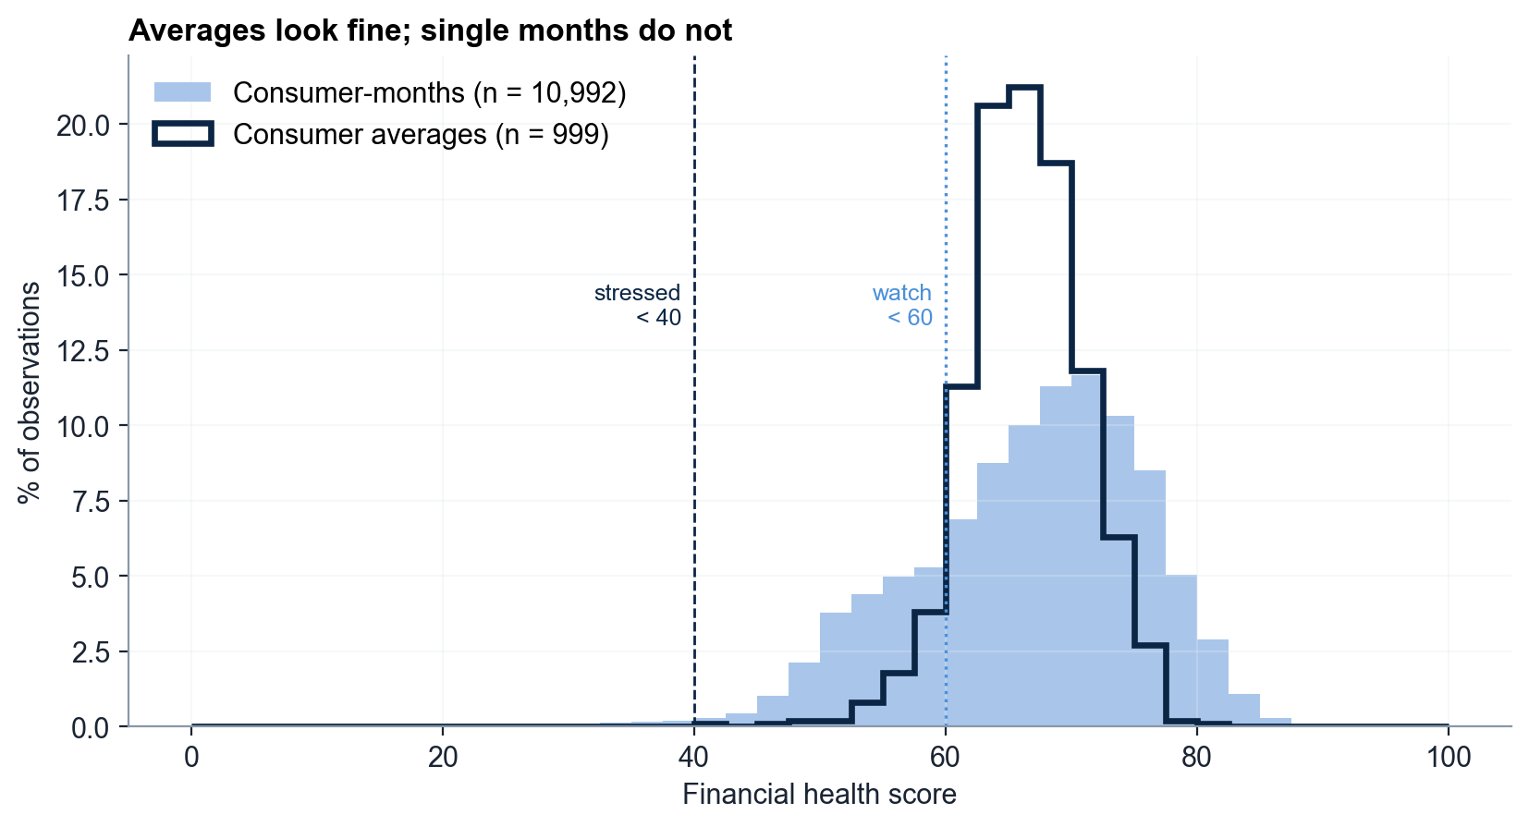
TASK 2 · FINANCIAL HEALTH · D1
No one is stressed on average, yet 87% of customers dip below 60 at least once
87%
of customers fall below 60 in at least one month
Customer averages: mean 66.3, IQR 63.4–69.3 — a tight band
Months are 2× more spread: 95 stressed months (0.9%) across 70 customers
January + December hold 46 of 95 stressed months → trigger help on the month
Source: consumer_financial_health_engagement_2025 (10,992 consumer-months, 999 customers). Charts: notebooks/full_pipeline.ipynb.
9
Notes:
Consumer level: mean 66.3, median 66.2, std 4.7, range 42.3–80.8, skew −0.32. Month level: std 9.5; Stable 72.5% · Watch 22.4% · Healthy 4.3% · Stressed 0.9%. Who the customer is explains only 22% of monthly variance, the calendar month 25%.

Slide 10
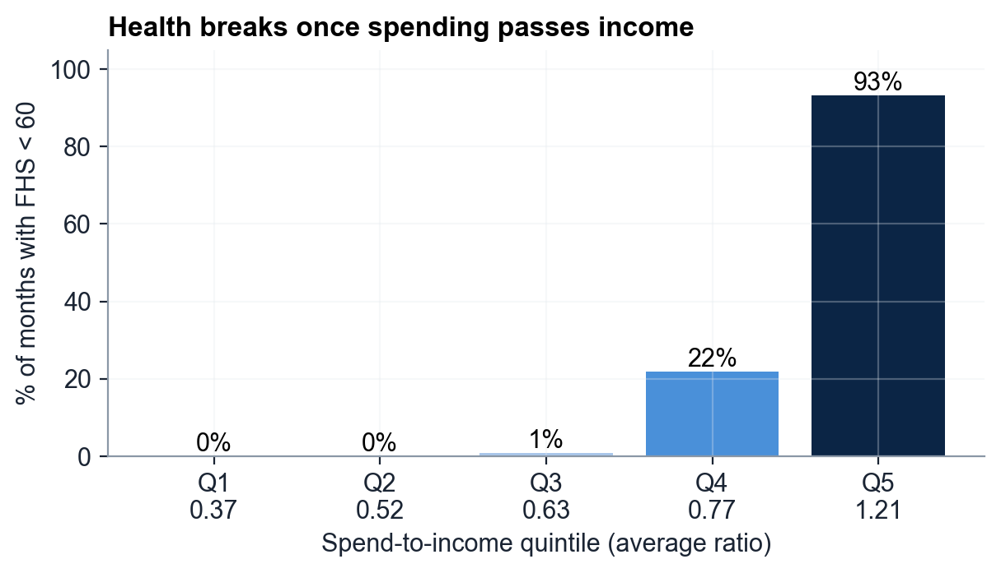
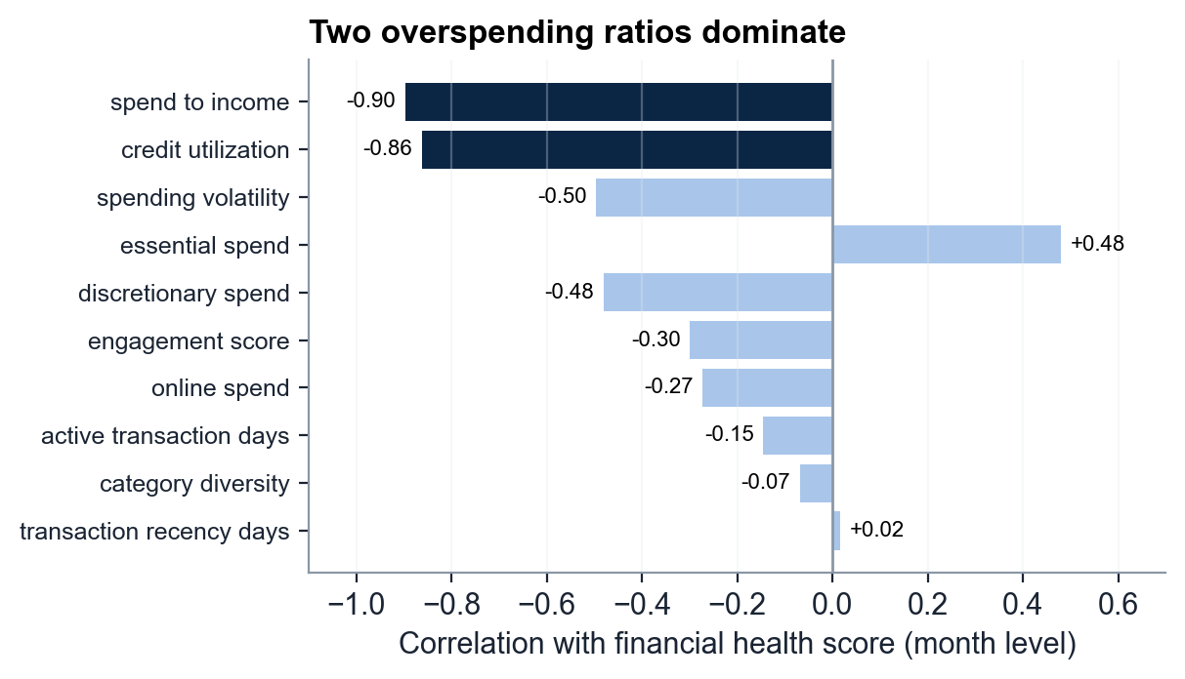
TASK 2 · FINANCIAL HEALTH · D2
Low health is an overspending story: it breaks once spend passes income
r −0.90
spend-to-income; with utilization (−0.86) it explains 82% of the health score
98%
of stressed months spend more than income
93%
of top-quintile months fall below 60 — none in the bottom two quintiles
Source: consumer_financial_health_engagement_2025 (10,992 consumer-months, 999 customers); category mix: transactions joined to consumer-months. Charts: notebooks/full_pipeline.ipynb.
10
Notes:
Spend-to-income and utilization move together (r 0.90): one overspending factor, which also holds within each customer (r −0.90). Stressed months are 71.6% discretionary by value and have 2× the e-commerce + app share (23% vs 12%). They are also more engaged (81.1 vs 72.7). FHS and the ratios share spend fields — directional, not causal.

Slide 11
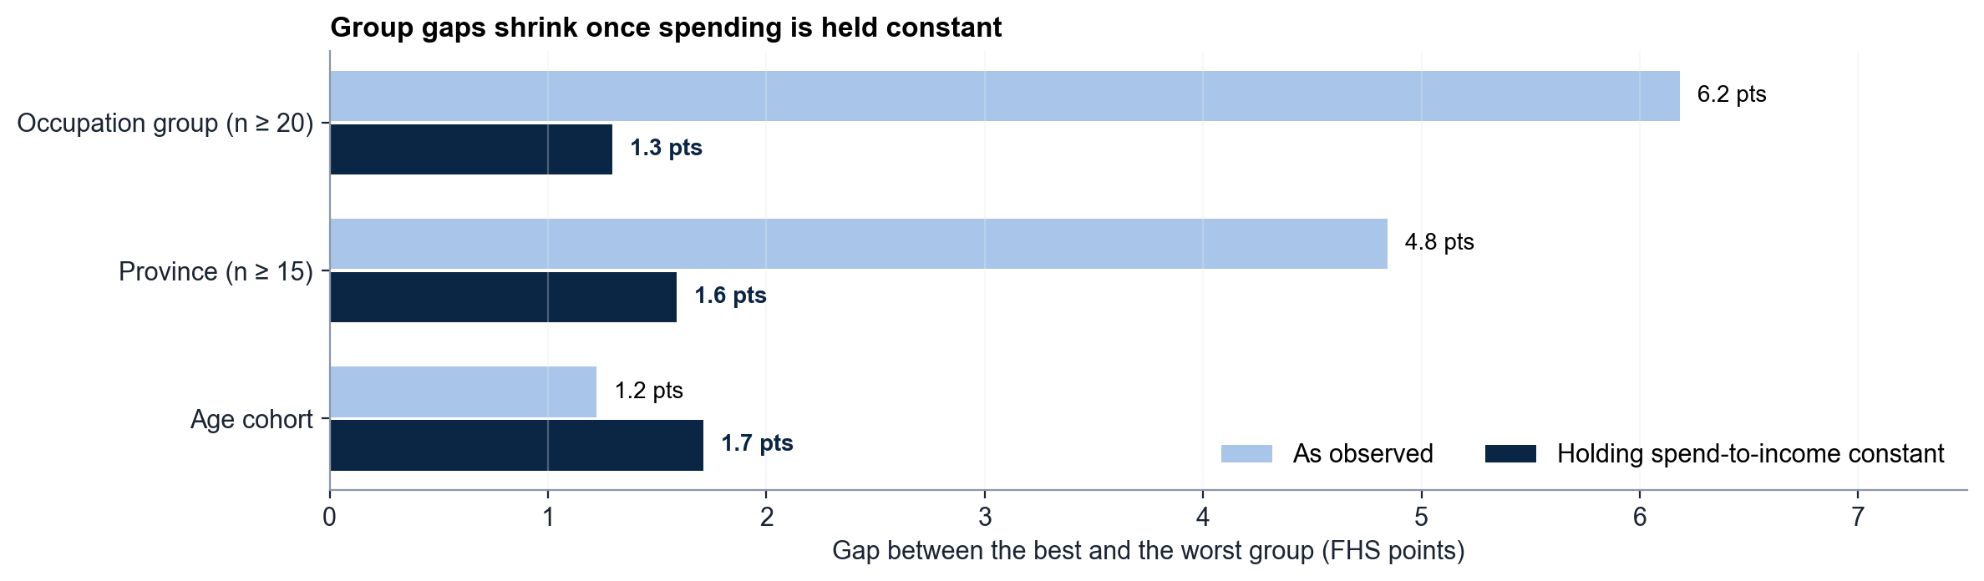
TASK 2 · FINANCIAL HEALTH · D3
Occupation and province gaps are really spending gaps; age is flat
6.2 → 1.3
points: occupation gap once spend-to-income is held constant
4.8 → 1.6
points: province gap (Ha Noi 67.8 top, Thai Nguyen 63.0 bottom)
1.2
points across six age cohorts — not significant (p = 0.13)
Source: consumer_financial_health_engagement_2025 (10,992 consumer-months, 999 customers) (customer level). Charts: notebooks/full_pipeline.ipynb.
11
Notes:
Occupation: 396 titles grouped into 8 keyword groups; Eng/science/IT 69.1 and Business/finance 68.7 vs Office/public 64.5 and Manual 62.9, mirroring spend-to-income 0.61 vs 0.76–0.79. Province ANOVA p = 0.009 but only 5% of variance. Target the ratio, never the group — fairer and more effective.

Slide 12
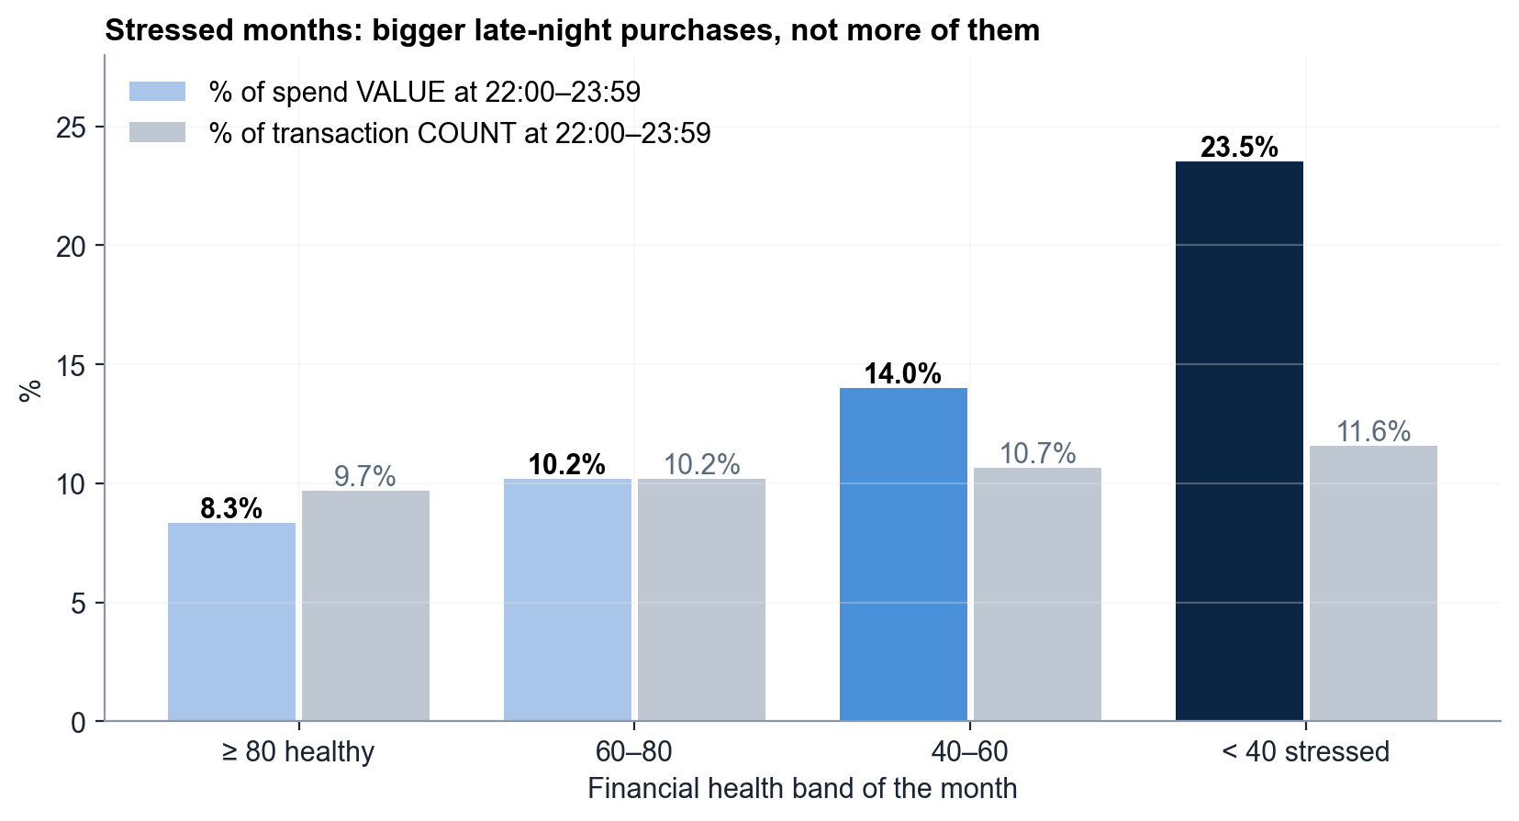
TASK 2 · FINANCIAL HEALTH · D4
43 active customers carry 52% of stress months — with big late-night purchases
52%
of all stress months belong to 43 highly engaged customers
Rule: FHS < 40 AND engagement ≥ 81.4 (top 25% of months); stable at top 30% / 20%
Profile: spend 1.89× income, utilization 0.55, online share 2.3× average
23.5% of stressed spend value lands at 22–23h (vs 8.3%) → opt-in alert before 22:00
Source: consumer_financial_health_engagement_2025 (10,992 consumer-months, 999 customers); timing: transactions joined to consumer-months. Charts: notebooks/full_pipeline.ipynb.
12
Notes:
Rule applied per customer-month; a customer belongs if any month qualifies. 49 months / 43 customers = 51.6% of stressed months vs 25% by chance (p < 0.001); top 30% / 20% give 44 / 41 customers. All 43 are full-year customers averaging FHS 62 in other months; 39 sit in the Stretched segment. Late-night count differs little (11.6% vs 9.7%): bigger tickets, led by online shopping (39%) and travel (14%). Wellbeing use only.

Slide 13
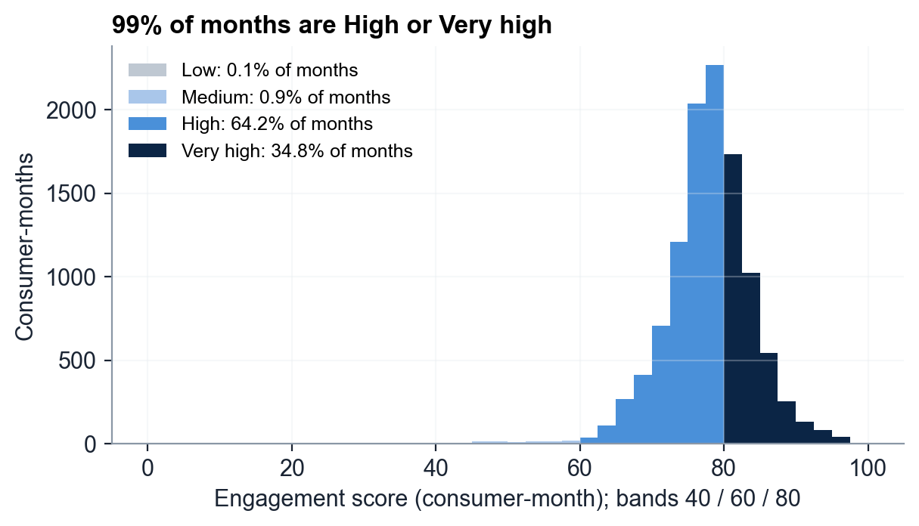
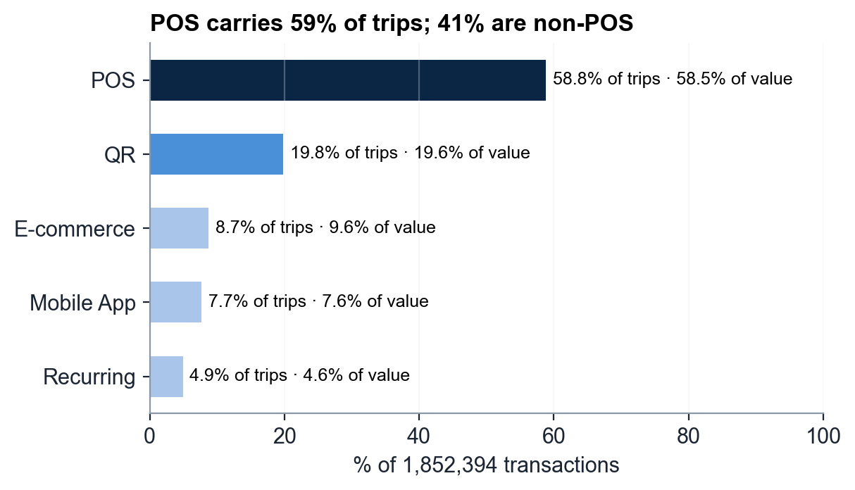
TASK 3 · ENGAGEMENT · D1–D2
Engagement is saturated; the whole low tail is 91 one-off customers
91%
of customers are High or Very high (1.0 / 8.0 / 66.9 / 24.1% by band)
91
customers seen on only 1–2 days are the entire below-High tail
21.0%
average online spend share; 925 of 999 customers use all five channels
Source: consumer_financial_health_engagement_2025 (10,992 consumer-months, 999 customers); channels: consumer_transactions_2025 (1,852,394 transactions). Charts: notebooks/full_pipeline.ipynb.
13
Notes:
Engagement score mean 77.8, median 78.1, IQR 74.8–81.4. Every full-year customer averages ≥ 69.8, so the score separates one-off users from the base, not good customers from great ones. Channels: POS 58.8% · QR 19.8% · E-commerce 8.7% · Mobile 7.7% · Recurring 4.9%; non-POS = 41% of trips and 41.5% of value. Chart choice: histogram for a continuous score (bands shaded so the 1% tail stays visible), sorted bars for nominal channels.

Slide 14
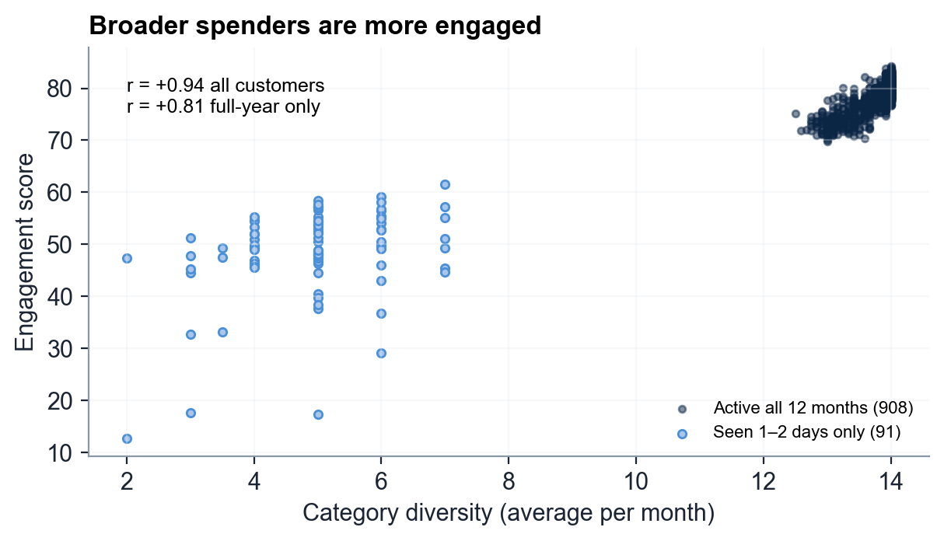
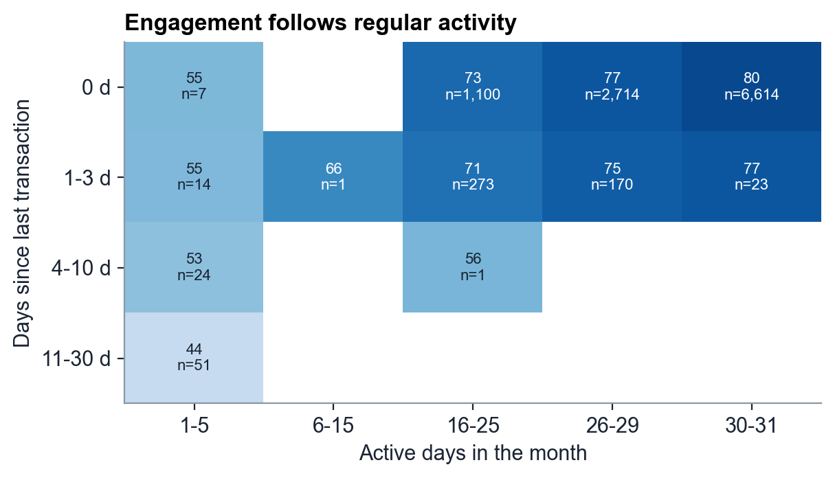
TASK 3 · ENGAGEMENT · D3–D4
Breadth and regular activity — not recency — separate engaged customers
2–14
categories per month; r +0.81 with engagement even within full-year customers
r +0.80
active days vs engagement — ahead of transaction count (+0.76) and recency (−0.58)
≤ 55
engagement whenever a customer is active on only 1–5 days, whatever the recency
Source: consumer_financial_health_engagement_2025 (10,992 consumer-months, 999 customers). Charts: notebooks/full_pipeline.ipynb.
14
Notes:
Ranges: recency 0–30 days (median 0), active days 1–31 (median 30), 2–713 transactions a month (median 150). r = +0.94 across all customers is partly two clusters; +0.81 within the 908 full-year base shows the link holds. Scatter for two continuous variables; heatmap for the recency × frequency interaction.

Slide 15
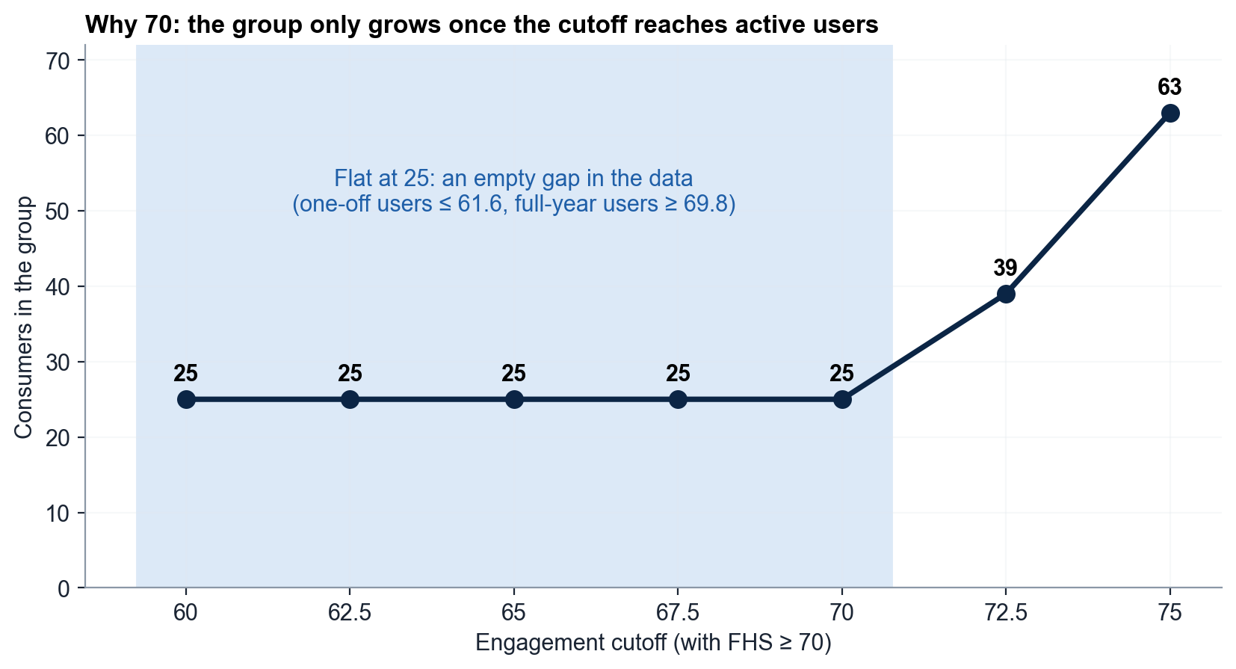
TASK 3 · ENGAGEMENT · D5
25 healthy customers used their card on only 1–2 days all year
25
customers (2.5%): FHS ≥ 70 and engagement < 70
The cutoff sits in an empty gap: 25 at any engagement cutoff from 60 to 70
Profile: 2 vs 27 active days, 10 vs 159 transactions a month, 61% vs 24% online
19 silent since Jan–Jul → win back everyday use, not budgeting
Source: consumer_financial_health_engagement_2025 (10,992 consumer-months, 999 customers). Charts: notebooks/full_pipeline.ipynb.
15
Notes:
FHS ≥ 70 = top 21% (p79); engagement < 70 is below the customer p10 (71.1). Looser cutoffs pull in active users (39 at 72.5, 63 at 75); FHS ≥ 65 gives 48, ≥ 75 gives 9. Also: age 61 vs 50, diversity 4.7 vs 13.1, spend/income 0.46 vs 0.70; 24 of 25 are Occasional Online-First. One month of data each: a watch-list, never used to limit credit.

Slide 16
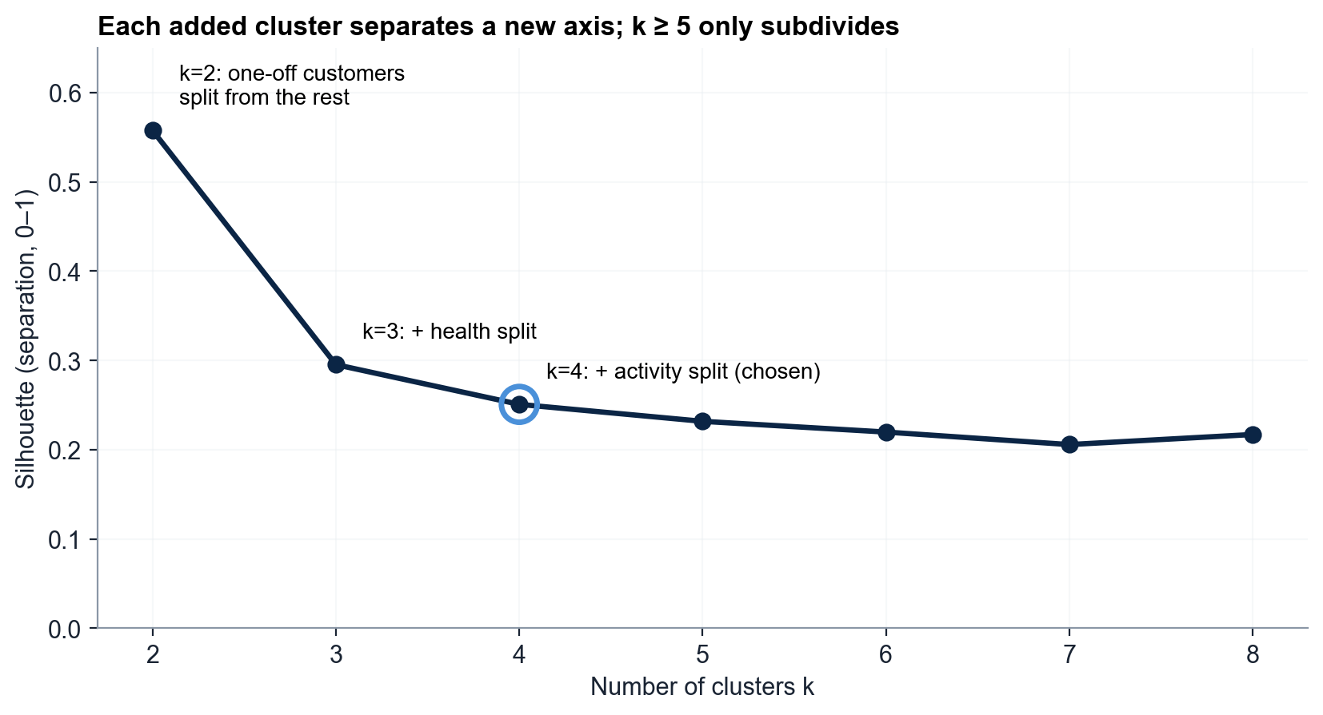
TASK 4 · SEGMENTATION · METHOD
Clustering 8 behavioural ratios yields four segments along three business axes
k = 4
k-means on 8 scaled ratios, 999 customers
Inputs: health, activity and spending-mix ratios; no raw VND, no demographics
k = 2 splits one-off users, k = 3 adds health, k = 4 adds activity; k ≥ 5 only subdivides
Coverage 999 / 999 incl. 7 minors; dataset + dictionary in the ZIP
Source: team k-means (k = 4) on 8 scaled ratios, 999 customers. Charts: notebooks/full_pipeline.ipynb.
16
Notes:
Preprocessing: 10,992 customer-months → 999 customers (yearly mean per ratio), 0 nulls. Features: FHS, spend/income, utilization, volatility, engagement, transactions, discretionary share, online share (z-scaled). Excluded: essential ratio (= 1 − discretionary); diversity, active days, recency (near-constant). Silhouette 0.25 = moderate separation, expected for behaviour.

Slide 17
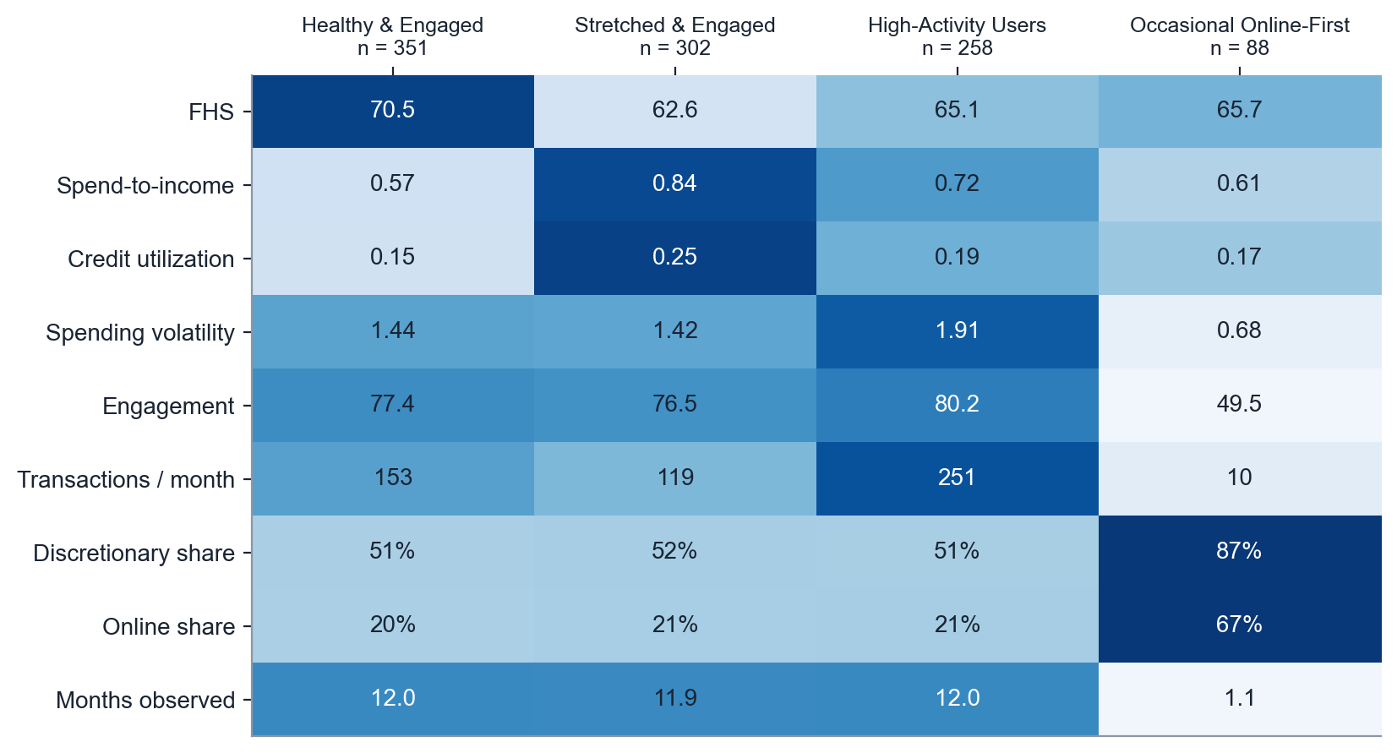
TASK 4 · SEGMENTATION · PROFILES
Four segments, four different jobs for the product team
Healthy & Engaged
351 · 35.1%
Best health, lowest spend/income → savings & opt-in offers
Stretched & Engaged
302 · 30.2%
Spend/income 0.84, 20% had a stress month → budgeting + alerts
High-Activity Users
258 · 25.8%
251 transactions/month, most volatile → planning reminders
Occasional Online-First
88 · 8.8%
Seen ~1 month, 67% online (≈ brief's Emerging Digital) → habit nudges
Source: team k-means (k = 4) on 8 scaled ratios, 999 customers. Charts: notebooks/full_pipeline.ipynb.
17
Notes:
The heatmap is the side-by-side comparison the brief asks for. Health splits Healthy from Stretched, activity isolates High-Activity (not more online: 21% vs 25% average; youngest, 60% female), and the Occasional group is defined by how rarely we see them (1.1 of 12 months). Suggested personas not formed: Essential-Spend-Focused = 4 customers; Healthy-but-Disengaged = 25, 24 of them Occasional.

Slide 18
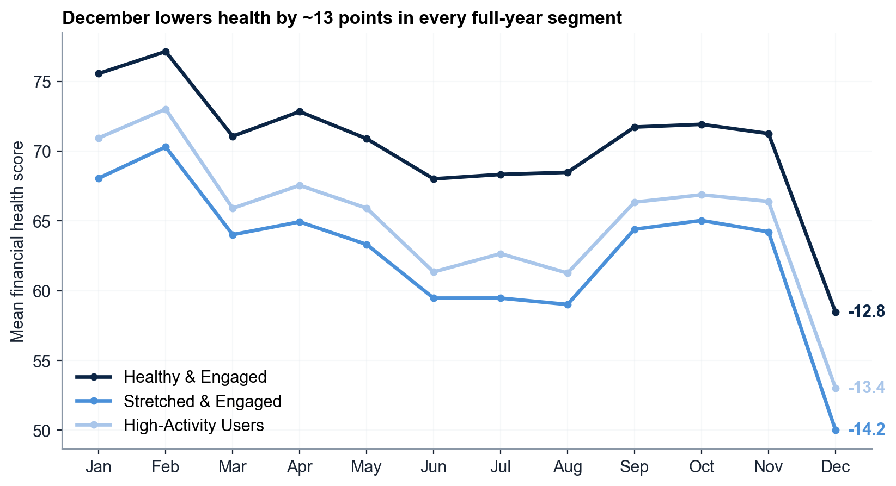
TASK 4 · SEGMENTATION · VALIDATION
Segments are stable — and December hits every segment by ~13 points
0.99
agreement across 20 random seeds (ARI, 1 = identical)
Bootstrap ARI 0.91; the three full-year segments form a continuum
December cuts health 12.8–14.2 pts in every segment → reminders for everyone
Limits: synthetic folded data; 88 occasional users rest on ~1 month; never for lending
Source: team k-means (k = 4) on 8 scaled ratios, 999 customers. Charts: notebooks/full_pipeline.ipynb.
18
Notes:
Stability: 20 seeds ARI 0.988; 80% bootstrap × 50 ARI 0.911; dropping December 0.873. GMM agrees 0.26 (Occasional identical). 2×2 median cross-check agrees on health (344/351, 273/302). Segments correlate with age/gender (Cramér's V 0.23 age / 0.13 gender) → act on behaviour only. Future work: hybrid model (rule for part-year + k = 3), trajectory features, chronological early-warning on next_month_low_health_flag (support only).

Slide 19
TASK 5 · RECOMMENDATIONS
Six non-punitive tools, each tied to a measured finding
Tool | Target (n, % of 999) | Evidence | Action | KPI
① Budgeting | Stretched & Engaged · 302 (30.2%) | spend/income 0.84; r −0.90 with FHS | Spend-vs-income view, self-set budget | spend/income; stress months
② Spend alerts | Crossover · 43 (4.3%) | 52% of stress months; late-night spend | Opt-in pacing alert before 22:00 | stress months / customer
③ Planning reminders | High-Activity · 258 (25.8%) | volatility 1.91; December −13 pts | Year-end plan sent in November | Dec drop vs holdout
④ Education | Low health & engagement · 67 (6.7%) | 86% discretionary vs 55% base | Needs-vs-wants micro-modules | essential share
⑤ Digital nudges | Occasional Online-First · 88 (8.8%) | 1–2 active days; 60.6% via app/e-com | Habit nudges in their app | active days
⑥ Product suggestions | Healthy & Engaged · 351 (35.1%), adults | lowest utilization 0.15; FHS 70.5 | Opt-in savings/loyalty, no credit increase | opt-in uptake
Segments ① ③ ⑤ ⑥ cover all 999 customers. Overlays: alerts 43 = 39 Stretched + 4 Healthy; education 67 = 64 Occasional + 3 Stretched (sequenced, never in the same week).
Source: team k-means (k = 4) on 8 scaled ratios, 999 customers; consumer_financial_health_engagement_2025 (10,992 consumer-months, 999 customers); consumer_transactions_2025 (1,852,394 transactions). Charts: notebooks/full_pipeline.ipynb.
19
Notes:
One tool per required type, each with an exact size, the column it rests on and a KPI. Every tool is opt-in and behaviour-triggered.

Slide 20
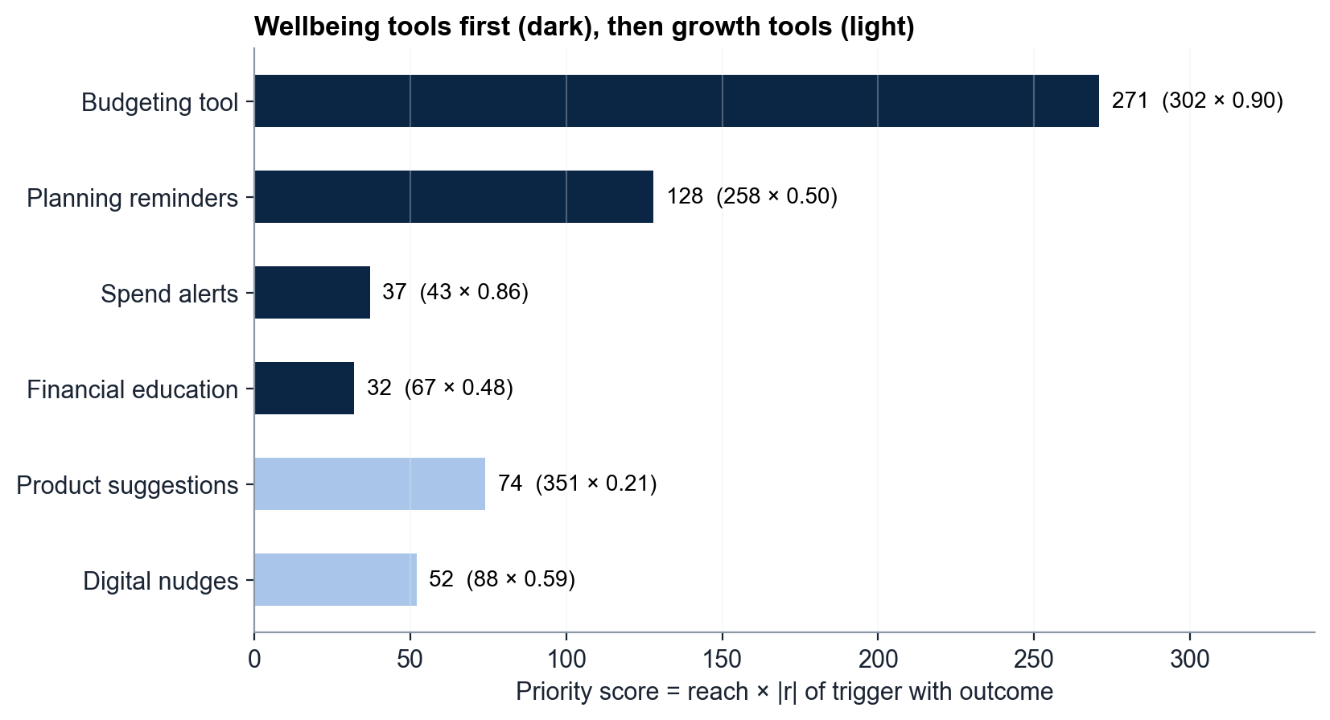
TASK 5 · PRIORITISATION
Budgeting leads on reach × driver strength; alerts launch first for precision
271
priority score of the budgeting tool (302 × 0.90)
Score = reach × |r| of the trigger with its outcome; wellbeing before growth
Alerts reach only 43 customers but 71% of stress months → wave 1
Fairness: behaviour-only triggers; uptake tracked by age & gender; no offers to minors
NEVER
financial_health_score → deny credit, cut a limit, raise a rate or block an account
Source: consumer_financial_health_engagement_2025 (10,992 consumer-months, 999 customers); team k-means (k = 4) on 8 scaled ratios, 999 customers. Charts: notebooks/full_pipeline.ipynb.
20
Notes:
Wellbeing: Budgeting 271 → Reminders 128 → Alerts 37 → Education 32. Growth: Products 74 → Nudges 52. Targets skew (Reminders 60.5% female; Education/Nudges mean age ~58), so we monitor uptake by group rather than target by it.

Slide 21
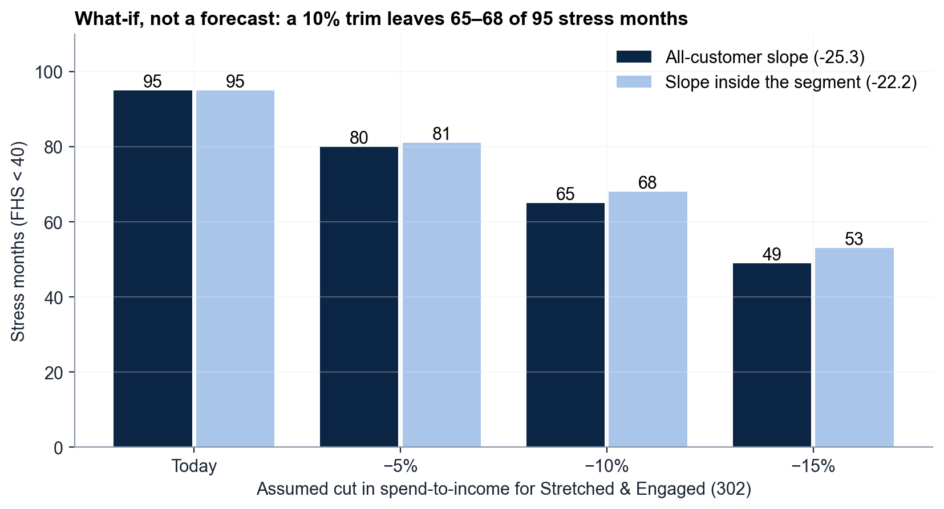
TASK 5 · IMPACT
A 10% spend trim could cut stress months by 28–32%, tested within 90 days
−28–32%
stress months if the Stretched 302 trim spend-to-income by 10%
What-if on FHS = 84.1 − 25.3 × spend/income; part of the gain is mechanical
Roadmap: 0–30 d budgeting + alerts · 31–60 d November reminders + nudges · 61–90 d education + products
Every tool vs a random 10% holdout for 3 months; scale only what wins
Source: consumer_financial_health_engagement_2025 (10,992 consumer-months, 999 customers). Charts: notebooks/full_pipeline.ipynb.
21
Notes:
95 → 65 stress months with the all-customer slope, 68 with the slope inside the segment (−22.2); 9 of the 95 stress months sit outside the 302. Spend-to-income and utilization explain 82% of FHS, so only the holdout test can show real behaviour change. A hypothesis to measure, not a promise.

Slide 22
THE CONTRACT
Protect the stretched, plan with the active, re-engage the occasional, grow the healthy — without ever touching their credit.
Why
Who
What
Overspending drives poor health (r −0.90); under stress 71.6% of spend is discretionary, and stress peaks in December.
4 stable segments cover all 999 customers; 43 active customers hold 52% of stress months.
Budgeting for 302 and opt-in evening alerts first, each measured against a random holdout within 90 days.
Honest limits: synthetic data (two source years folded onto 2025), 91 customers seen only once, segments on a continuum — sizes are directional; conclusions rest on ratios.
One guarantee: wellbeing help, never a credit decision.
Notes:
If a judge remembers three things: overspending, not income; timing, not a blacklist; help offered, never credit taken away.

