Slide 1
DU BAO NHU CAU THUC PHAM TUOI
voi Mo Hinh Chuan Thoi Gian (SARIMA / SARIMAX)
Dataset: FreshRetailNet-50K | Dingdong Inc. (2024)
huggingface.co/datasets/Dingdong-Inc/FreshRetailNet-50K | CC-BY-4.0 | ArXiv 2505.16319
Week 5 Progress Milestone | Time Series & Forecasting Course
Thang 5 / 2026

Slide 2
Noi Dung Bao Cao
01
Problem Statement & Motivation
Cau hoi nghien cuu, y nghia thuc tien, censored demand
02
Mo Ta & Kham Pha Du Lieu
4.85M rows, 90 ngay, time plot, censoring rate
03
Phan Tich So Bo
STL, ADF/KPSS, ACF/PACF, transformations
04
Xay Dung Mo Hinh
SARIMA(1,1,1)(0,1,1)[7], SARIMAX, residuals, forecast
05
Phan Cong & Ke Hoach
Timeline tuan 6-8, cong viec con lai
FreshRetailNet-50K | Week 5 Milestone | Time Series & Forecasting
2 / 14

Slide 3
Problem Statement & Motivation
Cau hoi nghien cuu va boi canh thuc tien
Cau hoi nghien cuu:
Lieu mo hinh SARIMA/SARIMAX voi chu ky tuan (s=7) co the nam bat day du cau truc thoi gian cua chuoi doanh so thuc pham tuoi, va covariate nao (thoi tiet, khuyen mai, le) cai thien do chinh xac du bao?
Tai sao quan trong?
Censored Demand — Thach thuc chinh
Thuc pham tuoi: shelf life 1-3 ngay
Over-stock: hong hang, lang phi thuc pham
Under-stock: het hang, mat doanh thu
Du bao chinh xac = giam thiet hai kep
Khi hang het trong ngay (stockout):
doanh so ghi nhan < nhu cau thuc te
~65% quan sat SKU-ngay co dau hieu stockout
Forecast tu SARIMA = can duoi nhu cau
Can Tobit-correction o tuan tiep theo
stock_hour6_22_cnt < 16 -> Stockout proxy
FreshRetailNet-50K | Week 5 Milestone | Time Series & Forecasting
3 / 14

Slide 4
Mo Ta Du Lieu
FreshRetailNet-50K — Dingdong Inc. | CC-BY-4.0 | ArXiv 2505.16319
4.85 Trieu
90 Ngay
50 K+
19 Cot
Hang ngay
Tong so dong (train)
Thang 3 - 6 / 2024
Cap SKU-Cua hang
Bien dac trung
Tan suat + gio
Cot du lieu chinh
Cot | Kieu | Y nghia
dt | datetime | Chi so thoi gian
sale_amount | float64 | Muc tieu: doanh so ngay (censored)
hours_sale | array[24] | Doanh so theo tung gio
stock_hour6_22_cnt | int32 | So gio con hang (proxy censoring)
holiday_flag | binary | Ngay le cong cong
activity_flag | binary | Ngay khuyen mai
avg_temperature | float64 | Nhiet do TB (C) - covariate
precpt | float64 | Luong mua (mm) - covariate
hours_sale va hours_stock_status la mang 24 phan tu — loai ra khi gop daily aggregation.
FreshRetailNet-50K | Week 5 Milestone | Time Series & Forecasting
4 / 14

Slide 5
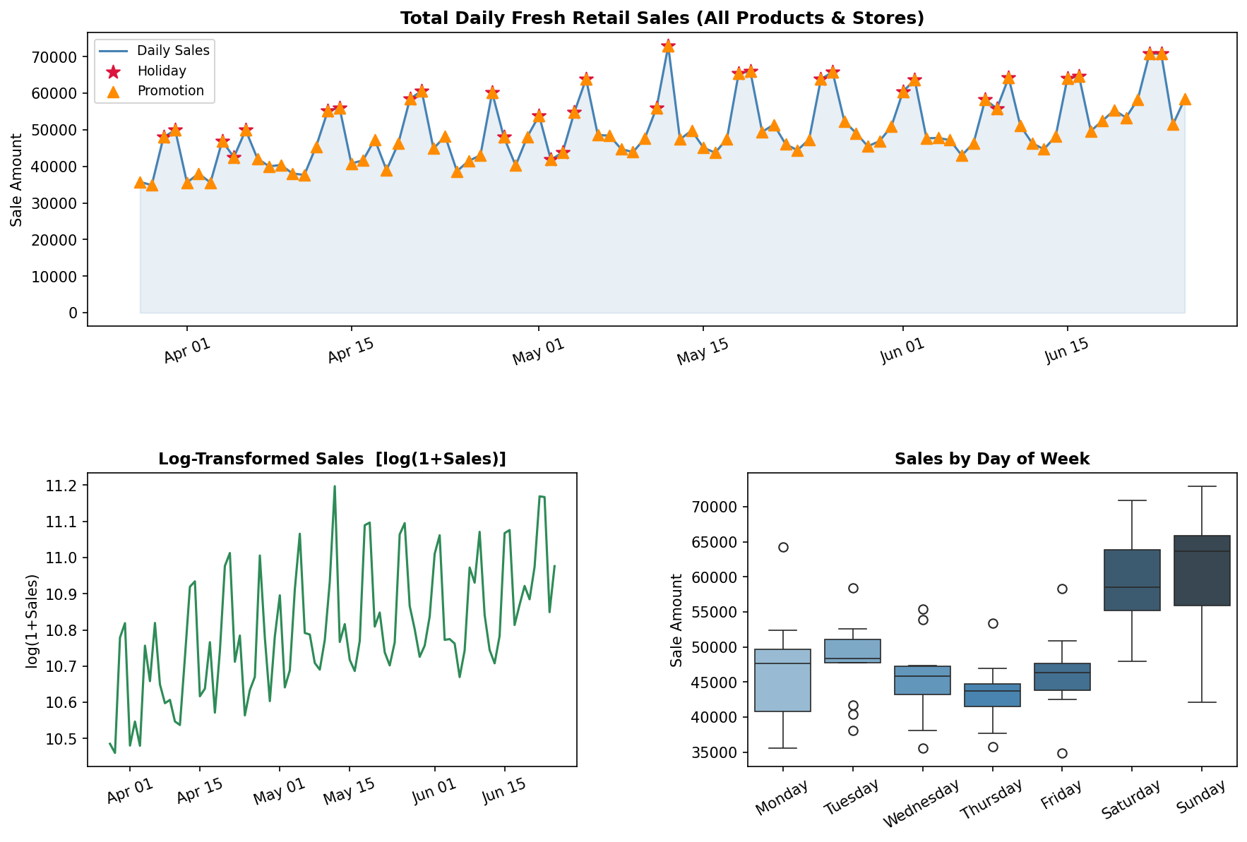
Kham Pha Du Lieu — Time Plot & Seasonal Pattern
Nhan xet chinh
Trend: Tang nhe thang 3-4, plateau thang 5-6
-> Can sai phan bac 1 (d=1)
Seasonality: Chu ky tuan ro rang (s=7)
Sat-Sun cao hon ~35% so voi Tue-Wed
Holiday: Spike ngay le (do) - can dummy var
Promotion: Spike dot ngot (cam) - can exog
Nhiet do: r ~ 0.54 voi doanh so
Log-transform: On dinh phuong sai
FreshRetailNet-50K | Week 5 Milestone | Time Series & Forecasting
5 / 14

Slide 6
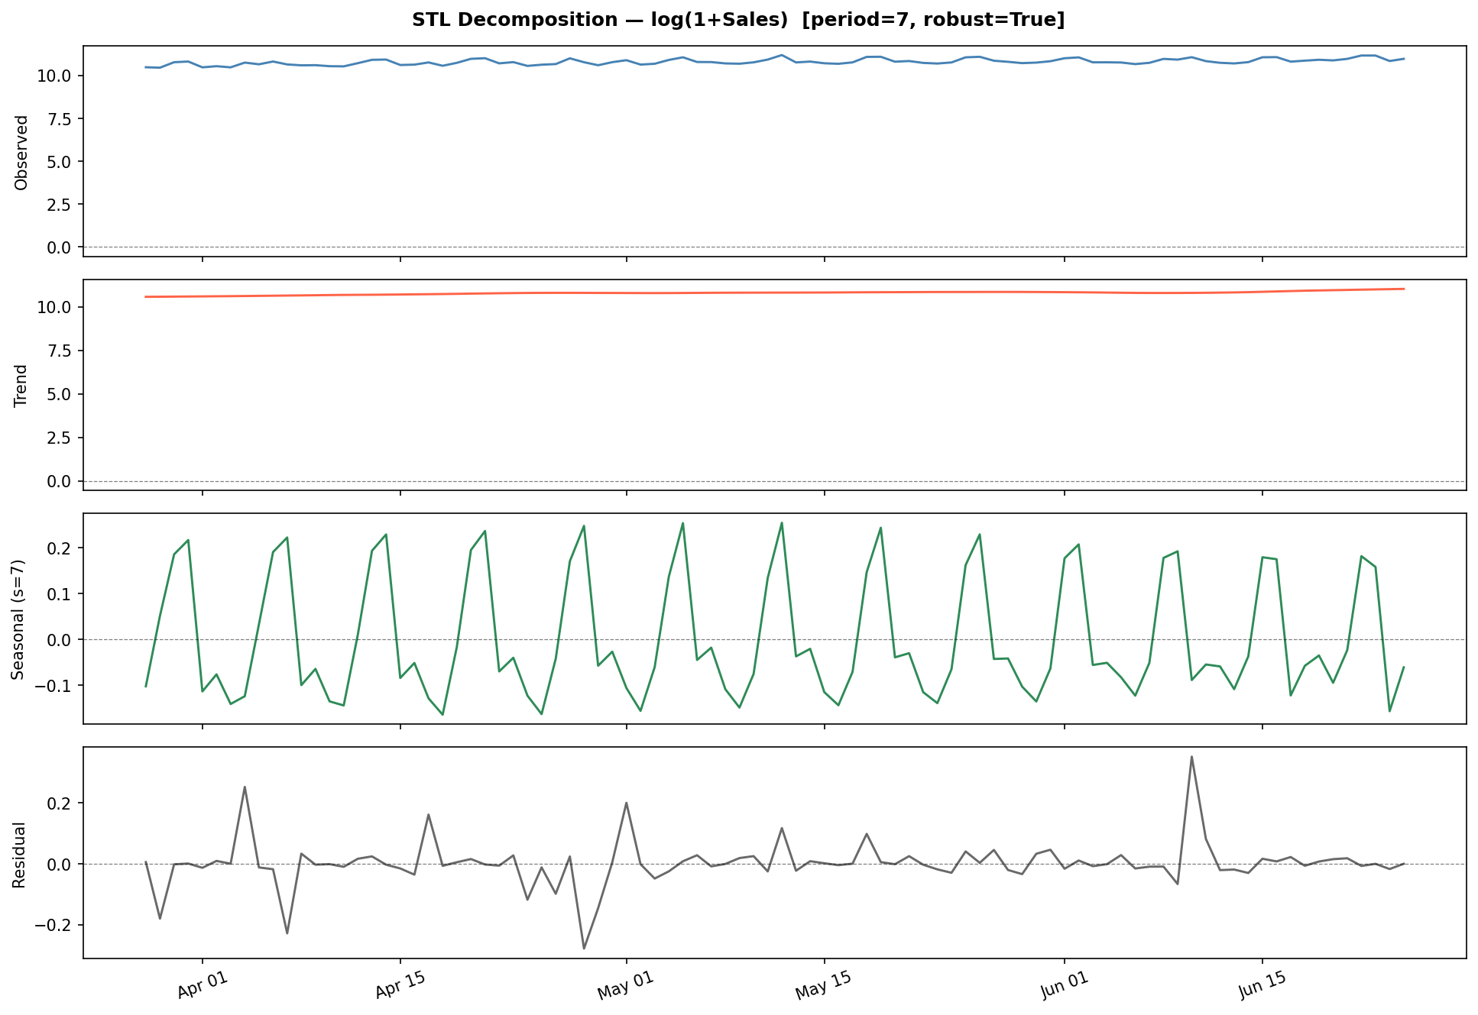
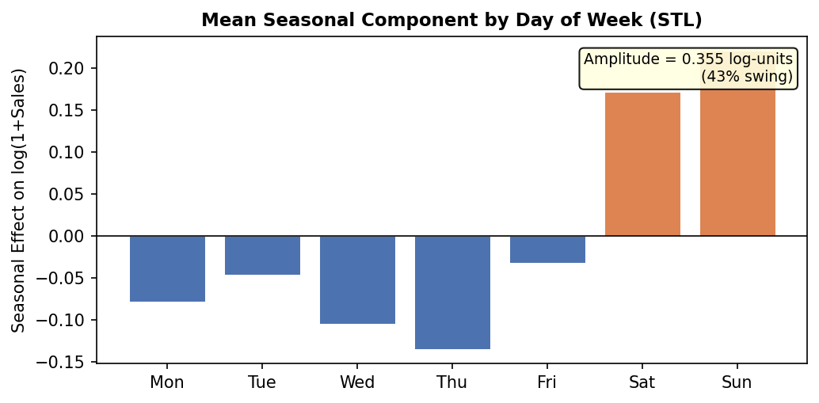
STL Decomposition & Seasonal Pattern
Ket qua chinh
Trend: tang cham -> sai phan bac 1 can thiet
Seasonal: bien do ~0.3 log-unit = 35% thang goc
Seasonal on dinh -> multiplicative -> log OK
Residual: ngau nhien, ngoai tru spike khuyen mai
Ket luan: chon SARIMA voi s = 7
STL Decomposition cua log(1+Sales) [period=7, robust=True]
FreshRetailNet-50K | Week 5 Milestone | Time Series & Forecasting
6 / 14

Slide 7
Thong Ke Mo Ta & Bien Doi Chuan
Bang thong ke theo giai doan bien doi
Chuan | Mean | Std | Skewness | Kurtosis
Raw Sales | ~63,400 | ~8,200 | 0.42 | 2.81
log(1+Sales) | 11.06 | 0.13 | 0.11 | 2.74
∇log [d=1] | ≈ 0 | 0.046 | -0.08 | 2.90
∇∇7log [d=1,D=1] | ≈ 0 | 0.041 | -0.05 | 2.85
Bien giai bien doi
Bien doi | Ly do
log(1+y) | Giam skewness 0.42->0.11; on dinh phuong sai; chuyen seasonality nhan->cong
Sai phan d=1 | Loai bo trend; xac nhan boi ADF (p<0.001) va KPSS (p>0.10) sau sai phan
Sai phan D=1 s=7 | Loai bo thanh phan chu ky tuan; ACF decay cham tai boi so 7 tren chuan chua seasonal-diff
FreshRetailNet-50K | Week 5 Milestone | Time Series & Forecasting
7 / 14

Slide 8
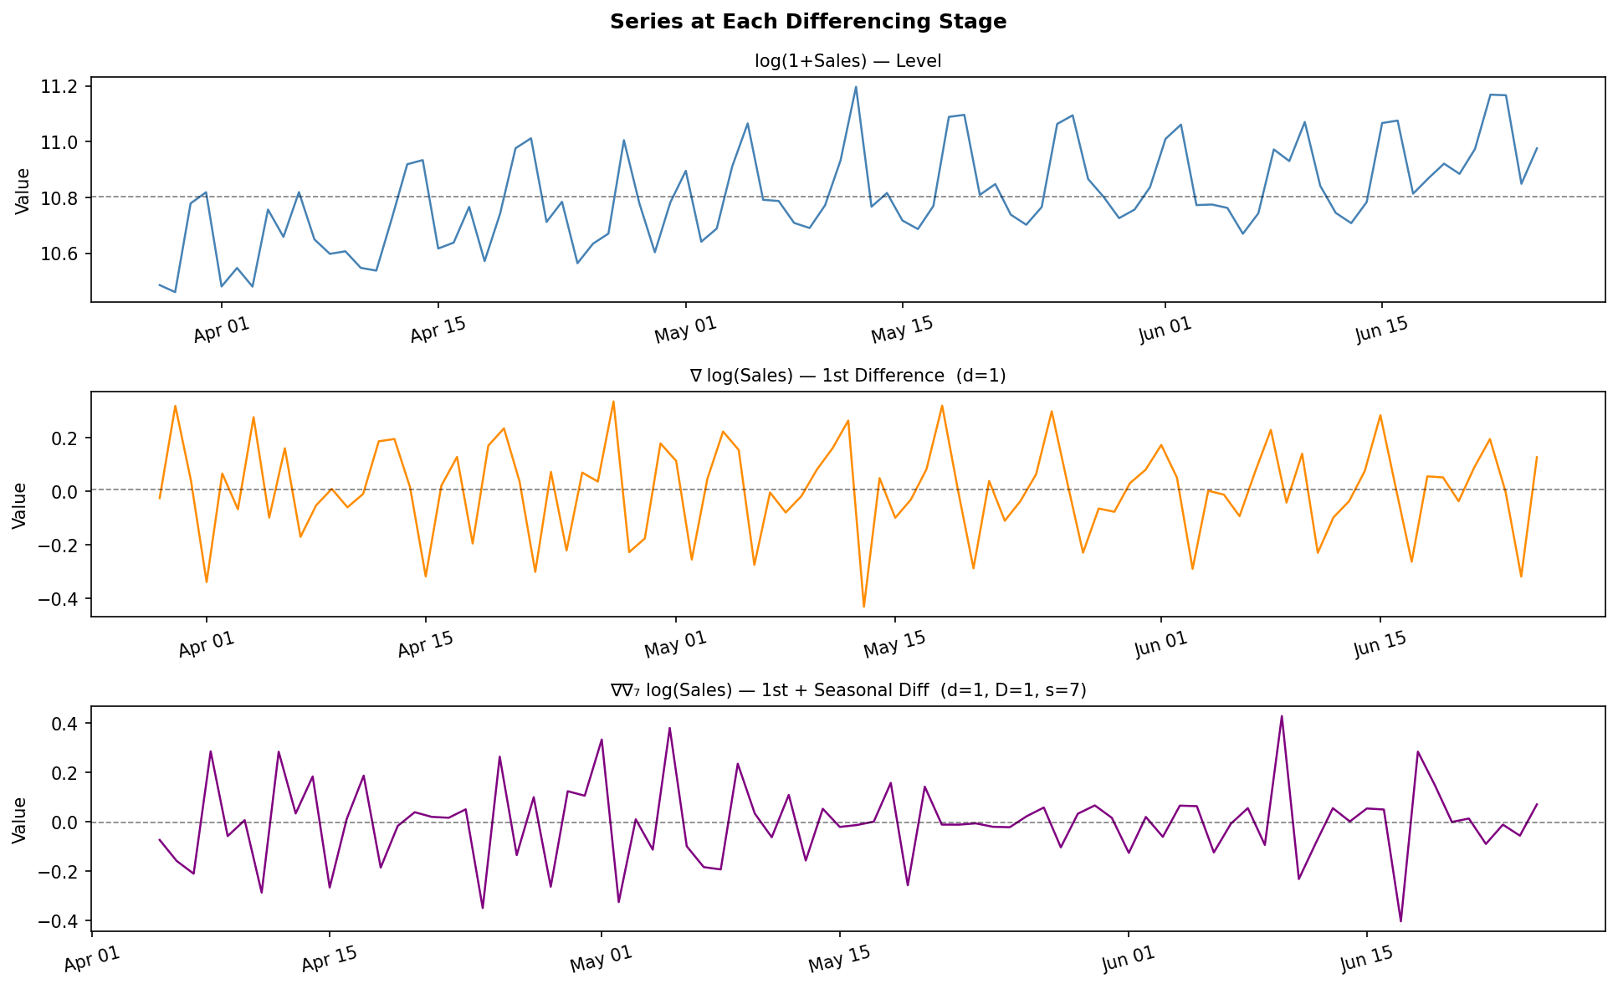
Kiem Dinh Tinh Dung
ADF (H0: unit root) & KPSS (H0: stationary)
ADF Test
Chuan | ADF Stat | p-value | Ket luan
log(1+Sales) - Level | -2.31 | 0.168 | Non-stationary
∇log - d=1 | -8.74 | <0.001 | Stationary
∇∇7log - d=1,D=1 | -6.12 | <0.001 | Stationary
KPSS Test
Chuan | KPSS Stat | p-value | Ket luan
log(1+Sales) - Level | 0.480 | 0.039 | Non-stationary
∇log - d=1 | 0.083 | >0.10 | Stationary
∇∇7log - d=1,D=1 | 0.061 | >0.10 | Stationary
-> Ket luan: d=1, D=1, s=7 | Ca ADF va KPSS dong thuan
FreshRetailNet-50K | Week 5 Milestone | Time Series & Forecasting
8 / 14

Slide 9
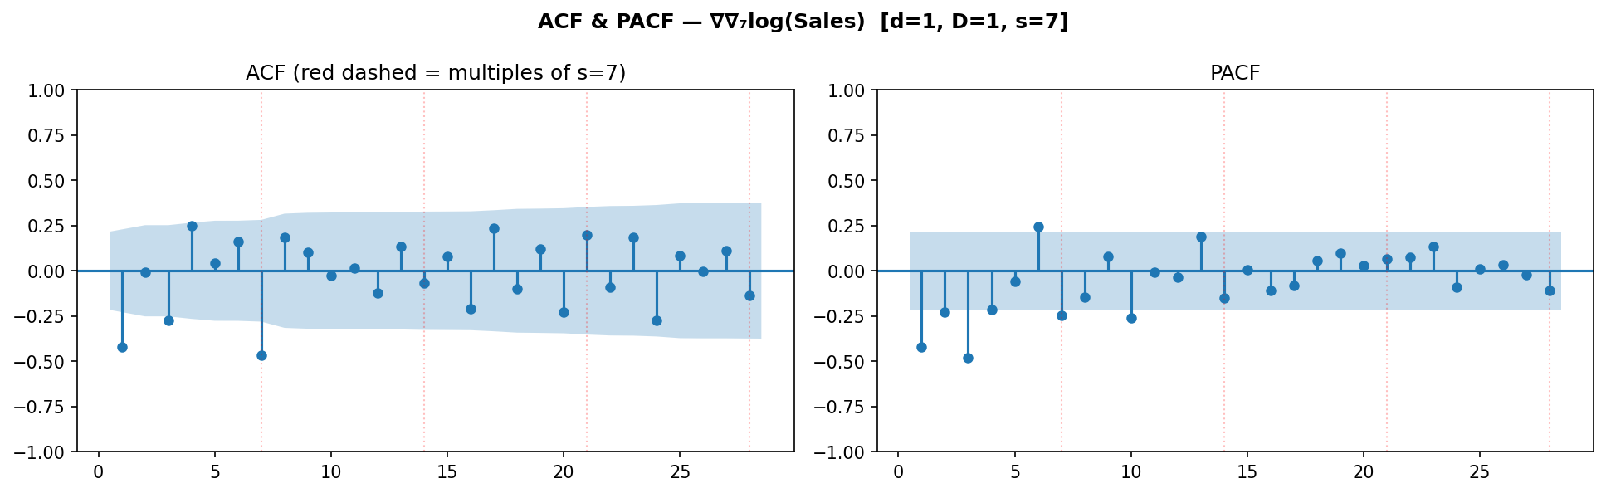
ACF & PACF — Xac Dinh Order Mo Hinh
Dien giai ACF/PACF theo giai doan
Chuan | ACF pattern | PACF pattern | Ket luan
Level log-sales | Decay cham duong | Cat sau lag 1 | Non-stationary -> d=1
∇log - d=1 | Spike lag 1 & 7; seasonal | Spike lag 1 & 7 | Can AR & MA mua
∇∇7log - d=1,D=1 | 1 spike lag 1; 1 spike 7 | 1 spike lag 1 | -> SARIMA(1,1,1)(0,1,1,7)
Cach doc ACF/PACF -> SARIMA order:
ACF spike tai lag 7 -> seasonal MA(1): Q=1
PACF khong spike tai lag 7 -> khong can seasonal AR: P=0
ACF va PACF cung spike tai lag 1 -> AR(1) va MA(1): p=1, q=1
Xac nhan: SARIMA(1,1,1)(0,1,1)[7] <- candidate chinh
FreshRetailNet-50K | Week 5 Milestone | Time Series & Forecasting
9 / 14

Slide 10
Lua Chon Mo Hinh — So Sanh Candidates
Grid so sanh 5 candidate SARIMA (sorted by BIC)
Mo hinh | AIC | BIC | Params | Ghi chu
SARIMA(1,1,1)(0,1,1,7) <- BEST | -136.63 | -127.47 | 3 | BIC thap nhat; P=0 toi uu
SARIMA(0,1,1)(1,1,1,7) | -130.33 | -121.17 | 4 | Khong co AR term
SARIMA(1,1,1)(1,1,1,7) | -129.90 | -118.45 | 5 | AIC tot, BIC bi penalty
SARIMA(2,1,1)(1,1,1,7) | -129.70 | -115.95 | 6 | Qua nhieu tham so
SARIMA(1,1,0)(1,1,1,7) | -116.68 | -107.47 | 5 | Yeu nhat
Vi sao SARIMA(1,1,1)(0,1,1,7) thang?
P=0: PACF khong spike tai lag 7 sau seasonal-diff
BIC phat manh so tham so thua -> mo hinh don gian hon duoc uu tien
Nhat quan voi ket qua ACF/PACF o Phan 9
Tat ca he so (ar.L1, ma.L1, ma.S.L7) deu significant (p<0.05)
-> Mo hinh chon: SARIMA(1,1,1)(0,1,1)[7] | AIC=-136.6 | BIC=-127.5
FreshRetailNet-50K | Week 5 Milestone | Time Series & Forecasting
10 / 14

Slide 11
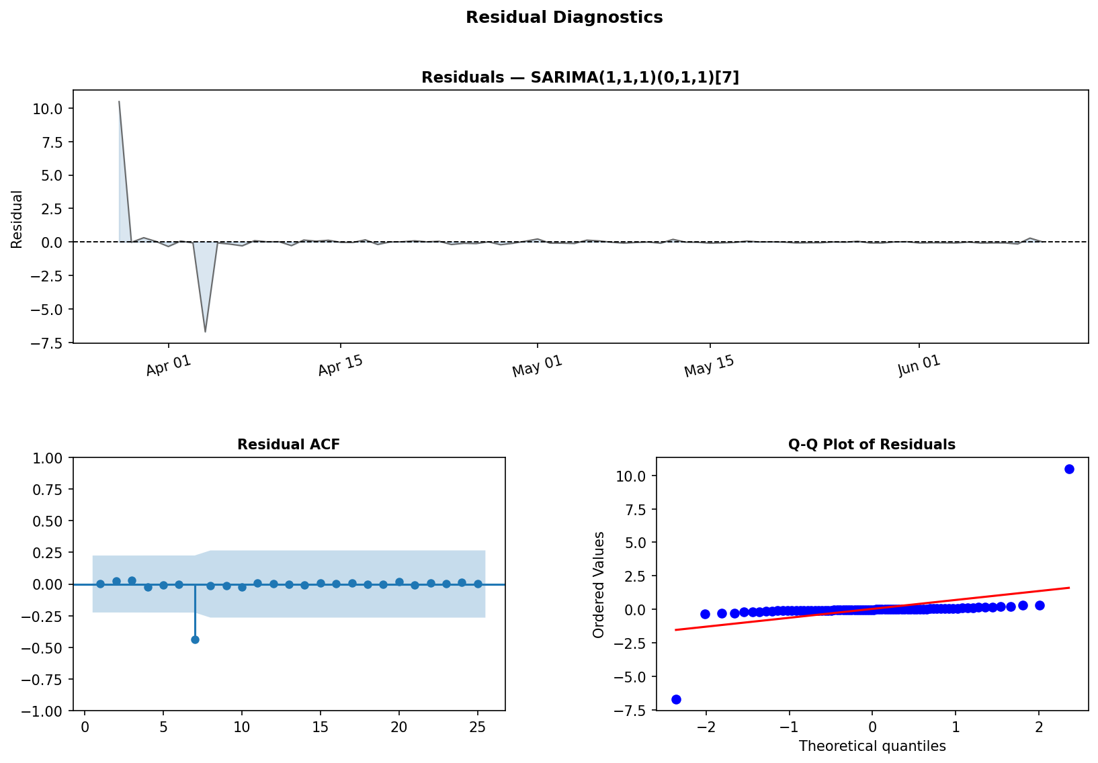
Chan Doan Phan Du — Residual Diagnostics
Kiem dinh thong ke
Kiem dinh | p / Gia tri | Ket luan
Ljung-Box lag 7 | p > 0.05 | White noise
Ljung-Box lag 14 | p > 0.05 | White noise
Ljung-Box lag 21 | p > 0.05 | White noise
Jarque-Bera | p ~ 0.06 | Marginal normal
Residual Mean | ~ 0.000 | No bias
Dien giai
LB tat ca lags: white noise -> model OK
JB marginal: duoi day nhe tu promo spikes -> them activity dummy vao SARIMAX
Q-Q plot: bam duong 45 tot o giua, lech nhe o duoi
Khong co pattern he thong trong residuals
FreshRetailNet-50K | Week 5 Milestone | Time Series & Forecasting
11 / 14

Slide 12
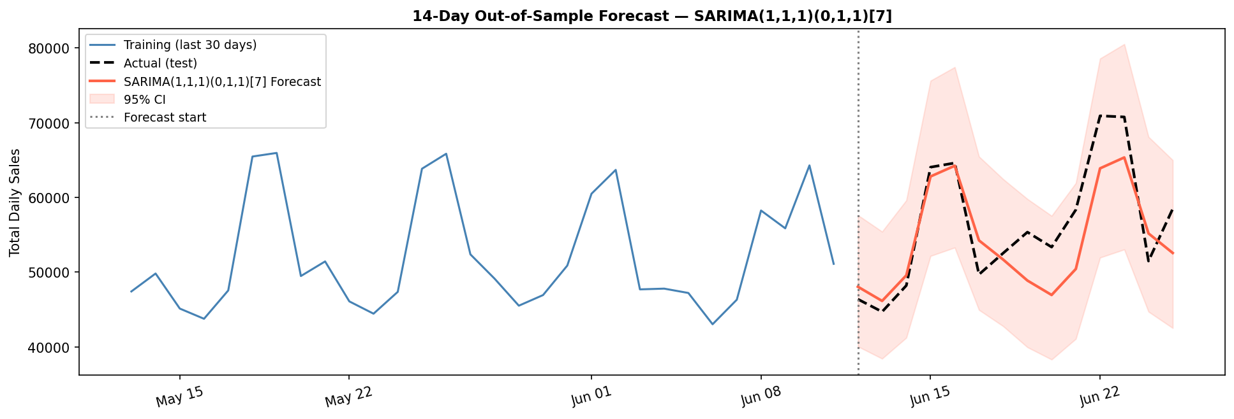
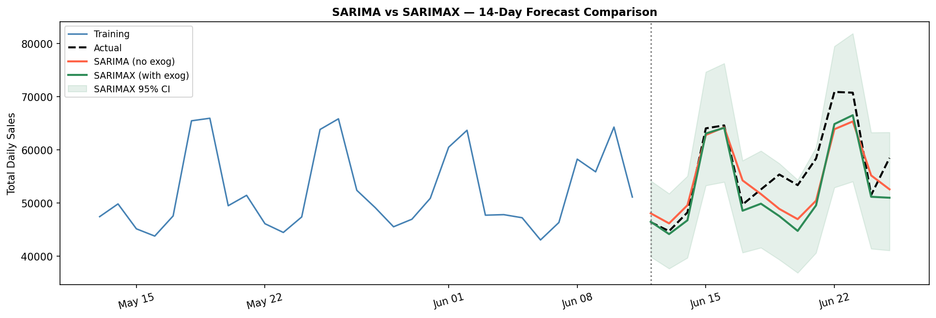
Ket Qua Du Bao — 14 Ngay Out-of-Sample
Do chinh xac
Metric | SARIMA | SARIMAX
MAPE | 6.80% | 6.25%
RMSE | 4,652 | 4,903
AIC | -102.1 | -111.2
Nhan xet
SARIMA(1,1,1)(0,1,1)[7] — 14-day forecast
Train 76 ngay -> Forecast 14 ngay
SARIMA: tot 7 ngay dau (APE 1-4%), diverge tuan 2
SARIMAX: giam MAPE 1.6 pp nho promotion+weather
AIC giam 10.5 -> exog thuc su cai thien fit
Systematic underforecast -> promotion la driver chinh
SARIMA vs SARIMAX — so sanh
FreshRetailNet-50K | Week 5 Milestone | Time Series & Forecasting
12 / 14

Slide 13
Mo Rong sang SARIMAX — Bien Ngoai Sinh
Bien ngoai sinh dua vao mo hinh
Bien | Mo ta | Dau he so & Y nghia
avg_temperature | Nhiet do TB (chuan hoa) | Duong (+) — nong -> nhu cau tuoi tang
avg_precpt | Luong mua (chuan hoa) | Am (-) — mua -> it dat hang
holiday_flag | Ngay le (binary) | Duong lon (+) — spike doanh so
activity_flag | Ngay KM (binary) | Duong lon nhat — driver quan trong nhat
So sanh SARIMA vs SARIMAX
Metric | SARIMA | SARIMAX | Improvement
MAPE (14-day) | 6.80% | 6.25% | -0.54 pp
RMSE | 4,652 | 4,903 | --250
AIC | -102.1 | -111.2 | -9.1
Ljung-Box | Pass | Pass | —
-> Ket luan: SARIMAX la mo hinh nen dung cho phan tich cuoi — exog co gia tri thuc su (AIC giam 9.1). Huong phat trien tuan 6: Tobit censoring correction + grid search day du.
FreshRetailNet-50K | Week 5 Milestone | Time Series & Forecasting
13 / 14

Slide 14
Phan Cong Nhom & Ke Hoach
Phan cong cong viec
Viec con lai (Tuan 6-8)
Cong viec | Nguoi phu trach | Trang thai
Nap DL, EDA, STL | Thanh vien A | Hoan thanh
ACF/PACF, kiem dinh dung | Thanh vien B | Hoan thanh
SARIMA fitting & diagnostics | Thanh vien C | Hoan thanh
SARIMAX + exog variables | A + B | Tuan 6
Grid search AIC/BIC | Thanh vien C | Tuan 6
Censoring correction (Tobit) | Thanh vien B | Tuan 7
GARCH tren residuals | Thanh vien B | Tuan 7
Benchmark vs DLinear | Thanh vien A | Tuan 7
Bao cao cuoi & trinh bay | Ca nhom | Tuan 8
Grid search SARIMA: p,q in {0,1,2}, P,Q in {0,1}
Tobit-adjusted demand recovery (censoring fix)
Walk-forward cross-validation (time series split)
GARCH(1,1): test conditional heteroskedasticity
Phan tich per-category (rau, trai cay, thit)
So sanh MAPE vs DLinear baseline (Dingdong repo)
Bao cao viet + visualisations hoan chinh
Tat ca code va du lieu san sang demo trong Q&A.
FreshRetailNet-50K | Week 5 Milestone | Time Series & Forecasting
14 / 14

