Slide 1

TellUs.

Slide 2
We are facing a suicide epidemic.
4157.
2nd.
Number of suicides in Canada in 2017
$25million.
Most common cause of death in Canada is suicide
Mental Health Spending by Canadian Government
Notes:
4,157 suicides took place in Canada in 2017

Slide 3
The current mental health system is failing our youth.
But why?

Slide 4

Problem:
Solution:
Mental crisis can happen 24/7, but school’s counselling appointments isn’t
Students in crisis are scared to take initiative to talk to a counselor
School counseling services lack privacy and ease of access
Make a NON-INTIMIDATING chat app to connect school counselors with their students ANONYMOUSLY, 24/7.
DEMAND

Slide 5
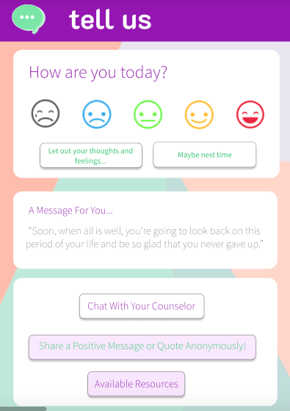


How does it work?
Every student will have TellUs App on their phone.
When they feel overwhelmed? They only need to send a quick message and an online counselor (School's or hired by TellUs) will reply right away, 24/7!
OUR APP:
TellUs.
The 24/7 service students DESERVE
to connect to a mental health advisor
Click here to chat
with your school
counselor!

Slide 6
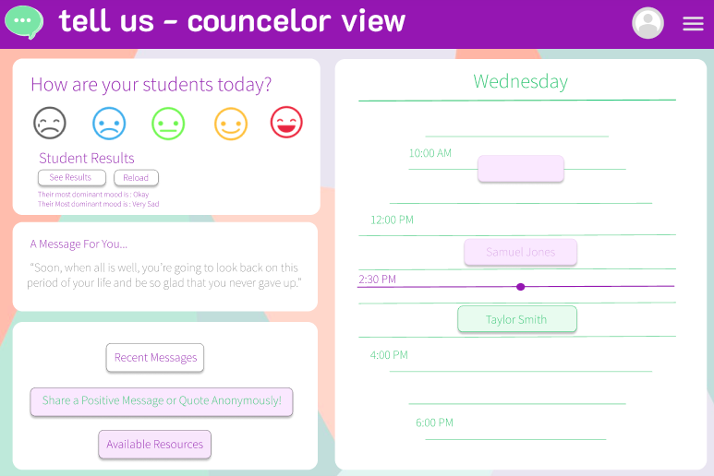
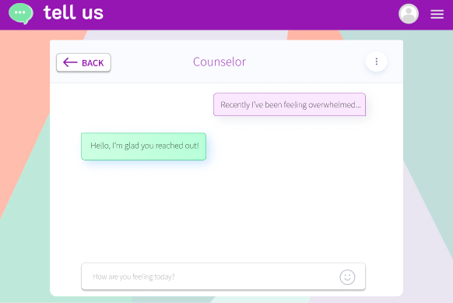

To overcome the humiliation of being seen walking to the school counselling room, and the delay from booking an appointment, students are given an anonymous chatting platform to directly connect to a caring professional, any where, any time of the day.
Counselors can follow up daily with their students on their progress and feeling without booking an appointment, and offer help the moment the student is in crisis. Being able and available to high-risk students outside the classrooms.

Slide 7
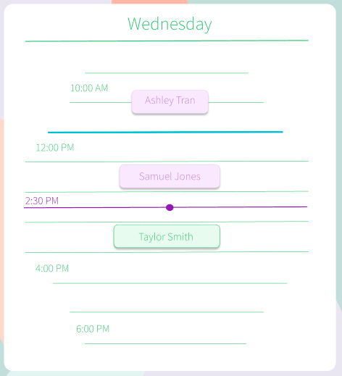
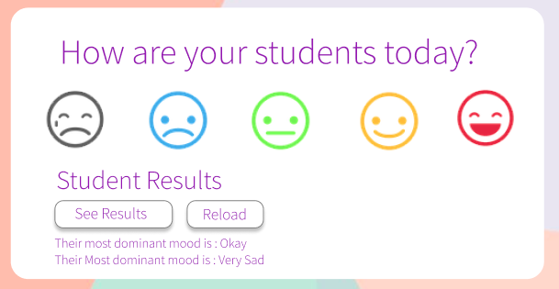
Data Driven Analytics
Built in metrics can detect high-risk students who frequently select “sad” and notify the counselor.
If the student still prefer in person sessions, they choose from a TellUs counselor or their school’s and book it right in the app!

Slide 8
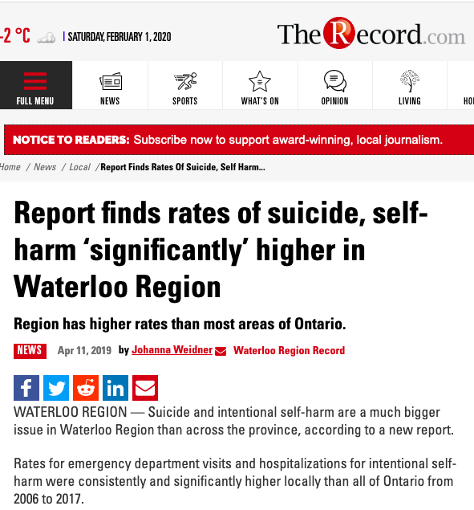
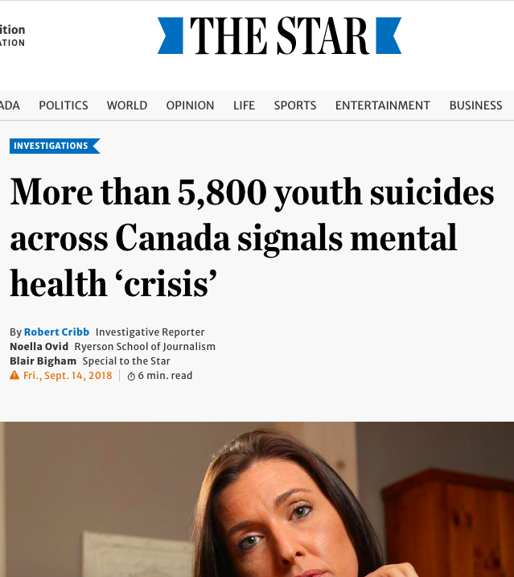
1. Proven Demand & Deep Client Pockets
PARENTS WANT IT:
School boards are receiving increase in pressure from parents to provide more resources for children’s mental health as bullying and student suicides are gaining increase in media coverage
GOVERNMENT HAS BUDGET:
$25 MILLION government spending on mental health in 2017. Our product only cost ~$300 per school.
STUDENTS NEED IT:
More than 5800 youth suicides in 2018 alone, students are protesting for the lack of resources available

Slide 9

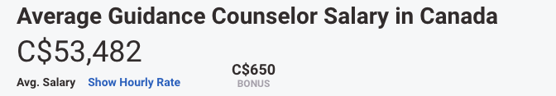
2. Affordable & at the Forefront of Tech
How does our fee compare to competitors?
Industry peer Brightspace Online Learning Platform charge $300 ~ $1250 per month.
Average students per school is 313 Students.
With the add on, students get 24/7 access to our own TellUs counselor for only $7212 per year.
$1/student per month for basic chat server.
$2/student add on: after-school online counselling.
PRICING:
… We are 75% CHEAPER than hiring a counselor!

Slide 10

3. Low Cost, High Profit Margin
$17 Million Profit 1st Year
(In Only Ontario Schools ALONE)
We will hire 4 psychology student coops per 1 full time counselor for cost savings
ONLY 10 schools needed to break even!

Slide 11
TellUs.
The 24/7 service students DESERVE
to connect to a mental health advisor
Demonstration

