Slide 1

Graph convolutional networks for node
classification on citation network
Vũ Trung Thành - 20220066

Slide 2
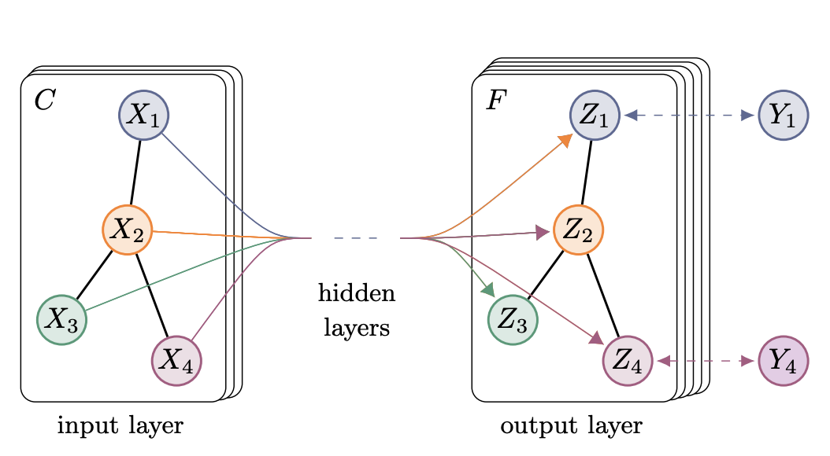
Introduction
Graph Neural Networks (GNNs) and Graph Convolutional Networks (GCNs)
Analyze graph-structured data, capturing complex relationships between entities
Leverage neighborhood information to learn meaningful representations
Useful for social networks, biological networks, citation networks, etc.

Slide 3
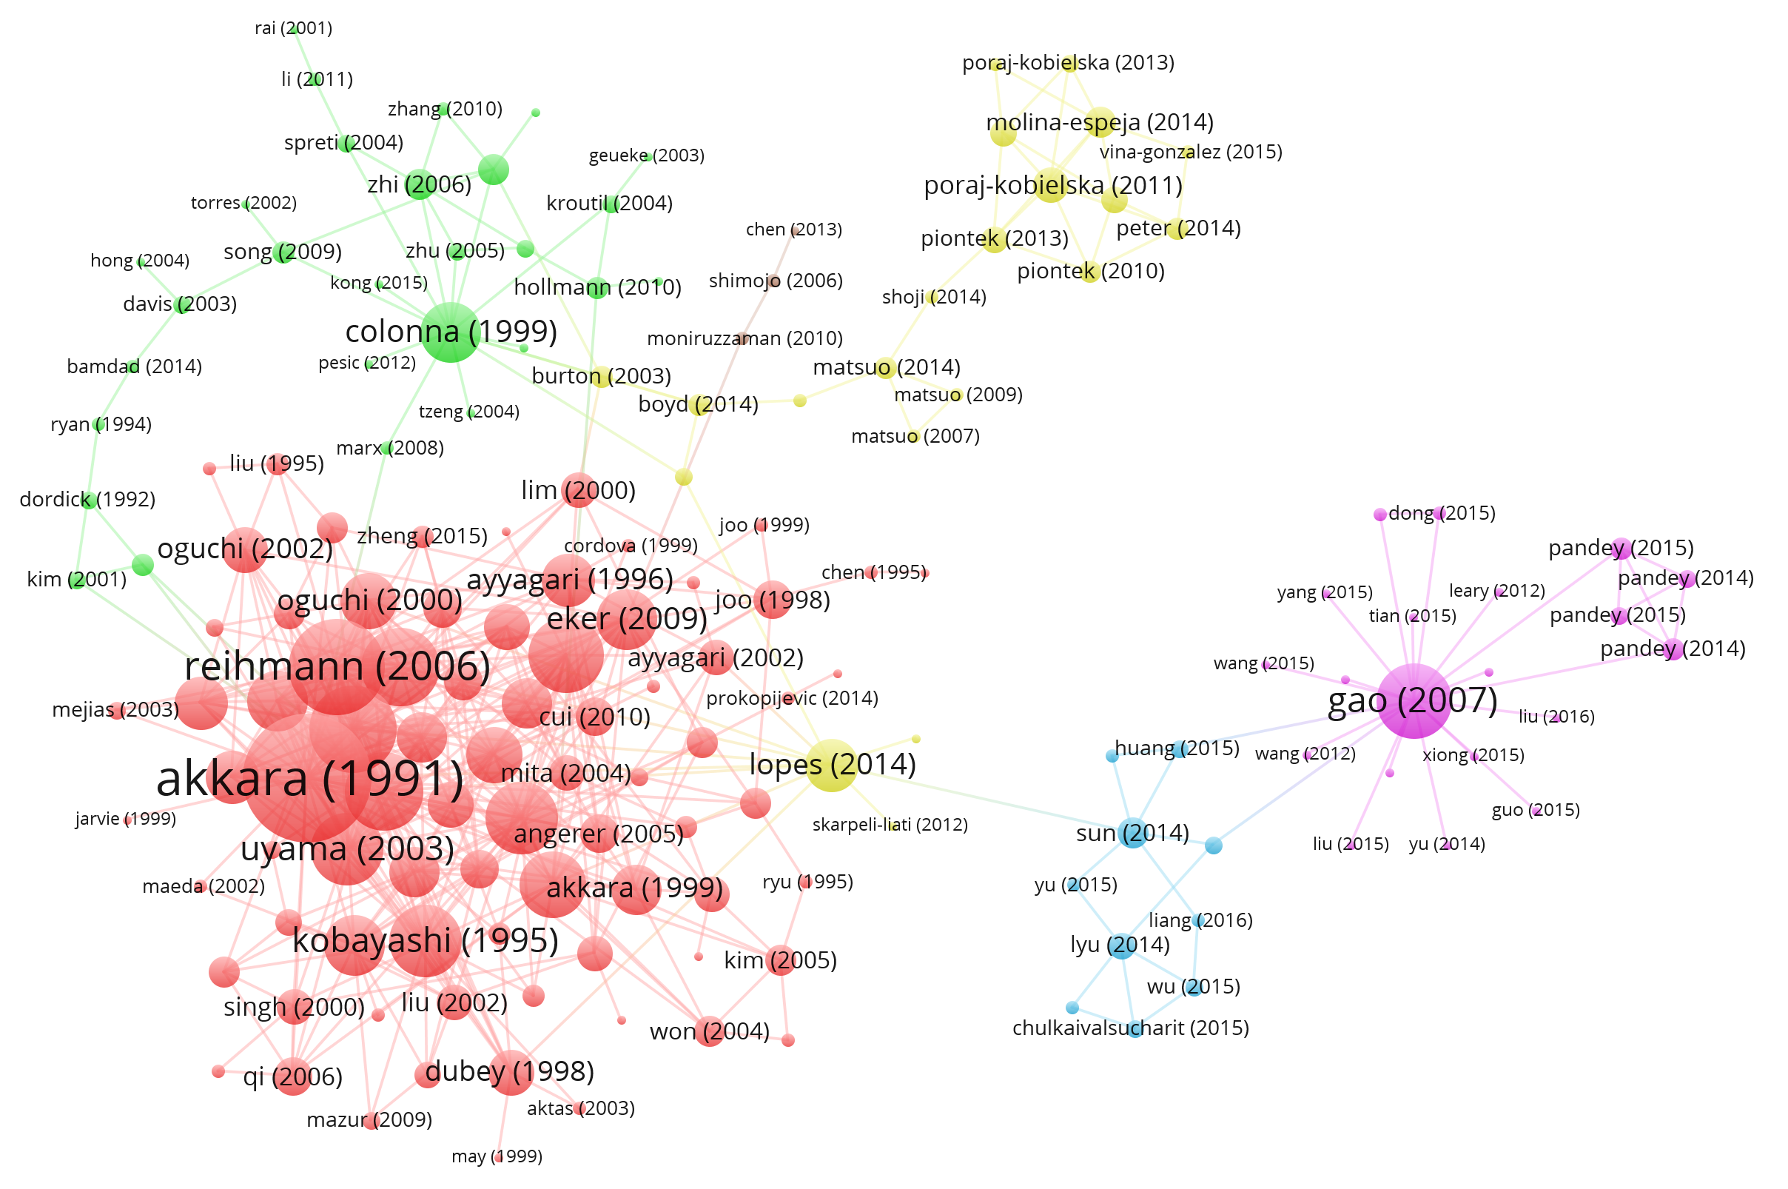
Introduction
Citation networks: Nodes represent papers, edges represent citations.
Task: Assign labels (e.g., research areas) to papers based on citation patterns and content.
Evaluate the performance of GCN architectures
Understand how different GCN variants capture graph structures for node label prediction.

Slide 4

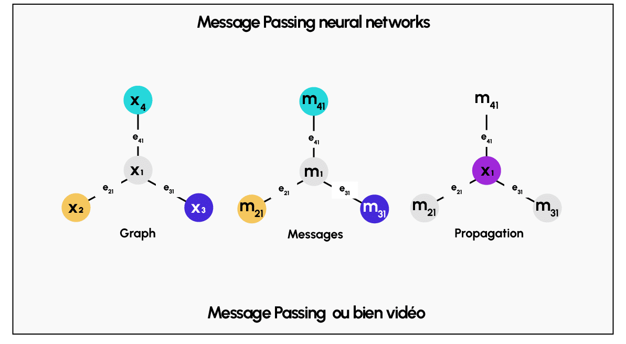


Methods
Most GNNs follow a neighborhood aggregation strategy (message-passing GNNs)
Node representation of node v at layer l:
: neighboring nodes adjacent to v
AGG^{l} : message aggregation function
UPDATE^{l} : update function
Initially: , feature vector of v

Slide 5
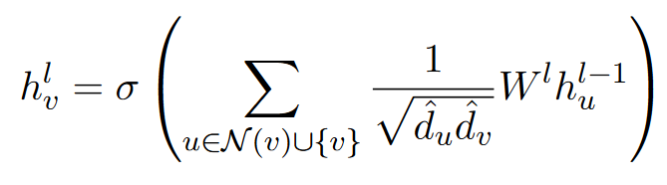
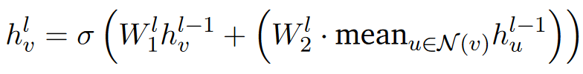

Methods
The architectures derived from message-passing GNNs mainly differ in their specific choices of the AGG^{l} and UPDATE^{l} functions
Four classical GNN models: GCN, GraphSAGE, GAT, and GIN.
GraphSAGE(SAmple and aggreGatE) Sampling and aggregating features from a node’s local neighborhood
Graph Convolutional Networks (GCN) Most well-known GNN architecture

Slide 6
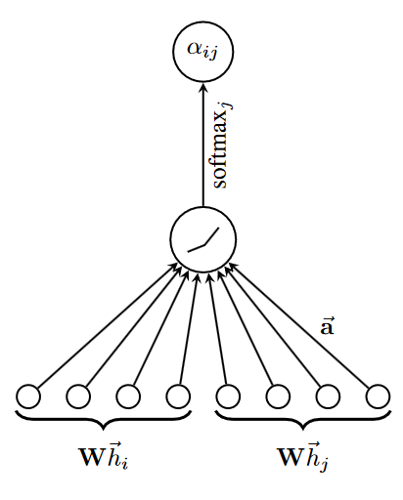

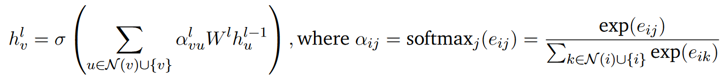
Methods
Graph Attention Network (GAT)
Make use of the attention mechanism a
Compute attention coefficients
Indicate the importance of node j’s features to i

Slide 7
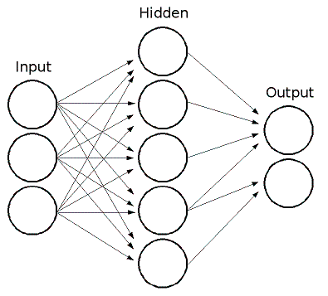

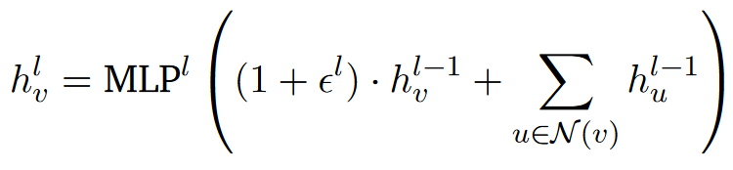
Methods
Graph Isomorphism Network (GIN)
Provably the most expressive among the class of GNNs
MLP^{l} is implemented as a two-layer MLP with ReLU activation

Slide 8
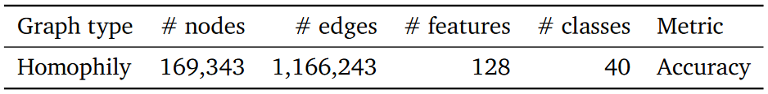
Experimental setup
Dataset: ogbn-arxiv from Open Graph Benchmark (OGB).
Graph type: Directed citation network of Computer Science arXiv papers indexed by MAG.
Nodes: Represent individual arXiv papers.
Edges: Directed, indicating citations between papers.
Node features: 128-dimensional vectors representing the content of the paper's title and abstract.
Classification task
Objective: Classify papers into 40 subject areas (e.g., cs.AI, cs.OS).
Labels: Manually assigned by authors and arXiv moderators.

Slide 9
Experimental setup
Preprocessing
Adjacency matrix converted to sparse format
Converted to an undirected format
Training and Evaluation
Loss: Multi-class cross-entropy
Metric: Accuracy
Data split by publication year:
Train: Papers published until 2017
Validation: Papers from 2018
Test: Papers from 2019 onward
Regularization and Hyperparameters
Used batch normalization and dropout
Optimizer: Adam
Execution
Each model trained for 10 runs; results averaged.
GAT model executed on cloud service due to GPU memory constraints

Slide 10
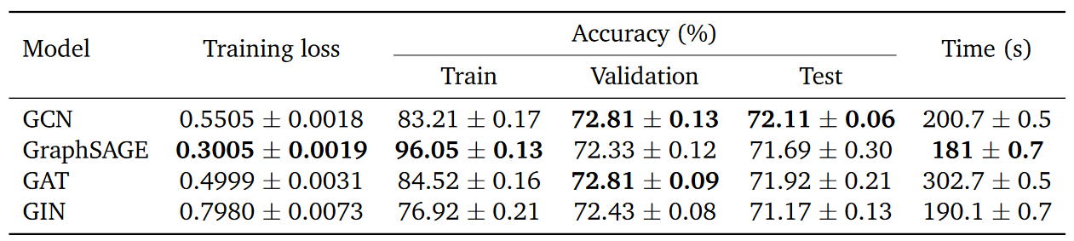
Result and Evaluation
GraphSAGE: Lowest training loss and highest training accuracy, but overfitted.
Best models: GCN and GAT performed best overall, with GCN slightly outperforming GAT in test accuracy.
GIN: Potential for improvement with a smaller gap between training and validation/test accuracy.
Resource usage: GCN, GraphSAGE, and GIN were efficient in time and memory, while GAT was significantly less efficient.

Slide 11
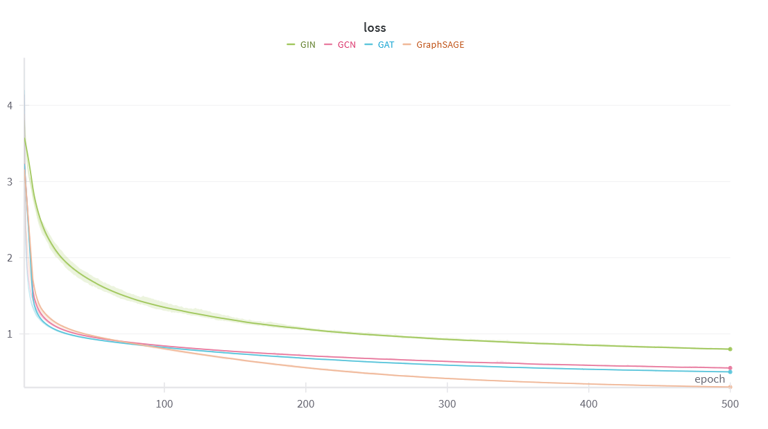
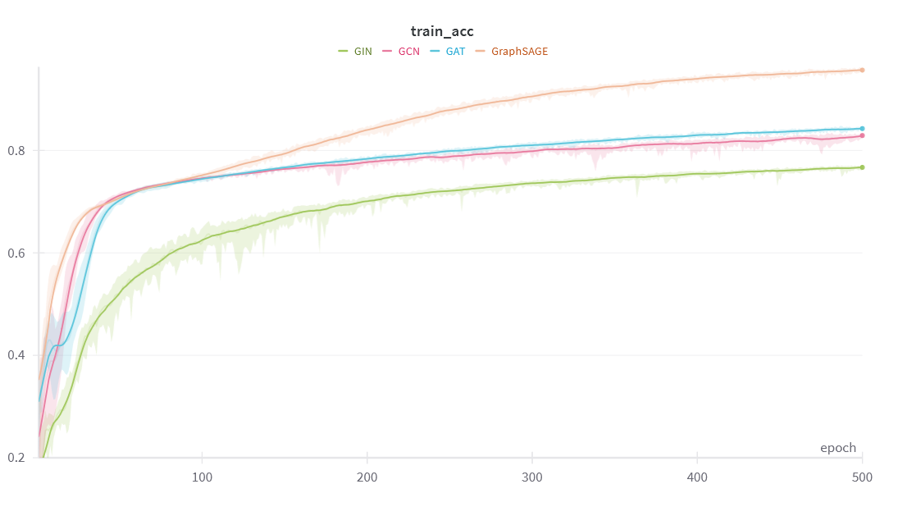
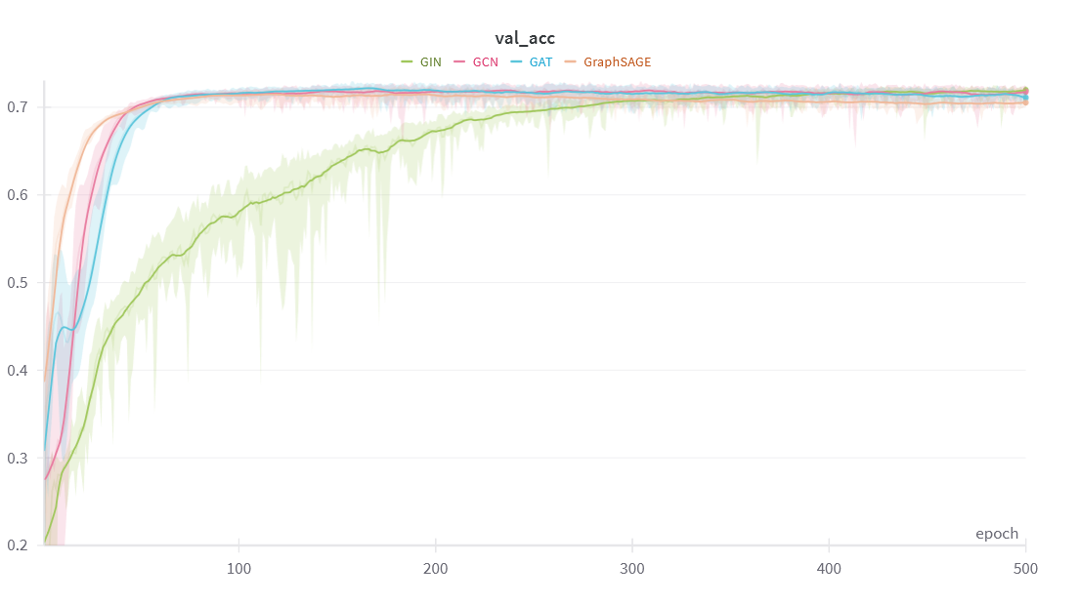
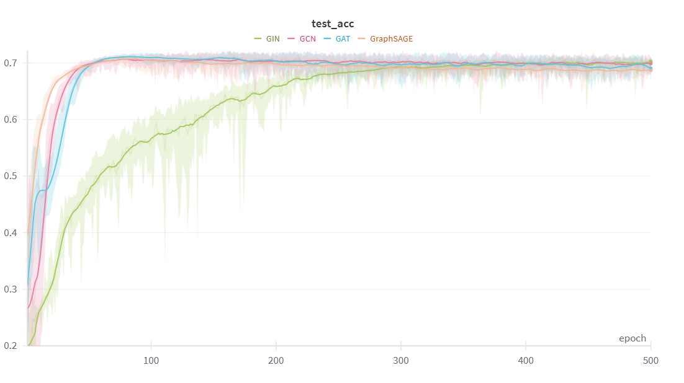
Result and Evaluation

Slide 12
Conclusion
Project overview:
Explored GNNs for node classification on the ogbn-arxiv dataset.
Compared GCN, GraphSAGE, GAT, and GIN based on training performance, generalization, and computational efficiency.
Performance:
GCN and GAT: Best test accuracy, with GCN slightly better in generalization.
GraphSAGE: Highest training accuracy but suffered from overfitting.
GIN: Balanced performance with potential for improvement through tuning.
Resource usage:
GCN, GraphSAGE, and GIN: Comparable efficiency.
GAT: Significantly higher time and memory requirements due to attention mechanisms.

Slide 13
Conclusion
Limitations:
Did not use all dataset information (e.g., treated edges as undirected and ignored temporal features).
Advanced architectures like graph transformers or self-supervised learning not explored.
No qualitative analysis (e.g., visualizing node embeddings) due to data complexity.
Future directions:
Incorporate directed edges and temporal features for richer insights
Experiment with advanced architectures (e.g., graph transformers, self-supervised learning)
Perform qualitative analysis of node embeddings

Slide 14
THANK YOU !

