Slide 1
Probability
Week 4

Slide 2
Objectives
On completion of this module you should be able to:
demonstrate understanding of basic probability concepts including sample spaces, events, contingency tables, marginal and joint probability,
use and compute conditional probabilities,
use the addition and multiplication rules,
explain and demonstrate statistical independence and
apply Bayes’ theorem and counting rules.

Slide 3
What is probability?
Probability is the theoretical aspect of statistics as opposed to application aspects such as EDA (Exploratory Data Analysis or descriptive statistics).
Its features are:
Probability is the likelihood or chance that a particular event will occur.
An event that is certain has a probability of 1.
An impossible event has a probability of 0.
All probabilities are values from 0 to 1 (inclusive).
Thus, a probability can never be a negative value or a number greater than 1.

Slide 4
Three approaches to probability
Classical probability – the probability of success is based on prior knowledge of the process involved.
Probability of occurrence
where
X = number of ways in which the event occurs
T = total number of elementary outcomes
Classical probability comes from intuitive understanding.

Slide 5
Examples
A six-sided die has T = 6 possible outcomes.
The probability of rolling a five is 1/6.
Rolling two dice, there are T = 36 = 6 × 6 possible outcomes.
The probability of rolling a total of six (adding the two values together) is 5/36 since you could roll 1 & 5, 2 & 4, 3 & 3, 4&2 and 5&1. This is shown on the next page.

Slide 6
Sample space and the event of rolling a total of 6 in a throw of two dice.
1, 1 | 1, 2 | 1, 3 | 1, 4 | 1, 5 | 1, 6
2, 1 | 2, 2 | 2, 3 | 2, 4 | 2, 5 | 2, 6
3, 1 | 3, 2 | 3, 3 | 3, 4 | 3, 5 | 3, 6
4, 1 | 4, 2 | 4, 3 | 4, 4 | 4, 5 | 4, 6
5, 1 | 5, 2 | 5, 3 | 5, 4 | 5, 5 | 5, 6
6, 1 | 6, 2 | 6, 3 | 6, 4 | 6, 5 | 6, 6

Slide 7
Three approaches to probability (contd.)
Empirical probability – probabilities are based on observed data, not on prior knowledge of the process.
Example – we might observe that one out of the five cars in a car park is white. Therefore, the probability that the next car that enters into the car park is white is 1/5.

Slide 8
Three approaches to probability (contd.)
Subjective probability – the chance of an event is assigned by a particular individual.
Different people will assign different probabilities.
Subjective probability is useful when probabilities of events can’t be determined empirically. Example – intuition of a punter as to which horse will win the Melbourne cup.
Subjective probability gives the opportunity to include the experience and intelligence of an expert.

Slide 9
Some definitions
Event – a possible type of occurrence.
Simple event – can be described by a single characteristic.
Sample space – the collection of all possible events of a process.
Complement – the complement of an event, A, (written A') is all the events which are not part of the event A in the sample space.
Joint event – an event that has two or more characteristics.

Slide 10
Some definitions
Contingency table – a table of cross-classifications.
Simple (marginal) probability – the probability of occurrence of a simple event.
Joint probability – a probability referring to two or more events.
Elementary event – an event that cannot be decomposed into smaller events. A simple event may not be an elementary event.

Slide 11
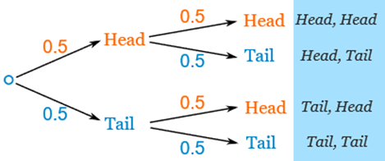
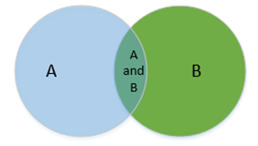
Pictorial depictions of probability
Tree diagram – It captures each possible outcome through the branch of a tree. The diagram below captures two experiments of throwing a coin twice.
Venn diagram – Schematic diagram capturing relationships between events.
Events A, B and their intersection in a rectangular sample space.

Slide 12
Tabular presentation of probability
A contingency table can describe probabilities in a tabular form. It can be in numbers of observations made (given in next slide) or in probability values as given below:
[P(XA) = Probability of X and A.]

Slide 13
Example 4-1
A store manager is interested in whether repeat customers spend more money in his store than do first-time customers.
He takes a random sample of 200 customers over a one month period with the following results:
New customer | Spent $200 or less | Spent over $200 | Total
Yes | 67 | 54 | 121
No | 29 | 50 | 79
Total | 96 | 104 | 200

Slide 14
Example 4-1
(a) Give an example of a simple event.
“spent $200 or less”
“is a new customer”
(b) Give an example of a joint event.
“a new customer who spent more than $200”
“a new customer who spent $200 or less”
(c) What is the complement of “new customer”?
“is not a new customer”

Slide 15
Example 4-1
(d) Why is “new customer who spent over $200” a joint event?
Joint events have two or more characteristics: “new customer” and “spent over $200”
(e) How can the simple event “Spent $200 or less” can be broken down into elementary events?
Simple event “Spent $200 or less” can be broken down into “Spent $200”, “Spent $190”, etc.

Slide 16
Example 4-1
If a customer is selected at random, what is the probability that he or she:
(e) is a new customer?
New customer | Spent $200 or less | Spent over $200 | Total
Yes | 67 | 54 | 121
No | 29 | 50 | 79
Total | 96 | 104 | 200

Slide 17
Example 4-1
(f) spent $200 or less?
New customer | Spent $200 or less | Spent over $200 | Total
Yes | 67 | 54 | 121
No | 29 | 50 | 79
Total | 96 | 104 | 200

Slide 18
Example 4-1
(g) is not a new customer and spent over $200?
New customer | Spent $200 or less | Spent over $200 | Total
Yes | 67 | 54 | 121
No | 29 | 50 | 79
Total | 96 | 104 | 200

Slide 19
Example 4-1
(h) is not a new customer or spent over $200?
New customer | Spent $200 or less | Spent over $200 | Total
Yes | 67 | 54 | 121
No | 29 | 50 | 79
Total | 96 | 104 | 200

Slide 20
Example 4-1 – alternative view for (h)
(h) is not a new customer or spent over $200?
New customer | Spent $200 or less | Spent over $200 | Total
Yes | 67 | 54 | 121
No | 29 | 50 | 79
Total | 96 | 104 | 200

Slide 21
Example 4-1
Explain the difference between your answers to (g) and (h).
(g) is not a new customer and spent over $200?
(h) is not a new customer or spent over $200?
“and” – look at only one cell in the table where both events occur
“or” – look at row and column totals and subtract the intersection (so that these customers are not counted twice)
alternative view of “or” – add up three cells

Slide 22
General addition rule

Slide 23
Addition rule: mutually exclusive events

Slide 24
Conditional probability

Slide 25
Statistical independence
Two events are statistically independent if and only if
General multiplication rule

Slide 26
Example 4-2
(a) Given that a customer spent over $200, what is the probability that he or she is a new customer?
New customer | Spent $200 or less | Spent over $200 | Total
Yes | 67 | 54 | 121
No | 29 | 50 | 79
Total | 96 | 104 | 200

Slide 27
Example 4-2
(b) Given that a customer is new, what is the probability that he or she spent over $200?
New customer | Spent $200 or less | Spent over $200 | Total
Yes | 67 | 54 | 121
No | 29 | 50 | 79
Total | 96 | 104 | 200

Slide 28
Example 4-2
(c) Explain the difference in your answers for (a) and (b).
The conditional events are reversed.
(a) explores only those customers who spent over $200 and of these, the probability that a customer is new.
(b) explores only those customers who are new and of these, the probability that a customer spent over $200.

Slide 29
Example 4-2
(d) Are the two events, new customer and spent over $200 statistically independent?
Events A and B are statistically independent if
Since these are not equal, the two events are not statistically independent.

Slide 30
Example 4-2
We can reverse the order of this test so that A and B would also be statistically independent if
Since these are not equal, we find again that the two events are not statistically independent.

Slide 31
Example 4-3
Chief Executive Officers (CEOs) of companies are demonstrating increasing mobility between companies.
A concerned employer at a particular company worries that constantly changing the CEO in his company has left an unstable work environment for staff, and customers confused by ever changing products.
He conducts a survey of 150 large companies, looking at whether the companies’ profit levels have increased or decreased and whether the company has had a new CEO within the last five years.

Slide 32
Example 4-3
Based on his survey he discovers that of the 150 companies, 67 have reported decreased profits.
A total of 31 of the companies have not replaced their CEO within the last five years and of these, 29 have increased their profits.
Produce a contingency table summarising this information and use it to find the probability that a company has increased its profits given that it has replaced its CEO in the last five years.

Slide 33
Solution 4-3
First identify the events:
“New CEO in the last five years” (call this N for new).
“Increased profit” (call this I for increase).
Want to find the value of
Use the information given to construct the contingency table…

Slide 34
Solution 4-3
Firstly create the table.
Here we’ve placed new CEO down the rows and profit across the columns and listed the two options for each.
Note we’ve included a totals row and column.
 |  | Increased profit
 |  | Yes | No | Total
New CEO in last five years | Yes
 | No
 | Total

Slide 35
Solution 4-3
Based on his survey he discovers that of the 150 companies, 67 have reported decreased profits.
A total of 31 of the companies have not replaced their CEO within the last five years and of these, 29 have increased their profits.
 |  | Increased profit
 |  | Yes | No | Total
New CEO in last five years | Yes
 | No
 | Total |  |  | 150

Slide 36
Solution 4-3
Based on his survey he discovers that of the 150 companies, 67 have reported decreased profits.
A total of 31 of the companies have not replaced their CEO within the last five years and of these, 29 have increased their profits.
 |  | Increased profit
 |  | Yes | No | Total
New CEO in last five years | Yes
 | No
 | Total |  | 67 | 150

Slide 37
Solution 4-3
Based on his survey he discovers that of the 150 companies, 67 have reported decreased profits.
A total of 31 of the companies have not replaced their CEO within the last five years and of these, 29 have increased their profits.
 |  | Increased profit
 |  | Yes | No | Total
New CEO in last five years | Yes
 | No |  |  | 31
 | Total |  | 67 | 150

Slide 38
Solution 4-3
Based on his survey he discovers that of the 150 companies, 67 have reported decreased profits.
A total of 31 of the companies have not replaced their CEO within the last five years and of these, 29 have increased their profits.
 |  | Increased profit
 |  | Yes | No | Total
New CEO in last five years | Yes
 | No | 29 |  | 31
 | Total |  | 67 | 150

Slide 39
Solution 4-3
Now fill in the blanks in the table using basic logic.
If 67 of the total have decreased profits then 150 – 67 = 83 have increased profit.
 |  | Increased profit
 |  | Yes | No | Total
New CEO in last five years | Yes
 | No | 29 |  | 31
 | Total | 83 | 67 | 150

Slide 40
Solution 4-3
If 31 of the total have not replaced their CEO then 150 – 31 = 119 must have replaced their CEO.
 |  | Increased profit
 |  | Yes | No | Total
New CEO in last five years | Yes |  |  | 119
 | No | 29 |  | 31
 | Total | 83 | 67 | 150

Slide 41
Solution 4-3
Of the 31 companies who have not replaced their CEO, 29 have increased profits and so 31 – 29 = 2 have decreased profit.
 |  | Increased profit
 |  | Yes | No | Total
New CEO in last five years | Yes |  |  | 119
 | No | 29 | 2 | 31
 | Total | 83 | 67 | 150

Slide 42
Solution 4-3
Of the 83 companies who have increased profits, 29 have not replaced their CEO and so 83 – 29 = 54 have replaced their CEO.
 |  | Increased profit
 |  | Yes | No | Total
New CEO in last five years | Yes | 54 |  | 119
 | No | 29 | 2 | 31
 | Total | 83 | 67 | 150

Slide 43
Solution 4-3
Finally, of the 67 companies who have not increased profits, 2 have not replaced their CEO and so 67 – 2 = 65 have replaced their CEO.
OR, of the 119 who have a new CEO, 54 have increased profit and so 119 – 54 = 65 who have not increased profit.
 |  | Increased profit
 |  | Yes | No | Total
New CEO in last five years | Yes | 54 | 65 | 119
 | No | 29 | 2 | 31
 | Total | 83 | 67 | 150

Slide 44
Solution 4-3
Now the desired probability can be found from the final table.
 |  | Increased profit
 |  | Yes | No | Total
New CEO in last five years | Yes | 54 | 65 | 119
 | No | 29 | 2 | 31
 | Total | 83 | 67 | 150

Slide 45
Bayes’ theorem

Slide 46
Example 4-4
Two large supermarket chains, “Value Mart” and “Goldies”, have been fiercely competitive with their range of products.
Data is collected by an external watchdog which indicates that when a new product is introduced to the market Goldies will begin to retail that product 90% of the time.
If Goldies has already begun to market a product, Value Mart will take up the product 85% of the time.
When Goldies does not begin to retail a product, Value Mart begins to retail it 25% of the time.

Slide 47
Solution 4-4
(a) Determine the probability that Goldies will market a product given that Value Mart is already retailing it.
Let V be the event that Value Mart retails a product
Let G be the event that Goldies retails a product

Slide 48
Solution 4-4
We know from the information given that:
“…Goldies will begin to retail that product 90% of the time.”
“If Goldies has already begun to market a product, Value Mart will take up the product 85% of the time.”

Slide 49
Solution 4-4
“When Goldies does not begin to retail a product, Value Mart begins to retail it 25% of the time”
We can calculate that:

Slide 50
Solution 4-4
Using Bayes’ theorem we find

Slide 51
Solution 4-4
(b) Find the probability that Value Mart retails a given product.

Slide 52
Solution 4-4
(b) Why might this information be useful?
The external watchdog might be interested in determining whether there is collusion between the two supermarket chains.
Do they only choose certain products or brands?
Does the decision of one supermarket chain impact on the decision of the other?
Is one supermarket following the other or are the decisions autonomous?

Slide 53
Counting rules
The size of a sample space can be enormous. It is then not possible to count the number of elements individually.
It then becomes necessary to apply some mathematical techniques to count the number of elements in a sample space or in desired event.
The information thus obtained can be used to calculate probability values.

Slide 54
Counting rule 1
For k events (mutually exclusive and collectively exhaustive) that can occur in each of n trials the number of possible outcomes is k^{n}.

Slide 55
Counting rule 1 - example
For example, a standard dice has six possible outcomes (k = 6). These are
mutually exclusive – there is no overlap between outcomes
collectively exhaustive – there are no other possible outcomes
If a dice is rolled twice, n = 2, then number of possible outcomes is 6² = 36 (which we have seen earlier).
If a dice is rolled three times, then for n = 3 there are 6³ = 216 possible outcomes.
Example: (1,1,1), (1,1,2), (1,1,3),… ,(1,2,1), (1,2,2), … ,(6,6,5), (6,6,6)

Slide 56
Counting rule 2
For k₁ possible outcomes on the first trial, k₂ on the second trial, … and k_{n} on the nth trial, the total number of possible outcomes is
k₁× k₂ ×…× k_{n}.

Slide 57
Counting rule 2 - example
A courier must travel between three drop-offs in the following order: A, B and C.
From A, there are two ways to reach B (k₁ = 2).
From B, there are four ways to C (k₂ = 4).
There are k₁ × k₂ = 2 × 4 = 8 different ways of travelling from A to C.
A
B
C

Slide 58
Counting rule 3
The number of ways that n objects can be arranged in order is
n! is read “n factorial” or “factorial n”.
We define 0! = 1 and 1! = 1.
Example – the number of ways you can arrange five cars in five parking slots is
5! = 5 × 4 × 3 × 2 × 1 = 120.
Note the difference from the previous – one car cannot be parked in two spaces.

Slide 59
Counting rule 4
Permutations - the number of ways of arranging X objects selected from n objects in order is
Example – the number of ways you can seat six persons (n = 6) in three chairs (X = 3) is

Slide 60
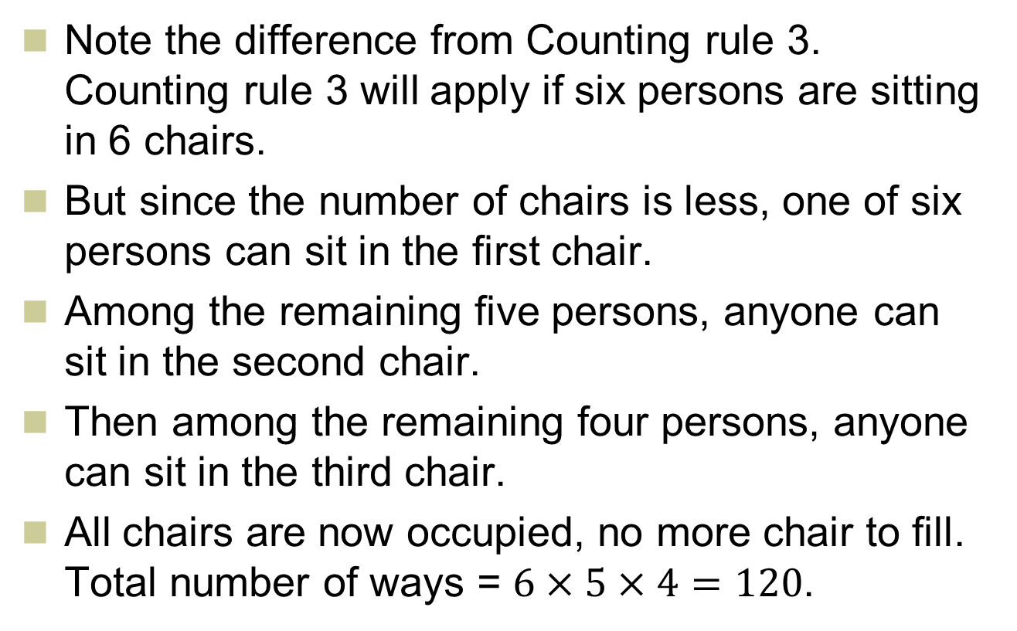
Counting rule 4 (contd.)
Note the difference from Counting rule 3. Counting rule 3 will apply if six persons are sitting in 6 chairs.
But since the number of chairs is less, one of six persons can sit in the first chair.
Among the remaining five persons, anyone can sit in the second chair.
Then among the remaining four persons, anyone can sit in the third chair.
All chairs are now occupied, no more chair to fill. Total number of ways = $6×5×4=120$.

Slide 61
Counting rule 5
Combinations - the number of ways of arranging X objects selected from n objects irrespective of order is

Slide 62
Counting rule 5 – example
The number of ways you can choose three people from a group of six to be members on a committee irrespective of order is
Note the difference from permutation. Within a committee of 3 members it doesn’t matter who is selected before whom. One can organize 3 persons in 3! ways, which is taken away in the combination formula by dividing with 3!.

Slide 63
Example 4-5
The CEO of a large accounting firm must choose a team of 6 accountants to work on a new project.
He has a pool of 14 accountants to choose from.
How many ways can the CEO select the team?

Slide 64
Solution 4-5
First decide whether to use permutations or combinations: order doesn’t matter so use combinations.

Slide 65
After the lecture each week…
Review the lecture material
Complete all readings
Complete all of recommended problems (listed in SG) from the textbook
Complete at least some of additional problems
Consider (briefly) the discussion points prior to tutorials

Slide 66
Brain teasers
Can a probability be ever negative?
Answer: No, never.
Can two events be independent and mutually exclusive at the same time?
Answer: No
What do we call a complete list where probability of each event is displayed?
Answer: A probability distribution.
Can the frequency distribution on the following page be used to construct a probability distribution?

Slide 67
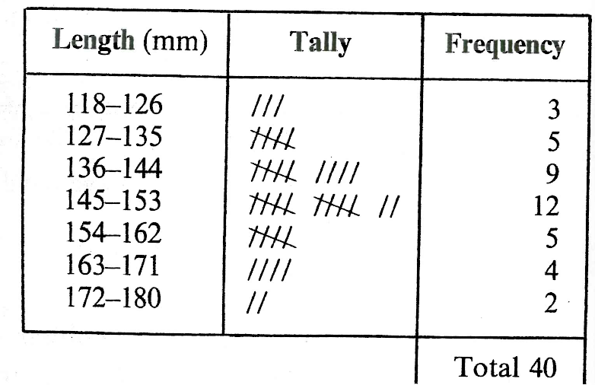
Brain teasers (Contd.)
Answer: Yes

