Slide 1
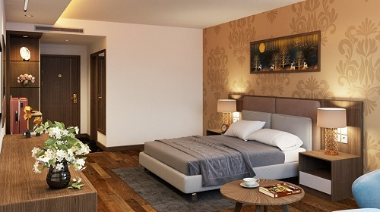
DEMON VILLA RESORT
Luxury Pool Villa
Fusce 11 tincidunt maximus leo, sed scelerisque massa auctor sit amet. Donec ex mauris, hendrerit quis nibh ac, efficitur fringilla enim.
Villa Amenities
Max Occupancy : 4 adults
Villa Size: 550 sqft
USD $200.00/night

