Slide 1

ANALYSIS OF TOP 1000 STREAMER DATA ON TWITCH
GROUP 09

Slide 2




GROUP MEMBER
Nguyễn Thanh Bình – 20133025
Nguyễn Nhật Triều – 20133102
Đoàn Quốc Trung – 20133104
Mai Thành Trung – 20133105

Slide 3
TOPIC INTRODUCTION
The streamer industry is quite flexible in terms of working time, the working tool is quite simple, just a laptop or phone, along with the level of service, high salary makes this industry quite "hot" for young people.
Twitch is a gathering place for many famous streamers in the world.
For a streamer channel, the number of followers is very important.
So, we will predict the number of followers a channel will gain after 1 year and analyze the relationship between the number of followers and the rest of the factors of a typical stream channel.

Slide 4
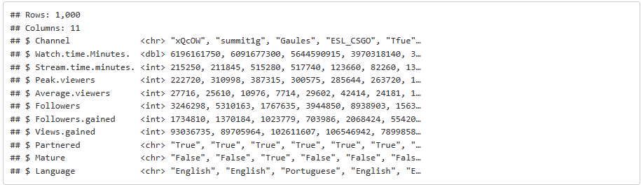
DATA INTRODUCTION
Download source: https://www.kaggle.com/datasets/aayushmishra1512/twitchdata
Sources collect: https://www.twitch.tv/
How to collect: Survey channels on Twitch

Slide 5
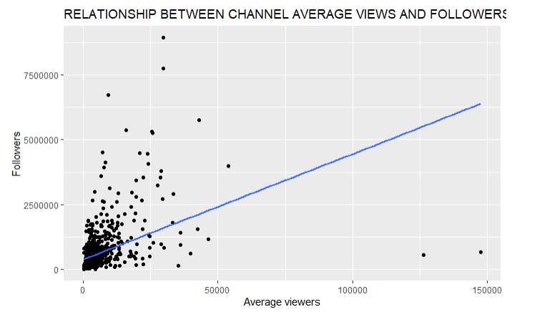
EDA
Through the chart, we see that the larger the number of followers, the higher the views

Slide 6
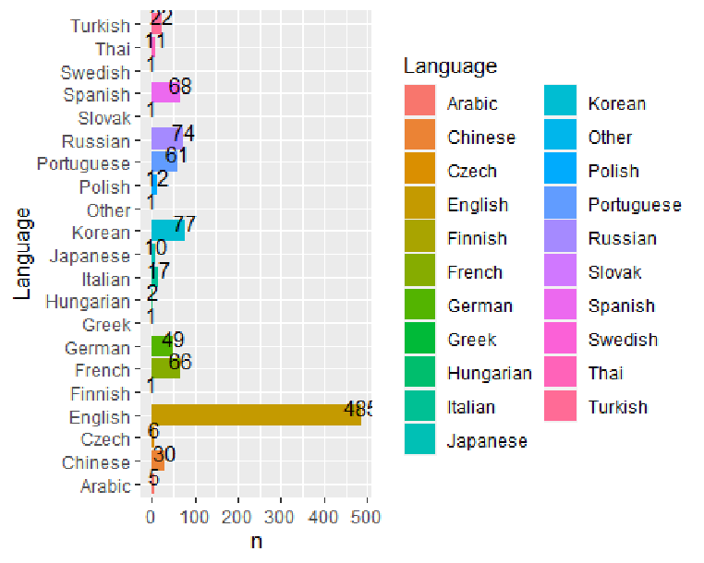
EDA
The number of streamers using English language accounts for nearly half. Prove that language is a part in the development of a channel

Slide 7
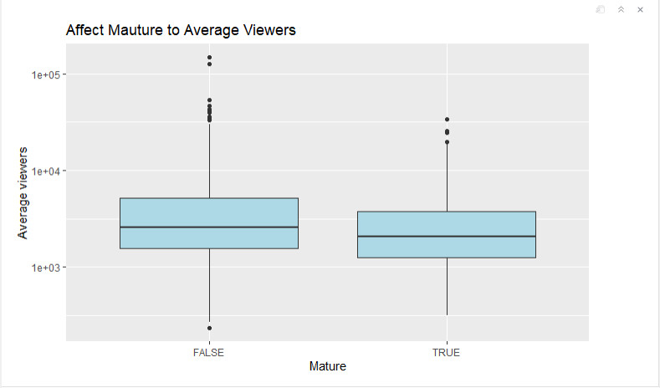
Does viewer age affect views?
- Through the graph, we can see that stream channels without age restrictions have a higher average view than age-restricted channels.
- The median of the channel without age restriction is still higher than the median of the restricted channel.
H₀ : stream channels without age restrictions have a higher average view than age-restricted channels.
p-value = 0.004897

Slide 8
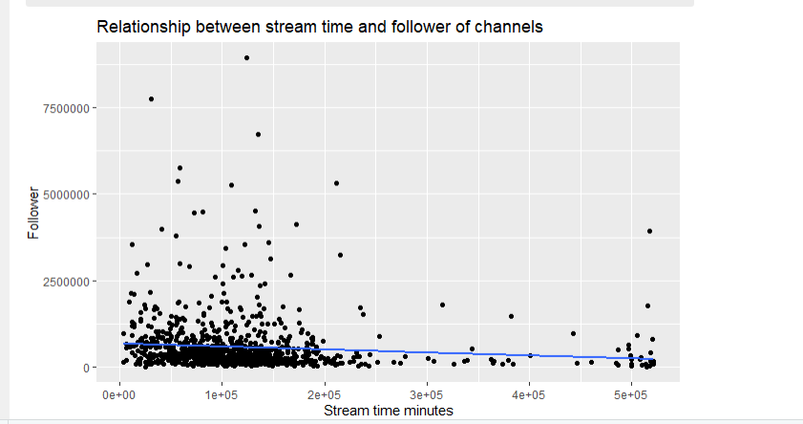
Does stream time affect the number of followers per channel?
Based on the chart, we can see that the higher the stream time, the more the number of followers tends to decrease.

Slide 9
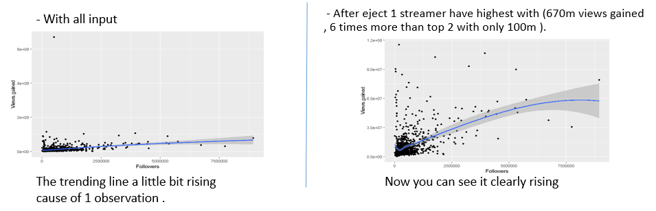
Will number of followers affects Streamer’s views ?
We use two variables (View gained & Followers ) to check that.
( Views gained are number of views gained during previous year)
- Conclusion:
+ Number of followers certainly affects views gained. The more followers the more views gained .
+ In addition, there are many variables affects view gained not only number of followers

Slide 10
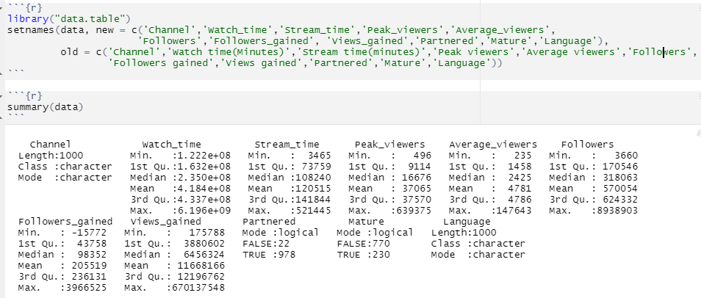
DATA GENERALIZATION

Slide 11
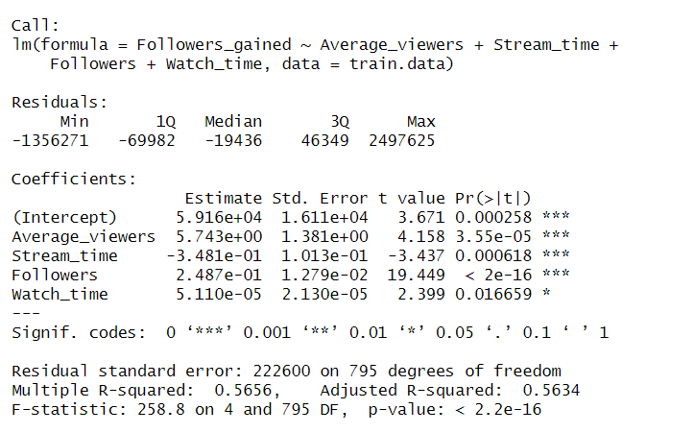
Perform the linear regression analysis and explain

Slide 12
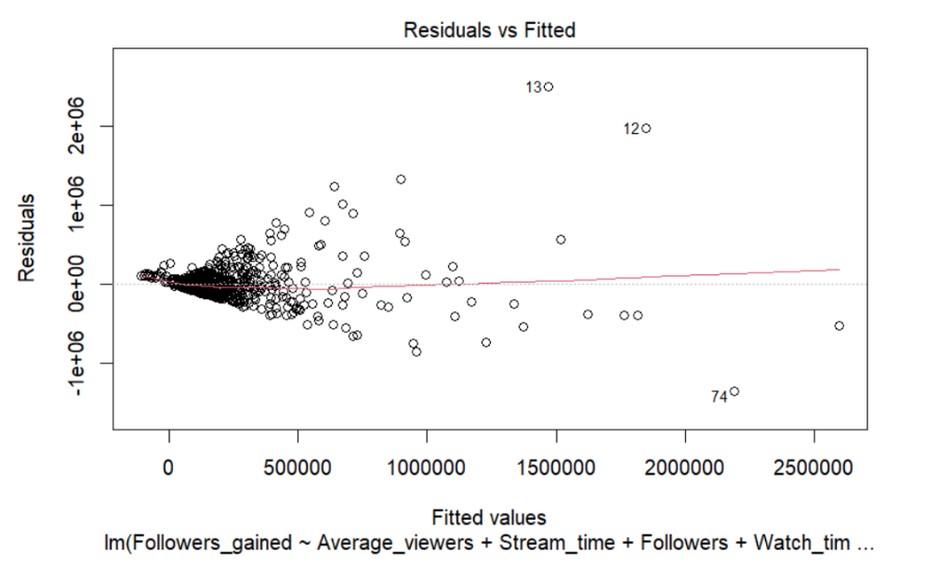
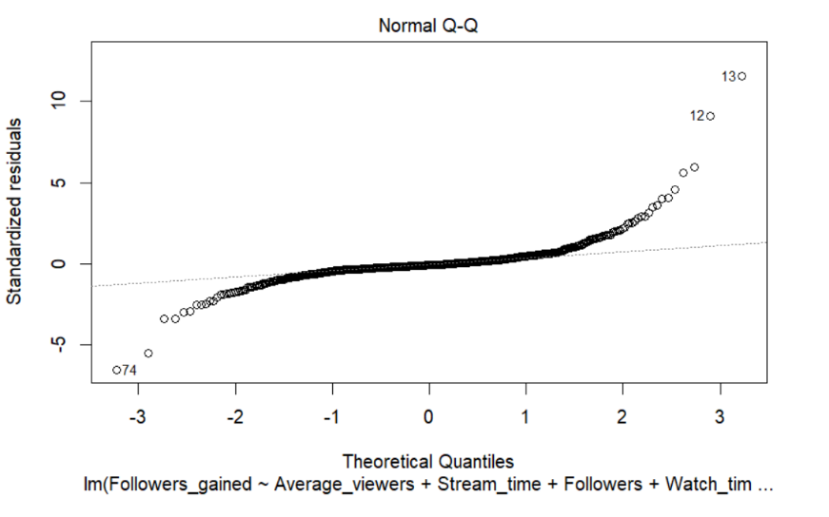
Visualize the results with a graph

Slide 13
Conclusion and development direction
Show the main relationship between the variables in the data set, as well as answer the questions posed in the report.
Predict the number of followers achieved after 1 year of a stream channel
Develop more random forest model

