Slide 1
Red-black trees
anhtt-fit@mail.hut.edu.vn

Slide 2
Symbol Table Review
Symbol table: key-value pair abstraction.
Insert a value with specified key.
Search for value given key.
Delete value with given key.
Different implementations
  Array
  Linked list
  BST (binary search tree)

Slide 3
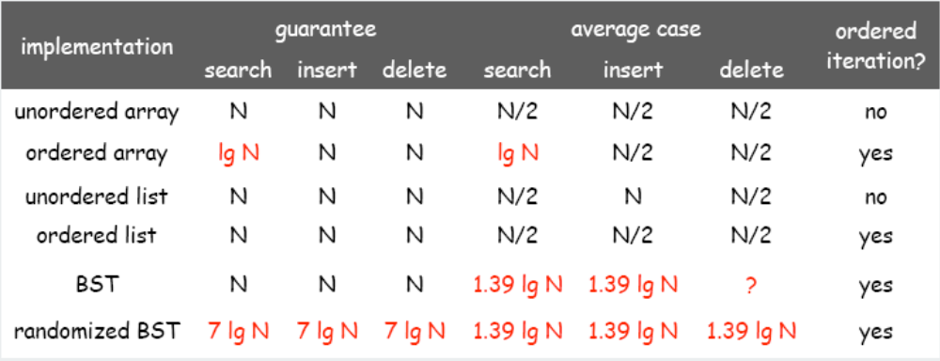
Complexity
Randomized BST.
  Guarantee of ~c lg N time per operation (probabilistic).
  Need subtree count in each node.
  Need random numbers for each insert/delete op.

Slide 4
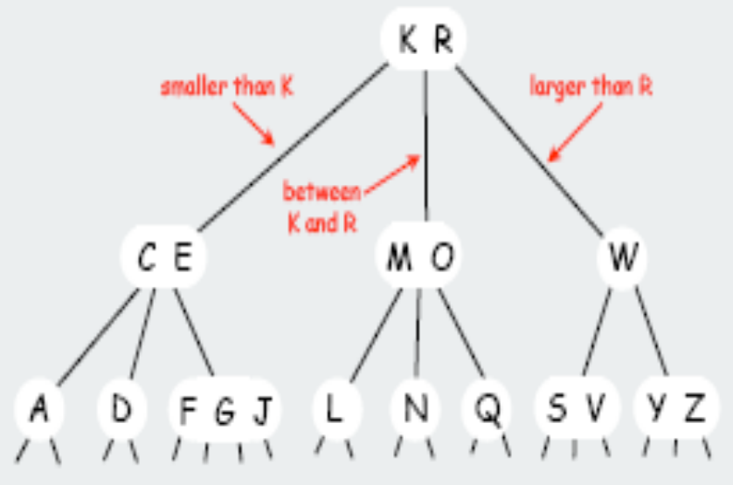
2-3-4 tree
2-3-4 tree. Generalize node to allow multiple keys; help to keep tree balanced.
Perfect balance. Every path from root to leaf has same length.
Allow 1, 2, or 3 keys per node.
  2-node: one key, two children.
  3-node: two keys, three children.
  4-node: three keys, four children.

Slide 5
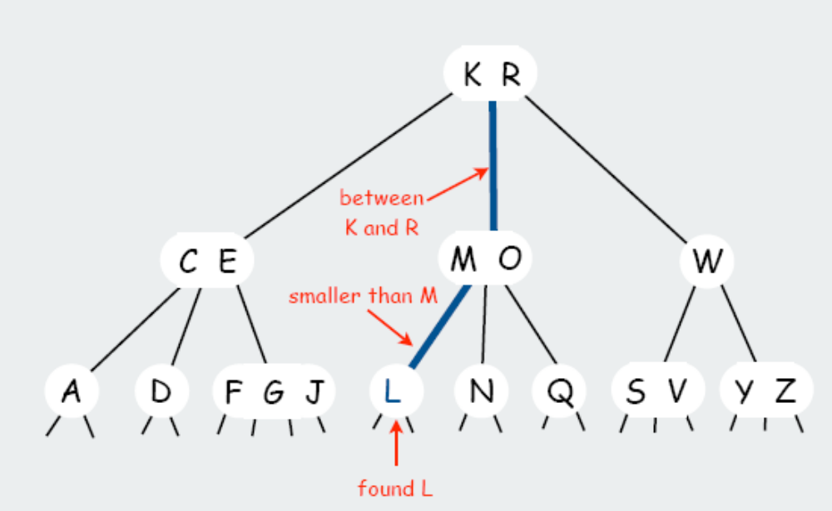
Search
Compare search key against keys in node.
Find interval containing search key.
Ex. Search for L

Slide 6
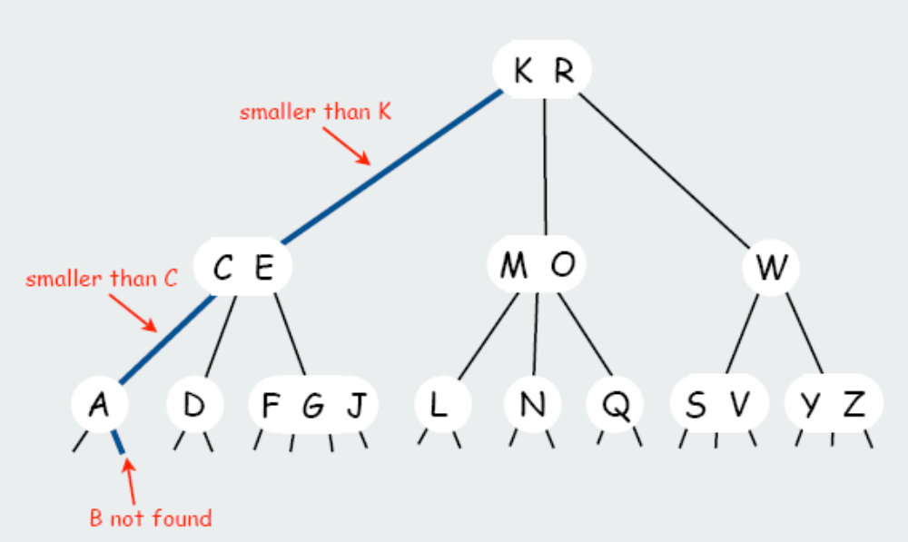
Insert (1)
Search to bottom for key.
Ex. Insert B

Slide 7
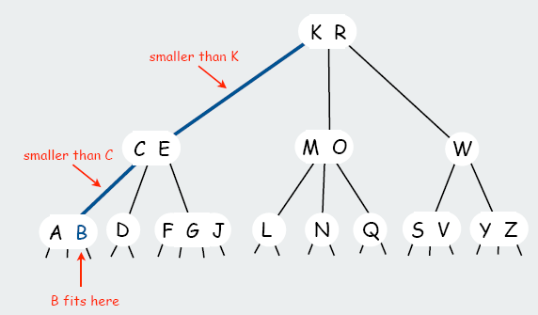
Insert (2)
2-node at bottom: convert to 3-node.
3-node at bottom: convert to 4-node.
Ex. Insert B

Slide 8
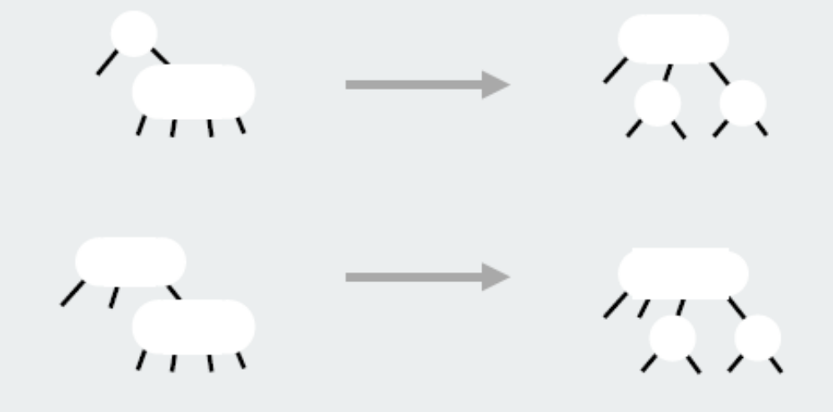
Transformation
Local transformations should be applied to keep the tree balanced.
Ensures that most recently seen node is not a 4-node.
Transformations to split 4-nodes:

Slide 9
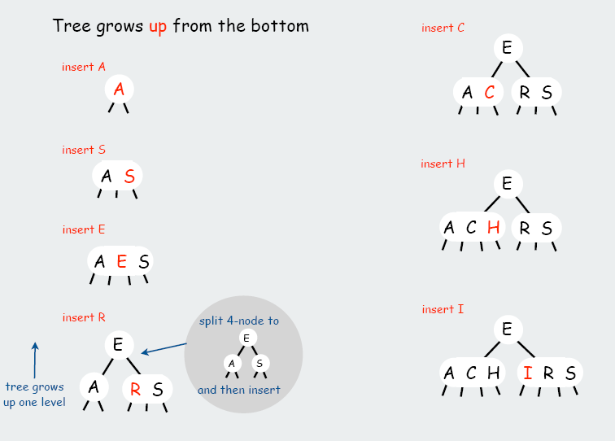
Growth of a tree

Slide 10
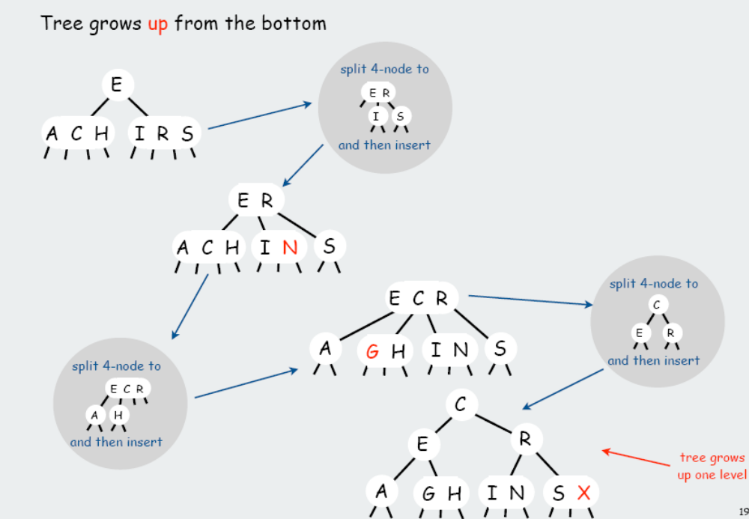
Growth of a tree (cont.)

Slide 11
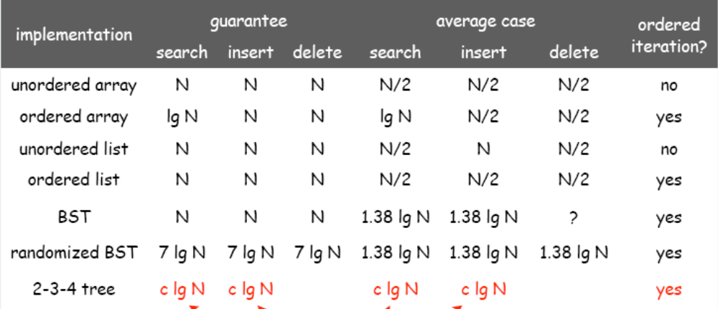
Complexity
Worst case: lg N [all 2-nodes]
Best case: log4 N = 1/2 lg N [all 4-nodes]
Between 10 and 20 for a million nodes.
Between 15 and 30 for a billion nodes.

Slide 12
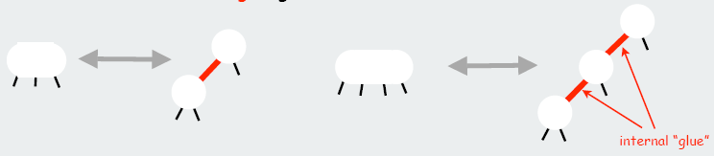
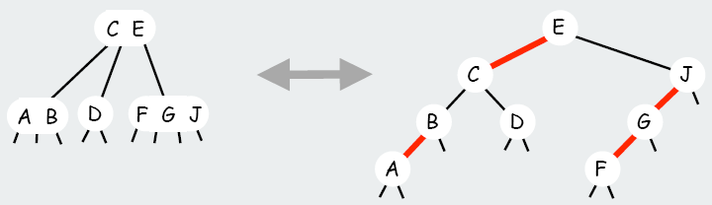
Red-black tree
Represent 2-3-4 tree as a BST.
Use "internal" left-leaning edges for 3- and 4- nodes.
1-1 correspondence between 2-3-4 and left-leaning red-black trees.

Slide 13
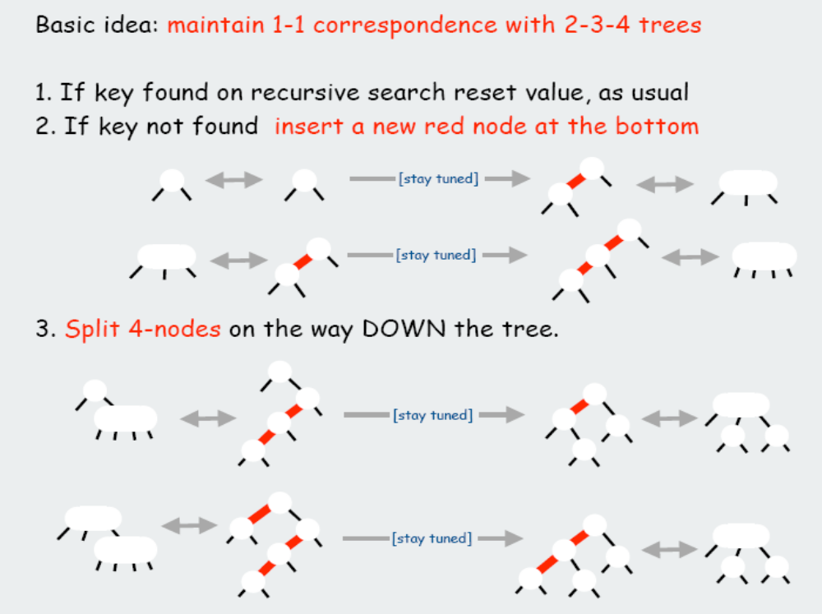
Insert implementation

Slide 14
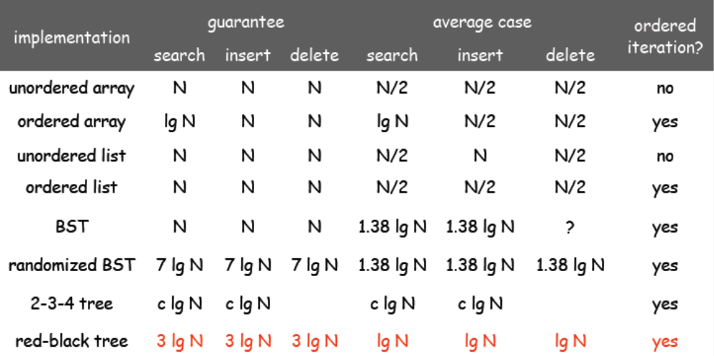
Complexity

Slide 15
Libfdr
Libfdr is a library which contains an implementation for generic red-black trees in C
Download and compile instructions at
http://www.cs.utk.edu/~plank/plank/classes/cs360/360/notes/Libfdr/

Slide 16
Jval datatype
A big union to represent a generic data type
  typedef union {
  int i;
  long l;
  float f;
  double d;
  void *v;
  char *s;
  char c;
  unsigned char uc;
  short sh;
  unsigned short ush;
  unsigned int ui;
  int iarray[2];
  float farray[2];
  char carray[8];
  unsigned char ucarray[8];
  } Jval;

Slide 17
Jval usage
Use Jval to store an integer
  Jval j;
  j.i = 4;
Jval.h defines a whole bunch of prototypes for ``constructor functions.''
  extern Jval new_jval_i(int);
  extern Jval new_jval_f(float);
  extern Jval new_jval_d(double);
  extern Jval new_jval_v(void *);
  extern Jval new_jval_s(char *);
Example:
  Jval j = new_jval_i(4);

Slide 18
JRB datatype
JRB is defined as a pointer to a node of the
  typedef struct jrb_node {
  unsigned char red;
  unsigned char internal;
  unsigned char left;
  unsigned char roothead;
  struct jrb_node *flink;
  struct jrb_node *blink;
  struct jrb_node *parent;
  Jval key;
  Jval val;
  } *JRB;

Slide 19
JRB API (1)
Make a new tree
  JRB make_jrb();
Insert a new node to a tree
  JRB jrb_insert_str(JRB tree, char *key, Jval val);
  JRB jrb_insert_int(JRB tree, int ikey, Jval val);
  JRB jrb_insert_dbl(JRB tree, double dkey, Jval val);
  JRB jrb_insert_gen(JRB tree, Jval key, Jval val, int (*func)(Jval,Jval));
Find a node via key
  JRB jrb_find_str(JRB root, char *key);
  JRB jrb_find_int(JRB root, int ikey);
  JRB jrb_find_dbl(JRB root, double dkey);
  JRB jrb_find_gen(JRB root, Jval, int (*func)(Jval, Jval));

Slide 20
JRB API (2)
Free a node (but not the key or val)
  void jrb_delete_node(JRB node);
Free all the tree
  void jrb_free_tree(JRB root);
Navigation in the tree
  #define jrb_first(n) (n->flink)
  #define jrb_last(n) (n->blink)
  #define jrb_next(n) (n->flink)
  #define jrb_prev(n) (n->blink)
  #define jrb_empty(t) (t->flink == t)
  #define jrb_nil(t) (t)
  #define jrb_traverse(ptr, lst) \
  for(ptr = jrb_first(lst); ptr != jrb_nil(lst); ptr = jrb_next(ptr))

Slide 21
Quiz 1
Try to compile and run some example programs (using libfdr) given at
http://www.cs.utk.edu/~plank/plank/classes/cs360/360/notes/JRB/

Slide 22
Quiz 2
Use libfdr to write the phone book program (add, delete, modify phone numbers). The phone book should be stored in a file.
NB: In the JRB, the insert function always creates a new node event the key exists already in the tree.
  You should check the existence of a record before insert it in the tree

Slide 23
Instruction
Create a phone book
  JRB book = make_jrb();
Insert a new entry
  jrb_insert_str(book, strdup(name), new_jval_l(number));
    You must allocate memory to store the name for the new node’s key. This memory should to be free when we delete all the key.
Navigation
  jrb_traverse(node, book)
  /* code to do something on node */

Slide 24
Solution
phonebook_jrb.c

