Slide 1
B-trees
anhtt-fit@mail.hut.edu.vn

Slide 2
B-Tree
Generalizes 2-3-4 trees by allowing up to M links per node.
Main application: file systems.
  Reading a page into memory from disk is expensive.
  Accessing info on a page in memory is free.
  Goal: minimize # page accesses.
  Node size M = page size.
Space-time tradeoff.
  M large ! only a few levels in tree.
  M small ! less wasted space.
  Number of page accesses is log_{M}N per op.
  Typical M = 1000, N < 1 trillion.

Slide 3
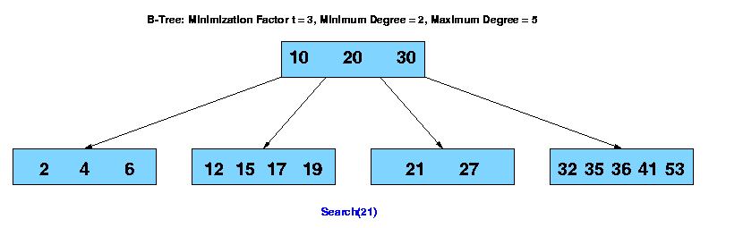
Search

Slide 4

Insert

Slide 5
B-Tree in the wild
Red-black trees: widely used as system symbol tables
  Java: java.util.TreeMap, java.util.TreeSet.
  C++ STL: map, multimap, multiset.
  Linux kernel: linux/rbtree.h.
B-Trees: widely used for file systems and databases
  Windows: HPFS.
  Mac: HFS, HFS+.
  Linux: ReiserFS, XFS, Ext3FS, JFS.
  Databases: ORACLE, DB2, INGRES, SQL, PostgreSQL
All nodes in B-Tree are assumed to be stored in secondary storage (disk) rather than primary storage (memory),
There basic operations for accessing a page: Disk-Read(), Disk-Write(), Allocate-Node()

Slide 6
B-Tree Library
Software and documentation is accessed at http://www.hydrus.org.uk/doc/bt/html/index.html

Slide 7
API
Creating a B Tree File
BTA* btcrt(char* fid, int nkeys, int shared);
Opening a B Tree File
BTA* btopn(char* fid, int mode, int shared);
Closing a B Tree File
int btcls(BTA* btact);

Slide 8
API (cont.)
Inserting a key and data
int btins(BTA* btact, char* key, char* data, int dsize);
Updating data for an existing key
int btupd(BTA* btact, char* key, char* data, int dsize);
Locating data for an existing key
int btsel(BTA* btact, char* key, char* data, int dsize, int* rsize);
Deleting a key and associated data
int btdel(BTA* btact, char* key);
Locating data for the next key in sequence
int btseln(BTA* btact, char* key, char* data, int dsize, int* rsize);

Slide 9
Building and installing the BT Library
Unpack the tar file into a convenient directory.
$cd <bt library>
$make clean
$make
Make built an UNIX static library libbt.a, a BT test harness bt, and a utility, kcp, which performs intelligent copies of BT index files.

Slide 10
Quiz 1
Install and compile BT Library in your machine
Run BT test harness to verify if successful installed
See documentation at
http://www.hydrus.org.uk/doc/bt/html/ch05.htm

Slide 11
Quiz 2
Use the BT library to write a phone book program that manipulates data on the secondary disk.

Slide 12
Another library for B-Tree
Download at
http://www.mycplus.com/utilitiesdetail.asp?iPro=10
This library allows specifying different comparison functions for keys.

Slide 13
Mini project 1
Make a program to manage a computer dictionary
  Add/Search/Delete a word (using B-Tree)
  Auto complete search. Ex. When we enter “comput” and <tab>, the word “computer” should be auto completed (like in Bash Shell)
  Suggestion search => Use soundex library
Please test the performance of your program with a dictionary of millions words (the words can be randomly created)
  Test for the two basic operations: search and insert
Project in group of 3-4 persons

