Slide 1
A PROPOSAL FOR THE REVENUE ORGANIZATION
Turn your SDR org into an
AI-augmented growth engine
How MindPal's multi-agent workforce cuts research time by 90%+, drops lead response under 5 minutes, and reclaims ~$700K/year in selling capacity — with a human approving every outbound message.
Prepared for: VP Sales / Chief Revenue Officer | Sales & Revenue Operations
July 2026

Slide 2
THE PROBLEM
Your reps aren't selling.
They're doing data entry.
60%
28%
29 hrs
of a rep's time goes to non-selling work — writing
emails, data entry, admin and internal meetings
of an SDR's time specifically goes to researching
targets and sourcing contact info before ever reaching out
average time B2B companies take to respond to a
lead — and that's only among the 36% who ever reply at all
Salesforce State of Sales 2026 (n=4,050 reps)
Sopro, State of Prospecting
RevenueHero, 2024: 1,000 live demo requests tested
Bottom line: your best-comped, highest-potential people are spending 6 of every 10 working hours on tasks that require zero judgment — nearly a third of it just hunting for who to contact — and 64% of B2B companies never respond to an inbound lead at all.
MINDPAL FOR REVENUE
2

Slide 3
THE COST
Here is what that's costing a
50-rep SDR organization
THE REVENUE LEAK: SPEED
CAPACITY BURNED ON RESEARCH & ADMIN
$1.4M / year
21x
more likely to qualify a lead if contacted within 5 min vs. 30 min
50 SDRs × $100K fully-loaded cost (Bridge Group 2025 SDR Metrics Report) × 28% of time spent specifically on researching targets and sourcing contacts (Sopro).
CONVERSION RATE BY RESPONSE SPEED
Under 5 min
21%
5–30 min
13%
That's the equivalent of 14 full-time reps doing lookup work instead of building pipeline.
30–60 min
8%
1–24 hours
5%
24+ hours
2.3%
Sources: Lead Response Mgmt. study (Oldroyd et al., MIT/InsideSales); 2026 Speed-to-Lead Benchmark, ArtemisGTM (15M sales interactions analyzed); Sopro State of Prospecting
MINDPAL FOR REVENUE
3

Slide 4
THE SOLUTION
MindPal: a coordinated team of
AI agents, not another chatbot
MindPal is a self-serve, no-code platform: you (or your RevOps team) build the agents and connect the workflow yourselves — either by dragging nodes manually, or describing the process to Mindie, MindPal's AI workflow assistant, in plain language.
A
Specialist Agents
B
Workflows, Not One-Offs
Each agent has one job — research, scoring, drafting — trained on your ICP, playbooks and brand voice via System Instructions and Knowledge Sources.
Agents hand off work like an assembly line: Router, Loop and Orchestrator-Worker nodes replicate your actual sales process.
C
Human-in-the-Loop
D
Plugs Into Your Stack
A Human Input Node pauses the workflow for a rep to review, edit or approve before anything ships — nothing sends unsupervised.
Connects to your CRM and inbox via Composio (100+ apps incl. HubSpot) and MCP (Beta) — no rip-and-replace.
MINDPAL FOR REVENUE
4

Slide 5
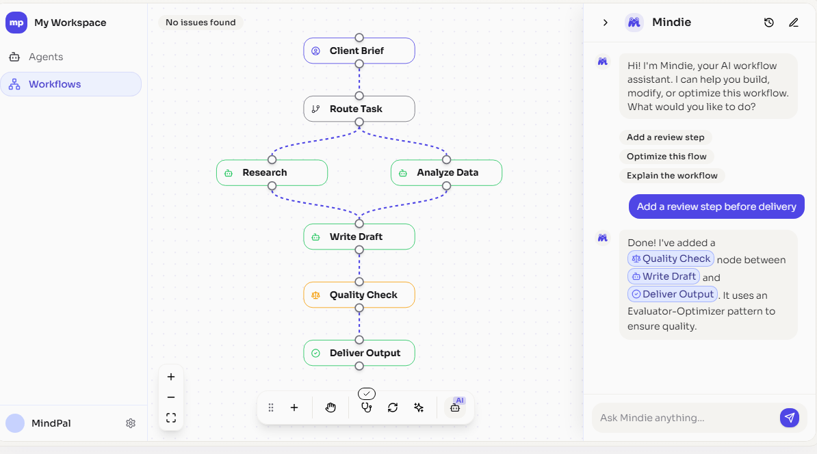
THE PRODUCT
This is the whole build surface
Not a mockup — MindPal's actual workflow canvas. Everything described on the previous slide is built here, by your team, without engineering.
Built by dragging — or by asking
Here Mindie was told “add a review step before delivery.” It inserted a Quality Check node between Write Draft and Deliver Output, using an Evaluator-Optimizer pattern.
Real branching, not a linear script
Route Task splits Research and Analyze Data to run in parallel, then rejoins them for the draft — the same shape as your actual sales process.
RevOps owns this surface
No code, no ticket, no deploy. The same canvas holds the Human Input Node that gates every message before it reaches a prospect.
MINDPAL FOR REVENUE
5

Slide 6
USE CASE 1 — RESEARCH & QUALIFICATION
The Research & Qualification Agent
BEFORE
AFTER MINDPAL
SDR spends 15-20 min per account on
manual research before the first touch
Research Agent builds a full account brief
in under a minute — SDR just reviews it
HOW THE WORKFLOW RUNS
1
Research Agent pulls firmographics, tech stack, funding/news signals and prior CRM history the moment a target account is queued.
2
Qualification Agent scores fit against your ICP and buying-signal rules, filtering out accounts that will never convert.
3
A Human Input Node hands the SDR a one-page brief and a recommended angle — the rep decides, the agent never sends anything alone.
4
Qualified accounts route automatically into the rep's queue in CRM, fully enriched — zero manual data entry.
MINDPAL FOR REVENUE
6

Slide 7
USE CASE 2 — SPEED-TO-LEAD
The Speed-to-Lead Response Agent
BEFORE
AFTER MINDPAL
Average inbound lead waits 29 hours
for a first human response — if one ever comes
First personalized response goes out in
under 5 minutes, 24/7 — rep is looped in live
HOW THE WORKFLOW RUNS
1
The moment a lead fills a form or replies to an email, the Response Agent drafts a personalized reply using the account's context and intent signal.
2
A Router Node classifies urgency: high-intent leads get an instant escalation ping to the assigned rep's phone.
3
Human Input Node: for anything outside pre-approved templates, a rep approves or edits before it sends — speed without losing control.
4
After-hours and weekend leads get covered automatically instead of sitting in a queue until Monday.
MINDPAL FOR REVENUE
7

Slide 8
USE CASE 3 — DEAL DESK
The Quote-to-Proposal Agent
BEFORE
AFTER MINDPAL
AE spends 2-4 hours assembling a custom
quote, proposal and redline-ready contract
Draft proposal, pricing and first-pass
contract markup ready in minutes
HOW THE WORKFLOW RUNS
1
Orchestrator-Worker workflow pulls deal terms from CRM, pricing rules from your rate card, and past win/loss data for similar deals.
2
Sub-agents draft the proposal narrative, build the pricing table, and flag any non-standard contract clauses for legal review.
3
Human Input Node: Deal Desk or AE reviews and approves before anything reaches the customer — agents draft, humans decide.
4
Turnaround for a standard proposal drops from days to same-day, directly shortening your sales cycle.
MINDPAL FOR REVENUE
8

Slide 9
THE VALUE, QUANTIFIED
Capacity redeployed. Revenue unlocked. Speed gained.
Every formula is shown in full — swap in your own headcount, pipeline and close rate. Bold rates are sourced (slides 2–3); reclaim/uplift assumptions are marked as estimates for you to pressure-test. Capacity and revenue are two separate mechanisms — deliberately not added together.
CAPACITY REDEPLOYED
REVENUE UNLOCKED
SPEED GAINED
~$700K / yr
+$240–720K ARR / yr
20 min → <1 min
29 hrs → <5 min
≈14 FTE-equivalent of selling time for a 50-rep org — not a headcount cut.
On a $24M example pipeline, 20% close rate. Conservative → optimistic.
Per-account research time and lead response time.
FORMULA
FORMULA
FORMULA
50 × $100K × 28% × 50%
$24M × 5–15% × 20%
—
reps × fully-loaded cost/rep (Bridge Group) × research-time share (Sopro) × est. reclaim rate
pipeline × est. conversion lift (5% conservative / 15% optimistic — see speed curve, slide 3) × close rate
pilot target, not a measured result — baselined Day 1, verified at Day 90 (see rollout plan)
MINDPAL FOR REVENUE
9

Slide 10
ROI & PAYBACK
The platform fee is not the decision driver here
MindPal is priced per seat and AI credits, self-serve — no procurement cycle required. Real published pricing, July 2026.
WHAT MINDPAL COSTS
WHAT IT'S MODELED TO CREATE (SEE FORMULAS, SLIDE 9)
Pilot (1 pod, 10-12 reps)
+$240–720K ARR
Advanced plan — $179/mo
5 editor + 20 user seats, 30K AI credits/mo
modeled revenue for a 50-rep org — plus ~$700K/yr of selling capacity redeployed (separate mechanism, not added — see slide 9)
Full rollout (50 reps)
Ultra plan — $449/mo
Ultra plan ($449/mo = $5,388/yr) is ~2% of even the conservative case. But the licence isn't the real cost — RevOps time and rep adoption are. Budget for those.
Unlimited seats, 100K AI credits/mo
White-glove option
MindPal Managed — $2,000/mo
Dedicated AI automation engineer builds it for you
MINDPAL FOR REVENUE
10

Slide 11
HOW IT WORKS
Agents do the work. A human always
holds the send button.
Research
Agent
→
Qualification
Agent
→
Human
Input Node
→
Outreach /
Draft Agent
→
CRM
Sync
Every workflow can include a Human Input Node at the step that matters most to you — first outbound message, quote value above a threshold, or contract terms. Agents draft and route; your reps stay the final decision-maker on anything that reaches a prospect.
Connects to your CRM and inbox via Composio (100+ apps incl. HubSpot) and MCP (Beta, via Zapier/Make/Composio servers) — no migration required.
MINDPAL FOR REVENUE
11

Slide 12
WHY MINDPAL
Why not just use what you already have?
The three alternatives your team will raise in this meeting — and where each one stops.
A
vs. Your CRM's built-in AI
B
vs. Point tools
Agentforce and Breeze are strong inside their own walls — but they assume one vendor's data model and sales motion, and typically arrive as an enterprise add-on with a procurement cycle attached. MindPal sits on top of the stack you already run.
Enrichment tools, sequencers and AI SDRs each nail one step well. None of them own the handoff between steps — that glue stays manual. MindPal orchestrates the whole chain, with a human gate wherever you choose to put one.
C
vs. Building it in-house
D
So the real question
Your RevOps team configures this in days, no code. The same orchestration on raw frameworks means engineering headcount up front — and permanent maintenance you own forever.
Isn't "can AI do this?" — every option says yes. It's who runs all three use cases end-to-end, on the stack you already own, with a human on the send button — provable in 90 days for $179/mo.
MINDPAL FOR REVENUE
12

Slide 13
ROLLOUT PLAN
From pilot to full deployment in one quarter
Days 1-30
Days 31-60
Days 61-90
Pilot Setup
Live Pilot
Prove & Decide
Start Advanced plan ($179/mo) for 1 pod (10-12 reps)
Launch Speed-to-Lead agent with a Human Input Node for review
Deal Desk / Proposal agent added for pod's AEs
Connect CRM and inbox via Composio
Weekly tuning with RevOps on scoring & templates
Full ROI readout vs. baseline
Configure Research + Qualification agents on your ICP
Track response time, SQL volume, hours reclaimed
Decide to upgrade to Ultra plan ($449/mo) and scale to all 50 reps
Baseline current response time & research time
MINDPAL FOR REVENUE
13

Slide 14
THE ASK
One pod. 90 days. A decision you can make today.
1
Plan
Start the pilot on MindPal's Advanced plan — $179/month, self-serve signup, no procurement cycle. Upgrade to Ultra ($449/mo) only once the pilot proves out.
2
People
One pod of 10-12 reps, a pod manager as sponsor, and ~3 hrs/week from RevOps to configure agents and connect tools via Composio.
3
Access
Login credentials to connect CRM and inbox via Composio (OAuth) for the pilot pod — no IT migration required.
4
Success bar
Agreed upfront: <5 min lead response, +20% SQL volume, 10+ hrs/week/rep reclaimed — measured at Day 90.
At $179/month, this pilot costs less than a single team lunch — if we don't hit the numbers by Day 90, we simply don't renew.
MINDPAL FOR REVENUE
14

Slide 15
IN ONE BREATH
The elevator pitch
Your SDRs spend 60% of their time on non-selling work — nearly a third of it just researching who to contact — while the average inbound lead waits 29 hours for a response, if one ever comes at all. On MindPal, your team builds a coordinated set of AI agents — with a Human Input Node holding every outbound message for review — that cuts research time by over 90%, drops response time under 5 minutes, and is modeled to redeploy roughly $700K a year of selling capacity in a 50-rep org. At $179–449 a month self-serve with no procurement cycle, this isn't a budget decision — it's a 90-day pilot with one pod to prove the numbers, so let's put one pod on it.
Let's put one pod on it.
MINDPAL FOR REVENUE
15

