Slide 1
Universal Verification Methodology

Slide 2
Introduction

Slide 3
Introduction
Industry Standard
Pure SystemVerilog
Universal Verification Manual
Open Source
Based on OVM and VMM
Testbenches for Verilog/VHDL/SystemC
Base Class Library(BCL) in SystemVerilog
Constrained Random Verification
Notes:
UVM is a verification methodology, written in SystemVerilog. It is an open source industry standard which is based on OVM(Open Verification Methodlogy) and VMM(Verification Methodology Manual).
UVM is a methodology for writing testbenches for the designs written in Verilog/VHDL/SystemC.
One of the deliverables of UVM is its Base Class Library.
UVM supports Constrained Random Verification (CRV)

Slide 4
Constrained Random Verification
Random Test Vectors
10100100
01001011
00010100
Design Under Test
(DUT)
10100100
01001011
00010100
Benefits of test vector randomization
Unexpected bugs identification
Stimulus generation is automated
Notes:
The idea of CRV is the usage of random vectors. Test vector randomization has its benefits.
Constrained random simulation is a good way to find out unexpected bugs. When planning verification of the design we would look only towards the bugs we are looking for, i.e. we can’t consider all posible bugs. The benefit of test vector randomization is that it is possible to find bugs we never thought about.
The other benefit is the automation of stimulus generation, with which engineer don’t need to write test vectors manually.

Slide 5
Constrained Random Verification (2)
Coverage
C C C
of CRV
Checkers
Constraints
Notes:
The concept of Constrained random verification comprises the so called “3 ‘C’s”, which are
Checkers
Coverage
Constraints

Slide 6
Constrained Random Verification (3)
UVM is for doing
Constrained Random Verification
Checker
Checker
10100100
01001011
00010100
Design Under Test
(DUT)
10100100
01001011
00010100
Constraints
Functional Coverage
Checker: Checks input and output consistency, i.e. checks if the design work
Functional Coverage: Checks if the design was verified enough.
Constraints: Help to increase test coverage.
Notes:
For the verification process it is critical to automate checking. The idea and the purpose of checkers is to check if the design works properly. They simply check if the outputs of the DUT are consistent with its inputs.
Functional coverage is about recording the verification process and checking if the DUT was exercised enough. In other words it tells if the verification is completed or still need to be continued.
If the design is not tested enough Constraints should be placed on the random vectors to increase test coverage

Slide 7
Benefits of UVM
Standardization
Class Library
Open standard and vendor independent
Notes:
The key benefits of UVM are:
It is a standard verification methodology. This means no more headache to choose a methodology to start a project
Ready classes and components increase reusability and improve time required for creating verification environment.
Vendor independence excludes tool portability issues.

Slide 8
UVM Basics
Professor: Sc.D. Professor
Vazgen Melikyan

Slide 9
Structure of UVM Testbench
Test
Env
Scoreboard
Agent
Agent
Sequencer
Sequencer
Driver
Monitor
Driver
Monitor
A transaction is a data item which is eventually or directly processed by the DUT.
DUT

Slide 10
Structure of UVM Testbench
Test
Env
Scoreboard
Agent
Agent
Sequencer
Sequencer
Driver
Monitor
Driver
Monitor
A transaction is a data item which is eventually or directly processed by the DUT.
DUT
Transaction: Inputs to the device under test

Slide 11
Structure of UVM Testbench
Is a stimulus generator that executes sequences that define the transactions provided to the driver for execution.
Test
Env
Scoreboard
Agent
Agent
Sequencer
Sequencer
Driver
Monitor
Driver
Monitor
DUT
Transaction: Inputs to the device under test

Slide 12
Structure of UVM Testbench
Is a stimulus generator that executes sequences that define the transactions provided to the driver for execution.
Test
Env
Scoreboard
Agent
Agent
Sequencer
Sequencer
Driver
Monitor
Driver
Monitor
Sequencer:
Random transaction generator
DUT
Transaction: Inputs to the device under test

Slide 13
Structure of UVM Testbench
Test
Env
Scoreboard
Is a VC which takes responsibility for executing or otherwise processing transactions, usually through interaction with the device under test (DUT).
Agent
Agent
Sequencer
Sequencer
Driver
Monitor
Driver
Monitor
Sequencer:
Random transaction generator
DUT
Transaction: Inputs to the device under test

Slide 14
Structure of UVM Testbench
Test
Env
Scoreboard
Is a VC which takes responsibility for executing or otherwise processing transactions, usually through interaction with the device under test (DUT).
Agent
Agent
Sequencer
Sequencer
Driver
Monitor
Driver
Monitor
Driver: Transaction processor
Sequencer:
Random transaction generator
DUT
Transaction: Inputs to the device under test

Slide 15
Structure of UVM Testbench
Test
Env
Scoreboard
Agent
Agent
Is a passive entity which samples DUT signals, but never drives them.
Sequencer
Sequencer
Driver
Monitor
Driver
Monitor
Driver: Transaction processor
Sequencer:
Random transaction generator
DUT
Transaction: Inputs to the device under test

Slide 16
Structure of UVM Testbench
Test
Env
Scoreboard
Agent
Agent
Is a passive entity which samples DUT signals, but never drives them.
Sequencer
Sequencer
Monitor: Samples DUT respond
Driver
Monitor
Driver
Monitor
Driver: Transaction processor
Sequencer:
Random transaction generator
DUT
Transaction: Inputs to the device under test

Slide 17
Structure of UVM Testbench
Test
Env
Is a container that is used to emulate and verify DUT devices.
Scoreboard
Agent
Agent
Sequencer
Sequencer
Monitor: Samples DUT respond
Driver
Monitor
Driver
Monitor
Driver: Transaction processor
Sequencer:
Random transaction generator
DUT
Transaction: Inputs to the device under test

Slide 18
Structure of UVM Testbench
Test
Env
Is a container that is used to emulate and verify DUT devices.
Scoreboard
Agent
Agent
Sequencer
Sequencer
Agent: Encapsulates Monitor, Driver, Sequencer
Monitor: Samples DUT respond
Driver
Monitor
Driver
Monitor
Driver: Transaction processor
Sequencer:
Random transaction generator
DUT
Transaction: Inputs to the device under test

Slide 19
Structure of UVM Testbench
Test
Is a mechanism used to predict the response of the design and check the consistence of the observed response against the predicted response.
Env
Scoreboard
Agent
Agent
Sequencer
Sequencer
Agent: Encapsulates Monitor, Driver, Sequencer
Monitor: Samples DUT respond
Driver
Monitor
Driver
Monitor
Driver: Transaction processor
Sequencer:
Random transaction generator
DUT
Transaction: Inputs to the device under test

Slide 20
Structure of UVM Testbench
Test
Is a mechanism used to predict the response of the design and check the consistence of the observed response against the predicted response.
Env
Scoreboard
Agent
Agent
Sequencer
Sequencer
Scoreboard: Correct vs. Observed
Agent: Encapsulates Monitor, Driver, Sequencer
Monitor: Samples DUT respond
Driver
Monitor
Driver
Monitor
Driver: Transaction processor
Sequencer:
Random transaction generator
DUT
Transaction: Inputs to the device under test

Slide 21
Structure of UVM Testbench
Test
Env
Env is a container that defines the testbench topology
Scoreboard
Agent
Agent
Sequencer
Sequencer
Scoreboard: Correct vs. Observed
Agent: Encapsulates Monitor, Driver, Sequencer
Monitor: Samples DUT respond
Driver
Monitor
Driver
Monitor
Driver: Transaction processor
Sequencer:
Random transaction generator
DUT
Transaction: Inputs to the device under test

Slide 22
Structure of UVM Testbench
Test
Env
Env is a container that defines the testbench topology
Scoreboard
Agent
Agent
Environment: Encapsulates Scoreboard and Agents
Sequencer
Sequencer
Scoreboard: Correct vs. Observed
Agent: Encapsulates Monitor, Driver, Sequencer
Monitor: Samples DUT respond
Driver
Monitor
Driver
Monitor
Driver: Transaction processor
Sequencer:
Random transaction generator
DUT
Transaction: Inputs to the device under test

Slide 23
Structure of UVM Testbench
Test
Test is used to exercise required functionality of the DUT and customize Env if needed.
Env
Scoreboard
Agent
Agent
Environment: Encapsulates Scoreboard and Agents
Sequencer
Sequencer
Scoreboard: Correct vs. Observed
Agent: Encapsulates Monitor, Driver, Sequencer
Monitor: Samples DUT respond
Driver
Monitor
Driver
Monitor
Driver: Transaction processor
Sequencer:
Random transaction generator
DUT
Transaction: Inputs to the device under test

Slide 24
Structure of UVM Testbench
Test
Test is used to exercise required functionality of the DUT and customize Env if needed.
Env
Scoreboard
Test: Instantiates and modifies environment
Agent
Agent
Environment: Encapsulates Scoreboard and Agents
Sequencer
Sequencer
Scoreboard: Correct vs. Observed
Agent: Encapsulates Monitor, Driver, Sequencer
Monitor: Samples DUT respond
Driver
Monitor
Driver
Monitor
Driver: Transaction processor
Sequencer:
Random transaction generator
DUT
Transaction: Inputs to the device under test

Slide 25
UVM Classes
Test: Instantiates and modifies environment
uvm_test
Environment: Encapsulates Scoreboard and Agents
uvm_env
Scoreboard: Correct vs. Observed
uvm_scoreboard
Agent: Encapsulates Monitor, Driver, Sequencer
uvm_agent
uvm_component
Monitor: Samples DUT respond
uvm_monitor
Driver: Transaction processor
uvm_driver
Sequencer:
Random transaction generator
uvm_sequencer
Transaction: Inputs to the device under test
uvm_sequence_item
uvm_transaction
Notes:
uvm_test, uvm_env, uvm_scoreboard, uvm_agent, uvm_monitor, uvm_driver, uvm_sequencer all extend from uvm_component class.

Slide 26
Execution Phases
build
Similar to elaboration in Verilog/VHDL
connect
end_of_elabortion
start_of_simulation
run
extract
check
FINAL
Notes:
virtual function void build()
In the build phase hierarchical structural components are created. This phase constructs child components/ports/exports and configures them.
virtual function void connect()
Connect phase connects together ports on those components.
Build and Connect together are similar to elaboration phase in Verilog/VHDL
virtual function void end_of_elaboration()
This phase is used for configuring the components if required.
virtual function void start_of_simulation()
This phase is used to print the banners and topology.
end_of_elaboration and start_of_simulation are the same phase in SystemC.
virtual task run()
In this phase main body of the test is executed. Sequences are executed, etc…
virtual function void extract()
In this phase, all the required information is gathered.
virtual function void check()
In this phase, check the results of the extracted information such as un responded requests in scoreboard, read statistics registers etc.

Slide 27
UVM Factory
The factory method is a software design pattern that is used to create generic code, deferring to run time the exact specification of the object that will be created.
For example: Suppose it is needed to modify the way data is sent to the DUT. To ensure required functionality it is needed to derive a new driver
The factory allows to substitute the verification component without having to provide a derived version of the parent component as well.
Registration
Using UVM factory
Construction
Overriding
Notes:
The steps to follow when using factory are:
Registration
Construction
Overriding

Slide 28
UVM Transaction
class mypacket extends uvm_sequence_item;
rand [7:0] array[];
rand [7:0] field1;
rand [7:0] field2;
`uvm_object_utils_begin(mypacket)
`uvm_field_int(field1, UVM_NO_PACK)
`uvm_field_int(field2, UVM_ALL_ON)
`uvm_field_array_int(array, UVM_ALL_ON)
`uvm_object_utils_end
function new(string name = “mypacket”);
super.new(name);
`uvm_info(“TRACE”, $sformatf(“%m”), UVM_HIGH);
endfunction : new
endclass
Transaction class
Class properties
Field automation macros
Constructor
Notes:
Data, sadd, dadd are the class properties which are of type rand
Field automation macros are used to specify function available for a specified class property
And a constructor that constructs object of type mypacket.

Slide 29
UVM Sequence (1)
`include “mypacket.sv”
class mysequence extends uvm_sequence #(mypacket);
`uvm_object_utils(mysequence)
function new(string name = “mysequence”);
super.new(name);
`uvm_info(“TRACE”, $sformatf(“%m”), UVM_HIGH);
endfunction : new
task body();
if(starting_phase != null) starting_phase.raise_objection(this);
repeat(5) begin
req = mypacket::type_id::create("req");
start_item(req);
item.randomize();
finish_item(req);
end
if (starting_phase != null)
starting_phase.drop_objection(this);
endtask
endclass
Sequence class
Registration in factory registry table
Constructor
body() task
Notes:
class mysequence extends uvm_sequence #(mypacket);
Here mysequence class will be created which will operate on mypacket transaction
req = mypacket::type_id::create(“req”); line creates req object of type mypacket.
`uvm_object_utils_begin(mysequence)
This registers mypacket transaction in the factory registry
`uvm_info(“TRACE”, $sformatf(“%m”), UVM_HIGH);
This command is used to print a certain information in the shell after simulation.

Slide 30
UVM Sequence (2)
`include “mypacket.sv”
class mysequence extends uvm_sequence #(mypacket);
`uvm_object_utils(mysequence)
function new(string name = “mysequence”);
super.new(name);
`uvm_info(“TRACE”, $sformatf(“%m”), UVM_HIGH);
endfunction : new
task body();
if(starting_phase != null) starting_phase.raise_objection(this);
repeat(5) begin
req = mypacket::type_id::create("req");
start_item(req);
item.randomize();
finish_item(req);
end
if (starting_phase != null)
starting_phase.drop_objection(this);
endtask
endclass
Simulation end will be delayed
Sequence class
Transaction is created
Registration in factory registry table
Start item randomization
Constructor
Finish item randomization
Check if starting_phase returned a value
body() task
Allow end of simulation if starting_phase is over
Notes:
class mysequence extends uvm_sequence #(mypacket);
Here mysequence class will be created which will operate on mypacket transaction
req = mypacket::type_id::create(“req”); line creates req object of type mypacket.
`uvm_object_utils_begin(mysequence)
This registers mypacket transaction in the factory registry
`uvm_info(“TRACE”, $sformatf(“%m”), UVM_HIGH);
This command is used to print a certain information in the shell after simulation.

Slide 31
UVM Driver (1)
class mydriver extends uvm_driver #(mypacket);
`uvm_component_utils(mydriver)
function new(string name = “mydriver”);
super.new(name);
`uvm_info(“TRACE”, $sformatf(“%m”), UVM_HIGH);
endfunction : new
virtual task run();
forever begin
seq_item_port.get_next_item(req);
$display("%0d: Driving Instruction %s", $time, req.inst.name());
#30;
seq_item_port.item_done();
end
endtask
endclass
Driver class
Registration in factory registry table
Constructor
run() task

Slide 32
UVM Driver (2)
Gets an item from sequencer. The sequencer unblocks wait_for_grant() method
class mydriver extends uvm_driver #(mypacket);
`uvm_component_utils(mydriver)
function new(string name = “mydriver”);
super.new(name);
`uvm_info(“TRACE”, $sformatf(“%m”), UVM_HIGH);
endfunction : new
virtual task run();
forever begin
seq_item_port.get_next_item(req);
$display("%0d: Driving Instruction %s", $time, req.inst.name());
#30;
seq_item_port.item_done();
end
endtask
endclass
Displays the name of driven instruction
Driver class
Indicate to the sequencer that the request is completed
Registration in factory registry table
Constructor
run() task

Slide 33
UVM Agent
“mysequencer” is a user-defined type of sequencer that works on “mypacket” object
`include “mysequence.sv”
`include “mydriver.sv”
typedef uvm_sequencer #(mypacket) mysequencer;
class myagent extends uvm_agent;
mysequencer myseq_inst;
mydriver mydrv_inst;
`uvm_object_utils(myagent)
// Here should be a constructor
virtual function void build_phase(uvm_phase phase);
myseq_inst = mysequencer::type_id::create(“myseq_inst”, this);
mydrv_inst = mydriver::type_id::create(“mydrv_inst”);
endfunction : build_phase
virtual function void connect_phase(uvm_phase phase);
super.connect_phase(phase);
mydrv_inst.seq_item_port.connect(myseq_inst.seq_item_export);
endfunction : connect_phase
endclass : myagent
Agent class
Sequence, Driver, Monitor
Object “myseq_inst” of type my sequencer is created
Build phase
Connect phase
Driver port is connected to the sequencer port

Slide 34
UVM Environment
`include “myagent.sv”
class myenv extends uvm_env;
myagent agent_inst;
`uvm_object_utils(myenv)
// Here should be a constructor
virtual function void build_phase(uvm_phase phase);
agent_inst = myagent::type_id::create(“agent_inst”, this);
uvm_config_db #(uvm_object_wrapper)::set(this, "agent_inst.myseq_inst.main_phase", "default_sequence", mysequence::get_type());
endfunction : build_phase
endclass
Environment class
Agents
This tells the sequencer to execute mysequence in the main phase
Build phase
Connect phase

Slide 35
UVM Test (1)
`include “myenv.sv”
class mytest extends uvm_test;
myenv env_inst;
`uvm_object_utils(mytest)
// Here should be a constructor
virtual function void build_phase(uvm_phase phase);
env_inst = myenv::type_id::create(“env_inst”, this);
endfunction : build_phase
virtual function void final_phase(uvm_phase phase);
uvm_top.print_topology();
factory_print();
endfunction
endclass
Test
Env
Agent
Sequencer
Driver

Slide 36
UVM Test (2)
`include “myenv.sv”
class mytest extends uvm_test;
myenv env_inst;
`uvm_object_utils(mytest)
// Here should be a constructor
virtual function void build_phase(uvm_phase phase);
env_inst = myenv::type_id::create(“env_inst”, this);
endfunction : build_phase
virtual function void final_phase(uvm_phase phase);
uvm_top.print_topology();
factory_print();
endfunction
endclass
Test
Test
----Env
------Agent
----------Driver
-------------driver_ports
----------Sequencer
-------------sqr_ports
-------------properties
Env
Agent
Sequencer
Type Name
---------
mydriver
myagent
mypacket
mysequence
myenv
mytest
Driver

Slide 37
UVM Reporting

Slide 38
Reporting class
The reporting classes provide a facility for issuing reports with consistent formatting.
Users can configure what actions to take and what files to send output based on report severity, ID, or both severity and ID.
Users can also filter messages based on their verbosity settings.
uvm_report_object is an interface to UVM reporting facility.

Slide 39
uvm_report_object
Most methods in uvm_report_object are delegated to an internal instance of an uvm_report_handler
uvm_report_handler stores the reporting configuration and determines whether an issued message should be displayed based on that configuration
To display a message, the report handler delegates the actual formatting and production of messages to a central uvm_report_server
uvm_object
uvm_report_object
uvm_report_handler
uvm_report_server
uvm_component
User-defined component

Slide 40
UVM reporting methods
a unique id for the report or report group that can be used for identification and therefore targeted filtering
virtual function void uvm_report_info (
string id,
string message,
int verbosity=UVM_MEDIUM,
string filename="",
int line=0)
virtual function void uvm_report_warning (
string id,
string message,
int verbosity=UVM_MEDIUM,
string filename="",
int line=0)
virtual function void uvm_report_error (
string id,
string message,
int verbosity=UVM_LOW,
string filename="",
int line=0)
virtual function void uvm_report_fatal (
string id,
string message,
int verbosity=UVM_NONE,
string filename="",
int line=0)
the message body, preformatted if necessary to a single string.
Is the verbosity of the message, indicating its relative importance
(Optional) The location from which the report was issued
Use the predefined macros, `__FILE__ and `__LINE__. If specified, it is displayed in the output
uvm_report_info(get_full_name(),
"Message : Level of verbo - UVM_NONE ",
UVM_NONE,
`__FILE__,`__LINE__);

Slide 41
Actions
Specified action(s) are associated with the with reports of the given severity, id, or severity-id pair by the previous methods.
UVM_NO_ACTION
UVM_DISPLAY
UVM_LOG
UVM_COUNT
UVM_EXIT
UVM_CALL_HOOK
Do nothing
Report is displayed to standard output
Write to a file
Before exiting count up to a max_quit_count value
Immediately terminate simulation
Callback the hook method

Slide 42
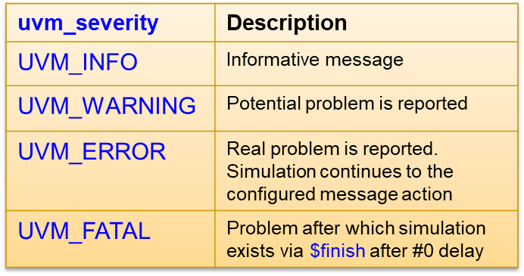
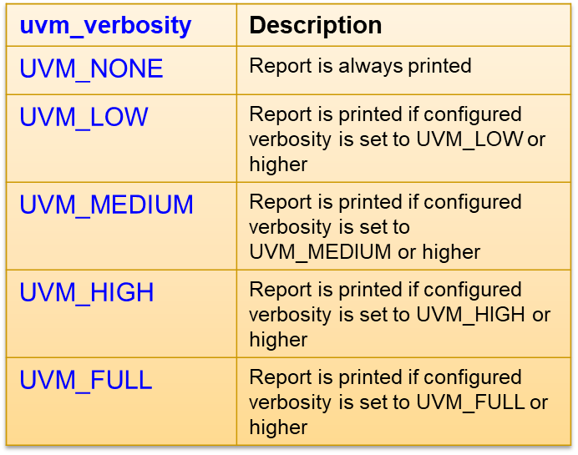
Verbosity and Severity Levels
`uvm_info("TRACE", $sformatf("%m"), UVM_HIGH);

Slide 43
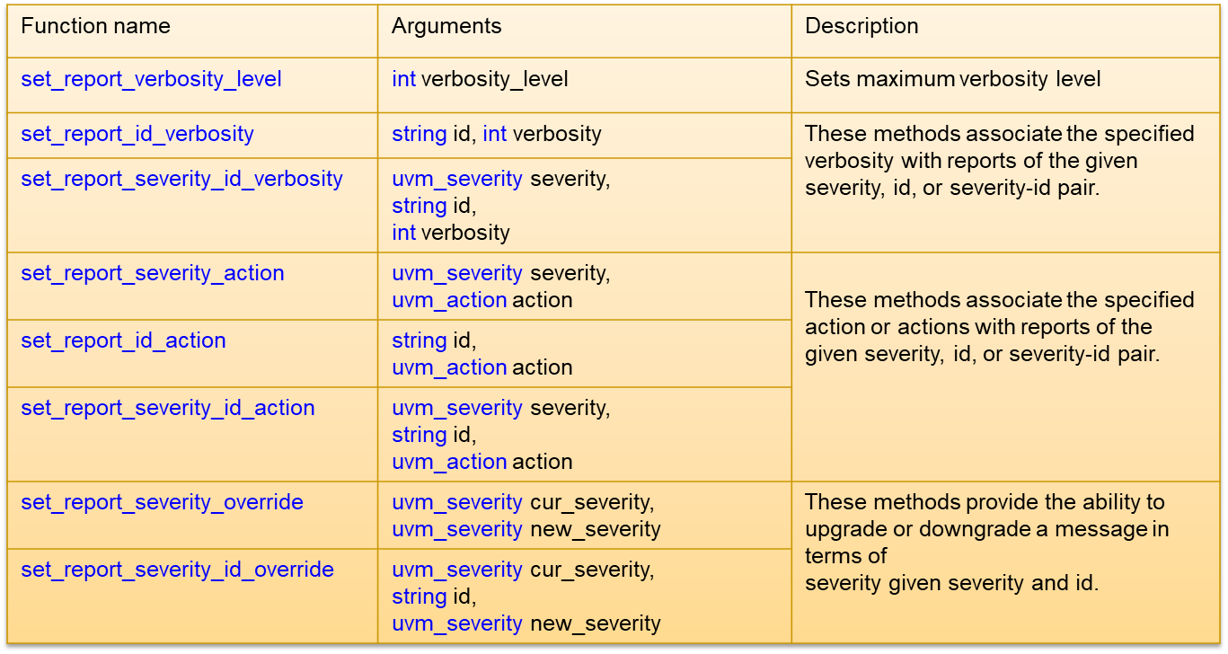
Configuration Functions

Slide 44
Running Example

Slide 45
Virtual Interface
For driver to be able to drive the DUT, driver should access the content DUT interface.
To avoid hardwiring of driver to DUT virtual interfaces are used
Virtual interface is a variable that contains reference to an actual interface

Slide 46
Example: Top
module top;
import uvm_pkg::*;
DUTIF dutif_inst();
counter_dec count_inst(.d(dutif_inst.d), .q(dutif_inst.q), .ce(dutif_inst.ce), .load(dutif_inst.load), .reset(dutif_inst.reset), .clk(dutif_inst.clk), .tc(dutif_inst.tc));
initial
begin
dutif_inst.clk = 0;
forever #10 dutif_inst.clk = ~dutif_inst.clk;
end
initial
begin
uvm_config_db #(virtual DUTIF)::set(null, "*", "DUTIF", dutif_inst);
uvm_top.finish_on_completion = 1;
run_test("Test");
end
endmodule : top
Path
Type
Caller
Name
Value
Register virtual interface into UVM configuration database

Slide 47
Example: Driver
class Driver extends uvm_driver #(Transaction);
`uvm_component_utils(Driver)
virtual DUTIF DUTVI;
function void build_phase(uvm_phase phase);
if( !uvm_config_db #(virtual DUTIF)::get(this, "", "DUTIF", DUTVI) )
`uvm_error("", "uvm_config_db::get failed")
endfunction : build_phase
task run_phase(uvm_phase phase);
forever begin
seq_item_port.get_next_item(req);
@(posedge DUTVI.clk);
DUTVI.q = req.q;
DUTVI.d = req.d;
DUTVI.ce = req.ce;
DUTVI.load = req.load;
DUTVI.reset = req.reset;
DUTVI.clk = req.clk;
DUTVI.tc = req.tc;
seq_item_port.item_done();
end
endtask : run_phase
endclass : Driver

Slide 48
Compilation and Simulation
export UVM_HOME=<PATH>
Setup UVM
vcs –sverilog –ntb_opts uvm-1.1 top.sv
Compilation
./simv +UVM_TESTNAME=Test
Simulation

Slide 49
Simulation Result
------------------------------------------------------------------------------------------------------------
Name Type Size Value
------------------------------------------------------------------------------------------------------------
uvm_test_top Test - @459
env Environment - @469
drv Driver - @600
rsp_port uvm_analysis_port - @617
sqr_pull_port uvm_seq_item_pull_port - @608
seqr uvm_sequencer - @477
rsp_export uvm_analysis_export - @485
seq_item_export uvm_seq_item_pull_imp - @591
arbitration_queue array 0 -
lock_queue array 0 -
num_last_reqs integral 32 'd1
num_last_rsps integral 32 'd1
-------------------------------------------------------------------------------------------------------------

Slide 50
Appendix: Transaction-Level Modeling

Slide 51
Introduction
TLM is a higher level of abstraction than RTL.
For communication between modules TLM uses function calls. Meanwhile in RTL communication is ensured via signal ports.
In TLM methods are not hierarchically fixed and can be reused
Port-based data transfer
module module1(
output [4:0] data);
endmodule
module module2 (
Input [4:0] data);
…
drive_data(data);
endmodule
Task-based data transfer
module module1;
….
top.module1.drive_data(data)
endmodule
module module2 ;
….
task drive_data(data)
endmodule

Slide 52
Advantages of TLM
Higher level of abstraction
Reusable
Faster Simulation
Connect to SystemC

Slide 53
Definitions (1)
Generator (producer) is a component which provides transactions to another components.
Consumer is a verification component which receives transactions generated by another component.
Initiator is a component which initiates process.
Target is a component which responds to initiator.

Slide 54
Definitions (2)
Blocking interfaces: This interface operates in a blocking manner. Its methods do not return until transaction is successfully sent or obained. Its methods are tasks.
Non-blocking interfaces: Its methods are functions. These methods may return with failed status if the delivery of transaction failed.
Combined interfaces: This type of interfaces contain both the blocking and non-blocking interfaces.

Slide 55
Definitions (3)
Ports are called unidirectional if data transfer is done in a single direction.
Ports are called bidirectional if data transfer is done in both directions.

Slide 56
TLM1
TLM1
TLM API
Ports
Exports
Imps
Analysis Ports

Slide 57
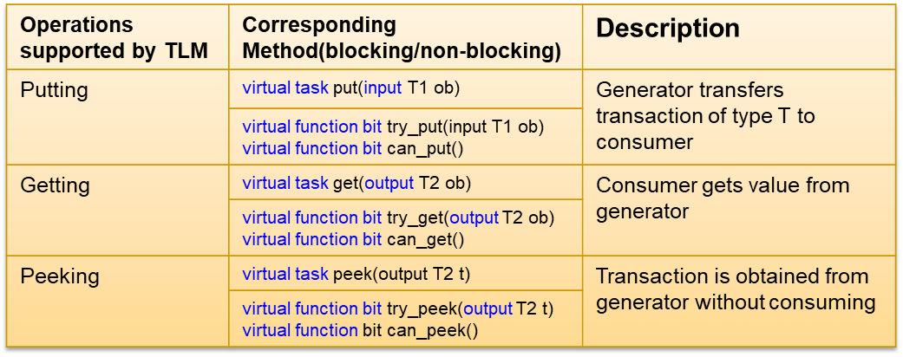
Methods of TLM API

Slide 58
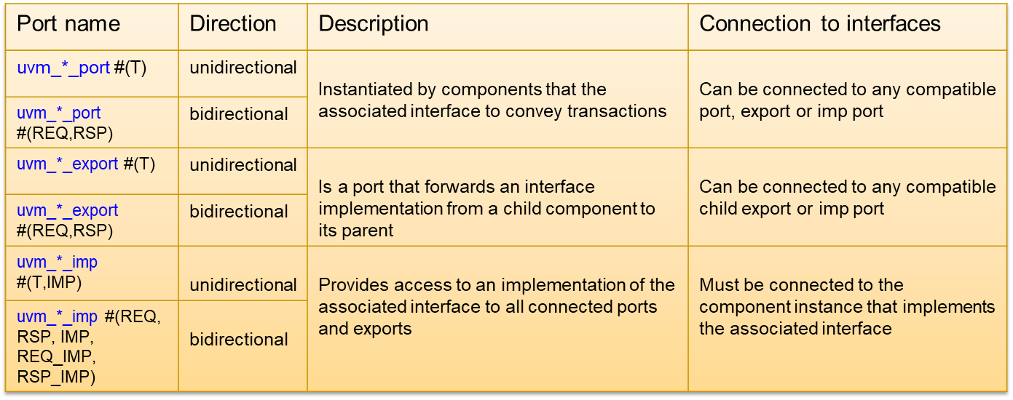
TLM1 Port/Export Classes

Slide 59
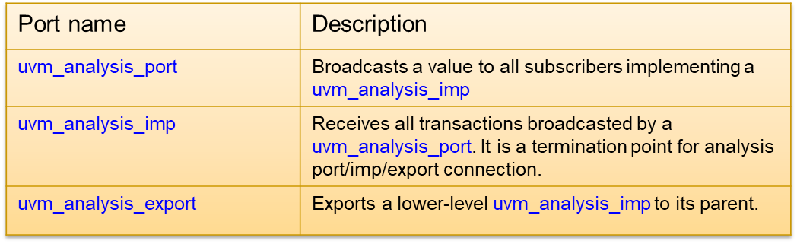
TLM1 Analysis Port Classes

Slide 60
TLM2
TLM1
Interfaces
Sockets
Ports
Exports

Slide 61
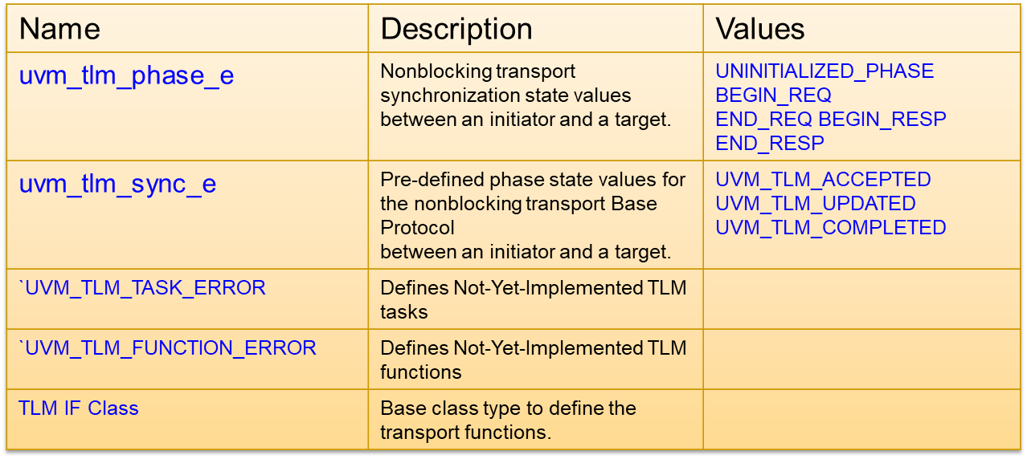
TLM2 Interfaces

Slide 62
TLM IF Class
uvm_tlm_if
Transport functions
nb_transport_bw
nb_transport_fw
b_transport
First call: Marks initial timing point
Other call: Marks timing point in execution
Final timing point: marked by a call to nb_transport_bw or a return from this or subsequent call to nb_transport_fw.
Must be implemented in the initiator component class.
Every call to this method may mark a timing point (also final) in the execution of the transaction.
Final point: marked by a call to nb_transport_fw or a return from this or subsequent call to nb_transport_bw.
Execute a blocking transaction.
Once this method returns, the transaction is assumed to have been executed.
The call to b_transport shall mark the first timing point of the transaction.
The return from b_transport shall mark the final timing point of the transaction.
virtual function uvm_tlm_sync_e nb_transport_fw( T t,
ref P p,
input uvm_tlm_time delay)
virtual function uvm_tlm_sync_e nb_transport_bw( T t,
ref P p,
input uvm_tlm_time delay)
virtual task b_transport ( T t,
input uvm_tlm_time delay)

Slide 63
TLM2 Sockets (1)
Socket
Sockets group together all the necessary core interfaces for transportation and binding.
Intent
Sockets allow more generic usage models than just TLM core interfaces.
Inheritance
Sockets are derived from the base class uvm_port_base #(IF)
Important notes
Socket provides both a forward and backward path.
By connecting sockets together asynchronous (pipelined) bi-directional communication can be enabled.
To enable it socket contains both ports and exports.
Cans and Cannots
Initiator sockets can connect to target sockets.
Initiator socket cannot be connected to other initiator socket.
Target socket cannot be connected to other target socket

Slide 64
TLM2 Sockets (2)
Socket
Any particular socket implements either the blocking interfaces or the nonblocking interfaces.
Terminator sockets are used on initiators and targets as well as interconnect components.
Passthrough sockets are used to enable connections to cross hierarchical boundaries.
Initiator
Target
Passthrough
Terminator
IS - A
HAS - A
Inheritance
Ownership

Slide 65
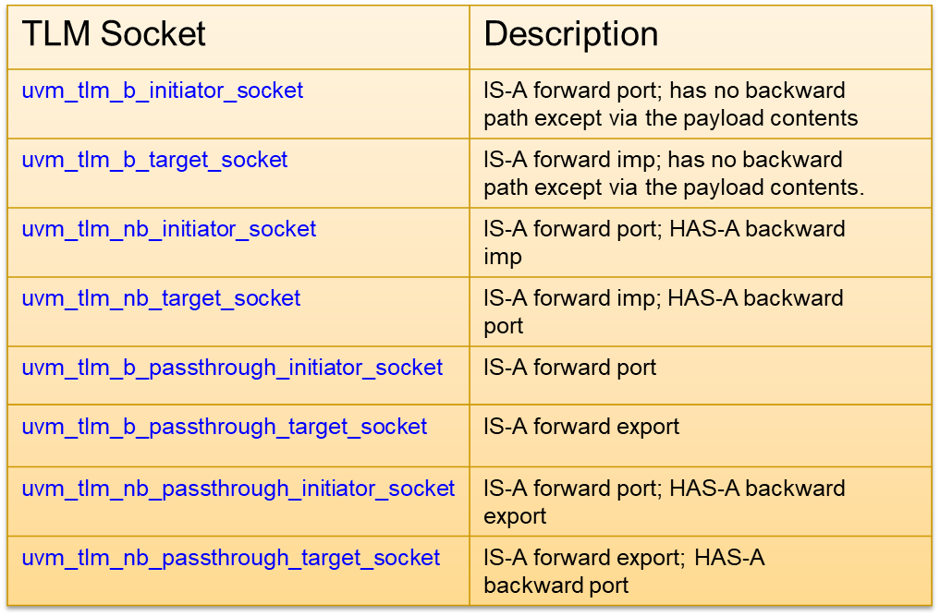
TLM2 Sockets (3)
task b_transport( T t, uvm_tlm_time delay);
function uvm_tlm_sync_e nb_transport_bw(T t, ref P p, input uvm_tlm_time delay
function uvm_tlm_sync_e nb_transport_fw(T t, ref P p, input uvm_tlm_time delay

Slide 66
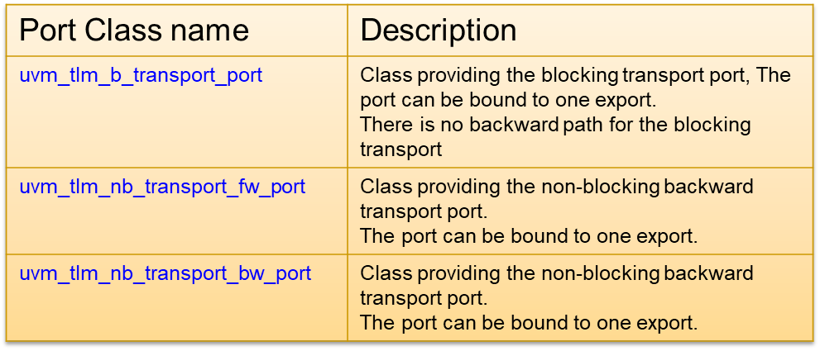
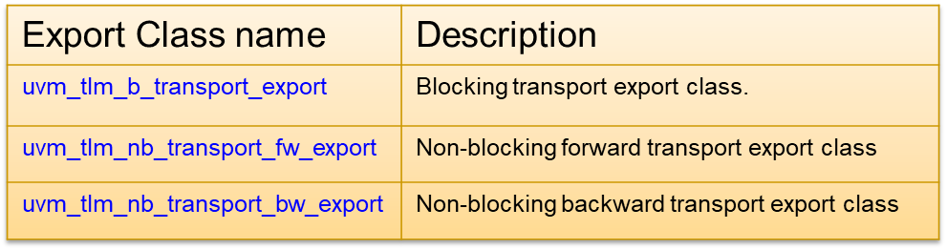
TLM2 Ports/Exports

