Slide 1




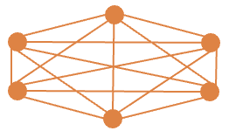
High-layer servers
(CSP - Follower)
Access servers
(MNO - Leader)
Layer-1 server (Access server – server at access network)
s, I, d
Mesh topology links between the layer-2 and layer-3 servers
Layer-2 server (High-layer server)
Point-to-point links between the layer-1 and layer-2 servers
Links between the layer-1 servers and users
Layer-3 server (High-layer server)
Simplified representation of mesh topology among high-level servers

