Slide 1
DataExodus
Where does your data actually go?
Early-Stage Presentation · Project Plan
Thanh Dat Phan · [Student ID]
[Unit code and name] · Week 8
github.com/thanhdat23102005/DataExo
Notes:
[0:00-0:15]
Good morning. My project is called DataExodus, and it answers one question:
when you open an ordinary Australian website, where does your data actually go?
Over the next ten minutes I'll cover the problem, what I'm building, how I'm
building it, and what is already working.
Do not read the slide. Say the question, then pause.

Slide 2
THE PROBLEM
A hash is not anonymous
you@example.com → 973dfe463ec857…
Companies call this anonymised. It is not.
The same email always produces the same hash
so that value is a stable name for you
It follows you between unrelated websites
any site receiving the same hash recognises the same person
The raw address never crosses the wire
which is exactly why the practice looks safe and is not
US Federal Trade Commission, 2024: "Hashing is not anonymization"
Notes:
[0:15-1:25]
This is the heart of the project. A tracker rarely sends your email address in
plain text - it sends the hash of it, and calls that anonymised.
But hashing is deterministic. The same email always produces the same hash. So
that value is still a name for you, it just isn't readable. Any site that
receives it recognises the same person.
The FTC said exactly this in 2024. My project doesn't argue the point - it
demonstrates it, on the audience's own traffic.
Pause after "It is not." Let it land.

Slide 3
BACKGROUND
Why this matters in Australia
APP 8 — Privacy Act 1988
organisations disclosing personal information overseas carry obligations; individuals cannot easily check compliance
ACCC Digital Platforms Inquiry
found consumers have little practical visibility of who receives their data
Nobody can check their own exposure
the tooling exists for researchers, not for the person whose data it is
Self-initiated individual project
no external client; assessor is the approving stakeholder
Notes:
[1:25-2:25]
Why Australia specifically. Australian Privacy Principle 8 places obligations on
organisations that send personal information overseas. The ACCC's Digital
Platforms Inquiry found consumers have almost no practical visibility of this.
So there is a law about cross-border disclosure, and no way for an ordinary
person to see whether it is happening to them. That gap is what I'm building for.
This is my own initiative - there's no external client. The assessor is the
approving stakeholder.

Slide 4
SCOPE
Two things you can install
1 · Chrome extension
2 · Raspberry Pi application
Shows the problem on one machine
• names the company behind every request
• scores the page 0–100 for privacy risk
• hashes your identifier locally and
watches for it leaving
Acts on it for the whole network
• adds owner and country attribution
• blocks tracker domains by DNS for
every device, including phones and TVs
• keeps history the browser forgets
The extension shows you the problem. The Pi does something about it.
Notes:
[2:25-3:25]
The project is two things a person actually installs.
First, a Chrome extension. It watches every request the browser makes, names the
company behind each destination, scores the page for risk, and detects your own
identifier leaving as a hash.
Second, a Raspberry Pi application. It collects what the extension sees, adds
country attribution the browser can't do, and blocks tracker domains by DNS -
which covers every device on the network, including the phone and the TV that
can never run an extension.
One line to remember: the extension shows you the problem, the Pi does something
about it.

Slide 5
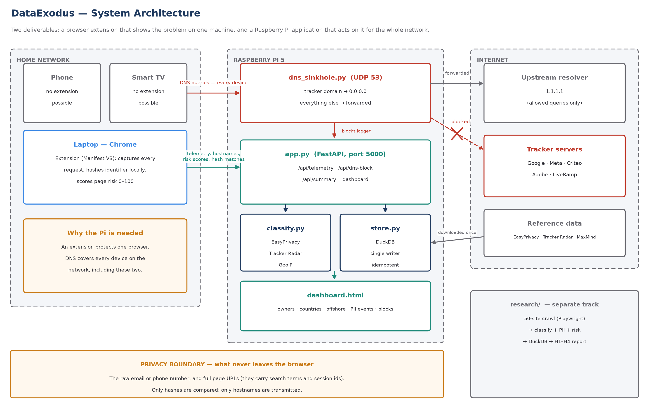
ARCHITECTURE
How the pieces fit
Notes:
[3:25-4:40]
This is the whole system on one slide.
On the left, the home network. The laptop runs the extension; the phone and the
TV cannot. In the middle, the Raspberry Pi: the DNS sinkhole at the top answers
tracker queries with 0.0.0.0, the FastAPI app receives telemetry, classify and
store handle attribution and storage, and the dashboard presents it.
Point at the orange bar along the bottom. That is the privacy boundary. The raw
email and the full page URLs never cross it. Only hashes are compared and only
hostnames are sent - because a URL carries your search terms and session ids, and
this is supposed to be a privacy tool.
Walk the diagram left to right with your hand, then turn back to the audience.

Slide 6
REQUIREMENTS
What it has to do
High-level — what
Low-level — how
HR-1 Who receives the data, and who owns them
HR-2 Which country, and is it offshore
HR-3 Detect the identifier leaving as a hash
HR-4 Covert third-party vs intentional use
HR-5 Block for every device, not one browser
HR-6 Present it so a non-specialist can act
HR-7 Measure across 50 Australian sites
Manifest V3 service worker observes requests
WebCrypto + local MD5, four algorithms
Every normalisation: digits, +61, Gmail dots
Hostnames only — never URLs, never raw values
GeoLite2 lookup on the Pi
dnslib UDP server, upstream 1.1.1.1
Playwright crawler over a frozen site list
Notes:
[4:40-5:40]
Seven high-level requirements on the left - what the system has to do. Seven
matching implementation decisions on the right - how.
I'll call out two. HR-4: distinguishing covert from intentional. If you type your
email into a site's own search box, that's you choosing to. If that site quietly
forwards the hash to Facebook, that's the thing worth alarming about. Early on I
treated both the same, and everything looked like a breach.
And the normalisation row. A tracker doesn't hash what you typed - it hashes what
its own pipeline normalised first. I'll come back to that.
In the plan each of these is traced through to how it gets verified.

Slide 7
SMART GOALS
Goals I can be held to
G1 · Attribute owner and country for ≥ 90% of destinations
by week 10, verified by manual spot-check against Tracker Radar
G2 · Match a hashed identifier across 4 algorithms and 4 forms
by week 10, evidenced by a reproducible test
G3 · Zero misclassification of covert vs intentional
by week 11, across the manual test set
G4 · Block ≥ 75,000 domains with zero false positives
by week 11, across twelve named Australian and global sites
G5 · A non-specialist can read the result unaided
by week 12, validated by a think-aloud walk-through
G6 · Report H1–H4 with stated statistical methods
by week 13, significant or not
Notes:
[5:40-6:25]
Six goals, each measurable and dated, and together they cover every requirement.
The one I'd point at is G4: zero false positives. Not "few". At the DNS layer a
false positive doesn't inconvenience one browser - it takes a website off the air
for everyone in the house. That's the number that has to be zero.
G6 says "significant or not" deliberately. If sectors don't differ, I report that.
I'm not designing this to confirm an answer I already like.
Don't read all six. Name the count, then talk about G4 and G6.

Slide 8
METHODOLOGY
Incremental layers, and why
Each layer is a complete working system on its own
L1 Extension alone → L2 + Pi collector → L3 + network-wide DNS blocking → L4 + 50-site study
Not waterfall — the riskiest unknowns are technical and early
whether Manifest V3 allows the observation; whether a blocklist breaks real sites
Not formal Scrum — ceremonies coordinate a team; there is one student
short increments and working software kept; meeting structure dropped
It already paid for itself
wikipedia.org and github.com were classified as trackers — caught before that layer ever reached the network
Notes:
[6:25-7:40]
Methodology, and this is where I want to be concrete rather than quote a textbook.
I build in vertical layers. Each one is a complete working system by itself, and
later layers add capability without making earlier ones worthless.
Why not waterfall: my riskiest unknowns are technical and they sit early. Waterfall
would surface them in an integration phase with no time left to react.
Why not formal Scrum: the ceremonies exist to coordinate a team. There's one of me.
I kept short increments and working software; I dropped the meetings.
And here's the evidence it was the right call. My DNS blocklist parser classified
wikipedia.org and github.com as trackers - because filter rules that block a single
path were being read as blocking the whole domain. At the DNS layer that takes
Wikipedia off the air for every device in the house. I caught it because I tested
that layer in isolation before connecting it to anything.
This story is worth telling properly - it's the strongest thing on the slide.

Slide 9
TOOLS & STANDARDS
Tools chosen for a reason
Manifest V3 — the only platform Chrome accepts
Python + FastAPI — runs comfortably on a Pi 5
DuckDB — analytical queries, single file, no server
dnslib — blocking logic stays readable and testable
Playwright — a real browser, so real trackers fire
GeoLite2 — free, offline, widely cited
Standards
Privacy Act 1988 — APP 8
Manifest V3; least-privilege permissions
Privacy by design — hashing stays client-side
PEP 8, type annotations, semantic versioning
Passive-observation research ethics
public pages, own traffic, no logins, no evasion
Every data source is public — EasyPrivacy, Tracker Radar, GeoLite2 — so any classification I report can be independently audited.
Notes:
[7:40-8:25]
Quickly on tools, because the plan justifies each one in detail.
Two worth naming here. DuckDB, because my questions are aggregate ones - "which
company receives the most requests" - and that's what a columnar database is for,
in a single file with no server to administer.
And dnslib rather than configuring dnsmasq, because I want the blocking logic to be
code I can read and test, not settings buried in a config file.
On standards: everything I classify comes from a public list. That means a marker
can check any claim I make. That's deliberate.

Slide 10
PROGRESS
Already built and tested
Extension v3.3 — capture, risk scoring, local hashing, malware blocking
Manifest V3, running in Chrome today
MD5 implementation verified against 12 test vectors
including UTF-8 input and the 55/56/57/64-byte padding boundaries
Identifier normalisation fixed a real miss
typed as "0412 345 678", matched when a tracker hashes "61412345678" — the old single-form version matched nothing
DNS sinkhole: zero false positives across twelve sites
blocked domains answer 0.0.0.0 and :: ; everything else forwarded
Telemetry is idempotent — a retried delivery double-counts nothing
tested by replaying the same payload
Study pipeline: 10 government sites crawled, 543 requests classified
remaining 40 sites scheduled for weeks 9–10
Notes:
[8:25-9:25]
This is the slide I'd most like you to take away, because none of it is a plan -
it's all been run.
The MD5 I wrote is verified against twelve reference vectors, including the padding
boundaries at 55, 56 and 57 bytes, which is where hand-written MD5 usually breaks.
The normalisation line is my favourite. If you type your phone number as "0412 345
678" and a tracker hashes "61412345678", the old version of my code matched nothing
and reported no leak - silently. The fix hashes every plausible form. I have a test
that proves the old one missed and the new one matches.
And zero false positives on the DNS blocking, which is the G4 number.
Say "none of this is a plan, it's all been run" and then pause.

Slide 11
TIMELINE & RISK
What is left, and what could go wrong
Remaining schedule
Top risks
W9–10 Full 50-site crawl (G1, G2)
W11 Network deployment, false-positive testing (G3, G4)
W12 Dashboard and usability walk-through (G5)
W13 Hypothesis testing and report (G6)
W14 Final presentation
A false positive takes a site off the air for the house
→ separate lists for blocking and labelling; allow-test first
The Pi becomes a single point of DNS failure
→ documented rollback; blank secondary is a stated trade-off
Chrome DNS-over-HTTPS bypasses the sinkhole
→ stated limitation; the extension still sees these requests
Notes:
[9:25-9:55]
Briefly: weeks 9 and 10 are the full crawl, 11 is deployment and the false-positive
testing, 12 and 13 are the dashboard and the analysis, 14 is the final presentation.
On risk - the honest one is the third. If someone turns on Chrome's secure DNS,
their queries go straight to Google and my sinkhole never sees them. I can't stop
that. But the extension still observes those requests, which is precisely why the
project is two deliverables and not one.
Don't rush this slide just because it's near the end.

Slide 12
A hash is not anonymous.
This project proves it on your own traffic — then blocks it.
Extension — shows the problem on one machine
Raspberry Pi — acts on it for every device on the network
Everything classified from public, auditable sources
Questions?
github.com/thanhdat23102005/DataExo
Notes:
[9:55-10:00]
To close: a hash is not anonymous, and this project proves it on your own traffic
rather than describing it. The extension shows you the problem; the Pi does
something about it for every device you own.
Happy to take questions.
Likely questions and short answers:
- "Why not just use Pi-hole?" Pi-hole blocks. It doesn't tell you who owns a
destination, which country it's in, or whether your identifier went with it.
- "Is this legal?" Public pages only, my own traffic, my own identifier, no logins
and no attacks - the same basis as published academic measurement work.
- "Why only 50 sites?" Because I verify every classification by hand. Fifty is a
number I can audit; five thousand is a number I could only assert.
- "What if you find nothing?" I report that. It's a measurement, not an argument.

