Slide 1



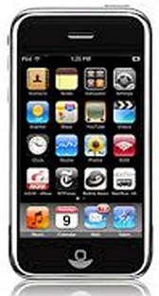
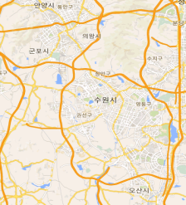
Program Architecture
Admin Program Install
Client Program distribution
Server Control
Send to request of user location.
Receive User location data by Google Map
Creating Report of User data.
Administration of Client program.
Find Client’s location by Mobile Phone
Make to Client Program
- For Mobile ( Android and iPhone )
Web Base Program
Can’t Remove and control in Client Mobile
Automatically send date to Server
2. Make to Administrator Program
Client Program install ( Web Base )
Use to Google Map
Program running in Back ground
Can’t Remove type
Send to Server : Location info by Google map
Send to client : Request to User location From Admin

Slide 2
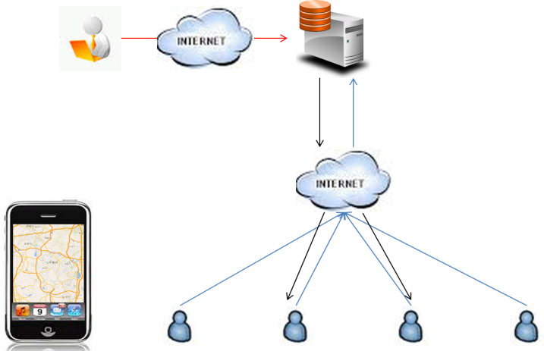
Detail Request for Server
Make server environment for Windows 2000 Server version
- English Version
- SQL 2000 ( If you need DB program )
Build to Administrator program.
- User administration ( DB and data managing )
- Client Program Control and distribution.
Data Search Functions
- For name
- For Joining date
- For Group ( We need group to 3 Level for users. )

Slide 3
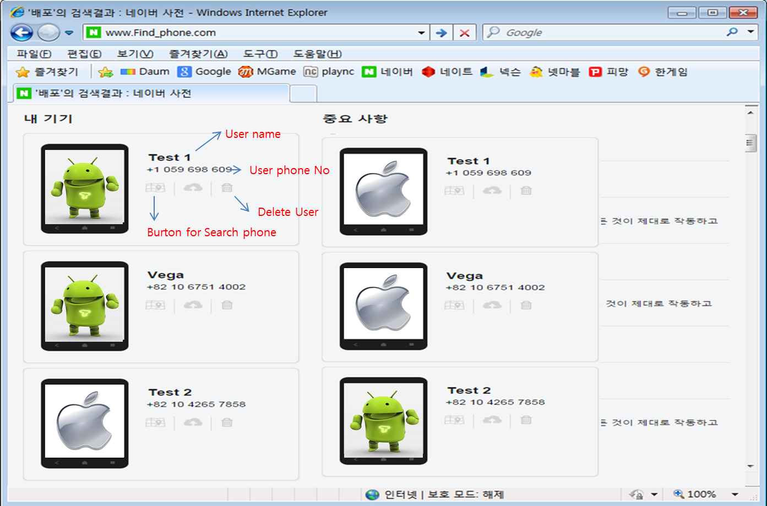
Sample Admin page View

Slide 4
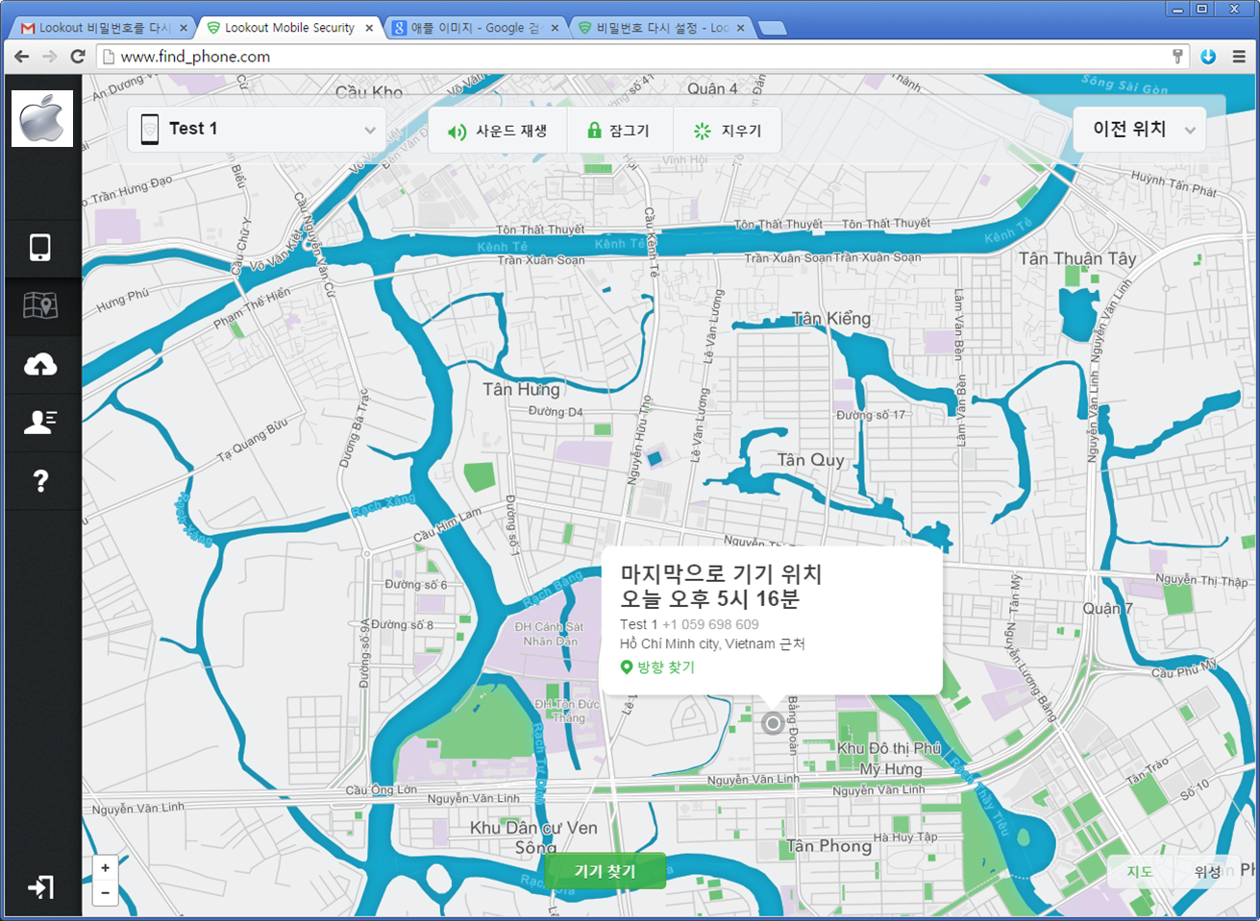
Sample Admin view of Success Searching to User phone

Slide 5
Detail Request for Client Program
For Web base program.
- All client access by Phone’s browser ( Explorer & Chrome )
- Easy access for home page.
- Ease Install for Background program.
- Never remove client program.
- Anybody can’t find and delete client background program.
( Only factory initialization for delete )
- Only for Install in to phone.
Install Detail
- Connect to Web Site.
- Login ( Admin Account )
- Program Download & Install
- Program will be send phone number and location to server
- Delete to access to web site
- Finish.

