Slide 1
WHAT IS GIT
Git is a distributed version-control system for tracking changes in source code during software development. It is designed for coordinating work among programmers, but it can be used to track changes in any set of files. Its goals include speed, data integrity, and support for distributed, non-linear workflows

Slide 2
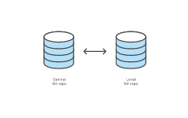
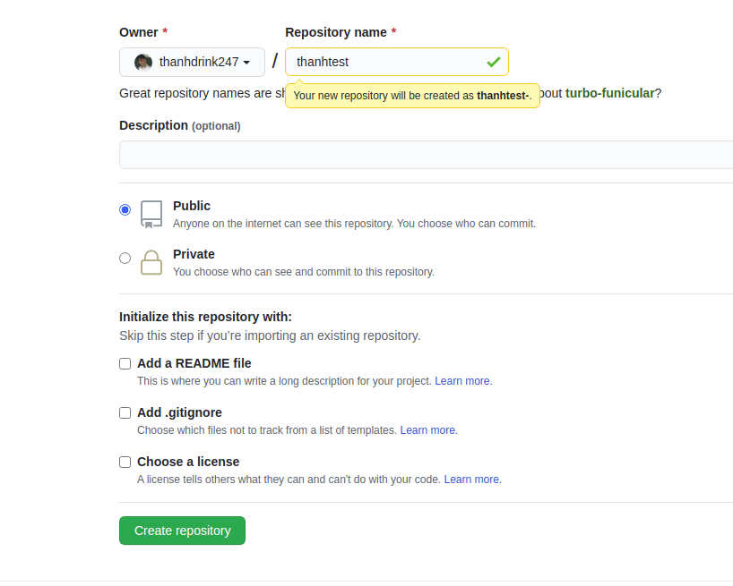
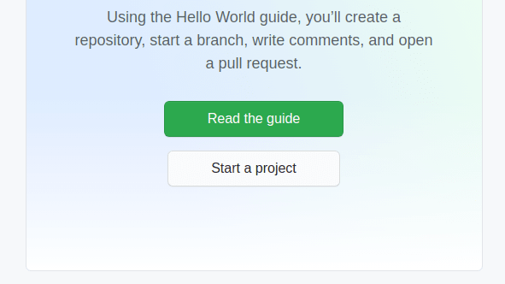
Create a Git repository
ON GITHUP.COM click start a project - Enter your name repo for the Repository. For example, if the user thanhdrink247 has a repository called thanhtest, the URL for that repository would be: https://github.com/thanhdrink247/thanhtest.
CENTRAL GIT REPO
LOCAL GIT REPO

Slide 3
clone repo in your computer on termiral git clone https://github.com/your-accoud/your-repo.git EX: git clone https://github.com/thanhdrink247/thanhtest-.git

Slide 4
ADD A FILE TO GIT
1, git add /path/to/file 2, git commit -m "COMMIT YOUR COMMIT " 3, git push origin YOUR_BRAND
example 1, git add /path/to/file 2, git commit -m "COMMIT YOUR COMMIT " 3, git push origin YOUR_BRAND

Slide 5
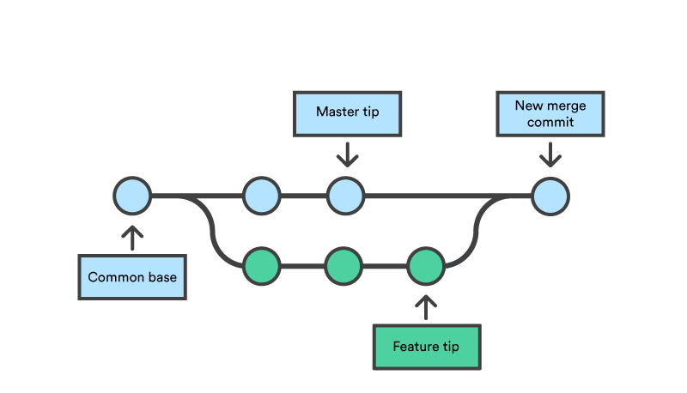

GIT MERGE Git merge will combine multiple sequences of commits into one unified history. In the most frequent use cases, git merge is used to combine two branches. The following examples in this document will focus on this branch merging pattern. In these scenarios, git merge takes two commit pointers, usually the branch tips, and will find a common base commit between them. Once Git finds a common base commit it will create a new "merge commit" that combines the changes of each queued merge commit sequence. GIT MERGE <branch> example : if you want merger branch1 to branch2 you can : git checkout branch2 git merge branch1
if it have conflick git will merge 2 branch , you must code and commit to branch

