Slide 1

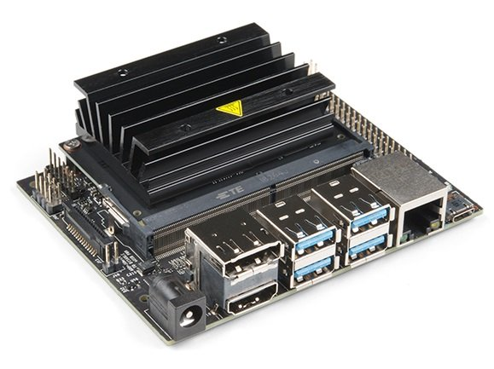
By Thanh Hai Chau

Slide 2

Documents:
NVIDIA Tegra Linux Driver Package: https://docs.nvidia.com/jetson/archives/l4t-archived/l4t-3231/index.html#page/Tegra%20Linux%20Driver%20Package%20Development%20Guide/introduction.html
Getting Started: https://www.hackster.io/news/getting-started-with-the-nvidia-jetson-nano-developer-kit-43aa7c298797
Use VNC to remote desktop
Progam Hardware: GPIO, I2C, SPI,…
Configuring the 40-pin Expansion Header: https://docs.nvidia.com/jetson/archives/l4t-archived/l4t-3231/index.html#page/Tegra%2520Linux%2520Driver%2520Package%2520Development%2520Guide%2Fhw_setup_jetson_io.html%23
Technical Reference Manual: https://developer.nvidia.com/embedded/downloads#?search=Technical%20Reference%20Manual
Pin Map on Jetson Nano: https://developer.nvidia.com/embedded/downloads#?search=jetson%20nano%20pinmux
Jetson Nano J41 Port: https://www.jetsonhacks.com/nvidia-jetson-nano-j41-header-pinout/
Learn programing driver on ubuntu:
https://www.youtube.com/watch?v=3MY8kLEZr98&list=PLL68erM6rDuJ4juXm6MzhppMsNB2wJ-Tk
https://www.youtube.com/watch?v=zw6St5zXEXg&list=PLL68erM6rDuLivN88lwS9YYAeBfuIOYvA
Note: NVIDIA supply forum for all users, you should register an account and join this forum for development projects

Slide 3
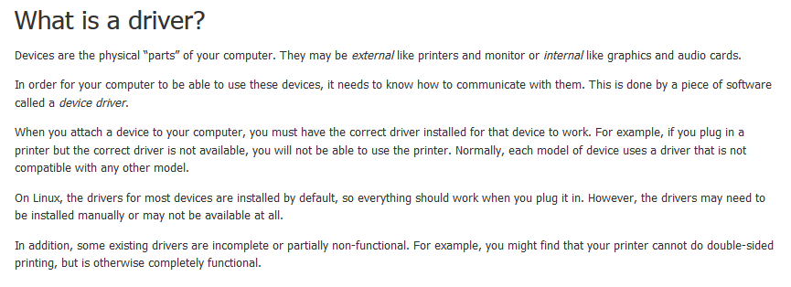
A Simple Example Programing Driver
Một cách dễ hiểu, lập trình driver là lập trình để giao tiếp với các cổng tty trên hệ thống, có thể dùng lệnh ls /dev để liệt kê các danh sách thiết bị có trên hệ thống.
Có 2 cách để lập trình GPIO hệ thống: lập trình kernel, lập trình C/C++ thông qua cổng /dev/mem
https://blog.sourcerer.io/writing-a-simple-linux-kernel-module-d9dc3762c234

Slide 4
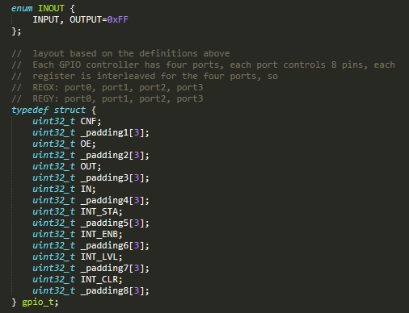
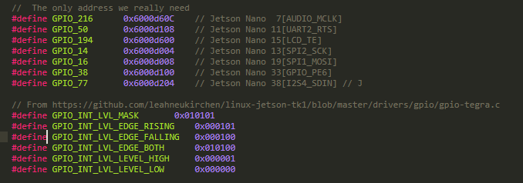
How to check Map Pin GPIO on Jetson Nano
Search in documents: NV_Jetson_Nano_Module_Pinmux_Config_Template, Tegra_X1_TRM_DP07225001_v1.3p

Slide 5
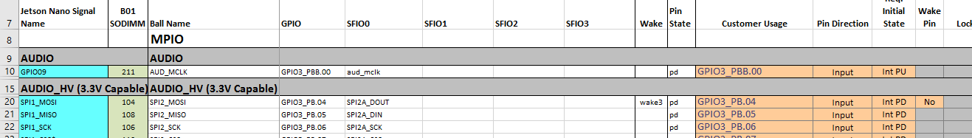
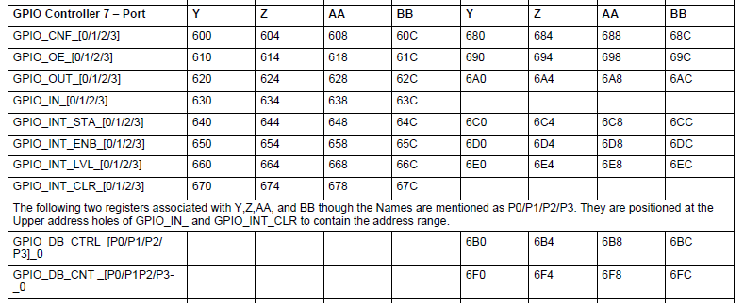
How to check Map Pin GPIO on Jetson Nano
Example: Program GPIO on GPIO216 [AUDIO_MLCK]
Step1: Configure GPIO on https://docs.nvidia.com/jetson/archives/l4t-archived/l4t-3231/index.html#page/Tegra%2520Linux%2520Driver%2520Package%2520Development%2520Guide%2Fhw_setup_jetson_io.html%23
Check in NV_Jetson_Nano_Module_Pinmux_Config_Template, where is your pin on chip ARM57? And what is it’s name?
GPIOBB.00
Step2: Check in Tegra_X1_TRM_DP07225001_v1.3p, which register does it respond for GPIOBB.00?
Offset memory: 0x60C

Slide 6
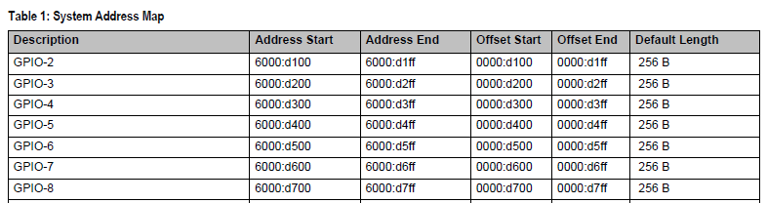
How to check Map Pin GPIO on Jetson Nano
Example: Program GPIO on GPIO216 [AUDIO_MLCK]
Step2: Check in Tegra_X1_TRM_DP07225001_v1.3p, which register does it respond for GPIOBB.00?
Offset memory: 0x60C
Adress Start + Offset memory
= 0x6000D60C

Slide 7
How to check Map Pin GPIO on Jetson Nano
Example: Program GPIO on GPIO216 [AUDIO_MLCK]
Step3: Download Github code:
https://github.com/jwatte/jetson-gpio-example
https://github.com/valentis/jetson-nano-gpio-example
https://github.com/thanhhaibk96/Jetson-Nano-C-Sample/tree/master/GPIO/jetson-nano-gpio-test
https://github.com/thanhhaibk96/Jetson-Nano-Kernel-Sample/tree/master/GPIO/jetson-nano-gpio-v1
Explaining Code:
Program C via using /dev/mem
Because Linux does not allow you access physical memory directly, so you have to use a function to create virtual memory - open("/dev/mem", O_RDWR | O_SYNC);
Program driver
In programming driver, Linux does not allow you access physical memory directly like program in C, you have to use function - ioremap(GPIO_216, sizeof(gpio_register)); to access undirectly physical memory
http://man7.org/linux/man-pages/man4/mem.4.html

Slide 8

How to check Map Pin GPIO on Jetson Nano
Example: Program GPIO on GPIO216 [AUDIO_MLCK]
Explaining Code:
“/dev/mem“: is a character device file that is an image of the main memory of the computer. It may be used, for example, to examine (and even patch) the system. Byte addresses in /dev/mem are interpreted as physical memory addresses. References to nonexistent locations cause errors to be returned. Examining and patching is likely to lead to unexpected results when read-only or write-only bits are present. Since Linux 2.6.26, and depending on the architecture, the CONFIG_STRICT_DEVMEM kernel configuration option limits the areas which can be accessed through this file. For example: on x86, RAM access is not allowed but accessing memory-mapped PCI regions is
It is typically created by:
mknod -m 660 /dev/mem c 1 1
chown root:kmem /dev/mem
“mmap”: https://vimentor.com/vi/lesson/memory-mapping
What is fd? https://blog.vu-review.com/file-descriptor-la-gi.html
Depend on architecture of CPU, in this case: 4096
0xFFF
http://man7.org/linux/man-pages/man4/mem.4.html

Slide 9
How to check Map Pin GPIO on Jetson Nano
Example: Program GPIO on GPIO216 [AUDIO_MLCK]
Pointer points to mapping address
Start address of module GPIO → GPIO-1: 0x6000d60C & 0xFFFFF000 (~0xFFF)
= 0x6000d000
Force type of pointer, it is easy to access registers
Access to address of GPIO216/GPIOBB00:
0x6000d000 + (0x6000d60C & 0xFFF)
https://linux.die.net/man/1/g++
https://explainshell.com/explain?cmd=g%2B%2B+-g+-O1+-o+gpio+gpio_toggle.cpp+-Wall+-std%3Dgnu%2B%2B17
https://courses.cs.washington.edu/courses/cse373/99au/unix/g++.html

Slide 10
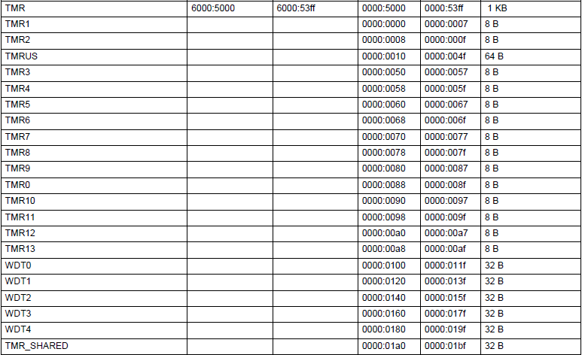
Timer Address Map

Slide 11
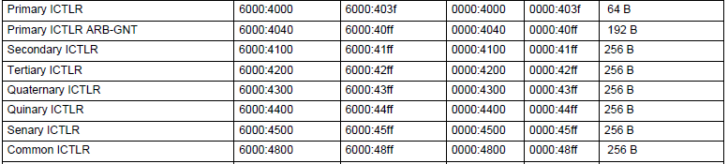
Interrupt Timer Address Map
The TMRs run at either a fixed 1 MHz clock rate derived from the oscillator clock (TMR0-TMR9]) or directly at the oscillator clock (TMR10-TMR13)
Each TMR can be programmed to generate one-shot, periodic, or watchdog interrupts
When a TMR is enabled, it loads the Present Trigger Value (PTV) timer into its counter and starts decrementing at its associated rate. When the Present Count Value (PCR) timer decrements to zero, it generates a timer interrupt.
When the periodic interrupt mode is enabled, then timer generates an interrupt and reloads the counter with the PTV value and starts to decrement again.

Slide 12
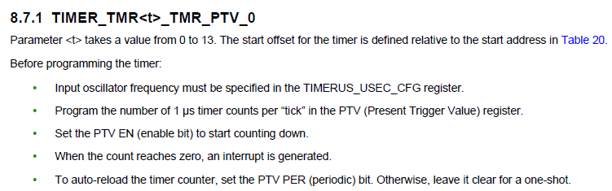
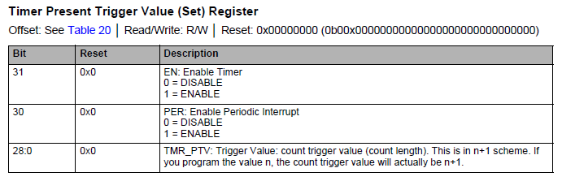
Timer Register

Slide 13
Timer Register
TIMERUS_USEC_CFG

Slide 14
Interrupt
ARM processors (Cortex-A57, and ARM7) each have two input pins to receive two different types of interrupts. These interrupts are called IRQ (Interrupt Request) and FIQ (Fast Interrupt Request). The interrupts are implemented as active-low pins on the ARM processor input; thus the processor pins are named nIRQ and nFIQ. The ARM processor goes into the IRQ mode or the FIQ mode depending up on which interrupt is activated. Generally, interrupts that require low latency or are time critical are configured as FIQ. All other interrupts are configured as IRQ. Nonsecure interrupts can only be IRQ.
There are three types of interrupt sources for the GIC and vGIC: SGIs, PPIs, and SPIs

Slide 15
Interrupt
Software Generated Interrupts (SGIs)
SGIs are software interrupts which are generated by writing to the Software Generated Interrupt register (GICD_SGIR). Each CPU interface can generate a maximum of 16 SGIs, with ID0-15 for each target processor. The SGIs are also referred to as IPIs (Inter Processor Interrupts).
Private Peripheral Interrupts (PPIs)
PPIs are interrupts generated by a peripheral that is specific to a single processor. There are seven PPIs for each Cortex-A57 processor: virtual maintenance interrupt (ID25), hypervisor timer interrupt (ID26), virtual timer interrupt (ID27), legacy nFIQ (ID28), secure physical timer interrupt (ID29), non-secure physical timer interrupt (ID30), and legacy nIRQ (ID31). Tegra X1 devices use all PPIs.
Shared Peripheral Interrupts (SPIs)
SPIs are external hardware interrupts which are generated by asserting signals on GIC or vGIC input pins (called IRQs). From a Tegra hardware perspective, these are the interrupts which are generated by various units to be sent to interrupt controllers. Tegra X1 devices use 192 of the possible 480 SPIs generated through the IRQS[191:0] pins. SPIs start at ID32. Tegra X1devices use level-sensitive SPIs only
Each IC32 generates five sets of IRQ/FIQ interrupts: one for BPMP (ARM7 BPMP-Lite) and the other ones for CPU<3:0>. The interrupts for CPU<3:0> are used by the flow controller only for wake events.

Slide 16
Interrupt
The interrupt routing (to the BPMP-Lite) is achieved by configuring the Interrupt Enable Register (IER) and the Interrupt Class Registers (IEP_CLASS). Each IC32 has a set of IER and IEP Class registers. The BPMP-Lite registers are called COP_IER and COP_IEP_CLASS. Similarly, the CPU IER/IEP Class Registers are called CPU_IER/CPU<1,2,3>_IER and CPU_IEP_CLASS/CPU_IEP_CLASS.
When a 1 is set in the proper bit position in the COP_IER register, that particular source is capable of interrupting the BPMPLite. Also, the class is set in the proper bit position of COP_IEP_CLASS for the corresponding interrupt to be routed as IRQ or FIQ
The interrupt status register (ISR) allows the processor to view the state of the pending hardware interrupt requests regardless of the bit enables programmed in COP_IER. The forced interrupt status register (FIR) allows the software to selectively force set or clear specific interrupts. The read-only VIRQ/VFIQ allows the BPMP-Lite to determine the source of the interrupt request(s) causing the processor to enter the interrupt service routine.
The nIRQ signals generated by six IC32 controllers are logically ANDed in the combiner to generate the final nIRQ which is routed to the BPMP-Lite. Similarly, nFIQ signals are logically ANDed in the combiner to generate nFIQ which is routed to the BPMP-Lite.

Slide 17
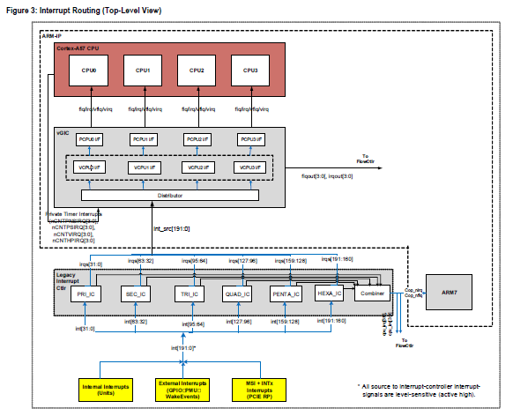
Interrupt

Slide 18
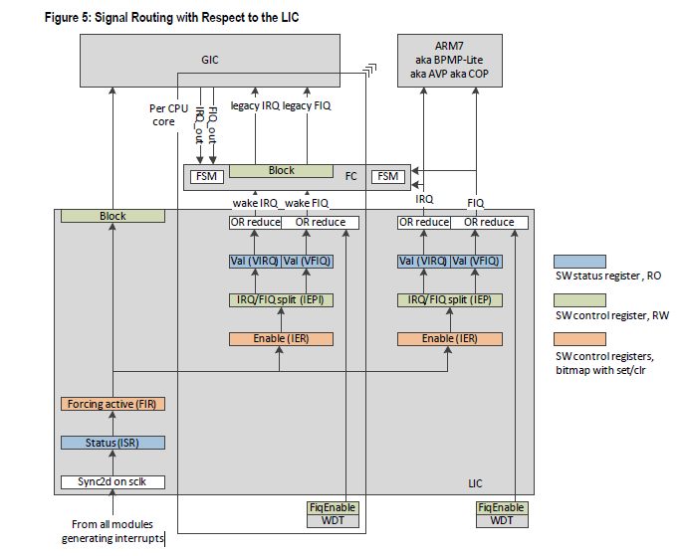
Interrupt

Slide 19
Device Tree
Convert the overlay into a Device Tree source file by entering this command
$ dtc -I dtb -O dts -o my-overlay.dts /boot/tegra210-p3448-0000-p3449-0000-a02-user-custom.dtbo
You can modify the generated Device Tree source as necessary for your custom hardware, adding any additional nodes and/or properties that the hardware module requires. Then you can re-compile the Device Tree source and place it in the /boot/ directory for Jetson‑IO to use:
$ dtc -O dtb -o my-overlay.dtbo -@ my-overlay.dts
$ sudo cp my-overlay.dtbo /boot
Modify function in Jetson by command:
$ sudo /opt/nvidia/jetson-io/jetson-io.py
https://docs.nvidia.com/jetson/archives/l4t-archived/l4t-3231/index.html#page/Tegra%2520Linux%2520Driver%2520Package%2520Development%2520Guide%2Fhw_setup_jetson_io.html%23
https://github.com/thanhhaibk96/JetsonNano-mcp2515/blob/master/tegra210-p3448-0000-p3449-0000-b00-mcp251x.dts

Slide 20
Device Tree
clocks {
can_clock {
compatible = "fixed-clock";
#clock-cells = <0x0>;
clock-frequency = <0xf42400>;
clock-accuracy = <0x64>;
linux,phandle = <0x1>;
phandle = <0x1>;
};
};
This is Crystal Oscillator of MCP2515: 16 MHz

Slide 21
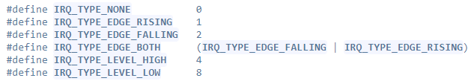
Device Tree
spi@0 {
compatible = "microchip,mcp2515";
reg = <0x0>;
spi-max-frequency = <0x989680>;
nvidia,enable-hw-based-cs;
nvidia,rx-clk-tap-delay = <0x6>;
clocks = <0x1>;
interrupts = <0xffffffff 0xc8 0x1>;
controller-data {
nvidia,cs-setup-clk-count = <0x1e>;
nvidia,cs-hold-clk-count = <0x1e>;
nvidia,rx-clk-tap-delay = <0x1f>;
nvidia,tx-clk-tap-delay = <0x0>;
};
};
SPI Clock 10MHz
Referrence to node clock through phandle
GPIOZ0.0 gpio200, 200 → 0xC8

Slide 22
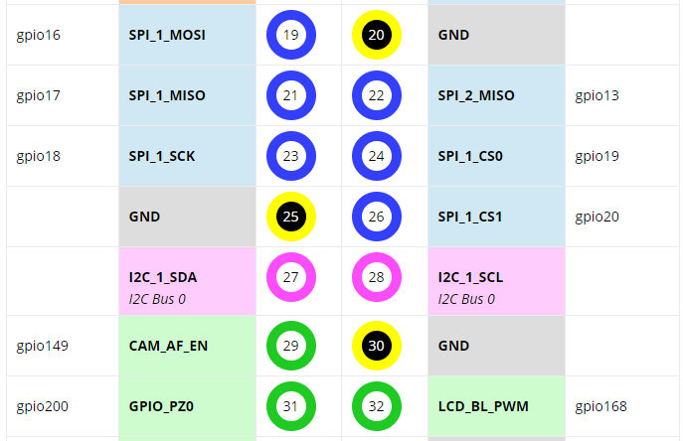
Device Tree
header-40pin-pinmux {
linux,phandle = <0x2>;
phandle = <0x2>;
pin16 {
nvidia,function = "spi2";
nvidia,pins = "spi2_cs1_pdd0";
nvidia,pull = <0x2>;
nvidia,tristate = <0x0>;
nvidia,enable-input = <0x0>;
};
pin19 {
nvidia,function = "spi1";
nvidia,pins = "spi1_mosi_pc0";
nvidia,pull = <0x0>;
nvidia,tristate = <0x0>;
nvidia,enable-input = <0x0>;
};
[…]

Slide 23
Device Tree
mcp2515_int:mcp2515_int {
gpio-hog;
input;
gpios = <0xc8 0>;
label = "mcp2515_int";
};
Configure GPIOZ0.0, gpio200 as input

Slide 24
Device Tree
https://github.com/thanhhaibk96/JetsonNano-mcp2515/blob/master/extlinux.conf
Add definitions of device tree

Slide 25
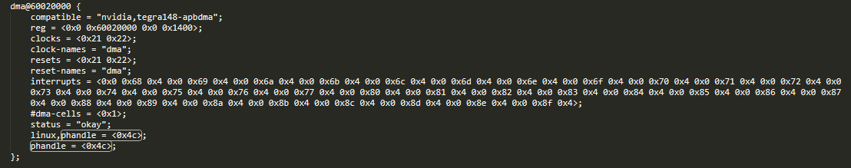
Device Tree
spi@7000d400 {
compatible = "nvidia,tegra210-spi";
reg = <0x0 0x7000d400 0x0 0x200>;
interrupts = <0x0 0x3b 0x4>;
iommus = <0x2b 0xe>;
#address-cells = <0x1>;
#size-cells = <0x0>;
dmas = <0x4c 0xf 0x4c 0xf>;
dma-names = "rx", "tx";
nvidia,clk-parents = "pll_p", "clk_m";
clocks = <0x21 0x29 0x21 0xf3 0x21 0xe9>;
clock-names = "spi", "pll_p", "clk_m";
resets = <0x21 0x29>;
reset-names = "spi";
status = "okay";
linux,phandle = <0x10c>;
phandle = <0x10c>;

Slide 26
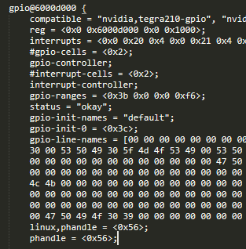
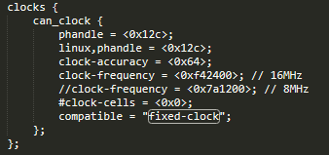
Device Tree
spi@0 {
interrupt-parent = <0x56>;
interrupts = <0xc8 0x2>;
//pinctrl-names = "default";
//pinctrl-0 = <&mcp2515_int>;
//interrupts = <0x56 0xc8 0x2>;
clocks = <0x12c>;
nvidia,rx-clk-tap-delay = <0x6>;
nvidia,enable-hw-based-cs;
compatible = "microchip,mcp2515";
reg = <0x0>;
spi-max-frequency = <0x989680>; // 10MHz
//spi-max-frequency = <0x1312d00>; // 20MHz
controller-data {
nvidia,tx-clk-tap-delay = <0x0>;
nvidia,cs-hold-clk-count = <0x1e>;
nvidia,cs-setup-clk-count = <0x1e>;
nvidia,enable-hw-based-cs;
nvidia,rx-clk-tap-delay = <0x1f>;
};
};

Slide 27
Platform driver:
static struct spi_driver mcp251x_can_driver = {
.driver = {
.name = DEVICE_NAME,
.owner = THIS_MODULE,
.of_match_table = mcp251x_of_match,
.pm = &mcp251x_can_pm_ops,
},
.id_table = mcp251x_id_table,
.probe = mcp251x_can_probe,
.remove = mcp251x_can_remove,
};
https://github.com/thanhhaibk96/JetsonNano-mcp2515/tree/master/mcp2515_driver
http://www.macs.hw.ac.uk/~hwloidl/hackspace/linux/drivers/net/can/spi/mcp251x.c

Slide 28
Platform driver:
static int mcp251x_spi_trans(struct spi_device *spi, int len)
{
struct mcp251x_priv *priv = spi_get_drvdata(spi);
struct spi_transfer t = {
.tx_buf = priv->spi_tx_buf,
.rx_buf = priv->spi_rx_buf,
.len = len,
.cs_change = 0,
.delay_usecs = 1,
};
struct spi_message m;
int ret;
spi_message_init(&m);
if (mcp251x_enable_dma) {
t.tx_dma = priv->spi_tx_dma;
t.rx_dma = priv->spi_rx_dma;
m.is_dma_mapped = 1;
}
spi_message_add_tail(&t, &m);
ret = spi_sync(spi, &m);
if (ret)
dev_err(&spi->dev, "spi transfer failed: ret = %d\n", ret);
return ret;
}

Slide 29
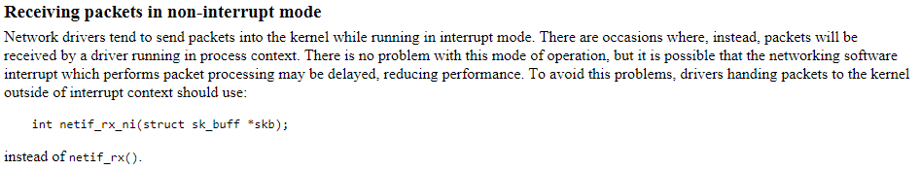
Platform driver:
static const struct net_device_ops mcp251x_netdev_ops = {
.ndo_open = mcp251x_open,
.ndo_stop = mcp251x_stop,
.ndo_start_xmit = mcp251x_hard_start_xmit,
.ndo_change_mtu = can_change_mtu,
};

Slide 30
Platform driver:
$> cansend can0 123#1122334455667788
static netdev_tx_t mcp251x_hard_start_xmit(struct sk_buff *skb,
struct net_device *net)
{
printk(KERN_ERR "mcp251x_hard_start_xmit \n");
struct mcp251x_priv *priv = netdev_priv(net);
struct spi_device *spi = priv->spi;
if (priv->tx_skb || priv->tx_len) {
dev_warn(&spi->dev, "hard_xmit called while tx busy\n");
return NETDEV_TX_BUSY;
}
if (can_dropped_invalid_skb(net, skb))
return NETDEV_TX_OK;
netif_stop_queue(net);
priv->tx_skb = skb;
queue_work(priv->wq, &priv->tx_work);
return NETDEV_TX_OK;
}
skb contains data of cansend

