Slide 1

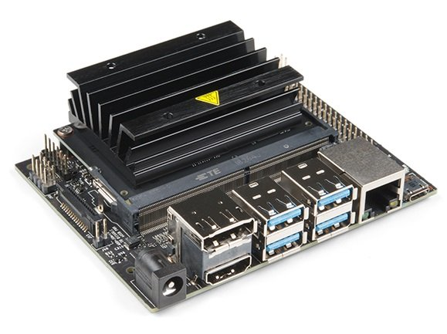
By Thanh Hai Chau

Slide 2

Documents:
NVIDIA Tegra Linux Driver Package: https://docs.nvidia.com/jetson/archives/l4t-archived/l4t-3231/index.html#page/Tegra%20Linux%20Driver%20Package%20Development%20Guide/introduction.html
Getting Started: https://www.hackster.io/news/getting-started-with-the-nvidia-jetson-nano-developer-kit-43aa7c298797
Use VNC to remote desktop
Progam Hardware: GPIO, I2C, SPI,…
Configuring the 40-pin Expansion Header: https://docs.nvidia.com/jetson/archives/l4t-archived/l4t-3231/index.html#page/Tegra%2520Linux%2520Driver%2520Package%2520Development%2520Guide%2Fhw_setup_jetson_io.html%23
Technical Reference Manual: https://developer.nvidia.com/embedded/downloads#?search=Technical%20Reference%20Manual
Pin Map on Jetson Nano: https://developer.nvidia.com/embedded/downloads#?search=jetson%20nano%20pinmux
Jetson Nano J41 Port: https://www.jetsonhacks.com/nvidia-jetson-nano-j41-header-pinout/
Learn programing driver on ubuntu:
https://www.youtube.com/watch?v=3MY8kLEZr98&list=PLL68erM6rDuJ4juXm6MzhppMsNB2wJ-Tk
https://www.youtube.com/watch?v=zw6St5zXEXg&list=PLL68erM6rDuLivN88lwS9YYAeBfuIOYvA
Note: NVIDIA supply forum for all users, you should register an account and join this forum for development projects

Slide 3
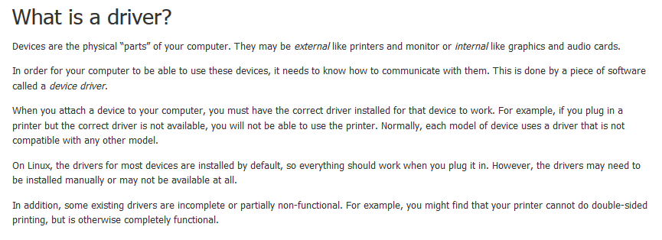
A Simple Example Programing Driver
Một cách dễ hiểu, lập trình driver là lập trình để giao tiếp với các cổng tty trên hệ thống, có thể dùng lệnh ls /dev để liệt kê các danh sách thiết bị có trên hệ thống.
Có 2 cách để lập trình GPIO hệ thống: lập trình kernel, lập trình C/C++ thông qua cổng /dev/mem
https://blog.sourcerer.io/writing-a-simple-linux-kernel-module-d9dc3762c234

Slide 4
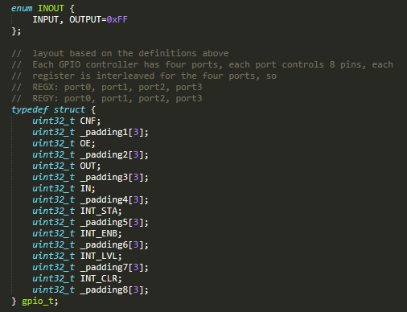
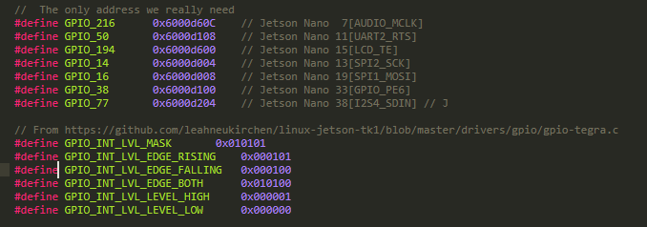
How to check Map Pin GPIO on Jetson Nano
Search in documents: NV_Jetson_Nano_Module_Pinmux_Config_Template, Tegra_X1_TRM_DP07225001_v1.3p

Slide 5
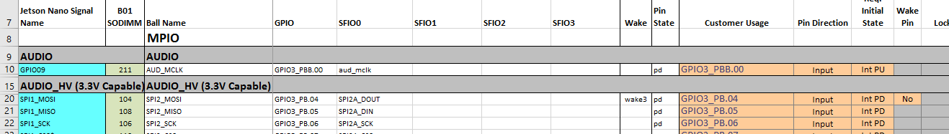
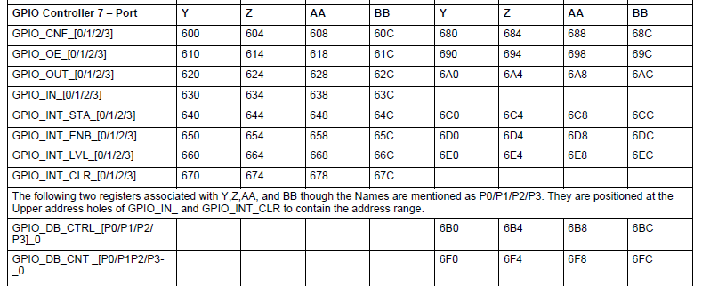
How to check Map Pin GPIO on Jetson Nano
Example: Program GPIO on GPIO216 [AUDIO_MLCK]
Step1: Configure GPIO on https://docs.nvidia.com/jetson/archives/l4t-archived/l4t-3231/index.html#page/Tegra%2520Linux%2520Driver%2520Package%2520Development%2520Guide%2Fhw_setup_jetson_io.html%23
Check in NV_Jetson_Nano_Module_Pinmux_Config_Template, where is your pin on chip ARM57? And what is it’s name?
GPIOBB.00
Step2: Check in Tegra_X1_TRM_DP07225001_v1.3p, which register does it respond for GPIOBB.00?
Offset memory: 0x60C

Slide 6
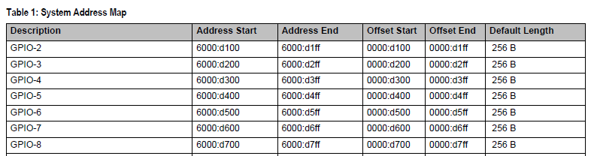
How to check Map Pin GPIO on Jetson Nano
Example: Program GPIO on GPIO216 [AUDIO_MLCK]
Step2: Check in Tegra_X1_TRM_DP07225001_v1.3p, which register does it respond for GPIOBB.00?
Offset memory: 0x60C
Adress Start + Offset memory
= 0x6000D60C

Slide 7
How to check Map Pin GPIO on Jetson Nano
Example: Program GPIO on GPIO216 [AUDIO_MLCK]
Step3: Download Github code:
https://github.com/jwatte/jetson-gpio-example
https://github.com/valentis/jetson-nano-gpio-example
https://github.com/thanhhaibk96/Jetson-Nano-C-Sample/tree/master/GPIO/jetson-nano-gpio-test
https://github.com/thanhhaibk96/Jetson-Nano-Kernel-Sample/tree/master/GPIO/jetson-nano-gpio-v1
Explaining Code:
Program C via using /dev/mem
Because Linux does not allow you access physical memory directly, so you have to use a function to create virtual memory - open("/dev/mem", O_RDWR | O_SYNC);
Program driver
In programming driver, Linux does not allow you access physical memory directly like program in C, you have to use function - ioremap(GPIO_216, sizeof(gpio_register)); to access undirectly physical memory
http://man7.org/linux/man-pages/man4/mem.4.html

Slide 8

How to check Map Pin GPIO on Jetson Nano
Example: Program GPIO on GPIO216 [AUDIO_MLCK]
Explaining Code:
“/dev/mem“: is a character device file that is an image of the main memory of the computer. It may be used, for example, to examine (and even patch) the system. Byte addresses in /dev/mem are interpreted as physical memory addresses. References to nonexistent locations cause errors to be returned. Examining and patching is likely to lead to unexpected results when read-only or write-only bits are present. Since Linux 2.6.26, and depending on the architecture, the CONFIG_STRICT_DEVMEM kernel configuration option limits the areas which can be accessed through this file. For example: on x86, RAM access is not allowed but accessing memory-mapped PCI regions is
It is typically created by:
mknod -m 660 /dev/mem c 1 1
chown root:kmem /dev/mem
“mmap”: https://vimentor.com/vi/lesson/memory-mapping
What is fd? https://blog.vu-review.com/file-descriptor-la-gi.html
Depend on architecture of CPU, in this case: 4096
0xFFF
http://man7.org/linux/man-pages/man4/mem.4.html

Slide 9
How to check Map Pin GPIO on Jetson Nano
Example: Program GPIO on GPIO216 [AUDIO_MLCK]
Pointer points to mapping address
Start address of module GPIO → GPIO-1: 0x6000d60C & 0xFFFFF000 (~0xFFF)
= 0x6000d000
Force type of pointer, it is easy to access registers
Access to address of GPIO216/GPIOBB00:
0x6000d000 + (0x6000d60C & 0xFFF)
https://linux.die.net/man/1/g++
https://explainshell.com/explain?cmd=g%2B%2B+-g+-O1+-o+gpio+gpio_toggle.cpp+-Wall+-std%3Dgnu%2B%2B17
https://courses.cs.washington.edu/courses/cse373/99au/unix/g++.html

