Slide 1
RPC over HTTP (Act as HTTP Proxy)
GROUP 10

Slide 2
GROUP MEMEBERS
Do Thanh Hieu( BI10-059 )
Tran Trung Hieu( BI10-58 )
Do Dinh Phuc( BI10 - 137 )
Nguyen Tan Dung( BI10 – 041 )
Nguyen Viet Nhan( BI10 – 132 )

Slide 3
CONTENTS
I. Introduction
II. Analysis & Design
III. Implementation
IV. Result
V. Conclusion & Future Works

Slide 4
01
INTRODUCTION

Slide 5
02
ANALYSIS & DESIGN

Slide 6

1. HTTPS

Slide 7
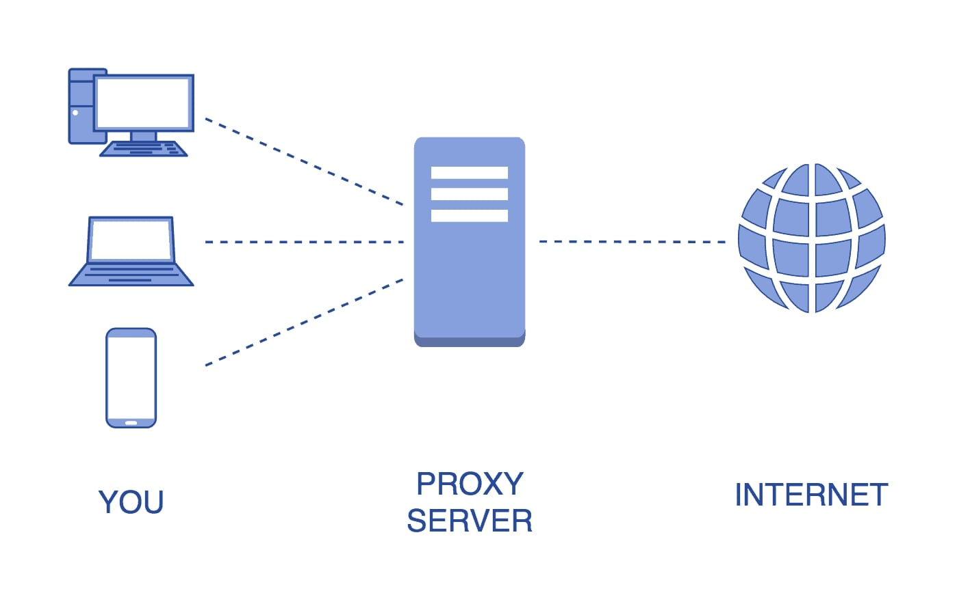
2. HTTP PROXY

Slide 8
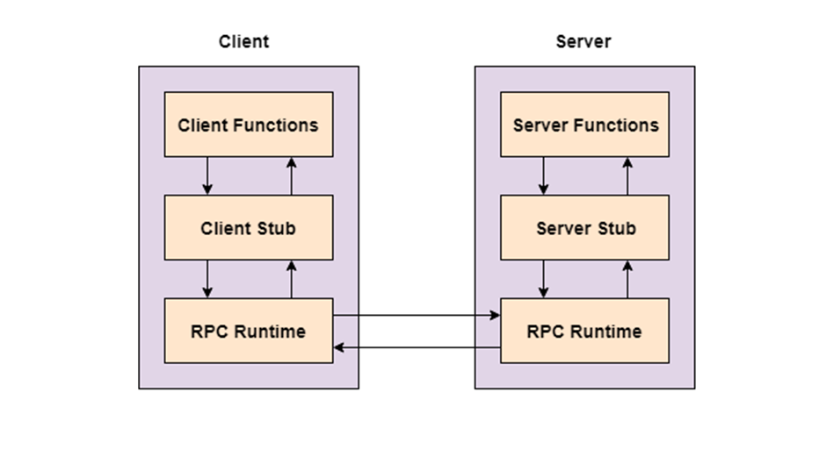
3.RPC

Slide 9

4.LIBCURL
- Definition

Slide 10
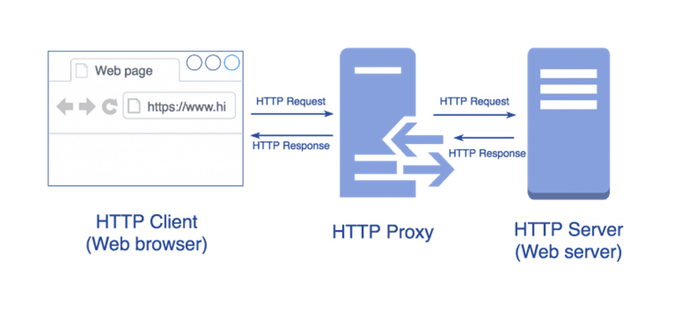
5.HOW HTTP PROXY WORK

Slide 11
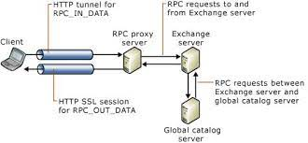
6.HOW HTTP over RPC WORK

Slide 12
03
IMPLEMENTATION

Slide 13
Softwares used to implement the project:
Ubuntu with VMware.
C programming language with GNU C Compiler.
RPCGEN to create Remote Procedure Call.

Slide 14
Project implementation process:
Create method http request and response directly using Libcurl library.
Create RPC connection between client and server using RPCGEN.
Combine the HTTP request and response method above into the generated RPC

Slide 15
RESULT
04

Slide 16
- HTTP Request and direct response succeed.
- In RPC, Server and Client have successfully connected.
- HTTP over RPC not yet.

Slide 17
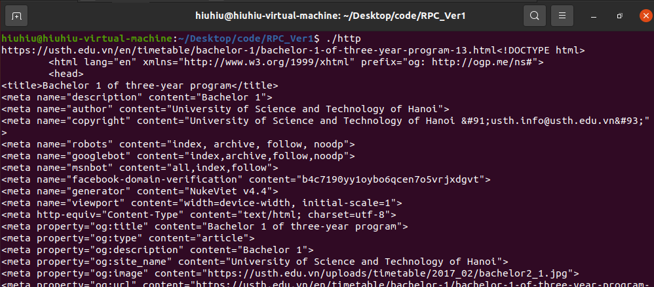
- HTTP Request and direct response:

Slide 18
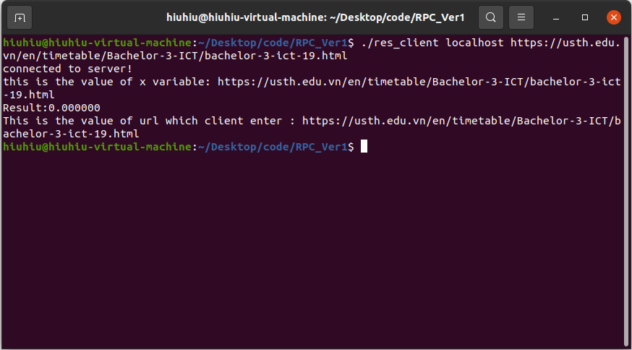
HTTP over RPC:
- Client:

Slide 19
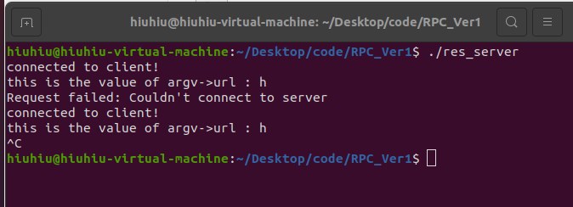
- Server:

Slide 20
05
CONCLUSIONS

Slide 21
The project is not done:
- Complete HTTP over RPC.
- System upgrade.

Slide 22
Thanks
For listening

