Slide 1
Manage Retail Transaction
Our Members:
- Đỗ Thành Đạt BI10-026
- Đỗ Thanh Hiếu BI10-059
- Trần Trung Hiếu BI10-058
- Nguyễn Viết Nhân BI10-132
- Đỗ Đình Phúc BI10-137
- Nguyễn Tấn Dũng BI10-041
Notes:
© Copyright Showeet.com – Free PowerPoint Templates

Slide 2
Table of contents
01
02
03
04
Idea
AD & DisAD
Process, Structures
Demo
Notes:
© Copyright Showeet.com – Free PowerPoint Templates

Slide 3
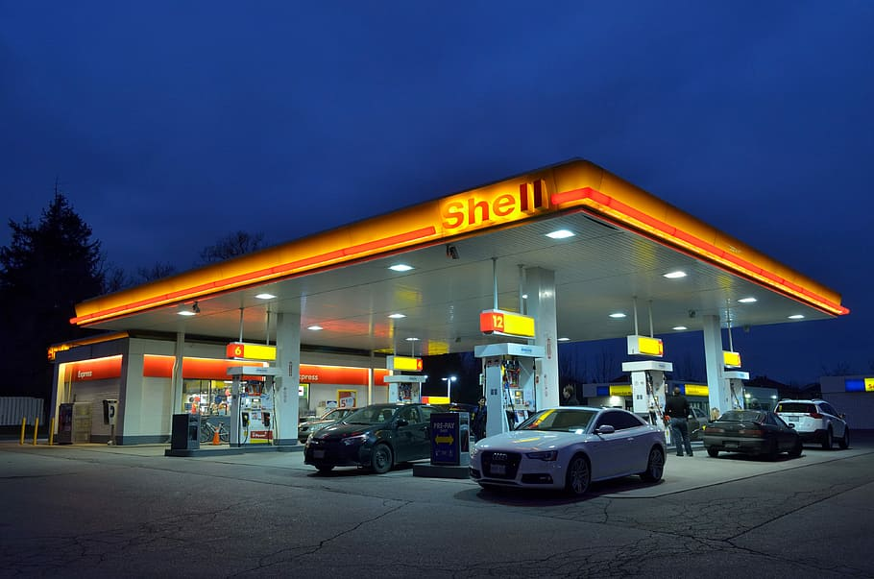
Idea
- A web application to manage retail transactions of a petrol store
Notes:
© Copyright Showeet.com – Free PowerPoint Templates

Slide 4
Advantages
Accurate, instant statistics when there is a change
Saving human resources
Specific and accurate statistics on the situation of import and export of fuel inventory to calculate fuel management plans
Big data storage system
Notes:
© Copyright Showeet.com – Free PowerPoint Templates

Slide 5
Disadvantages
Security
Legal issues
Advertising costs
Notes:
© Copyright Showeet.com – Free PowerPoint Templates

Slide 6
Process
Create Database
Using Bootstrap to build the UI
Connect Database and the UI
We used: PHP, CSS, JS, MySQL, XAMPP, Apache
Notes:
© Copyright Showeet.com – Free PowerPoint Templates

Slide 7
WebPage Structures
Home page
4 gasoline pumps with input, table, chart
My Account
Notifications
Login, Register
Privacy policy, Term and Conditions
Notes:
© Copyright Showeet.com – Free PowerPoint Templates

Slide 8
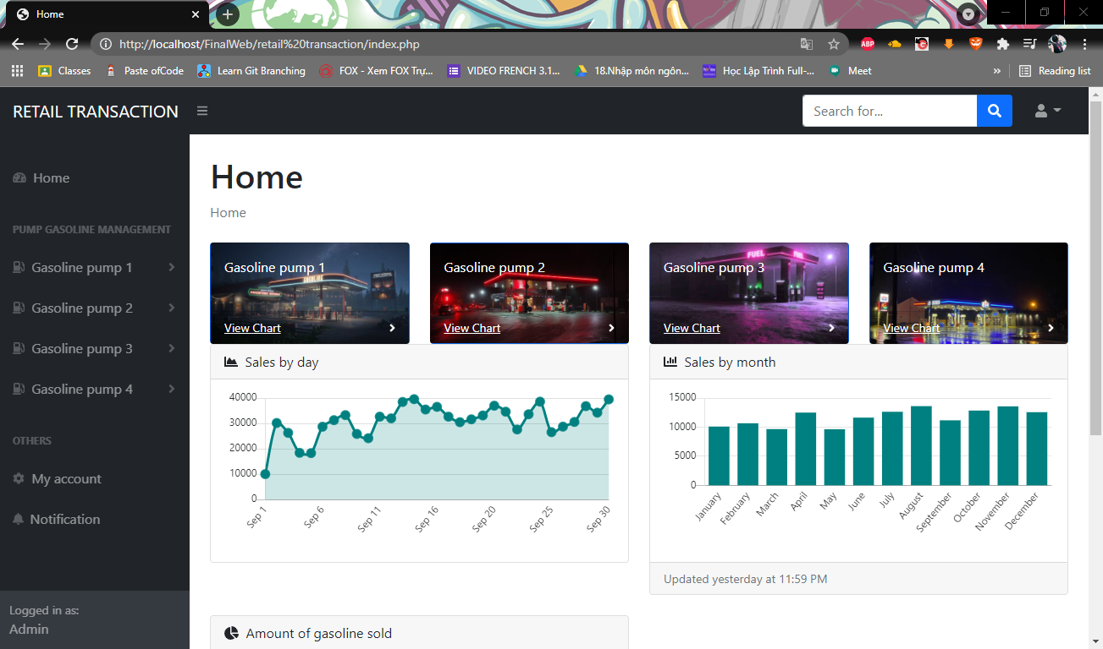
Home Page
Notes:
© Copyright Showeet.com – Free PowerPoint Templates

Slide 9
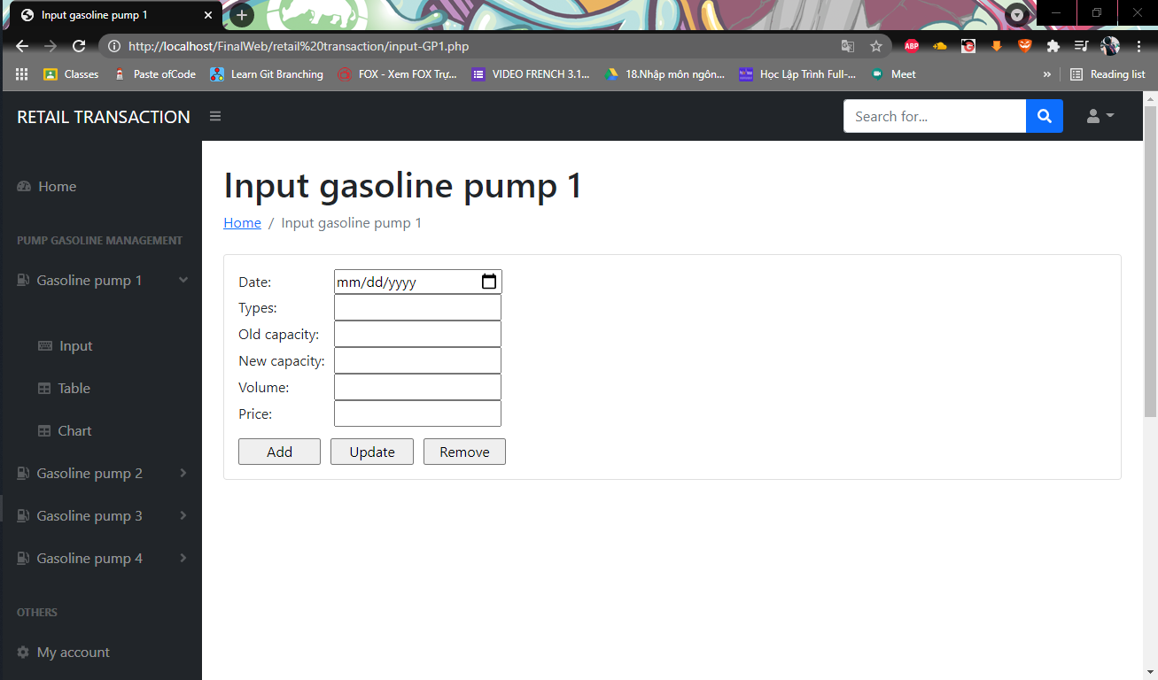
Gasoline Pump
Notes:
© Copyright Showeet.com – Free PowerPoint Templates

Slide 10
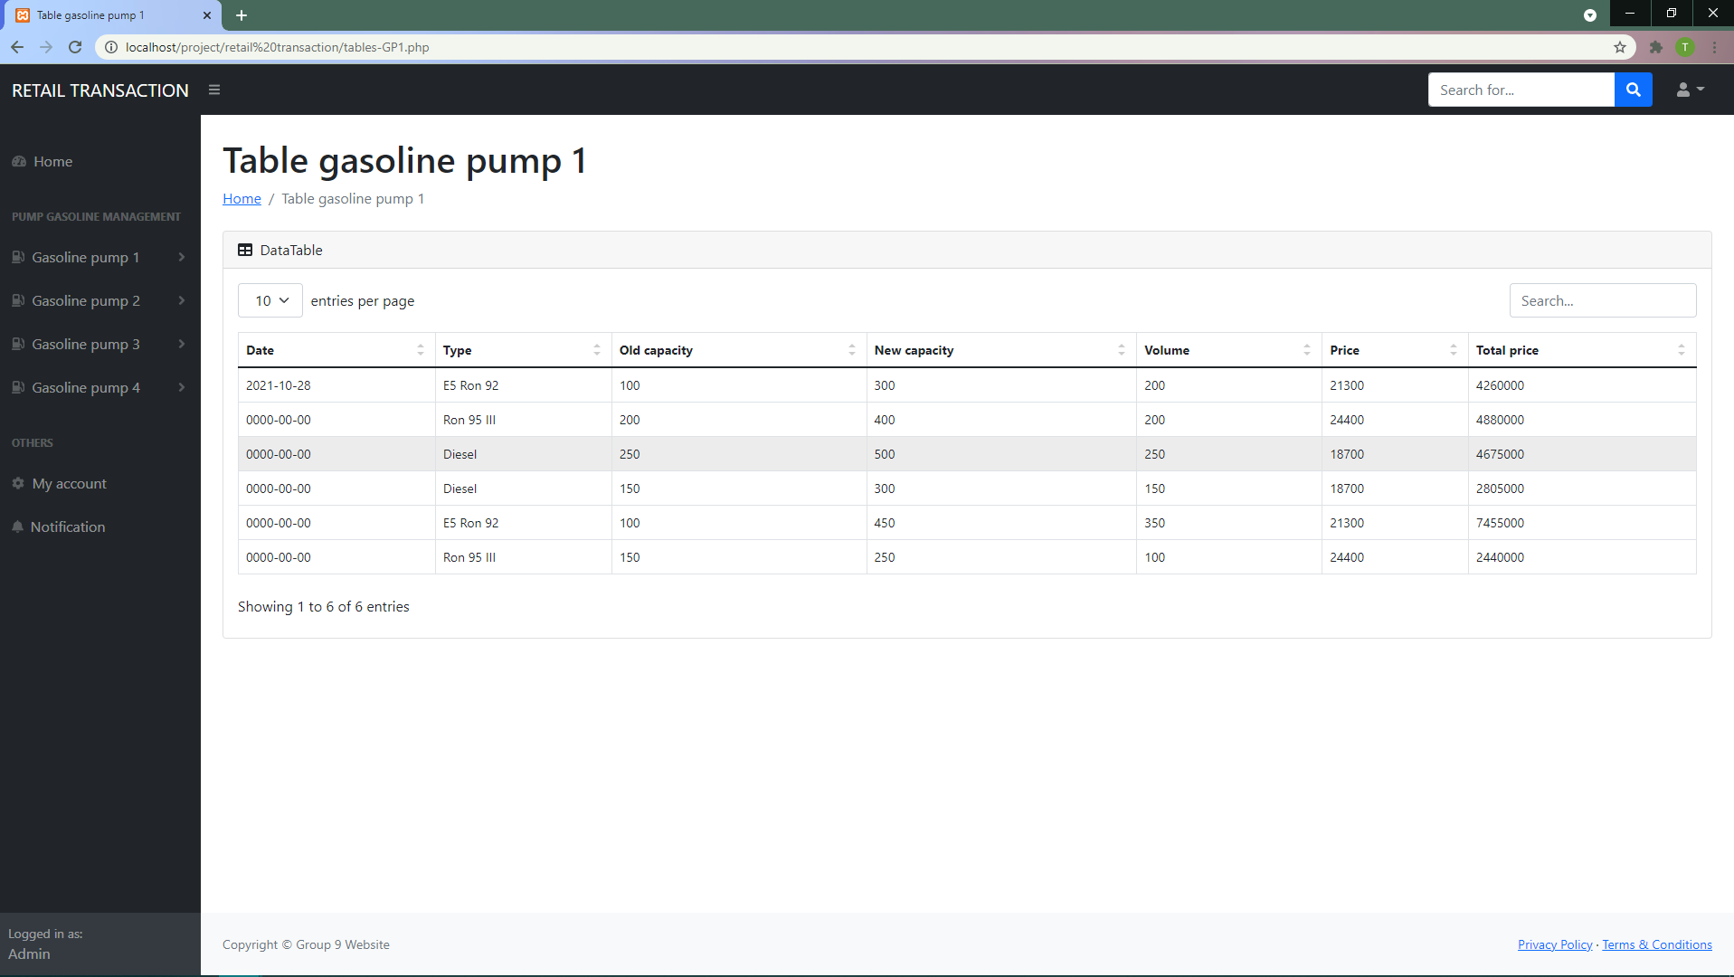
Gasoline Pump
Notes:
© Copyright Showeet.com – Free PowerPoint Templates

Slide 11
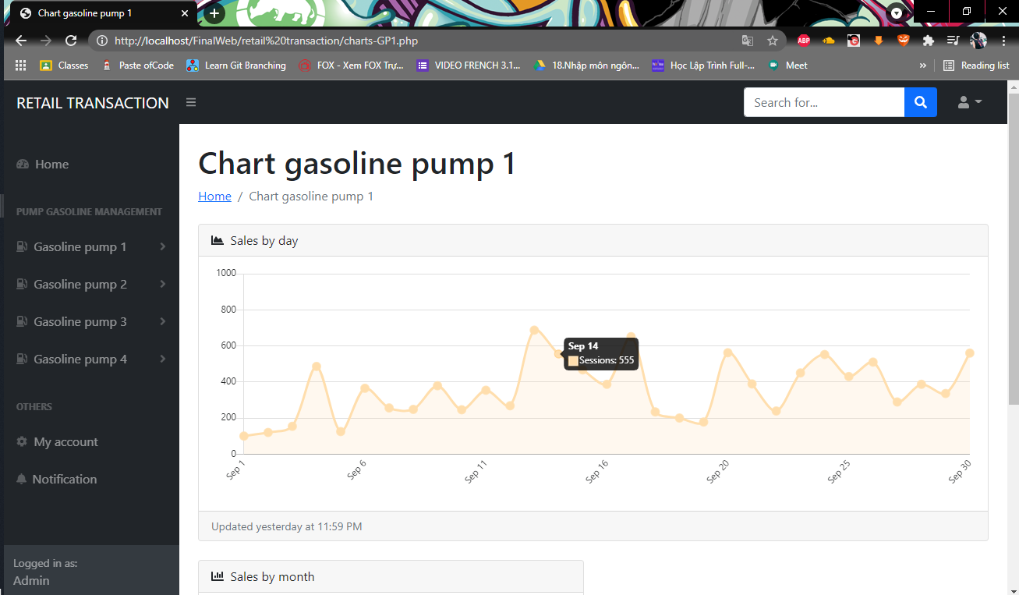
Gasoline Pump
Notes:
© Copyright Showeet.com – Free PowerPoint Templates

Slide 12
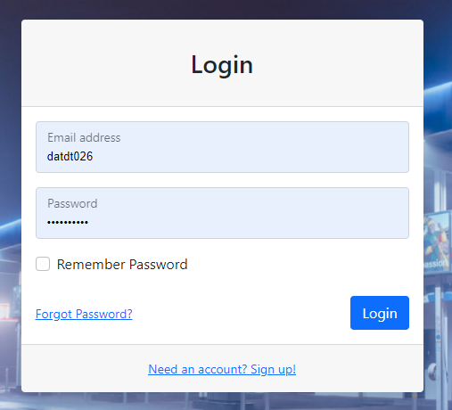
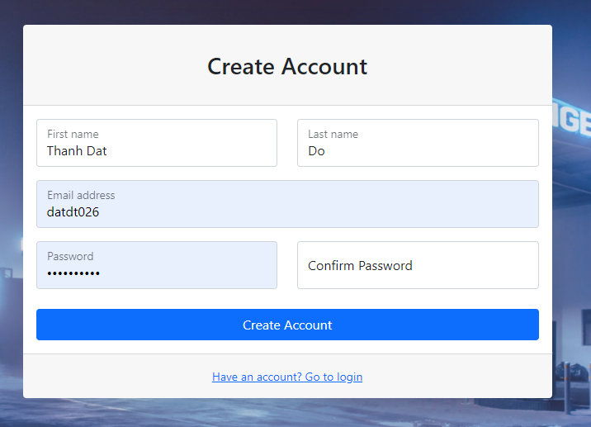
Login
Notes:
© Copyright Showeet.com – Free PowerPoint Templates

Slide 13
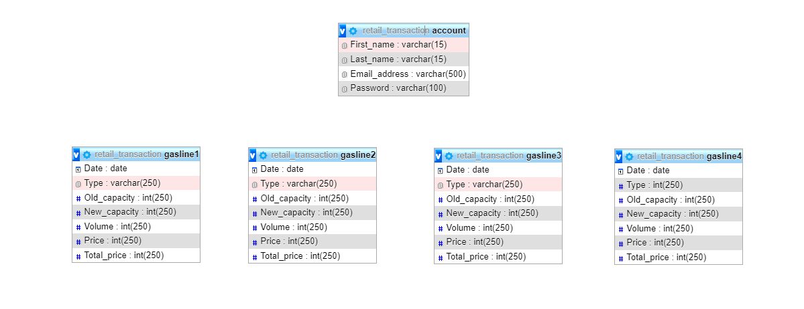
Database
Notes:
© Copyright Showeet.com – Free PowerPoint Templates

Slide 14
Demo
Notes:
© Copyright Showeet.com – Free PowerPoint Templates

