Slide 1
INTERNET SERVICE INFORMATION MANAGEMENT SYSTEM
Advanced Programming with Python

Slide 2
OUR MEMBER
Do Thanh Hieu
Tran Trung Hieu
Phi Nguyen Hai Minh
Nguyen Viet Nhan
Do Dinh Phuc

Slide 3
TABLE OF CONTENTS
01
02
03
DEMO & QNA
OUR PROCESS
PROBLEM, SOLUTION & TARGET

Slide 4
01
PROBLEM, SOLUTION & TARGET

Slide 5
UNDERSTANDING THE PROBLEM
Internet Users
Number of Internet users increase over the time and will continue unstopable in the future

Slide 6
4,720,000,000
60.1% World’s Population
Internet Users Worldwide

Slide 7
OUR SOLUTIONS
RESEARCH
BUILD-UP
SOFTWARE “MAKE-UP”
TEST,FIX & UPDATE
Find out the target Client’s need.
Step by step build up software based on Client’s need.
Make the software be professional
Test & fix the software. Update software.

Slide 8
TARGET
Small & Micro
Internet Providers

Slide 9
OUR PROCESS
02

Slide 10
OUR PROCESS
RAW CODE
OOP - UPDATE
STEP 2
STEP 4
STEP 1
STEP 3
DATABASE CREATING
SOFTWARE “MAKE-UP”
Create basic entitys,attributes, define functions,…
Make OOP for entitys, …
Create & link Database
GUI designing for the software

Slide 11
STRUCTURE
Function Ideas :
List & Define objects and required attributes.
Create & Connect Python with MySQL Database.
Fundamental manipulation with MySQL : Create, Read, Update and Delete (CRUD).
Create function to calculate the total amount for Customers.
Create function to issue bills for Customers.
Create functions to show information.

Slide 12
STRUCTURE
Py Class
Input/Output, Main, GUI (“Main.py”)
Class “Customer” (“Customer.py”)
Class “Dataplan” (“Dataplan.py”)
Class “Bill” (“Bill.py”)

Slide 13
STRUCTURE
Module :
Tkinter.messagebox : Access to standard Tk Dialog Boxes.
Tkinter.ttk : Provide access to the Tk themed widget set.
MySQL Connector : Database driver to process data in MySQL from Python

Slide 14
STRUCTURE
Packages
“Domain” : Storing 3 classes files (“Customer.py”, “Bill.py”, “Dataplan.py”).
“___init__.py” : Just a empty file, appear when creating pakage.

Slide 15
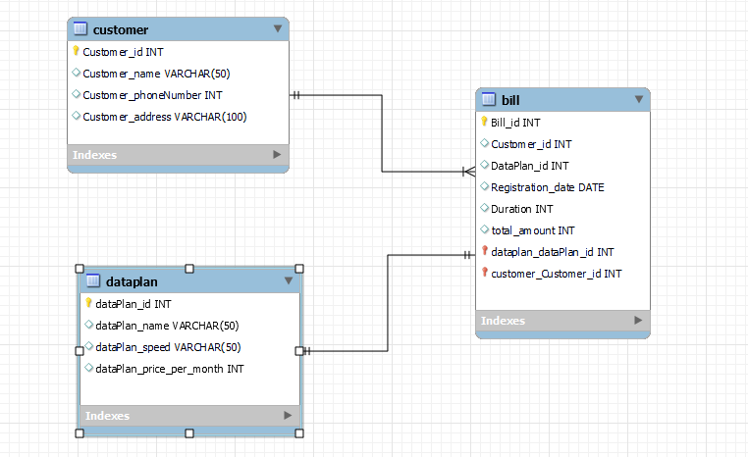
DATABASE DIAGRAM

Slide 16
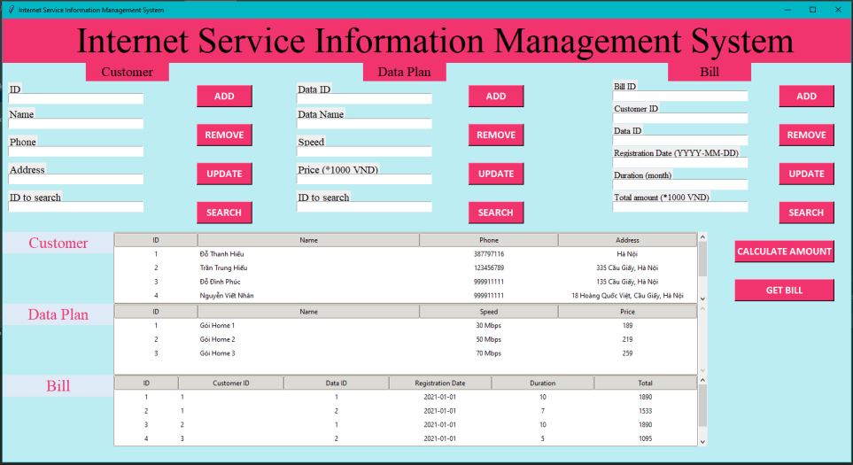
GUI

Slide 17
DEMO & QNA
03

