Slide 1


Team 7
Client
Our Members:
- Đỗ Thành Đạt BI10-026
- Đỗ Thanh Hiếu BI10-059
- Trần Trung Hiếu BI10-058
- Nguyễn Viết Nhân BI10-132
- Đỗ Đình Phúc BI10-137

Slide 2

Table of contents
1
2
3
IDEA
PROCESS
DEMO

Slide 3




IDEA
Creating a moodle client with 4 monitors:
Home
Person
My courses
Menu

Slide 4
Process
Creating
new project
Editing fragments, layouts
Creating toolbar
1
3
5
2
4
6
Creating
bottom tab
combining fragments, layouts with activities
Creating
other activities

Slide 5
HOME
School’s information:
Name
News
Mail
Telephone
Others

Slide 6
Person
Student’s Information:
Personal information
Major and class

Slide 7
Courses
My
List of subjects

Slide 8
Menu
Includes:
Options:
Shortcuts

Slide 9
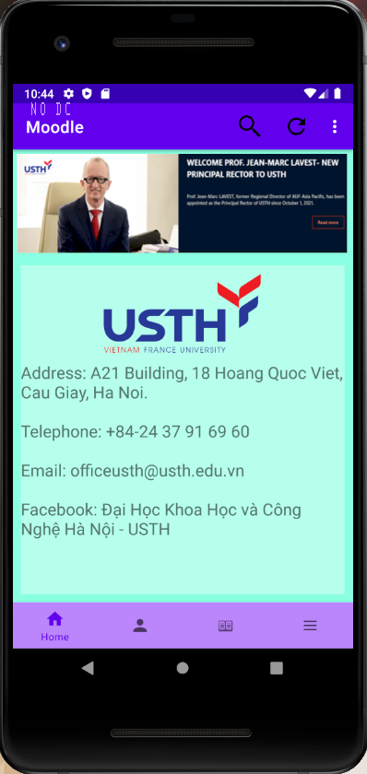
Source code: https://github.com/thanhhieudo278/midapp

