Slide 1
Testing, Maintenance and Auditing
The testing process
Maintenance practices
Auditing
1

Slide 2
The Testing Process
Program testing with test data
Link testing with test data
Full system testing with test data
Full system testing with live data

Slide 3
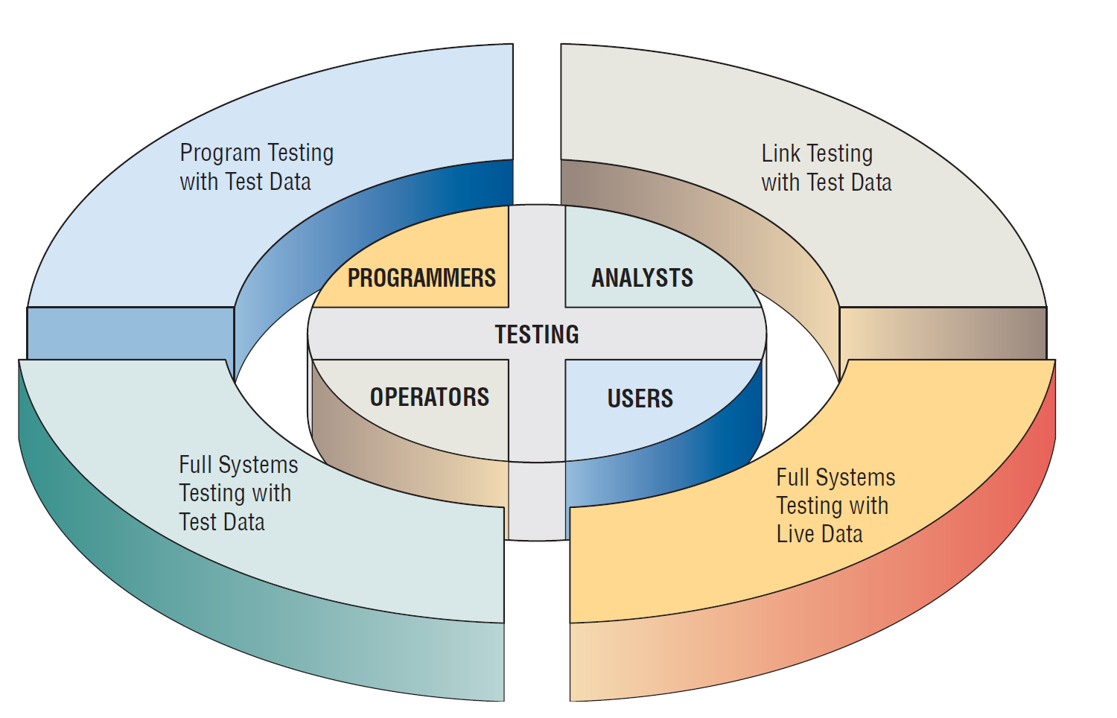
Programmers, analysts, operators and users all play different roles in testing software and systems.
3

Slide 4
Program Testing with Test Data
Desk check programs.
Test with both valid and invalid data.
Check output for error and make any needed corrections.
4

Slide 5
Link Testing with Test Data
Also referred to as string testing.
Checks to see if program that are interdependent actually work together as planned.
Test for normal transactions.
Test with invalid data.
5

Slide 6
Full System Testing with Test Data
Adequate documentation in procedure manuals.
Are procedure manuals clear enough.
Do work flows actually “flow”.
Is output correct and do users understand this output.
6

Slide 7
Full System Testing with Live Data
Comparison of the new system’s output with what you know to be correctly processed output.
Only small amounts of live data are used.
7

Slide 8
Maintenance Practices
Reduce maintenance costs.
Improve the existing software.
Update software in response to the changing organization.
Ensure channels for feedback.
Classification scheme.
8

Slide 9
Auditing
Having an expert who is not involved in setting up or using the system examine information in order to ascertain its reliability.
There are internal and external auditors.
Internal auditors study the controls used in the information system to make sure that they are adequate.
External auditors are used when the information system processes data that influences a company’s financial statements
9

